Slide 1

WELCOME

Slide 2

Seminar-I
Theoretical Orientation in Social Sciences
Presented by,
  Suresh D.K.
  PALB-4023
2

Slide 3

Short take of seminar
Introduction
Objectives of the seminar
Concept of theory
Theoretical orientation
Application of theory
Conclusion
3

Slide 4

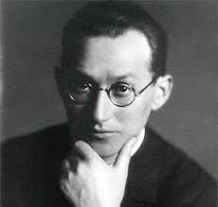

Introduction
There is nothing so practical as a good theory - Kurt Lewin
Without theories??
Theories and observations
Inductive research and deductive research
Reality!!!!

Slide 5



Mountains of data
“Theory guides research then research builds theory”- Walizer and Wienir
Basic aim of science??
Facts and theories
Data, facts and theories

Slide 6

Objectives of the Seminar
To know the concept of theory
To know the theoretical orientation in social sciences
To know the application of theory in social sciences

Slide 7

The Concept of Theory
7

Slide 8


Theory ????
Greek
“Theoria” = looking at, seeing, viewing or beholding a vision that yields understanding
An idea or set of ideas
The analysis of a set of facts
Ex: Oil floats on water, rock sinks in water due to specific gravity

Slide 9
Definition
It is a set of interrelated concepts, definitions and propositions that presents a systematic view of phenomena by specifying relations among variables with the purpose of explaining, predicting and controlling the phenomena
(F.N.Kerlinger,1966)
“A scientific theory is a system of constructs (concepts) and propositions (relationships between those constructs) that collectively presents a logical, systematic, and coherent explanation of a phenomenon of interest within some assumptions and boundary conditions”
    (Bacharach,1989)

Slide 10
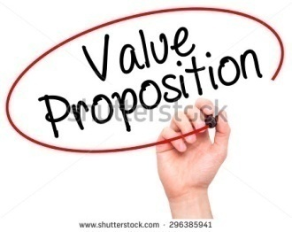



Characteristics of Theory
Set of propositions
Interrelations among a set of variables
Empirically tested phenomenon
Has a constitutive core of concepts

Slide 11

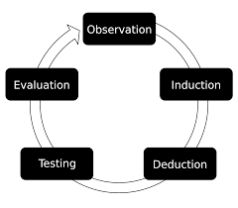


Functions of theory

Slide 12

Terminologies
12

Slide 13


Fact
Latin: factum = is something that has really occurred or is actually the case.
Logical constructs of concepts.
Definition: Fact is defined as empirically verifiable observation (Anonymous)
Ex:
  Balanced nutrition increases crop yield
  Insecticides kills insects

Slide 14


Data
A data (singular datum)
Definition: It refers to purposive gathering of facts relevant to the subject matter of the study from the units under investigation (Anonymous)
Ex:
  Population data or adopters data

Slide 15

Axiom
Greek; ‘Axioma’ = which is thought worthy or fit
Any mathematical statement
Definition: It is defined as logical statement that is assumed to be true or believed to be true but can’t be examined (Webster’s dictionary)
Ex:
  Existence of God

Slide 16

Postulate
Is something accepted as truth
Basis for an argument or theory
Find relationship between two phenomenon
Ex: Severe drought = farmers suicide

Slide 17


Proposition
Statement
Definition: Proposition is a statement about the nature of reality and may in principle be evaluated in terms of truth and fault (Anonymous)
Ex:
  Mass media creates awareness in farmers about farm technology

Slide 18


Hypothesis
Greek ; hype= under, thesis= theory
Definition: it is defined as a proposition which can be put to test to determine its validity (Goode and Hatt)
  Null hypothesis:
    There is no significant relationship between awareness of farm technology and exposure to mass media
    10 % increase in the salary of an individual bring changes in his life style

Slide 19

Phenomenon
It means things that appears
Definition: It is the selection tendency which guards the research against preconception, prediction and against selective support of hypothesis (Anonymous)
Ex:
  Natural or social phenomenon

Slide 20

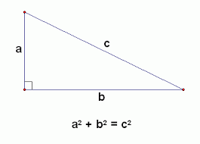
Theorem
A theorem is a statement that has been proven on the basis of previously established statements
Formed on basis of cause and effect relationships
Mathematics
Self evident truth
Ex: Pythagoras theorem

Slide 21
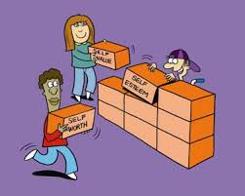

Concepts
Basic blocks of theories
An abstraction from observed events
Ex: words such as chair, dog, tree, liquid, etc.,

Slide 22



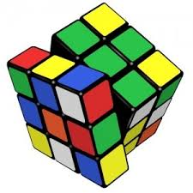
Constructs
They are higher-level abstractions produced by combining concepts and less complex constructs
It is more abstract than concept
Ex: Motivation, justice and problem-solving

Slide 23
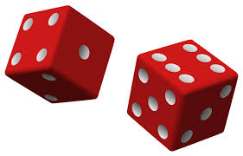
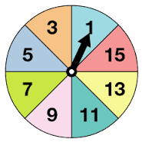
Probability
It is a subjective representation of uncertainty about events
It is a measure or estimation of how likely it is that something will happen or that a statement is true.

Slide 24
Operationalization: Establishing operational definitions that is specifying the exact operations involved in measuring a variable
Operational definition: The concrete and specific definition of something in terms of the operations by which observations are to be categorized

Slide 25
Theory v/s Research
Sl no | Components | Theory | Research
1 | Definition | Generalized concept | Way of expanding the existing knowledge base and creating new knowledge.
2 | Nature | Conceptual framework and used to explain things. | Creative work that generate new knowledge.
3 | Practical Nature | Not only include practical elements. | Mostly a practical approach.
4 | Arrangement | Result of research. An assumption is made to a theory after a series of researches. | Usually precedes theories

Slide 26

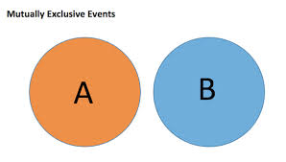

Ideal criteria of theory

Slide 27
Relationship between different components of theory
Degree of Abstractness | Component | Amount of evidence required for confidence
Concrete | Law and principles Theories Propositions Hypothesis | Considerable
Abstract |  | Little
PUJARI DAIVADEENAM (2002)

Slide 28

Theory Orientation in Social Science

Slide 29
How to build theory
Theory building and testing is the core of scientific investigation.
Selecting Phenomena
Finding critical commonalities
Abstracting (theorizing)
Hypothesis testing
(Ying-yi Hong, 2010)

Slide 30


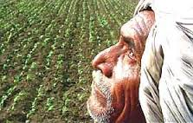
Selecting Phenomena
Do not exist in a social vacuum
Have to be grounded in social phenomena
Gain insights from real-life events and incidents
To increase the generalizability

Slide 31
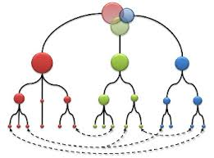



Finding Critical Commonalities
Generating new theories and testing existing theories.
Analyze the particular psychological mechanisms underlying the phenomena and to identify their commonalities and/or their differences.

Slide 32
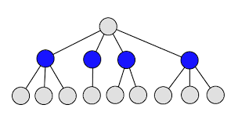
Abstracting (Theorizing)
Critical commonalities identified
Explanation from particular to general

Slide 33
Hypothesis testing
Against future observations
Reversal of abstracting!!!
Hypotheses also dictate what statistical modeling should be used to evaluate

Slide 34


Theoretical framework
Structure that can hold or support a theory of a research study.
Introduces and describes the theory that explains why the research problem under study exists.
Consists of concepts……

Slide 35
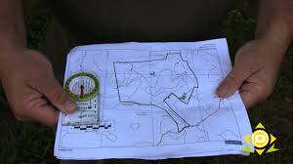
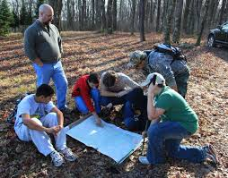
Theoretical orientation
Means orienting oneself
Helps the readers of your research report

Slide 36

Cntd..,
Selecting or creating appropriate theory
Worldview, the lens through which one organizes experience.
Attempt to explain and predict behavior in particular contexts.

Slide 37




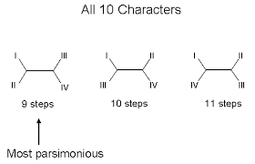
Attributes of a good Theory
Logical Consistency:
Explanatory power:
Falsifiability:
Parsimony:

Slide 38

Strategies for Developing the Theoretical Framework
Examine your thesis title and research problem
Brainstorm
Review related literature
List the constructs and variables
Review key social science theories
Discuss the assumptions

Slide 39

Important Theories in Social Sciences

Slide 40



1. Intrapersonal communication Theories
Attribute theory
Classical theory
Osgood’s principle of cognitive theory
Festinger’s theory of cognitive dissonance

Slide 41

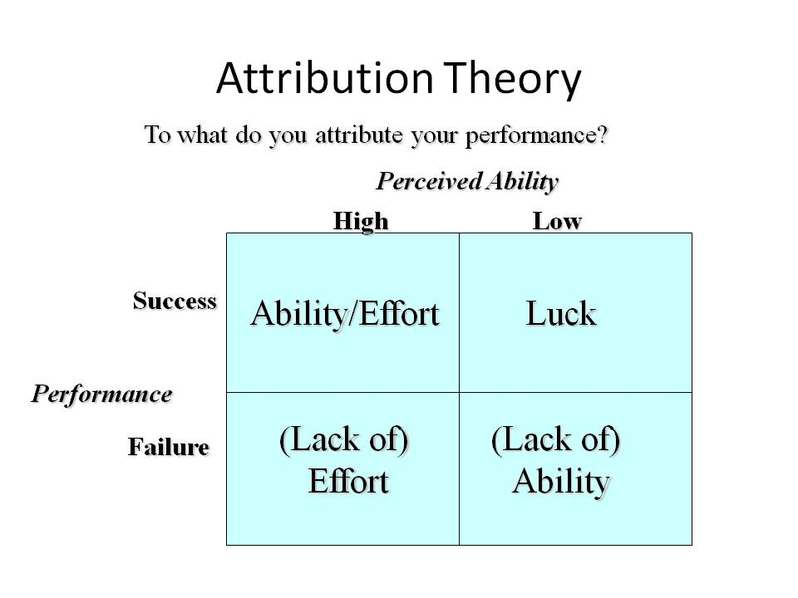


Attribute Theory
F.Heider (1958)
Person has two attributes i.e., Internal and external
Application:
Achievers have difference in motivation

Slide 42

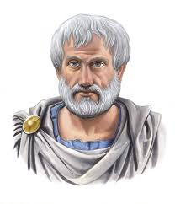
Classical Theory
Aristotle
Finding all the available means of persuasion in a given situation
Application: Used to Persuade people

Slide 43




Cognitive Theory
Osgood (1955)
Individual listening to a communicator
Application:
Specific direction of attitude change
Predict the amount of attitude change
Listener changes his attitude

Slide 44


Cognitive dissonance Theory
Festinger
Tendency for individuals to seek consistency among their cognitions
Application:
Used in attitude formation and change
Decision making and problem solving process

Slide 45



Interpersonal communication Theories
Language expectancy theory
Social cognitive theory
Planned behaviour theory
Speech act theory
Network theory

Slide 46


Language Expectancy Theory
Language is a rule -- language employed by other in persuasive attempts
Application:
Use of different linguistic variations on people who use persuasive message

Slide 47
Social Cognitive Theory
Miller, Dollard, Bandura and Walters
How people learn and maintain certain behavioral pattern
Framework for designing, implementing and evaluating programmes
Application:
Helps in heath education programmes
Provides basis for intervention strategies

Slide 48


Planned Behaviour Theory
Ajzen and Fishbein
Behaviour can be deliberative and planned
Application:
Applied in developing communication strategies and evaluation studies.

Slide 49
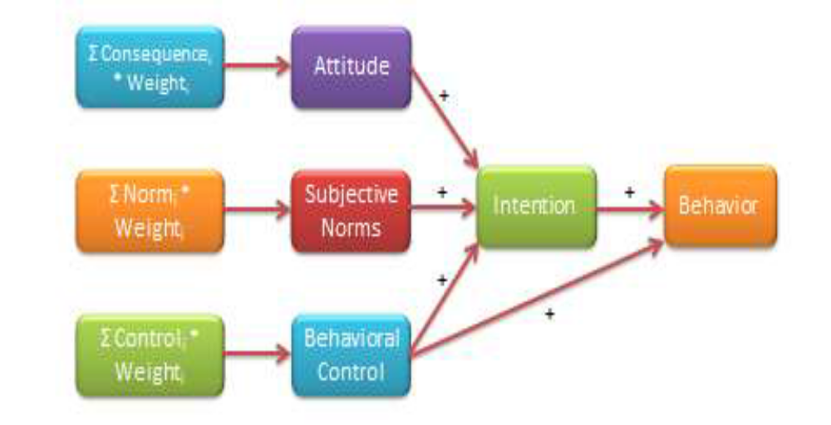
Theory of Planned Behavior

Slide 50

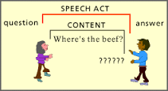

Speech Act Theory
Willgenstein and Austin
It is a sentence
Intension
Application:
Analyzing conversational misunderstanding and rules followed by speakers

Slide 51


Network theory
Relational approach
How social structure of relationship among a person, group or organization affects belief or behaviour
Application:
Applied in psychology, anthropology etc.,
Network analysis is applied in group/ organization/ society

Slide 52



Mass communication theories
Two step flow theory
Diffusion of innovation theory
Hypodermic needle theory
Knowledge gap theory

Slide 53
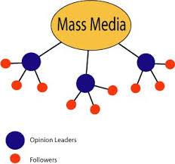
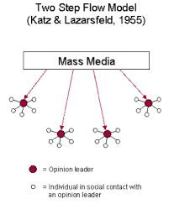
Two step flow theory
Katz and Lazersfeld
The message conveyed by the mass media are invariably mediated by the opinion leaders of groups
Application:
Diffusion of innovation among the receivers

Slide 54
Diffusion of Innovation Theory
Gabriel Trade
Everett Rogers in 1962
Four key elements in this theory are: innovation, communication channels, time and social system.
Consists 5 different stages
5 Presumed characteristics
Every individual don't adopt innovation at same time

Slide 55
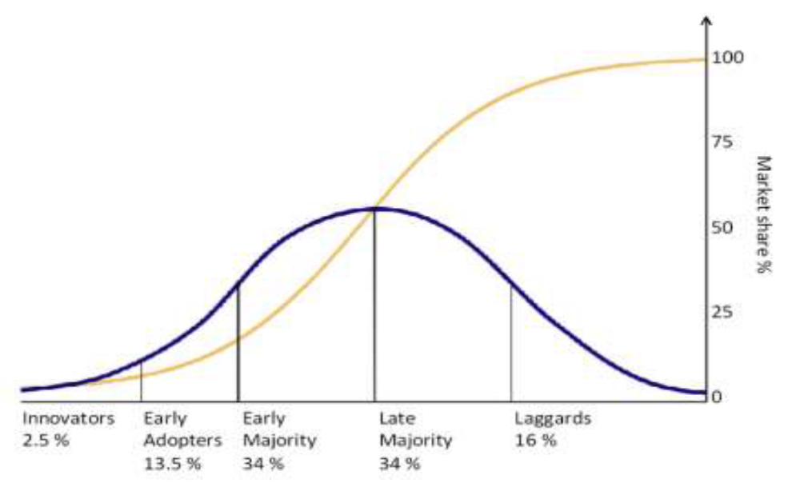
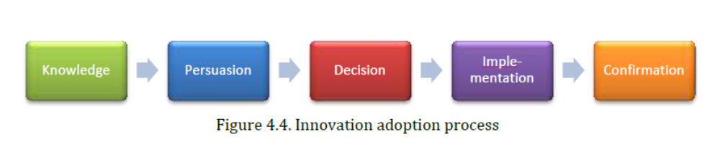
S-shaped diffusion curve

Slide 56
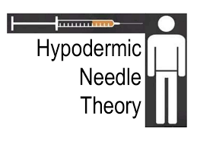

Hypodermic needle theory
Mass media had rapid, uniform and powerful effect on passive audience
Application:
Field of mass communication

Slide 57
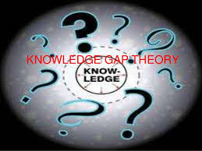

Knowledge gap theory
Olien
High socio economic status
Mass media
Application:
Media should present information based on their usability among different groups

Slide 58

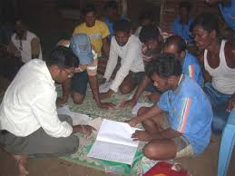

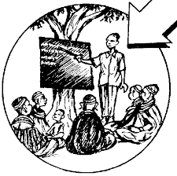
Adult Educational Theory

Slide 59

Transformative Learning Theory
Jack Mezirow
Father of transformative learning theory
Transformative learning for emancipation education is the business of all adult education. (Mezirow, 2000)

Slide 60
Implications for Extension Transformation
Problem solving
Dynamic
Role of the Extension worker as a helper and facilitator of learning
Includes applied and participatory research
Reinforces autonomy with accountability

Slide 61
Theory Limitations for Transformation
Does not address the role of established power relationships
It cannot be generalized
Individuals believe instrumental (skill based) learning than transformative learning.
Require higher levels of cognitive functioning

Slide 62




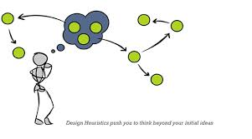
Ideal criteria of evaluating theory

Slide 63

Applications of theory in social science

Slide 64
Theories which support the importance of FFS in teaching adults
Sl no | Principle/ Theory and the stage of FFS | Effect of FFS on participants
Planning stage
1 | Maslow (1954) | Encourages farmers to enroll as participants/ collaborator in FFS, Genuine participation is ensured
2 | Congruity by Brown (1965) | Motivation for the farmers to enroll as participants/ learners
3 | n-Ach (Achievement motivation theory) | Motivation for the farmers to enroll as learners
(Suresha, R., 2005)

Slide 65
Cont…
Sl no | Principle/ Theory and the stage of FFS | Effect of FFS on participants
Execution stage
4 | Theory of Association | Learning takes place in a systematic manner among the members of the group
5 | Commitment to activism by learner (1981) | Provide opportunity to an individual to become innovative
6 | Gestalt’s theory | An individual to understand importance and effect of sub activities in the main activity. Cumulative effect of each activity can be tracked
7 | Seeing is believing, learning by doing | Provides opportunity to practice skills. Psychomotor domain is activated.
8 | Internal group dynamics | Help to sustain group action
9 | Principle of frequency by Watson (1919) | Scope for frequent practice of different operations during FFS.
10 | Trial and error method by Thorndike (1898) | Learning is a result of reward which comes from success after trail and error
(Suresha, R., 2005)

Slide 66
Cont…
Sl no | Principle/ Theory and the stage of FFS | Effect of FFS on participants
Follow up stage
11 | Dissonance theory by Festinger (1957) | Internal pressure is created among FFS trainee to adopt what has been learnt in FFS
12 | Cancian theory (1972) | Ensures continued adoption of technologies learnt in FFS
13 | Instincts of imitation by Tarde (1969) | Promote urge in neighbors to adopt what has been adopted by FFS participants/ collaborator
14 | Conditional learning by Pavalov | FFS participants will be conditioned to conduct experiments when they observe new problem
(Suresha. R., 2005)

Slide 67
Theoretical orientation of a research problem extension
“A study of the entrepreneurial characteristics and farming performance of fish farmers in Nellore district of Andhra Pradesh”

Slide 68
Theories of Entrepreneurship
Sl no | Social scientists | Views on Entrepreneurship
Economists
1 | Cantillon (1755) | A dealer who buys wares of a country and sells them again at certain place as entrepreneur and his role is entrepreneurship
2 | Say (1803) | Entrepreneur is one who generally worked with his own or borrowed capital and opined that an entrepreneur to be successful, should possess judgement, perseverance, knowledge of the world business and also the ability to superintend and administer
3 | Walker (1870) | Entrepreneur are engineers of industrial progress and chief agents of production.

Slide 69
Sl no | Social scientists | Views on Entrepreneurship
Psychologists
1 | Shumpter (1934) | Entrepreneurs are individuals motivated by a strong will power with an inherent capacity with his energy, will and mind to overcome fixed talents of thoughts and capacity to withstand social opposition
2 | McClelland (1960) | The need for achievement (n-ach), an intermediating psychological motive as the important factor to perform better, leading to entrepreneurial behaviour
3 | Hagen (1961) | Entrepreneur as a creative problem solver interested in things that lie in the practical and technological realm driven by a motive to achieve
4 | Kunkel (1965) | Entrepreneurial behaviour as a function of surrounding social structure both past and present which can be readily influenced by maniputable economic and social incentives.

Slide 70
Sl no | Social scientists | Views on Entrepreneurship
Sociologists
1 | Weber (1930) | The main factor for contributing development of entrepreneurship emerges from religious belief system such as protestant, ethic, Hinduism, Buddhism and islam
2 | Coehran’s (1970) | Theory of entrepreneurship mainly revolves round the cultural value, role expectations and social sanction.
3 | Young (1966) | Entrepreneurship as an organizational phenomenon and observed that economic development involves the organization of production resources.

Slide 71
Role of theory in social research
As orientation
As conceptualisation and classification
Summarising
Predicts facts
Find gap in our knowledge

Slide 72
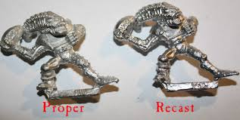



Role of research in development of theory
It initiates theory
Helps in recasting theory
Refocuses theory
Helps in clarifying theory

Slide 73

Conclusion

Slide 74

THANK YOU

