Slide 1



Slide 2
Social Audit-A Tool for Transparency and Accountability
Chaithra.G.J.
PALB-4018
II Ph.D.

Slide 3

Flow of Presentation
Introduction
Objectives
Concept of Social Audit
History of Social Audit
Need and principles
Models and scope
Stages in Social Audit
Case studies
Conclusion

Slide 4
Introduction
Governments are facing an ever growing demand to be more accountable and socially responsible
people are becoming more assertive about their rights to be informed and to influence government’s decision making processes.
Faced with these vociferous demands, the executive and the legislature are looking for new ways to evaluate their performance.

Slide 5
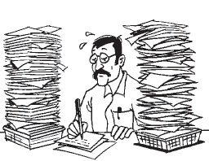
Civil society organizations are also undertaking social audits to monitor and verify the social performance claims of the organizations and institutions.
Increasing awareness of public towards their rights to be served by the government services and their stake in influencing the decision making process necessitates exhibition of greater transparency and accountability.

Slide 6

Objectives of seminar
To understand the concept and principles of social audit
To know the scope and models of social audit
To review the selected case studies

Slide 7

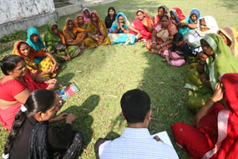

Concept
The concept of “Social Audit” has been derived from the concept of “Corporate Social Responsibility”

Slide 8
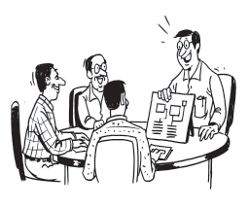
Social audit
Social Audit is “a way of measuring, understanding, reporting and ultimately improving an organization’s social and ethical performance” as per the National Institute of Rural Development (NIRD)
Social Audit is a process in which, details of the resource, both financial and non-financial, used by public agencies for development initiatives are shared with the people, often through a public platform.

Slide 9
Broadly, this process of Social Audit involves, three components
Availability of information or details of the resource, financial and non-financial, used by public agencies for development initiatives.
Organising the ultimate users or beneficiaries or people.
Scrutiny of the information by the end users.

Slide 10
History of Social Audit
The word Audit is derived from Latin that means ‘to hear’
In ancient times, emperors used to recruit special auditors.
Charles Medawar in 1972 in medicine policy, drug safety issues, governmental and professional accountability.
In mid 1970’s in UK and Europe: NGOs started using social audit (A fair trade retail and wholesale company in UK) and New Economic Foundation (NEF- a London-based NGO))
In 1997, the Social Enterprise Partnership: The first European Social Audit programme involving groups from Ireland, Spain, Finland, Sweden, Denmark, England

Slide 11
Cont…..
5. NICDA, (A Social Economy Promotion Agency) in North Ireland started running accredited training courses in Social Audit in 1998.
6. In India, TISCO, Jamshedpur implemented Social Audit in 1979.
7. 73rd Amendment of the Constitution relating to Panchayat Raj institutions- a formal recognition.
8. The approach paper to the Ninth Five Year Plan (1997-2002) emphasized social audit.
9. In Kerala, the state government has taken a decision to introduce social audit for local bodies

Slide 12
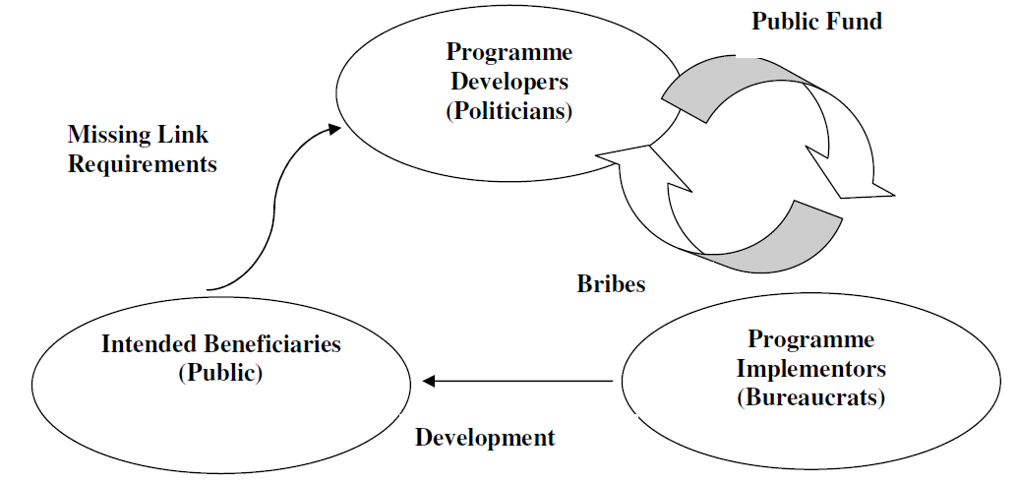
Need for social Audit

Slide 13
Principles of Social Audit
Multi‐Perspective
Comprehensive
Participatory
Regular
Comparative
Verification
Disclosure

Slide 14
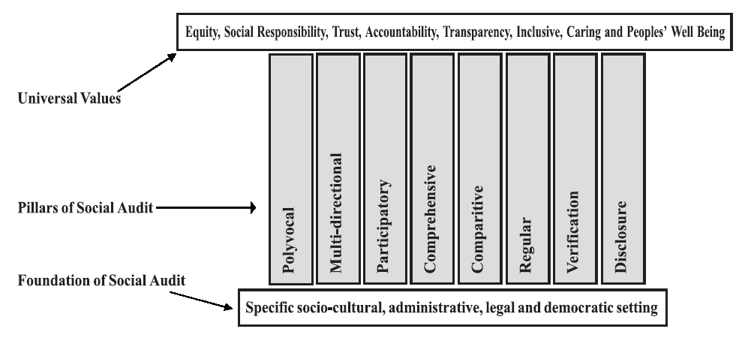
Upholding Universal values through Social Audit

Slide 15
Objectives of Social Audit
Assessing the physical and financial gaps.
Creating awareness among beneficiaries.
Increasing efficacy and effectiveness of local development programmes.
Scrutiny of various policy decisions.

Slide 16
Advantages of social audit
Trains the community on participatory local planning.
Encourages local democracy.
Encourages community participation.
Benefits disadvantaged groups.
Promotes collective decision making and sharing responsibilities.
Develops human resources and social capital.

Slide 17
Key Factors for Successful Social Audit
Level of information shared with and involvement of stakeholders, particularly of the rural poor, women, and other marginalized sections.
Commitment, seriousness and clear responsibilities for follow up actions by elected members of the Gram Panchayat
Involvement of key facilitators in the process.

Slide 18
How to Enhance Local Capacities for Social Audit?
Organization of a mass campaign to increase public awareness about the meaning, scope, purpose and objectives of social audit.
Establishment of a team of social audit experts in each district who are responsible for training social audit committee members (stakeholders).
Implementation of training programmes on social auditing methods conducting and preparing social audit reports, and presentation at Gram Sabha

Slide 19
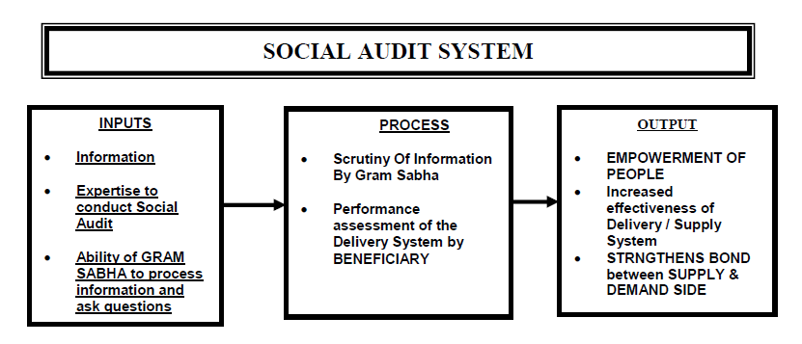
Social Audit System
Inputs
Process
Output

Slide 20

Who will carry out Social Audit???

Slide 21
Who will carry out Social Audit?
Community of stakeholders
Beneficiaries or Participants.
Gram panchayat Representatives
Implementing agency

Slide 22
Models of Social Audit
Village Social Auditors (VSA)
In Andhra Pradesh government has permitted appointment of two Village Social Auditors (VSA) for each Gram Panchayat under the NREGS.
The VSAs also help the Gram Sabha to form a social audit team comprising educated youth, members from community based organisations, representatives of the beneficiaries or workers etc.

Slide 23
Vigilance and Monitoring Committee (VMC)
This model is being adopted in Rajasthan.
VMCs are constituted with the beneficiaries, social workers, retired civil or defence or private sector officials, other retired employees like teachers, representatives from SC/ST/Women.
These VMCs with proper training and orientation can also be a Social Audit team and their findings are placed and discussed in Gram Sabha.

Slide 24

Scope of a Social Audit
A. Acts as Monitoring Tool
Review, Inspection, Supervision, Verification and Control mechanism of the progress of project or scheme implementation.

Slide 25
B. Acts as Evaluation Tool
Evaluation is defined as an assessment either after the completion of a scheme or project or on an on-going or continuing basis, of the processes and end results or impact of a project or scheme.
Usually, evaluation is taken up by an external agency to ensure unbiased and objective assessment of processes and results.
A social audit carried out with external facilitators along with local communities could be termed as participatory evaluation.

Slide 26
When Should Social Audit be Conducted?
Planning stage: To ensure that the Plan is need-based covering productive investments
Preparation stage: to ensure that estimates are proper and are in tune with the approved quantum of work

Slide 27
Cont....
Implementation stage: To ensure that wages are paid rightly, properly and to right people.
After the completion of work: To ensure that quality of work is in tune with quantity and estimated cost.

Slide 28
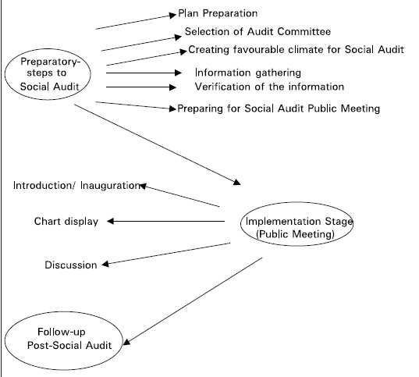
Stages in Social Audit

Slide 29

How does one conduct a social audit of a scheme or programme
Step 1: Study the details of the scheme and the Right to Information Act.
Step 2: Identify the various stages of the scheme, especially those where decisions have to be made, beneficiaries identified, sites selected, strategies determined, details specified, etc.
Step 3: For each of these stages, identify the vulnerabilities, in terms of what can go wrong, what can be corrupted, what distortions can occur.

Slide 30
Cont....
Step 4: Identify for each stage, the appropriate measures to be taken to ensure that the identified vulnerabilities are addressed through the relevant social audit mechanisms.
Step 5: Identify the functionaries and institutions that would be responsible for ensuring that the social audit is conducted, and conducted properly.
Step 6: Call a meeting of the village or community and discuss the principles and method of social auditing in detail with them.

Slide 31
Cont....
Step 7: Ensure that the identified institution and functionary complies with all the requirements of a social audit.
Step 8: Every six months, prepare for a public hearing. In this , hearing the affected persons collectively review the process of social audit. Also reviewed the progress of the scheme.

Slide 32
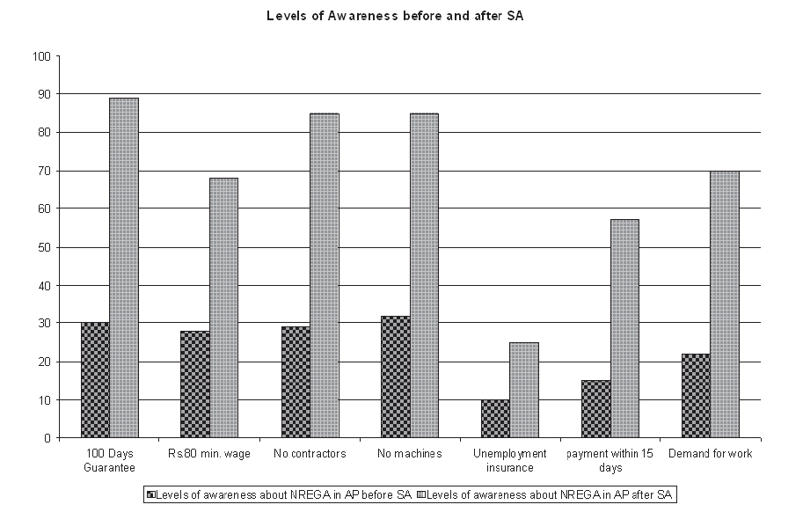
Benefit of Social audit in Case of NGREGS

Slide 33
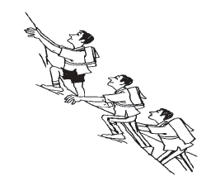
Benefits of Social Audit for Government departments
Enhance reputation
Alerts policymakers to stakeholder trends
Increases accountability
Assist in re-orienting and re-focusing priorities
Provides increased confidence in social areas

Slide 34

Social Audit v/s other Audits
Financial Audit
Operational Audit
Social Audit

Slide 35
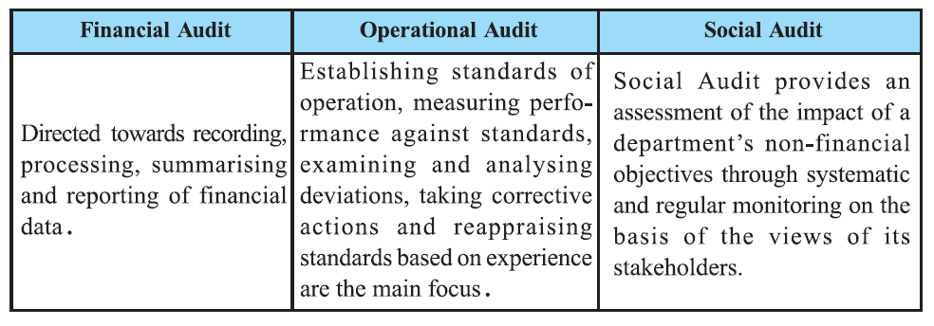

Slide 36


Social (SA) and Financial Audit (FA)
FA = Was the money spent correctly?
SA = Did the spending make a difference?
Social Audit:
Assesses performance and unpacks decisions
Complements financial audit
SA + FA = True Picture

Slide 37

Case studies related to Social audit

Slide 38
Social audit in Jharnipalli Panchayat, Agaipur block, Bolangir district, Orissa.
In October 2001, the gram sabha members of Jharnipalli Panchayat conducted a one day social audit of development works.
This audit took place with the active participation of many individuals and agencies, including block and district administration officials, MKSS [Mazdoor Kisan shakti Sanghatan], NCPRI (National Campaign for People’s Right to Information) and Action Aid India.

Slide 39
The audit found that
Although the works were not carried out, the sanctioned funds were shown in the records as having been utilized.
Contractors were banned under government guidelines, but 31 contractors were working on the project.
Muster rolls were not maintained by the contractors.

Slide 40
Instead of the target of 100 man-days of employment for families below the poverty line (BPL), only 12 half days of work were generated.
The BPL families could not buy subsidized food from the public distribution system (PDS) shops as partial wages because they did not possess the needed ration cards.

Slide 41
Micro-development planning as part of social audit
A voluntary development organization Samarthan and PRIA
collaborated in a participatory micro-planning exercise with local officials, Panchayat members, members of different castes
This led to the identification of several goals.
Every member of the Gram Sabha developed a sense of ownership of the project. The Gram Sabha monitors the work. Gram Panchayat representatives also hold regular ward-level meetings.

Slide 42
Social Audit in Delhi initiated by Parivartan
A social audit was conducted by Parivartan, a citizen's initiative, along with the local residents of two resettlement colonies of North East Delhi.
A social audit of the Corporation of Delhi showed that public money is routinely redirected away from the purposes it is intended.
After the initiatives of Parivartan, a number of people from different parts of Delhi have filed applications under the Delhi Right to Information Act and sought the records of their ration shopkeepers.

Slide 43
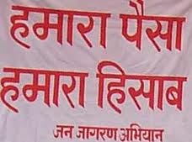
HAMARA PAISA, HAMARA HISAAB:
initiated by Mazdoor Kisaan Shakti Sangathan (MKSS), Rajasthan
The MKSS- 1990, is a big grassroots organisation
People in Rajasthan have always had difficulty getting paid the minimum wages.
The campaign of Mazdoor Kisaan Shakti Sangathan in Rajasthan is known as Hamara Paisa, Hamara Hisaab.
Initially, demands to see the muster rolls were met with refusal on the grounds that these were ‘secret documents’.

Slide 44
Cont...
The MKSS brought people together and simply read out official documents.
People who would have been intimidated on their own now had a platform where they could speak out.
MKSS in Rajasthan demanded and got information on minimum wages and government infrastructure programmes,

Slide 45
How effective are social audits under MGNREGS ? LESSON FROM KARNATAKA
Rajasekhar, salim lakha and Manjula

Slide 46
This case study on social audits under MGNREGS in Karnataka aims to provide suggestions on how to improve the design and implementation of social audits in the state. With the help of the primary data collected from five Gram panchayats in Chitradurga district.

Slide 47
Lack of participation of women
Relative ineffectiveness of the VMCs
Lack of independent auditors
Inadequate training provided to villagers for conducting social audits
Insufficient scrutiny of the possession and distribution of job cards
Complaints by labourers that not enough work was available under MGNREGS

Slide 48
Social Audits in India
- Gahlot Sushmita (2013)
Through an example of Andhra Pradesh , Rajasthan and the North Eastern states, it discusses the evolution problems faced while conducting social audits and also
suggests measures to improve upon social audits of the various government schemes.

Slide 49
Suggestions
While conducting a social audit, it is required that the purpose is clearly defined.
The stakeholders should be properly identified.
The auditor must obtain information from reliable sources.
The performance indicators adopted by the society at large should be taken as standards in order to judge the performance

Slide 50
Contd..
Regular meetings and follow ups must take place in order to ensure the continuity and effectiveness of audits.
Proper mechanisms must be set up in order to recover the swindled money from the corrupt officials.
Hierarchy needs to be defined for conducting social audits.
External Parties such as NGOs should be involved in conducting audits.

Slide 51


Slide 52


