Slide 1

WELCOME

Slide 2

Crop Insurance-An effective tool to protect the farmers from Risk and Uncertainties
Presented by,
SURESH D. K.
PALB-4023

Slide 3

Short take of seminar
Introduction
Objectives of the seminar
Concepts used and approaches
Different Insurance schemes
Review the literature
Conclusion
3

Slide 4
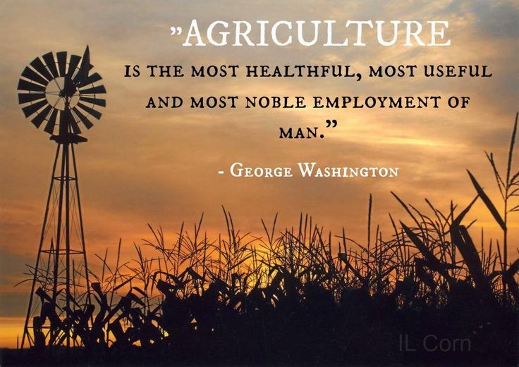



Slide 5



INTRODUCTION
52 per cent
15.30 per cent- GDP (2015-16)
Agriculture production and farm income
(Natural calamities and Man made disasters)

Slide 6

Objectives of the Seminar
To know the concept of crop insurance
To study the different crop insurance schemes in India
To review studies related to crop insurance

Slide 7

The Concept of crop insurance
7

Slide 8


Crop Insurance
It is an insurance arrangement aiming at mitigating the financial losses suffered by the farmers due to damage and destruction of their crops as a result of various production risks (AIC of India).

Slide 9

Key terms
Actuary
Claim
Premium
Indemnity
Guaranteed Yield
Insured
Sum Insured

Slide 10
Risks in Agriculture
Production Risk
Market/Price Risk
Price drop through change
of demand and supply in market
Yield loss through natural
disasters
Risk management
Financial Risk
Institutional Risk
Non payment in the event of
crop failure
Government policies and
legal issues

Slide 11
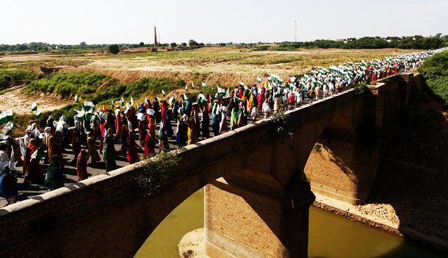


Slide 12
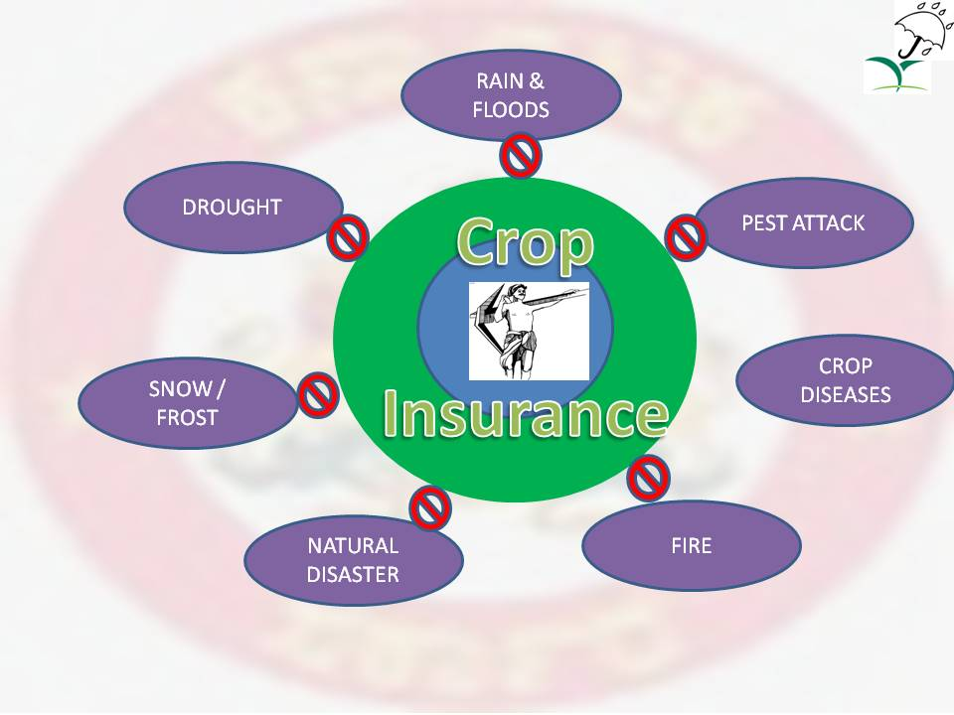

Slide 13
Need for crop Insurance
For Farmers:
Can avoid the loss incurred
Pest and Diseases
Fire
For Banks:
Avoiding the risk of non payment
For Government:
Reducing the payment of relief package
A prosperous, stable and happy nation

Slide 14

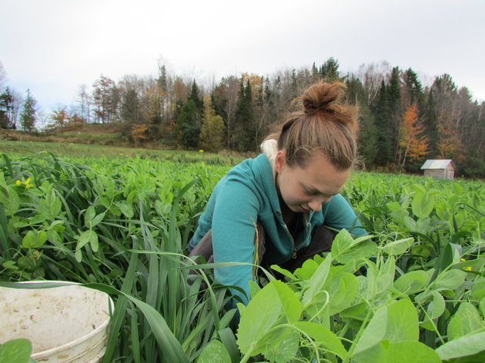
Approaches to crop insurance
Individual approach
Area approach

Slide 15

Different insurance schemes in india

Slide 16
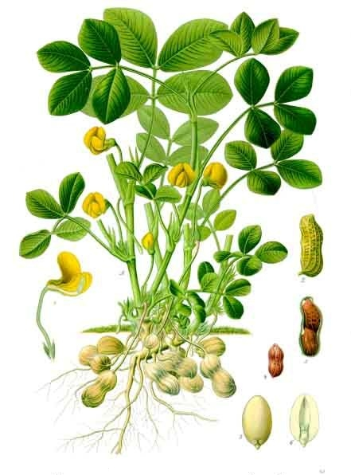
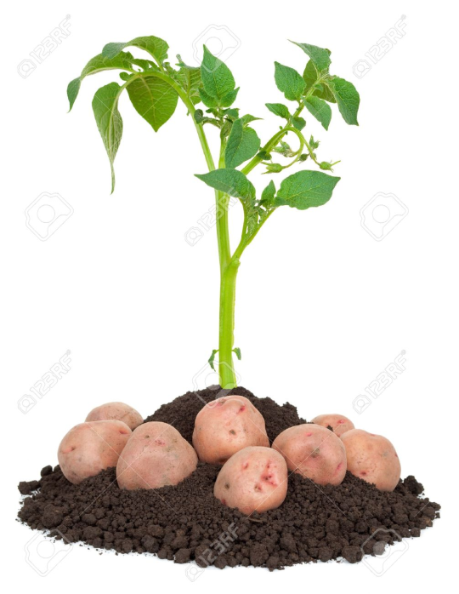

First Ever-Individual Approach Scheme
1972-73
General Insurance Department of Life Insurance Corporation of India
H-4 cotton Gujarat
Individual Approach
Gujarat, Maharashtra, Tamil Nadu, Andhra Pradesh, Karnataka and West Bengal.

Slide 17

1978-79
3110 farmers
Premium of Rs.4.54 lakhs
Claims of Rs.37.88 lakhs

Slide 18
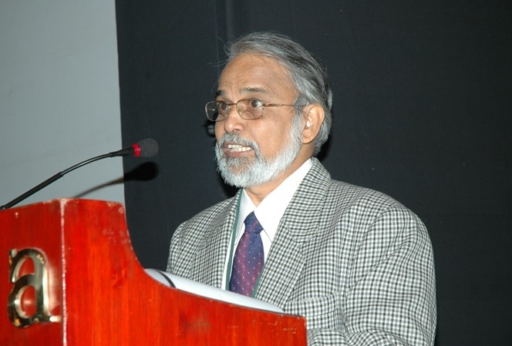
Pilot Crop Insurance Scheme (PCIS) – 1979
Area approach
Cereals, Millets, Oilseeds, Cotton, Potato
Loanee farmers
Voluntary basis

Slide 19

Cont..,
Till 1984-85
13 states
6.27 lakh farmers
Rs. 196.95 lakhs
Rs.157.05 lakhs

Slide 20

Comprehensive Crop Insurance Scheme (CCIS)
1st April 1985
GOI and State Governments
Short term crop credit
Implemented on homogeneous area basis.

Slide 21

Main features of the scheme
Covered loanee farmers on compulsory basis
The premium rates…..
Optional to state governments
Multi-agency effort

Slide 22
Cntd…
Farmers covered : 761.79 lakh.
Area covered : 1275.13 lakh hac.
Total sum insured: 24,922 Crores
Premium collected : 402.83 crores
Total claims : 2302.68 crores

Slide 23

Experimental Crop Insurance Scheme (ECIS)
1997
The scheme was similar to CCIS
Small and Marginal farmers with 100 per cent subsidy in premium
4,54,555 farmers
Sum insured : Rs.168.11 Crores
Claims paid : Rs.37.80 Crores
Premium of Rs.2.84 Crores

Slide 24

National Agricultural Insurance Schème
(NAIS)
1999-2000
Both loanee & non-loanee farmers
All food grains, oilseeds and annual horticultural / commercial crops
“Area Approach” and “Individual Approach”
Farmers including share croppers and tenant farmers

Slide 25
National Agricultural Insurance Schème (NAIS)
'Indemnity' to the farmer is calculated as per the following formula
Shortfall in Yield X Sum Insured
Threshold yield
(Shortfall in Yield = Threshold Yield - Actual Yield)
Three levels of Indemnity:
  90 per cent: Low Risk
  80 per cent : Medium Risk
  60 per cent : High Risk areas

Slide 26
NAIS: How it Works?
Crop : Sorghum Sum Insured (INR): 10000
Years | 2006 | 2007 | 2008 | 2009 | 2010
Yields(kg./ha) | 1200 | 875 | 250 | 950 | 1200
Average Yield (Kg./ha.) = 895
Actual Yield (Kg./ha.) – 2011 = 650
Shortfall in Yield X Sum Insured
Threshold Yield
Indemnity Level = 80 per cent
Threshold Yield (Kg./ha.) = 716
Shortfall in Yield (Kg./ha.) = 66
Shortfall (%) = 10.15
Claim Payable (INR) = Rs. 921.78

Slide 27
Premium rates for different crops under NAIS
Sl. No. | Season | Crops | Premium Rate
1. | Kharif | Bajra and Oilseeds | 3.5 per cent of SI or Actuarial rate, whichever is less
 |  | Other Crops (Cereals, Other, Millets and Pulses) | 2.5 per cent of SI or Actuarial rate, whichever is less
2. | Rabi | Wheat | 1.5 per cent of SI or Actuarial rate, whichever is less
 |  | Other Crops (Other Cereals, Millets, Pulses and Oilseeds) | 2.0 per cent of SI or Actuarial rate, whichever is less
3. | Kharif and Rabi | Annual commercial / Annual Horticultural crops | Actuarial rates
Note: SI: Sum Insured
Source: Agriculture Insurance Company of India Limited.

Slide 28
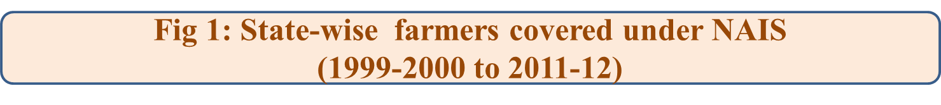

Slide 29
Fig 2: State-wise area covered under NAIS (1999-20 to 2011-12)
Source: Agriculture Insurance Company of India Limited

Slide 30

Strengths of NAIS
Practically ‘All-risk’ insurance
Insurance unit is largely Homogeneous
It’s a good solution where Historical Farm Yield Data do not exist

Slide 31

Key challenges in NAIS
‘Basis risk’ as the area is rarely a homogenous
‘Sowing till harvesting’
Infrastructure and manpower required
Delay in settlement of indemnities

Slide 32
WEATHER BASED CROP INSURANCE
Individuals and Institutions likely to be impacted by adverse weather incidences
2003-ICICI Lombard
World Bank for Groundnut and Castor farmers of Mahbubnagar district ( Andhra Pradesh)
Pilot Rainfall insurance scheme in 2004-05 in Andhra Pradesh, Karnataka and Gujarat

Slide 33

It is not Yield guarantee insurance scheme but based on weather index such as rainfall, temperature and relative humidity.
Based on concept of Area Approach i.e., for the purposes of compensation, a ‘Reference Unit Area (RUA)’ shall be deemed to be a homogeneous unit of Insurance.

Slide 34
State-wise Weather based crop insurance scheme (WBCIS) up to 2014
[Rs. In Lakhs]
Sl. No. | States/UT | Farmers insured (No) | Area insured (Ha.) | Sum insured | Farmers Premium | Gross Premium | Farmers benefited (No) | % benefited
1 | AP | 2880796 | 4696118 | 1181202.42 | 45288.49 | 17823.45 | 2016440 | 6.42
2 | Assam | 21651 | 11338 | 6921.58 | 348.67 | 696.44 | 68 | 0.00021
3 | Bihar | 12877373 | 13105023 | 3047062.11 | 86802.32 | 265616.85 | 7679325 | 24.46
4 | Gujarat | 497661 | 413126 | 22394.75 | 251.8 | 2239.48 | 170576 | 0.54
5 | Haryana | 359343 | 601957 | 189823.74 | 3693.45 | 16764.59 | 201135 | 0.64
6 | HP | 153276 | 1016159 | 65085.55 | 3747.75 | 7495.48 | 92175 | 0.29
7 | Jharkhand | 521496 | 502608 | 105797.47 | 3596.29 | 9766.33 | 313476 | 0.99
8 | Karnataka | 942265 | 1162743 | 205279.02 | 9765.8 | 23097.14 | 631623 | 2.01
9 | Kerala | 116500 | 82667 | 25617.09 | 945.54 | 2637.7 | 59034 | 0.18
10 | MP | 1032262 | 1709397 | 385087.44 | 10583.63 | 35222.57 | 804398 | 2.56
11 | MH | 1928690 | 1878757 | 453755.49 | 21527.081 | 51188.592 | 476129 | 1.51
12 | Orissa | 315755 | 456504 | 117798.57 | 1414.07 | 5656.27 | 215814 | 0.68
13 | Rajasthan | 36179884 | 49470358 | 4040932.22 | 124214.66 | 391811.17 | 18042120 | 57.48
14 | WB | 106561 | 116844 | 18524.22 | 524.45 | 1803.12 | 61480 | 0.19
15 | Total | 60194219 | 76686458 | 10192911.77 | 322862.601 | 865627.812 | 31387572 | 100
Source: Agriculture Insurance Company of India Limited

Slide 35

Advantages
Rainfall, temperature, relative humidity
Speedy settlement of claims, say within 45 days
Government is providing Subsidy in Premium
Claim payment is automatically calculated..

Slide 36

Key Challenges
Non-availability of reliable and quality weather data
Non-coverage of perils other than weather parameters
Poor infrastructure facilities such as Automatic Weather Stations(AWS) and trained manpower etc.,

Slide 37
Rainfall Insurance (Varsha Vima)
Deficit and Excess rainfall, consecutive dry and wet days etc.,
Areas spread over 27 districts of 4 states viz, Andhra Pradesh, Karnataka, Rajasthan and Uttar Pradesh in 2004- 05

Slide 38
Cntd…
It has targeted three risks
  Inadequate Rainfall over the entire cropping Cycle
  Inadequate Rainfall during critical stages of crop development
  Sowing failure due to inadequate rainfall at the start of the season

Slide 39

Modified National Agricultural Insurance Scheme (MNAIS)
2010-11
Village/ Village panchayat as Insurance Unit (IU)
Extending risk coverage to….

Slide 40
Payment up to 25 per cent of likely claims in advance
Indemnity levels of 70 , 80 and 90 per cent respectively
Increasing subsidy in premium up to 75 per cent

Slide 41
Modified National Agricultural Insurance Scheme (MNAIS)
from 2010 to 2013-14
Achievements:
Coverage: Selected District of 18 states/UT’s
Farmers Insured: 75.03 lakhs
Premium: Rs. 1935.86 Crores
Claims: Rs.1465.75 Crores

Slide 42
Performance of different Insurance schemes
Coverage of Farmers
Coverage of Area
Report of the committee to Review the implementation of crop insurance schemes in India, Ministry of Agriculture, GOI, 2014

Slide 43
Coverage of crops in all schemes
Sl. No. | Crops | Gross area (Mha) | Insured area (Mha) | Insurance coverage (%)
1 | Paddy | 42.76 | 10.02 | 23.43
2 | Wheat | 30.50 | 7.74 | 25.39
3 | Coarse grains | 25.15 | 5.95 | 22.89
4 | Sugarcane | 5.44 | 0.15 | 2.67
5 | Cotton | 11.90 | 1.53 | 12.92
6 | Jute and Mesta | 0.85 | 0.07 | 8.18
7 | Oilseeds | 29.10 | 10.43 | 35.84
8 | Pulses | 21.96 | 5.77 | 26.27
9 | Vegetables | 5.51 | 2.09 | 37.99
10 | Fruits | 3.77 | 0.21 | 5.58
Total | Total | 194.40 | 45.34 | 23.32
Source: Ministry of Agriculture, Co-operation & Farmers Welfare, Government of India

Slide 44
Coverage of States in all schemes
Sl. No. | States | Gross cropped area (Mha) | Insured area (Mha) | Insurance coverage (%)
1 | Rajasthan | 23.95 | 11.91 | 49.70
2 | Bihar | 7.78 | 3.74 | 48.02
3 | Madhya Pradesh | 23.13 | 10.62 | 45.91
4 | Maharashtra | 21.87 | 4.87 | 22.26
5 | Karnataka | 11.75 | 1.44 | 12.25
6 | Gujarat | 12.60 | 1.39 | 11.02
7 | Uttar Pradesh | 25.82 | 2.05 | 7.95
8 | Andhra Pradesh | 13.65 | 0.54 | 3.96
9 | All India | 194.40 | 45.34 | 23.32
Source: Ministry of Agriculture, Co-operation & Farmers Welfare, Government of India

Slide 45
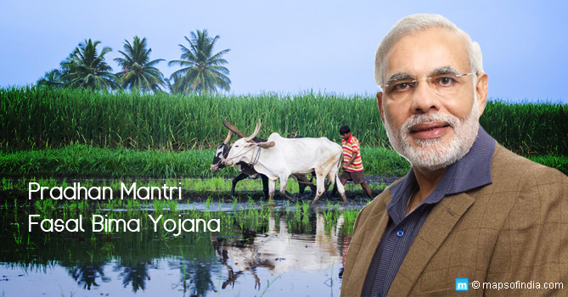
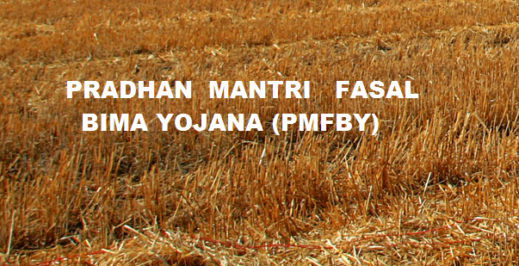
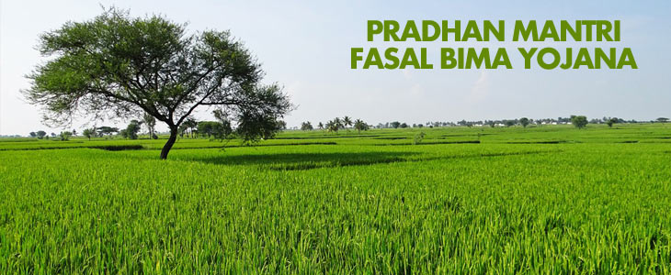

PMFBY

Slide 46
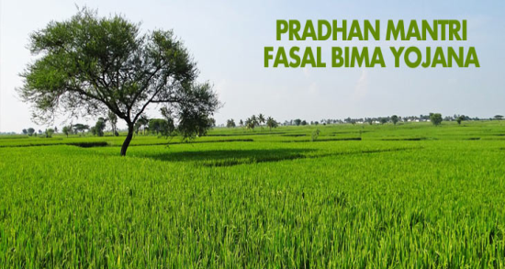
Pradhan Mantri Fasal Bima Yojana (PMFBY)
13th January 2016
April 1, 2016
NAIS and MNAIS
‘Minimum Premium’, ‘Maximum Insurance’ for farmers
Remote sensing technology, smart phones and drones
25 per cent to 50 per cent

Slide 47
Cntd…
5000 -AWS (PPP mode)
Ministry of Agriculture and Farmers’ Welfare, GOI
Total budget estimated- Rs. 17,600 crore

Slide 48

Reasons to Announce
Bid to address the rural distress that is driving farmers to suicide
Disillusionment in the rural India about the central government.

Slide 49
Objectives
Failure of any of the notified crop as a result of natural calamities, pests & diseases
Farmers to ensure their continuance in farming
To adopt innovative and modern agricultural practices
To ensure flow of credit to the agriculture sector

Slide 50
Exclusions from PMFBY
War & kindred perils
Nuclear risks
Malicious damage
Theft or act of enmity
Grazed and/or destroyed by domestic and/or wild animals

Slide 51
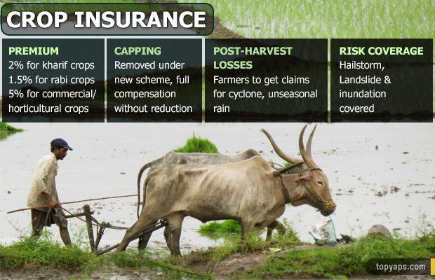
Key Features of PMFBY

Slide 52
Role of Banks
Ensuring compulsory coverage of loanee farmers
Timely remission of premium and related data to the insurance companies –provision of penal interest for delay period
Crediting the claims received from Insurance companies into the farmers Accounts timely
Carry out Awareness

Slide 53

Role of Insurance companies
Adequate publicity
Coverage of non loanee farmers
Ensuring timely payment
Adequate number of loss assessors

Slide 54

Review the Research and Case Studies:

Slide 55
Agricultural Insurance in India Problems and Prospects
(Raju and Ramesh,2008)

Slide 56
Borrowers’ perception on premium rate
n= 60
Perception | Response | Per cent
Paying Premium rate | High | 61.67
 | Low | 3.33
 | Reasonable | 31.67
 | Cant say | 3.33
Premium rate willing to pay | Up to 2% | 95.00
 | 2-3 % | 5.00

Slide 57

Case study
Risk in rainfed Maize production in
Karnataka - An econometric analysis
(Shashi Kiran ,2012)

Slide 58
Summary of willingness to pay (WTP) for crop insurance
(Per cent)
Season | Prevailing premium rate | Farmers WTP | Difference
Kharif | 2.5 | 2.84 | 0.34
Rabi | 2.0 | 2.34 | 0.34

Slide 59
Distribution of maize farmers by WTP premium for crop insurance
Sl. No. | Premium (%) | Numbers | Percent
1 | up to 25 | 35 | 11.67
2 | 25-50 | 23 | 07.67
3 | 50-75 | 13 | 04.33
4 | 75-100 | 4 | 01.33
5 | >100 | 48 | 16.00
 | Sub total | 123 | 41.00
6 | Unwilling to pay | 177 | 59.00
 | Total | 300 | 100.00

Slide 60
Distribution of maize farmers by response to WTP for crop insurance premium
Sl. No. | Response | Numbers | Per cent
1 | YY | 48 | 16.00
2 | YN | 44 | 14.67
3 | NY | 31 | 10.33
4 | NN | 177 | 59.00
 | Total | 300 | 100.00

Slide 61
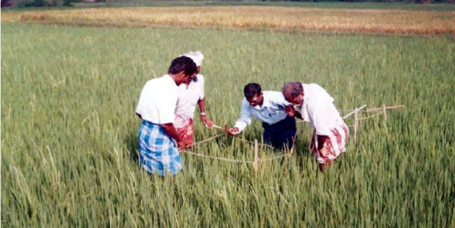
Key Issues and challenges to Crop Insurance in India
Settlement of claims
Crop-cutting experiments for accurate estimation of crop yield
Confidence in weather data
Role of Government, AIC and banks
Insurance Premium related issue
A typical crop cutting experiment

Slide 62
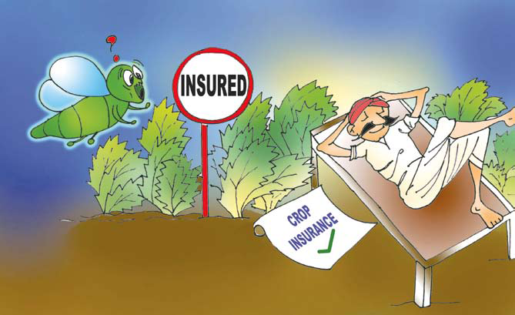

Conclusion

Slide 63

THANK YOU

