Slide 1

WELCOME

Slide 2


Application of distribution theories in Social Science Research
SUDHA, C. K.
Ph. D. Scholar
PALB 3019

Slide 3

Contents
Introduction
Concept of distribution
Observed frequency distribution
Theoretical probability distribution
Binomial distribution
Poisson distribution
Normal distribution
Conclusion

Slide 4

INTRODUCTION

Slide 5

Objectives
1
3
2
To know the existing distributions in Social Science Research
Applications of distributions in Social Science Research
To know the concept of statistical distribution theory

Slide 6

I. Concept of statistical distribution theory
Statistics- Latin- Status – Political state
“Statistics may be defined as the science of collection, presentation, analysis and interpretation of numerical data”
- Croxton & Cowden

Slide 7

Functions of statistics
Presents facts in a defined form
Facilitate comparison
Formulating and testing hypothesis
Predicting or forecasting
Formulation of suitable policies

Slide 8

Limitations
Quantitative characteristics rather than qualitative
It does not study the individuals

Slide 9

CONT…
Random variable: variable whose value is determined by the outcome of a random experiment
It may be discrete or continuous
Discrete : variable which assumes some specified value in a given range
Continuous : variable which assumes all the values in a given range

Slide 10

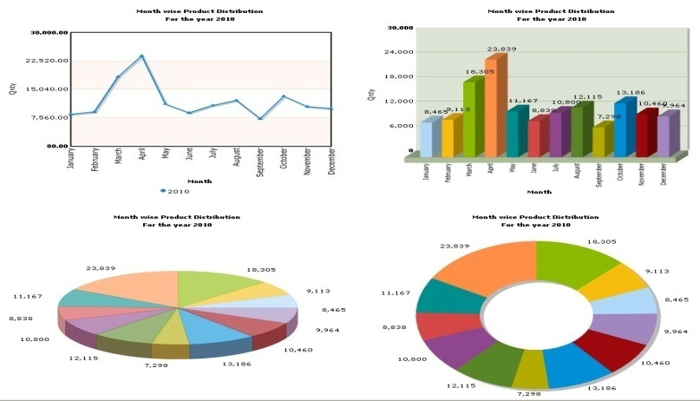
Distribution theory
Distribution : An order or pattern formed by the tendency of a sufficiently large number of observations to group themselves around a central value.
It gives us a law
Applied in decision making
Help for interpreting the data (Graphically)

Slide 11

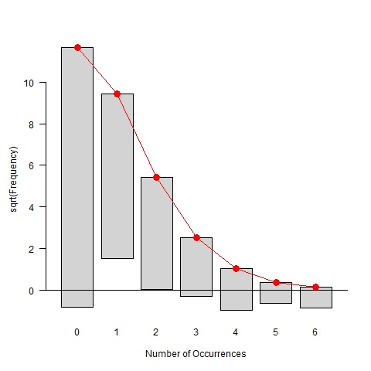
Types of distributions
Observed frequency distribution
Theoretical probability distribution

Slide 12

1. Observed frequency distribution
Frequency (f) : number of times a particular item is repeated.
3 2 5 6 3 6 3
Frequency distribution : arrangement of the data which gives the frequency corresponding to each successive value of the variable.
Ex.
Relative frequency (f/n): frequency of class / total number
Cumulative Frequency : is the tally or count of the number of data values in a class plus the frequencies for all lower classes.
Class | No. of students | Cumulative f
1 | 15 | 15
2 | 12 | 27
3 | 10 | 37

Slide 13

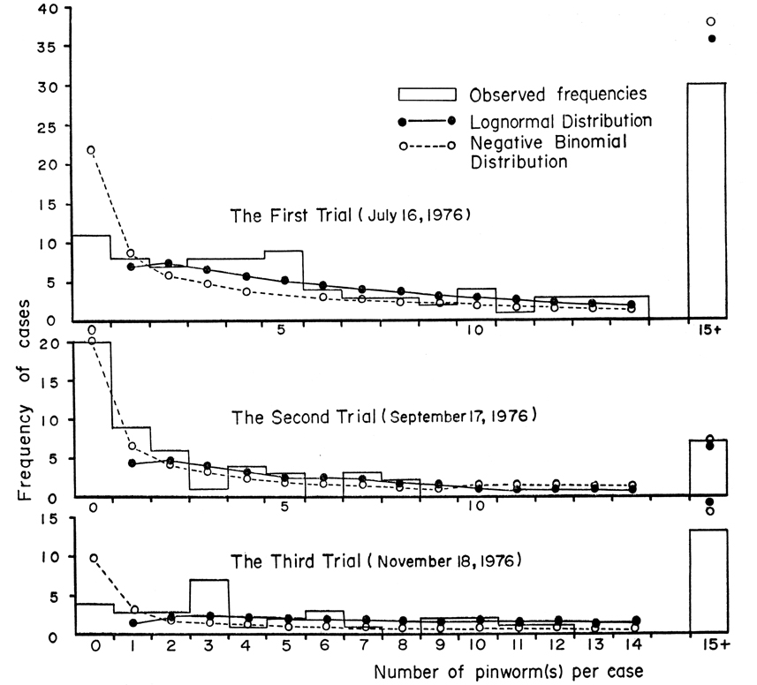
Types of Frequency Distributions
1.1 Discrete Frequency Distributions
1.2 Continuous Frequency Distributions
1.3 Cumulative Frequency Distributions

Slide 14

1.1 Discrete Frequency Distribution
Education (variable) | No. farmers (frequency)
4 | 3
5 | 1
6 | 3
7 | 8
8 | 4
9 | 2
10 | 7
11 | 3
12 | 4
Total | N= 35
No class intervals
No classes
No fractions / decimals

Slide 15

1.2 Continuous Frequency Distributions
Inclusive method :
Marks (class interval) | No. of students (F)
10-16 | 3
17-23 | 1
24-30 | 3
31- 37 | 14
ii. Exclusive method
Marks (class interval) | No. of students (F)
9.5-16.5 | 3
16.5-23.5 | 1
23.5-30.5 | 3
30.5- 37.5 | 14

Slide 16


Procedure to find the Class Limits from Data
Groups are known classes - 9.5-16.5
The two boundaries of each class are known as lower limit (9.5) and upper limit (16.5)
The difference between upper and lower limit in classes – width of the class interval
We add all the frequencies of individual classes – total frequency

Slide 17


Characteristics of Classes or Groups
There should be between 5 and 20 classes.
The class width should be an odd number (Suggested by Bluman)
The classes must be mutually exclusive
The classes must be continuous
The classes must be able to include all data
The classes must be equal width

Slide 18

1.3 Cumulative Frequency Distributions
Marks ( variable) | No. of students (frequency) | Less than cumulative | More than cumulative
10 | 3 | 3 | 15=N
22 | 1 | 4 | 12
24 | 3 | 7 | 11
35 | 8 | 15=N | 8
Marks ( variable) | No. of students (frequency) | Less than cumulative | More than cumulative
9.5-16.5 | 3 | 3 | 21=N
16.5-23.5 | 1 | 4 | 18
23.5-30.5 | 3 | 7 | 17
30.5- 37.5 | 14 | 21=N | 14

Slide 19

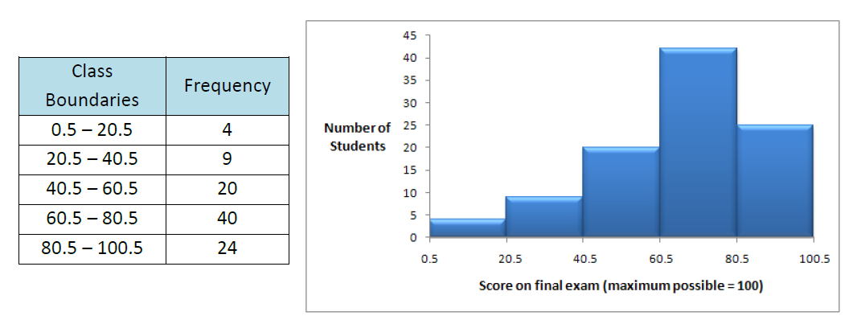
Graphs of frequency distribution
The Role of Graphs
• Presents the data in pictorial form.
• Attracts attention in a publication or a presentation.
B. Types of Graphs
1. Histogram

Slide 20

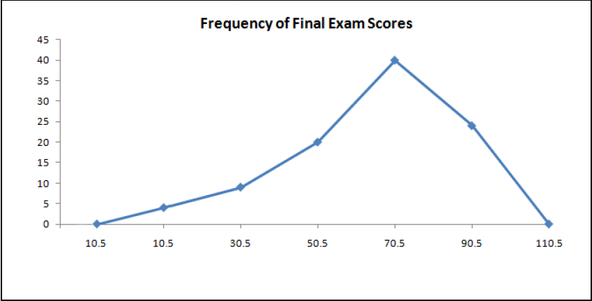
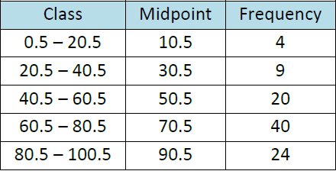
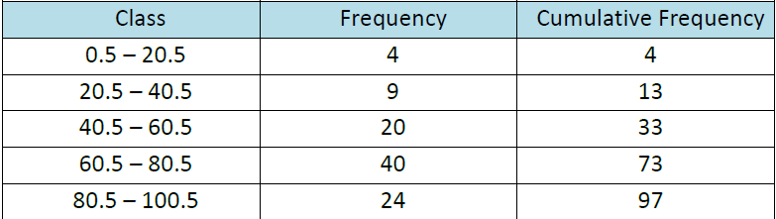
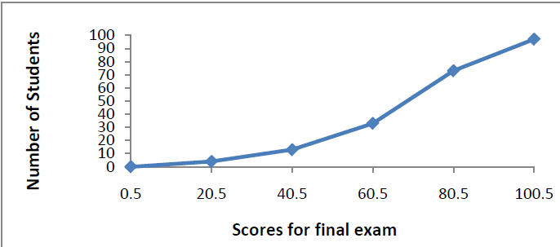
2. Frequency polygon
3. Ogive

Slide 21

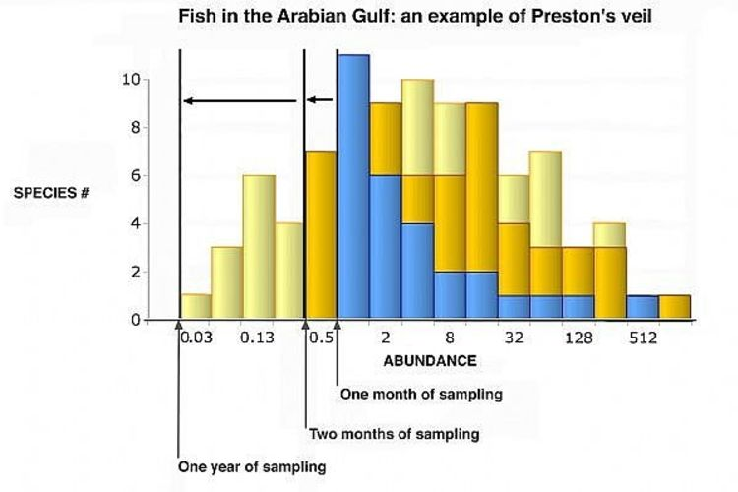
Frequency Distributions?
To organize the data for interpretation
To compare different data sets
To simplify the computation for measures of average and speed
To determine the shape distribution
To draw charts and graphs for data

Slide 22

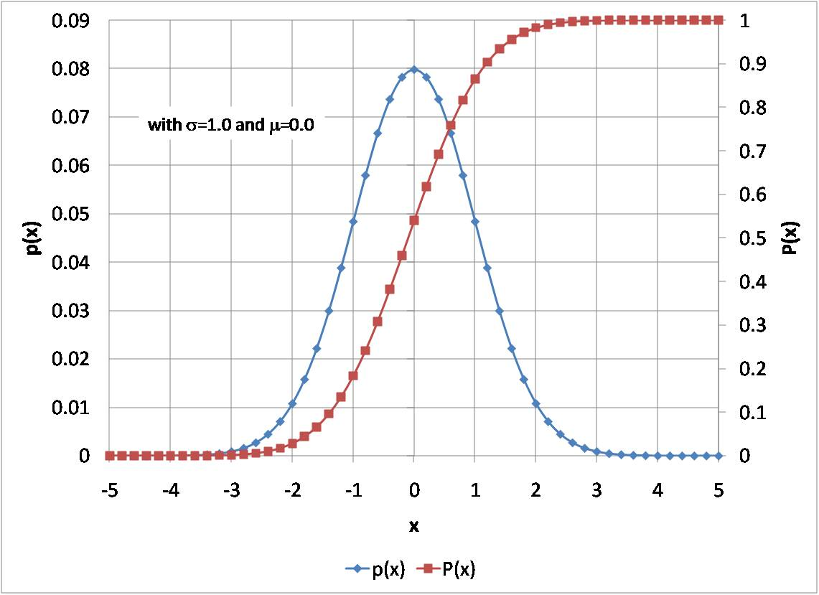
2. Theoretical Probability Distribution?
Mathematical models
Certain hypothesis is assumed, it is some time possible to derive under mathematical models
OR
It is the frequency distribution of a certain events in which frequencies are obtained by mathematical computation

Slide 23

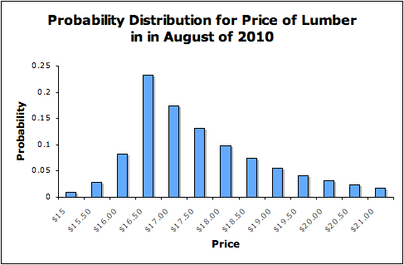
Probability Distributions
Random variable - X
Its value - x
Every probability is 0 to 1
Sum of all probabilities = 1
Example ,
X represents the random variable X.
P(X)
P(X = x)
P(X = 1)

Slide 24

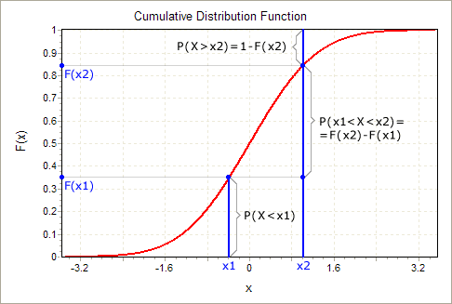
Cumulative Probability Distributions
Cumulative probability refers to the probability that the value of a random variable falls within a specified range.
P(X < 1) = P(X = 0) + P(X = 1) = 0.25 + 0.50 = 0.75
P(X < 2) = P(X = 0) + P(X = 1) +P(X=2)
= 0.25+ 0.50 + 0.25
= 1.00

Slide 25


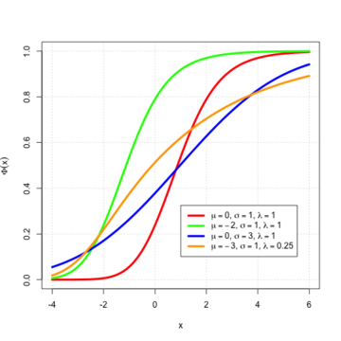
Types of Probability Distributions
2.1 Discrete probability distributions
2.2 Continuous probability distributions

Slide 26

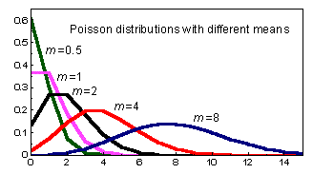
Discrete Probability Distributions
a. Binomial Distribution
b. Poisson Distribution

Slide 27

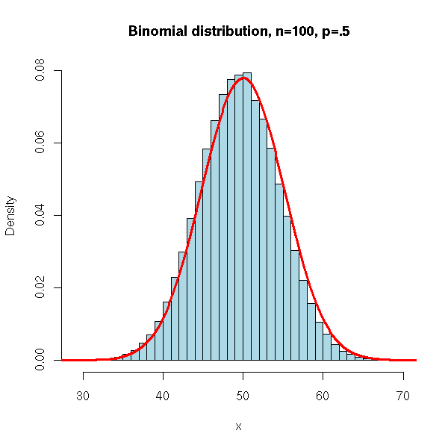
a. Binomial Distribution
Events / experiments carried out getting dichotomous out comes.
It was developed - James Bernoulli
Determined by two parameters
Mean- np
Variance – npq
Mean>variance

Slide 28

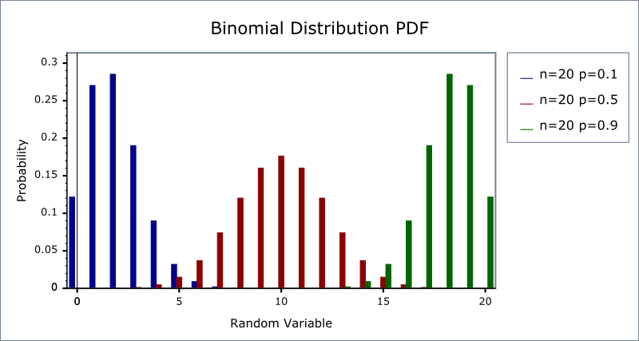
Definition
Where:
x: number of successes in trail
n: number of trials
n-x : no. of failures in trail
p: probability of success
q: probability of failure (1 - p)
BD= P(X=x) = _{n}C_{x} p^{x} (q)^{n – x}

Slide 29

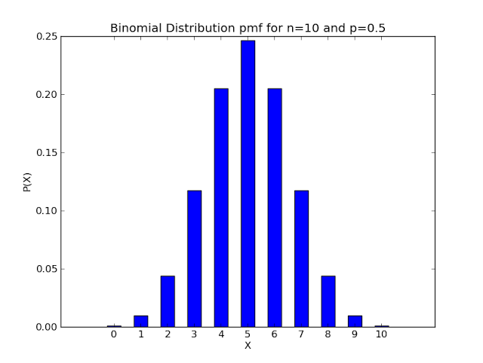
Assumptions
Out comes expected with dichotomous
No. of trails conducted should be fixed (n)
Sum of probability of outcome (p&q) should be =1
Trail should be independent
Variables should be discrete

Slide 30

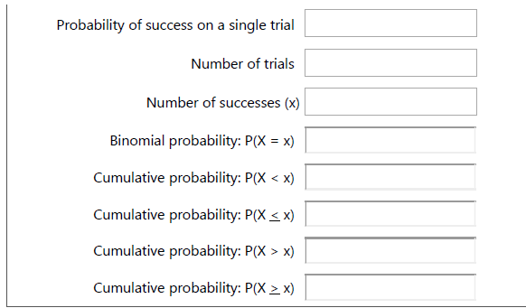
Online BD calculator

Slide 31

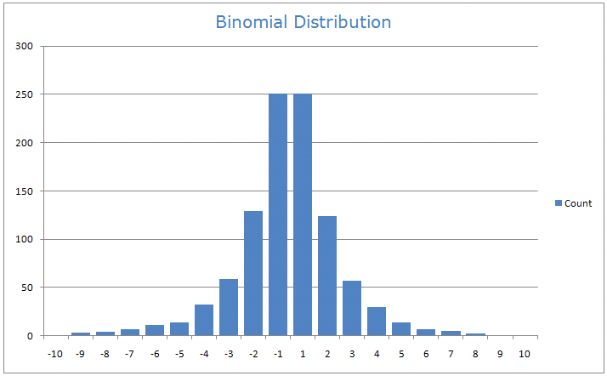
Application in social science research
Maize variety -6
What is the probability for adopting 3
Ans:
No. of trails – 6
P(x)= 3

Slide 32

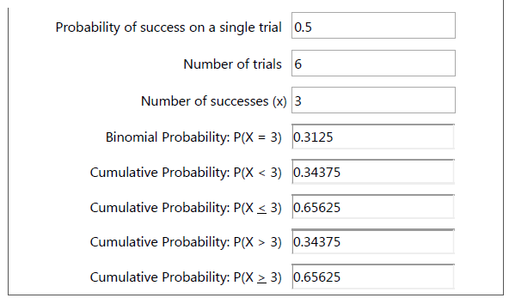

Slide 33

b. Poisson Distribution
Developed – S D Poisson
no. trails are very large (n-infinity)
It used to describe the behaviour of random events that occur rarely over a time / space
Time
The no. of insects caught in a trap in one hour
Space
No. of wilt affected coconut trees in a locality

Slide 34

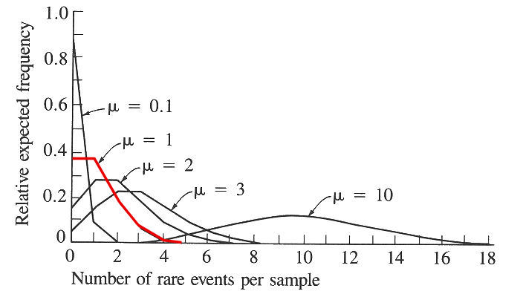
CONTI…
no. of accidents on road in particular time interval
No. of printing mistakes in each page of a book
Properties
Only one parameter
Mean- ƛ
Variance – ƛ
Mean = variance

Slide 35

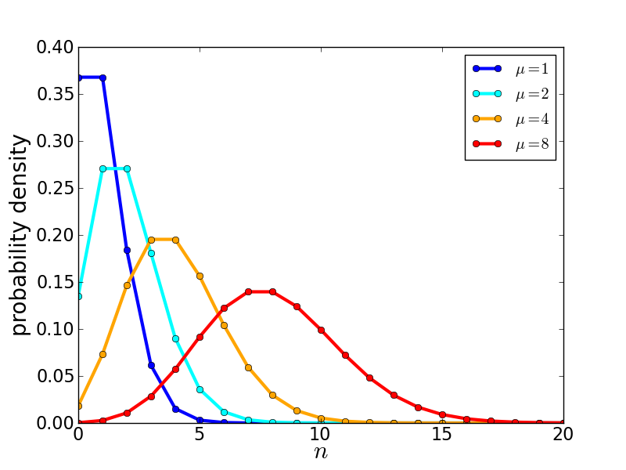
Definition
X – no. of times the events occurred
ƛ=np= mean no. of times an event occurred
e - 2.71828.
P(x; ƛ) = (e^{-μ}) (μ^{x}) / x!

Slide 36

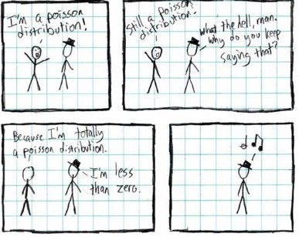
Application in social science
Ex. 1. Suppose a book of 585 pages contains 43 typographical errors. If these errors randomly distributed through out the book, what is the probability that 10 pages selected at random, will be free from error?
Ans. Given n= 10, p = 43/ 585= 0.0735
np = 10*0.0735 = 0.735
P(x=0) = (e^{-μ}) (μ^{x}) / x!
= 0.4795

Slide 37

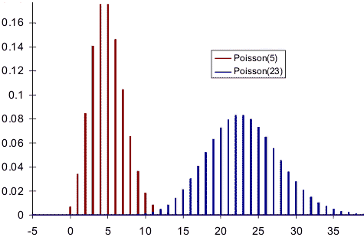
Example 2
Suppose the average number of suicides seen on a 1- month is 5. What is the probability that will see fewer than four suicides on the next month ?
Solution:
Where,
μ = 5; since 5 suicides are seen per month, on average.
x = 0, 1, 2, or 3.
e = 2.71828
Thus, we need to calculate the sum of four probabilities:
P(0; 5) + P(1; 5) + P(2; 5) + P(3; 5)
P(x < 3, 5) = P(0; 5) + P(1; 5) + P(2; 5) + P(3; 5)

Slide 38

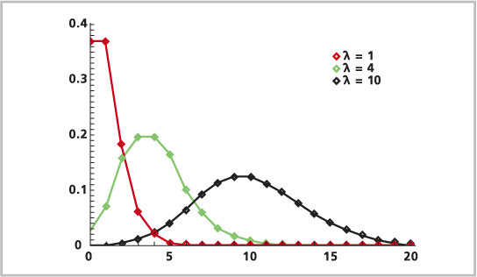
P(0; 5) + P(1; 5) + P(2; 5) + P(3; 5)
P(x < 3, 5) = P(0; 5) + P(1; 5) + P(2; 5) + P(3; 5)
P(x < 3, 5) = P(0; 5) + P(1; 5) + P(2; 5) + P(3; 5)
P(x < 3, 5) = [ (e⁻⁵)(5⁰) / 0! ] + [ (e⁻⁵)(5¹) / 1! ] + [ (e⁻⁵)(5²) / 2! ] + [ (e⁻⁵)(5³) / 3! ]
P(x < 3, 5) = [ (0.006738)(1) / 1 ] + [ (0.006738)(5) / 1 ] + [ (0.006738)(25) / 2 ] + [ (0.006738)(125) / 6 ]
P(x < 3, 5) = [ 0.0067 ] + [ 0.03369 ] + [ 0.084224 ] + [ 0.140375 ]
P(x < 3, 5) = 0.2650
Thus, the probability of seeing at no more than 3 suicides is 0.2650.

Slide 39

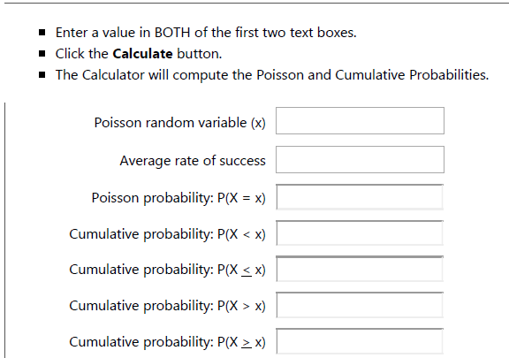
Online calculation

Slide 40

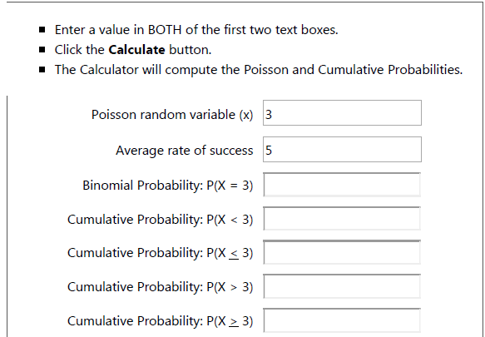

Slide 41

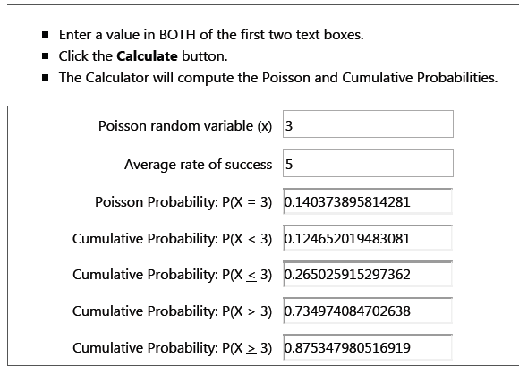

Slide 42

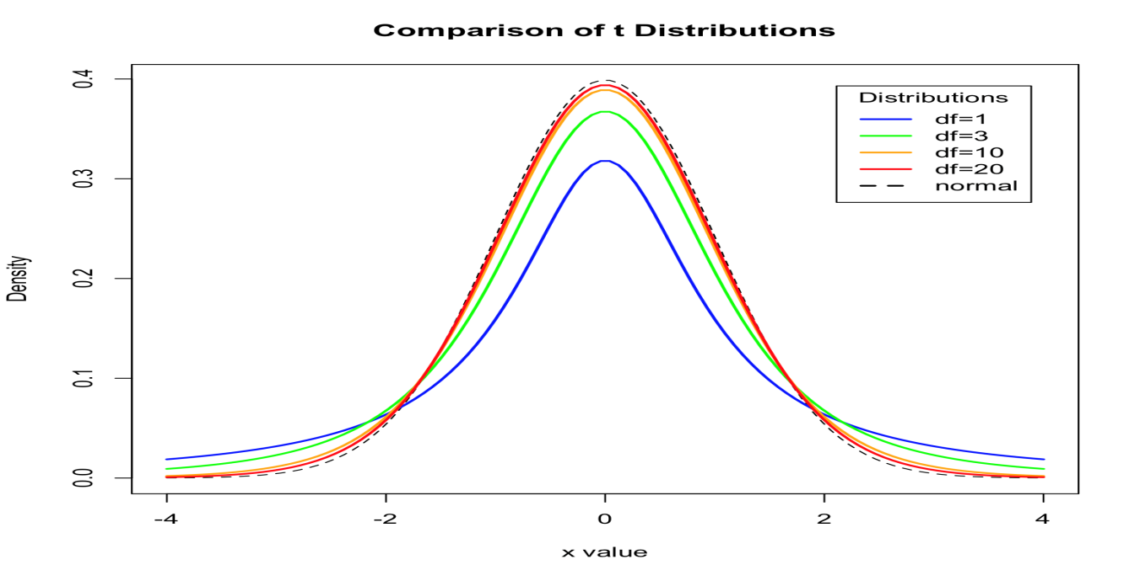
2.2 Continuous Probability Distributions
If a random variable is a continuous variable, its probability distribution is called a continuous probability distribution.

Slide 43

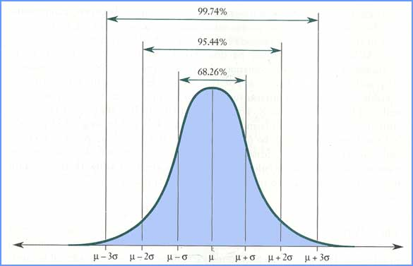
Normal distribution
First applied to the description of measurement errors
1835 Adolphe Quetelet - Physical attributes, such as height,
1869 Francis Galton - individual differences in ability
Psychometric instruments in which test scores are actually defined according to the normal distribution the IQ scores on most intelligence tests are assigned in terms of a person’s position in the distribution.

Slide 44

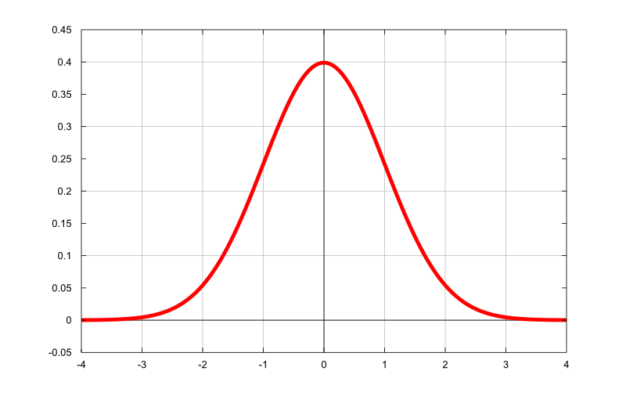
What is the Normal Distribution?
The bell shaped curve
When no. of trails are very large (n- infinite)
Normal Equation
Y = { 1/[ σ * sqrt(2π) ] } * e^{-(x - μ)2/2σ2}
Where π – 3.142
e- 2.718
^{μ-} population mean
σ- population standard mean
x- given value of the random variable

Slide 45



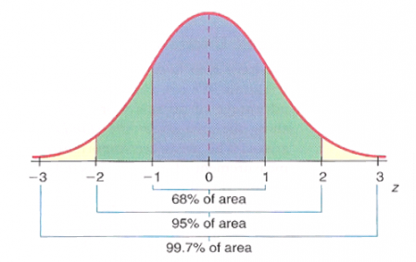
Standard Normal Distribution
A random variable Z, normal distribution with mean= 0 and SD= 1
To find out Z value

Slide 46

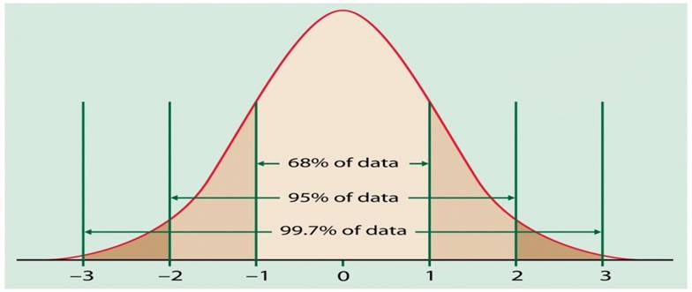
Normal Curve

Slide 47

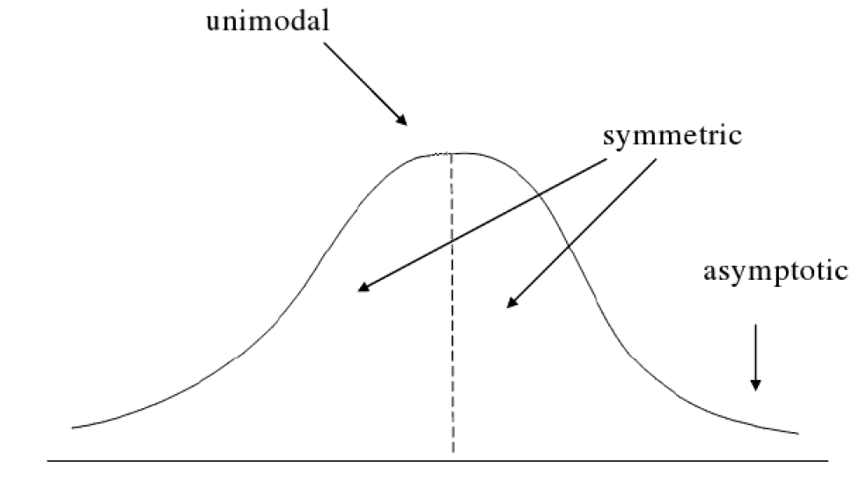
Characteristics of Normal Distribution
Symmetric
Unimodal
Asymptotic
Mean, median and mode are all equal
The total area under the normal curve is equal to 1

Slide 48

Normal Curve
Mean - location of the center of the graph
Standard deviation - height and width of the graph
Standard deviation is large, the curve is short and wide
Standard deviation is small, the curve is tall and narrow
All normal distributions look like a symmetric, bell-shaped curve

Slide 49

EXAMPLE
Assume the mean height of children to be 68.22cm with the variance of 10.8 cm. How many children in a school of 1000 would you expect to be over 72 cm tall?
Ans : X- variate – mean – 68.22
SD- √10.8
= 72-68.22 / √10.8 = 1.15
Now P(x>72)= P(Z>1.15)
Z=0 to Z=1.15
= 0.5000- 0.3749
= 0.1251
Expected no. of children to be above 72cm out of 1000
= 1000*0.1251
= 125

Slide 50

Fitting a normal distribution
To judge the whether the normal curve is good fit to the sample data
To estimate the characteristics of population
Class interval | 11-20 | 21-30 | 31-40 | 41-50 | 51-60 | 61-70 | 71-80
f | 12 | 28 | 40 | 60 | 31 | 20 | 8
Mean = 43.7, SD= 14.8

Slide 51

Fitting a Normal Distribution by Area Method
Class Interval | Lower Class | D=x-μ | Z= x-μ σ | Area from 0 to Z | Area in class interval | Expected fre quencies
10.5-20.5 | 10.5 | -33.2 | -2.24 | 0.4875 | 0.0457 | 9
20.5-30.5 | 20.5 | -23.2 | -1.57 | 0.4418 | 0.1285 | 26
30.5-40.5 | 30.5 | -13.2 | -0.89 | 0.3133 | 0.2262 | 45
40.5-50.5 | 40.5 | -3.2 | -0.22 | 0.0871 | 0.2643 | 54
50.5-60.5 | 50.5 | 6.8 | 0.46 | 0.1772 | 0.1936 | 40
60.5-70.5 | 60.5 | 16.8 | 1.13 | 0.3708 | 0.0941 | 20
70.5-80.5 | 70.5 | 26.8 | 1.81 | 0.4649 | 0.0285 | 6
 | 80.5 | 36.8 | 2.48 | 0.4934
 |  |  |  |  |  | N=200

Slide 52

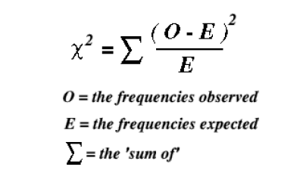
Chi square test / Goodness of fit
It is useful to measure of comparing experimentally obtained results with those expected theoretically and also based on hypothesis

Slide 53

Conti…
O | E | O-E | (O-E)2 | (O-E)2/E
12 | 9 | 3 | 9 | 1
28 | 26 | 2 | 4 | 0.15
40 | 45 | -5 | 25 | 0.55
60 | 54 | 6 | 36 | 0.66
32 | 40 | -8 | 64 | 1.6
20 | 20 | 0 | 0 | 0
8 | 6 | 2 | 4 | 0.66
Σ (O-E)2/E= 4.63 df= 6
Since the calculated value is < table value so, accept the null hypothesis

Slide 54

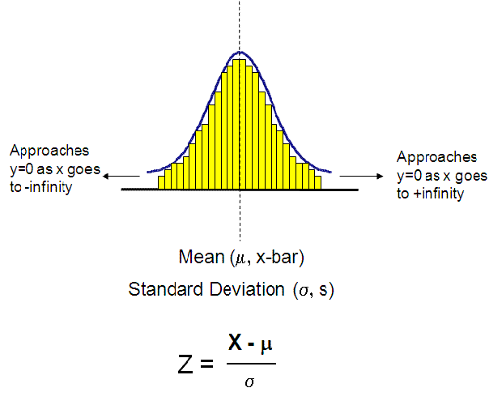
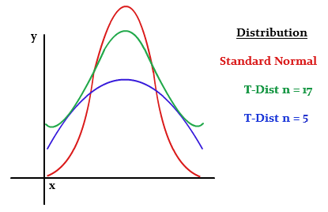
Significance tests
Z -distribution
t -distribution
t = X - µ / SD

Slide 55

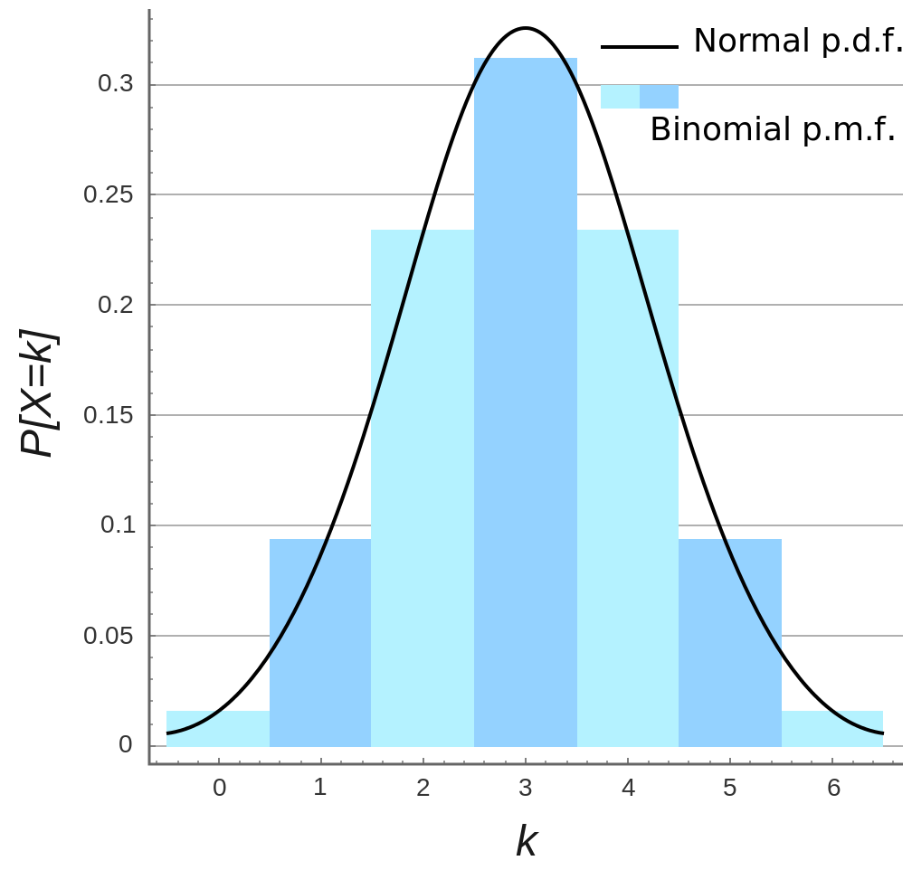
BD, PD----- ND
If the sample size should be more – normal distribution
N ≥ 30/ 40
It must be Mean ≥ 5
SD ≥ 5

Slide 56


Slide 57


