Slide 1
ACTION RESEARCH IN SOCIAL SCIENCES
Priyanka
PALB 4118

Slide 2
Objectives Of The Seminar
To know the origin and the concept of action research
To get familiar with the process and various models of action research
To review case study

Slide 3
What is
Action Research?
Dr. Gregory S. Waddell

Slide 4
According to experts . . .
it is . . .

Slide 5
“a cycle
Notes:
Definitions:
Action research is the process of posing a question (a doubt, question, dilemma, problem, challenge), gathering data, reflecting on that data, and making decisions about a course of action.
Does NOT mean extracting information about a certain topic from an encyclopedia.
Does NOT mean simply solving a problem.

Slide 6
“a cycle
of posing questions,
Notes:
Definitions:
Action research is the process of posing a question (a doubt, question, dilemma, problem, challenge), gathering data, reflecting on that data, and making decisions about a course of action.
Does NOT mean extracting information about a certain topic from an encyclopedia.
Does NOT mean simply solving a problem.

Slide 7
“a cycle
of posing questions,
gathering data,
Notes:
Definitions:
Action research is the process of posing a question (a doubt, question, dilemma, problem, challenge), gathering data, reflecting on that data, and making decisions about a course of action.
Does NOT mean extracting information about a certain topic from an encyclopedia.
Does NOT mean simply solving a problem.

Slide 8
“a cycle
of posing questions,
gathering data,
reflection,
Notes:
Definitions:
Action research is the process of posing a question (a doubt, question, dilemma, problem, challenge), gathering data, reflecting on that data, and making decisions about a course of action.
Does NOT mean extracting information about a certain topic from an encyclopedia.
Does NOT mean simply solving a problem.

Slide 9
“a cycle
of posing questions,
gathering data,
reflection,
& deciding on a course of action.”
Eileen Ferrance, "Action Research," Providence, RI: The Education Alliance, 2000, available from www.alliance.brown.edu/pubs/themes_ed/act_research.pdf
Notes:
Definitions:
Action research is the process of posing a question (a doubt, question, dilemma, problem, challenge), gathering data, reflecting on that data, and making decisions about a course of action.
Does NOT mean extracting information about a certain topic from an encyclopedia.
Does NOT mean simply solving a problem.

Slide 10
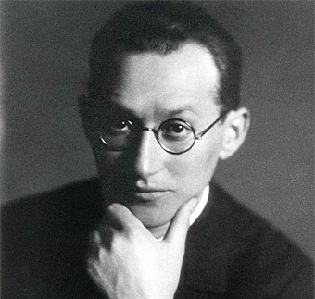
ACTION RESEARCH : RETROSPECT
The term "action research" was coined by the social psychologist Kurt Lewin in about 1944 (Marrow, 1969).
He used the term to describe a form of research which could marry the experimental approach of social science with programs of social action in response to major social problems of the day.
Through action research, Lewin argued,
advances in theory and
needed social changes might
simultaneously be achieved.

Slide 11
Action research, according to Lewin, "consisted of
analysis,
fact-finding,
conceptualisation,
planning,
execution,
more fact-finding or evaluation;
and then a repetition of this whole circle of activities; indeed a spiral of such circles

Slide 12
What were the problems which impelled the originators of action research?

Slide 13

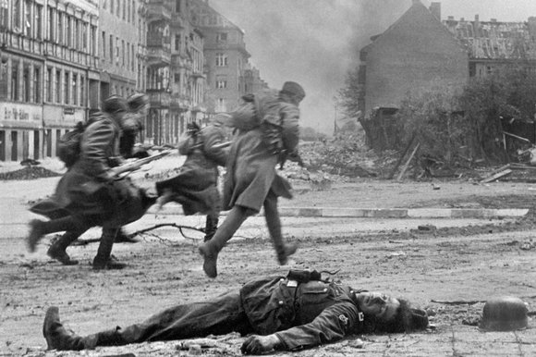

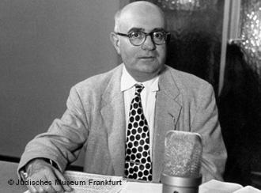

Slide 14
The social psychologist Lewin was intensely concerned with all of these problems.
A German Jew, he had fled Germany in 1933.
Known for his development of a "field - theoretic" approach in social psychology
apart from "action research",
he was also the originator of the
-terms
“Groupdynamics" and "sensitivity
training".

Slide 15
THE DEVELOPMENT OF ACTION RESEARCH
The first explicit formulation of the idea of action research was made by Kurt Lewin, in the context of work with minority communities in urban areas in the Unites States (Lewin 1946)
Friere (1982) focused on research based on “learning to do it by doing it”.
He introduced a strong activist or emancipatory element into action research.

Slide 16
In this approach to action research the focus is on empowering people by allowing them to take control of the research process and addressing their own needs.
Emancipatory learning and empowerment are strong thematic trends within the action research literature

Slide 17
Definition
A process in which a group of people with a shared issue of concern collaboratively, systematically and deliberately plan, implement and evaluate actions. Action research combines action and investigation. The investigation informs action and the researchers learn from critical reflection on the action.
(Lewin, 1946)

Slide 18
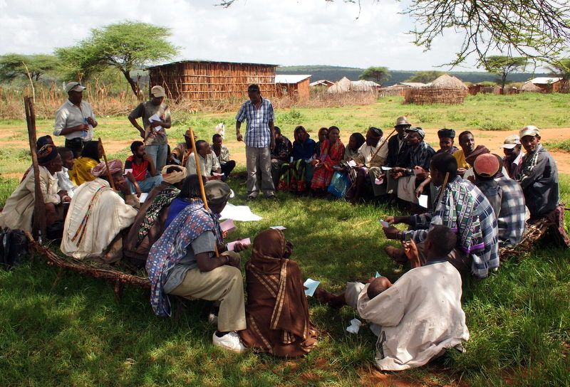
Action research is used in real situations, rather than in contrived, experimental studies, since its primary focus is on solving real problems.
It can, however, be used by social scientists for preliminary or pilot research, especially when the situation is too ambiguous to frame a precise research question.
Mostly, though, in accordance with its principles, it is chosen when circumstances require flexibility, the involvement of the people in the research, or change must take place quickly or holistically.
When is Action Research used ???

Slide 19
It is often the case that those who apply this approach are practitioners who wish to improve understanding of their practice,
social change activists trying to mount an action campaign, or,
more likely, academics who have been invited into an organization (or other domain) by decision-makers aware of a problem requiring action research, but lacking the requisite methodological knowledge to deal with it.

Slide 20
Characteristics of action research
1)Cyclic (or a spiral)
2)Qualitative
3)Participative
4) Adaptive and flexible

Slide 21
Action research can be a suitable methodology in the following types of situations:
a problem being investigated is very complex (involving diverse elements)
people don’t know where to start in solving a problem (and especially when they lack confidence due to the complexity of the problem)
change involves people with differing perspectives or conflicting objectives and
there is a need for a common vision or negotiated compromise;
the situation or context is changing.

Slide 22
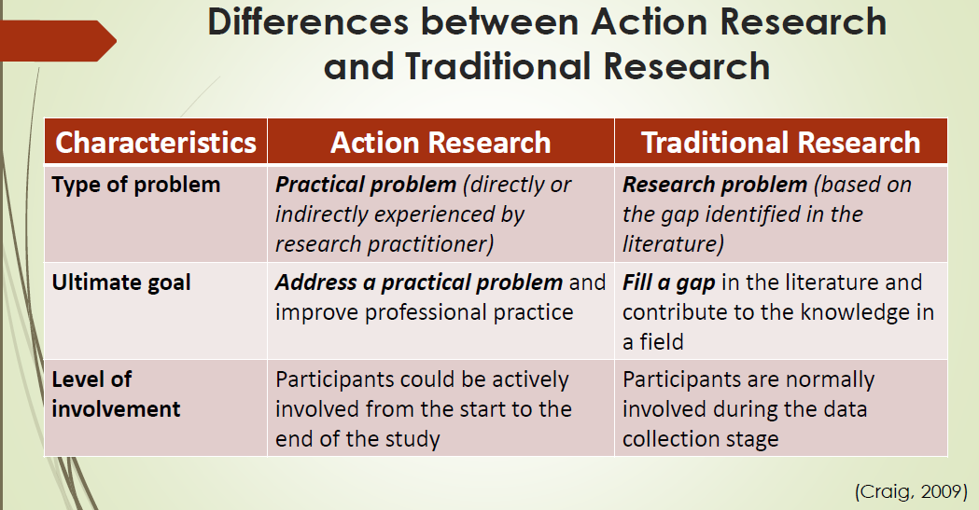

Slide 23
Major Theories
Chris Argyris' Action Science
Chris Argyris' Action Science begins with the study of how human beings design their actions in difficult situations.
Humans design their actions to achieve intended consequences and are governed by a set of environment variables

Slide 24
How those governing variables are treated in designing actions are the key differences between single-loop learning and double-loop learning.

Slide 25
2) John Heron and Peter Reason's cooperative inquiry
major idea of cooperative inquiry is to "research 'with' rather than 'on' people.”
It emphasizes that all active participants are fully involved in research decisions as co-researchers.

Slide 26
3) Paulo Freire's participatory action research (PAR)
PAR builds on the critical pedagogy put forward by Paulo Freire as a response to the traditional formal models of education where the “teacher” stands at the front and "imparts" information to the "students" who are passive recipients.
This was further developed in "adult education" models throughout Latin America.

Slide 27
4) William Barry's living educational theory approach to action research
The mission of the LET action researcher is to overcome workplace norms and self- behavior which contradict the researcher's values and beliefs.
The vision of the LET researcher is to make an original contribution to knowledge through generating an educational theory proven to improve the learning of people within a social learning space.

Slide 28
ACTION RESEARCH TOOLS
Action Research is more of a holistic approach to problem-solving, rather than a single method for collecting and analyzing data.
generally common to the qualitative research paradigm, include:
keeping a research journal, document collection and analysis, participant observation recordings, questionnaire surveys, structured and unstructured interviews, and case studies.

Slide 29
Role of the Action Researcher
planner leader
catalyzer facilitator
teacher designer
listener observer
synthesizer reporter
main role is to nurture local leaders to the point where they can take responsibility for the process.
This point is reached they understand the methods and are able to carry on when the initiating researcher leaves.

Slide 30
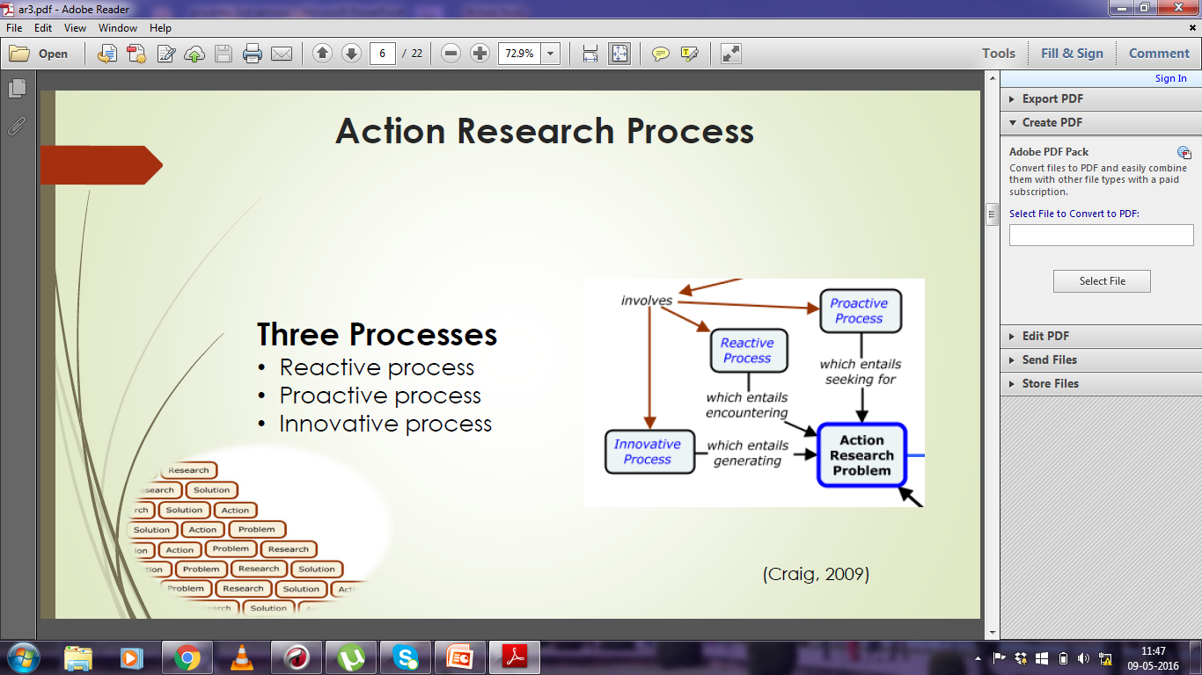

Slide 31
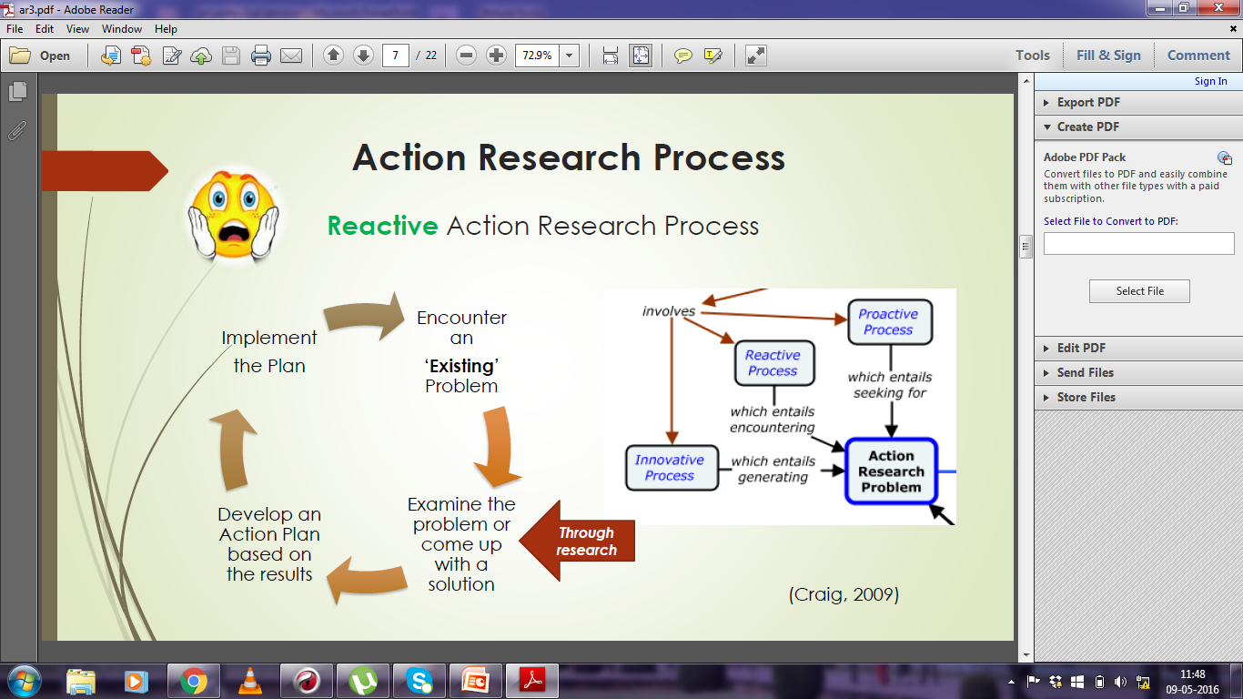

Slide 32
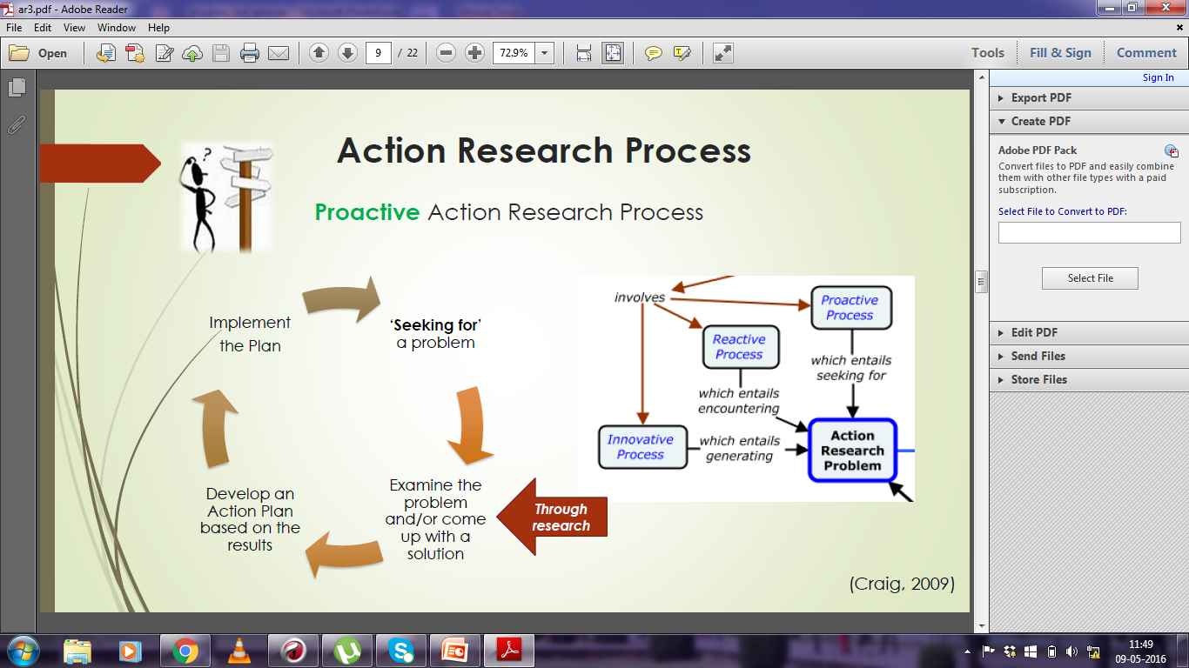

Slide 33
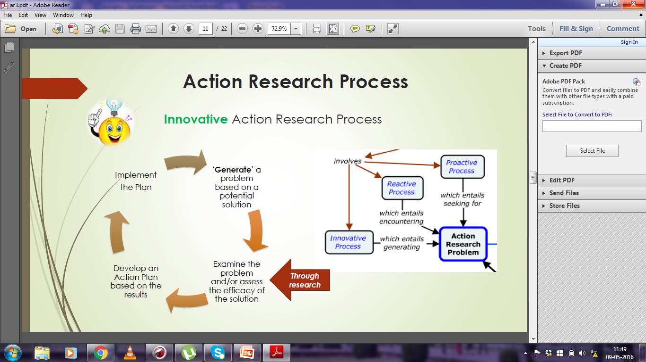

Slide 34
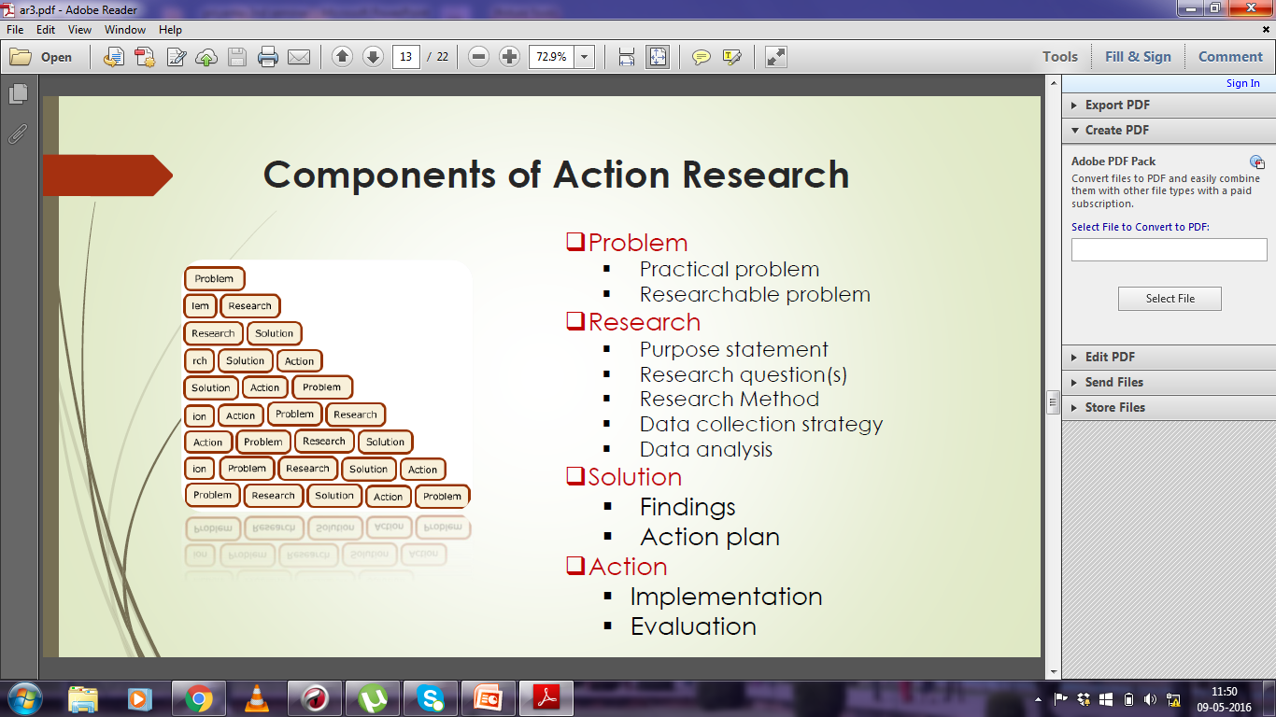

Slide 35
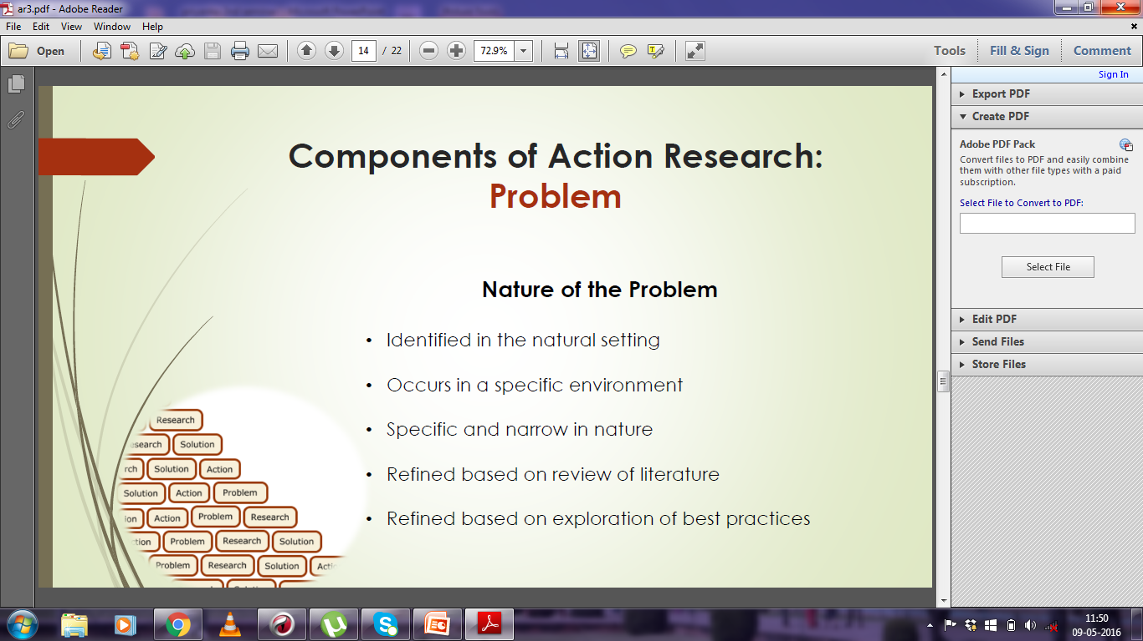

Slide 36
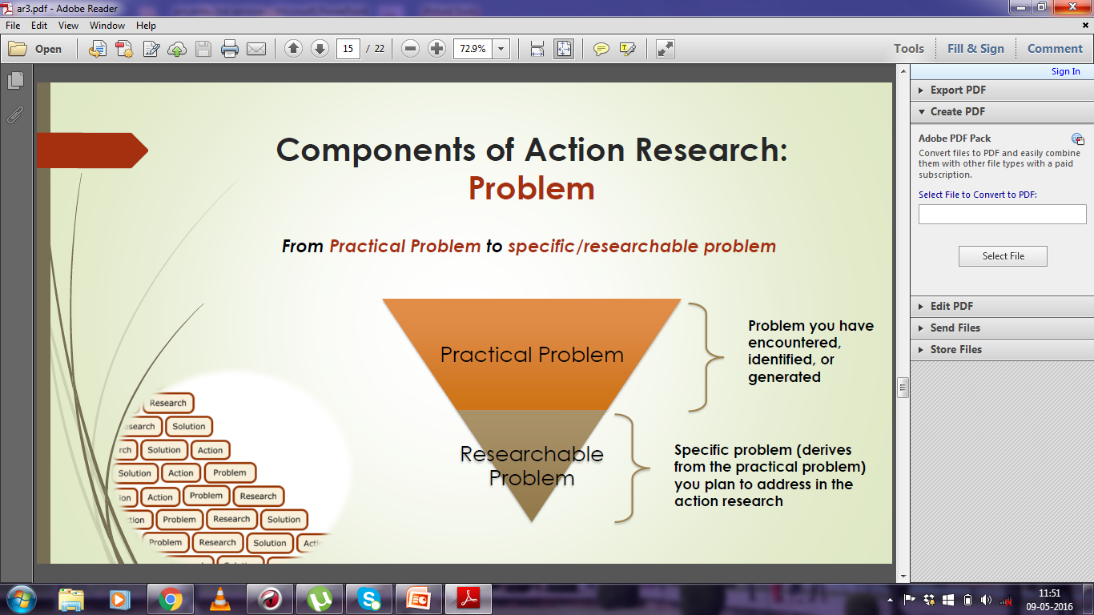

Slide 37
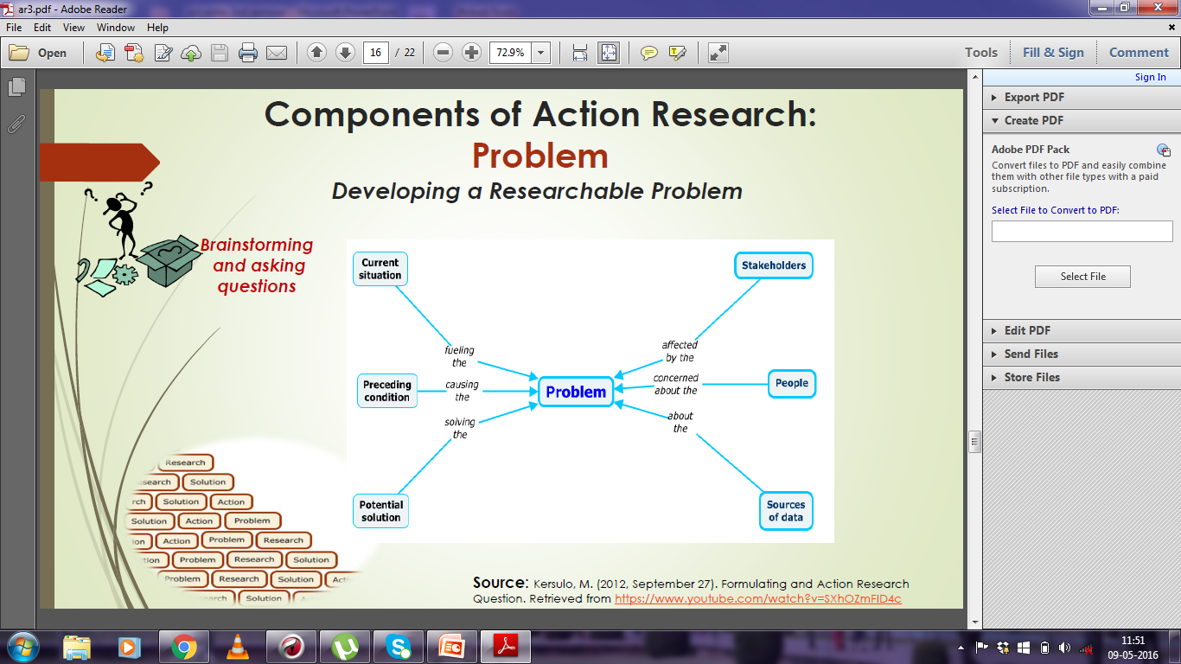

Slide 38
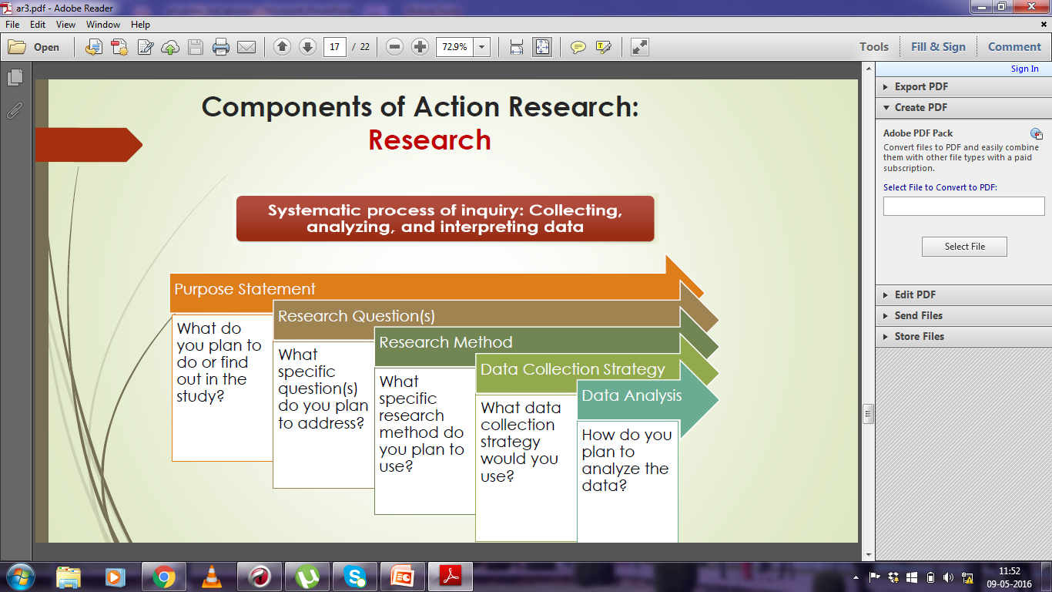

Slide 39
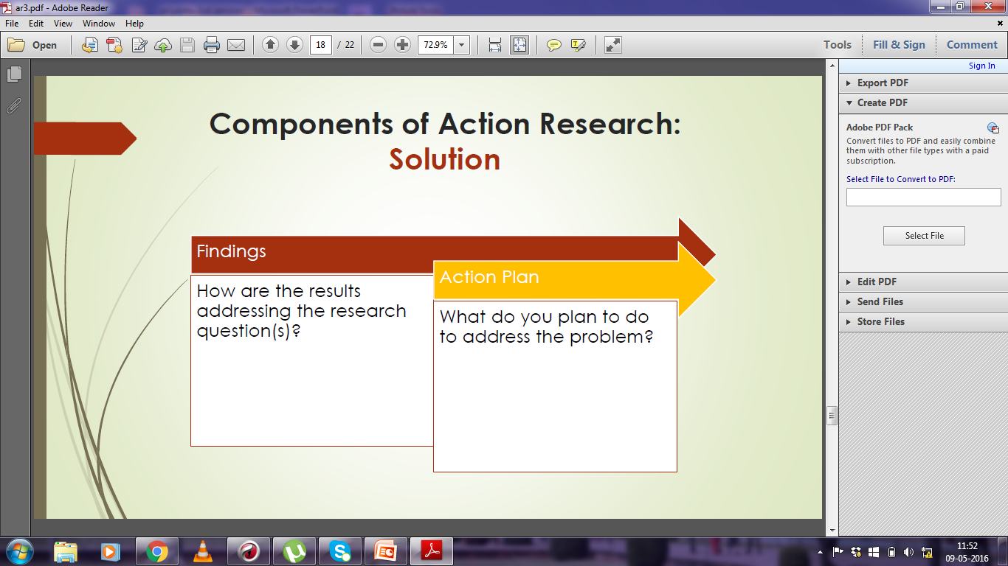

Slide 40
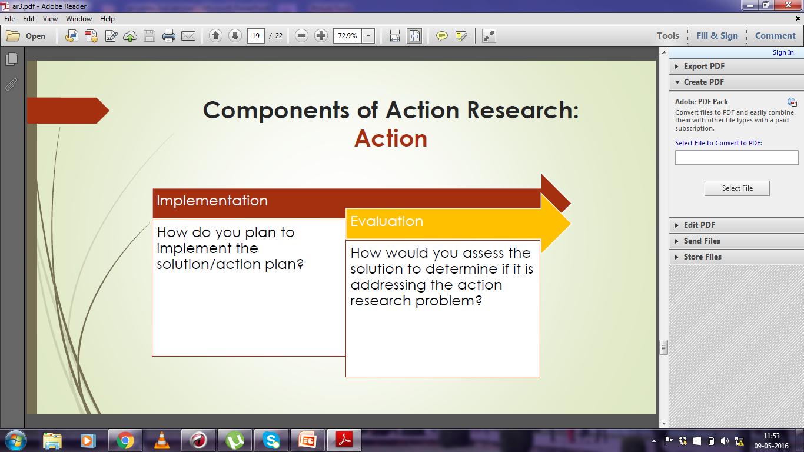

Slide 41
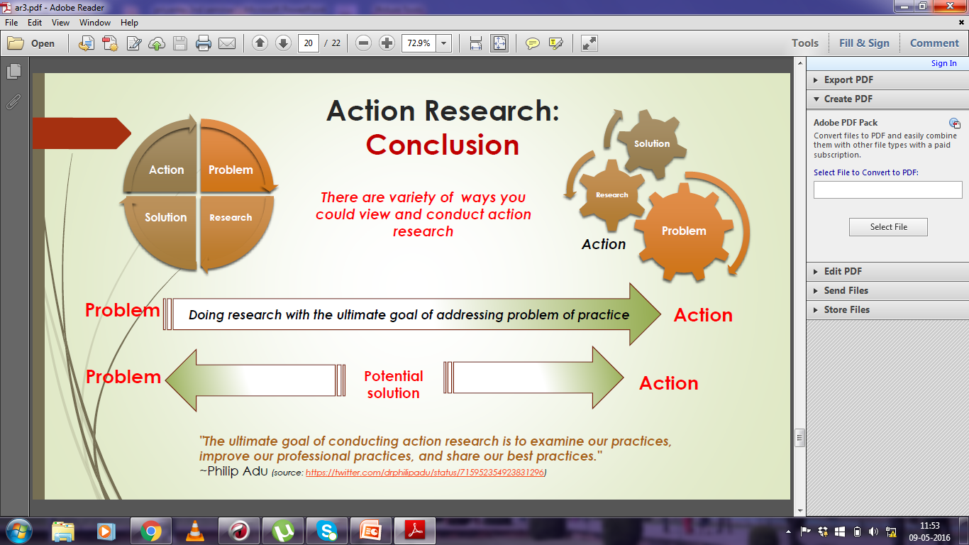

Slide 42
Strategies For Group/Self Evaluation
Daily informal personal reflection
Weekly reviews(journal entry or informal meetings)
Special effort evaluations for particular aspects of practice
Monthly collective problem pooling sessions
Annual “what we have achieved” and “where we are heading next year” workshops

Slide 43
Ethical Considerations
Richard Winter (1996) lists a number of principles:
Make sure that the relevant persons, committees and authorities have been consulted, and that the principles guiding the work are accepted in advance by all.
All participants must be allowed to influence the work, and the wishes of those who do not wish to participate must be respected.
The development of the work must remain visible and open to suggestions from others.

Slide 44
Permission must be obtained before making observations or examining documents produced for other purposes.
Descriptions of others’ work and points of view must be negotiated with those concerned before being published.
The researcher must accept responsibility for maintaining confidentiality

Slide 45
AR vs. PAR
Action Research | Participatory Action Research
Researcher achieves learning, and larger group may also learn | Participants (and researcher) achieve learning within larger group
The researcher facilitates the process, and collaborates with clients to create or actualize change. Researcher typically does not engage in change actions. | Actions taken through process – action is incorporated into research itself
Researcher collaborates with “clients” | Researcher works with “participants”

Slide 46
Action Research | Participatory Action Research
Researcher and clients engage in self-reflection | Participant issues, actions and learning highlighted / No Expert
3rd party researcher engages in change as expert | 3rd party group works to change self and larger groups
Subjective | Holistic
Emergent property: improved capacity and wisdom | Emergent property: creativity

Slide 47
Benefits
For Kurt Lewin and many others, action research is a process of empowering those on the front lines of action to conduct research into their own practices,rather than relying on and more importantly –being subject to research findings of outsiders

Slide 48
Criticisms
Lengthy and time taking
Potential for bias can question validity of research
Results can’t be generalized

Slide 49
MODELS OF ACTION RESEARCH

Slide 50
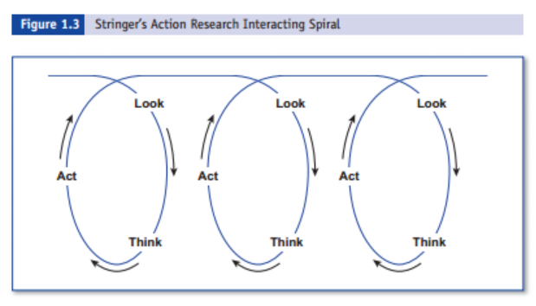
Nn

Slide 51
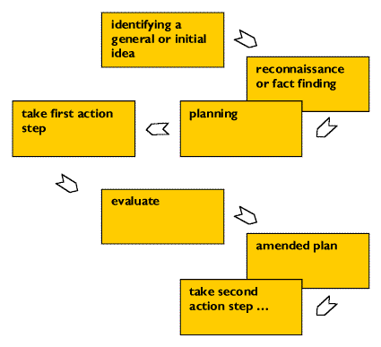
• Kurt Lewin (Smith, 2007)—who, by the way, is credited with coining the term “action research”—also depicts an action research spiral, which includes fact finding, planning, taking action, evaluating, and amending the plan, before moving into a second action step

Slide 52
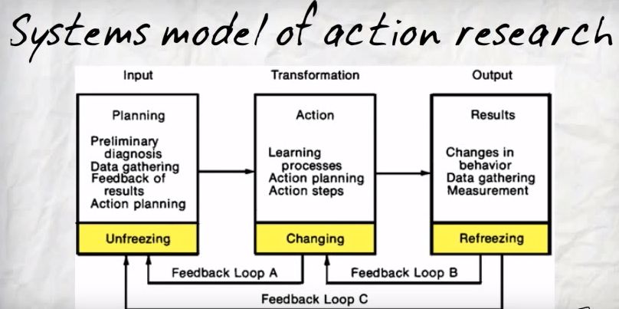

Slide 53
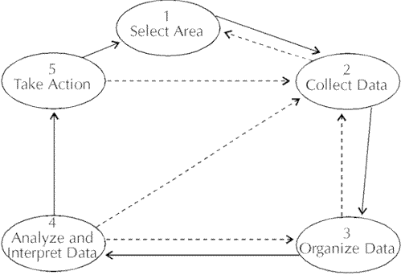
• Calhoun’s (1994) action research cycle, while not appearing as a “spiral,” still represents a process that is built around a cyclical notion. As she describes, the solid lines indicate the primary direction of the action research cycle through the phases, in numerical order. The dotted lines indicate backward and forward movement within the cycle as refinement or clarification of information is warranted

Slide 54
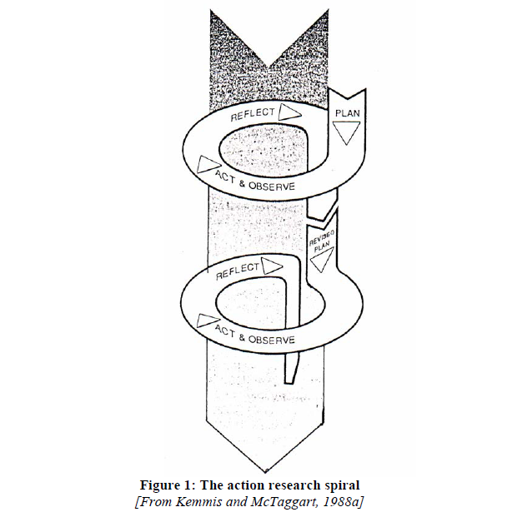

Slide 55
Action research to improve irrigation operations:
Example from India
-D.L. Vermilion and J.D. Brewer, Irrigation Specialists, International Irrigation Management Institute, Colombo, Sri Lanka,2006

Slide 56
THE PALIGANJ DISTRIBUTARY CANAL, SONE COMMAND
creation of a farmers' distributary canal committee
the introduction of new operational procedures for enhancing equity and management control in the Paliganj Distributary Canal of the Sone Command in Bihar, India.
Involvement of farmers, agency staff and researchers in problem identification, proposing solutions, implementation and evaluation was essential in achieving results.

Slide 57
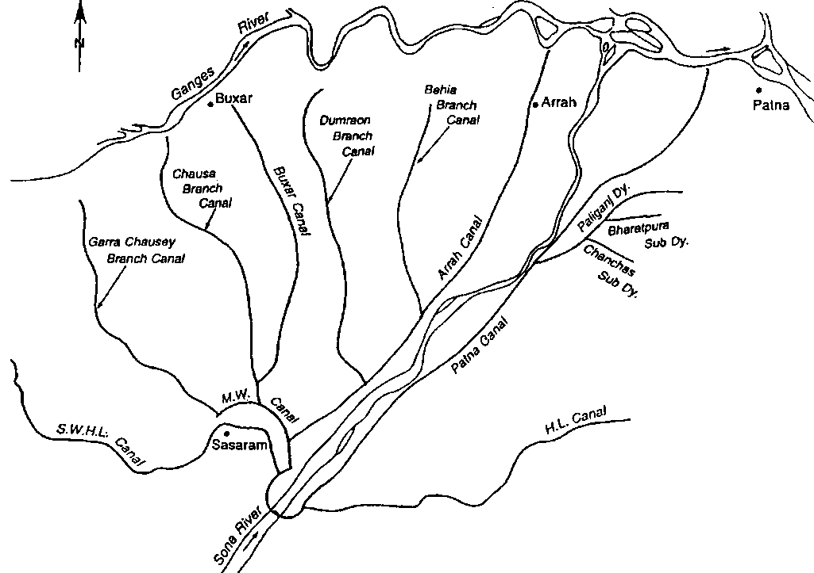

Slide 58
Canal officers supply water to each outlet, from where sattadar(a farmer) provides water to the farmers on request.
Farmers near the outlet block the water to use as much water as they want.
The agency tended to assume that all farmers within the command received water and all were assessed water charges, irrespective of whether water was actually delivered.

Slide 59
The Water and Land Management Institute (WALMI) was created in 1993 to train Bihar State irrigation engineers and others in improved irrigation and land management.
In 1998, with support from the United States Agency for International Development (US AID), WALMI staff organized an Action Research Programme (ARP) at the Paliganj Distributary to improve the performance of the canal network so as to improve the productivity and profitability of irrigated agriculture in the area.

Slide 60
Defining the problem
Farmers and the AR team found many water distribution problems, including, among others:
unreliable supply at the head of the Paliganj Distributary
unavailability of water when required and excess water when not needed
poor condition of the canals and structures, including broken and missing regulators
open cuts in the canal banks to take water

Slide 61
failure of agency officers to visit the area
no channels for communication between farmers and officers
and lack of a system for inter-village cooperation.

Slide 62
Devising solutions
formation of a Farmers' Committee which represented 20 villages. Farmers and the AR team identified three problems for priority action:
'unattended' operation of the distributary canal
lack of farmer involvement in irrigation management
lack of communication between users and system managers.

Slide 63
Farmers' Ad Hoc Canal Operation Committee was formed for handing operation of the system.
Group 'walk-throughs' along the distributary canal were made by Committee members to identify problems with obstructions and unwanted water tapping

Slide 64
Committee began implementing new arrangements for patrolling and removal of canal obstructions and tapping, rotational irrigation and maintenance.

Slide 65
Implementing innovations in canal operations
By early Oct.’99, farmers were removing canal obstructions and informing farmers of a new collective plan for improving operations.
Water began reaching the tail end for the first time in ten years.
For the 2000 kharif season, the Farmers' Committee adopted a simple operations plan developed with the help of the ARP team.
The plan rotated water among five blocks - head, middle, tail, and Chandos and Bharatpura sub-distributaries - within the standard 10 day rotation for the whole distributary.

Slide 66
Performance outcome
Between 1998 and 2003, the equity of kharif season water distribution among the five blocks of the Paliganj Distributary improved significantly.
Tail areas now receive a significantly higher fraction of the water.
The tail-end section of Paliganj Distributary Canal serves 30.7% of the irrigable area. Before the action research, this portion of the canal received only 10 to 12% of the water diverted into the canal.

Slide 67
Between 2000 and 2003, the area irrigated by the Paliganj Distributary Canal during the kharif season rose from 3,614 ha in 2000 to 4,350 ha in 2003.

Slide 68
CONCLUSION
action research can be particularly useful in community development, agricultural research and extension.
One of the key points is that “promoting” change requires very close attention to the specific rural context and that action research is a very good means of working in such conditions, especially where it is difficult to know where to start because much is unknown.
Action research is one way to avoid being paralysed by lack of detailed understanding.

