Slide 1

Welcome to 2nd seminar

Slide 2
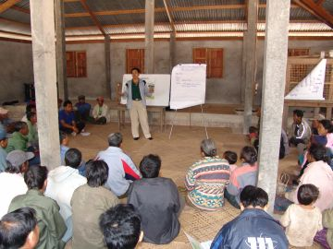

Privatization of agricultural extension services in India: Approaches and case studies
NAVEEN KUMAR P
Ph. D. Scholar
PALB-4021

Slide 3
INTRODUCTION
Agricultural extension is a general term meaning the application of scientific research and new knowledge to agricultural practices through farmer education
The term extension was first used to describe adult education programs in England in the second half of the 19th century

Slide 4
Based on pre-independence experiences of the early extension efforts, systematic, planned and country-wide extension system passed through various stages to meet the needs of farming community
Immediately after the independence, organised extension activities were undertaken by the government through initiation of community development programme and others

Slide 5
Four generations of extension in India
The development of extension services has differed from country to country. Despite the variations, it is possible to identify a general sequence of four periods or ‘'generation’’
    Colonial agriculture
    Diverse top-down extension
    Unified top-down extension
    Diverse bottom-up extension

Slide 6
Colonial agriculture
Experimental stations were established in a country by the colonial powers
The focus of attention was usually on export crops such as rubber, tea, cotton and sugar
Technical advice was provided to plantation managers and large landowners
Assistance to small farmers who grew subsistence crops was rare, except in times of crisis

Slide 7
Diverse top-down extension
After independence, commodity-based extension services emerged from the part of the colonial system, with production targets established as part of five-year development plans
In addition, various schemes were initiated to meet the needs of small farmers, with support from foreign donors
IADP, IAAP ,ICDP ,HYVP…etc

Slide 8
Unified top-down extension
During the 1970s and 1980's, the Training and Visit system (T&V) was introduced by the World Bank
Existing organizations were merged into a single national service
Regular messages were delivered to groups of farmers, promoting the adoption of "Green Revolution" technologies
The delivery of public extension services is based on a supply driven, top down approach rather than a demand driven approach

Slide 9
Diverse bottom-up extension
When World Bank funding came to an end, the T&V system collapsed in many countries, leaving behind a patchwork of programs and projects funded from various other sources
The decline of central planning, combined with a growing concern for sustainability and equity, has resulted in participatory methods gradually replacing top-down approaches
The delivery of private extension services is based on a demand driven, bottom-up approach
Therefore private extension supplementary or alternative to public extension services

Slide 10
Objectives
To know the concept of private Extension
To know the important private extension service providers in India
To understand the private extension approaches which could be tried in India
To review the case studies related to private extension

Slide 11
Concept of Private Extension
It involves personnel in the private sector that delivers advisory services in the area of agriculture and is seen as an alternative to public extension
“Services rendered in the area of agriculture and allied aspects by extension personnel working in private agencies or organizations for which farmers are expected to pay a fee and it can be viewed as supplementary or alternative to public extension services”
- Saravanan and Shivalinge Gowda (1999)

Slide 12
Reasons Behind the Privatization Issue
  The most important reasons behind the issue of privatization of extension system are
To reduce financial burden on government | : | Declining trend in government expenditure for extension
Disappointing performance of public extension service | : | Ineffective extension work Non viable transfer of technologies Unmatching with farmers needs Bureaucratic nature of extension workers No accountability to farmer
Low coverage of public extension system | : | In terms of both time and services
Wide extension worker : farmer ratio in India | : | 1:1000 extension worker to farmer ratio 25 percent of extension workers - administrators An extension worker attends office for about 250days in a year 50 percent time goes for administrative work

Slide 13
Commercialization of agriculture | : | Shifting of agriculture from subsistence to commercialised agribusiness Globalisation and liberalization era demand for effective alternative extension approach
To reduce marketing problems | : | Farmers are facing lot of marketing problems Specialised nature of agriculture demands quick and technically sound marketing information

Slide 14
Assumptions Behind Private Extension
• Generates new income, extension become economic input
• Provides Demand-Driven Service
• Increases the voice of farmers in the extension service
• More cost effective with efficient and quality service
• Extension personnel become more client accountable
• Increases staff professionalism
• Clients (farmers) are more committed to the service
• Don’t concentrate on food grain production

Slide 15
Expected Elements in the Private Extension System
Objectives | Profit maximization Efficiency
Target group | Only those who can pay (commercial, big farmers) More committed Highly careful Active participation
Offerings: Technologies Input supply | Location specific Demand driven Profitable Timely
Organization | Private consultancy Commercial, agro-based firms Input agencies Farmer’s organizations etc.

Slide 16
Extension personnel | Accountable to farmers Highly motivated High professionalism
Funding | Clients contribution Development agencies
Extension service | Advisory in nature Economic input, generates new income
Methods | Personal communication Low with group and mass communication

Slide 17
Important private extension service providers
Input agencies (dealing with seeds, fertilisers, pesticides, equipments)
Large agri-business firms (involved in manufacture and sale of inputs and purchase of farm produce)
Farmer organisations and producer co-operatives
Non-governmental organisations (NGOs)
Media (print, radio and television)
Financial agencies involved in rural credit delivery, and
Consultancy services

Slide 18
Input agency extension
About 2.82 lakh agro-input dealers are operating in rural areas covering all parts of the country
Though not equipped with adequate knowledge, dealers are one of the most important sources of information for farmers
Many agro-input companies perform some extension functions
A few of them also take up few demonstrations to publicize new products
Meetings or seminars organised by line departments such as DoA
Major categories of agro-input companies include, those dealing with seeds, fertilisers, pesticides and agro-machinery

Slide 19
Agri-business firms (aggregators, processors)
Major agri-business firms like ITC and Pepsi co during the last few years have initiated innovative arrangements to provide farmers with integrated production and marketing support
ITC’s extension effort revolves around e-chaupals, which are essentially village internet kiosks that enable access to information on weather, market prices and scientific practices
PepsiCo was a pioneer in the concept of contract farming under which the company transfers agricultural best practices and technology and procures the produce at a guaranteed price

Slide 20
Farmer organisations and producer co-operatives
User groups, including farmer interest groups, farmer clubs, commodity groups, women farmer groups, special interest groups’ etc play a very important role in extension
Government is also keen on promoting farmer organizations as it could create mechanism at the village level among farmer members to empower them for their own problem solving
One of the oldest and most successful farmer organisations in India is the Grape Growers Association of Maharashtra which provides a wide range of services to its member producers

Slide 21
Non-Governmental (voluntary) organisations (NGOs)
NGOs active in rural development in India range from fewer than 10,000 to several hundred thousand depending on the type of classification used
15,000-20,000 are actively engaged in rural development
India has a number of NGOs with varying levels of capacity, implementing a wide range of programmes
NGOs receive funding from the Government, corporate bodies as well as international donors
Bharatiya Agro-Industries Federation (BAIF), Professional Assistance for Development Action (PRADAN) and Action for Food Production (AFPRO)

Slide 22
Media and Information Technology
The widespread availability and convergence of information and communication technologies (ICTs) – computers, digital networks, telecommunication, television etc
Private TV channels like E-TV started telecasting daily programmes on agriculture. E-TV currently telecast agricultural programmes in Telegu, Kannada and Marathi languages every day
Similarly most of the private regional TV channels telecast agricultural programmes at least once a week

Slide 23
Community Radio (CR) is another innovation in use of media and it is a short range radio station that caters to the information needs of communities living in surrounding areas
Newspapers and farm magazines are important sources of information for farmers
Newspapers, especially those in local languages, provide at least one page every week for news and articles on different aspects of agriculture

Slide 24
Financial Institutions
Financial institutions lending to agricultural sector provide advice and consultancy to potential borrowers on financial viability of their proposals
All banks involved in agricultural lending organises farmer meetings and seminars every year
Banks also lend limited financial assistance to other organisations or state Department of Agriculture for organising agricultural seminars and farmer meetings
NABARD has been supporting the establishment of farmer clubs. Farmers’ Clubs are grassroot level informal forums of farmers
The broad objective of setting up Farmers’ Clubs is to achieve prosperity for the farmers with overall agricultural development in its area of operation

Slide 25
Consultancy
Farmers generally consult progressive farmers for information and advice related to production, post harvest management and marketing
Another major source of advice is the local input dealer
Some input firms such as AGROCEL and Tata Kisan Kendras provide free consultancy services
Many professionals after retirement from agricultural research organizations have been providing consultancy to farmers
At present big farmers, farmers growing commercial crops like coffee, tea, spices, flowers, grapes, pomegranate etc and those having large poultry units and dairy farms are availing consultancy services

Slide 26
Para technicians (those without professional degrees but trained in specific skills) do provide services for a fee in the area of artificial insemination, grafting, etc and charge for the service
Similarly para extension workers promoted by DoA in states such as UP, Rajasthan and Madhya Pradesh also provide limited extension services (message delivery and training) to fellow farmers in his/her village

Slide 27
Private Extension in India -SWOT analysis
Strengths:
Efficiency of delivery channels and economic efficiency
More demand – driven
High quality of services
Trained manpower, sustained finances and resource allocation
Closeness to markets. E.g.: input companies
Better linkages with research
Improved agricultural productivity and Standards of living
Flexible in program implementation and practical in approach

Slide 28
Weaknesses
More face-to-face contacts and less emphasis on mass media
Increased dependence of farmers and hence exploitation
Payments cannot be deferred nor based on impact; and extension becomes an economic input
Contradictory message flows from competing sources due to advertisements and publicity techniques
Human resource and organizational development are sidelined
Group formation will be totally missing in this process

Slide 29
Opportunities
Support and control by clients leading to client orientation. Since farmers are paying money, they shall have the right to exercise and draw services
Availability of specialized services to specific clientele groups
Employment opportunities opened up due to more requirement of manpower
More export oriented due to more concentration on crops earning valuable foreign exchange
Increased accountability and commitment of Extension Personnel due to job demands and compulsion

Slide 30
Threats:
Possible risk of marginalization of small farmers-an advent of ‘more pay - more receive ‘ philosophy
Market failure due to unauthentic multiplication of agencies providing products with no emphasis on quality. Obviously, a case of unhealthy competition. E g: Seed companies
Social development of the people takes a backstage due to ‘profit motto’ of the actors

Slide 31
Private Extension approaches which could be tried in India
  Share cropping system
  Extension contract system
  Village extension contract system
  Contract farming
  Public extension through private delivery

Slide 32
Share cropping system
The extension worker provides advisory and inputs
Farmer uses his land and labour
Extension worker share the crop with farmer for a profit
Hired labour and other costs are shared
The extension workers using his link easily obtain farm inputs from input dealers even for credit until the harvest
Share cropped field serves as a demonstration plot. Since, extension worker has a personal stake, it motivates him to put maximum effort
Extension worker can also enter into agreement with as many farmers as he can, depending on his financial position and time

Slide 33
Extension contract system
Agricultural consultant / firm will provide advisory and inputs to individual farmer or group
The cost of input is recovered after the harvest
The extension worker / firm is compensated by the farmer with some percent of the value of the crop above the agreed target
If the harvest falls below the agreed target as a result of poor technical recommendations or non-supply of timely inputs, the compensation amount will be proportionately reduced

Slide 34
Village extension contract system
An agricultural advisory committee consisting of representatives of farmers at village level hire consultancy
Even Panchayat can undertake similar role. Consultant work for the village as per the requirements of village, as mutually decided by committee and consultant
The committee collect money from villagers based on some criteria like area / crop and pay for consultancy
Here, consultancy is a group approach where as for specific visits farmer has to pay

Slide 35
Contract farming
The agri-business firm provides all inputs and technology
It also supervises production process
Farmer has to sell his product, as quality specified to the firm only, for a premium price
The firm process and sell the product
Here the farmer gets input, technology and market support
The firm gets quality products at reasonable price by eliminating the middlemen

Slide 36
Public extension through private delivery
Agricultural consultancy firms are graded and certified by a government agency
Depending on PESP capacity, extension services are awarded to competitive bidders at different levels i.e. state, district, block / village Panchayat
The service cost is shared between government and clients i.e. Farmers in different proportions
If the clients are not happy about the service, the consultancy firm will be replaced by others

Slide 37
Criticism against privatization of extension
The major drawback pointed out in private extension is the lack of human face and exploitation of marginal farmers
Small and marginal farmers who take up production of cereals and pulse crops are likely to be totally neglected
Privatization is bound to neglect less profitable crops
Privatization may not care for sustainability

Slide 38
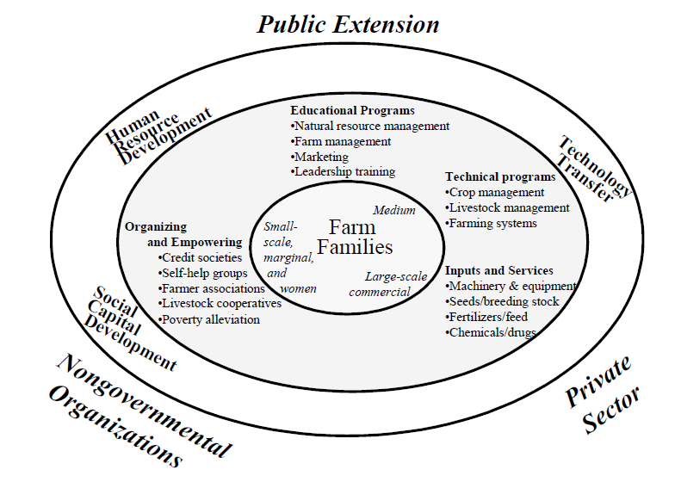
Conceptual Framework Depicting a Public, Private and NGO Partnership

Slide 39
Case studies

Slide 40
An analysis of public and private agricultural extension
services in Balochistan, Pakistan
-Mengal, A. A., 2012

Slide 41
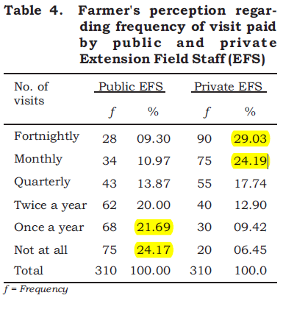

Slide 42
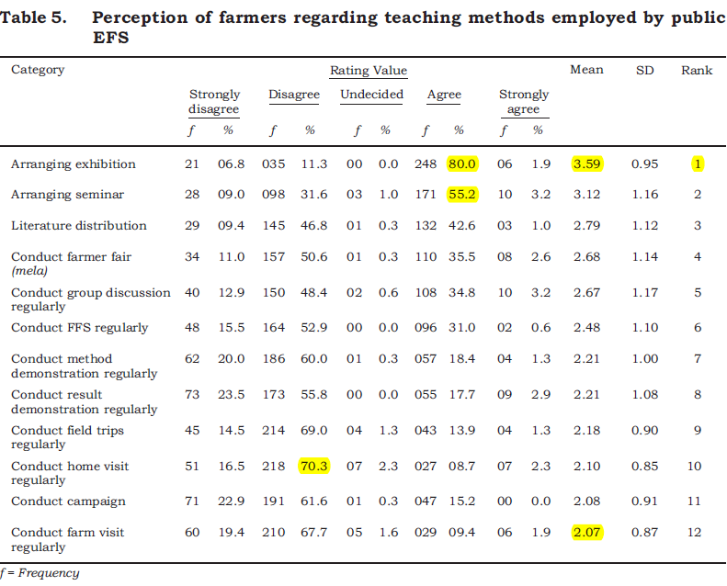

Slide 43
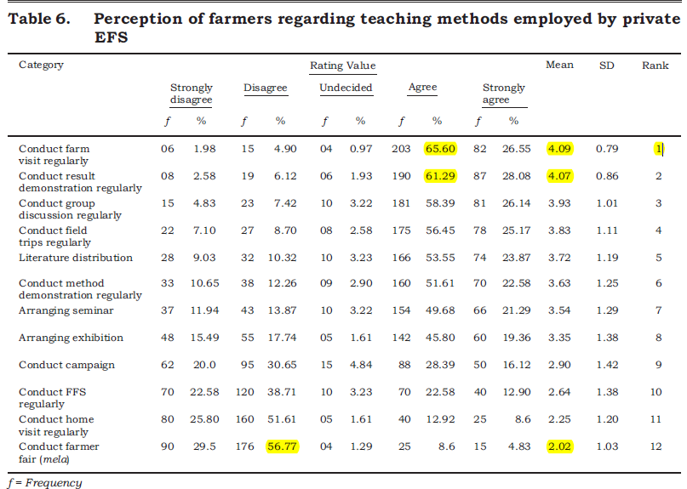

Slide 44
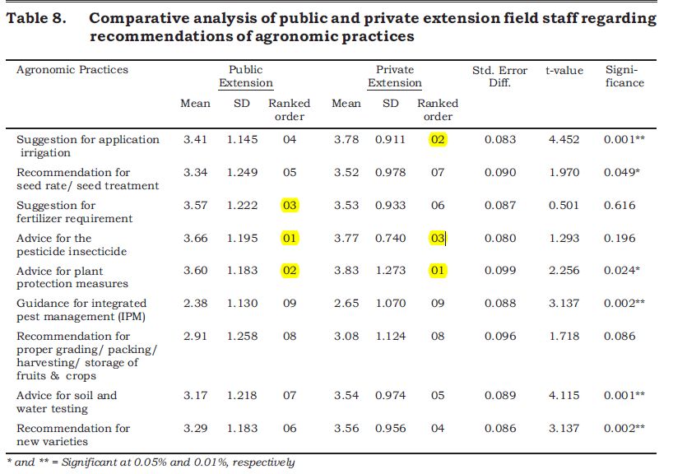

Slide 45
Comprehensive study on private extension service availing farmers in Tarai region of Uttarakhand
Itigi Prabhakar, et al., (2011)

Slide 46
Objective
To find out the activities provide by the PESP’s
Methodology
Study area : Tarai region of Uttarakhand
Research design: Analytical research design
Sample size n= 60

Slide 47
Table1: sources of various services used by respondents
n=60
Sl.no | Services | Sources
 |  | SDA |  | PESPs |  | Agri. Univ./KVK |  | Co.operatives
 |  | f | % | f | % | f | % | f | %
1 | Planting material | 23 | 38.33 | 19 | 31.66 | 18 | 30.00 | 00 | 00.00
2 | Fertilizers | 06 | 10.00 | 28 | 46.66 | 00 | 00.00 | 26 | 43.33
3 | Cultivation practices | 13 | 21.66 | 28 | 46.66 | 19 | 31.66 | 00 | 00.00
4 | Plant protection measures | 02 | 03.33 | 43 | 71.66 | 15 | 25.00 | 00 | 00.00
5 | Marketing information | 19 | 31.66 | 41 | 68.33 | 00 | 00.00 | 00 | 00.00
6 | Soil testing | 24 | 40.00 | 19 | 31.66 | 17 | 28.33 | 00 | 00.00
7 | veterinary services | 45 | 75.00 | 00 | 00.00 | 15 | 25.00 | 00 | 00.00

Slide 48
Table.2 Relative importance of information as perceived by respondents.
n=60
Sl. no | Type of information | Weighed mean score | Rank | Level
1 | Planting material | 3.32 | I | Extremely important
2 | Cultivation practices | 3.20 | II | Extremely important
3 | Fertilizers | 3.18 | III | Extremely important
4 | Plant protection measures | 3.05 | IV | Extremely important
5 | Veterinary services | 2.82 | V | Very important
6 | Soil testing | 2.77 | VI | Very important
7 | Marketing information | 2.58 | VII | Very important
8 | Packaging information | 2.20 | VIII | Very important
9 | Farmers training | 1.88 | IX | Important
10 | Harvesting technique | 1.42 | X | Important
11 | Post harvest processing information | 1.12 | XI | Important

Slide 49
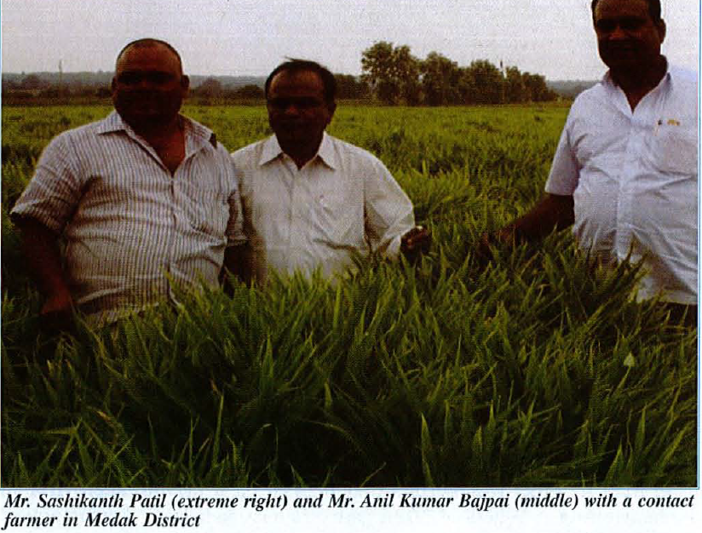
Private Extension in Ginger: A successful Story in Telangana
Private sector efforts can play an important role in case of high value commodities, specialty products, technology intensive production methods, new crops and commodities
Focus is an innovative private extension service model in ginger in Medak district of Telangana State which may be rated as resource poor area
Sasikumar, 2016

Slide 50
Background
Mr. Sashikant Patil and Mr. Anil Kumar Bajpai
Mr. Sashikanth Patil is a progressive farmer as well as active political leader
Mr. Bajpai - Agricultural professional with more than 15 years of experience in agricultural marketing
Sugarcane -farm economy of Medak district; 2007-08: more area
Production led to low price
Mr. Patil (Chairman of CDC) crop diversification-logical solution
Visited a private seed firm in Chhattisgarh on a mission to learn about improved technologies in agriculture
Ginger farmers getting much higher yield & profit in Chhattisgarh
Mr. Patil did not miss the chance for a creative intervention in ginger cultivation in Medak
Sasikumar, 2016

Slide 51
Sowing seeds of success
Mr. Patil well connected with farmers of Bidar and Telangana
Organized a technical seminar in Medak & Bidar by bringing experts from the private firm in Chhattisgarh during 2008
Mission: To improve the ginger yield in Medak to respectable levels through adoption of improved technology especially introducing the raised bed system of cultivation with drip irrigation
Need for continuing advisory support & demand for marketing assistance from the farmers - prompted Mr. Patil and Mr. Bajpai establish Rapid Seeds Ltd.
Sasikumar, 2016

Slide 52
Private Extension Model
300 ginger farmers -AP, Telangana, Karnataka and Tamil Nadu
Provides good ginger seed material and detailed guidance
The farmers maintain a direct contact with the firm
Mr. Patil & Mr. Bajpai travels during crop season to visit the plots
Disease free plots for collection of seed ginger are identified
Offers a price premium for seed material
Sell their produce either in the market or to the firm
Sasikumar, 2016

Slide 53
The Impact :
5.24 tonnes/ha (2006-07) to 12 tonnes/ha (2011-12)
Reduces the water demand
Conclusion:
PE services- viable business opportunity for enterprising persons as their service is demand or need driven
The different path treaded by Mr. Patil and Mr. Bajpai is scripting a new chapter in the evolving area of private extension in spice crops

Slide 54
Conclusion
Providing demand driven services
Increasing participation of the farmers in the extension
Cost effective with efficient and quality services
Private extension supplementing and complementing public sector extension
To increase the competitiveness in the world and give justice to our farmers.

Slide 55
THANK U

