Slide 1

welcome

Slide 2
Climate Change Knowledge Network in Indian Agriculture
Murthy M.A
III rd year Ph.D
Department of Agricultural extension

Slide 3

Flow of Seminar
Introduction
Major activities of Climate Change Knowledge Network
Concept of Climate Change Knowledge Network
Work flow of Climate Change Knowledge Network
Development of knowledge components
Review of the study
Conclusion.

Slide 4

Introduction
Climate change presents India with major challenges.
In the course of the 21st century, the average decade temperature in the country increased by 0.6°C, and the trend continues upward.
Rainfall is becoming scarce but intense, increasingly affecting the use of natural resources and agricultural production.
Almost 60% of agriculture in India is rain-fed and nearly 90 million farmers are small and marginal, especially vulnerable to climate changes.

Slide 5

cont….
Farmers are in need of timely, authentic and localized knowledge in order to cope better and adapt to the effects of climate change
While there are existing organizations, experts and institutions regularly updating knowledge and expertise on climate change adaptation, better integration, exchange and localization of such knowledge is important.
There is need of revamping the existing Agricultural Knowledge and Information Networks and Systems (AKINS) and making it more dynamic, responsive and relevant to all stakeholders especially Indian farmers, is the core thrust area of the climate change knowledge network in Indian agriculture project.

Slide 6

Objectives of the Seminar
1
To know the background and concept of Climate Change Knowledge Network in Indian Agriculture (CCKN-IA)
3
2
To know the work flow of Climate Change Knowledge Network In Indian Agriculture
To review the research studies related to the climate change knowledge network

Slide 7

Definition of knowledge network
“A combination of inter-organization relationships, polices , information content , work process and technology tools and architecture brought together to achieve collectively defined purposes” (Clark, H. C.1998)

Slide 8

Introduction
The Ministry of Agriculture, Government of India implemented the project ‘Establishment of Climate Change Knowledge Network in Indian Agriculture, called as CCKN-IA’ with technical support from Deutsche Gesellschaft für Internationale Zusammenarbeit GIZ).
The specific objective of the CCKN-IA is to develop a Network Of Agricultural Knowledge and extension services for different stakeholders at various levels.

Slide 9

Cont…
CCKN-IA is a four year project, initiated in September, 2013 and has two phases - Inception phase of one year and Implementation phase of three years to ensure full participation of all stakeholders, right from the planning stage.
The core concept of this network is National and State level partners will have facilities for a two-way flow of communication for sharing data, solutions and relevant agricultural and climate information to different stakeholders at different levels including the farmers.

Slide 10
Project location
CCKN-IA project implemented in three states namely Jharkhand, Maharashtra and Odisha on a pilot basis in 6 districts (two districts in each state) and 12 blocks (2 blocks per selected district) to validate the measures/technologies developed under the project.

Slide 11
Major activities
Developing NICE (Network for Information on Climate (ex) Change) as web-based, open access and customizable technology platform for effective integration and exchange of information on climate change across all stakeholders.
Developing Quality Content: The project has a strong emphasis on quality of content developed and disseminated through NICE to the farmers. This will be ensured through established processes and engagement of domain experts.

Slide 12

Cont…
Effective Dissemination: The CCKN-IA project will integrate various modes of dissemination to the farmers as well as other stakeholders that include SMS, out bound calls, videos, posters and others.
Capacity Building: Capacity Building will an intrinsic and critical part of all the interventions. This will include building capacities of human resources as well as institutional capacities

Slide 13
National level Partner and stakeholders
India Meteorological Department (IMD),
Indian Council of Agriculture Research (ICAR),
Department of Agricultural Research and Education (DARE),
e.g. Migration
Ministry of Agriculture (MoA),GOI
National Centre of Organic Farming (NCOF),
NGOs
Central Research Institute for Dryland Agriculture (CRIDA)
Central Arid Zone Research Institute (CAZRI),

Slide 14
State level Partner and stakeholders
Agricultural Technology Management Agency (ATMA),
State Agricultural University (SAU),
Climate Change Cell (CCC)
e.g. Migration
Department of Agriculture (DoA).
Subject Matter Specialists
private actors
NGOs
Agricultural Technology Information Centre (ATIC),

Slide 15
District, Block and Village level
Krishi Vignyan Kendra's (KVKs) is the main partner
stake holders are;
Agriculture Extension personnel including Agriculture Extension Officers (AEOs), District Agriculture Officer (DAO), Block Agriculture Extension Officers (BAEOs), Block Technology Manager (BTM), Assistant Agriculture Officer (AAO) and Village Level Extension Workers (VLEWs).
Input Suppliers, Sarpanch, Ward member, Block Agriculture Officer (BAO), NGOs, Village Agricultural Workers (VAWs), Krishak Mitras and the reference farming communities in operational villages.

Slide 16
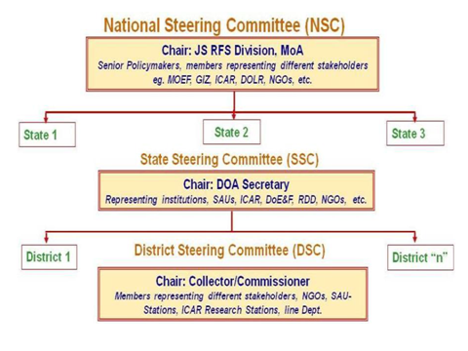
INSTITUTIONAL SET UP OF CCKN-IA

Slide 17
Consortium Approach
CCKN-IA consortium approach’ that would provide a platform for converging knowledge and expertise of diverse agencies at various levels.
Mechanisms like National Steering Committees (NSC), State Steering Committees (SSCs) and District Steering Committees (DCSs)/ District Working Groups (DWGs) have been established to provide the needed platform for bringing on board diverse partners to collectively think, guide and support the CCKN-IA project.

Slide 18
Consortium Facilitation Agency
The Government nominated leading institute at state level appointed as ‘Consortium Facilitation Agency’ (CFA)
CFA coordinate and leverage skills and expertise of various existing and potential partners for implementation CCKN-IA at the state level.

Slide 19
parameters for identification of the Consortium Facilitation Agency (CFA)
Should be a registered entity appointed and nominated by Central/State Government and demonstrated experience of minimum five (05) years of facilitating capacity building in the agriculture sector
Should have the ability to work across the state and at least in the project districts
Availability of dedicated resources and facilities for designing and conducting trainings on climate smart agriculture
Should have sound financial management systems and processes to be able to receive and manage foreign funds

Slide 20

Objective II . Work flow of CCKN-IA
The CCKN-IA work cycle is divided into six broad stages
Development of network for information on climate (Ex) change (NICE)
Creating Quality Content
Content Review
Content Management
Translation
Dissemination

Slide 21
Development of NICE frame work
CCKN-IA has developed a web based technology platform - ‘NICE’ OR Network for Information on Climate (Ex) change..
NICE enables exchange of weather variability early warnings, climate change research information and knowledge set across various institutions and farmers
This platform connect national, state and block level agricultural knowledge organizations with local agricultural extension delivery organizations and farmers

Slide 22
Cont…
NICE adopted the web 3.0 technologies to allow existing knowledge nodes ( knowledge producing organizations) to interact and collaborate with each other
The central hub located at the Ministry of Agriculture,GOI.
Once the knowledge node links are established the knowledge organizations populate the platform with dynamic content and enable the knowledge repository to grow day by day

Slide 23
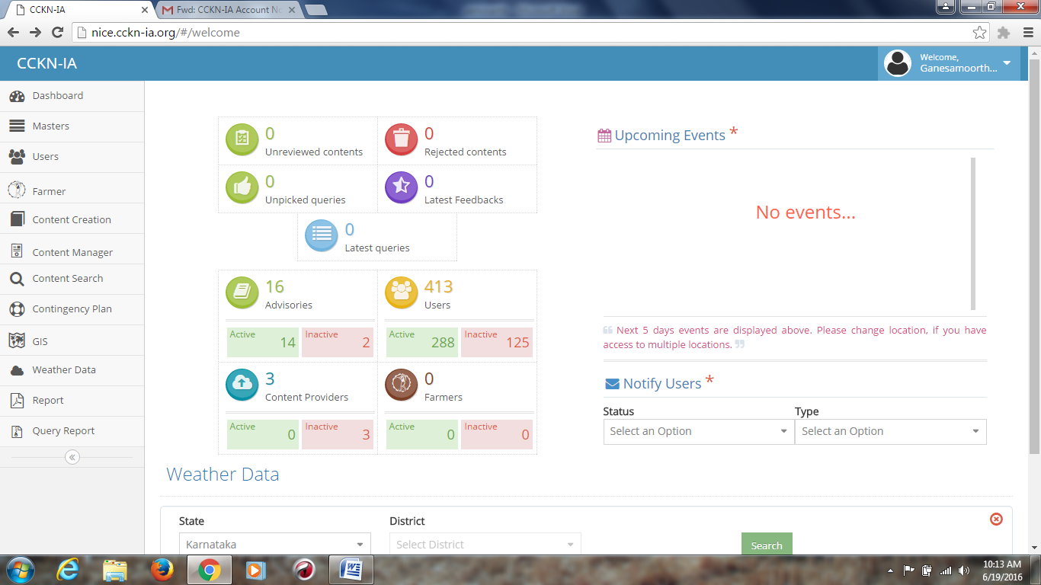
NICE Platform

Slide 24
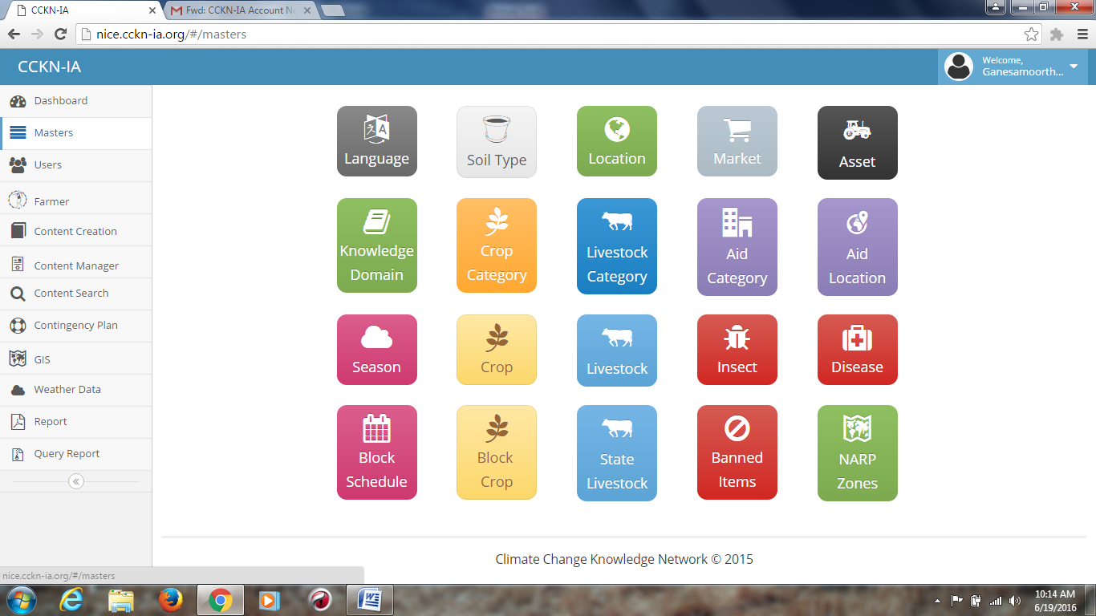

Slide 25
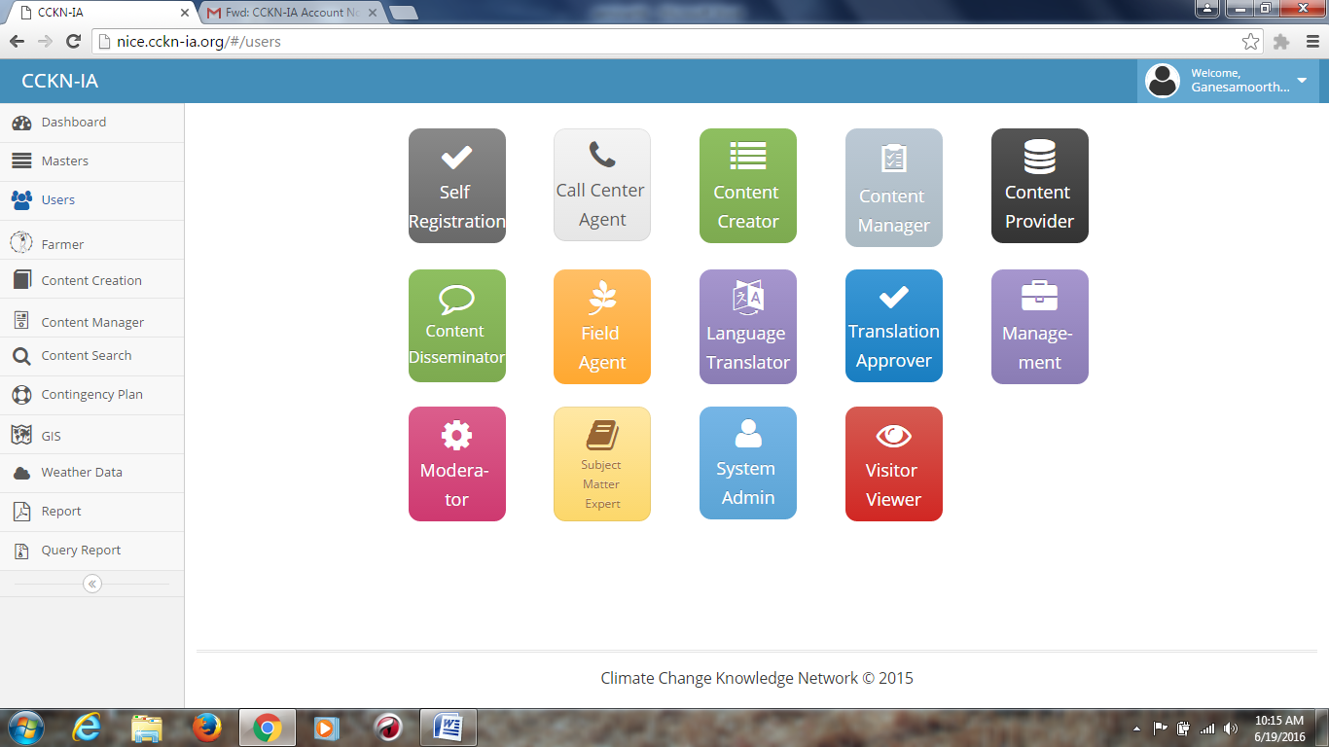
Users

Slide 26
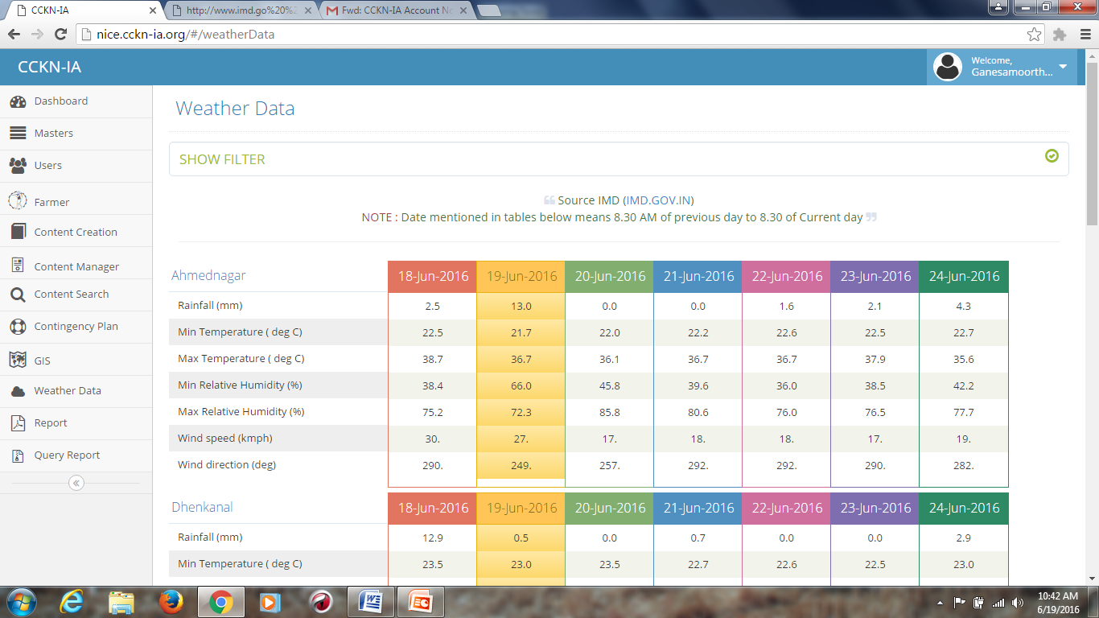
weather

Slide 27

Creating quality content
Creating content is an important stage in CCKN-IA project.
Content need assessment is conducted every season in close consultation with farmers and scientist from agriculture science centers based on inputs content is developed through
Existing content: Partnership leverage exist contents and knowledge products
Localized need based :The content topics will be developed based on feedback and needs of farmers, climate change trends and predictions as per the local agro-climatic needs
Indigenous technical knowledge: CCKN-IA will be map and capture the relevant ITK practices for content creation

Slide 28
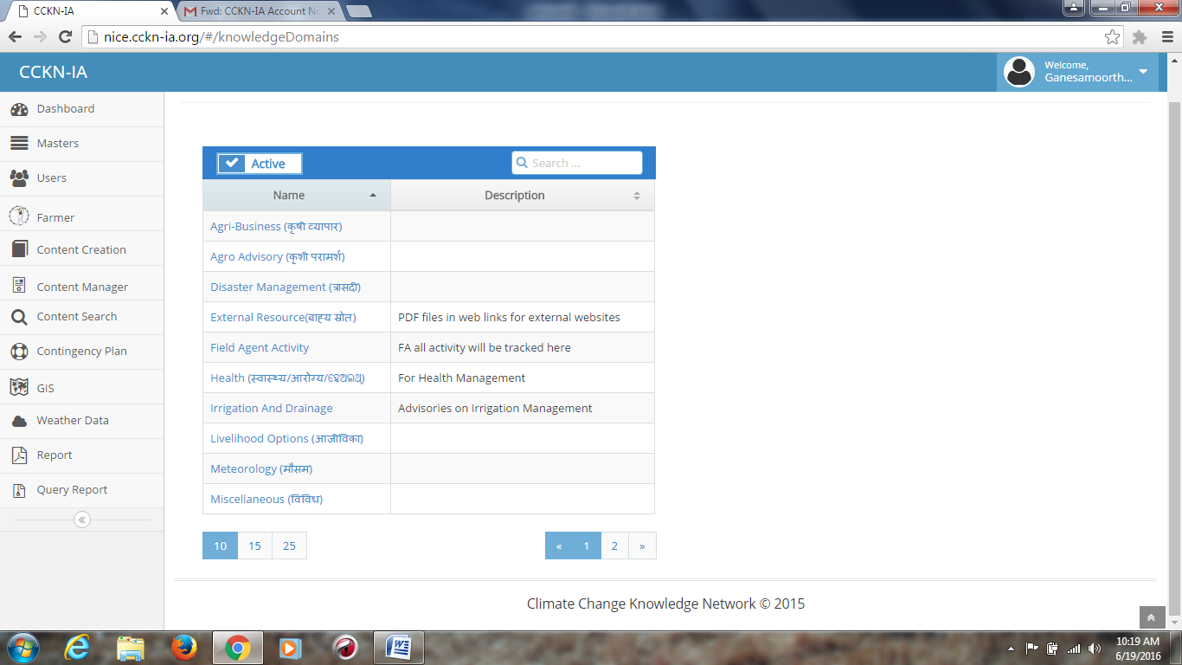
Content structure

Slide 29
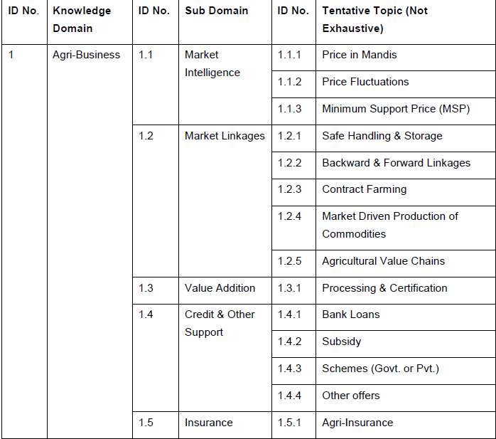
Classification of knowledge domains

Slide 30
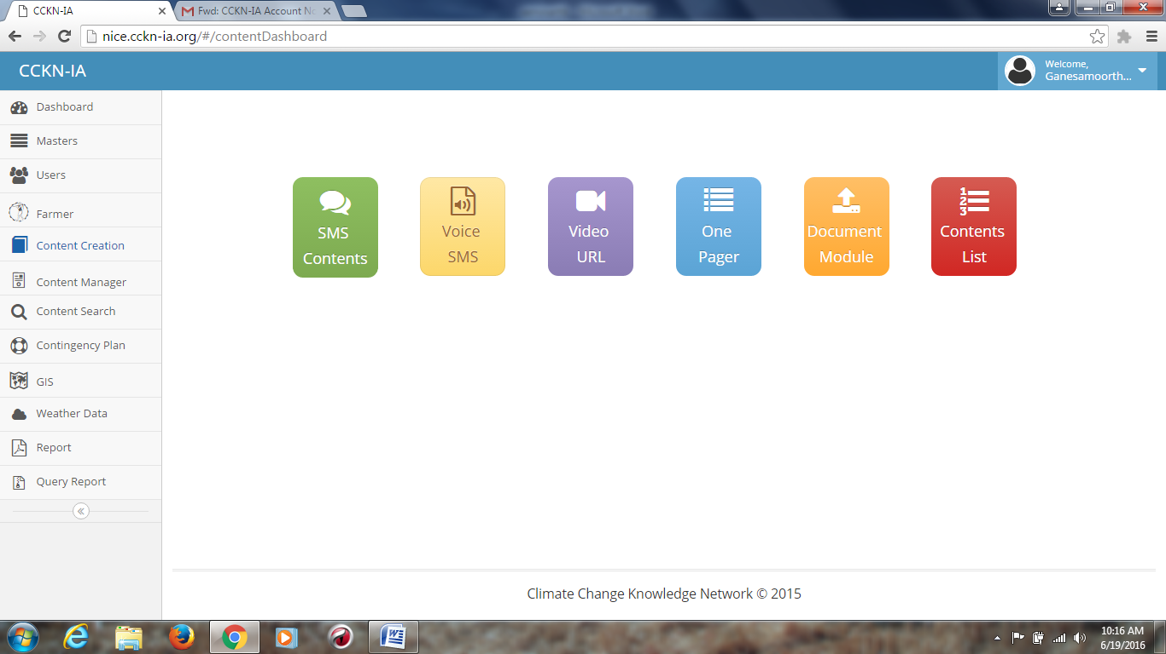
Content form

Slide 31
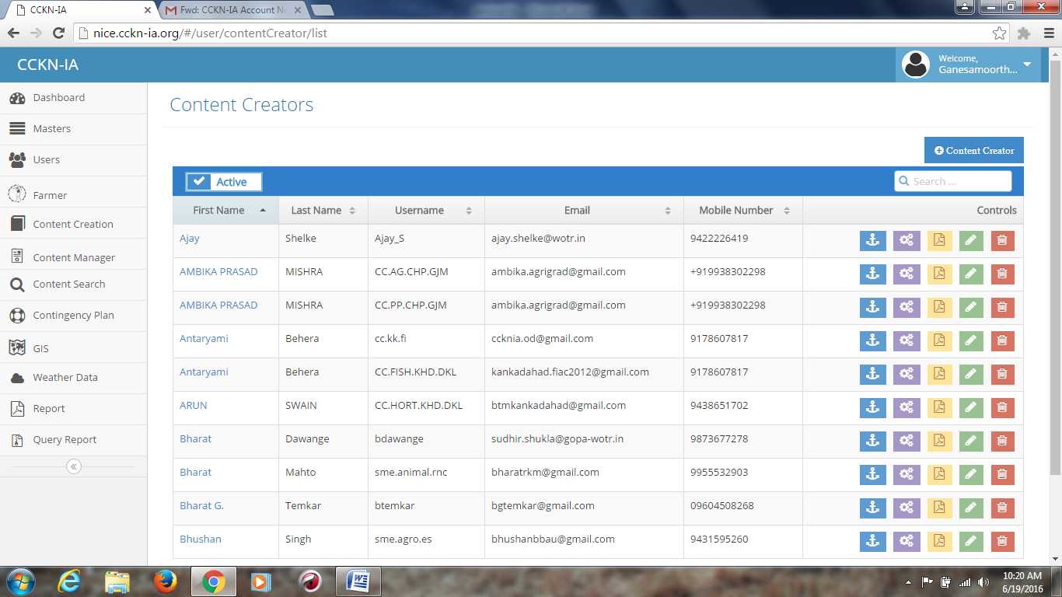
Content creators

Slide 32
Content review
CCKN-IA technology framework has a built-in ‘approval processes’ for the content created.
The CFA members will review the localized contents and validate/fine-tuned as per the farmer needs. Only the approved content will be disseminated to the farmers and other stakeholders

Slide 33
The quality of the content will be assured on following parameters:
Timeliness: The advisories created are aligned to the concurrent needs of farmers and timely delivered
Complete: the content should be complete (logically as well as technically)
Understandable: the advisories thus created should be in local language and use simple terms that could be understandable by a farmer
Relevance of the content: aligned to concurrent and local needs of the farmers

Slide 34
Content management
Content management entails ensuring that the quality content is developed, approved and disseminated on a timely manner and as per the local needs and contexts.
Content manager plan important role in this process
Ensure that climate change adaptation content and topics are identified as per the local needs and contexts
Follow-up and make sure that content is created, reviewed and approved on a time-sensitive manner

Slide 35
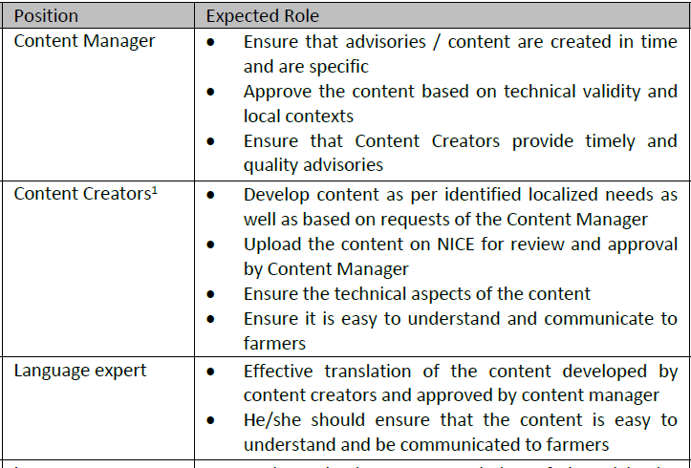
Expected role

Slide 36
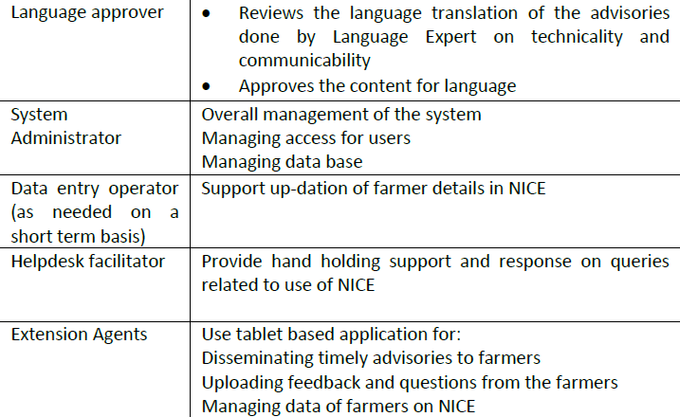
Cont..

Slide 37
Translation
Once the content is developed, reviewed and approved; it would be translated into local languages by a language expert. Finally the translated content send to the further process.

Slide 38

Dissemination
CCKN-IA support to the partners in dissemination of climate smart agricultural information and advisories to all stakeholders. This includes
Direct information to farmers through SMS, posters and videos
Integration with existing Kisan Call Centres (KCCs)
For effective dissemination of information to farmers CCKN-IA use cadre of extension agents equipped with NICE application on the tablet .

Slide 39
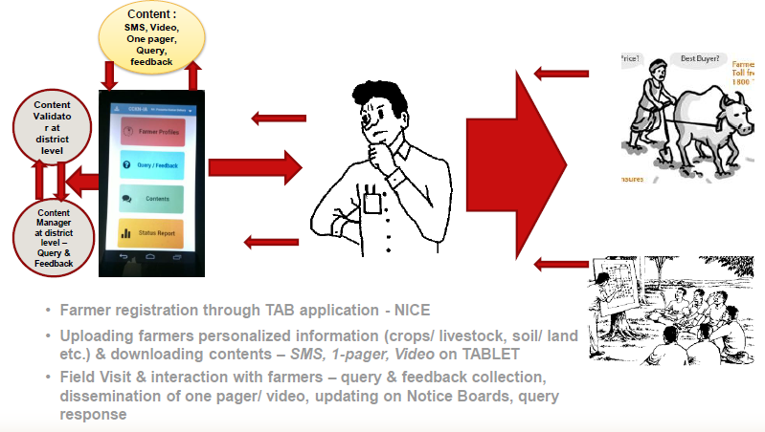
Extension services and Information dissemination through field agent

Slide 40
Cont…
The extension agents receive Bi-weekly agro metrology advisory that contain information on weather forecast, weekly agriculture advisory, climate change adoption practices.
This information regularly hand written on black board that have been constructed at the center at village.
This is read, analyzed and discussed with farmers to adopt climate change adoptions.

Slide 41
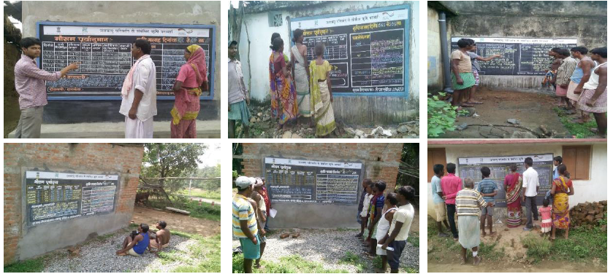
Content displayed at village level

Slide 42
MONITORING, EVALUATION AND LEARNING (MEL)
CCKN-IA adopted the Monitoring, Evaluation and Learning (MEL) framework.
CFA to undertake annual audit and submit the audit report to CCKN-IA.
CFA to facilitate collection of success stories, case studies, high resolution photographs and share with all stakeholders as per need and demand at the state and national levels.
The project progress to be shared at the SSC and NSC meetings, monthly review meetings at block, district, state and national levels.

Slide 43
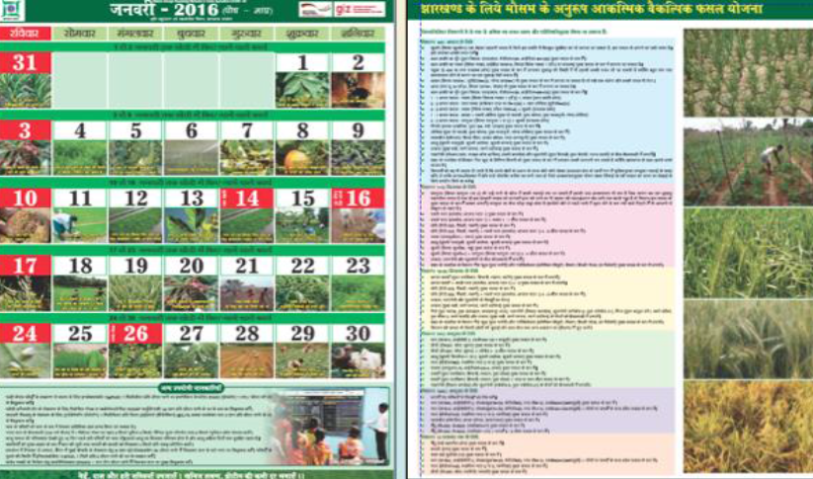
Development Crop Calendar
Development of knowledge component

Slide 44
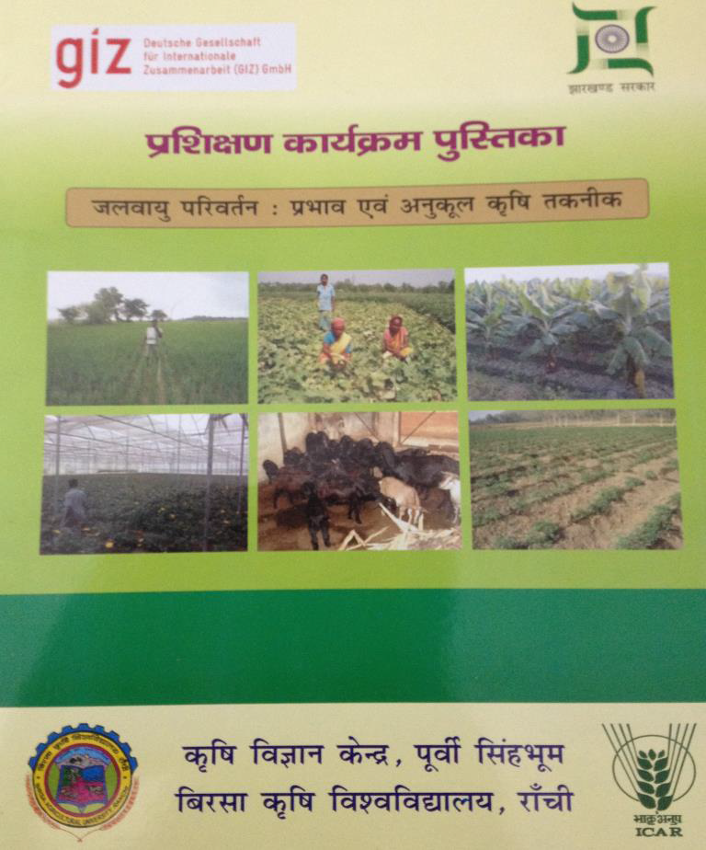
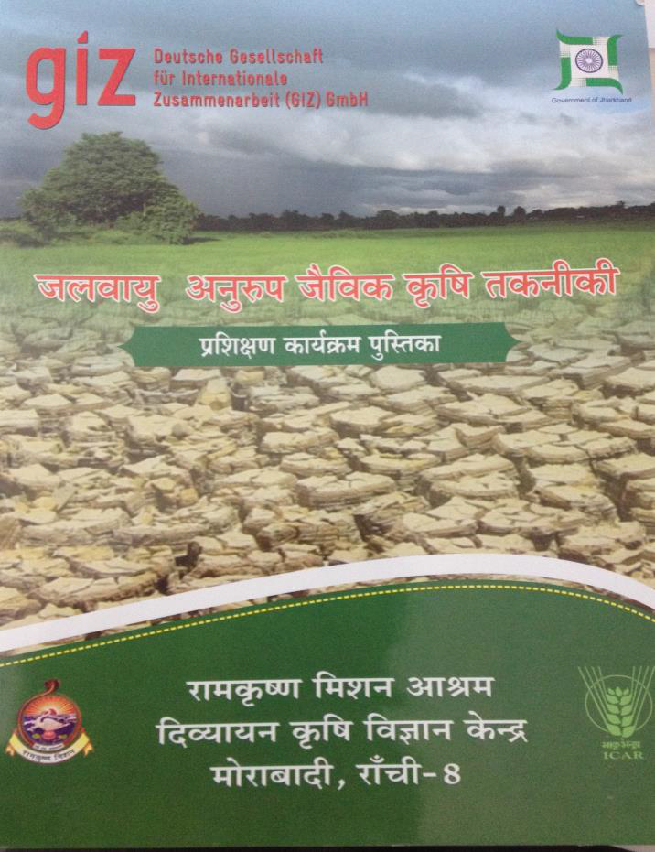
Publications

Slide 45
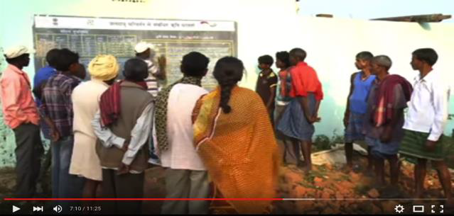
CCKN-IA video production
CCKN-IA team at Jharkhand had produced a video for stakeholders on it objective, process, major strategies, and activities. The video can be found at https://www.youtube.com/watch?v=qy0XqE5ByIE

Slide 46
Trainings and capacity building
Creating cadre of Master Trainers through structured Training of Trainers (TOT)/Master Trainers
Climate Change integrated into training modules of mandated State level training institutes like SAMETIs, KVKs and others
Technical trainings on use of technology platform to experts who would create content, users of the technology platform to manage and disseminate timely content and extension agents on extraction and use of information

Slide 47
III Objective : Review of research studies
Farmers’ knowledge and communication network regarding climate and weather parameters in relation to crop management (Ravi kumar2013)

Slide 48
Knowledge network needs of the farmers about climate and weather in relation to crop management (N=120)
S.I | Knowledge network needed areas | Frequency and percentage of respondents
 |  | Not needed | Some what needed | Most needed
1 | General climate and weather parameters | 47 (39.2) | 65 (54.2) | 08 (6.6)
2 | Crop planning | 32 (26.6) | 65 ( 54.2) | 23 (19.2)
3 | Crop production | 0 | 26 (21.7) | 94 (78.3)
4 | Crop protection | 0 | 20 (16.7) | 100 (83.3)
5 | Post harvest management | 17 (14.2) | 80 (70.6) | 19 (15.2)

Slide 49
Training needs of the farmers about climate and weather in relation to crop management (N=120)
S.I | Training needed areas | Frequency and percentage of respondents
 |  | Not needed | Some what needed | Most needed
1 | General climate and weather parameters | 42 (35.0) | 65 (59.2) | 07 (5.8)
2 | Crop planning | 18 (15.0) | 72 ( 60.0) | 30 (25.0)
3 | Crop production | 0 | 32 (26.7) | 88 (73.3)
4 | Crop protection | 0 | 23 (19.2) | 97 (80.8)
5 | Post harvest management | 14 (11.7) | 88 (73.0) | 18 (15.0)

Slide 50
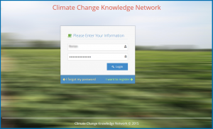
CCKN-IA Project review

Slide 51
CCKN-IA Project review
This technology platform will be useful to mainstream CCA interventions, adaptation and mitigation strategies. This project covered about 278 villages across three states in India, 78 organizations attending in dissemination and 14,789 farmers registered with having 15 thematic domains (Anon., 2015).

Slide 52
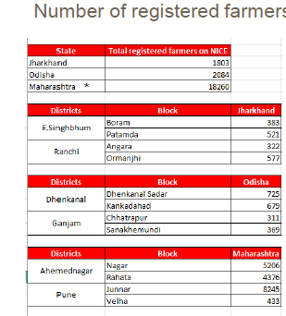
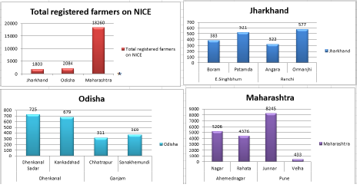
Total registered farmers on NICE

Slide 53
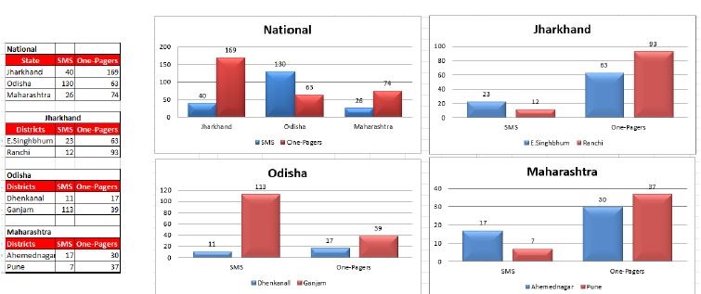
Content production

Slide 54
Conclusion
CCKN-IA believes that information is power.
In order to adapt for climate change, CCKN-IA provides timely, relevant and hyper localized information to the farmers. It has shown to have important cross sectorial knowledge management in the field of the climate change adaption with high level ICT penetration in rural areas and also it provides very unique solution for using technology to leverage of information for the benefits of farmers.

Slide 55

Thank you
Thank you

