Slide 1
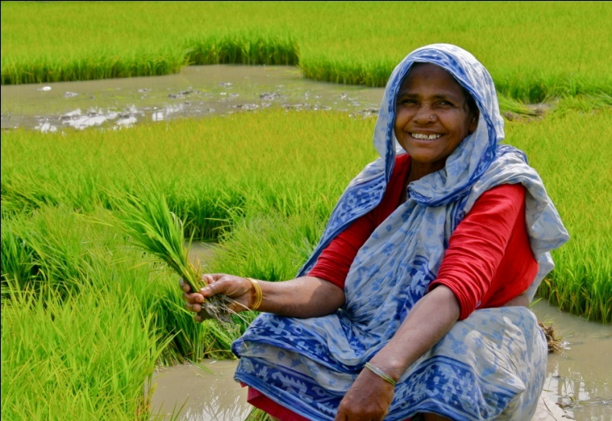
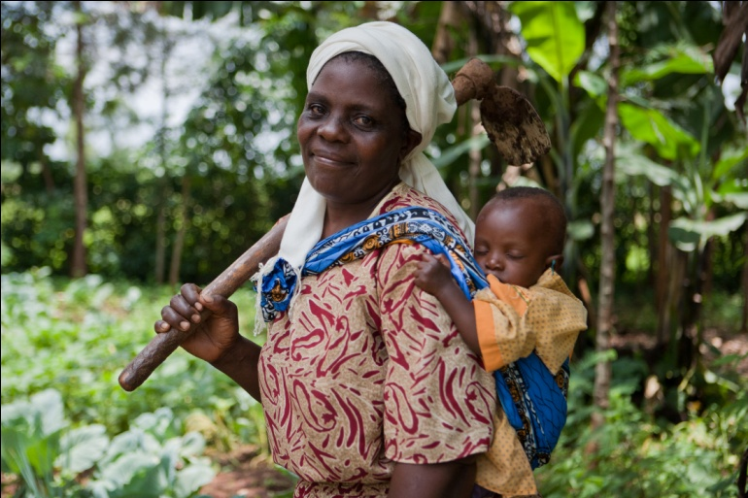
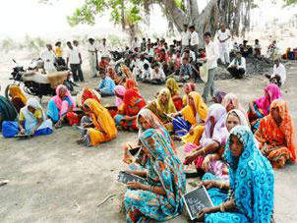

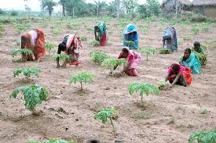
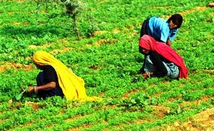
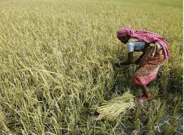
Gender analysis, budgeting , auditing and policy approaches to gender mainstreaming
Ms. Swetha. B S
III Ph.D.
Department of Ag. Extension

Slide 2

Women produce half of the world’s food and 60-80% in most developing countries
Women comprised 28% of the economically active population
Out of this, 63% in agriculture alone
The contribution of women in farm production has been estimated at 55-66% of the total labour

Slide 3
FAO
Even if women enjoy ownership rights, they do not exercise control over resources
Women are principal food providers but remain invisible partners in development
Women account for just 9.21% of the total 119 lakh farm land owners in our country which depicts that less than 10% of women are owning land in our country

Slide 4
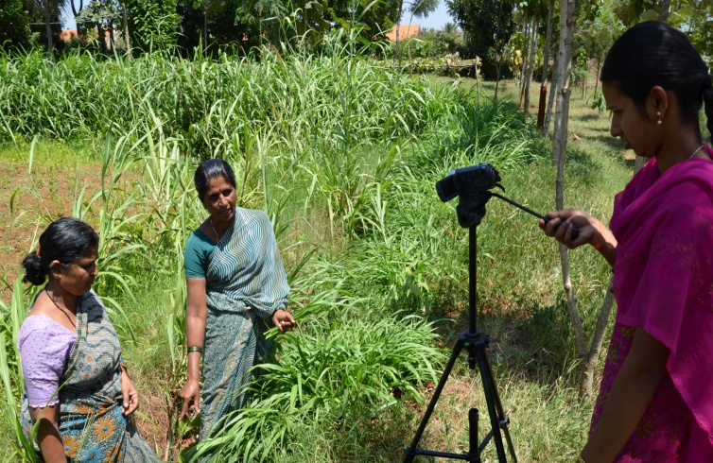
Women are still invisible partners in development?
Lack of gender disaggregated data
Women’s contribution to agriculture is very poorly understood in the country
Women specific needs are ignored in development planning. Eg farm tools

Slide 5
Objectives of the Seminar
1
2
To understand the concepts of Gender budgeting and Gender auditing
3
To review the existing institutional and policy approaches for Gender mainstreaming
To study the concept of gender and Gender analysis
4
To study the Concept of Gender mainstreaming

Slide 6
What is gender?
The term “gender” was first used by Ann and Oakley in 1970
Gender refers to “socially determined ideas and practices of what it is to be female or male (Reeves and Baden, 2000)

Slide 7
Definition
“Gender refers to the roles and responsibilities of men and women that are created in our families, our societies and our cultures.
The concept of gender also includes the expectations held about the characteristics, aptitudes and likely behaviors' of both women and men (femininity and masculinity)”

Slide 8
What is Gender Analysis……….
Gender analysis is a tool to better understand the different social, economic, cultural and political realities of women and men, girls and boys.
Its core is understanding culture (underlying values, norms and beliefs), expressed in the construction of gender identities and inequalities.

Slide 9
What Gender Analysis Will Provide?
Analysis of the Division of Labour and Access and Control of Resources
Understanding of gender relations and their Implications for development policy and implementation
Specific gender disaggregated statistics
A Review of Women’s Priorities, Women’s Practical Needs and Strategic Interest and ways to address them
A Review of Social, Economic, Political Power Dynamics
Absence of GA propose high risk of program failure, less success or reinforce inequity

Slide 10
Some examples
A gender analysis of health program will inform you how inequalities disadvantage women’s health, the constraints women face, ways to overcome constraints.
A gender analysis of women worker’s situations, their needs, work places, wages, market trends will provide practical information to advocate for all (women and men) worker’s rights
A gender analysis of product supply chain will tell you women’s involvement at different stages in the supply chain so to increase their visibility and gain economic benefits
A gender analysis of water project will inform you where women collect water, what should be done to increase women’s access to safe water

Slide 11
When to conduct a Gender Analysis
Gender Analysis should/can be undertaken at any/all stages of a program/project cycle, including:
Identification of the project;
Planning or design of the activity;
Implementation; and
Monitoring and evaluation of program

Slide 12
Who should do gender analysis
Government
Policy makers
Donors
Program Managers
Development Staff
Field workers, etc.
GA should be participatory involving key stakeholders from the field where the intervention is to take place
Gender Analysis can be conducted through a variety of Tools and Frameworks

Slide 13
How To Do Gender Analysis
Collect Relevant Data: Sex–disaggregated information for analysis (Who does what? Gender roles, responsibilities, priorities of men and women both within and outside the household? Who has what? Who controls what?)
Identify Relevant Gender Issues (women’s and men’s practical needs and strategic interests)
Understand the institutional, economic, social, and political contexts (What are the differences, constraints, influences, power dynamics between women and men?)
Understand the priorities and needs of both men and women affected by the project (what do they need/want?)

Slide 14
Gender Analysis Frameworks
Harvard Analytical framework
Moser’s Gender Planning Framework
Gender analysis matrix (GAM)
Equality and empowerment framework (Sara Longwe)
Notes:
A Standardized format that guide you to do GA
Frameworks are only tools, you have to decide how to confront the situation
Frameworks can be combined according to particular situations
The frameworks address different aspects of gender equality and therefore are useful in different situations. Harvard and Moser are particularly useful when analysing the division of labour in agriculture and in urban settings; Levy is useful for gender mainstreaming in institutions; GAM is useful when assessing gender differential impacts of projects at community level; Longwe is useful for assessment of empowerment of women due to interventions in all sectors; CVA deals mainly with humanitarian and disaster preparedness issues; POP is an expanded version of Harvard, dealing mainly with refugee issues; SRF is useful when dealing with sustainable development and institutional change
Harvard framework was developed at Harvard university. It is also called the Gender Roles Framework, was developed by the Harvard Institute for International Development in collaboration with the Women In Development office of USAID, and was first described in 1984 by Catherine Overholtand others. It was one of the earliest of such frameworks.^{[7]} The starting point for the framework was the assumption that it makes economic sense for development aid projects to allocate resources to women as well as men, which will make development more efficient – a position named the “efficiency approach"
Harvard framework informs planners about the situations, roles, resources, various social, economical and political influencing factors and on the basis of this overall information, planners can design better and efficient projects
It improves the visibility because it generates the sex dissegrated data

Slide 15
Harvard Analytical framework
Aims
To demonstrate that there is an economic rationale in investing women as well as men
To assist planners in designing more efficient projects and improve overall productivity
To emphasise the importance of better information as the basis for meeting the efficiency/ equity goal
To map the work of men and women in the community and highlight the kea differences
Notes:
A Standardized format that guide you to do GA
Frameworks are only tools, you have to decide how to confront the situation
Frameworks can be combined according to particular situations
The frameworks address different aspects of gender equality and therefore are useful in different situations. Harvard and Moser are particularly useful when analysing the division of labour in agriculture and in urban settings; Levy is useful for gender mainstreaming in institutions; GAM is useful when assessing gender differential impacts of projects at community level; Longwe is useful for assessment of empowerment of women due to interventions in all sectors; CVA deals mainly with humanitarian and disaster preparedness issues; POP is an expanded version of Harvard, dealing mainly with refugee issues; SRF is useful when dealing with sustainable development and institutional change
Harvard framework was developed at Harvard university. It is also called the Gender Roles Framework, was developed by the Harvard Institute for International Development in collaboration with the Women In Development office of USAID, and was first described in 1984 by Catherine Overholtand others. It was one of the earliest of such frameworks.^{[7]} The starting point for the framework was the assumption that it makes economic sense for development aid projects to allocate resources to women as well as men, which will make development more efficient – a position named the “efficiency approach"
Harvard framework informs planners about the situations, roles, resources, various social, economical and political influencing factors and on the basis of this overall information, planners can design better and efficient projects
It improves the visibility because it generates the sex dissegrated data

Slide 16
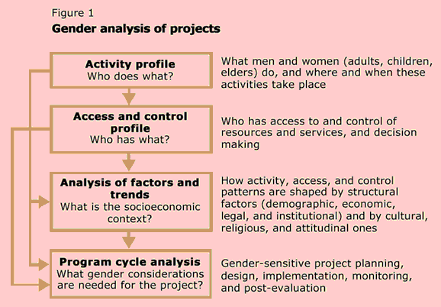

Slide 17
GENDER ANALYSIS : Harvard tool 1: The activity profile
Activities
Males
Females
Crop Production
Crop ………….. or Field 1
Task-1 …………………..
Task-2…………………...
Task-3…………………..
…………………………….
……………………………..
…………………………….
…………………………….
…………………………….
……………………………..
…………………………….
…………………………….
…………………………….
Livestock Production
Activity……….………….. Activity……….…………..
Activity……….…………..
Activity……….…………...
……………………………..
…………………………….
…………………………….
…………………………….
……………………………..
…………………………….
…………………………….
…………………………….
Household Production
Activity……….………….. Activity……….…………..
Activity……….…………..
Activity……….…………...
……………………………..
…………………………….
…………………………….
…………………………….
……………………………..
…………………………….
…………………………….
…………………………….
Off-farm Production
Activity……….………….. Activity……….…………..
Activity……….…………..
Activity……….…………...
……………………………..
…………………………….
…………………………….
…………………………….
……………………………..
…………………………….
…………………………….
…………………………….

Slide 18
GENDER ANALYSIS
ACTIVITIES OF DAIRY
S.No | Activities | Male | Female | Others
1 | Selection of breed
2 | Rearing the animal
3 | Purchase of animals
4 | Feeding the animal
5 | Washing and cleaning the animals and cattle sheds
6 | Watering
7 | Identification of diseases and administering medicines
8 | Milking
9 | Marketing
10 | Processing of milk and preparation of milk products

Slide 19
Activity Profile
Activity | Women | Men | Girls | Boys
Reproductive activities
Productive activities
Community management activities
Community politics activities

Slide 20
Harvard tool II : Access and Control Profile
Resource | Access |  | Control |  | comment
 | Women | Men | Women | Men
Land
Equipment
Labour
Cash
Employment opportunities
Education / Trainings
Others

Slide 21
Harvard Tool 3: Influencing factors
Example of Harvard Tool 3: Influencing factors
Influencing Factors | Constraints | Opportunities
Community norms and social hierarchy Demographic factors Institutional structures Economic factors Political factors Legal parameters Training Attitude of community to development workers

Slide 22
Uses of the framework
Best suited for project planning, rather than program or policy planning
For baseline data collection
It is practical and hands on
Once data have been collected, it gives a clear picture of who does what,
when and with what recourses.
5. It makes women’s roles and work visible
6. It can be easily adapted to a variety of settings and situations
(The Harvard Analytical Framework- Gender Roles in Development
by Overholt, Anderson, Austin, and Cloud (1985))

Slide 23
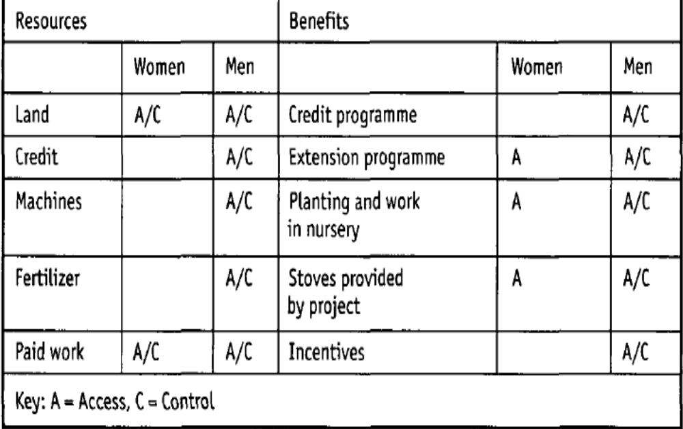
Case study of the Harvard Analytical Framework: Indonesia
Community Forestry Project

Slide 24
Moser’s Gender Planning Framework
Caroline Moser developed it as a method of gender analysis Development Planning Unit (DPU)
University of London, UK in the early 1980s.
At the heart of the Moser Framework are three concepts:
• Women's triple role;
• Practical and strategic gender needs;
• Categories of WID/GAD policy approaches (policy matrix).

Slide 25
Moser Tool 1: Gender roles identification / triple role
Productive Roles:
Reproductive Roles:
Community Role–
Community-managing activities
Community politics
1.

Slide 26



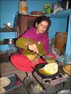

Some recognized….. Some hidden…

Slide 27



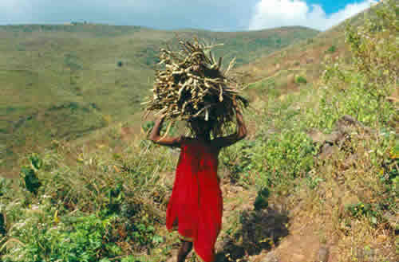
This results in different needs

Slide 28
Moser Tool 2: Gender needs assessment
1. Practical gender needs: Moser defines practical gender needs as those which, if they were met, would assist women in their practical gender needs may include:
2. Strategic gender needs: Moser defines these as the needs which, if they were met, would enable women to transform existing imbalances of power between women and men.
Challenges to the gender division of labour;
1.

Slide 29
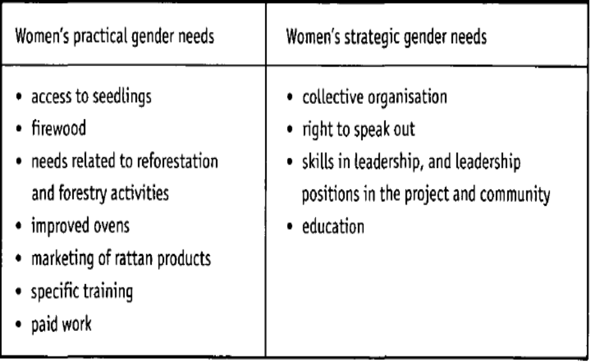
Case study of the Harvard Analytical Framework: Indonesia
Community Forestry Project

Slide 30
Practical and Strategic Gender Needs
Practical gender needs | Strategic Gender Needs
Tend to be immediate | Tend to be long term
Unique to particular Women | Common to almost all women
Relate to daily needs Food, Water, Housing, Income, Health etc., | Relate to the disadvantaged Position Subordination, Lack of Resources, Education, Violence etc.,
Always identifiable by target groups, Water, Food, Medicine, Land, Fuel, Fodder etc., | Not always easily identifiable by target group sense of self-esteem, self confidence, ability to mobilize, organise, leadership and management skills
Responding to PGN does not change the existing power relations | Responding to SGN wants to change unequal gender relations by getting women in decision making position
Responding to PNG can improve the living condition of women | Responding to SGN can improve the position of women in the society
Involves women as beneficiaries and perhaps as participants | Involves women as agents or enables women to become agents of change of development

Slide 31
Moser Tool 4: Distinguishing between different aims in interventions: the WID/GAD Policy Matrix
This is mainly a tool for evaluation
To examine what approach has been used in an existing project, programme, or policy.
It can also be used to consider what would be most suitable approach for future work.
Examining the policy approaches can help you anticipate some of their inherent weaknesses, constraints, and possible pitfalls.
1

Slide 32
Uses of the Moser’s framework
Used for planning at all levels from policies to projects
Conceptualises planning as aiming to challenge unequal gender relations and support women’s empowerment
Makes all work visible and valuable to planners through the concept of triple roles
Distinguishes between types of gender needs
Categorises policy approaches
1
Gender Planning in Development: Theory, Practice and Training,
by Caroline Moser 1993, Routledge, London,

Slide 33
Gender Analysis Matrix (GAM)
Aims
The GAM aims to help determine the different impact development interventions have on women and men,
by providing a community-based technique for identifying and analysing gender differences.
The GAM use is intended to initiate a process of analysis by community members themselves.
It encourages the community to identify and constructively challenge their assumptions about gender roles.
GAM Tool : 1: Analysis at four 'levels 'of society
2: Analysis of four kinds of impact

Slide 34
Example of GAM
 | Labour | Time | Resources | Culture
Women
Men
Household
Community
Manual on Gender Analysis Training for Grassroots Workers, by A. Rani Parker, published by UNIFEM in 1993.

Slide 35
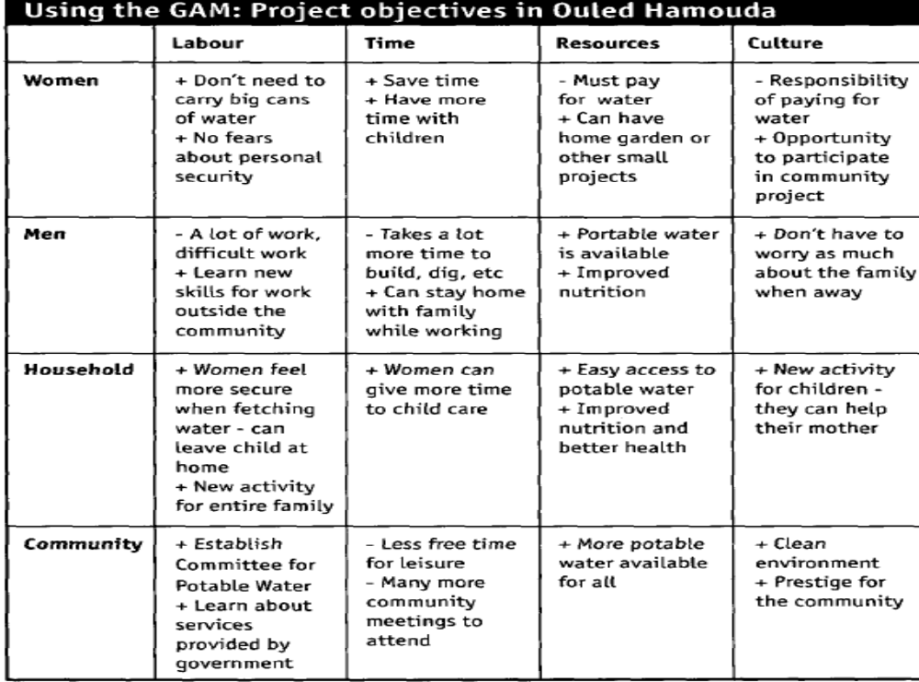
Case study of GAM: Potable water in Ouled Hamouda

Slide 36
Decision making matrix
Topic | Initiation |  | Discussion |  | Decision |  | Implementation
 | W | M | W | M | W | M | W | M
Children’s Education
Purchased of land
Selection of crop
Construction of House
To Start Business
To Join SHG
Treatment

Slide 37
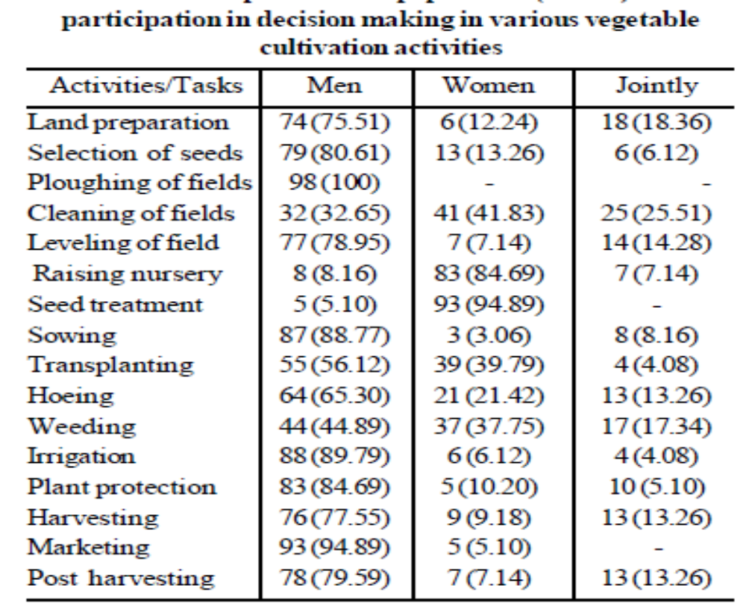
Gender difference in decision making Pattern of Hill vegetables growers- Uttarakand
(Sonu Fartyal and Surya Rathor, 2104)

Slide 38
D. Women’s Empowerment framework
Developed by
Gender expert from Lusaka, Zambia
Aim – to achieve women’s Empowerment by enabling women to achieve equal control over the factors of production and participate equally in the development process

Slide 39
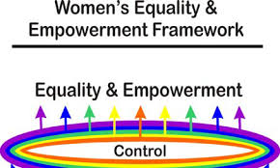
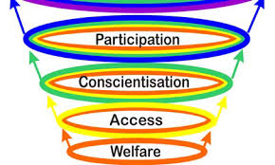

Slide 40


Gender budgeting
Dissection of the budget, how it addresses women based on health, education, employment, agriculture etc.
Seeing what percent of the budget is spent on women

Slide 41
What is GENDER BUDGETING?
Contributing to Good Governance and effective service delivery
It is a way of linking equality policy with macroeconomic policy.
It is based on the premise that budgets are not gender neutral.
It is not a separate budget.
It is a way of expediting gender mainstreaming.
It means close scrutiny of the outcomes of budgets.
It allows for better targeting, and therefore more efficient allocation of public expenditure.

Slide 42
What is GB?
Gender Budgeting is a process which helps to look at General Budgets from a Gender Perspective. It is an exercise to translate stated gender commitments of the Government into budgetary commitments.
It does not seek to create a separate budget, nor divide the budget - 50% for women and 50% for men, but to provide affirmative action to address the specific needs of women

Slide 43
Why GRB?
Integration of
women’s & men’s
Concerns in all
policies & projects
Equality
Strategy:
Twin-track
Gender
mainstreaming
Goal:
Gender
Equality
Outcomes
2. Specific activities
aimed at
empowering
women
Empowerment
Of women

Slide 44
The three stages of gender budgeting
Stage 1
Analysis of budget from a gender perspective impact on women and men
Stage 2
Reformulating budgetary policies/ distribution of resources to achieve gender equality outcomes
Stage 3
Working systematically to embed gender within the budgetary process

Slide 45
Institutionalizing GB in India
(1) 7th FYP 1985- Ministry of Human Resource Development set up - Dept. for WCD constituted in HRD Ministry
27 major women specific schemes identified for monitoring to assess quantum of funds/benefits flowing to women
(2) 8th FYP(1992-97) for the first time highlighted the need to ensure a definite flow of funds from general developmental sectors to women
(3) 9th FYP (1997-2002) Women’s Component Plan- 30% of funds were sought to be ear-marked in all women related sectors – inter-sectoral review and multi-sector approach. Special vigil to be kept on the flow of the earmarked funds/benefits.

Slide 46
Contd..
(4) 10th FYP (2002-2007) Reinforces commitment to gender budgeting to establish its gender-differential impact and to translate gender commitments into budgetary commitments. GB Statement the new entry point introduced in the Union Budget
(5) 11th FYP (2007 -2012) – Focussed on adequate provisions to be made in policies and schemes across Mins/Depts &strict adherence to GRB across the board.
(6) 12th FYP (2012-2017) envisages strengthening of GB initiatives e.g., modification of planning and budget approval systems to make gender clearance and specific approvals of GBCs mandatory , GB and gender audit in Rural and ULBs

Slide 47
Status of GB in India
Year | No. of Ministries (No. of Demands) | Total Magnitude of Gender Budget (BE) (in Rs. crore)
2005-06 | 9 ( 10) | 14378.68 (2.79 %)
2006-07 | 18 (24) | 28736.53 (5.09%)
2007-08 | 27 (33) | 31177.96 (4.5%)
2008-09 | 27 (33) | 27661.67 (3.68%)
2009-10 | 28 (33) | 56857.61 (5.57%)
2010-11 | 28 (33) | 67749.80 (6.11%)
2011-12 | 29 (36) | 78251.02 (6.22%)
2012-13 | 29 (34) | 88142.80 (5.91%)
Source: GB Statements, All Years, Ministry of Finance, Expenditure Budget, Vol. I.
47
Notes:
47

Slide 48
Gender Budget 2016-17
 | Gender Budget (BE) (in Rs. crore)
Total outlay of the Gender Budget Statement | Rs. 90, 625 Crores (4.46%.)
Indira Gandhi Matritva Yojana (IGMSY) | Rs. 400 Crore, Rs. 460 crores
Rajiv Gandhi Scheme for Empowerment of Adolescent Girls (RGSEAG) | Rs. 460 crores
Nirbhaya Fund | Rs. 500 cores
National Mission for Empowerment of Women | 50 crore.
Support to Training and Employment Programme (STEP) | 500 crores
Cost of providing these LPG connections | Rs. 2000 Crore
48
Notes:
48

Slide 49
What is Gender Audit?
A tool to assess the extent of Gender mainstreaming accomplished
It helps to assess the differential reach and impact of projects and policies on women and men.
Its aim is to see whether the policy, programme guidelines, practices, systems, procedures and budgets are being used in the most effective way to deliver the Governments commitments to gender equality.

Slide 50
Objectives of the Gender Audit
Examine whether the programme guidelines, practices, systems, procedures, and resources are being used in the most effective way to deliver the gender specific scheme’s commitment to gender equality.
Assess the extent of gender mainstreaming in terms of the development and delivery of products and services
Analyze the expenditure pattern of the allocated financial resources and its reach to the last women beneficiary.
Examine whether the programme has addressed the specific needs to women.
Assess the level of resources allocated and spent on the same as well as its adequacy.

Slide 51
Objectives of the Gender Audit
Identifies critical gaps, challenges and recommends ways of addressing them
Design and evaluate appropriate output indicators for the programme with in a Gender perspective.
Documents good practices towards the achievement of gender equality.
Establish a baseline

Slide 52
When can a GA be conducted?
GA is an ongoing process of review to improve the capacity of the Government to deliver schemes/programmes more effectively and formulate strategies that will lead to gender equality.
GA should particularly be carried out as and when each project is completed
GA can be a useful tool in the GPs/Block’s/District’s performance monitoring framework particularly while preparing the District / State Annual Plan for the next financial year.
The results of the first Gender Audit can become the baseline against which to measure progress. The Annual Plan should refer to the findings of the previous gender audits.
6/11/2016
52

Slide 53
METHODOLOGIES OF GENDER AUDIT
Levels | Description | Review of documents | Methodological strategies
Policy | Women’s policy Quantitative analysis of local government projects | Women’s policy Women’s status study report Guidelines Development document Development report Annual project documents | Content analysis Focus group discussions with Sector experts, elected representatives, Secretary, Working Group members.
Plan | In depth case studies of the projects | - Number of projects for gender equality - Number of projects for women’s empowerment | Analysis and review of sector-wise resource allocation; related documents and project documents

Slide 54
Levels | Description | Review of documents | Methodological strategies
Institutional level | Whether the institution is women friendly, number of women and men in each institution, vacancies and process of filling up vacancies etc. | - Projects for poverty alleviation - Projects for sustainable livelihoods - Health - Small scale industry | Focus group discussions with beneficiaries, implementing officers and field visits Carry out gendered cost benefit analysis
Structural level | Quantitative and qualitative analysis of the following local government structures Gram Sabha / Ward Sabha Working Groups Standing Committee (Administrative Committee) | - Whether institutions provide basic facilities for women? - Whether there is a women friendly atmosphere? - Whether there is an anti-sexual harassment committee? - Whether personnel are aware of innovative projects for gender equality? - The basis for appointment, promotion, transfer etc. | - Conservation - Focus Group Discussions with members of Gram Sabha, Working Group members and elected representatives - Review records and cross checking - Check attendance books and reports

Slide 55
Levels | Description | Review of documents | Methodological strategies
Process level | Analysis of all decentralization processes - Planning - Implementation - Monitoring - Evaluation | Participation, interventions, role of women in discussions and in decision making (Governing bodies) | Observation, minutes of meetings and focus group discussions - Process documentation and analysis. - Interviews with governing body members - Focus group discussions with monitoring committee members
Source : Gender Planning, Budgeting and Auditing, Sakhi Women’s Resource Centre, 2006

Slide 56
Gender Audit Score Card – The Methodological Tool
A simple, easily understood, system of scoring may be
 | Objective/indicator has been fully achieved
 | Objective/indicator has been mostly achieved, and action is in place to fully achieve it
 | Objective/indicator has been partly achieved, but there remain concerns about some aspects.
 | Objective/indicator has not been achieved at all, and there are no plans for achieving it.
6/11/2016
56

Slide 57
Policy Approaches to Women and Development:
The Welfare Approach
Women In Development (WID)
  The Equity Approach
  The Anti-poverty Approach
  The Efficiency Approach
Gender And Development (GAD)
  The Empowerment Approach

Slide 58
Policy Approaches to Women and Development: Welfare to GAD
Post-Independence: The welfare approach
  A Community Development Programme (CDP) was launched in 1952 to improve agriculture and transform village society.
  It provided for the appointment of two gram sevikas (village level workers) and a mukya sevika (woman animator) in each block.
  Attempts were also made to organize women into mahila mandals (women's groups).
  They reinforced women's traditional roles (the mother-child dyad), saw the household as an undifferentiated unit with man as the head and (economic) provider and were largely nonthreatening to the patriarchal order.

Slide 59
Policy Approaches : Women in Development
Equity Approach: 1970’s ...
  Report of Status of Women Committee (1974), “Towards Equality”, concluded that two to three decades of planned development had seen a worsening of women's situation on various fronts.
  Spurred by the activities under the UN Decade for Women (1975-85), the 1970s can be seen as the first phase of the women's movement in India with the emergence of extensive campaigns against all forms of violence.
  Public awareness on the declining sex ratio and violence against women, provided support to women victims and sought legal reforms in antiquated laws.

Slide 60
Women in Development
The anti-poverty approach: 1980’s...
  A large number of (one-third ) rural households around the world headed by women.
  Large-scale migration from rural areas , compulsion for women to take care of landholdings, little resources and expertise.
  Women's poverty was not a problem of subordination vis-a-vis men, but one of underdevelopment - lack of access to or control over productive resources including land, credit, skills, information and knowledge.
  Initiation of poverty alleviation programmes to be either targeted at women directly (DWCRA) or have special quotas for them (IRDP, TRYSEM, STEP, JRY).
  Savings and credit activities were an integral part of these schemes, which ranged from self-employment through enterprise promotion to wage employment.

Slide 61
Women in Development
Efficiency Approach
Investment in women as a productive resource to ensure that development is more efficient and effective.
Women are seen more or less entirely in terms of service delivery, capacity and ability to extend the working day - the underlying rationale being that 'women can always cope' (with more work).
The purpose of this approach is to ensure that development is made more 'efficient' and 'effective' through women's economic contribution.
The main assumption is that increased economic participation automatically leads to increased equity.
This approach shifted the focus away from 'women' to 'development.

Slide 62
GAD
The GAD concept emerged in the 1980s out of the criticisms of the earlier WID concept, and has its roots in socialist feminism:
  Socialist feminists have identified the social construction of production and reproduction as the basis of women's oppression
  Need to pay attention on the social relations of gender, questioning the validity of roles that have been ascribed to both women and men in different societies .

Slide 63
The Empowerment Approach
The capacity of women to increase their own self-reliance and internal strength. This is identified as the right to determine choices in life and to influence the direction of change, through the ability to gain control over material and nonmaterial resources. (Moser, 1989).
The structures of inequity start within the family, and reach all levels of socio-economic, political, and cultural structures of our societies.
The empowerment approach views the issue of women's gender subordination within this complex socio-political, economic, and cultural context. It therefore understands that the solutions proposed need to be accordingly sophisticated:

Slide 64
WID & GAD
WID | GAD
The Approach
An approach which views women as the problem | An approach to development
The Focus
Women | Relations between men and women
The Problem
Exclusion of women ( 50 % productive resources) from development process | Unequal relations of power (rich and poor women and men) that prevents equitable development and women's full participation
The Goal
More efficient and effective development. | Equitable, sustainable development with women and men as decision-makers.

Slide 65
WID | GAD
The Solution
Integrate women into development process. | Empower the disadvantaged and women.
The Strategies
Women's projects
Integrated projects Increase women’s productivity Increase women’s income | Identify different tasks/activities women and men can do across different socio-economic groups.
Enhance women’s ability to look after households. | Address different dimensions of social exclusion and vulnerability in terms of access/control of resources/benefits
 | Organize and empower the poor to 'own' and define the process of development.

Slide 66
National Agricultural Policy and Gender Mainstreaming
The National Agricultural Policy (2001) supports the various Plan initiatives for women farmers and calls for the 'main streaming of gender concerns in agriculture'.
In practice, this implies "appropriate structural, functional and institutional measures to empower women, build their capabilities and improve their access to inputs, technology and other farming resources“.
Further, the policy discusses the need for land reforms - consolidation of landholdings, redistribution of ceiling-surplus lands and wastelands among the landless and the recognition of women's land rights

Slide 67
Understanding Gender Mainstreaming
“ …the process of assessing the implications for women and men of any planned action, including legislation, policies or programs, in all areas and at all levels.
It is a strategy for making women’s as well as men’s concerns and experiences an integral dimension of the design, implementation, monitoring and evaluation of policies and programs in all political, economic, and societal spheres so that women and men benefit equally and inequality is not perpetuated.”
Notes:
In the last session we saw that the way forward was addressing gender concerns. Now lets see what this means. Essentially we have to, for any planned action look at implications for men and women. Please take a minute to read this definition.
Any comments?

Slide 68
The National Policy of Farmers 2007,
Defines ‘mainstreaming the human and gender dimensions in all farm policies and programmes’ as one of its major Policy goals. The Policy measures favouring women which find a mention under NPF include
  Joint pattas for both homestead and agricultural land
  Promoting women’s role as water users both in access and management of ‘Water’ as a resource
  ‘Fish for All’ training and capacity building centres for fisher families and fisher women
  Promote measures to improve productivity and overall efficiency of livestock and poultry sectors which engage women in much larger proportions
  Promoting women friendly implements/ tools which can reduce drudgery, save time, enhance output and can be handled comfortably by them
  Augmenting and utilizing resources available with Ministry of Panchayati Raj, Ministry of Rural Development and Ministry of agriculture to provide support services to women viz. Crèches, child care centres, nutrition, health and training etc.
  Issuance of Kisan Credit Cards to women with Joint Pattas for homestead/ agricultural land. For the cases without joint pattas, indemnity bonds,/ guarantees from husband and relative to be considered by the bank for extending credit Kisan Credit Cards to women farmers,
Creating multiple livelihood opportunities through crop-livestock farming systems, agri-processing, etc

Slide 69
Women Farmers' Entitlements Bill, 2011
Right to recognition as farmers
Married Women's Property Act, 1874 recognised the wages, earnings and other property acquired by an married woman in any employment, occupation or trade carried on by her in her individual capacity as her separate property;
Water, seed, land rights to women farmers

Slide 70
Women Farmers' Entitlements Bill, 2011
Section 5: Every woman shall have equal ownership and inheritance rights over her husband's self acquired agricultural land, or his share of family property, or his share of land transferred by the Government under land reform or resettlement scheme
It is provided that concurrence of both the spouses shall be necessary in the case of land transfer or acquisition as per the provision of the provided land acquisition and rehabilitation law

Slide 71
Initiatives of National Gender Resource Centre in Agriculture (NGRCA)
Macro/micro level and action research studies in critical thrusts areas
Gender sensitization of extension functionaries at senior, middle and at the cutting edge level
Revision of the existing Reporting Formats of various schemes / programmes of the Department to reflect gender disaggregate data i.e. budget provisions and physical targets, which flow to women farmers.

Slide 72
Cont..
Convergence of women SHGs formed under various schemes of the Department of Agriculture & Cooperation to ensure flow of benefits to Women Self Help Groups under different schemes
As a part of its networking strategies, the NGRCA is committed to initiate appropriate action on the National Plan of Action on National Policy for Empowerment of Women (NPEW) formulated by Ministry of Women & Child Development (MW&CD) related to Agriculture.
function as a Gender Budgeting Cell (GBC) of the Department

Slide 73
Special Provisions for Women under Different
Schemes/Mission
Sl. No | Scheme / Mission & Component |  | Provisions
A. | National Mission on Agricultural Extension & Technology (NMAET) – Sub-Mission on Agricultural Extension (SMAE)
1) | Agriculture Technology Management Agency (ATMA)
i. | Support for Women Food Security Groups (FSGs) | Rs.0.10 lakh per group/year to achieve food security at the domestic/house hold level through setting up of kitchen garden, promoting off farm activities such as piggery, goat-rearing, bee-keeping etc. Support available for at least 2 FSGs/Block.
ii) | Support for Gender Coordinator | one ‘Gender Coordinator’/State in the team of committed extension personnel under ATMA
iii) | Representation of Women farmers in decision making bodies | State, District, Block Farmer Advisory Committees ATMA Governing & ATMA Management Committee at District Level

Slide 74
Sl. No | Scheme / Mission & Component | Provisions
iv) | As Beneficiary | At least 30% of total scheme beneficiaries are to be women; and Minimum 30% of resources meant for programmes and activities are to be allocated to women farmers and women extension functionaries.
b) | Provisions (where women get benefits either over & above/along with men)
v) | Provision of Seed money /Revolving Fund | Rs. 0.10 Lakh per group (of men & women) (to viable groups on competitive basis)
vi) | Capacity building, skill development and support services | Rs. 0.05 lakh Per group / year (of men & women) ( Upto 20 groups per block)
vii) | Farmer Friend @ 1 over every 2 villages | ✓ Rs. 6000/per year/ farmer friend
2) | Agri-Clinics & Agri-Business Centers (AC ABC)
i) | Back-ended Composite Subsidy | 44% Back-ended composite subsidy towards cost of project to women as compared to 36% to men

Slide 75
Sl. No | Scheme / Mission & Component | Provisions
3) | Mass Media Support to Agricultural Extension
i) | Outreach to women | One day specially allocated to cover areas of core competence women farmers in programmes of All India Radio & Doordarshan.
B. | Mission for Integrated Development of Horticulture (MIDH)
i) | As Beneficiary | Specific coverage of women beneficiaries Assistance for horticulture Mechanization Women farmer groups
b) | Provisions Procurement of Agricultural Machinery & Equipments (Subsidy Pattern)
i | Tractor | 35% of cost, subject to a maximum of Rs. 1.00 lakh per unit for women / 25% -0.75 lakh
ii | Power Tiller | 0.50 lakh/unit/ Rs.0.40 lakh/unit
iii | Plant Protection Equipment, Sowing, planting reaping and digging equipment Plastic mulch laying machine, Powered Knapsack sprayer/ Eco Friendly Light Trap

Slide 76
Sl. No | Scheme / Mission & Component | Provisions
2. | Area expansion under Bamboo Mission (MIDH)
i) | Forest areas (Through JFMC / Panchayati Raj Institutions / SHGs, Women group etc. |  | 100% of cost in 3 installments (50:25:25) (Max. Subsidy per unit area Rs. 42,000/ha) both for women & men
3 | Coconut Development Board (CDB) under MIDH
i) | Adoption of technologies |  | 33.3% of the project cost / 25%
C) | National Mission on Oilseeds & Oil Palm (NMOOP)
 | a) Provisions |  | Promoting Women Groups
 | For manualsprayers:Tractor driven, farm implements like Rotavator/ Seed Drill/Zero Till Seed Drill/ Multi-Crop Planter/Zero Till Multi-Crop Planter
 | Distribution of preprocessing, processing and oil extraction equipment- Rs. 6.50 lakhs for setting up one unit/project per organization/individual.
 | Establishment of One time assistance for a max. Rs.10.00 lakh as subsidy seed Gardens

Slide 77
Sl. No | Scheme / Mission & Component | Provisions
D) | Integrated Scheme for Agricultural Marketing (ISAM)
i) | Storage Infrastructure |  | 33.33% Subsidy (on capital cost) for women/25%
E) | National Food Security Mission (NFSM)
i) | Provisions as Beneficiary | At least 30% allocation of the funds is for women farmers.
ii) | Promotion of Farmer Producer Organizations | Rs.2.00 lakh per group of 15 farmers, for one time support only)
F) | National Mission for Sustainable Agriculture (NMSA)
i) | Soil & water conservation; Water use efficiency; Soil health management and Rain-fed Area Development. | 30% are women beneficiaries/ farmers.
G) | Sub-Mission on Agricultural Mechanization (SMAM) Training Programmes on Gender friendly Equipment for Women farmers At least 30% allocation of the fund is to be made for women farmers. Tractor-1lakh/0.75, Power Tillers-0.50/0/40, Rice Trans-planter- Rs.0.94/0.75 Power operated horticulture tools Rs. 1.25 lakh/1 lakh

Slide 78
Government Officials
Must Not Assume
It means that all government officials…… at all levels, no longer simply assume that either gender (especially women) will automatically benefit from a proposed policy or program. Rather, it is consciously thinking about how this will happen.
Notes:
So the more consciously we address gender, the better the chances of having a positive impact on women and men.
On this note we end our session on Mainstreaming Gender in Policies, Programs and Projects.

Slide 79
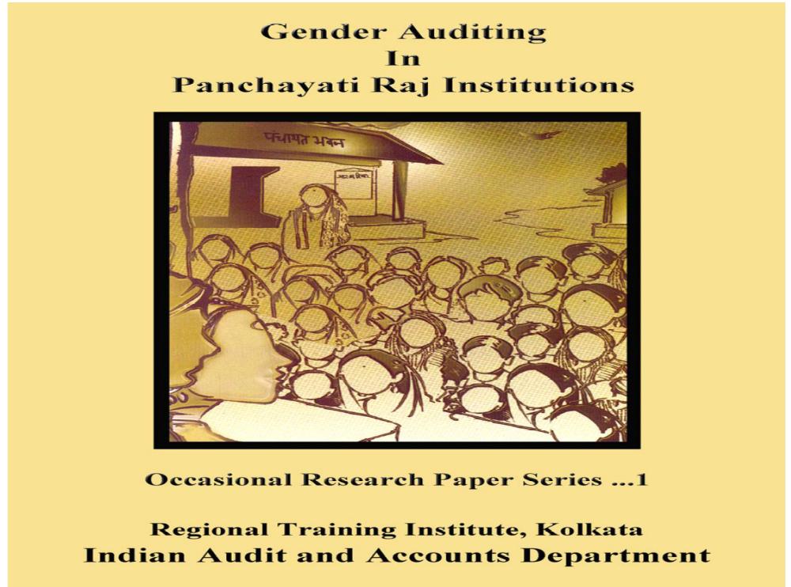

Slide 80
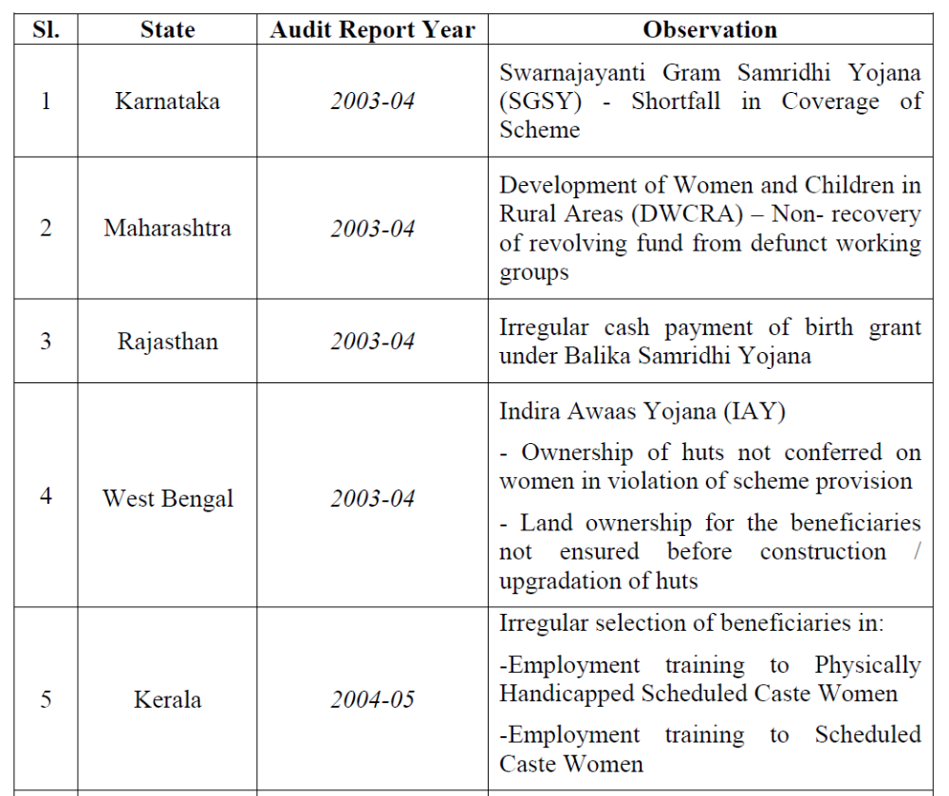

Slide 81
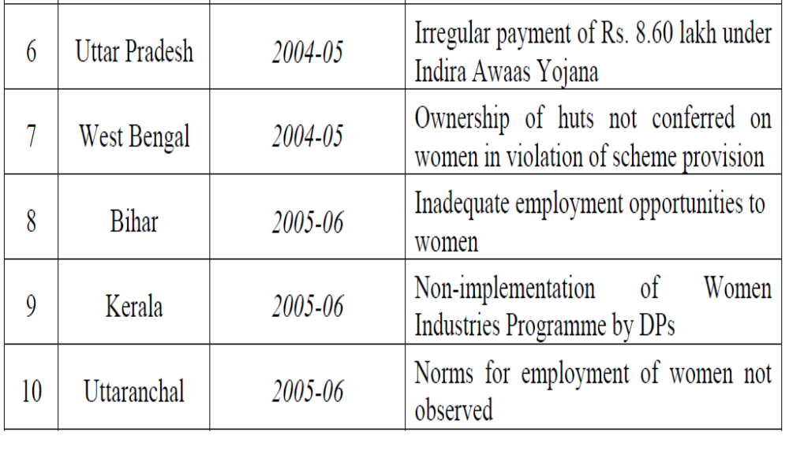

Slide 82
MAIZE Gender Audit 2013

Slide 83
Objective of the MAIZE gender audit
To make an analytical and operational contribution to the process of strengthening institutional capacity to integrate gender as an analytical tool for enhanced targeting and impact of research for development under MAIZE.

Slide 84
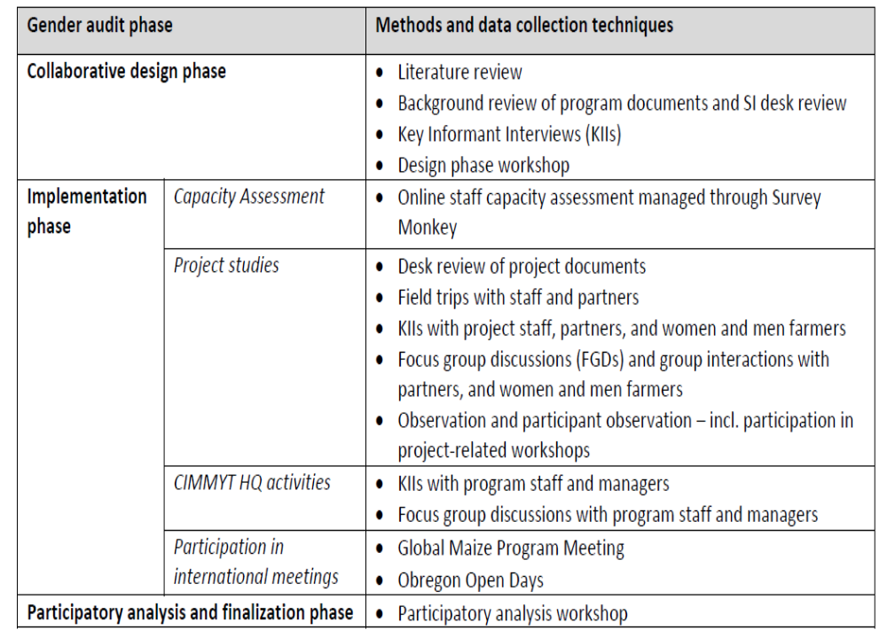

Slide 85
Understandings of gender in MAIZE
Gender is a given and cannot be changed
Gender is concerned with counting women and men without considering the inter-relations between them:
Gender roles give rise to different needs among men and women that need to be addressed in order to achieve project aims
Social relations of gender constrain women’s access to resources and benefits, which needs to be recognized and addressed in order to achieve project aims:

Slide 86
Project activities:
Efforts to integrate gender into projects under MAIZE have been observed in technology development and in brokering relationships with farming system actors. This is addressed in different ways, e.g.:
Introducing targets for women’s participation in farmers groups in on-farm trials or in training. These targets ranged from 30% - 55%.
Integrating gender considerations in breeding, particularly in conducting gender-aware Participatory Varietal Selection (PVS).
Working on or initiating steps to ‘broker relationships’ between women farmers and different actors across the maize value chain.
Working with mechanisms to link farmers, researchers and other stakeholders in such a way as to provide space for solving local problems and taking advantage of opportunities.

Slide 87
CLOSING THE “GENDER GAP”
FOR AGRICULTURE
Could increase yields on farms by 20 – 30 percent which…
Could raise total agricultural output in developing countries 2.5 – 4 percent which…
Could reduce the number of hungry people in the world by 12 – 17 percent
State of Food and Agriculture FAO 2011

Slide 88
CONCLUSION AND WAY FORWARD
Mainstreaming gender and investing in rural women will significantly increase productivity, reduce hunger, malnutrition and improve rural livelihoods.
Gender budgeting and auditing assist policy makers and implementers to evolve outcome and impact- based indicators from the perspective of gender into micro-level planning processes and thereby take corrective action to reduce gender imbalances.

Slide 89
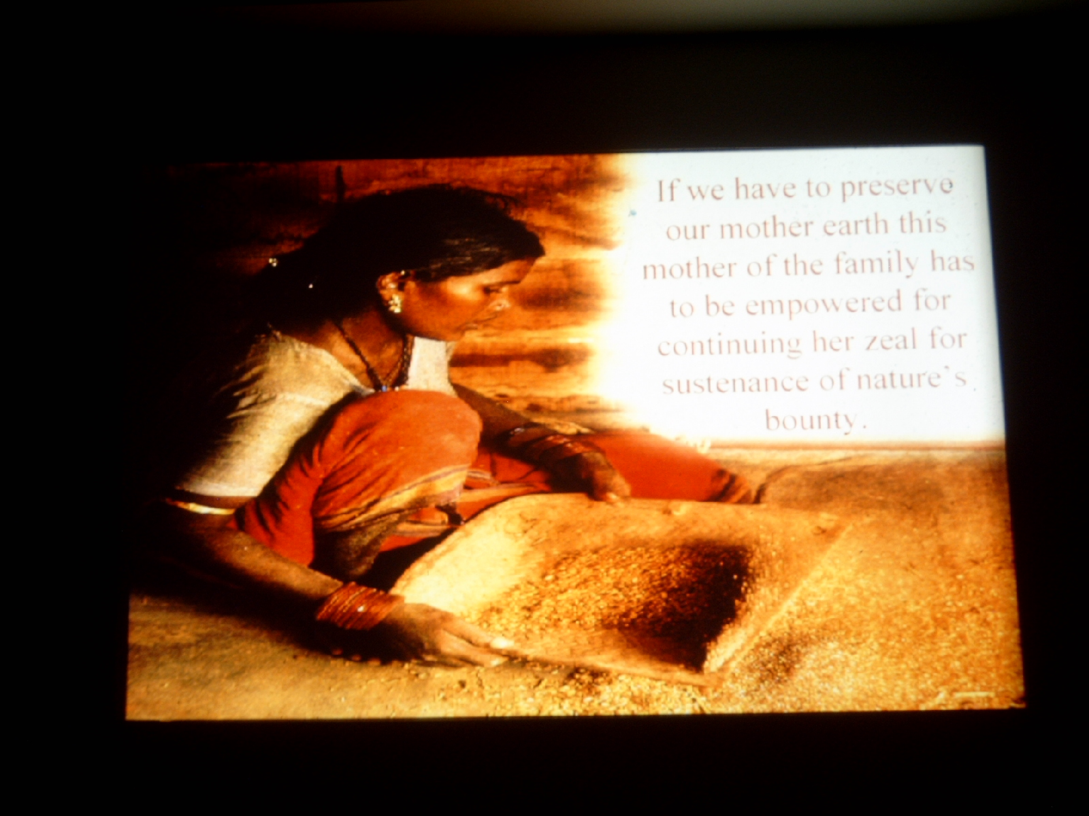
If we have to preserve our mother earth, this mother of the family has to be empowered for continuing her zeal for sustenance of nature’ s bounty.
. . . . . . . .

Slide 90
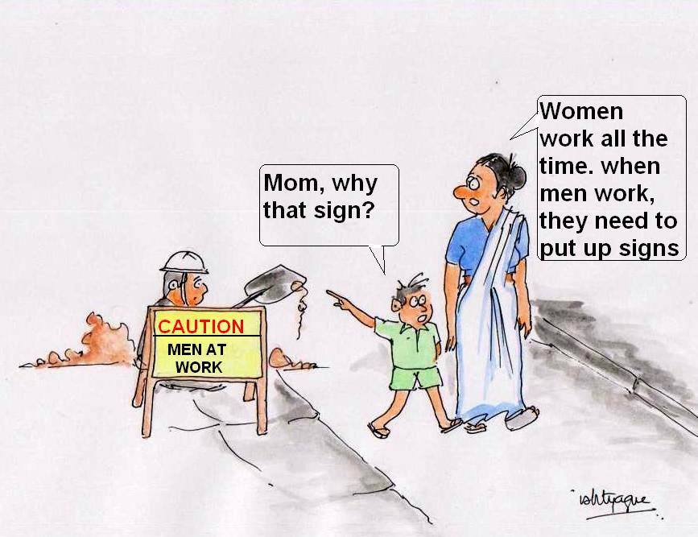

Slide 91
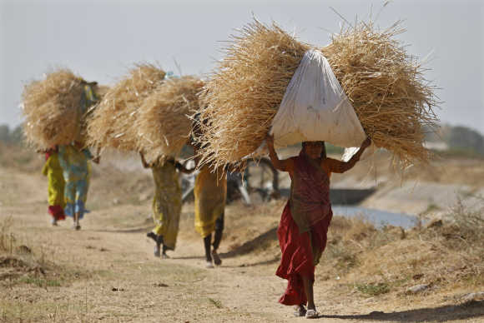

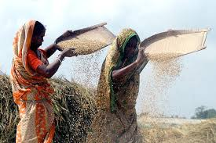
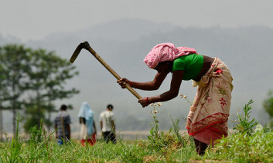
Thank You

