Slide 1
Welcome

Slide 2
Pradhan Mantri’s Initiatives for Rural Development-An overview
Presented by,
Yashashwini.M.A.
PALB3021
III Ph.D

Slide 3
Outline
Introduction
Objectives
Concept of Rural Development
Different Initiatives for Rural Development
Review studies

Slide 4
Introduction
121 crores - 83.3 crores.
70 per cent
Rural development programmes
Multidimensional process
People participation
Liberalization, privatization and globalization

Slide 5
Objectives
To know the concept of Rural Development
To know the Pradhan Mantri’s initiatives for rural development
To review the studies related to rural development programmes

Slide 6
Concept of Rural Development

Slide 7
Terminologies
Rural – is an area sparsely settled places away from the influence of large cities and towns (Abhishek Chauhan, 2014)
Development: It refers to growth, evolution, stage of inducement or progress (Abhishek Chauhan, 2014)

Slide 8
Rural Development
It is the process of improving the quality of life and economic well-being of people living in relatively isolated and sparsely populated areas (Wikipedia)
It is a strategy designed to improve the economic and social life of rural poor
(Agarwal ,1989)
Is defined as structural changes in the socio-economic situation to achieve improved living standards of low-income population residing in rural areas and making the process of their development self sustained
(Baby, 2014)
Is a process, which aims at improving the well being and self realization of people living outside the urbanized areas through collective process. (Abhishek Chauhan,2014)

Slide 9
Objectives of Rural Development
Availability and distribution of life sustaining goods
Per capita income & purchasing power
Enhanced production and productivity
Broad based community participation
Socio economic equity

Slide 10
Scope and importance of RD
Three fourth- Population
50 % national income
Seventy percent- Population
Bulk of raw materials
Political instability

Slide 11
Pradhan Mantri’s Different Initiatives for Rural Development

Slide 12
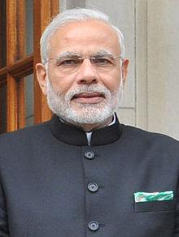
Introduction
15th PM
26 May 2014
Bharatiya Janata Party
2001 to 2014
  Reforming and modernizing India's infrastructure
  Reducing bureaucracy
  Encouraging increased foreign direct investment
  Improving national standards of Health and sanitation
  Improving foreign relations
Narendra Damodardas Modi
(born 17 September 1950)

Slide 13
Government Initiatives in India (Active)
Sl no | Category | Name of the initiative
1 | Schemes | Atal Pension Yojana, Beti Bachao, Beti Padhao Yojana, DAY, DBT, DDUGJY, DDU-GKY, DELP, HRIDAY, Housing for All, KVPY, Midday Meal Scheme, NSAP, NSS, PMAY, PMGSY, PMJDY, PMKSY, PMMY, Pradhan Mantri Jeevan Jyoti Bima Yojana, Pradhan Mantri Suraksha Bima Yojana, Pradhan Mantri Ujjwala Yojana, SAGY, Soil Health Card Scheme, SGSY
2 | Missions | AMRUT, SSA, Smart city, TB-Mission-2020, NRHM
3 | Projects | Bhartmala, Indian rivers inter link, Sagar mala, Setu Bharatam
4 | Campaigns | Digital India, Make in India, Skill India, Start up India, Swachh Bharat Abhiyan
5 | ID’s | Aadhar, BIN, PAN, RC, Voter ID, WIN

Slide 14
Pradhan Mantri’s Different Initiatives for Rural Development
Sl no | Initiative | Ministry | Year
1 | Pradhan Mantri Jan-Dhan Yojana (PMJDY) | Finance | 2014
2 | Deen Dayal Upadyaya Grameen Kaushalya Yojana (DDU-GKY) | Rural development | 2014
3 | Sansad Adarsh Gram Yojana (SAGY) | Rural development | 2014
4 | Soil Health Card Scheme | Agriculture | 2015
5 | Pradhan Mantri Mudra Yojana (PMMY) | Finance | 2015
6 | Pradhan Mantri Krishi Sinchai Yojana (PMKSY) | Agriculture & Farmers Welfare | 2015
7 | Deen Dayal Upadyaya Gram Jyothi Yojana (DDUGJY) | Power | 2015

Slide 15


Pradhan Mantri Jan-Dhan Yojana
Ministry: Finance
Launched: 28 August 2014
Website: www.pmjdy.gov.in
Status: Active
Purpose: Financial Inclusion

Slide 16
About
Financial services in an affordable manner
'Universal and clear access to banking facilities'
1.5 Crore (15 million)
“Day of financial freedom."
10 February 2016, 20 crore bank accounts and 323.78 billion amount

Slide 17
Benefits:
Interest on deposit.
Accidental insurance cover of Rs.1.00 lakh.
No minimum balance required.
Life insurance cover of Rs.30,000/-
Easy Transfer of money across India
Direct Benefit Transfer in these accounts.
6 months- an overdraft facility will be permitted
Overdraft facility up to Rs.5000/- is available in only one account per household, preferably lady of the household
RuPay Debit Card must be used at least once in 45 days.

Slide 18
Documents required to open an account
Aadhaar Card/Aadhaar Number
Voter ID Card, Driving License, PAN Card, Passport & NREGA Card.
Identity Card with applicant's photograph issued by Central/State Government Departments, Statutory/Regulatory Authorities, Public Sector Undertakings, Scheduled Commercial Banks and Public Financial Institutions
Letter issued by a gazette officer, with a duly attested photograph of the person.

Slide 19
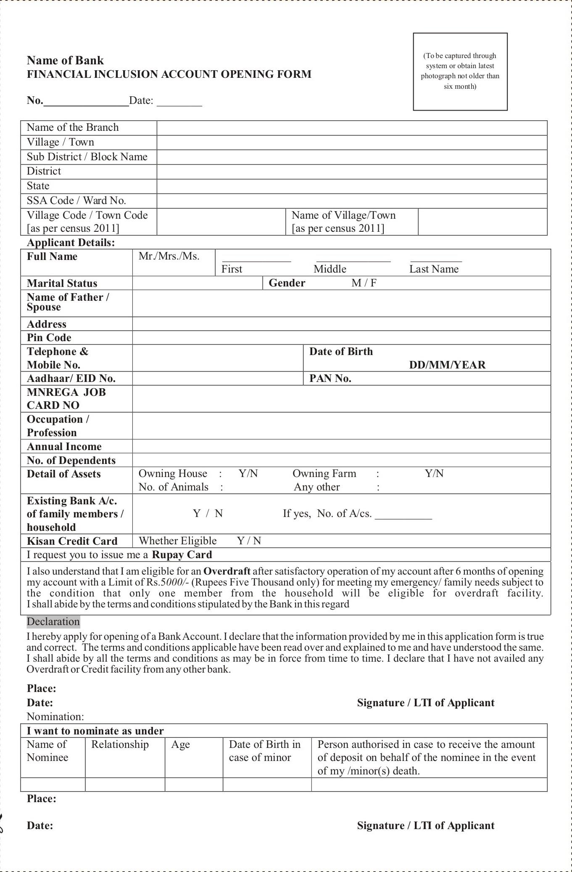

Slide 20
(Statistics as on 30 March 2016) (All Figures in Crores)
Sl.No |  | No Of Accounts |  |  | No Of RuPay Debit Cards | Aadhaar Seeded | Balance In Accounts | % of Zero Balance Accounts
 |  | Rural | Urban | Total
1 | Public Sector Banks | 9.43 | 7.42 | 16.85 | 14.32 | 8.04 | 28139.17 | 27.74
2 | Regional Rural Banks | 3.26 | 0.54 | 3.79 | 2.69 | 1.16 | 6178.12 | 23.15
3 | Private Banks | 0.48 | 0.30 | 0.79 | 0.74 | 0.30 | 1354.72 | 40.34
 | Total | 13.17 | 8.26 | 21.43 | 17.75 | 9.50 | ₹35672.01 crore(US$5.3 billion) | 27.39

Slide 21
Achievement
On 20 January 2015, the scheme entered into Guinness book of world records setting new record for 'The most bank accounts opened in one week'. (1,80,96,130)

Slide 22



Deen Dayal Upadhyaya Grameen Kaushalya Yojana or DDU-GKY
Ministry: Rural Development
Launched: 25 September 2014
Status: Active
Purpose: Youth employment scheme

Slide 23
Need
55 million potential workers(15-35 years) in rural areas
Shortage of 57 million workers by 2020
To transform its demographic surplus into a demographic dividend
To drive national agenda for inclusive growth, by developing skills and productive capacity of the rural youth from poor families.
Challenges- Competing in the modern market
Lack of formal education and marketable skills
Bridges this gap by funding training projects benchmarked to global standards

Slide 24
Features
Enable Poor and Marginalized to Access Benefits
Inclusive Program Design
Shifting Emphasis from Training to Career Progression
Greater Support for Placed Candidates
Proactive Approach to Build Placement Partnerships
Enhancing the Capacity of Implementation Partners
Standards-led Delivery

Slide 25
Beneficiary Eligibility
Rural Youth:18 - 35 Yrs
SC/ST/Women: up to 45 Yrs

Slide 26
Implementation Model
3-tier implementation model
  National Unit -policy-making, technical support and facilitation agency
  State Missions -implementation support
  Project Implementing Agencies -implement the programme

Slide 27
Training Requirements
It funds a variety of skill training programs - 250 trades
Demand based and 75% placement of the trainees
Curriculum and norms (National Council for Vocational Training and Sector Skills Councils)
Employability and soft skills, functional English and functional Informational technology literacy

Slide 28
Achievement:
Applicable to the entire country.
33States- 610 districts - 202 PIAs - 250 trades
2014-15,
  10.94 lakh candidates- trained
  8.51 lakh candidates -placement.

Slide 29

Soil Health Card Scheme
Ministry: Agriculture
Launched: 17 February 2015
Website: soilhealth.dac.gov.in
Status: Active
Purpose: To issue soil cards
Slogan: "Swasth Dharaa. Khet Haraa." - Healthy Earth. Green Farm.

Slide 30

What is soil health card?
Complete evaluation of the quality of soil
Contain corrective measures

Slide 31
How does it help the farmers?
Well-monitored report of the soil
Monitoring will be done on a regular basis.
Guided by experts
Study and evaluate the results of different soil management practices.
Most helpful and effective when filled out regularly by the same person over a period of time.
To find out methods to improve soil fertility
To get an idea on the crop-wise recommendations of nutrients and fertilizers required in each type of soil.

Slide 32
The Process
Soil testing laboratories
Results analyzed by the experts
Strength and weaknesses of the soil
Experts suggest methods to improve the soil quality
Results and suggestions are displayed in the soil health cards.

Slide 33
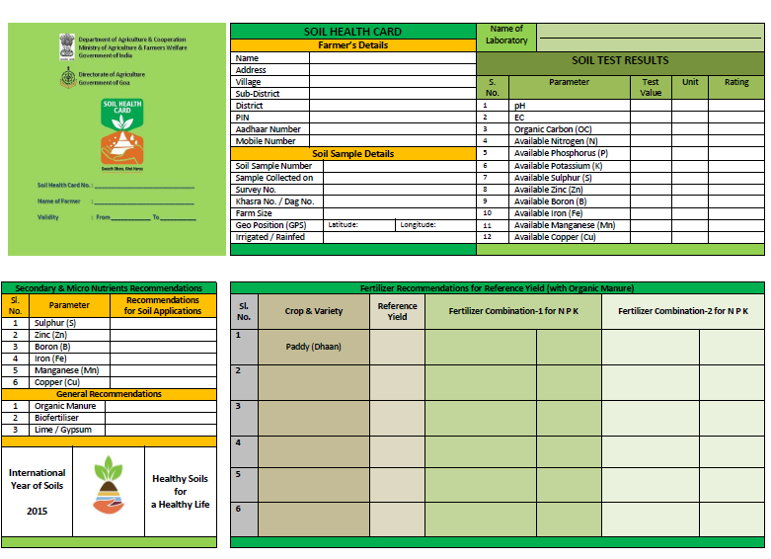

Slide 34
Achievement
34 lakh cards have been issued (July 2015)
Andhra Pradesh
Soil health card agriculture portal (soilhealth.dac.gov.in)
  Soil Samples Registration
  Test Results by Soil Testing Labs
  Fertilizer and Nutrients Recommendations
  Soil Health Card generation
  MIS module for monitoring progress

Slide 35

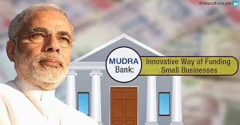
Pradhan Mantri Mudra Yojana
Ministry: Finance
Launched: 8 April 2015
Website: www.mudra.org.in
Status: Active
Purpose: Facilitate the micro units

Slide 36
What is the MUDRA Yojana?
Small businesses are often unable to avail loans from banks
577 crore small businesses
Micro Units Development and Refinance Agency (MUDRA)
To provide loans to small businesses and micro institutions.

Slide 37
Objectives
Policy guidelines to finance micro/small enterprises
Register and regulate
Grow and develop their enterprise further.
Lower income groups in setting up and developing their business.
Easy access to finance
To give SC/ST preference in lending.
Manufacturing, service and trading.

Slide 38
Three stages:
Shishu:
Loan up to Rs.50,000
Kishor:
Rs.50, 000 up to Rs.5 lakh.
Tarun:
Rs.5 lakh to Rs.10 lakh.

Slide 39
Who is eligible for loan under MUDRA Yojana?
Small businesses and enterprises
Proprietary/partnership
Manufacturing units

Slide 40
How to apply for a loan under MUDRA Yojana?
Public and private sector banks
Prepared a proper business plan
  All Scheduled Commercial Banks in public and private sector.
  Regional Rural Banks
  All Micro Finance Institutions (MFI), small business finance companies
  Scheduled urban and state co-operative banks
MUDRA card

Slide 41
Documents required for applying for loan under MUDRA Yojana?
Self attested proof of identity -2 photographs.
Quotation of items and machinery to be purchased
Details of suppliers and machineries
Identity of ownership of business and business address along with copies of necessary licenses and certificates.
Proof of category life SC/ST and others if any.

Slide 42
Benefits
Application fee for loan is not required
Its interest rate is only 1%
Easy access
Systematic guidelines
Low cost of finance
Mudra Loan Android Mobile App

Slide 43


Pradhan Mantri Krishi Sinchai Yojana
Ministry: Agriculture & Farmers Welfare
Launched: July 2015
Website: http://www.gktoday.in/blog/pradhan-mantri-krishi-sinchai-yojana/
Status: Active
Purpose: Protective irrigation to agricultural farms
Slogan: Har Khet ko Pani
      More crop per drop

Slide 44
About
Farm productivity and better utilization of the resources
Budget -500 billion-five years

Slide 45
Objectives
Attract investments in irrigation system
Develop and expand cultivable land in the country
Enhance ranch water use
Enhance crop per drop
Precision irrigation.

Slide 46
Process
  Accelerated Irrigation Benefit Programme (AIBP)
  Integrated Watershed Management Programme (IWMP)
  On Farm Water Management
Decentralized State level planning
District Irrigation Plan (DIP) and State Irrigation Plan (SIP)
State Level Sanctioning Committee (SLSC)
For 2015-16, an outlay of Rs.5300 crore has been made

Slide 47


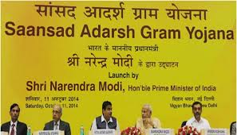
Saansad Adarsh Gram Yojana
(SAGY)
Ministry: Rural development
Launched: 11th October 2014
Website: www.saanjhi.gov.in
Status: Active
Purpose: Translate comprehensive and organic vision of Mahatma Gandhi into reality

Slide 48

Objectives:
1. Holistic development of identified Gram panchayaths.
2. To improve the standard of living and quality of life of all the sections of the population.
3. To generate a models of local level development and effective local governance
4. To nurture the identified Adarsh gram as school of local development to train other gram panchayaths.

Slide 49
Key features
Adopting people’s participation
Adhering the Anthyodaya
Gender equality and ensure respect for women
Guaranteeing social justice
Dignity of labour and spirit of community service and voluntarism.
Promoting a culture of cleanliness
Nurturing local self government
Preserving and promoting local cultural heritage.
Inculcating mutual co-operation, self help and self-reliance

Slide 50
Identification of villages
MPs can select any gram panchayat
3000-5000 people –plains
1000-3000 people -hilly areas.
Lok Sabha MPs -their constituency
Rajya Sabha MPs from the state
Nominated members -any district of the country.
MPs which represent urban constituencies- neighboring rural constituency.

Slide 51
Funding
Funds from existing schemes
2. The Member of Parliament Local Area Development Scheme (MPLADS)
3. The gram Panchayat’s own revenue,
4. Central and State Finance Commission Grants
5. Corporate Social Responsibility funds.

Slide 52
Implementation
A Village Development Plan
Develop a list of activities to be carried out
Monitoring
A web based monitoring system
Outputs relating to physical and financial targets will be measured each quarter
A mid-term evaluation and post-project evaluation will be conducted through an independent agency.

Slide 53
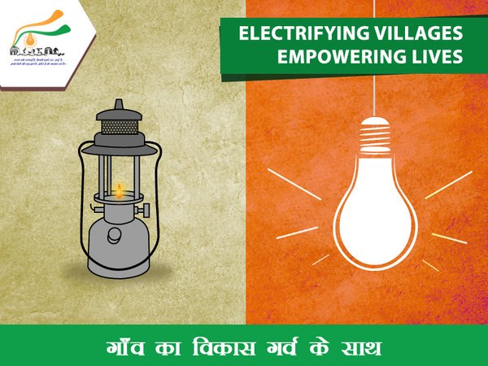
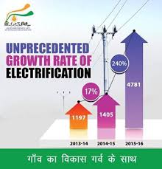

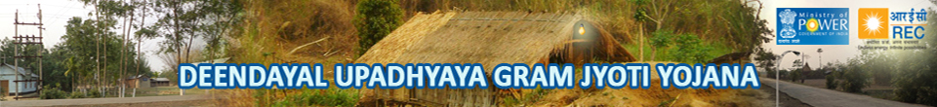
Deen Dayal Upadhyaya Gram Jyoti Yojana (DDUGJY)
Ministry: Power
Launched: 25th July 2015
Status: Active
Purpose: Continuous power supply to rural India.

Slide 54
Need
Serviced through the local distribution network.
Insufficient electricity supply
Load shedding
The demand of power
The investment in the distribution network is low
Reliability and quality of supply distribution network needs to be strengthened.
To improve the commercial viability of power distribution
756 billion for rural electrification under this scheme.

Slide 55
Objectives:
To provide electrification to all villages
Feeder separation to ensure sufficient power to farmers and regular supply to other consumers
Improvement of Sub-transmission and distribution network to improve the quality and reliability of the supply
Metering to reduce the losses

Slide 56
Benefits
All villages and households shall be electrified
Increase in agriculture yield
Business of Small and household enterprises
Improvement in accessibility;
  Health, Education, Banking (ATM) services
  Telephone, television, internet and mobile etc.
  Schools, panchayats, hospitals and police stations etc.
Betterment in social security due to availability of electricity
Rural areas shall get increased opportunities for comprehensive development

Slide 57
Review Research Studies

Slide 58
Impact Analysis of Mahatma Gandhi National Rural Employment Guarantee Act in Dhalai district of Tripura.
Roy (2009)

Slide 59
Attitude of beneficiaries towards MGNREGA programme
(n=150)
Sl no | Attitude categories | MGNAREGA beneficiaries
 |  | Number | Percent
1 | Unfavourable | 21 | 14.00
2 | Neutral | 54 | 36.00
3 | Favourable | 75 | 50.00
 | Total | 150 | 100.00
Mean=41; SD=9.17

Slide 60
Awareness and Impact of SGSY on women beneficiaries and their attitude towards the programme.
Vanitha Chethan (2002)

Slide 61
Table 1 : Categorization of women beneficiaries based on their overall awareness about SGSY
(n=120)
Category | No | Percent | Mean | F-test value
Partially aware | 40 | 33.33 | 25.40 | 95.07*
Reasonably aware | 34 | 28.33 | 37.82
Highly aware | 46 | 38.33 | 50.46
*Significant at 5 per cent level

Slide 62
Table 2 Distribution of women beneficiaries of SGSY based on the employment generation
(n=120)
Category | No | Percent | Mean | F-test value
Low | 63 | 52.70 | 155.72 | 64.70**
Medium | 17 | 14.17 | 220.34
High | 40 | 33.33 | 348.01
**Significant at 1 per cent level

Slide 63
Impact of MGNAREGA on women beneficiaries in Bangalore rural District.
Bhuvana.N. (2013)

Slide 64
Attitude level of Women beneficiaries towards MGNAREGA programme
(n=120)
Attitude level | Score | Respondents
 |  | No | Percent
Unfavourable | <88.22 | 35 | 29.20
Moderate | 88.22-95.42 | 54 | 45.00
Favourable | > 95.42 | 31 | 25.80
Mean=91.82; SD=7.2

Slide 65
A study on attitude and empowerment of MGNAREGA beneficiaries in Kalaburagi District of Karnataka
Sunil (2015)

Slide 66
Overall attitude of beneficiaries towards MGNAREGA
(n=120)
Sl no | Attitude categories | MGNAREGA beneficiaries |  | Mean | SD
 |  | No | Percent | 91.28 | 09.77
1 | Unfavourable | 40 | 33.33
2 | Undecided | 46 | 38.33
3 | Favourable | 34 | 28.33

Slide 67
Conclusion
Development intervention
Restructured and revamped
Issues and challenges
Convergence
Capacity building & skill up gradation

Slide 68
Thank you…

