Slide 1



Slide 2

SEMINAR – 1
DEVELOPMENT COMMUNICATION - METHODOLOGICAL FRAMEWORK AND ITS APPLICATIONS
PRESENTED BY ASWATHY CHANDRAKUMAR
PALB 4112

Slide 3

OBJECTIVES
To conceptualise the evolution of interdisciplinary field of Development Communication and provide an overview of the main theoretical frameworks.
To study the wide range of methodological and practical applications of Development Communication.
To document the way Development Communication is positioned and applied at the World Bank.
To review related case studies.

Slide 4

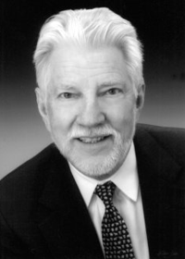
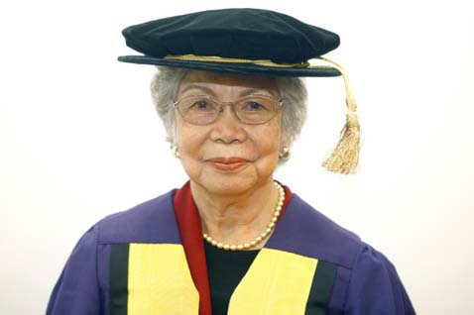
INTRODUCTION
The term “Development Communication’’ was first coined by Nora C. Quebral in 1972.
“Art and science of human communication linked to a society’s planned transformation from a state of poverty to one of dynamic socio-economic growth that makes for greater equity & the larger unfolding of individual potential.”
Development Communication is the integration of strategic communication in development projects
(World Bank)
EVERETT ROGERS –FATHER OF DEVELOPMENT COMMUNICATION

Slide 5
REFLECTIONS ON THE THEORIES AND PRACTICE OF DEVELOPMENT COMMUNICATION

Slide 6
BRETTON WOODS
LATIN AMERICAN
INDIAN
LOS BANOS
AFRICAN
PARTICIPATORY

Slide 7
3 PARADIGMS

Slide 8
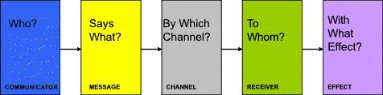
MODERNIZATION PARADIGM
Central idea – modernize underdeveloped countries
Communication = dissemination of information and messages aimed at modernizing “backward” countries and their people.
relied heavily on the traditional vertical one-way model:

Slide 9

Heavy emphasis on media owing to the belief that it could change people’s mindsets and attitude, when used properly.
Hypodermic Needle Theory
UNESCO, for example, considered media to be a crucial means for promoting change, and in the 1960s, it provided guidelines about a country’s desirable per capita consumption of television sets, radio receivers, newspapers, and cinema seats.

Slide 10
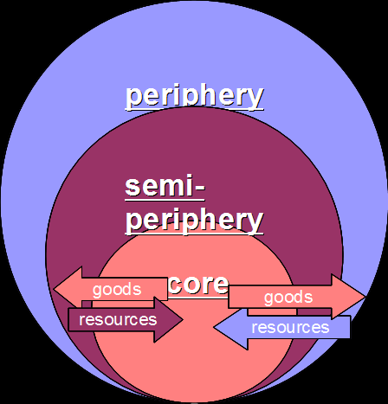
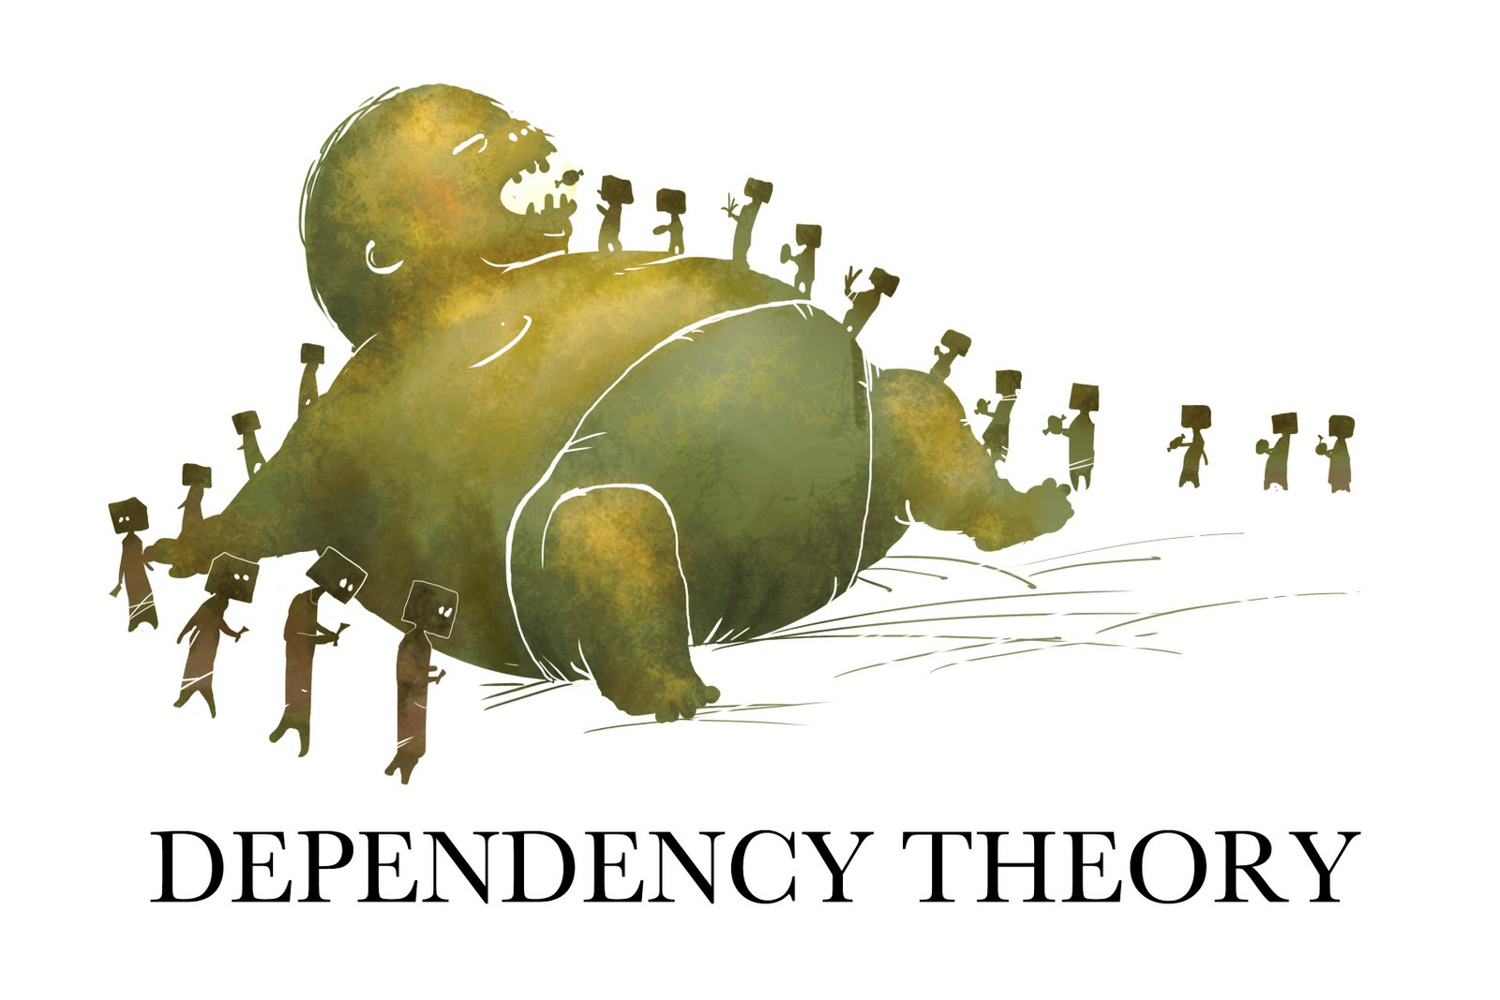
DEPENDENCY AND WORLD SYSTEMS THEORY
Originated in Latin America.
A.G. Frank (1969) considered development and underdevelopment as two sides of the same coin.
Imbalances in the world’s state of affairs were mainly owing to the international division of labor and to the continuation of past patterns of domination.

Slide 11
Uneven flow of media and information from rich countries.
At the national level, failed to give proper attention to the potential of privately owned media and community media.
Did not consider and support the wider role of “freer” communication systems
Despite significant differences between modernization and dependency theories, their communication model was basically the same:
a one way communication flow

Slide 12
PARTICIPATORY PARADIGM
Participatory paradigm
Emphasis on people
Endogenous vision of development
Attention to power and rights issues
Development efforts have been refocused to increasingly engage stakeholders
New priorities, well beyond the economic dimension, are paid attention to.

Slide 13

Mefalopolus identified 4 types of participation (2003)
1.
PASSIVE PARTICIPATION
Attend meetings to be informed
2.
PARTICIPATION BY CONSULTATION
Stakeholders are consulted but decision made by experts
3.
FUNCTIONAL PARTICIPATION
Stakeholders put some input
4.
EMPOWERED PARTICIPATION
Participation throughout development

Slide 14
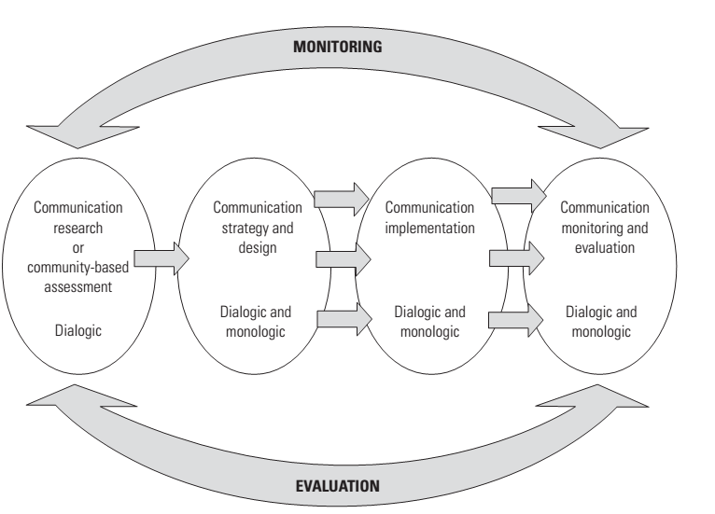
THE MULTITRACK COMMUNICATION MODEL
Monologic
Dialogic
2 modes of communication

Slide 15
BASIC PRINCIPLES OF DEVELOPMENT COMMUNICATION
1. Dialogic
relevant stakeholders have their voices heard and that project priorities are aligned with people priorities.
2. Inclusive
identifies, defines, hears, and understands relevant stakeholders
3. Heuristic
solving problems during the initial phases of a development initiative is essential.

Slide 16
4. Analytical
Going beyond communicating
5. Contextual
No precooked universal formula applied a priori in development communication
6. Persuasive
To induce voluntary changes in individuals.

Slide 17
Results
Monitoring & Evaluation
Activities implementation
METHODOLOGICAL FRAMEWORK
Strategy design
Communication – based assessment
(monitoring and evaluation)

Slide 18
Bird’s eye view of the overall
situation is gained.
a type of field research
It utilizes principles and tools to facilitate dialog, build trust, analyze political risk, and assess conditions to identify entry points for the communication strategy.
CBA is always necessary to design an effective communication strategy.
Flexible instrument
1. COMMUNICATION BASED ASSESSMENT

Slide 19
EFFECTIVE DIALOG FOR SUSTAINABLE CHANGE
The value of dialog leading to change can be seen in a visual image known as the Johari Window.
Developed by Joseph Luft and Harry Ingham
Used to map interaction leading to change at a broader level (Anyaegbunam et al. 2004)
Window 1: OPEN KNOWLEDGE What We know and They know | Window 3: THEIR HIDDEN KNOWLEDGE What They know and We do not know
Window 2: OUR HIDDEN KNOWLEDGE What We know and They do not know | Window 4: THE BLIND SPOT What neither We nor They know
MOST CRITICAL

Slide 20
STEPS IN CBA
1.Become acquainted with key issue
4. Probe problems, causes, risks and opportunities
3. Assess communication networks
2. Build trust
7. Transform best solutions in objectives
5. Assess and rank options and solutions
6. Validate extent of problem

Slide 21
Free discussions
In – depth
Semi - structured
INTERVIEWS
FOCUS GROUP DISCUSSIONS
PRCA
Tools for CBA
BASE - LINE SURVEYS
OPINION POLLS
SURVEYS

Slide 22
PRCA
4 SEQUENTIAL STEPS IN PRCA
to warm up, get to know each other and build trust among stakeholders;
to know the community better
to assess the situation
to identify the best options and opportunities that can be addressed through communication
Participatory Rural Communication Appraisal was first developed in Africa to promote the use of participatory communication in the Southern Africa Development Community (SADC) region.
Strong horizontal connotations in communication issues
PRCA can be defined as an empowerment communication research approach,
based on dialog

Slide 23
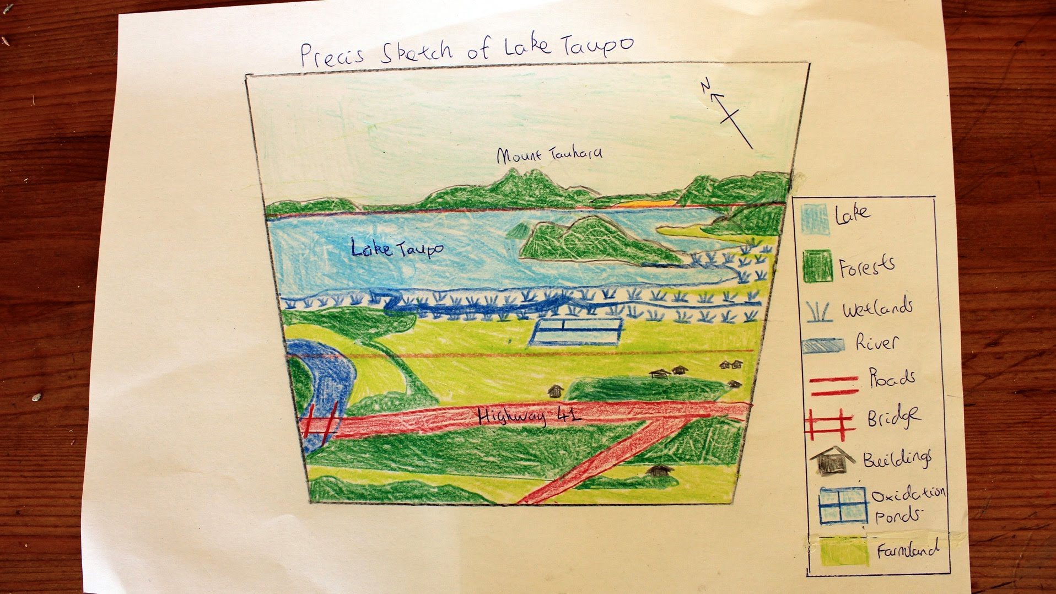
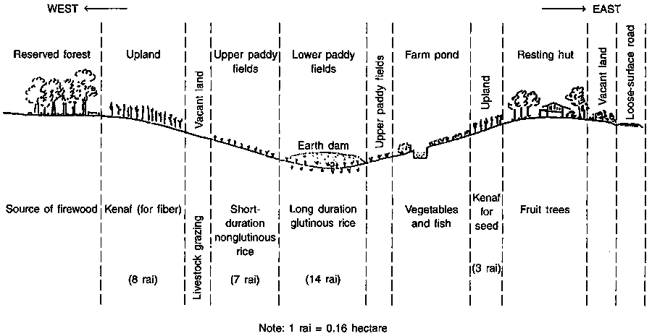
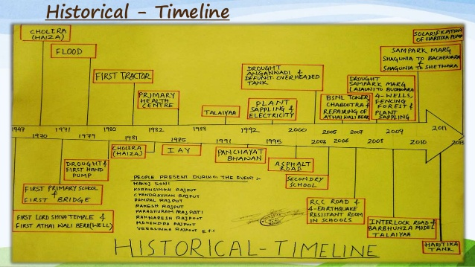
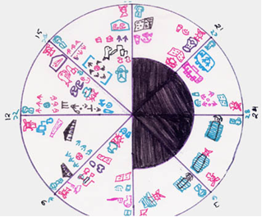
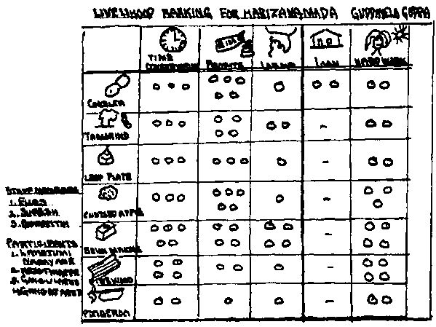
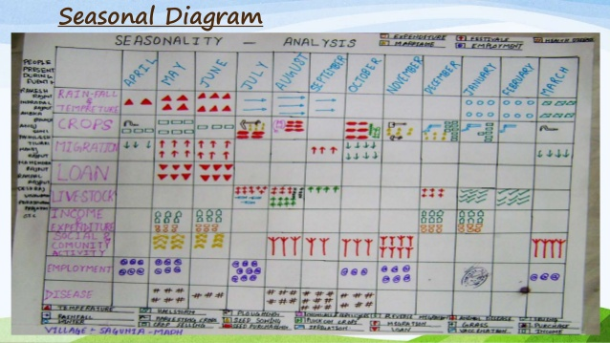
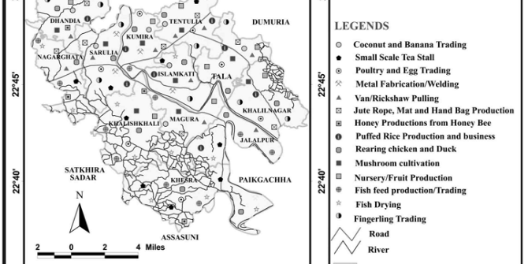
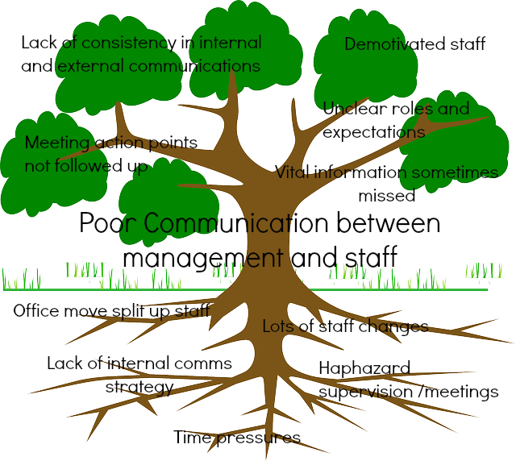
TOOLS USED IN PRCA
Sketch Map
Transect Walk
Time lines
Seasonal Calendars
Problem Tree
Ranking
Livelihood map
Venn Diagram

Slide 24
The idiomatic expression “jumping the gun” (starting a race before the signal to begin) represents one of the most common flaws in the application of communication interventions; that is, a strategy design is created without analyzing the situation properly and understanding all of the crucial issues and perceptions of the various groups (Anyaegbunam et al. 2004)
2. COMMUNICATION STRATEGY DESIGN

Slide 25
EXAMPLE
Problem as defined by management | Main Causes of the problem | Stakeholder’s perspective / AKAB | Solution / Change needed / objective
Deforestation caused by fires | Farmers using fires to clear their fields | Not sufficiently known. | Persuade farmers to stop burning the field
Baseline survey conducted – No specific intention to burn the forests.

Slide 26
MAIN STEPS OF COMMUNICATION STRATEGY DESIGN
BASIC STEP | MAIN ACTIVITIES | PRACTICAL EXAMPLE
1. Definition of SMART objectives (reviewing focal problem and its causes) | Solutions transformed ) into objectives in a Feasible and measurable way | Reduction in the incidence of forest lost due to uncontrolled fires by 80% within next two years
2. Definition of primary stakeholders (1SHs and secondary audiences and stakeholders (2SHs | Define and probe main groups of interest or audiences, including those indirectly related | Local farmers (their cultural ) and socioeconomic context), their families, other ) local actors, NGOs, and to the issues governmental agencies.
3. Definition of type/level of change | Define if change is related to awareness, knowledge, attitudes, behaviors, mobilization, collaboration, or mediation | For 1SHs: improve knowledge and skills of fire control techniques For 2SHs: raise awareness

Slide 27
4. Define communication approaches or tactics | Select the most effective communication approaches (linear or interactive mode) | For 1SHs: capacity building, technical training For 2SHs: awareness raising media campaign
5. Select channels or media | Select most appropriate media for 1SHs and 2SHs | For 1SHs: use preferred sites and venues to provide information For 2SHs: select appropriate media mix in that context
6. Design messages or content topics | Define key content message and the most effective way to package them | For 1SHs: instructional design, key technical issues For 2SHs: messages for raising awareness and knowledge
7. Expected results once the strategy is carried out | Set goal for 1SHs: a change in behaviors to reduce forest destruction Set goal for 2SHs : raising the awareness about the importance of conservation | 1SHs: adopt more secure techniques to reduce incidence of uncontrolled fires 2SHs: become more aware of the importance or benefits of preserving the forest

Slide 28
SOCIAL MARKETING
“strategy,” however, denotes the overall design of the communication program, which might include one or more communication approaches and objectives.
ADVOCACY
INFORMATION DISSEMINATION & CAMPAIGNS
INFORMATION, EDUCATION, AND COMMUNICATION
INSTITUTIONAL STRENGTHENING
COMMUNITY MOBILIZATION
NONDIRECTIVE PARTICIPATORY COMMUNICATION

Slide 29
Five Management Decisions
Situation Analysis Framework
Logical Analysis Framework

Slide 30
FIVE MANAGEMENT DECISIONS
Audience
Behaviour
Message
Channel
Evaluation Indicators
Developed by Cabañero-Verzosa, in order to highlight the link between management objective and communication objective.
Used in monologic / diffusion mode.
It addresses five basic communication concepts, closely resembling the Lasswell (1948) five question model : WHO, says WHAT, in WHICH channel, to WHOM, with what EFFECT.

Slide 31
Implement the work plan and to produce and distribute media and information products.
Communication Objectives
Pretesting the communication material
Drawing up the action plan
3.
IMPLEMENTING THE COMMUNICATION PROGRAMME

Slide 32
Communication Tools for Implementation
Tools used in this phase relate mostly to the specific media selected (for example, print, radio, video), and on the training needed to carry out the successful implementation of the activities.
Aware of the potentials of each medium and the criteria for its best utilization

Slide 33
Evaluation can be defined as the process of determining whether, and to what extent, a certain intervention has produced the intended result (Babbie 2002).
4.
COMMUNICATION FOR MONITORING AND EVALUATION
Formative Evaluation
Summative Evaluation

Slide 34
WHAT & HOW TO MEASURE
Identify key indicators from the start
It is important to consider and to assess if and how external variables have influenced the outcome
As stated by Mazzei and Scuppa (2006), communication objectives are either about changing specific knowledge, attitudes, and behaviors or practices in individuals and groups of individuals, or they are about improving the degree of mutual understanding, social and cultural exchange, or the cooperation among different groups of stakeholders, engaging them in the development initiative.

Slide 35
BASICS OF EVALUATION DESIGN
01
EXPERIMENTAL DESIGNS
02
QUASI – EXPERIMENTAL DESIGNS
03
QUALITATIVE RESEARCH DESIGNS
04
Text Title
Place your own text here
According to Babbie (2002), “the most effective evaluation research is one that combines qualitative and quantitative components.”

Slide 36

DEVELOPMENT COMMUNICATION SERVICES AND EXPERIENCES AT THE WORLD BANK

Slide 37
A Division in the External Affairs, Communications and United Nations Affairs Vice-Presidency. Primary clients are Bank operational staff and client country personnel. Capacity to work in 18 languages, delivering programs in 7 languages.

Slide 38

DevComm Mission
To ensure that development interventions incorporate political, social and cultural diagnosis in their design and implementation.
To ensure that communications becomes a pillar of development that supports:
    better development outcomes
    real political participation in decision making
    the information base for policy design options
    an instrument for creating awareness of development priorities

Slide 39
Scaling up Communications for Operational Results
Internal
Communication
Creating a common platform for messages and programs
Institutional Communication
Communicating what we do and how we do it; building trust in the institution and support for development.
Advocacy
Communication
Issue campaigns to accelerate action on key global public goods – including at the country level
Development Communication
Integrating communications and assessing political and development risks for more effective strategy and design leading to better outcomes

Slide 40
Communication in Operations
Public Opinion
Research
Knowledge and Learning
DevComm work is organized into three service lines

Slide 41
Communication in Operations
Application of communication approaches and methods for behavior and social change in different projects.
DevComm is actively involved in more than 100 projects a year in various sectors
A number of trust-fund donations from donor countries are received to augment its capacity.
Communication for Sustainable Development in Operations Unit
Communication for Governance and Accountability Program
Partnership Building

Slide 42
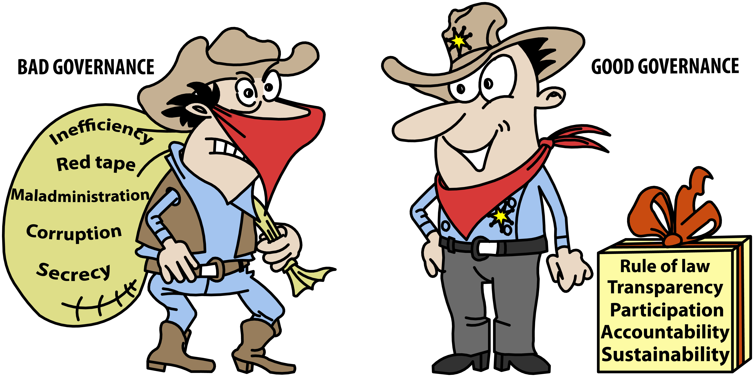
CommGAP
Training and capacity building
Research and advocacy
Support to operations
Good Governance
Seeks to promote good
and accountable governance

Slide 43
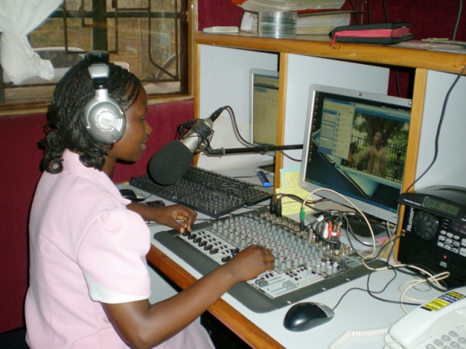
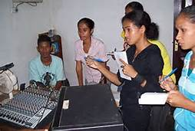
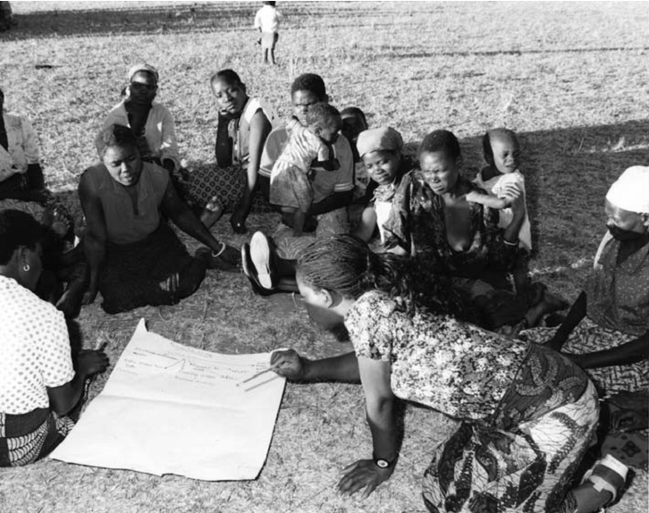
DevComm-SDO
WOMEN’s PARTICIPATION IN COMMUNITY RADIO – TIMOR LESTE
Created in 2001 with a mandate to mainstream development communication into development projects and programs.
DevComm-SDO was instrumental in carrying out the first World Congress on Communication for Development, which took place at FAO headquarters in Rome, on October 25–27, 2006.
COMMUNITY RADIO IN KENYA

Slide 44
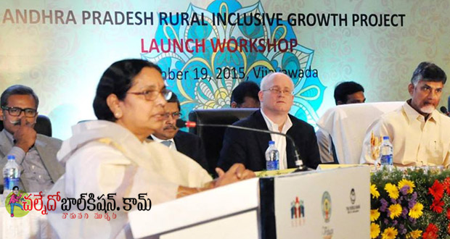
ANDHRA PRADESH RURAL INCLUSIVE GROWTH PROJECT
To enhance agricultural incomes and ensure increased access to services related to health, nutrition, sanitation and social entitlements.
Focus on small and marginal farmers, especially from Scheduled Caste (SC) and Scheduled Tribe (ST)
Enhance market access for farmer
To exploit growth opportunities for high value commodities and significant investments in ICT and mobile-based service delivery systems.

Slide 45

Responsible for partnering with UN agencies, bilateral donors, think tanks, foundations, academia, and other international financial institutions
To enhance the use of communication to promote effectiveness in development programs and projects.
To produce global public goods in communication that everyone can use
Partnership Buildidng

Slide 46
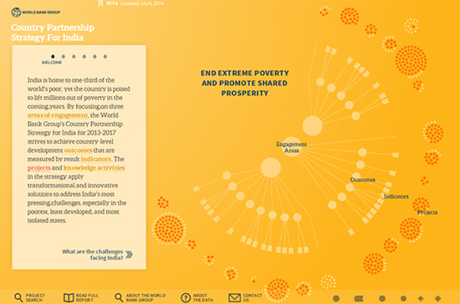
LAUNCH OF OpenIndia
Lays out the World Bank Group's entire India program in a transparent and easy-to-use manner.
Allows the user to learn about the country's development challenges and track the World Bank Group's (WBG) programs to address them.

Slide 47

Public Opinion Research
2.
Design, management, and development of polls at a global level as well as opinion research initiatives across the Bank.
Focuses on external constituents—clients and other stakeholders.
Client surveys tailored to the needs of the country.

Slide 48

Knowledge and Learning
3.
Conduct courses on communication to support lending operations and knowledge products
offers distance-learning courses and operational customized workshops.
helps Bank staff, governments, and other local partners enhance their capacity to implement and sustain communication activities.
this unit is also engaged in collecting, systematizing, and sharing knowledge

Slide 49
DevComm Portfolio by Sectors—OctoberFY04 [total = 93 projects]
SOURCE – www.worldbank.org

Slide 50
DevComm Portfolio by Sectors—JUNE FY06
(Total = 126)
SOURCE – www.worldbank.org

Slide 51

The World Of Practice : Some Experiences

Slide 52
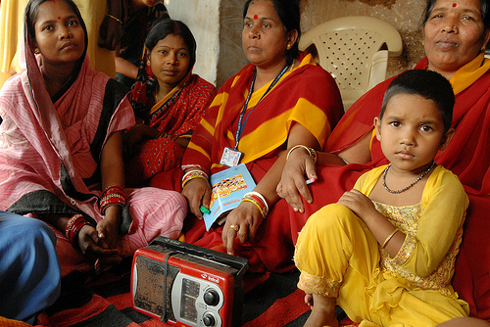
1. Participatory Communication
Entertainment - education radio soap opera in India
Parasocial interactions
Horizontal conversations
Collective listening groups

Slide 53

2. Communication for better Public Services
Surveys have shown that between 80-90% of Sanglap audiences believe the programme has improved political debate, helped raise the 'voice of the people', especially those from deprived backgrounds, and established a good standard for political discussions programmes on TV and radio
(Prosser 2008)

Slide 54

3.Communication and Governance
Newspaper campaign in Uganda successfully prompted greater transparency on the part of the government.
Flow of funds increased dramatically – from an average of 13 percent reaching schools in 1991 –95 to about 80 percent in early 2001
(Reinikka and Svensson, 2004)

Slide 55
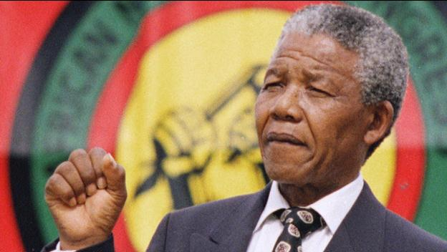
It is people that make the difference

Slide 56
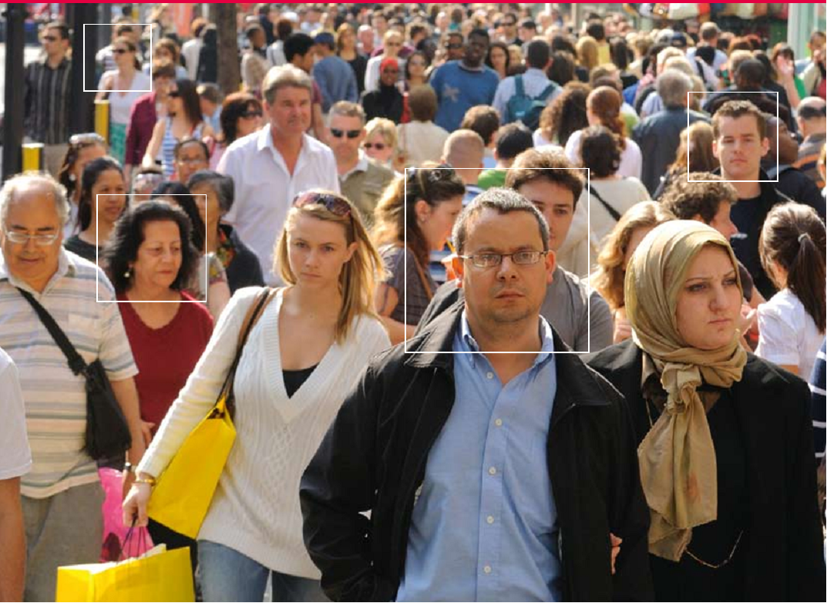
CONCLUSION
Communication is about people. Communication for Development is essential to making the difference happen.

Slide 57


