Slide 1

Welcome

Slide 2
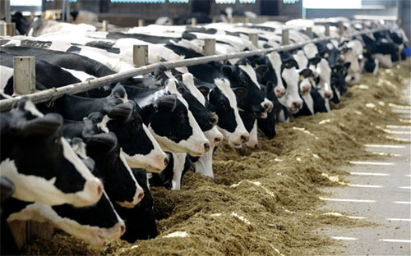
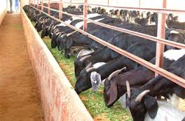
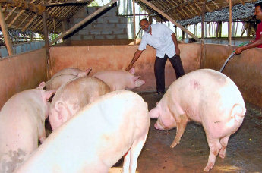
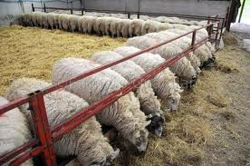
Second seminar on
Benefits of subsidiary occupations and training needs of farmers

Slide 3
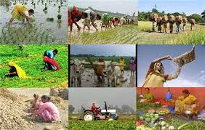
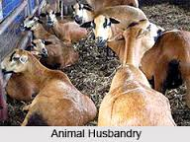
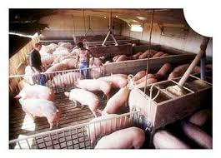
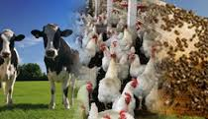
Introduction
Agriculture throughout the world is still single most important human occupation.
The crop production is not always helpful to farmers to improve their livelihood status or the betterment of their socio-economic conditions.
Hence, it is imperative to develop strategies that enable adequate employment, income generation and livelihood improvement through subsidiary occupations.

Slide 4
Objectives
To know different subsidiary occupations and their benefits.
To understand the training needs of farmers practicing subsidiary occupations.
To review case studies/ research.

Slide 5
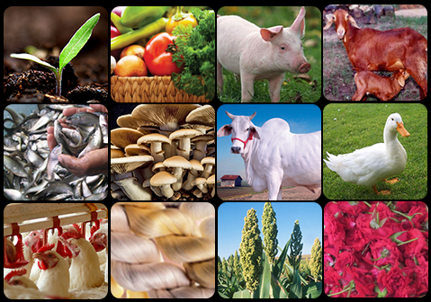
Subsidiary Occupation
The subsidiary occupations are the additional income generating activities.
Providing more employment opportunities, make optimum use of available resources and complete use of the by-products obtained from the farming activities.

Slide 6

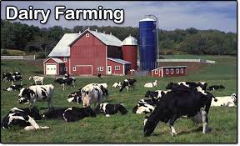
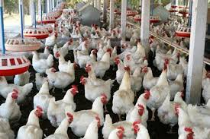
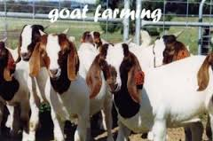

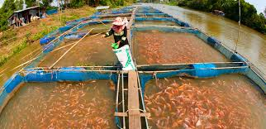
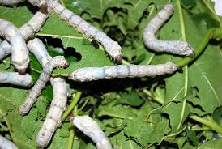
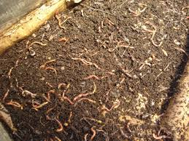
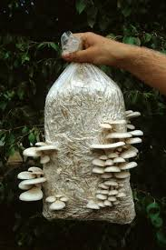
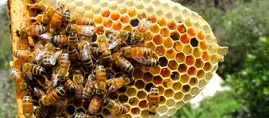
Important subsidiary occupations
Dairy farming
Poultry
Sheep/ goat rearing
Fishery
Sericulture
Apiculture
Mushroom cultivation
Vermi composting
Custom hiring of farm machineries and implements etc.

Slide 7
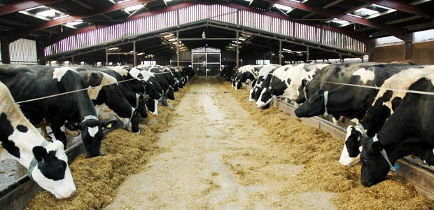
Dairy farming
Important source of generating additional income to small farmers as well as landless agricultural labourers.
It is also environment friendly
The surplus fodder and agricultural by-products may be successfully utilized by feeding animals.

Slide 8
Scope of dairy farming
India is endowed with the largest livestock population in the world.
Accounts for about 57.3 per cent of the world’s buffalo population and 14.7 per cent of the cattle population.
The value of output of milk is Rs. 3,05,484 crore in 2011-12. The total milk production in the country is 127.9 million tonnes per annum at the end of the Eleventh Plan (2011-12) and the demand is expected to be 180 million tonnes by 2020.
To achieve this demand annual growth rate in milk production has to be increased from the present 2.5 % to 5%. The Annual growth rate for production of milk is about 5% in 2011-12.

Slide 9
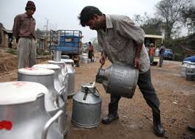
Advantages of dairy farming
Dairy industry is not reliant on rainfall.
The amount at which milk is marketed in the market place has never gone down.
The need for milk has always improved. Intake of dairy is increasing by both vegans and non-vegetarians.
Dairy agriculture is the only industry where earnings are assured for 30 days.

Slide 10
Case study
Shri Mahadevaswamy, a farmer of Hosaholalu village of K.R. Pete taluk is having 3 acres of land.
The crops he is growing are paddy, ragi and sugar cane. He started practicing the dairy farming along with the crop production during 2010.
He was earning Rs.76, 900 net income per annum by practicing crop production alone. He started the dairy farming initially with four cows, now he is having 30 HF cows and 6 buffaloes and 8 calves.
His annual income from the dairy farming is Rs. 15,00,000 along with Rs. 1,44,000 annual net income from crop production.
Every day he is getting 250 litres of milk from 30 cows and sells at the rate of Rs.30 per litre at the local tea shops of the near town.

Slide 11
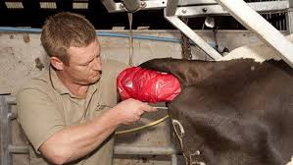
Training Need Areas in Dairy farming
Breeding Management
Detection of heat symptoms
Time of artificial insemination
Knowledge of high yielding breed
Repeat breeding management
Infertility problems and Reproductive disorder
Pregnancy diagnosis

Slide 12
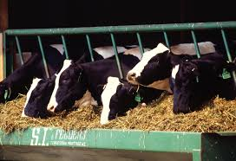
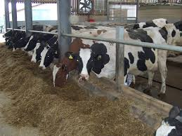
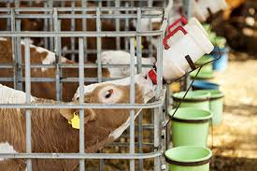
Feeding practices
Feeding of milch animals
Feeding of pregnant animals
Feeding of new born calves
Importance of feeding mineral mixture
Preparation of balanced ration for their animals at a cheaper rate
Preservation of fodder crops (Hay/Silage making)

Slide 13
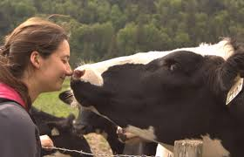
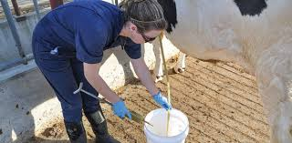
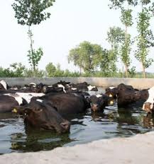
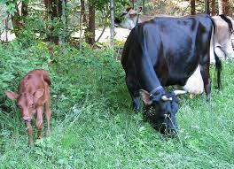
Health care and management practices
Care and management of sick animals
Disease Prevention
Deworming schedule and procedures
Information on infectious diseases
First aid measures to be taken during emergency
Care and management of new born calves
Care and management of pregnant animals at the time of parturition
Care and management of milking animals

Slide 14
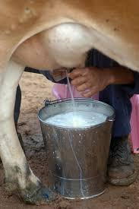
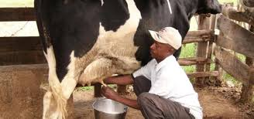
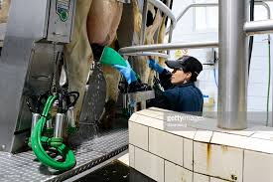
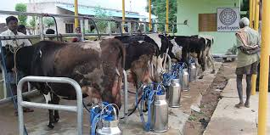
Clean milk production
Type of milking
Hygienic method of clean milk production
Knowledge of zoonotic disease that spread through infected milk
Storage of excess milk
Preparation of milk products

Slide 15
Research evidence
Perceived training needs of livestock farmers in Karnataka
by: B L Balaraju (2014)
A sample of 120 livestock owners with at least 1-2 milch animals and 2 small ruminants from 8 Gram panchayat (15 livestock owners from each Gram panchayat) of the 4 blocks of Davangere district was selected randomly.
The training needs of livestock owners was assessed for six major areas of dairy farming at five point continuum like most important, important, somewhat important, less important and least important with scores 5, 4, 3, 2 and 1, respectively.
The ranking of each major area was done based on the obtained total weighted mean score. According to livestock owners’ perceived training needs, health care ranked first followed by feeding (II), breeding (III), housing & management (IV), marketing & finance (V) and products preparation (VI).

Slide 16
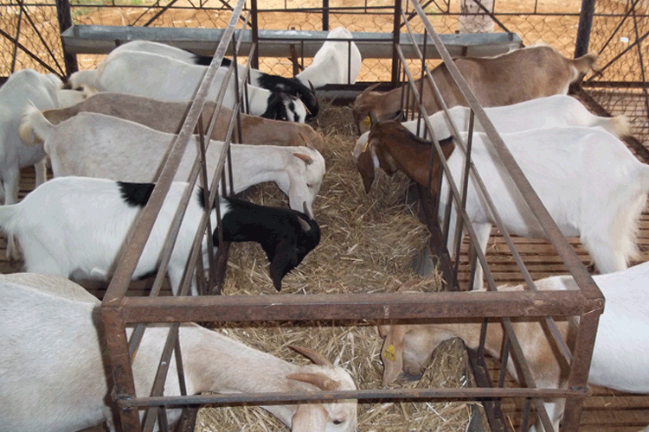
Goat and Sheep Rearing
The system of sheep and goat rearing in India is different from that adopted in the developed countries.
In general, smaller units are mostly maintained as against large scale in fenced areas in the developed countries.
Goat Rearing: In India, activity of goat rearing is sustained in different kinds of environments, including dry, hot, wet and cold, high mountains or low lying plains.

Slide 17
Goat has been described as a poor man’s cow (or mini-cow) .
They not only supply nutritious and easily digestible milk to their children but also regular source of additional income.
can easily be managed by women and children.
Feeding, milking and care of goats does not require much equipment and hard work.
Capital investment and feeding costs are also quite low.
In rural areas, goat farming plays a vital role in providing gainful employment

Slide 18
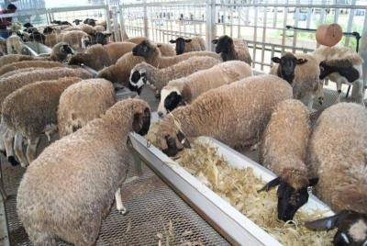
Sheep Rearing:
Sheep are well adapted to many areas. They are excellent gleaners and make use of much of the waste feed.
They consume large quantities of roughage, converting a relatively cheap food into a good cash product.
Scope for Sheep Farming and its National Importance
The country has 71.6 million sheep as per 2012-13 annual report of Animal Husbandry Department and ranks sixth in the world.
The contribution of sheep through export of meat is 8 per cent of the total export value of agricultural and processed food products. Sheep skin in the form of leather and leather products is also exported.

Slide 19
Advantages of sheep farming
Multi-faceted utility.
Three different sources of income per year.
Since the two major products of sheep (wool and mutton) are entirely different in their production and utilization, the price of one may not necessarily have a bearing on the other. Wool may be stored and held for higher prices or sold at shearing time.
A crop of lambs may be marketed from 5-6 months onwards (preferably before one year), bringing rather a quick return.
Mutton is one kind of meat towards which there is no prejudice by any community in India

Slide 20
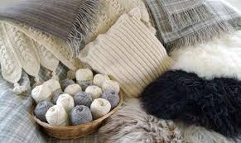
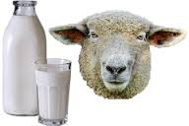
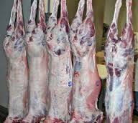
In addition to wool, mutton and to some extent milk, sheep provide employment to about 3 million people in the form of self-employment, as hired labour for tending flocks during migration, and persons engaged in wool shearing and in wool and skin processing.

Slide 21
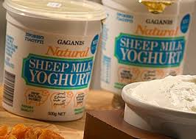
Since sheep eat different type of plants than any other kind of livestock, they can turn waste into profit and at the same time improve the appearance of many farms (i.e. excellent weed destroyer).
Sheep dung is a valuable fertilizer, and since they are grazed on sub-marginal lands, their droppings are the only means of improving the growth of plants in such areas.

Slide 22
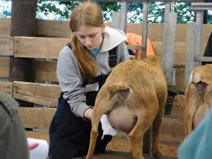
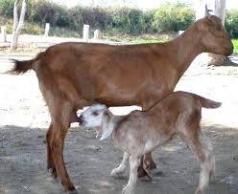
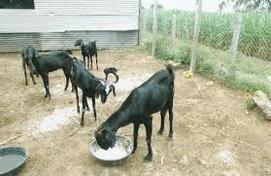
Training need areas
About various Goat & Sheep Breeds(Exotic & Indian)
Selection of breeds for stallfed farming
Feed & Fodder cultivation
Silage preparation, Silo Pit Construction
Supplements(Mineral Mix) & Concentrates
Vaccination Cycle
Deworming & Livertonic Cycles
Health & Disease Management
Pregnancy and Kid Management
Shed Planning & Construction
Project Financials
Bank Loans & Insurance

Slide 23
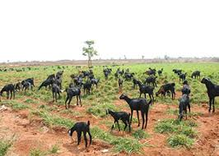
Training needs on goat production and management practices
Care and management
Feeding management
Breeding management
Health care and disease control
Marketing and record keeping

Slide 24
Research evidence
Training Needs of Goat Keepers in Maharashtra
By :Mangesh Tekale, D.S. Deshmukh, Prakashkumar Rathod
and Manish Sawant (2013)
The study revealed that about 35 per cent and 37 per cent of respondents’ perceived training needs in goat care and management as ‘most important’ and ‘not important’ activity respectively.
About 24 and 41 per cent of farmers perceived training needs in goat feeding management as ‘most important’ and ‘important’ activity respectively .
while about 33 and 38 per cent of farmers perceived training needs in goat breeding management as ‘most important’ and ‘important’ activity respectively.
With regards to health care and disease control management, 45 and 30 per cent goat keepers felt training as most important and important respectively
34 and 36 per cent of farmers perceived training needs in goat marketing management as ‘most important’ and ‘important’ activity respectively.

Slide 25
Majority of respondents preferred training of one week duration during summer season in their own village. The study concluded that, goat keepers needed training on feeding and health care management to a greater extent to improve the production potential of goats. Hence, Extension agencies should disseminate information based on training needs at the field conditions for livelihood security of the farmers.

Slide 26
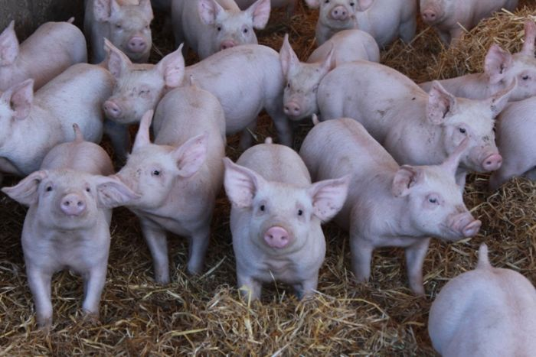
piggery
Pigs are maintained for the production of pork. They are fed with inedible feeds, forages, certain grain byproducts obtained from mills, meat byproducts, damaged feeds and garbage.
The pig grows fast and is a prolific breeder, farrowing 10 to 12 piglets at a time. It is capable of producing two litters per year under good management conditions.
The carcass return is high at 65-70% of the live weight.

Slide 27
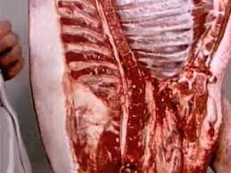
The advantages of the pig farming
The pig has got highest feed conversion efficiency.
The pig can utilize wide variety of feed stuffs viz.
They are prolific with shorter generation interval. A sow can be bred as early as 8-9 months of age and can farrow twice in a year. They produce 6-12 piglets in each farrowing.
Pig farming requires small investment on buildings and equipment's.
Pigs are known for their meat yield, which in terms of dressing percentage ranges from 65 – 80% in comparison to other livestock species whose dressing yields may not exceed 65%.

Slide 28
Pork is most nutritious with high fat and low water content and has got better energy value than that of other meats. It is rich in vitamins like thiamin, Niacin and riboflavin.
Pigs manure is widely used as fertilizer for agriculture farms and fish ponds.
Pigs store fat rapidly for which there is an increasing demand from poultry feed, soap, paints and other chemical industries.
Pig farming provides quick returns since the marketable weight of fatteners can be achieved with in a period of 6-8 months.
There is good demand from domestic as well as export market for pig products such as pork, bacon, ham, sausages, lard etc.

Slide 29
Case study
Mr. Ramesh farmer in Jadigenahalli of Hoskote taluk is presently realising a net income of Rs. 3,54,000 from his piggery unit.
In his six acre land he is growing ragi, rose, bottle gaurd. The crops have been able to fetch him a gross income of Rs. 1, 27, 000 a year.
He constructed a thatched shed with concrete flooring and compartments, with a capacity to house 30 sows and 250 piglets at a time. Thirty 75 day- old piglets (4 male) of Duroc and White Yorkshire breeds were procured from pig farms and the unit was started in September 2011. Within 16 months each sow delivered 8-12 piglets.
The piglets were reared up to 60-75 days and then sold at Rs.1,500 each. He also disposes male and old pigs for pork. So far he has sold about 25 adults (around 2,500 kg of pork) in 2013. He also sold 200 piglets in 2013, keeping the remaining piglets as parental stock.
He spends about Rs.1,000 per month on medicines and veterinary care for his animals and has also engaged a labourer to look after the unit, paying him Rs.6,000 as salary per month.

Slide 30
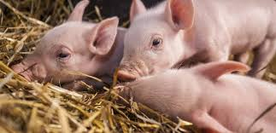
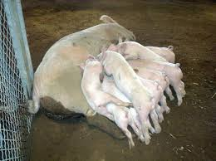
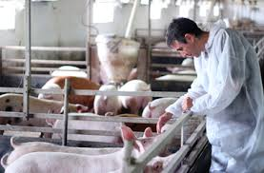
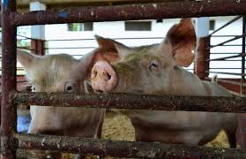
Training need areas
Housing management.
Feeding management.
Breeding management
Animal healthcare management
General management
Animal welfare
Environment control.
Record keeping Marketing strategies

Slide 31
Research evidence
AWARENESS AND NEEDS OF PIG FARMERS IN KERALA
A. Kannan, Francis Xavier, T. V. Raja and M. Murugan (2008)
The results revealed that the farmers knew about deworming, iron injection, sanitation, waste disposal and castration but lacked awareness on vaccination and ectoparasite control.
Apart from pig farming, farmers were interested in integrated farming, biogas production, expansion of farm and management through cooperative societies’ assistance. Digestive disorder was found to be the major problem in pig farming and piglet mortality was mainly due to ‘Mastitis Metritis Agalactia’ (MMA) of the dam, scours, crushing and nutritional deficiency.
The prime concern of farmers regarding training was on breeding management rather than on health, feeding and meat processing. The constraints in pig production systems were lack of financial support followed by the unavailability of stock and social risk factor.

Slide 32
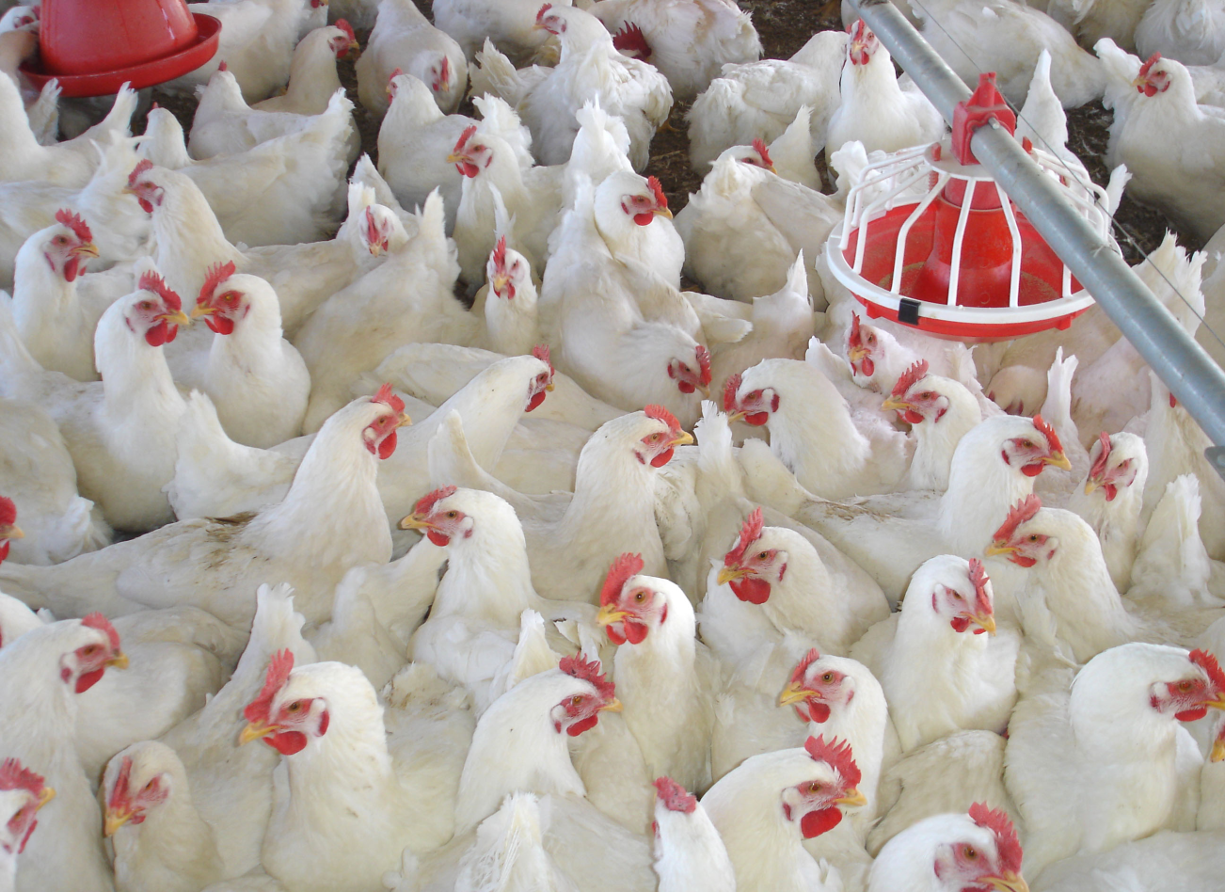
Poultry
Poultry farming is the raising of birds domestically or commercially, primarily for meat and eggs but also for feathers.
Poultry farms are increasing steadily
Many government agencies are encouraging poultry farming and even short term training courses are organised regularly.
Death of birds during transit is the main bottleneck.

Slide 33
Poultry is one of the fastest growing food industries in the world.
Poultry meat accounts for about 27% of the total meat consumed worldwide and its consumption is growing at an average of 5% annually.
Poultry industry in India is relatively a new agricultural industry. Till 1950, it was considered a back yard profession in India.
Broiler production is increasing at the rate of 15% per year.

Slide 34
The growth of the poultry sector is mainly attributed to the interventions of the corporate sector with an enabling policy environment provided by the Government of India / State Governments from time to time.
The activity provides huge employment opportunities for the rural poor either under backyard poultry production system or under small scale commercial broiler farming units.
Over 5 million people are engaged in the poultry sector either directly or indirectly.

Slide 35
Case study
Sharada Bai residing in Chandurayanalli village of Magadi Taluk of Ramanagara District owns 20 guntas of land. Under IFSD Programme, seven number of Giriraja chicks were inducted to integrate the farming of Sharada Bai with an objective of improving the social economic status and to attain sustainable livelihood.
In addition to the seven Giriraja birds, she had bought another 10 local chicks. Within a period of 8 months she got multiplied the chicks to 110 numbers.
Ms. Sharada Bai took the poultry as a challenging enterprise and now she is selling 300-350 number of eggs per month earning Rs. 2100-Rs. 2450 at Rs. 7 per egg.

Slide 36
She is earning additional income of Rs. 3750/- by selling minimum of 12.5 kgs of chicken (5 birds) once in 3 months. She is not incurring high cost towards feed instead the birds are fed with locally available feed (Ragi, food waste, etc) and a part with commercial feed. In addition she is spending Rs.1000/- towards medical expenses per year.
In addition to the income from horticultural crops the earnings from poultry is a boon. To bring diversification, KVK has introduced duck rearing which would further boost her annual income.

Slide 37
Training need areas
Brooding of chicks,
Stress management of birds,
Disinfection procedures,
Feed formulation,
Vaccination techniques and
Record keeping

Slide 38
Research evidence
Training needs of broiler farmers in north Karnataka, K.C. Veeranna and Shubhangi B.Tajane (2005)
The study was conducted among randomly selected 120 farmers of 12 villages of four districts in north Karnataka. Data were collected through a structured interview schedule and subjected to statistical analysis. The results revealed that training on brooding of chicks, stress management of birds, disinfection procedures, feed formulation, vaccination techniques and record keeping were perceived as important and necessary by more than 60 per cent of the respondents.

Slide 39

Sericulture
Sericulture is defined as a practice of combining mulberry cultivation, silkworm rearing and silk reeling.
Sericulture is a recognized practice in India. India occupies second position among silk producing countries in the world, next to China.
The total area under mulberry is 188 thousand ha in the country.
It plays an important role in socio-economic development of rural poor in some areas.
In India more than 98% of mulberry-silk is produced from five traditional sericultural states, viz., Karnataka, Andhra Pradesh, West Bengal, Tamil Nadu, and Jammu and Kashmir.

Slide 40
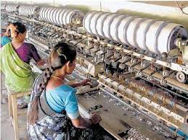
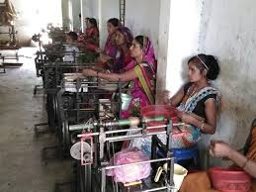

Benefits
High employment potential
Provides vibrancy to village economies
Low Gestation, High Returns
Women friendly Occupation
Ideal Programme for Weaker Sections of the Society
Eco-friendly Activity
Satisfies Equity Concerns

Slide 41
Training need areas
Chawki silk worms rearing.
Production of quality mulberry leaves through improved cultivation practices.
Disinfection of rearing house and equipments.
Rearing technology practices.
Management of pest and diseases in mulberry and silkworm.
Soil fertility management.
Mulberry varieties.
Package of practices for mulberry cultivation.
Mechanization in sericulture.

Slide 42

Bee keeping
Beekeeping is the science and culture of honeybees and their management.
Beekeeping is a subsidiary occupation and it is a additional source of income for farm families. It requires low investments and so can be taken up by small, marginal and landless farmers and educated unemployed youth.

Slide 43

Benefits
Excellent source of employment for the rural unemployed: currently approximately 2,50,000 farmers in India are employed through beekeeping.
Provides an excellent source of income for the landless farmers: since beekeeping in migratory in nature, even the landless farmers can take up this profession.
No farm land is wasted as apiaries are kept on the boundaries and not cultivable land.
Increases crop yield by cross ––pollination: can increase yields in some crops by up to 200%.

Slide 44
Case study
Athigere’s Suresh Gowda won state-level award for apiculture recently at Haveri.
As an organic farmer, Suresh is a hard worker. In his 2.17 acre land, he grows coffee, pineapple, ginger, guava, lemon and vegetables, he has started apiculture and has seen success in it. He has started apiculture with minimum effort and money.
He rears honeybees in 15 litre clay pot and oil cans. The cost of clay pot is Rs 50 while oil cans costs Rs 25.

Slide 45
He says “about 100 gram honey wax, 25 gram jaggery powder, 25 gram cinnamon powder and 25 gram sand powder should be collected for rearing honeybees. The can or clay pot should be heated and cleaned thoroughly. The honey wax should be put inside the pot should be heated and mixed with jiggery powder, cinnamon powder.
When the mixture is hot, it should be made to spread all over the pot. About three holes should be made in the pot. The mixture should be rubbed outside the hole as well. The smell of cinnamon powder attracts honeybees. If the pot is safely handled, then it can last for four to five years.
A bee colony can yield about 5 to 10 kg honey per year. Through this method, the honeybees can be reared in one’s yard. The honey will be ready by last week of March,”

Slide 46
Training need areas
About Honey bees.
Importance of honey bees.
Different species of honey bees.
Bee equipments .
Handling of honeybees.
Management during the dearth period and honey flow season.
Dividing and uniting of colonies pest and diseases of honey bees .
Honey extraction and processing beehive products.

Slide 47

Fishery
Ponds serve various useful purposes, viz., domestic requirement of water, supplementary irrigation source to adjoining crop fields and pisciculture.
With the traditional management, farmers obtain hardly 300-400 kg of wild and culture fish per ha annually.
However, composite fish culture with the stocking density of 5000-7500 fingerlings/ ha and supplementary feeding can boost the total biomass production.

Slide 48
Farmers can easily take up fish culture in village ponds, tanks or any new water body and can improve their financial position substantially.
It also creates gainful employment for skilled and unskilled youths. The technology developed for fish culture in which more than one type of compatible fish are cultured simultaneously is the most advanced and popular in the country. This technology is known as Composite Fish Culture.
This technology enables to get maximum fish production from a pond or a tank through utilization of available fish food organisms in all the natural niches, supplemented by artificial feeding.

Slide 49

Mushroom Cultivation
Mushroom is an edible fungus with great diversity in shape, size and color.
Essentially mushroom is a vegetable that is cultivated in protected farms in a highly sanitized atmosphere.
Just like other vegetables, mushroom contains 90% moisture with high in quality protein.
Mushrooms are fairly good source of vitamin C and B complex.
The protein have 60-70% digestibility and contain all essential amino acids. It is also rich source of minerals.
They contain less fat and CHO and are considered good for diabetic and blood pressure patients.

Slide 50


Advantages of Mushroom Growing
Use of ideal structures.
Involvement of small initial capital.
Possible production all the year round.
Use of Agricultural waste as substrate- mostly waste materials from farms, plantations or factories.

Slide 51
Other subsidiary occupations
Vermicomposting
Rabbit rearing
Duck rearing
Ornamental fish culture
Custom hiring of farm machineries.

Slide 52

Vermicomposting

Slide 53

Rabbit rearing

Slide 54

Duck rearing

Slide 55

Ornamental fish culture

Slide 56
conclusion

Slide 57
THANK you

