Slide 1

Welcome to 3rd seminar

Slide 2


Local Organizations in Decentralized Development: Their Functions and
Performance in India
NAVEEN KUMAR P
Ph. D. Scholar
PALB-4021

Slide 3

Short take of seminar
Introduction
Objectives
Concept of Decentralization
Local organizations and its functions
Measuring performances of Local organizations
Research studies related to Local organizations
Conclusion
3

Slide 4
Introduction
More than 70 per cent of people live in rural areas
Rural people have to be involved in planning, decision making, monitoring and execution of developmental programmes in order to speed up the process of development
So, there needs a shift from top down to bottom up approach

Slide 5
  In 1992 constitutional amendments that paved the way for decentralization of government throughout India
Decentralization of government has been attempted periodically within states in post independent India
Local organizations are central actors in the rural development strategies sponsored by government and donor agencies in India

Slide 6

OBJECTIVES OF SEMINAR
1
To know the concept of decentralization and local organizations
2
To understand the functions and performances of local organizations
3
To review the research studies related to decentralized local organizations

Slide 7
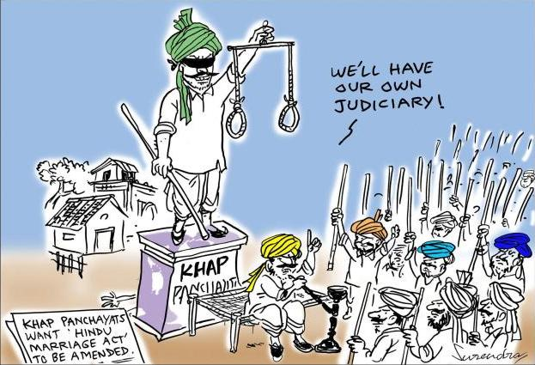
Concept of Decentralization
The policy of delegating decision-making authority down to the lower levels in an organization
Crook and Manor (1998)-It is a political process whereby administrative authority, public resources and responsibilities are transferred from central government agencies to lower-level organs of government or to non governmental bodies

Slide 8
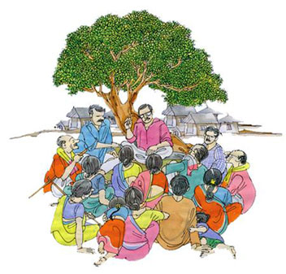
Rondinelli (1981)- Decentralization as the transfer of authority to plan, make decisions, and manage public functions from a higher level of government to any individual, organization, or agency at a lower level

Slide 9

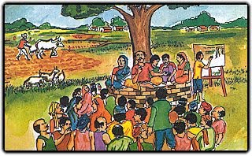
Why decentralized ?
Diversified country
Bridge for development and
social harmony

Slide 10

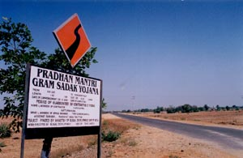
Give justice and social
security to all
Providing Facilities of urban in
rural area

Slide 11

Promote equal right to
every member of society

Slide 12

Milestones in Indian Decentralization
1882-Planing on Local Self-Government
1907-The Royal Commission on Decentralization
1948-Debates between Gandhi and Ambedkar on Gram Swaraj, and ‘self-rule’
1957-Balwantrai Mehta Committee- An early attempt to implement the Panchayat raj

Slide 13
1963-K. Santhanam Committee– Revenue raising powers
1977-Asoka Mehta Committee–District serve as the administrative unit
1985-G.V.K. Rao Committee–Block development office (BDO) powers for planning, implementing and monitoring rural development programmes

Slide 14
1986 L.M. Singvhi Committee – Gram Sabha should be the base of decentralized democracy in India
1992 The 73rd Amendment to the Indian Constitution – PRIs at district, block and village levels
1996 The Adivasi Act – Powers of self-government are extended to tribal communities

Slide 15
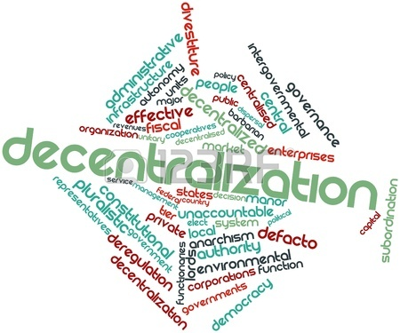
Different forms of Decentralization
I. Political Decentralization-Associated with increased power of citizens and their representatives in public decision-making
Formulation and implementation of policies
DM power will be in the hand of local-authorities who are more aware of the local situation and hence are in a better position to take judicious decision

Slide 16

II. Administrative Decentralization
Authority, responsibility and financial resources among different levels of government for providing public services
Planning, financing and management of public functions
Central government and its agencies to elected local governments
It transfer of functional responsibilities

Slide 17

Administrative Structure of PRI’s
LEVELS | PRI | ADMINISTRATION
DISTRICT | ZILLA PANCHAYAT | CEO
TALUK | TALUK PANCHAYAT | EO
VILLAGE | GRAM PANCHAYAT | PDO/RDO
Directorate panchayath

Slide 18

III. Fiscal Decentralization
Expenditure decisions with funds either raised locally or transferred from the central government
It can be viewed from two dimension
  Decentralization of a tax instrument, when local governments have the power to raise taxes, or
  2. Decentralization of expenditures when local governments bear the responsibility for implementing expenditure functions

Slide 19
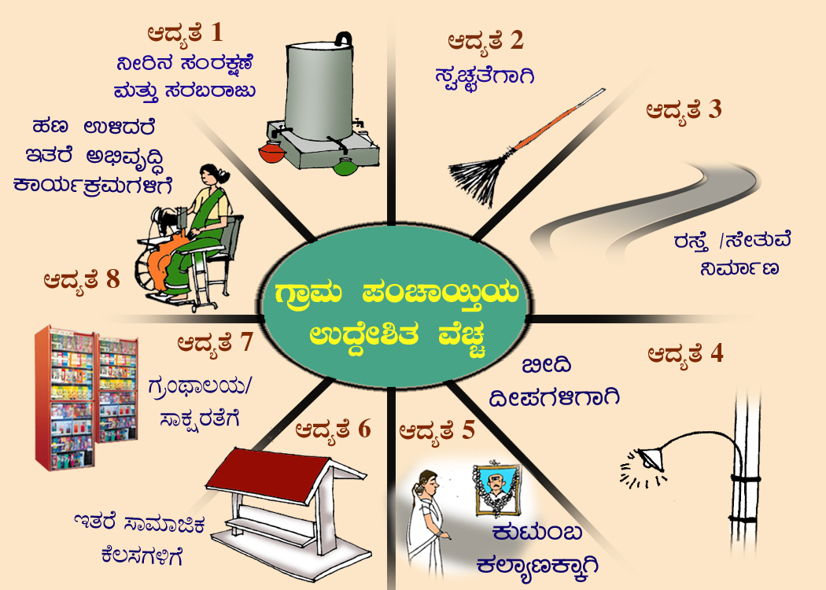

N®±h±º… N®Œ¯ãoN¯ÊT

Slide 20

Salient Features
Transfer of political, administrative, and fiscal responsibilities to local elected bodies
Enhance transparency and accountability of development activities, governance, and service delivery
Involves communities in collective decision making over local resource allocation and management
Empowerment of citizens

Slide 21
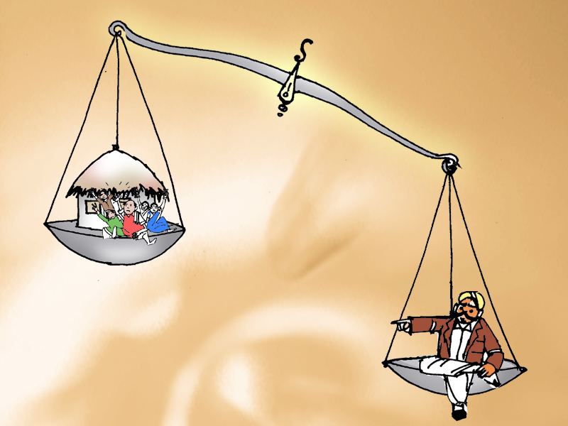
Decentralization reforms have enjoyed mixed success…..
Unwillingness on the part of central, state governments to devolve significant powers
Lack of funds-particularly untied funds-available to transfer to local bodies
Lack of a revenue base at the local level
The inability of government organizations to respond to local needs and priorities
The lack of accountability of service providers to citizens
The poor design of decentralized interventions by governments

Slide 22

To address some of these issues
Central and state governments are placing greater responsibility on local organizations
Local organizations -Closer to citizens
More capable of understanding and responding to them

Slide 23

Local Organizations
All types of organizations working at the district level and below
Covers a series of activities at the local/ community level aimed at bringing about desired improvement in the social well being of individuals, groups and neighborhoods

Slide 24


Organizational Typology
Government organizations
Project organizations
Private organizations
CBOs

Slide 25

Government organizations
Administrative government organizations
General civil servants (All government employees)
Line department staff
Elected government organizations
Zilla panchayats (ZP)
Taluk panchayats (TP)
Gram panchayats (GP)

Slide 26


Project organizations
These are created by the sector programs or projects in order to oversee implementation activities at the district, block, or village level.
Drought Prone Area Program
Desert Development Program
Karnataka Watershed Development Project
Joint Forest Management Program

Slide 27


Private organizations
Organizations that are managed independently in each of the sectors
Input agencies
Large agri-business firms
Farmer organisations and producer co-operatives
Non-governmental organisations (NGOs)

Slide 28

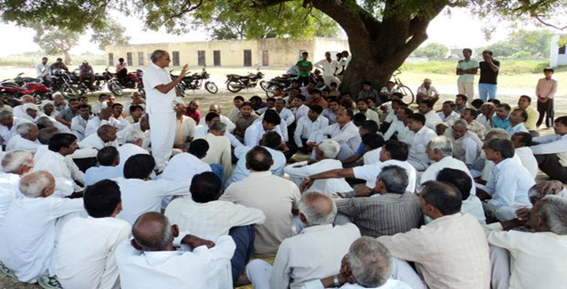
Community-based organizations
CBOs are membership organizations based on collective action and are found almost entirely at the village level
Women groups
Credit/saving groups
Youth clubs
Cooperative groups
Caste associations
Labour Unions
Farmer's Groups

Slide 29



Functions of Local Organizations
Financing: Mobilizing and securing funds and other resources that support the work of local organizations
Staffing: Determination of manpower requirements of the organization and providing it with adequate competent people at all levels
Provisioning: Activities that facilitate access to services, resources, and local assets
Community-based action: covers physical construction and mobilization of village resources by group members

Slide 30


Capacity building: Provision of training programs
Coordination: Coordination with other organizations of the same type or of different types and at different levels
Monitoring and evaluation (M&E): Activities undertaken to track organizational inputs, outputs, and performance

Slide 31




Conflict resolution and accountability: Resolve disputes through mediation and negotiation
Information sharing and dissemination: Sharing information within and among local organizations

Slide 32

Measuring Performance of Local Organizations
Four factors play significant roles in shaping an organization’s performance:
Assets
Processes
Linkages
Context
The first three of these are attributes particular to an organization
Last relates to the environment in which the organization and its members operate

Slide 33


Assets
Assets are the resources of any organization which are very much vital to achieve the objective of organization
An objective is useless if it is not achieved and It will remain as daydream only
Hence, resources are the means for getting results or for fulfilling objectives
Human, material, and financial assets

Slide 34


Human Assets- Quantity and quality of human resources
Material Resource: Physical resources like land, vehicles, buildings, internet facilities etc…

Slide 35


Cont..
Financial resources: To accomplish organizational activities
Financial resource is the life blood of organization
The time and extent of the availability of financial resource in any organization indicates the health of a concern of organization
Finance resources requires not only for survival but also for strengthening themselves

Slide 36
Processes
Processes refer to the manner in which beneficiaries participates in organizational activities
Knowledge of organizational rules- Representatives’ and members’ awareness about the rules of the organization
Transparency of operation-Everyone should know the activities undertaken in organization
Decision-making processes- Collective decision making

Slide 37



Linkages
It refers to the number and form of connection/relation with line agencies, PRIs, and other organizations
Local organization’s linkages with GP
Local organization’s linkages with other local organizations, ranging from village to district levels
Local organization’s linkages with Line Departments

Slide 38
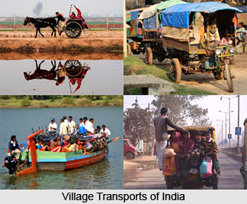
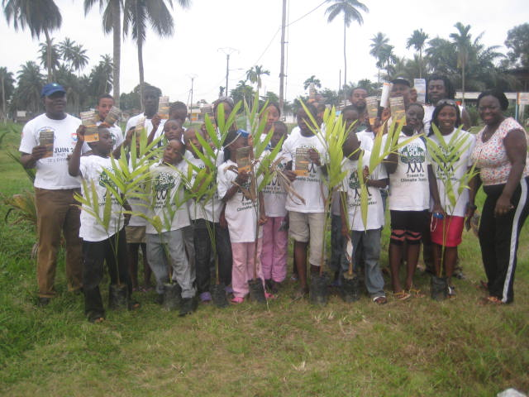
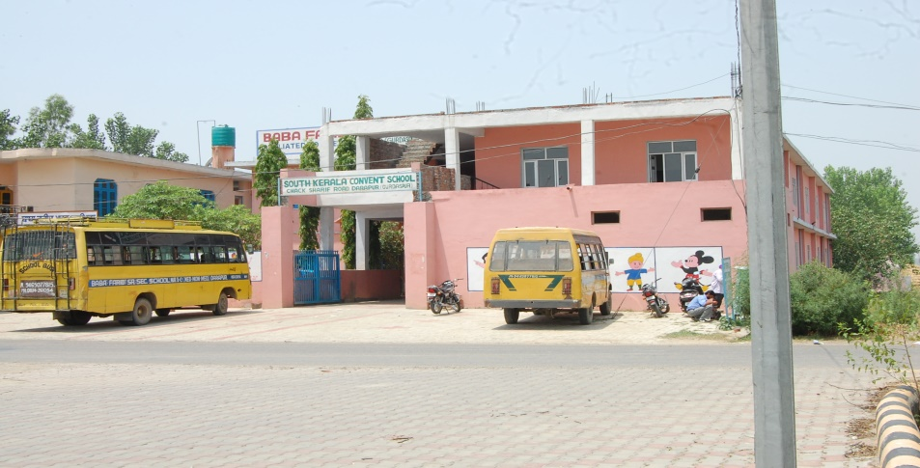
Context
Context is a situation/environment in which local organization exists
Physiographic environment
Social environment
Infrastructural environment

Slide 39


Research studies

Slide 40

Research Study-1
Title of the study:
IMPACT ANALYSIS OF COMMODITY BASED ASSOCIATIONS
Authors:
GOPAL, Y.M.
Year:
2014

Slide 41
METHODOLOGY
Locale of the study- Tubugere Hobli of Doddaballapura taluk of Bangalore Rural District
Selection of respondents- 250 members from ten CBAs under Rural Bio-Resource Complex (RBRC) project

Slide 42
Table-1. Overall Attitude Level of Members Towards Commodity Based Associations
(n=250)
Attitude Level | Criteria | Score | CBA Members
 |  |  | Number | Percent
Less favourable | <(Mean – ½ SD) | <66.31 | 66 | 26.40
Favourable | (Mean ± ½ SD) | 66.31-73.03 | 76 | 30.40
More favourable | >(Mean + ½ SD) | >73.03 | 108 | 43.20
Total |  |  | 250 | 100.00

Slide 43
Table-2. Reasons for Success of CBAs as Perceived by its Members (n=250)
Sl. No. | Reasons* | CBA Members |  | Rank
 |  | Number | Percent
1 | Timely technical guidance from supporting organization | 199 | 79.6 | I
2 | Economic benefits for CBA members | 198 | 79.2 | II
3 | Self employment opportunity provided by CBA | 190 | 76.0 | III
4 | Lower marketing cost due to pooled marketing | 160 | 64.0 | IV
5 | Reduction in production cost due to labour sharing | 134 | 53.6 | V
6 | High reserve funds, increased assets, total sales and profits of the CBA | 131 | 52.4 | VI
7 | Appropriate leadership in the commodity based association | 125 | 50.0 | VII
8 | Recognition in the society for the CBA members | 113 | 45.2 | VIII
9 | Interdependence among group members | 104 | 41.6 | IX
10 | Minimization of the gap between social perception and CBA action | 100 | 40.0 | X
11 | Small group size of the commodity based association | 99 | 39.6 | XI
12 | Gender composition of the group members | 23 | 9.2 | XII

Slide 44
Table-3.Constraints Faced by the CBA Members (n=250)
Sl. No | Constraints* | CBA members |  | Rank
 |  | Number | Per cent
1 | Non availability of loan for the members. | 192 | 76.8 | I
2 | Lack of separate market for the commodities produced by CBA members. | 184 | 73.6 | II
3 | Place for conducting CBAs activities is not available/not sufficient. | 173 | 69.2 | III
4 | Lack of transport facility for pooling and marketing of produce. | 102 | 40.8 | IV
5 | Longer tenure of office bearers of CBA. | 85 | 34.0 | V
6 | Passive participation of members in decision making. | 72 | 28.8 | VI
7 | Prevention of participation due to household work. | 61 | 24.4 | VII
8 | Delay in the realization of benefits. | 57 | 22.8 | VIII
9 | Conflicts among the members of commodity based association. | 55 | 22.0 | IX
10 | Misconception of CBA goals. | 54 | 21.6 | X
11 | Lack of need based training for the CBA members. | 43 | 17.2 | XI
12 | Groupism and politics within the members of CBA. | 37 | 14.8 | XII

Slide 45
Research Study-2
Title of the study:
A STUDY ON PERFORMANCE OF PANCHAYAT RAJ INSTITUTIONS IN KARNATAKA
Authors:
AMARESH KUMAR, K.
Year:
2004

Slide 46
METHODOLOGY
Locale of the study- Chikkamagalur and Chitradurga districts
Selection of respondents-45 each better performing and poor performing PRI’s were selected
Total sample size is 90

Slide 47
Table-1. Degree of Involvement of Members in Various Activities at
Grama Panchayat Level
N=20
S.N | Activities | Degree of Involvement
 |  | Better Performing GP ( n=10) |  |  | Poor Performing GP ( n=10)
 |  | AM | IM | FM | AM | IM | FM
 |  | % | % | % | % | % | %
1 | Health and hygiene | 60 | 40 | 00 | 10 | 70 | 20
2 | Education and welfare | 60 | 40 | 0.0 | 00 | 90 | 10
3 | Infrastructure | 40 | 50 | 10 | 40 | 40 | 20
4 | Community activities | 50 | 30 | 20 | 30 | 10 | 60
5 | Rural development programme | 40 | 40 | 20 | 50 | 40 | 10
6 | Official activities | 50 | 50 | 00 | 50 | 50 | 00
AM-All the meetings IM-Important meetings FM-Few meetings

Slide 48
Table-2.Satisfaction of Beneficiaries about Information Provided in Grama Sabha Meetings
S.N. | Extent of satisfaction by the beneficiaries | Better Performing GP (n=10) |  | Poor Performing GP(n=10)
 |  | No. | % | No. | %
1 | Very much satisfied | 14 | 31.3 | 0 | 0.0
2 | Satisfied | 19 | 42.2 | 8 | 17.7
3 | Un satisfied | 8 | 17.7 | 12 | 26.7
4 | Not satisfied | 4 | 8.8 | 15 | 33.4
5 | Very much dissatisfied | 0 | 0.0 | 10 | 22.2

Slide 49
Table-3.Problems Perceived by the Beneficiaries of Better Performing PRIs
N=45
S.N. | Problems perceived by the beneficiaries of better performing PRIs | No. | %
1 | Amount given for agricultural activities was not sufficient | 38 | 84.45
2 | Development works are not carried out within the stipulated period | 30 | 66.67
3 | Funds allotment from the government is not sufficient and not released in proper time | 29 | 64.45
4 | Nepotism in development works | 26 | 57.78
5 | Lack of official staff in panchayat | 25 | 55.56
6 | Poor attendance of people in grama sabha | 24 | 53.34
7 | Lack of management skills among the members | 23 | 51.12
8 | Egoism among the members | 19 | 42.22
9 | Limted scope for industrial developments | 16 | 40.00

Slide 50
Table-4.Problems Perceived by the Beneficiaries of Poor Performing PRIs
N=45
S.N. | Problems perceived by the beneficiaries of Poor performing PRIs | No. | %
1 | Poor quality of works by the panahayat | 41 | 91.12
2 | Members are not taken initiation and responsibility regarding work | 38 | 84.45
3 | Poor industrial development and poor attendance of members in meetings | 36 | 80.00
4 | Lack of cooperation among the members | 32 | 71.12
5 | Poor participation of people in grama sabha meetings | 31 | 68.89
6 | Favourism in selection of the members | 28 | 62.23
7 | Political intervention in all the stages of developmental works | 27 | 60.00
8 | Lack of supervision by the members in all the stages of works | 26 | 57.78
9 | Negligence for important and burning issues | 25 | 55.56
10 | Lack of official staff | 14 | 31.12

Slide 51
Research Study-3
Title of the study:
A STUDY ON KNOWLEDGE LEVEL OF GRAM PANCHAYAT MEMBERS ABOUT SAMPOORNA GRAMEENA ROZGAR YOJANA IN RAICHUR DISTRICT OF KARNATAKA
Authors:
bheemappa
Year:
2006

Slide 52
METHODOLOGY
Locale of the study- Raichur district of Karnataka
Selection of respondents-120 Gram Panchayat members from 12 Gram Panchayats.

Slide 53
Table-1. Extent of Participation of Gram Panchayat Members in Sampoorna Grameena Rojgar Yojana
(n=120)
SL.NO | Category | Frequency | Percentage
1 | Low | 23 | 19.16
2 | Medium | 79 | 65.84
3 | High | 18 | 15.00

Slide 54
Table-2.Overall Knowledge Level of Panchayat Member about SGRY programme
(n=120)
SL.NO | Category | Frequency | Percentage
1 | Low | 22 | 18.33
2 | Medium | 79 | 65.83
3 | High | 19 | 15.84

Slide 55
Table-3.Problems Faced by the Gram Panchayat Members in Implementing the SGRY Programme
(n=120)
Sl.no | Problems | Frequency | Percentage
1. | Delaying in sanctioning of fund | 104 | 86.66
2. | Lack of training facility | 91 | 75.83
3. | Less payments to the panchayat members | 89 | 74.17
4. | Lack of co-operation from the villagers | 82 | 68.33
5. | Non-availability of proper building for the panchayat | 78 | 65.00
6. | Lack of time for adequate guidance | 60 | 50.00

Slide 56

Conclusion
For development of any country/programme local organizations playing a key role
For effective performance of local organizations needs a people participation
Hence these two are increasingly recognized as basic component of democratic decentralization
Combination of these two hastens the country’s development
They could help the 70% of rural population to secure their livelihood and it leads to healthy and wealthy nation

Slide 57

Thank you

