Slide 1


Slide 2

Conceptual framework of
Sansad Adarsh Gram Yojana and Krishi Bhagya Yojana
KRISHI BHAGYA
M.LALITHA
PALB4116

Slide 3



×
1.Conceptual framework of SAGY
2.Case studies on SAGY
3.Conceptual framework of Krishi Bhagya
4.Case study on Krishi Bhagya

Slide 4
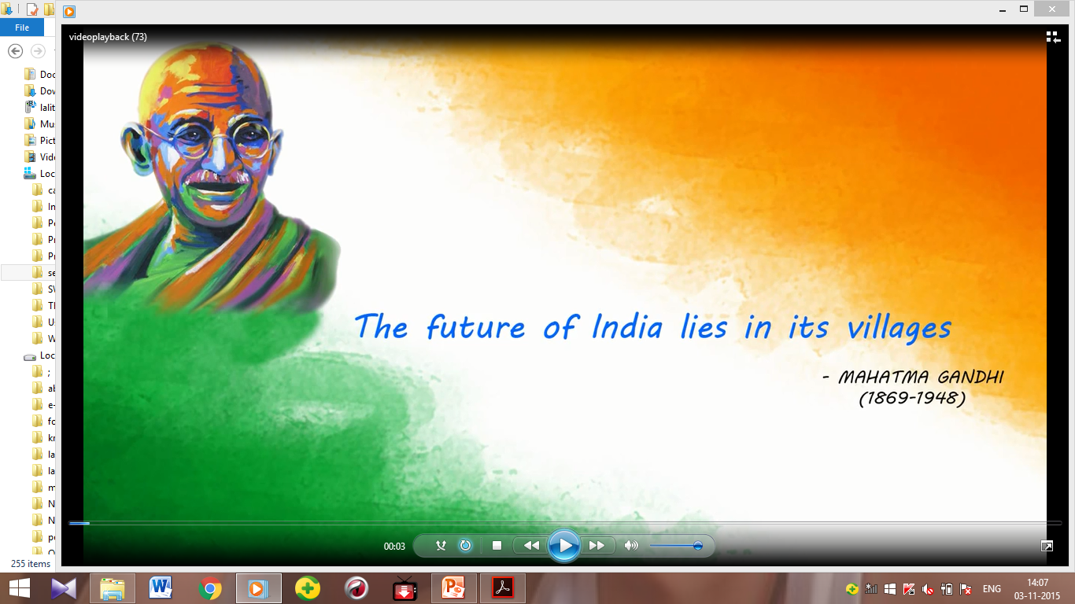

MAHATMA GANDHI’S VISION OF A MODEL VILLAGE

Slide 5
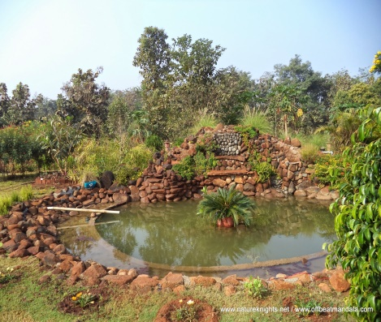
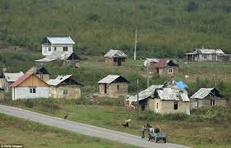
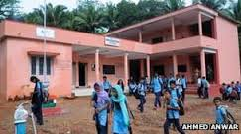
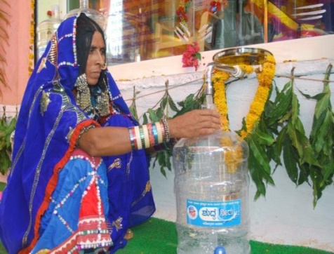
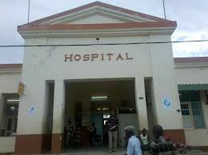
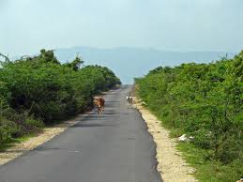
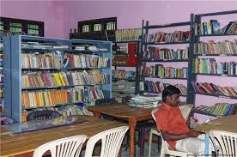
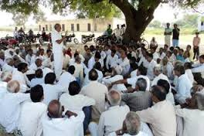
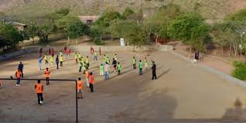
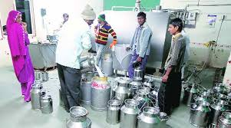
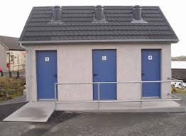
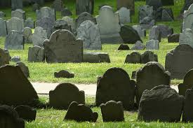
His vision of an ideal village.......

Slide 6


Introduction
India-agrarian country
68.90% - villages
Education
Civil amenities
Medical facilities
Economic well being
Hence it becomes important that proportionate amount of attention and funds be spent on the rural folk

Slide 7

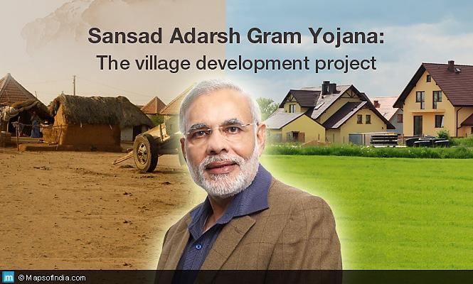

Slide 8
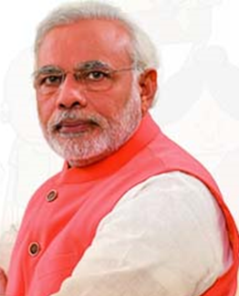

2. GOAL
The goal of Sansad Adarsh Gram Yojana (SAGY) is to translate the comprehensive vision of Mahatma Gandhi into reality, keeping in view the present context.

Slide 9

VALUES OF SANSAD ADARSH GRAM YOJANA
Ensuring the involvement of all sections of society in all aspects.
Adhering to Antyodaya.
iii. Affirming gender equality and ensuring respect for women.
iv. Guaranteeing social justice.
v. Instilling the spirit of community service and voluntarism.
vi. Promoting a culture of cleanliness.

Slide 10

vii. Ensuring a balance between development and ecology.
viii.Preserving and promoting local cultural heritage.
ix. Inculcating mutual cooperation, self-help and self-reliance.
x. Fostering peace and harmony in the village community.
xi. Bringing about transparency, accountability and probity in public life.
xii. Nurturing local self-governance.
xiii. Adhering to the values in the Fundamental Rights and Fundamental Duties of the Indian Constitution.

Slide 11

OBJECTIVES of SAGY
i. To trigger processes which lead to holistic development of the identified Gram Panchayats.
ii. To substantially improve the standard of living and quality of life of all sections of the population.
iii. To generate models of local level development and effective local governance which can motivate and inspire neighbouring Gram Panchayats to learn and adapt.
iv. To nurture the identified Adarsh Grams as schools of local development to train other Gram Panchayats.

Slide 12
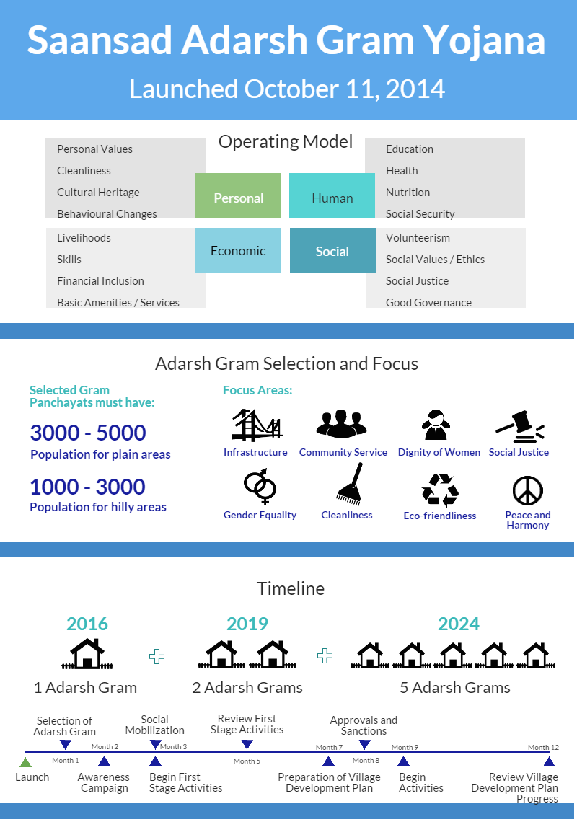
IDENTIFICATION OF ADARSH GRAM
The MP will be free to identify a suitable Gram Panchayat for being developed as Adarsh Gram, other than his/her own village or that of his/her spouse.

Slide 13

Primarily, the goal is to develop three Adarsh Grams by March 2019, of which one would be achieved by 2016. Thereafter, five such Adarsh Grams (one per year)

Slide 14

Activities in an Adarsh gram
Personal development
Basic amenities and services
Social development
ACTIVITIES
Economic development
Good
Governance
Environmental development
Social security

Slide 15
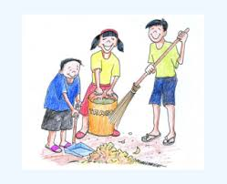

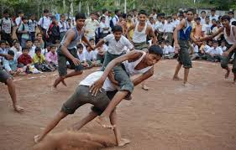


a. Personal development
i. Inculcating hygienic behaviour and practices –NHM(2005).ICDS (1975),Swachh Bharat mission(2014).
ii. Fostering healthy habits –state Government sports scheme.
iii. Reducing risk behaviour-NHM,Schemes of health and Family welfare

Slide 16



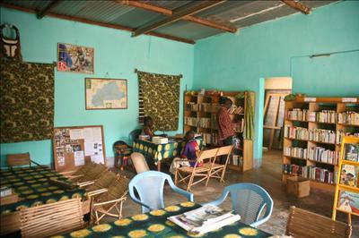
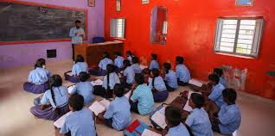
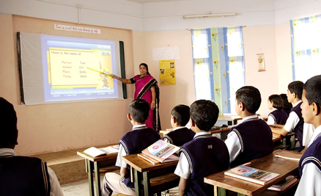
b. Human Development
Health
Facilities-NHM,ICDS.
Balancing the sex-ratio
Nutrition status
Village libraries
Smart schools
Sarva shiksha Abhiyan(SSA)(2001)
Rashtriya Madhyamic shiksha Abiyan(RMSA)(2009)
National Literacy Mission(NLM)(1988)
National Child Labour Project(NCLP)(1988)

Slide 17

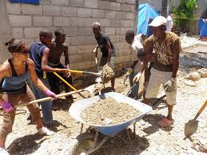
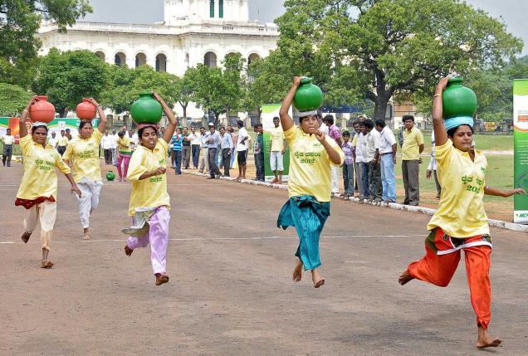
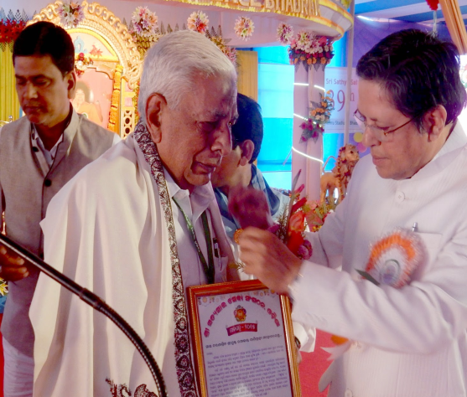
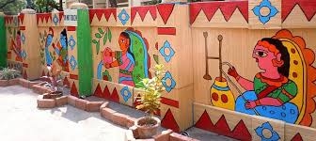
c.social Development
Voluntarism
Violence and crime free villages
Village sports and folk arts festivals.
honouring
village song
Village Day

Slide 18
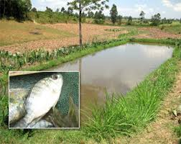
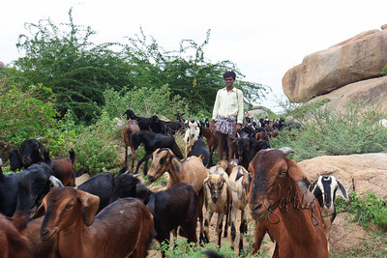
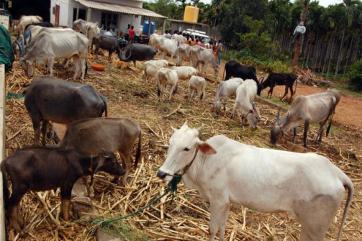
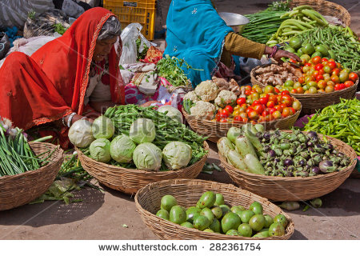
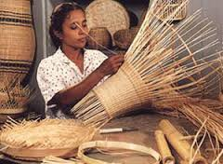
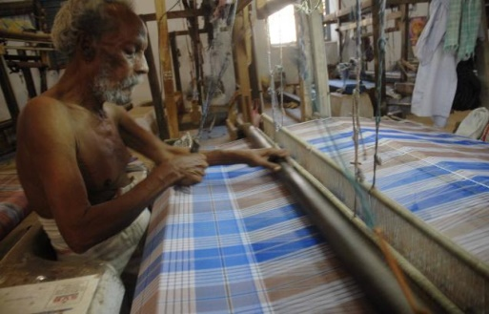
d. Economic Development
,
Promoting diversified agricultural and allied livelihoods, including livestock and Horticulture-
Schemes of Ministry of Agriculture,MKSP(2011) ,MGNREGA(2005)
ii. Rural industrialization-
MoA, Dept of Food Processing, MoT.
iii. Skill Development of all eligible youth for self-employment and placement-
NRLM(2011),MSME,RSETI.

Slide 19
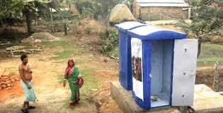
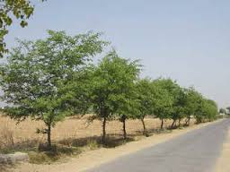
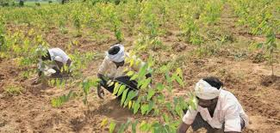
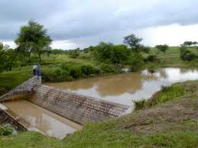
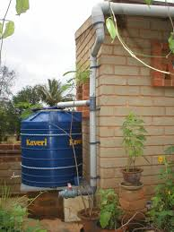
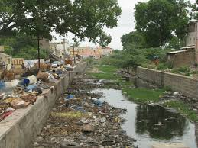
e.Environmental Development
clean and green village
MGNREGA,Swacch Bharat
Abiyan
Roadside plantations and
Social forestry
MGNREGA,NHM,
Shemes of the Ministry of Environment and Forest.
Watershed management-
IWMP,MGNREGA
Rainwater harvesting-
NRDWP,MGNREGA.
Reducing local pollution-
MNRE,MGNREGA,
Ministry of Agriculture.

Slide 20
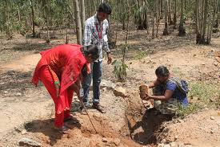
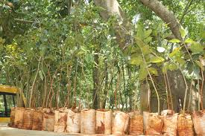
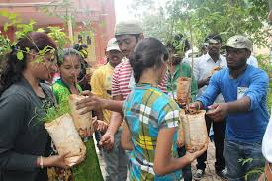
Karnataka,Bangalore South ,Shri Ananth Kumar,Bengaluru Urban ,Anekal, Ragihalli
Mega Tree Plantation program at Ragihalli Village on 06-Sept-2015 as part of the Sansad Adarsh Gram Yojana(SAGY), for Bangalore South.
1500 neem trees planted, 500 volunteers and team members participated.

Slide 21
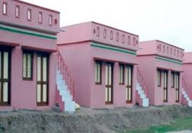
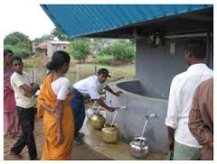
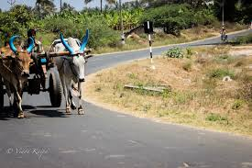
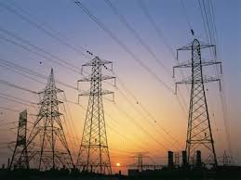
f. Basic amenities and services
i.Pucca houses for all-IAY(1985)
ii.Drinking water-NRDWP
iii.Internal all weather roads-PMGSY,MGNREGA
iv.Electricity connection to all Households-Rajiv Gandhi Grameen Vidyutikaran Yojana(2005)
v.Pucca infrastructure for public institutions-MGNREGA,Backward Regions Grant Fund, RGPSA(2013),Sarva Shiksha Abhiyan, ICDS.

Slide 22
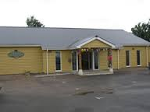
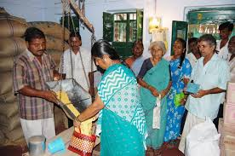
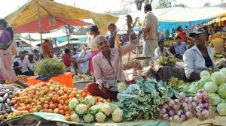



vi.Civic infrastructure –community halls,play ground,PDS outlets,Burial grounds.
vii.Village markets-NRLM,MGNREGA
viii.Micro mini banks /post offices/ATMs-BRGF,PM Jan Dhan Yojana
ix.Broadband connectivity and Common Service Centres-CSC Scheme(2006),DEIT
x.Telecom connectivity
CCTVs in public places

Slide 23
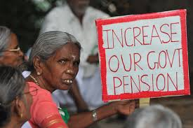

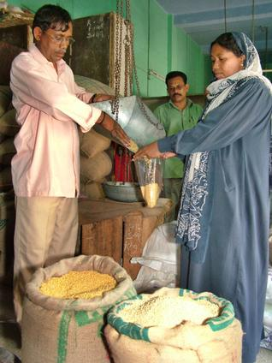
g. Social Security
Pensions for all
eligible families-IGNOAPS(1995),
IGNWP
Insurance schemes-Aam aadmi bima yojana,RSBY,
PMJDY.
PDS
State PDS schemes.

Slide 24
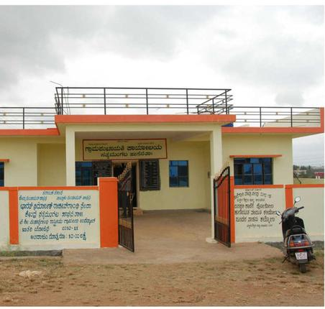


h. Good Governance
i. Strengthening of local democracy(village panchayats)
ii.Ensuring regular and punctual attendance of government and panchayat
Staff
iii.Holding of a Gram Sabha at least 4 times a year
iv.Timely redressal of grievances

Slide 25
Time line from the date of launch
Sl.no | Items of work | Time from the date of launch
1 | Selection of Adarsh Gram | One month
2 | Awareness generation on the scheme | Two months
3 | Environment creation and social mobilisation | Three months
4 | Initialisation of First Stage activities | Three months
5 | Review of First Stage activities | Five months
6 | Completion of preparation of VDP | Seven months
7 | Approvals and sanctions | Eight months
8 | Activities to begin | Nine months
9 | Review of progress of VDP at Gram Sabha level and District Level | One year

Slide 27
Gram Panchayats identified by Lok Sabha Members

Slide 28
Sl.no | Constituency Name | MP | District | Block/Sub district | Gram panchayats
1 | Belgaum | Shri Suresh Chanabasappa Angadi | Belgaum | Belgaum | Muthnal
2 | Uttara Kannada | Shri Anant Kumra Dattatreya Hegde | Uttar Kannad | Siddapur | Kangod
3 | Hassan | Shri H.D. Devegowda | Hassan | Hassan | Channangihalli
4 | Chamrajanagar | Shri Rangaswamy Dhruvanarayana | Mysore | Heggadadevankote | D.B.Kuppe
5 | Bagalkot | Shri Parvatagouda Chandanagouda Gaddigoudar | Bagalkot | Badami | Cholachagud
6 | Chikkodi | Shri Prakash Babanna Hukkeri | Belgaum | Chikodi | Shiradawad
7 | Bijapur | Shri Ramesh Chandappa Jigajinagi | Bijapur | Bijapur | Makhanapur
8 | Dharwad | Shri Pralhad Venkatesh Joshi | Dharwad | Dharwad | Harobelawadi
9 | Koppal | Shri Sanganna Amarappa Karadi | Raichur | Sindhnur | R.H.Colony
10 | Udupi Chikmagalur | Km. Shobha km Karandlaje | Chikmagalur | Mudigere | Daradahalli
11 | Dakshina Kannada | Shri Nalin Kumar Kateel | Dakshin Kannad | Sulya | Balpa
12 | Gulbarga | Shri Mallikarjun Kharge | Yadgir | Yadgir | Konkal

Slide 29
Sl.no | Constituency name | MP | District | Block/sub district | Gram panchayats
13 | Bidar | Shri Bhagwanth Khuba | Bidar | Basavakalyan | Gorta B
14 | Bangalore South | Shri Ananth Kumar | Bengaluru Urban | Anekal | Ragihalli
15 | Chikkballapur | Dr. M. Veerappa Moily | Bangalore Rural | Nelamangala | Agalakuppe
16 | Tumkur | Shri S.P. Muddahanumegowda | Tumkur | Madhugiri | Chikkadaalavatta
17 | Kolar | Shri K.H. Muniyappa | Kolar | Bangarapet | Gatta Kamadena Hally
18 | Raichur | Shri Bhagavanthraya Venkatesh Naik | Raichur | Raichur | Jagir Venkatapur
19 | Davanagere | Shri Gowdar Mallikarjunappa Siddeshwara | Davangere | Jagalur | Mustur
20 | Mysore | Shri Prathap Simha | Mysore | Hunsur | Karimuddanahalli
21 | Bellary | Shri B. Sreeramulu | Bellary | Hagaribommanahalli | Thambralli
22 | Bangalore Rural | Shri Doddaalahalli Kempegowda Suresh | Tumkur | Kunigal | Madikehalli
23 | Haveri | Shri Shivkumar Chanabasappa Udasi | Gadag | Shirhatti | Yalavatti
24 | Shimoga | Shri B. S. Yeddyurappa | Udupi | Kundapura | Keradi

Slide 30
Gram Panchayats identified by Rajya Sabha Members
Sl.no | MP | District | Block/ sub district | Gram panchayats
1 | Shri Rajeev Chandrasekhar | Bangalore Rural | Devanahalli | Jalige
2 | Dr. Prabhakar Kore | Belgaum | Chikodi | Janwad
3 | Shri Aayanur Manjunatha | Shimoga | Shimoga | Thammadihalli
4 | Smt. B. Jayashree | Tumkur | Tumkur | Hebbur
5 | Shri Oscar Fernandes | Udupi | Kundapura | Shiruru
6 | Shri Basawaraj Patil | Gulbarga | Sedam | Kukkunda

Slide 31

Roles and responsibilities

Slide 32

MEMBER OF PARLIAMENT
Identify the Adarsh Gram
Facilitate the planning process
Mobilise additional funds
Monitor the scheme

Slide 33

B.Ministry of Rural Development
Monitor the process of identification and planning
Review the implementation of the scheme
Identify bottlenecks in the scheme
Issue operational guidelines

Slide 34

C.STATE LEVEL –Headed by chief secretary
Supplement central guidelines for the scheme
Review Village Development Plans
Review implementation
Design a grievance redressal mechanism for the scheme

Slide 35


D.District level
Conduct the baseline survey
Facilitate the preparation of the Village Development Plan
Converge relevant schemes
Ensure grievance redressal
Monthly progress review of the scheme

Slide 36


Implement of the scheme
Identify common needs of the village
Leverage resources from various programmes
Ensure participation in the scheme

Slide 37

Funding
Funds from existing schemes.
The Member of Parliament Local Area Development Scheme (MPLADS).
The gram panchayat’s own revenue.
Central and State Finance Commission Grants, and Corporate Social Responsibility funds.
.

Slide 38








Slide 39

Karnataka state :
Dakshina kannada district:MP Nalin kumar kateel:sulya taluk:balpa village
Syndicate bank-20 lakhs –solar lamps to the village and 6 government schools.
Mangalore refinery and petrochemicals Ltd-20 lakhs-community hall.
My special economic zone-model gram panchayat building.
MCF- community health centre.
New Mangalore port trust –development of 6 schools and 2 anganwadis.
SELCO foundation-e-school project provide computers, projectors and screens to schools.

Slide 40
Case studies

Slide 41







Slide 42
After adoption ……

Slide 43









1
2
3
4
5
6
7
8
9

Slide 44

Thank you sachin
13
1 | Karnataka | Belgaum | Shri Suresh Chanabasappa Angadi | Belgaum | Belgaum | Muthnal
2 | Karnataka | Uttara Kannada | Shri Anant Kumra Dattatreya Hegde | Uttar Kannad | Siddapur | Kangod
3 | Karnataka | Hassan | Shri H.D. Devegowda | Hassan | Hassan | Channangihalli
4 | Karnataka | Chamrajanagar | Shri Rangaswamy Dhruvanarayana | Mysore | Heggadadevankote | D.B.Kuppe
5 | Karnataka | Bagalkot | Shri Parvatagouda Chandanagouda Gaddigoudar | Bagalkot | Badami | Cholachagud
6 | Karnataka | Chikkodi | Shri Prakash Babanna Hukkeri | Belgaum | Chikodi | Shiradawad
7 | Karnataka | Bijapur | Shri Ramesh Chandappa Jigajinagi | Bijapur | Bijapur | Makhanapur
8 | Karnataka | Dharwad | Shri Pralhad Venkatesh Joshi | Dharwad | Dharwad | Harobelawadi
9 | Karnataka | Koppal | Shri Sanganna Amarappa Karadi | Raichur | Sindhnur | R.H.Colony
10 | Karnataka | Udupi Chikmagalur | Km. Shobha km Karandlaje | Chikmagalur | Mudigere | Daradahalli
11 | Karnataka | Dakshina Kannada | Shri Nalin Kumar Kateel | Dakshin Kannad | Sulya | Balpa
12 | Karnataka | Gulbarga | Shri Mallikarjun Kharge | Yadgir | Yadgir | Konkal
13 | Karnataka | Bidar | Shri Bhagwanth Khuba | Bidar | Basavakalyan | Gorta B
14 | Karnataka | Bangalore South | Shri Ananth Kumar | Bengaluru Urban | Anekal | Ragihalli
15 | Karnataka | Chikkballapur | Dr. M. Veerappa Moily | Bangalore Rural | Nelamangala | Agalakuppe
16 | Karnataka | Tumkur | Shri S.P. Muddahanumegowda | Tumkur | Madhugiri | Chikkadaalavatta
17 | Karnataka | Kolar | Shri K.H. Muniyappa | Kolar | Bangarapet | Gatta Kamadena Hally
18 | Karnataka | Raichur | Shri Bhagavanthraya Venkatesh Naik | Raichur | Raichur | Jagir Venkatapur
19 | Karnataka | Davanagere | Shri Gowdar Mallikarjunappa Siddeshwara | Davangere | Jagalur | Mustur
20 | Karnataka | Mysore | Shri Prathap Simha | Mysore | Hunsur | Karimuddanahalli
21 | Karnataka | Bellary | Shri B. Sreeramulu | Bellary | Hagaribommanahalli | Thambralli
22 | Karnataka | Bangalore Rural | Shri Doddaalahalli Kempegowda Suresh | Tumkur | Kunigal | Madikehalli
23 | Karnataka | Haveri | Shri Shivkumar Chanabasappa Udasi | Gadag | Shirhatti | Yalavatti
24 | Karnataka | Shimoga | Shri B. S. Yeddyurappa | Udupi | Kundapura | Keradi

Slide 45
Story of Jayapur
PM Modi transformed a village in 10 months under Sansad Adarsh Gram Yojana

Slide 46




1
2
3
4

Slide 47







5
6
7
8
9

Slide 48


Punsari village,Gujarat
Punsari village has emerged as a model village with modern urban amenities such as
24X7 power supply.
WiFi connectivity.
CCTV cameras to ensure security.
Pucca roads connecting the village with other villages and towns.
A reverse osmosis plant which supplies 20 litres of water to each household at Rs 4.
Use of solar power for agricultural purposes.
Accidental Insurance cover to one member of every household.
Air-conditioned primary schools with no dropouts.
Bus facility for all households.
Focus on behavioural change through campaigns and awareness drives. For this purpose, 120 loudspeakers have been installed in different parts of the village
Punsari was awarded with the Best Gram Panchayat Award from the Central and the State in 2011.

Slide 49

Awards
Best practices
ii. Best Charge Officers
iii. Best District Collectors
iv. Best Adarsh Grams

Slide 50
Bottle necks of SAGY
Criteria for selection of Village.
Number of villages under Adarsh gram Yojana are very less.
Term of MP.
Honesty.
Bias in selection of Gram panchayat.

Slide 51
Karnataka
India
5631 Gram panchayats in Karnataka
24+6 constituencies
30×1=30villages by 2016
30×2=60 villages by 2019
30×5=150 villages by 2024
Totally=240 Adarsh grams by 2024 in karnataka.
But……29,736 villages are there in Karnataka
2,40,355 Gram panchayats
Loka saba MPs =510
Rajya saba MPs=230
Total=740
740×1=740 AG by 2016
740×2=1480 AG by 2019
740×5=3700 AG by 2024
Total=5920 AG by 2024
But ...... total number of villages in india are 6,38,590

Slide 52
How SAGY is useful for farmers and Agriculture Extension workers
All weather roads
Community hall
Rural banks
Veterinary hospital
Prevent distress migration from rural to urban areas -lack of oppertunities,facilities and decent standard of living.
Electricity
Small scale industries specially Agro based industries
Reduce the diversion of Agriculture funds.

Slide 53

KRISHI BHAGYA SCHEME

Slide 54
Introduction

Slide 55
In Karnataka 70% of the land -rain fed area.
Around 55% - food grains and 75% - oil seeds are coming from rain fed areas.
5 agro-climatic zones are facing deficit rainfall ,450-850mm.
Drastic change in the climate which is adversely affecting the farmers life.
Agriculture productivity is also decreasing day by day.
The agricultural land holding in Karnataka has decreased from 2.56 ha to 1.55 ha (2001 report)
Small and marginal farmers are falling in debt because of the failure of bore wells.

Slide 56


Krishi Bagya
Started in the year 2014.
Implemented in 5 Agro-climatic zones of Karnataka covering 23 districts ,107 taluks (45 lakh ha).
Each taluk 210 beneficiaries are selected.

Slide 57

Selection of farmers
Applications - issued in Raitha Samparka Kendra’s (RSK).
Filled in applications are selected by lottery method
With polyhouse(1 taluk-10 members)
Without polyhouse(1 taluk -200 members)

Slide 58



Slide 59


Slide 60

1. In-situ soil and water conservation (Farm ponds)
Water conservation by using polythene/ tarpaulin in farm ponds.
.

Slide 61






In-situ Water conservation by forming bunds
Compartment bunding
Tied ridges
Conservation furrows
Graded bunds
Zing conservation terrace
Contour bunding

Slide 62


2.Diesel pump set
5hp diesel pump set 80% subsidy
2hp solar pump set 50% subsidy

Slide 63


Slide 64


3.Micro irrigation-1 ha
80% subsidy for general category
90% subsidy for SC/ST

Slide 65
4.cropping systems
Agriculture crops
Horticulture crops
Agri-horti crops
5000 Rs is given to the farmers who have changed their agriculture crops cropping systems.
For general category 80% subsidy ( 1 lakh)
For SC/ST 90% subsidy (1.1 lakh)

Slide 66


5.Seed production and distribution
Sl.no | Category | Farmers,Kg(Rs) | Seed companies Kg(Rs) | total
1 | monocots | 750 | 250 | 1000
2 | Dicots | 750 | 250 | 1000
3 | Oil seeds | 750 | 250 | 1000

Slide 67

6.Horticulture Department
Construction of green house units In identified farmers fields in 105 taluks.
Supplying of quality seedlings to the farmers

Slide 68


The krishi bhagya package has been divided into two groups
a. With poly house -50% subsidy (10 to 13 lakhs)
Sl.no | Units(sq.m) | Unit cost(Rs)
1 | Green house Tubular structure(2000 sq.m), Rs 890/- | 20,90,000/-
2 | High value vegetables(2000) Rs140/ | 2,80,000/-
 | Total | 23,70,000/-

Slide 69


b. Without poly house-
Horticulture crops:80%(1.6 lakhs ) subsidy for general category and 90% (1.8 lakhs)for SC/ST.
Agriculture crops:80%(1 lakh ) subsidy for general category and 90% (1.1 lakhs) for SC/ST
Important note:IFS adopting farmers are given more preference
Plots coming under krishi bagya scheme are considered as demonstration plots.

Slide 70


7.Veterinary department
Organising Animals health camps
Distribution of animal feed

Slide 71




Sl.no | Package information |  | Rs
1 | Hybrid cow(1) |  | 58605/-
2 | Improved buffalo rearing(1) |  | 52035/-
3 | Sheep rearing(10+1) |  | -
4 | Goat rearing(10+1) |  | -
5 | pig rearing(3+1) |  | 80,000/-
6 | Backyard poultry(10+1) |  | 15,700/-

Slide 72


8.Processing units
Sl.no | Processing units
1 | Onion drying and storage unit
2 | Potato drying and storage unit
3 | Chilli processing unit
4 | Multi purpose processing unit
5 | Seed storage go downs

Slide 73

9.Fodder crop cultivation
Fodder Crop Cultivation in 0.1 Ha. area Cost = Rs.6000: This component
can be fitted into any of the models depending on farmers requirement

Slide 74
Funds
500 crores
For The current year the funds will be doubled.

Slide 75
Case study

Slide 76


Slide 77


139 farm ponds

Slide 78



Slide 79




Slide 80

Loop holes
Number of beneficiaries are limited to 210 per taluka.
Duplicate bills.
Non availability of big amount of cash with farmers
Poor quality of polythene/ tarpaulin

Slide 81
Comparision of both the schemes
Sl.no | Particulars | SAGY | Krishi bhagya
1. | scheme | Central | state
2. | Implemented by | Narendra modi, PM of India | Siddharamaiah, CM of Karnataka State
3. | Launch | October 2014 | February 2014
4. | Commonality | Integrated approach | Integrated approach
5. | Unit of operation | Gram panchayat | Hobli (RSK)
6. | Duration | 9 years | 5 years
7. | Funds | No funds | 500 crores
8. | Target | village | Farmer
9. | Benefits to the farming community | Indirect benefits | Direct benefits
10 | Evaluation and follow up | Monthly once | Monthly once

Slide 82
Conclusion
If…each GP select 5 village
5631×5=28,155 AG in 5 years
If...... 2,40,355 gram panchayats
2,40,355×2=4,80,710 AG

Slide 83




http://www.panchayat.gov.in/
http://www.nird.org.in
http://censusindia.gov.in/
http://www.mapsofindia.com/
Ministry of Rural Development
SAGY Guidelines
http://rdpr.kar.nic.in
www.raitamitra.kar.nic.in
www.thehindu.com
http://www.isec.ac.in/
Krishidarshana programme

Slide 84


