Slide 1

Performance of SHG’s in Rural Development
Seminar II
RAJENDRA PRASAD S
Sr. MSc (Agril. Extn)
PALB 4119

Slide 2
INTRODUCTION
Development of a nation is very much dependent on the development of rural people. Today, the real problem faced by every developing country like India is the poverty.
The financial requirement is one of the basic needs of the poor rural people of the society for their socio-economic upliftment.
Microfinance to Self Help Groups (SHGs) may be considered as a vital tool for meeting the financial requirement of those poorer sections of the society living in the rural areas.

Slide 3
Above the poverty line
ensuring appreciable increase in income over a period of time
achieved through a process of social mobilization
skill development training
based on local requirement, and
capacity building
along with the provision of income-generating assets through a mix of bank credit and government subsidy.

Slide 4
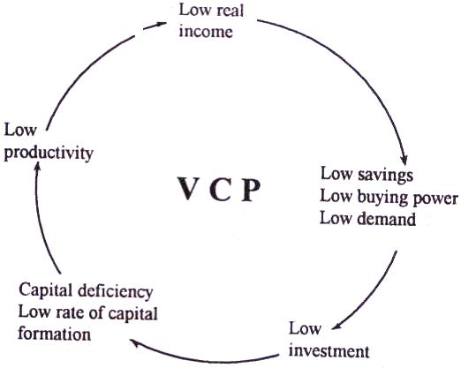

Slide 5

Objectives of Seminar
1
To understand the concept of Self Help Groups
2
To know the Performance of SHG’s in Rural Development
3
To review the research studies related to Self Help Groups

Slide 6
Concept of Self help groups (SHGs)

Slide 7
Meaning of Self help groups (SHGs)
According to the National Bank for Agriculture and Rural Development (NABARD) …
‘’Self help group is a : small, economically homogenous and affinity group of rural poor, voluntarily formed to save and mutually agree to contribute to a common fund to be lent to its members as per group decision for their socio-economic development”.
A self help group is meant for those people who develop themselves out of their own determination and with their own effort.
Sometimes little assistance from outside will speed up the process.

Slide 8
Definition of SHG
"A voluntary association of poor with a common goal of social and economic empowerment“
It is a voluntary association.
Homogenous, informal group & having common interest.
Intend to carry on savings & credit for mutual benefit.

Slide 9
Who promotes SHGs ?
Self Help Promoting Institutions (SHPI) like
Non-governmental organisations (NGOs)
Govt. agencies
Bank staff
Farmers' clubs
Rural volunteers

Slide 10
Role of self help promoting institutions (SHPI)
Identify poor
Organise poor into SHGs
Capacity building
Books maintenance
Social activities
Bank linkage
Guidance in economic activities
Plan for withdrawal

Slide 11
How poor are identified by SHPIs ?
Income/expenditure method- adopted by government agencies. Categorises rural families into BPL & APL families

Slide 12
Non-economic criteria
No access to pucca housing
No access to safe drinking water
No access to sanitary latrines
Unemployed person in the household
Eat less than two meals a day
Regularly borrow from moneylenders
More than two children in the family
Family belonging to weaker caste
Old illiterate members in the family
Permanently ill members in the family
Alcoholic and/or drug addicts in the family

Slide 13
Group formation norms
Affinity group - bound by
Mutual trust
Respect
Affection
Homogenous group-people with similar
Caste
Income
Age
Gender
Literacy level
Occupation
Place of origin

Slide 14
Books of accounts
What books of accounts?
Minutes Book
savings & loan register
cash book
members’ pass book
bank pass book

Slide 15
Growth path of a SHG
Stage | Time (months) | Focus
Pre-formation | 1-2 | Identification & organising poor
Formation | 2-6 | Group norms, meetings, savings, small loans, group cohesion
Stabilisation | 7-18 | Linkage with bank, leadership development, less reliance on others
Growth & expansion | >18 | Support for new groups federation of SHGs

Slide 16
Micro finance paradigm
The three players
SHGs – Facilitators for collective decision making by the poor and for providing doorstep banking.
Banks – Wholesalers of credit and providers of resources.
NGOs – Agencies to organise the poor, build their capacities and facilitate the process of empowering them.

Slide 17
SHG - Various models
Direct
Model I - Banks lend directly to SHGs formed by them & Govt. Agencies
Model II - Banks lend to SHGs with NGOs/MFIs acting as facilitators for organising & nurturing of groups
Indirect
Model III –Banks finance SHGs through NGOs / MFIs. In this model, banks lend in bulk to NGOs / MFIs for on lending to SHGs

Slide 18
SHG bank linkage- Savings Linkage
Savings first - Credit later - motto be followed by all members
Concept of “Income – Savings = Expenditure” to be followed
SHGs to open SB A/C in the nearby bank branch of its choice.
Bank to obtain group resolution & authorisation to open and operate the savings account
SHGs are not required to deposit their entire savings in the bank
Groups will become eligible to apply for loan after 6 months
Six months is not from the date of opening of SB account but from the date of formation of the group.

Slide 19
Assessment / Grading SHGs, Rating factors depend on
Composition
Age of the SHG
Meetings
Attendance %
Minutes book
Participation
Savings
Savings & loan recovery
Functioning & decisions
Internal lending
Interest on int. lending
Turnover of savings
Recovery of internal loans
Books of accounts
Group by-laws

Slide 20
FORMING SELF-HELP GROUPS
How do We Start?
How are Groups Formed?
How are Group Meetings Organised?
How do SHGs take shape?
How do SHGs function?
Characteristics and Functions of SHGs

Slide 21
Linking of SHGs to Bank
Step 1 – Opening of S/B Account for the SHG
Step 2 – Conduct of internal lending by the SHG
Step 3 – Assessment of SHGs
Step 4 – Sanction of Credit Facility to the SHG

Slide 22
Characteristics of SHG
" The ideal size of an SHG is 10 to 20 members.
" The group need not be registered.
" From one family, only one member.
" The group consists of either only men or of only women.
" Women’s groups are generally found to perform better.
" Members have the same social and financial background.
" The group should meet regularly.
" Compulsory attendance.

Slide 23
Functions of SHG’s
Saving and thrift
Internal lending
Discussing problems

Slide 24
Income generating activities of SHGs
Microfinance (lending small loan)
Preparation of paper bags, agarbathi, garlands, leather bags, phenyl, detergents, wire basket, candles, vermicompost, milk cova, palm leaf products, pickles and fruit juices
Dairying, sheep and goat rearing, poultry keeping, vegetable cultivation, fodder cultivation, fish culture, nursery raising, value addition to Non-timber forest products.
Vegetable, tailoring and cloth business/tea and grocery shops etc

Slide 25

Concept of Micro-Finance
Joshi, 2006
Micro-finance is defined as “The provision of thrift, credit and other financial services and products of very small amounts to the poor in rural, semi-urban or urban areas for enabling them to raise their income levels and improve their living standard”.
Source: JOSHI, D.P., 2006, Social Banking, Foundation Books Private limited, New Delhi.

Slide 26
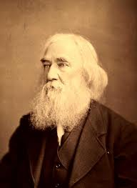
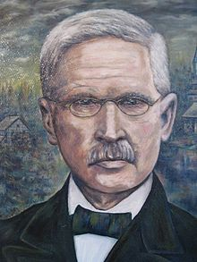
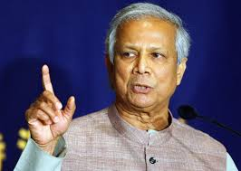
History of Microfinance
The concept evolved in 18th century with the publications of Lysander Spooner on benefits from small credits.
Friedrich Raiffeisen founded the first cooperative lending banks to support farmers in rural Germany.
The modern use of the expression "micro-financing" has roots in the 1970s when Dr. Muhammad Yunus started Grameen Bank in Bangladesh
Notes:
Lysander Spooner an American philosopher, argued that the small credit should be provided to poor people without interest by government.
Friedrich Raiffeisen started Agricultural Cooperative Bank in Germany to provide small credit to farmers.
Md younus started a project of financing rural poor women without any collateral

Slide 27
HISTORY OF MICRO-FINANCE
IN INDIA
Microfinance in India started in 1974 in Gujarat with Shri Mahila SEWA (Self Employed Women’s Association) Sahakari Bank.
Microfinance later evolved in the early 1980s around the concept of informal Self-Help Groups (SHGs).
During 1992, NABARD started linking SHGs to banks in India
Notes:
Microfinance in India started in 1974 in Gujarat as Shri Mahila SEWA (Self Employed Women’s Association) Sahakari Bank. Registered as an Urban Cooperative Bank, they provided banking services to poor women employed in the unorganised sector. Microfinance later evolved in the early 1980s around the concept of informal Self-Help Groups (SHGs) that provided deprived poor people with financial services. From modest origins, the microfinance sector has grown at a steady pace. Now in a strong endorsement of microfinance, the National Bank for Agriculture and Rural Development (NABARD) and Small Industries Development Bank of India (SIDBI) have committed themselves to developing microfinance.
In 1972 the Self Employed Women's Association (SEWA) was registered as a trade union in Gujarat (India), with the main objective of "strengthening its members' bargaining power to improve income, employment and access to social security." In 1973, to address their lack of access to financial services, the members of SEWA decided to found "a bank of their own". Four thousand women contributed share capital to establish the Mahila SEWA Co-operative Bank. Since then it has been providing banking services to poor, illiterate, self-employed women and has become a viable financial venture with today around 30,000 active clients.

Slide 28

Need of micro-finance in India
In India around 27 per cent population living below the poverty line.
About 60 percent of the poorest households do not have access to credit.
Only 20% access loan from the formal sources
Annual credit demand by the poor is estimated to be about Rs. 60,000/- crores and only Rs.12,000/- crores are disbursed.
Source: Indiastat, 2012

Slide 29
Activities of Micro-Finance
Micro-finance involves the activities like
Small loan for working capital,
Collateral securities such as group guarantees or compulsory savings,
Access to repeat and larger loans based on repayment performance,
Streamline loan disbursements and monitoring
Secure savings.
Rao and Sharma (2006)

Slide 30
Microfinance Models in India
Self Help Group- Bank linkage model
Micro-finance Institution Model (MFI)
Grameen Model
Individual Lending
> 97 per cent of Microfinance business

Slide 31
THE SELF HELP GROUP-BANK LINKAGE MODEL
It is the dominant microfinance methodology in India.
Started as a pilot project in 1992 by NABARD.
SHGs were linked to banks.

Slide 32
WORKING OF SHG-BANK LINKAGE MODEL
BANK
CREDIT
CLIENT
NGO /FACILITATOR
PROMOTION & TRAINING
SHG
MEMBER/CLIENT

Slide 33
TYPES OF SHG-BANK LINKAGE MODEL
Model | Type
I | Banks forms SHGs and finance them
II | NGOs forms SHGs and banks finance them
III | NGOs and other agencies, as financing intermediaries between banks and SHGs

Slide 34
MICRO-FINANCE INSTITUTIONS MODEL (MFI)
Micro-finance Institutions (MFls)
MFIs include NGOs, trusts, NBFCs,
These lend small sized loans to individuals or SHGs.
They also provide other services like capacity building, training, marketing of products etc.
Example
  Bhartiya Samruddhi Investments and Consulting Services Ltd. (BASICS Ltd) in Hyderabad

Slide 35
WORKING OF MFI MODEL
BANK
CREDIT
CLIENT
MFI/NGO
CLIENT
PROMOTION & TRAINING
SHG
MEMBER/CLIENT

Slide 36
Loans disbursed to MFIs by banks
Year | No. of MFIs | Amount (crores)
2008-09 | 581 | 3732.33
2009-10 | 779 | 10728.50
2010-11 | 471 | 8448.96
2011-12 | 465 | 5206.29
2012-13 | 426 | 7839.51
2013-14 | 545 | 10282.49
Source: Status of Micro-finance in India- 2015, NABARD

Slide 37
PROBLEMS IN MICROFINANCE
Insufficient loan amount
High interest rate (12 to 36% p.a. )
Low recovery of loans
Regional Imbalances in formation of SHGs
High level of illiteracy and lack of organizational experience of most members is a constraint for most SHG members in performing this role (Risk management, repayment monitoring, financial management, accountability etc.)

Slide 38
HOW MICRO-FINANCE HELPS IN AGRICULTURE DEVELOPMENT
1. Financial services:
-Funding for purchase of implements and inputs.
2. Non-financial services:
-Technical assistance, capacity building and information by the development officers
3. Market access for the produce:
-Formation of groups and encouraging group marketing
- Coordination with local extension agencies

Slide 39
Performance of SHG’s in Rural Development

Slide 40
Highlights of the SHG-Bank Linkage Programme
Sl.no | Particulars | Achievements
 |  | Physical (in lakhs) | Financial (Rs in crores)
1 | Total number of SHGs saving linked with banks | 74.30 | 9897.42
(i) | Out of total (of which) exclusive Women SHGs | 62.52 | 8012.89
(ii) | Out of total (of which) SHGs under NRLM/SGSY/Other Govt. spons. programmes | 22.62 | 2477.58

Slide 41
Highlights of the SHG-Bank Linkage Programme
Sl.no | Particulars | Achievements
 |  | Physical (in lakhs) | Financial (Rs in crores)
2 | Total number of SHGs credit linked during 2013-14 | 13.66 | 24017.36
(i) | Out of total (of which) exclusive Women SHGs | 11.52 | 21037.97
(ii) | Out of total (of which) SHGs under NRLM/SGSY/Other Govt. spons. programmes | 2.26 | 3480.60

Slide 42
Highlights of the SHG-Bank Linkage Programme
Sl.no | Particulars | Achievements
 |  | Physical (in lakhs) | Financial (Rs in crores)
3 | Total number of SHGs having loans outstanding as on 31 March 2014 | 41.97 | 42927.52
(i) | Out of total (of which) exclusive Women SHGs | 34.06 | 36151.58
(ii) | Out of total (of which) SHGs under NRLM/SGSY/Other Govt. spons. programmes | 13.07 | 10177.42

Slide 43
Highlights of the SHG-Bank Linkage Programme
Sl.no | Particulars | Achievements
 |  | Physical (in lakhs) | Financial (Rs in crores)
4 | Average loan amount outstanding/SHG as on March 2014 |  | 102273.21
5 | Average loan amount disbursed/SHG during 2013-14 * |  | 175768.36
6 | Estimated number of families covered up to 31 March 2014 | 97 million

Slide 44
Overall Progress under SHG-Bank Linkage for last 3 years
Particulars |  | 2011-12 |  | 2012-13 |  | 2013-2014
 |  | No. of SHGs (lakh) | Amount (crore) | No. of SHGs (lakh) | Amount (crore) | No. of SHGs (lakh) | Amount (crore)
SHG Savings with Banks as on 31st March | Total SHGs | 79.60 (6.7%) | 6551.41 (-6.7%) | 73.18 (-8.1%) | 8217.25 (25.4%) | 74.30 (1.53%) | 9897.42 (20.45%)
 | Of which NRLM/ SGSY/ Other Govt. spons. programmes | 21.23 (5.0%) | 1395.25 (-23.2%) | 20.47 (-3.6%) | 1821.65 (30.6%) | 22.62 (10.46%) | 2477.58 (36.01%)
 | % of NRLM/SGSY/ Other Govt. spons. programme Groups to Total | 26.7 | 21.3 | 28.0 | 22.2 | 30.45 | 25.03
 | All women SHGs | 62.99 (3.3%) | 5104.33 (-3.7%) | 59.38 (-5.7%) | 6514.86 (27.6%) | 62.52 (5.27%) | 8012.89 (22.99%)
 | Percentage of Women Groups | 79.1 | 77.9 | 81.1 | 79.3 | 84.15 | 80.96

Slide 45
Particulars |  | 2011-12 |  | 2012-13 |  | 2013-2014
 |  | No. of SHGs (lakh) | Amount (crore) | No. of SHGs (lakh) | Amount (crore) | No. of SHGs (lakh) | Amount (crore)
Loans disbursed to SHGs during the year | Total SHGs | 11.48 (-4%) | 16534.77 (13.7%) | 12.2 (6.3%) | 20585.3 (24.5%) | 13.6 (12.0%) | 24017.3 (16.67%)
 | Of which NRLM/ SGSY/ Other Govt. spons. programmes | 2.10 (-12.9%) | 2643.56 (6.6%) | 1.81 (-13.8%) | 2207.47 (-16.5%) | 2.26 (24.56%) | 3480.60 (57.67%)
 | % of NRLM/SGSY/ Other Govt. spons. programme Groups to Total | 18.3 | 16.0 | 14.8 | 10.7 | 16.52 | 14.49
 | All women SHGs | 9.23 (-9.2%) | 14132.02 (12.0%) | 10.37 (12.4%) | 17854.3 (26.3%) | 11.52 (%) | 21037.97 (11.02%)
 | Percentage of Women Groups | 80.4 | 85.5 | 85.1 | 86.7 | 84.3 | 87.6

Slide 46
Particulars |  | 2011-12 |  | 2012-13 |  | 2013-2014
 |  | No. of SHGs (lakh) | Amount (crore) | No. of SHGs (lakh) | Amount (crore) | No. of SHGs (lakh) | Amount (crore)
Loan out- standing against SHGs as on 31st March | Total SHGs | 43.54 (-9%) | 36340.00 (16.4%) | 44.51 (2.2%) | 39375.30 (8.4%) | 41.97 (-5.71%) | 42927.52 (9.02%)
 | Of which NRLM/ SGSY/ Other Govt. spons. programmes | 12.16 (-5.4%) | 8054.83 (2.9%) | 11.93 (-1.9%) | 8597.09 (6.7%) | 13.07 (9.55%) | 1177.42 (18.38%)
 | % of NRLM/SGSY/ Other Govt. spons. programme Groups to Total | 27.9 | 22.2 | 26.8 | 21.8 | 31.1 | 23.7
 | All women SHGs | 36.49 (-8.4%) | 30465.28 (16.6%) | 37.57 (2.9%) | 32840.04 (7.8%) | 34.06 (-9.34%) | 36151.58 (10.08%)
 | Percentage of Women Groups | 83.8 | 83.8 | 84.4 | 83.3 | 81.2 | 84.2

Slide 47
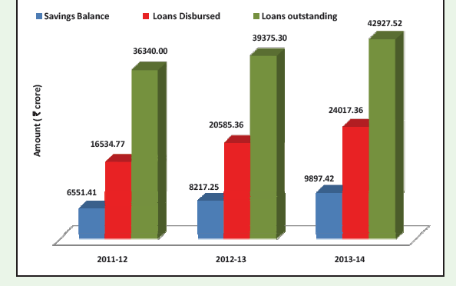
SHG‐Bank Linkage ‐ Highlights 2014

Slide 48
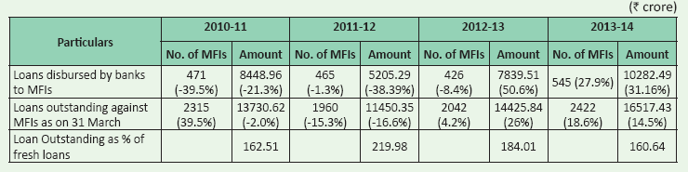
Progress under MFI-Bank Linkage Programme

Slide 49
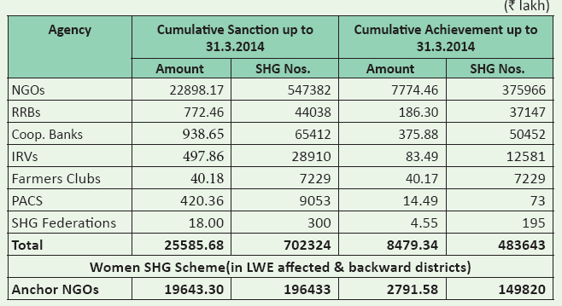
Grant Support to Partner Agencies for Promotion and Nurturing of SHGs
Notes:
Individual Rural Volunteers (IRVs)

Slide 50
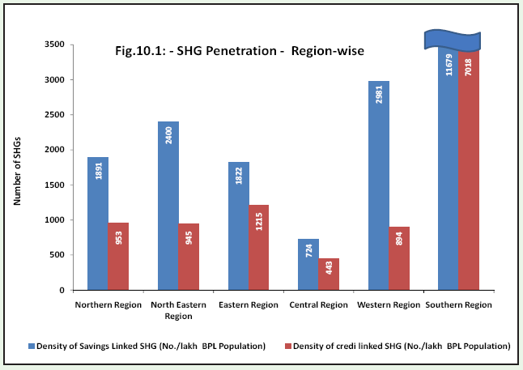
SHG penetration in different regions

Slide 51
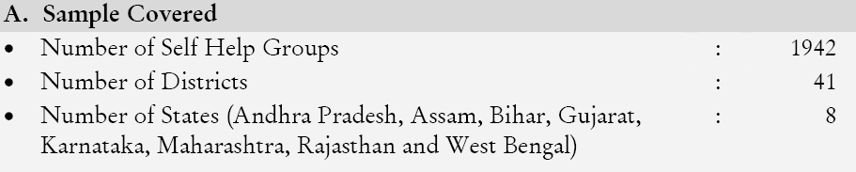
Self Help Groups (SHGs) in India: A Study on Quality and Sustainability
December 2012, K. Raja Reddy., C.S. Reddy
ENABLE

Slide 52
Profile of SHG members
Total SHG Members | 23,781
SC & ST members (%) | 33
Illiterate members (%) | 62
Vulnerable women category (%) | 14
Primary occupation (Labour & Agriculture) | 87
Landless households (%) | 43
Below Poverty Line members (%) | 62

Slide 53
Profile of SHGs
SC & ST groups (% of SHGs) | 30
Other SHGs (% of SHGs) | 70
Average age of SHGs (in years) | 5.38
Average size of SHGs (number of members) | 12
Percentage of SHGs reported dropouts | 38

Slide 54
Grades of SHGs
A-grade SHGs (%) | 42
B-grade SHGs (%) | 36
C-grade SHGs (%) | 22
SHGs enrolled with Federations (%) | 28

Slide 55
Savings
Average savings per month per member (in Rs.) | 53
Average cumulative savings amount per SHG (in Rs.) | 33,148
Average cumulative savings per member (in Rs.) | 2786
SHGs distributed savings among members (%) | 23.2
Avg. amount of idle funds – cash on hand + bank balance (in Rs.) | 13,516

Slide 56
Meetings
Periodicity of SHG meetings –monthly (%) | 66
Meetings – Weekly and Fortnightly (%) | 21
Avg. percentage of meetings conducted over the past 6 months | 84
Avg. percentage of members’ attendance in meetings | 73

Slide 57
Book Keeping
Maintenance of books by SHG leaders (%) | 78
Books written by SHG members (%) | 62
SHGs paying honorarium to book keepers (%) | 21
Avg. amt. of honorarium to book keeper per month (in Rs.) | 72

Slide 58
Leadership
SHGs changed their group leaders (%) | 41
Number of SHG women contested for PRI elections | 375
Number of SHG women won in the elections | 239

Slide 59
Average On-Time Repayment Rate (in %)
SHGs to Banks | 72
SHGs to Federations | 88
SHGs to NGO-MFIs | 81

Slide 60
Financial performance
Average amount of group corpus(in Rs.) | 102,863
Avg. balance in SHG SB Account (in Rs.) | 11,900
SHG reported profit/surplus (% of SHGs) | 87

Slide 61
Credit access to banks
Percentage of sample SHGs having a loan outstanding to banks | 59
Avg. loan size under SHGs – BL programme (in Rs.) | 118,623
SHG savings and Loan ratio | 1: 3.5
A& B-grade SHGs not credit linked to banks (% of SHGs) | 35/41
Inadequate quantum of loan (%) | 43
Bank loans are not timely (%) | 27
Short loan repayment period (%) | 22

Slide 62
Impact –Opinion of sample SHGs
Percentage of SHGs promoted new groups | 20
Percentage of SHGs revived defunct groups | 10
Percentage of SHGs formed on their own | 12
Money lenders reduced interest rates on loans (%) | 9
Learnt to sign (% of SHGs) | 88
SHG Women attends (alone) to meetings outside the village | 66
Casting of own vote- decides solely (%) | 52
SHG women contested to political office (%) | 29
Women taking up non-traditional works (%) | 30
Work burden on women – increased (%) | 50
Different etiquettes to various social categories (%) | 29
Husband shares the household work (%) | 68

Slide 63
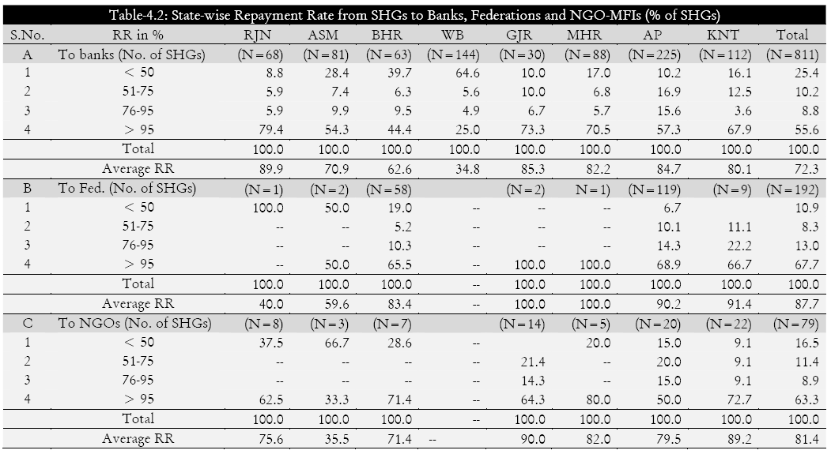

Slide 64
SELF HELP GROUPS PERFORMANCE IN INDIA
DR. N. SREEDHAR
Arth Prabandh: A Journal of Economics and Management
Vol.1 Issue 8, November 2012, ISSN 2278‐0629

Slide 65
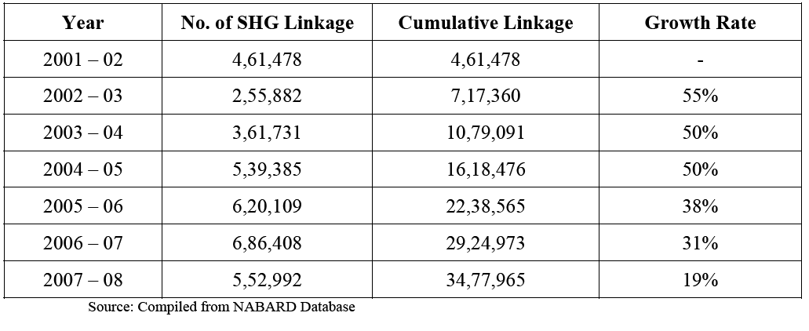
SHG BANK LINKAGE IN INDIA

Slide 66
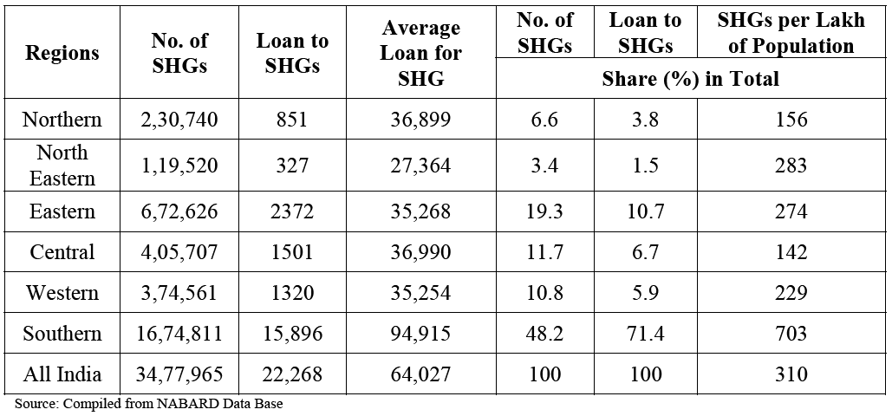
REGION – WISE PROGRESS OF SHG – BANK LINKAGE PROGRAMME
AS ON 31ST MARCH, 2008

Slide 67
impact of SHGs on socio economic development
Development of strong, cohesive Self help Women groups, through inculcation of self help and team spirit.
Habit of saving
leadership development
Helping to build a financially sound and sustainable future by getting out of the clutches of moneylenders.
Knowledge on various welfare programmes of Government and banks in villages through linkages facilitated with Government agencies.
Economic development
Women gain confidence and their voices are heard.
Access to markets through training and exposure.

Slide 68
Role of SHG in women empowerment
The role of SHG contributing for women’s empowerment includes
Economic empowerment
Social empowerment:
Education, skill and training empowerment:
Political empowerment:

Slide 69
Economic empowerment
Roles include,
Enhances the women’s contribution to the household’s income as a result of credit access.
Helps in employment generation,
Helps in understanding the bank transactions.
Improves women’s access and control over the resources.

Slide 70
Social empowerment
Roles include,
Micro-finance helps women to gain confidence,
Helps to gain respect in the family,
Increase the role of women in household decision making,
Improves the ability of women to freely interact with members of the group and outsiders and
Increase mobility of women within and outside their locality.

Slide 71
Education, skill and training empowerment
Roles include,
Micro-finance improves the literacy level of the family Members.
Creates awareness about children’s education.
Imparts training on income generating activities.
Helps in gaining knowledge on maintaining records of financial transactions.

Slide 72
Political empowerment
Roles include,
Micro-finance increases the participation of women in local bodies.
Increase the number of women in decision making power of local governments.
Increase the number of women in local protests and political campaigns.

Slide 73
SHGs contribute for the Rural development in the following manner
Inculcate saving habit
Increase income and standard of living
Alleviate poverty and promote economic independence
Increase self confidence and self respect
Generate self employment opportunities
Decision making and political leadership
More access to amenities.

Slide 74
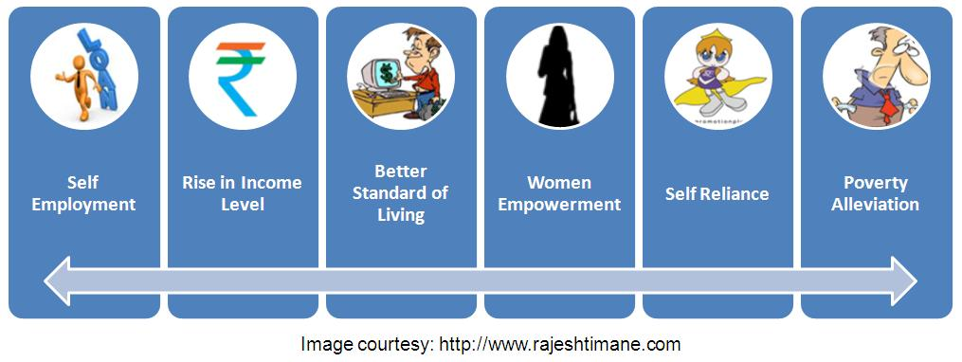
socio-economic impact of SHGs on rural development

Slide 75
Capacity building for SHGs
SHGs are provided with ‘seed money’ to initiate income generation activities and micro financing activities.
The Government departments, NGOs, Banks and other agencies will imparted training for the SHGs to undertake income generation activities for their livelihood.

Slide 76
Capacity building and marketing strategies for SHG members
Training should be imparted by either Government or NGOs to the SHG members on the IGAs (selection and manufacturing of products ), packing and packaging, quality consciousness, pricing, promoting through branding and advertising.
Ensuring the availability of raw materials at subsidized rate at affordable prices at appropriate time.
Adequate finance should be made available for SHG members when needed so that they can purchase raw materials.
SHG members should be trained to identify potential markets, first in their own locations, taluks, district, and states, before embarking on the national or international markets.
Create avenues for marketing/selling of rural products :
Government/ NGOs should facilitate in exhibit and sell their (SHGs) products regularly.
There is also a need to construct permanent market places for the marketing /selling of the products.

Slide 77
Constraints of SHGs
Insufficient ‘seed money’ to initiate and sustain income generation activities
Inadequate availability of raw materials at the right time
High cost of raw materials
Lack of skill enhancement training on various IGAs
Time constraints on part of the women
Politicization and vested interests
Illiteracy and lack of common place for meetings.
Difficulty in maintaining books and records keeping due to illiteracy among SHG members
Lack of cooperation and team work among group members
Lack of adequate storage and transportation facilities
Lack of marketing knowledge among SHG members
Lack of good price and local demand/marketing facilities
Delayed payment for goods etc.,

Slide 78
SWOT analysis of SHGs
Strengths
  Good quality of the produce
  The members are trained to move in a group
  The members are generating income and also gradually empowered etc

Slide 79
SWOT analysis of SHGs
Weakness
  Cropping of inter and intra personal problems after a few months of the formation of group
  Unnecessary political interference violates the noble goals and aims of SHG
  Many SHG units find it difficult to market their products immediately after the production
  Occasionally competition between SHGs and also competition from outside agencies leads to failure of SHGs
  The long run sustainability is a very important issue

Slide 80
SWOT analysis of SHGs
Opportunities
  Penetration in the rural markets
  Developing networks
Threats
  Competition
  Sustainability

Slide 81
CASE STUDY

Slide 82
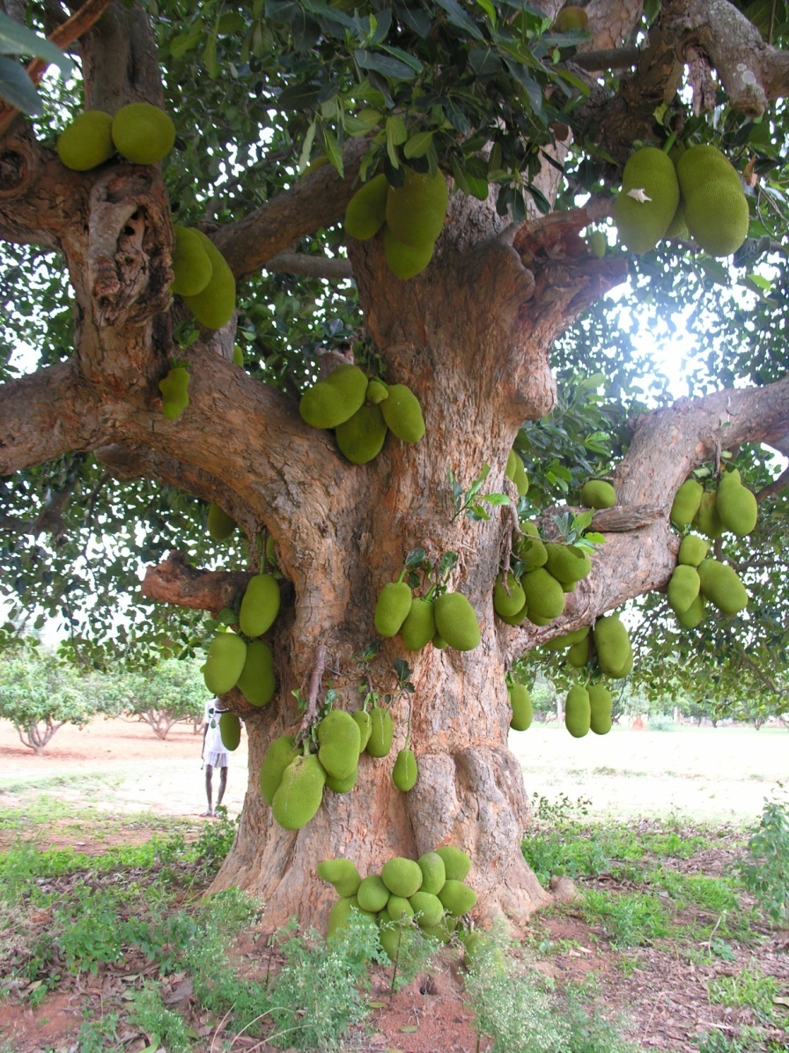
RURAL BIO-RESOURCE COMPLEX (RBRC) MODEL
Mandate: To increase farmers’ income and living standards by way of addressing end-to-end issues.
April 2005 – March 2010
Families Covered: 8340
Villages Covered : 75, Tubagere Hobli
Geographical Area : 13990 ha
Cultivated Area: 9469 ha
Enhanced Net Income : 3 folds
Agricultural Growth Rate : 11 %

Slide 83
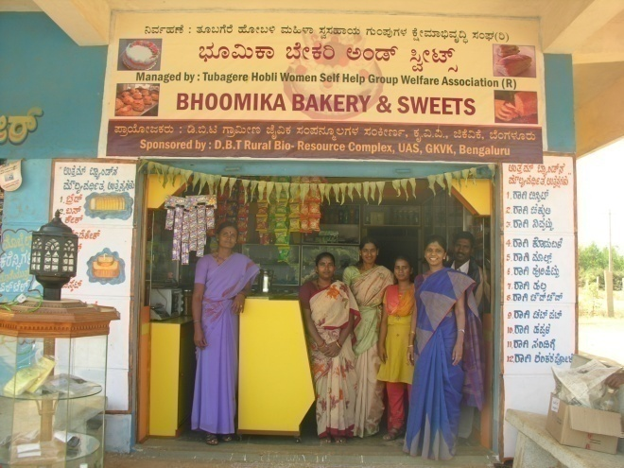
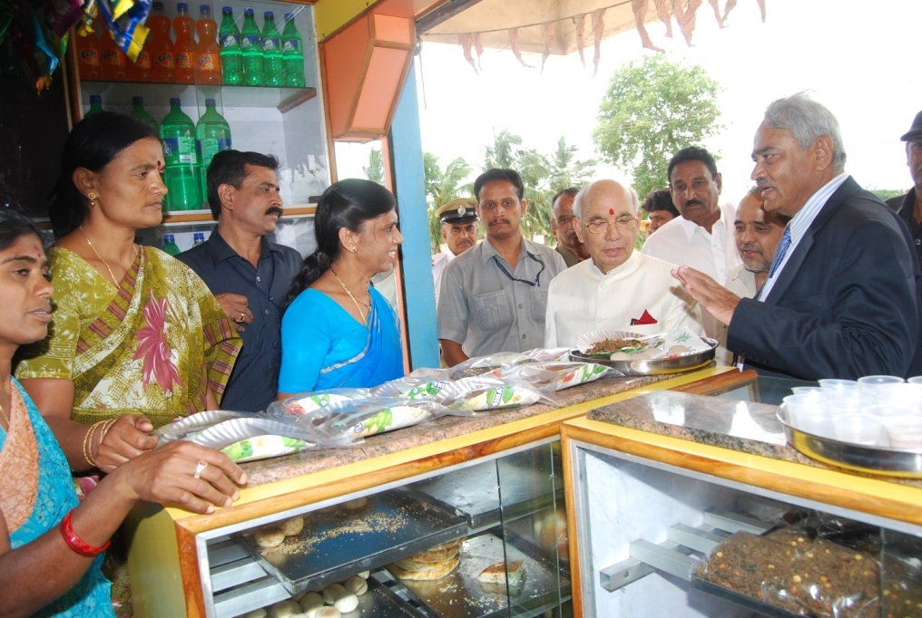
FEDERATION OF WOMEN SHG’S, HADONAHALLI
To address Ragi malt marketing
Launched on 29-9-2007 involving all 272 SHGs of Tubagere Hobli.
24 SHGs are members and others to follow
Licensed and authorized to produce & sell Ragi malt.
182 SHGs trained on ragi malt production technology
5 Mini Flour Mills with sealing machines were provided to hasten production and ensure quality.
Federation’s Bakery Unit is selling 15 value added products of ragi under the brand “UTHAM”
  The daily transaction of the bakery is Rs. 1500 – 2000.
Honorable Governor, GOK interacts

Slide 84
A model for Federation of Women SHG’s
Local leaders
Local Institutions and NGOs
DBT-RBRC and KVK
Empowerment and Follow up
Federation of Women’s Association
KMF
Corporation Bank, Tubagere

Slide 85
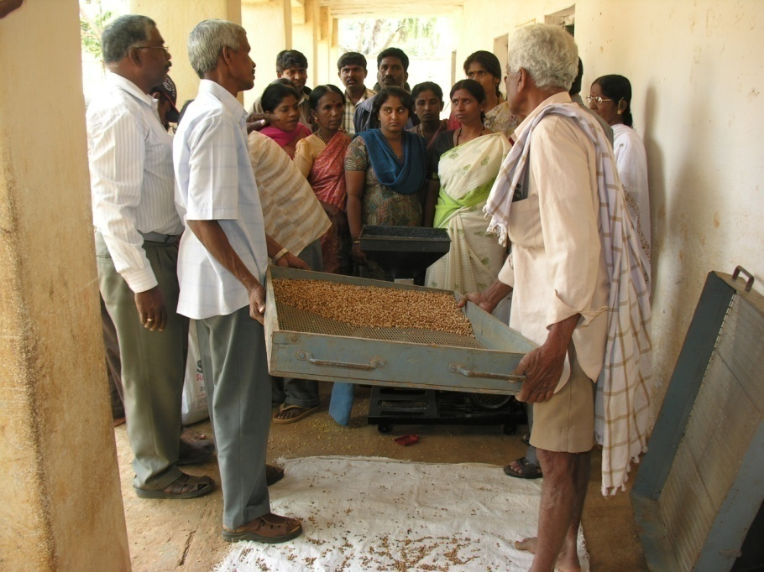
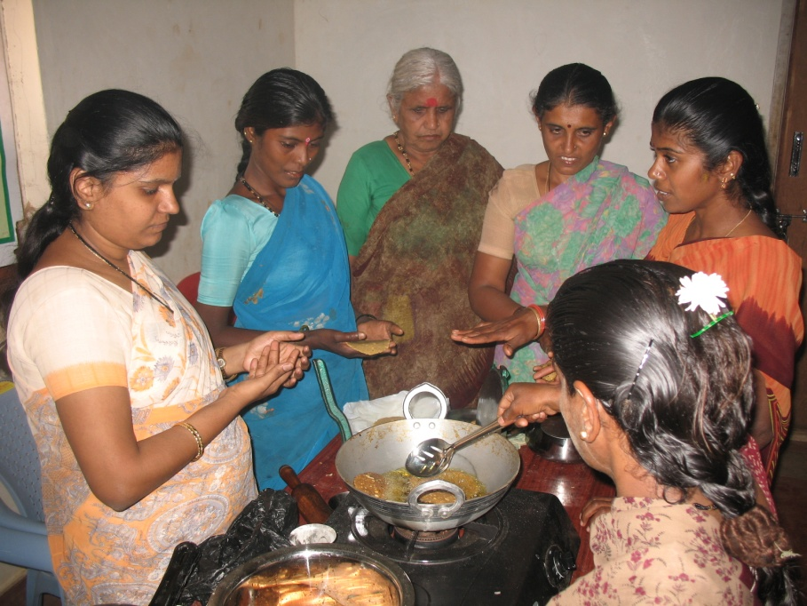
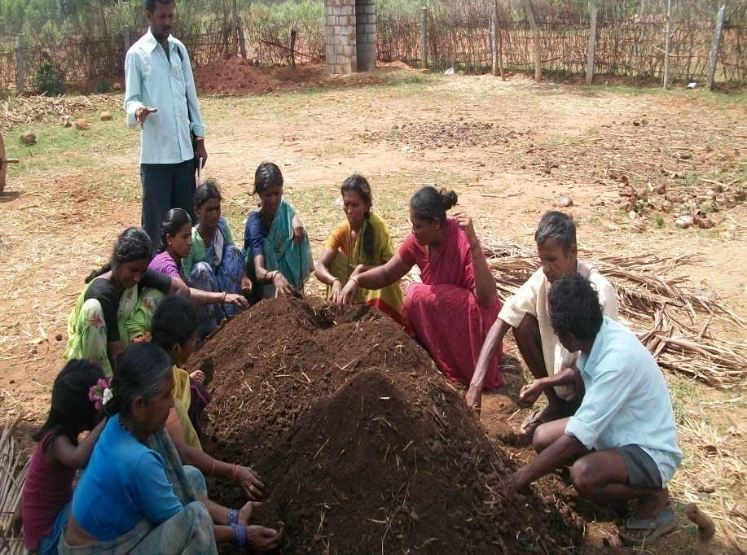
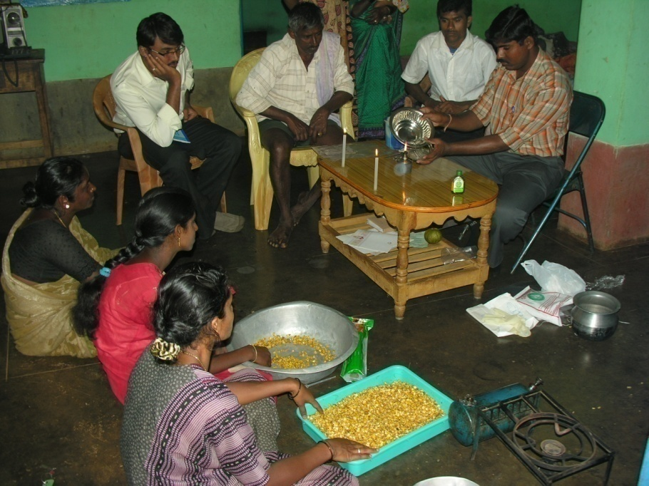
Empowering Rural Women through SHGs
Training on Dhal Mill
Value Added Ragi Products
Vericompost preparation
Trichoderma preparation

Slide 86
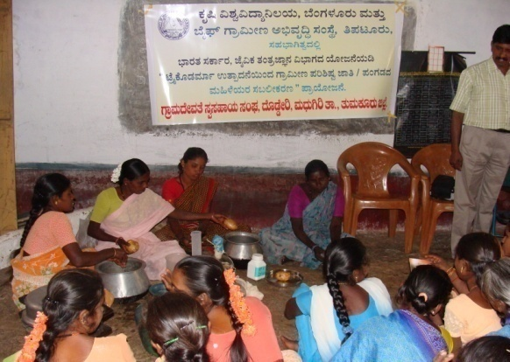
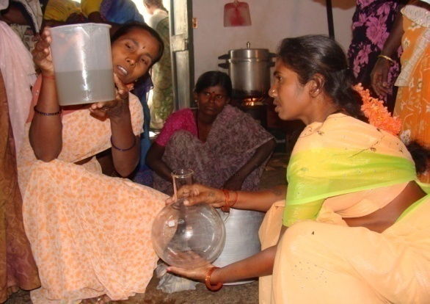
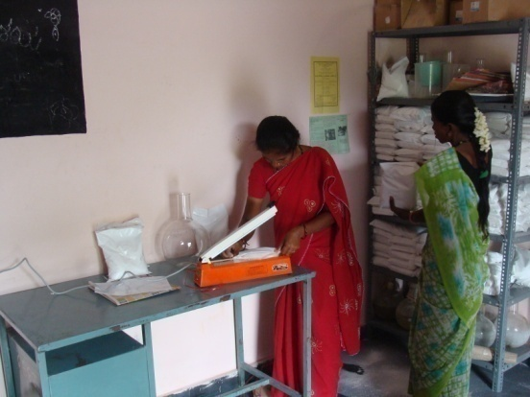
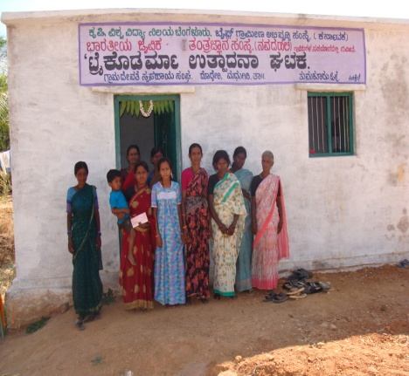
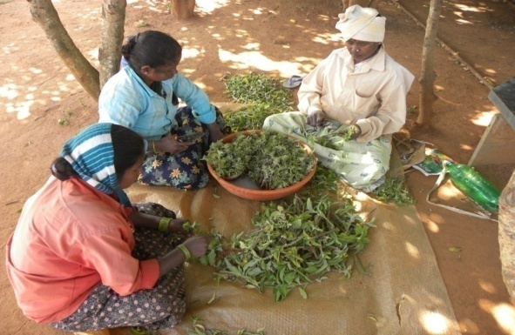
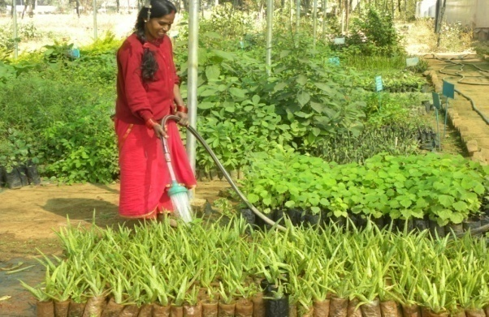
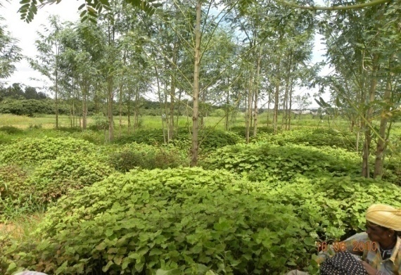
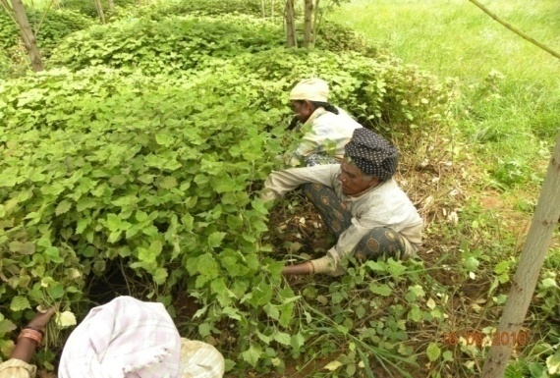
Trichoderma Production
Income Generation activities of SHGs
Quality Planting Material of Medicinal and Aromatic Plants

Slide 87
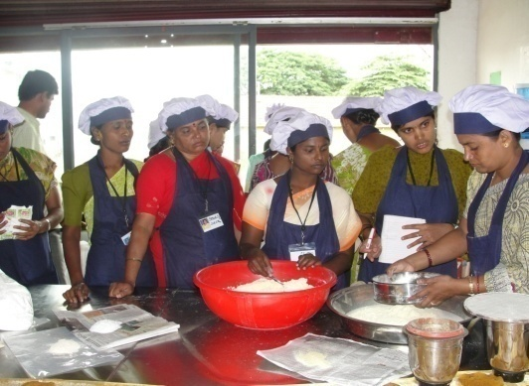
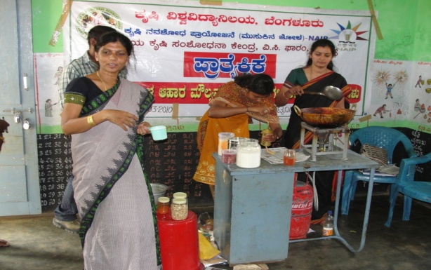
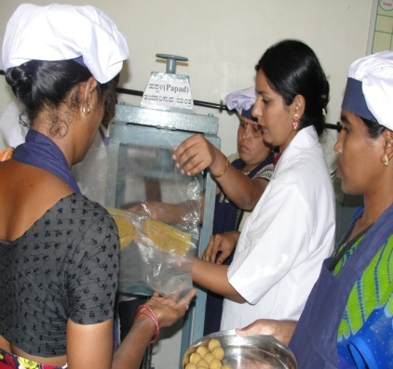
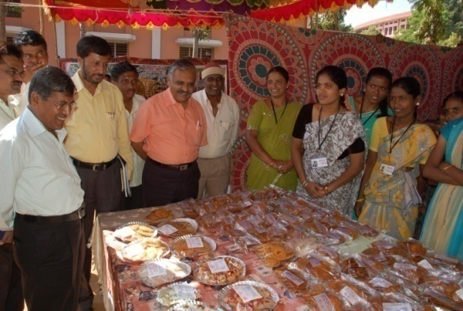
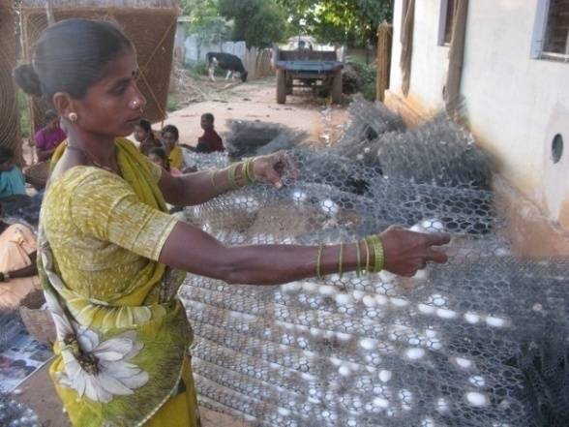
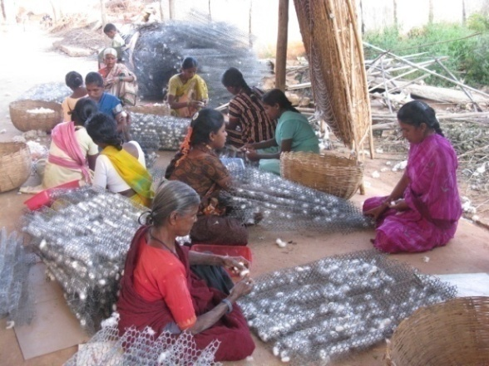
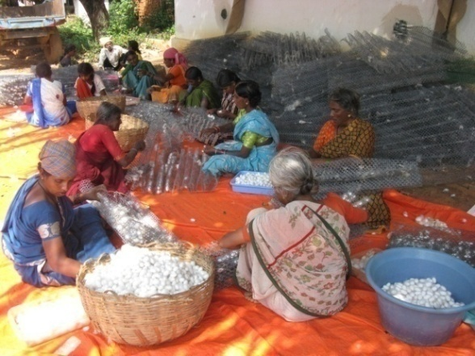
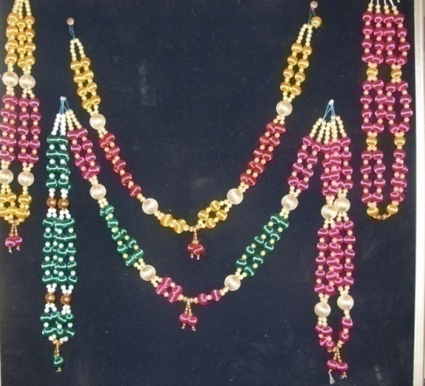
I. b. Income Generation activities of SHGs
Value Added Products of Maize
Preparation of garlands using cocoons

Slide 88
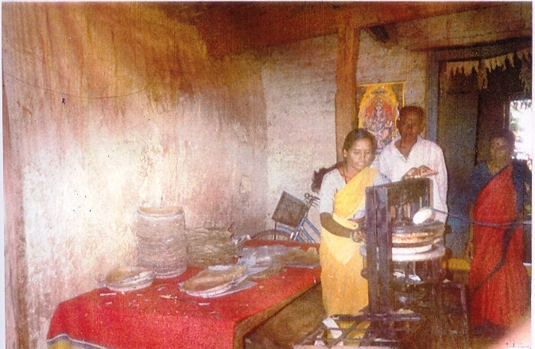
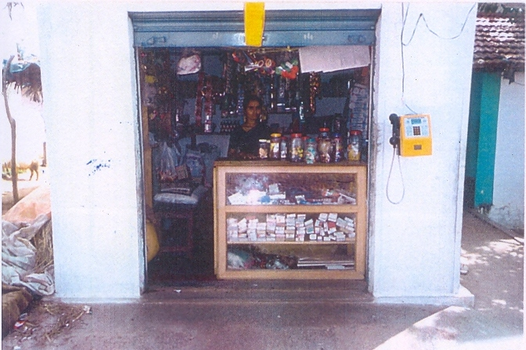
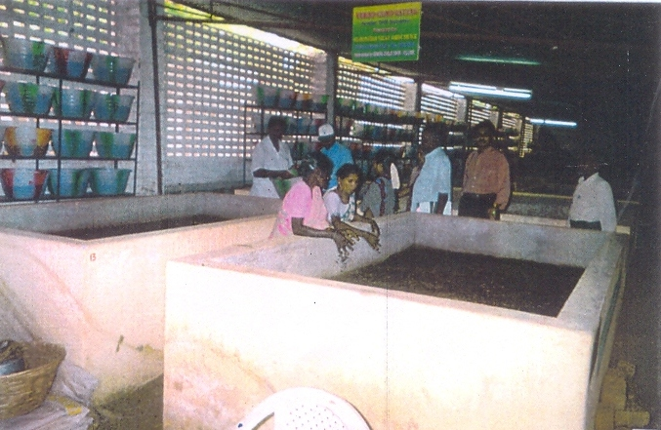
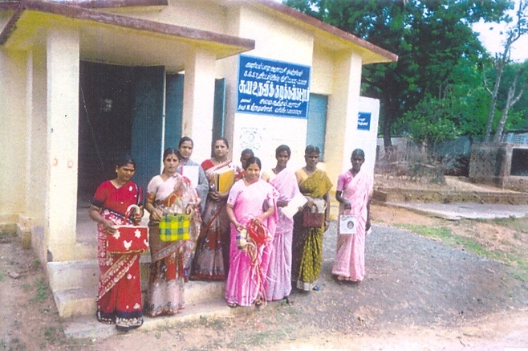

Slide 89
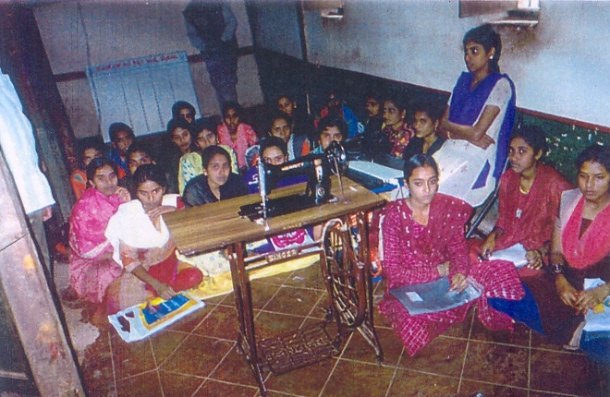
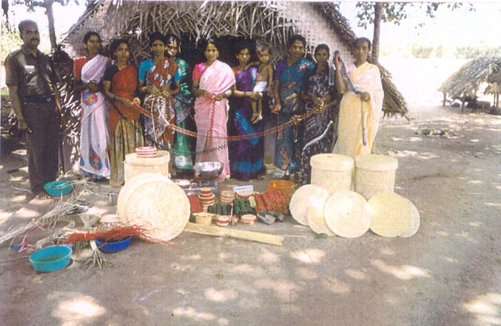
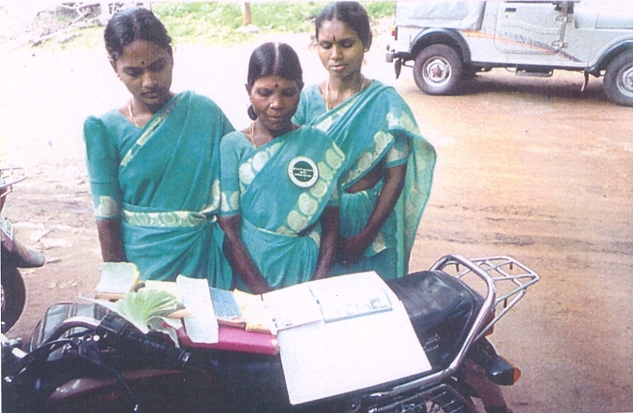
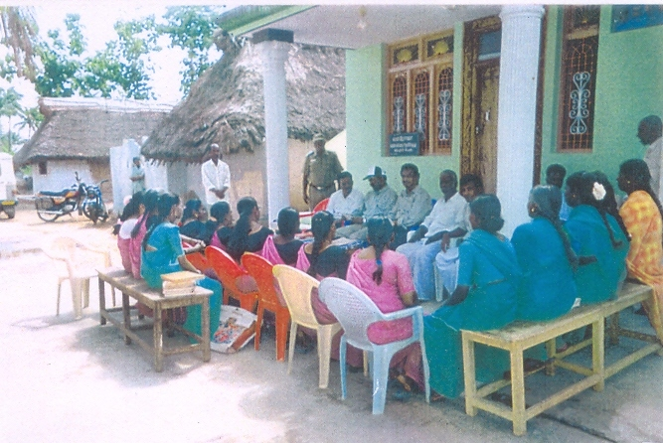

Slide 90
RESEARCH STUDIES

Slide 91
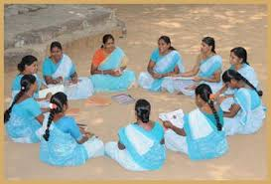
Research study 1
“A study on the performance of Self Help Groups (SHGs) in Ramanagara District of Karnataka.”
ASHA K., 2015

Slide 92
Methodology
Sample size:
President,
Secretary &
13- Members
from each SHG
Total sample size n=120
SHG 1
SHG 2
Magadi Taluk
SHG 3
SHG 4
Ramanagara District
SHG 1
SHG 2
Channapattana Taluk
SHG 3
SHG 4

Slide 93
distribution of SHGs according to their level of performance
(n=8 SHGs)
Sl. No. | Category | Frequency | Per cent
1. | Low (≤ 27.29) | 2 | 25.00 | Mean = 28.25
2. | Medium (27.29 – 29.21) | 2 | 25.00
3. | High (≥ 29.21) | 4 | 50.00 | S.D. = 1.915
 | Total | 8 | 100.00

Slide 94
Association between Independent variables with Performance of SHG (n = 120)
Sl. No. | Independent variables | Chi square | Coefficient of contingency (c)
1. | Age | 19.57** | 0.87
2. | Education | 00.71^{NS} | 0.06
3. | Family type | 38.81** | 0.96
4. | Family size | 13.12** | 0.76
5. | Marital status | 74.64** | 0.98
6. | Annual income | 03.43 ^{NS} | 0.29
7. | Extension participation | 00.29 ^{NS} | 0.02
8. | Social participation | 12.19** | 0.74
9. | Mass media exposure | 00.55 ^{NS} | 0.05
10. | Cosmopoliteness | 06.35* | 0.50
11. | Risk willingness | 00.65 ^{NS} | 0.05
12. | Achievement motivation | 00.89 ^{NS} | 0.08
13. | Management orientation | 07.39* | 0.56
14. | Deferred gratification | 00.69 ^{NS} | 0.06
* Significant at 5% level ** Significant at 1% level NS – Non Significant

Slide 95
Overall constraints experienced by SHG members
Sl. No. | Problems | Per cent | Rank
1. | Opposition from family members | 21.67 | I
2. | Not able to attend training | 10.83 | II
3. | Not able to attend meeting | 5.00 | III
4. | Insufficient savings | 4.17 | IV
5. | Sometimes difficult to repay loan | 2.5 | V

Slide 96
Suggestions offered by the members to overcome the constraints of Self Help Groups
Sl. No. | Suggestions | Per cent | Rank
1. | Convincing the family members | 13.33 | I
2. | Change the time or place of meeting or training | 11.67 | II
3. | Increase the amount to be saved | 04.17 | III
4. | Somehow manage to participate | 03.33 | IV
5. | Support from other members at the time of difficulty | 02.5 | V

Slide 97
Research Study 2.
Title of the study:
Income generating activities of Self Help Groups in the JFM committees under NAP scheme in four Southern States-A Special study,
Authors:
Bhaskar, V., Lakshminarayan, M.T., Umamaheshwar, P, And Siddeshwara, H.E.
Year:
2006

Slide 98
Methodology
The study conducted by Regional Centre, National Afforestration and Eco-development Board (NAEB), Bangalore during 2005-06.
A total of 71 women SHGs were sampled in four states
Totally 181 respondents were selected for the study.
State | No. of SHGs selected
Karnataka | 18
Andhra Pradesh | 18
Kerala | 15
Tamil nadu | 20

Slide 99
Findings
Micro-financing was the common activity of SHGs.
Rate of interest on loans
Loans were used for taking up income generating activities
Activity | ROI (Per Cent/Month )
Income generating activity | 2
Other purpose (marriage and education ) | 1

Slide 100
Income generating activities in four states
Collection and sale of NTFPs (Honey, Tamarind, soap nut, etc.) and medicinal plants.
Preparation and sale of bamboo handicrafts
Nursery raising and selling seedlings
Petty shops and canteen
Cloth, milk and tailoring business
Collection of plastic wastage, grinding and reselling
Sheep and goat rearing and
Vegetable cultivation
SHG Members were able to get full employment throughout the year and save money

Slide 101
Findings
Table1. Additional income generated by SHG members utilizing loans through microfinance
State | Income of SHG member/month
Andhra Pradesh | Rs. 500-Rs. 1800
Karnataka | Rs. 750-Rs. 1400
Kerala | Rs. 500-Rs. 1500
Tamil nadu | Rs. 500-Rs. 1500

Slide 102
Findings
Social impact of micro-finance includes
Peer support
Mobility of members outside the locality
Expansion of knowledge and awareness
Collective discussion and action
Skill building and training
Greater respect within the family

Slide 103
Research Study 3.
Title of the study:
Role of Micro-finance in women’s empowerment
(A study in Pondicherry region rural SHGs)
Authors:
Sarumathi, S, and Mohan, K.
Year:
2011

Slide 104
METHODOLOGY
Locale of the study- Rural areas of Pondicherry region
Selection of SHG- Six SHGs promoted by NGO were selected
Selection of respondents-181 SHG women members
Members who are engaged in micro enterprises through microfinance were selected for the study

Slide 105
Findings
Table 1. Perception of members about reduction in poverty level due to micro finance
(n=181)
Category | Number | Percentage
To greater extent | 167 | 92.26
To some extent | 14 | 07.74
To lower extent | 0 | 0.00
Total | 181 | 100

Slide 106
FINDINGS
Table 1: Social empowerment of women members
n=181
Dimensions | Response | Frequency | Percentage
Expression of opinions freely | Yes | 179 | 98.90
 | No | 2 | 1.10
Moving independently | Yes | 164 | 90.60
 | No | 17 | 9.40
Role in decision making in family | Yes | 176 | 97.20
 | No | 5 | 100.00

Slide 107
Findings
Table 3: Cross tabulation of psychological variables with different age groups
n-=181
Variables | 20-30 |  | 31-40 |  | 41-50 |  | 51-60 |  | Total
 | Yes | No | Yes | No | Yes | No | Yes | No
Self confidence | 85 | 0 | 40 | 0 | 31 | 0 | 25 | 0 | 181
Improvement in courage | 90 | 0 | 35 | 0 | 36 | 0 | 20 | 0 | 181
Improvement in skill | 93 | 0 | 30 | 0 | 38 | 1 | 20 | 2 | 181
Improvement in literacy level | 76 | 9 | 22 | 11 | 18 | 13 | 7 | 25 | 181
Awareness on children's education | 78 | 7 | 40 | 7 | 18 | 10 | 10 | 11 | 181
Awareness about the environment | 84 | 1 | 38 | 2 | 31 | 21 | 21 | 4 | 181
Happiness and peace in the family | 83 | 3 | 38 | 1 | 29 | 23 | 23 | 2 | 181

Slide 108
Research Study 4.
Title of the study:
Role of micro-finance in political empowerment of women: Bangladesh experience.
Authors:
Mohshin Habib and Christine Jubb
Year:
2012

Slide 109

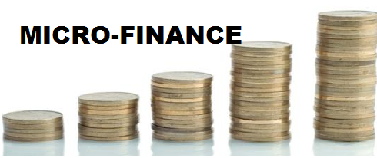
Methodology
Locale of the study: Three districts Gaibandha, Gazipur and Kurigram in Bangladesh.
Respondents:
Sl.no | Sample | Number
1 | Members of Bangladesh Association for Social Advancement (BASA) | 198
2 | Control group | 99

Slide 110
FINDINGS
Table 1: Voting practice of BASA members and control group
Voted at last election | Non members (n=99) |  | BASA members (n=198)
 | Number | Per cent | Number | Per cent
Yes | 80 | 80.81 | 195 | 98.00
No | 19 | 19.19 | 3 | 02.00

Slide 111
FINDINGS
Table 2: Factors influencing the voting decision of the members and non-members
Factors Influencing on voting decision | NON members (n=99) * |  | BASA members (198) *
 | No. | Per cent | No. | Per cent
Personal preference | 24 | 24.24 | 124 | 62.60
Local community preference | 23 | 23.23 | 18 | 09.10
Perceive candidate will bring economic prosperity | 15 | 15.55 | 91 | 45.95
Influence of the leader is from locality | 2 | 02.02 | 34 | 17.17
Candidates personal qualities | 7 | 07.07 | 28 | 14.14
Candidates educational attainment | 1 | 01.01 | 18 | 09.09
Candidates financial capacity | 1 | 01.01 | 3 | 01.50
Party affiliation | 0 | 0 | 49 | 24.74
Pressure from local leader | 37 | 37.37 | 25 | 12.62
* Multiple responses

Slide 112
Research Study 5.
Title of the study:
Impact of Microfinance - an empirical study on the attitude of SHG leaders in Kanyakumari district of Tamil Nadu
Authors:
N. Thalavai Pillai and S. Nadarajan
Year:
2012

Slide 113
Methodology
Locale of the study-Kanyakumari District of Tamil Nadu
Selection of SHGs -
Selection of respondents- leader of each SHG
Blocks | No of SHGs
Thovalai | 30
Thiruvattar | 26
Total | 56

Slide 114
FINDINGS
Table - 1 Impact of Microfinance on Psychological well being
(n=56)
Sl.No | Variable | No | Percentage
1 | Improvement in Courage | 54 | 96.42
2 | Improvement in Self confidence | 53 | 94.64
3 | Improvement in Self worthiness | 51 | 91.07
4 | Improvement in Skill development | 28 | 50.00
5 | Improvement in Literacy level | 26 | 46.42
6 | Awareness on Health and Sanitation | 25 | 44.64
7 | Awareness on Children’s Education | 34 | 60.71
8 | Awareness on Food and Nutrition | 22 | 39.28
9 | Awareness about the Environment | 29 | 51.78
10 | Awareness about Peace in the family | 41 | 73.21

Slide 115
Findings
Table - 2 Impact of Microfinance on Economic Improvement of women
(n=56)
Sl.No | Variable | Number | Percentage
1 | Women are economically empowered | 39 | 69.64
2 | Microfinance reduce poverty | 37 | 66.07
3 | Microfinance improve rural savings | 38 | 67.85
4 | Increased employment opportunities | 34 | 60.71
5 | Created assets in rural areas | 28 | 50.00
6 | Increase the standard of living | 26 | 46.42

Slide 116
FINDINGS
Table -3 Impact of Microfinance on Social empowerment of women
(n=56)
Sl.No | Variable | Number | Percentage
1 | Managerial abilities of women | 32 | 57.00
2 | Role in decision making within the family increased | 30 | 54.00
3 | Group management skill improved | 28 | 50.00
4 | Awareness about training by NGO | 35 | 62.50
5 | Micro enterprises in study area | 28 | 50.00
6 | Participation in democratic institutions | 21 | 37.50
7 | Freedom to express opinion in society | 40 | 71.42
8 | Improved independent movement | 39 | 70.00

Slide 117
Research Study 6.
Title of the study:
Impact of SHG based micro finance in women empowerment and poverty alleviation
Authors:
Himanshu Tiwari
Year:
2012

Slide 118
Methodology
Locale of the Study- Nagpur city
Selection of SHGs- 3 SHGs were selected randomly
Selections- 50 respondents selected from 3 SHGs

Slide 119
Findings
Table-1: Impact of micro finance on standard of living
(n=50)
Sl.No | Name of the instrument purchased | Number | Percentage
1 | Cooking gas | 6 | 12
2 | Sewing machine | 5 | 10
3 | Television | 5 | 10
4 | Motorcycle | 3 | 6
5 | Washing machine | 2 | 4
6 | Refrigerator | 4 | 8
7 | Cooker | 6 | 12
8 | Phone | 6 | 12
9 | Cooler | 5 | 10
10 | Utensils | 8 | 16

Slide 120
Table 2. impact of micro finance on employment
(n=50)
Sl.no | Average number of mandays Before joining SHGs | Average number of mandays after joining
mandays | 120 | 180

Slide 121
CONCLUSION
SHGs have done well in the country to alleviate poverty and empower rural people.
The emergence of small enterprises and its activities have made a considerable contribution in the socio-economic development of rural poor in the society.

Slide 122
Thank you……………

