Slide 1
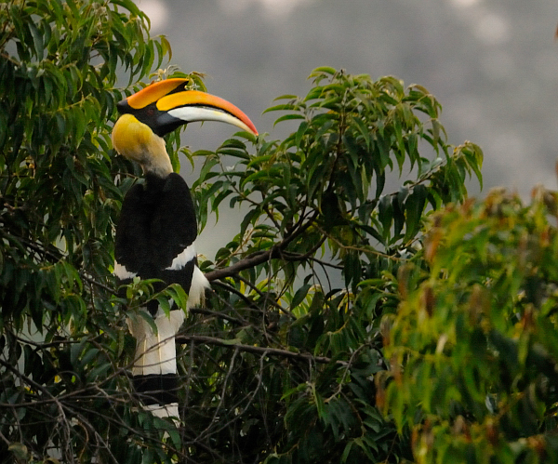
WELCOME
WELCOME

Slide 2
IV - SEMINAR
ON
Application of Break-Even Analysis – A review
PRESENTATION BY :
ABDUL SATTAR FAZELY
PALB 2309
Sr. Ph.D.(Agril. Extn.)

Slide 3
CONTENT OF THE SEMINAR
Introduction
Objectives
Concept and definition
Theory of production
Application of Break-even analysis
Case Studies
Conclusion

Slide 4
Break – even analysis is a useful tool to study the relationship between fixed costs, variable costs and returns. A break- even point defines the value of output or benefit generated, will be equal to the total cost incurred. This is the no profit no loss point and if at all any profit is expected, the level or value of the output should increase above break-even point. This technique can be used to arrive at the level of production or benefit to generate for reaching the derived level of profit.
INTRODUCTION

Slide 5
OBJECTIVES OF THE SEMINAR
To understand the concept and definition of Break even analysis
To know and discuss about the application of Break even analysis
To review the case studies related to Break even analysis.

Slide 6
Concept and definition
Break even analysis is used to determine how much sales volume your business need to start making a profit.
Thus, Break even analysis is specially useful when you are developing a pricing strategy, either as part of a marketing plan or business plan.

Slide 7
Cont..
Break even point analysis is a decision-making aid that enable a manager to determine whether a particular volume of sales will result in losses or profits.
In economic and business, specifically cost accounting, the break even point (BEP) is the point at which cost or expenses and revenue are equal ; there is no net loss or gain, and one has “broken even” (Total cost=Total revenue= BEP)

Slide 8
Basic concept
Fixed cost : are those costs, which are incurred after the decision to enter into a business activity is made. These are expenses that do not vary or change according to production. Whether there is production or no production, this cost will have to be incurred as long as the unit is functioning. The fixed cost includes depreciation on equipment and building, interest costs and taxes.
Variable cost : are those cost which vary in the same proportion with variation in output. This includes expenses directly related to the production of an output or commodity.

Slide 9
Cont…
Revenue is the total income received.
Profit is the money you have after subtracting fixed cost and variable cost from revenue.
Expected unit sales is the number of units of the product projected to be sold over a specific period of time.
Unit price is the amount of money changed to the customer for each unit of a product or service.

Slide 10
Cont..
Total variable cost is the product of Expected Unit Sales and Variable Unit Cost
(TVC = EUS * VUC)
Total cost is the sum of fixed cost and total variable cost for any given level of production.
( Total Cost = Fixed cost + Total variable Cost)
Total Revenue is the product of expected unit sales and unit price. (TR = EUS*UP)
Profit or loss is the monetary gain (or loss) resulting from revenues after subtracting all associated cost. ( P or L = TR – TC)

Slide 11
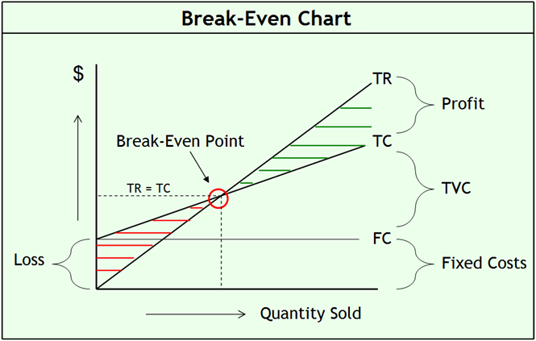

Slide 12
Theory of production
1- Meaning of production
2- Production function
3- Factors of production
4- Law of variable proportion and law of returns to scale.

Slide 13
Meaning of production
Production is a process that creates/adds value or utility.
It is the process in which the inputs are converted into outputs.
Production refers to the transformation of inputs or resources into outputs of goods and services.
Input: The factors of production such as land, labour, capital, technology etc.
Output: The goods and service produced such as soap, shoes, car etc.

Slide 14
Production function
It means the functional relationship between inputs and outputs in the process of production.
It is a technical relation which connect factors inputs used in the production function and the level of outputs.
Q = F (Land, labour, capital, technology, organization etc)

Slide 15
Factors of production
According to classical economics the factors of production are as follows:
Land/Natural resource: such as surface, air, rivers, sea, fauna and flora etc.
Labour: Mental or physical effort done by a man.
Capital: Man made goods used in the production process.
Organization: Entrepreneur or coordinator of all other factors of production.

Slide 16
Law of variable proportion and law of returns to scale.
Under law of variable proportion: only one variable input varies all other variables kept constant and it is for short period.
Under law of returns to scale: all the variables inputs varies except the enterprise and it is for long period.

Slide 17
Fixed inputs and Variable inputs
Fixed inputs | Variable inputs
Remain the same in the short period and in any level of output | In the long run all factors of production are varies according to the volume of outputs
The cost of these inputs are called fixed cost | The cost of variable input is called variable cost
Example: building, land etc. | Example: raw materials labour, etc

Slide 18
Various concept of production
Total Product (TP): Total physical product is equal to the total amount of output produced in physical units
Average Product (AP): Total output divided by total units of input, means production per unit of input ( AP = TP/L)
Marginal Product(MP): The extra product or out put added by one extra unit of that input while other inputs are held constant.
(MP =ΔTP/ΔL )

Slide 19
Types of cost
Money cost: The amount spend in terms of money for the production of the commodity is known as money cost.
Nominal cost: It is the money cost of production
Real cost: It is the mental and physical and sacrifices undergone with a view to producing a commodity.
Opportunity cost: The real concept of production of given commodity is the next best alternative sacrificed in order to obtain that commodity

Slide 20
Cont..
Implicit cost: It is the cost of self-owned resources such as salary of proprietor.
Explicit cost : It is the paid- out cost.
Accounting or business cost: Cash payments which firms make for factor and non-factor input depreciation other book keeping entries
Social cost: It is the amount of cost the society bears due to industrialization.

Slide 21
Cont..
Entrepreneurs cost: It is the cost of production in the sense of money cost or expenses of production.
Economic cost: It is the cost related to the future, it is in the nature of the incremental cost
Direct cost: It is the cost that have direct relationship with a unit of operation like a product- process or a department of the firm. Ex; Variable cost.

Slide 22
Cont..
Indirect costs: Are those whose source cannot be easily and definitely traced to a plan, a product, a process or a department.
Ex: fixed cost.
Controllable costs: Are those which are capable of being controlled and can be used for assessing executive efficiency.
Non controllable costs: Are those which cannot be subjected to administrative control and supervision

Slide 23
Types of Average cost
Average Fixed Cost: It is the per-unit cost of the fixed factor (AFC=TFC/Q)
Average Variable Cost: It is the per unit cost of the variable factors (AVC=TVC/Q)
Average Total Cost: It is the total cost divided by the number of units produced (ATC=TC/Q)
Marginal Cost: Change in the total cost resulting from the unit change in the quantity produced (MC=change in Q/change in TC)

Slide 24
Application of Break-Even analysis

Slide 25
Uses of Break-Even analysis
Break-even output price can be used as a sample risk management tool to evaluate the impacts of marketing decisions under the price variability.
Break-even yield analysis can be used to find the maximum potential yield losses due to detrimental weather condition

Slide 26
Cont…
Break-even input price can be used to determine the price prevailing in the market.
Input requirement break-even analysis can be used to study the economic impact of input requirement during unfavorable season to avoid yield losses.

Slide 27
Sample Problem (1)
Assume you own a business selling burgers.
It costs Rs. 7.00 to make one burger.
That’s your V or Variable cost.
You sell each burger for Rs. 12.50
That’s your P or price per unit.
Your cost for rent utilities, overhead, etc. is Rs. 100,000 per month. That’s your F or Fixed cost.

Slide 28
Cont…
Answer
Given: V = Rs 7.00
P = Rs 12.50
F = Rs 100,000
Solution: X= F/(P - V)
X= 100,000/(12.50 – 7)
X= 100,000/(5.5)
X= 18,181.818 = 18,182
To break-even you would need to sell 18,182 burgers

Slide 29
Sample Problem (2)
Assume you own a lemonade stand. It costs you Rs. 1.50 to make cup of lemonade.
You sell your lemonade for Rs. 5.00. It costs you Rs. 5,000 to rent for the space of your lemonade stand.
How many cups of lemonade do you have to sell to breakeven?

Slide 30
Cont…
Given: V = Rs 1.50
P = Rs 5.00
F = Rs 5,000
Solution: X= F/(P - V)
X= 5,000/(5 – 1.50)
X= 5,000/(3.5)
X= 1,428.57 ≈ 1,429
You would need to sell 1,429 cups of lemonade to breakeven

Slide 31
Margin of safety:
Margin of safety defined as the percentage of excess production over break-even point to the actual production. It indicates to what extend the production may decline before the firm starts incurring losses. In the break-even point, the distant between break-even point and the point of actual production indicates the margin of safety.

Slide 32
Cont..
Margin of Safety = Actual output-BEP/
Actual output × 100
Higher margin of safety indicates the financially soundness of the company.

Slide 33
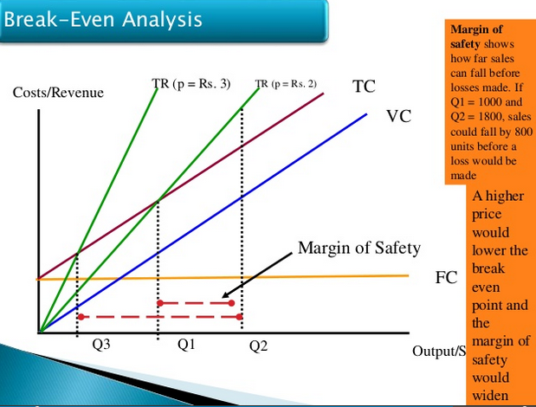

Slide 34
Advantages of break-even analysis
The main advantages of break-even analysis are:
It explains the relationships between cost and output level.
The technique is useful to determine changes in the profit level whenever there is change in fixed cost, variable cost, and prices of commodity.
It indicates the lowest amount of business activity to prevent losses.
This technique is also used to determine the viability of project at the particular point of time.

Slide 35
Uses of Break Even Point
Helpful in deciding the minimum quantity of sales.
Helpful in the determination of tender price
Helpful in examining effects upon organization’s profitability.
Helpful in sales price and quantity
Helpful in determining marginal cost.

Slide 36
Limitation
It is best suited to analysis of one product at a time.
There should be no change in the investment of fixed assets.
Variable cost should remains constant per unit.
Productivity of workers remains constant, i.e. method of production and efficiently of men and machine remain unchanged.

Slide 37
REVIEW OF CASE STUDIES

Slide 38
I. “PROJECT APPRAISAL BY BREAK-EVEN ANALYSIS: CASE STUDY OF A DAIRY PROJECT”
C. Kannpiran (1987)

Slide 39
In this study the practical utility of the break-even analysis with reference to dairy project is discussed.
The details of the cattle are:
Cross-bred cows were purchased immediately after calving in 2 stages of 5 animal each at an interval of 6 months.

Slide 40
Cont…
The average milk yield is 10 liters/day/animal and sale price is Rs. 4/liters of milk.
Average day-in milk 10 months and dry-day 5 months
Feeding cost per animal details is presented in the table below

Slide 41
Table: 1 Details of feeding cost per animal
Sl.No. | Details | Maintenance of all animals | Production ration for milking animal
1 | Concentrate feed for maintaining at 1 Kg/ animal | 2.5
 | For milking animal at 1 Kg for every 2.5 liters of milk yield (4) |  | 10.0
2 | Green fodder 25 Kgs × 0.10 | 2.5
3 | Dry fodder 5 Kgs ×0.20 | 1.0
 | Total | 6.0 | 10.0

Slide 42
Cont..
The dairy project should carefully analyze the cost considered. These cost include capital cost and operating cost.
A. Capital cost (Investment cost):
Capital costs are those cost incurred for creation of goods that are capable of producing economic wealth is termed as capital assets. In case of dairy projects, the investment made on building (cattle shed), equipments and animals are considered.

Slide 43
Table: 2 Investment cost in dairy projects
Sl. No. | Particulars | Cost (Rs)
1 | Cost of 5+5 dairy animals at Rs. 6000 each | 60,000
2 | Cost of construction of cattle shed, i.e. 700 sq. ft at Rs. 50 per sq. ft | 35,000
3 | Cost of equipments (buckets, milking vessel, ect.) | 5,000
 | Total capital cost | 1,00,000

Slide 44
B. Operating cost :
Fixed cost: such as permanent labour wages, land taxes, electricity bills, maintenance ration and depreciation
Variable cost: Are those cost, in which milking animal ration and special veterinary care are considered. The milch or milk ratio is 1 Kg of concentrate feed for every 2.5 liters of milk yield and this varies according to the production of milk.

Slide 45
Table:3 Annual Operating cost in dairy projects
Sl. No. | Particular | Cost (Rs.)
A | Fixed Cost
1 | Maintenance cost of ration for all animals (10×365×6) | 21,900
2 | Labour charges (permanent labourers) | 6,000
3 | Taxes, electricity, etc. | 1,200
4 | Veterinary care (average Rs. 50/animal/year | 500
5 | Depreciation
a) | On animal 15% | 9,000
b) | On equipment 10% | 500
c) | On sheds 2% | 1,200
 | Total Fixed cost | 40,300
B | Variable cost
1 | Cost per liter | 1

Slide 46
Table: 4 Milk flow chart
Years | 1st batch animal (5) |  | 2nd batch animal (5) |  | Total days |  | Total milk production (liters)
 | Milk days | Dry days | Milk days | Dry days | Milk | Dry
I | 1500 | 300 | 900 | 900 | 2400 | 1200 | 24000
II | 1350 | 450 | 1050 | 750 | 2400 | 1200 | 24000
III | 1050 | 750 | 1050 | 750 | 2100 | 1500 | 21000
IV | 1050 | 750 | 1500 | 300 | 2550 | 1050 | 25500
V | 1050 | 750 | 1350 | 450 | 2400 | 1200 | 24000
VI | 1500 | 300 | 1050 | 750 | 2550 | 1050 | 25500
VII | 1350 | 450 | 1050 | 750 | 2400 | 1200 | 24000

Slide 47
Break-even analysis:
Break-even level for production = FC/(Sale price/unit – variable cost/unit)=
40,300/(4-1)= 13,433 liters/year
Break-even level for sales =
FC × Sale price/unit /(Sale price/unit – variable cost/unit)= 40,300×4/(4-1)= Rs. 53,732/yp
Margin of safety = Actual output – BEP/AO×100
= 21000-13433/21000×100
= 56.33%

Slide 48
Findings
>Break-even point at a milk production level of 13,433 litters per year, Break-even level of Rs. 53,732/year’s production for sales and the percentage of 56.33% on Margin of safety ↓
> Indicates that dairy project is a viable and profitable project

Slide 49
II. Application of Break-even analysis in Vanilla cultivation as intercrop in areca garden
Carl R. Dillon(1993)

Slide 50
Cost element
The cost element used in break-even analysis is classified into :
A. Establishment cost
B. Cost of cultivation and Return of vanilla
A. Establishment cost:
These cost incurred for establishing vanilla in areca garden. These costs are non-recurring costs. The establishment cost include fixed cost and variable cost

Slide 51
Table: 5 Establishment cost of vanilla as inter crop in areca garden
Sl. No. | Particular | Units | Per Hectare
 |  |  | Quantity | Cost | Percentage
A. | Variable cost
I | Labour cost
1 | Digging pits for planting cutting | days | 31 | 1,860 | 1.10
2 | Manure and Silt application | days | 56 | 3,360 | 1.99
3 | Mulching | days | 132 | 7,920 | 4.69
4 | Weeding | days |  | 7.575 | 4.49
5 | Watch and ward | days |  | 5.600 | 3.32
6 | Other expenses | Rs. |  | 800 | 0.47
7 | Total labour cost | Rs. |  | 27,115

Slide 52
Cont…
Sl. No. | Particular | Units | Per Hectare
 |  |  | Quantity | Cost | Percentage
II | Material cost
8. | Manure | Tons | 47 | 23,500 | 13.94%
9. | Silt | Tons | 8 | 1.000 | 0.59%
10. | Planting materials | No. | 2207 | 1,10,350 | 65.46%
11. | Mulching materials | Rs. | 1,500 | 0.88
 | Total variable cost (I+II) | Rs. |  | 1,62,465.00 | 96.98%

Slide 53
Cont…
Sl. No. | Particular | Units | Per Hectare
 |  |  | Quantity | Cost | Percentage
B. | Fixed cost
1. | Rental value of land | Rs. |  | 4,650 | 2.75%
2. | Land revenue | Rs. |  | 50 | 0.02%
3. | Depreciation | Rs. |  | 386.33 | 0.22%
 | Total fixed cost | Rs. |  | 5,086.33 | 3.01%
 | Total establishment cost | Rs. |  | 1,67,401.33 | 100%

Slide 54
B. Cost of cultivation and Return of vanilla
Include the variable cost and fixed cost
i) Variable cost: Manurring, silt application, mulching, weeding, watch & ward, purchase of manure, interest on working capital.
ii) Fixed cost: Rental value on land, land Tax, Depreciation, Annual repair, interest on fixed capital etc.

Slide 55
Table: 6 Annual cost of cultivation of vanilla as intercrop in areca garden
Sl. No. | Particular | Unit | Per hectare
A. | Variable cost
I | Labour cost | Rs. | 57,372.45
II | Material cost
1 | Manures | Tons | 23,000
2 | Silt | Tons | 1,000
3 | PPC application | Rs. | 500
4 | Mulching | Rs. | 1,750
III | Interest rate on working capital | Rs. | 9,238.07
 | Total variable cost | Rs. | 93,220.52

Slide 56
Cont..
Sl. No. | Particular | Units | Per Hectare
B | Fixed cost
1 | Land rental value | Rs. | 4,650
2 | Land revenue | Rs. | 50
3 | Depreciation | Rs. | 319.18
4 | Interest on fixed capital | Rs. | 13,800
5 | Fixed capital | Rs. | 12,427.9
6 | Annual repair (Rs.) | Rs. | 760
7 | Amortized establishment cost | Rs. | 13,028.39
 | Total fixed cost | Rs. | 46,154.8
 | Total cost (A+B) | Rs. | 1,39375

Slide 57
Table: 7 Yield and returns from vanilla in areca nut garden (Rs./hectare)
Sl. No. | Particular | Years
 |  | III | IV | V | VI
1. | No. of vines | 2,207 | 2,207 | 2,207 | 2,207
2. | No. of yielding vines | 1,850 | 1,980 | 2,207 | 2,207
3. | Yield per vine (Kg) | 0.5 | 1 | 1.5 | 2
4. | Total yield (Kg) | 925 | 1,980 | 3,310.5 | 4,414
5. | Sale price (per Kg) | 250.00 | 250.00 | 250.00 | 250.00
6. | Return by sale of bean (Rs.) | 2,31,250 | 4,95,000 | 8,27,625 | 11,03500

Slide 58
By applying the break-even analysis, the following result are obtained:
Total of both FC= 46154.8+5o86.33= 51241.13
Total of both VC=162465.00+93220.52=255685.52
i) Breakeven production= 51241.13/(250-115.85)
= 381.97 Kg/year
ii) Breakeven sale level= 51241.13 × 250 /
(250-115.85)
= Rs. 95492/yr/hectare

Slide 59
FINDINGS OF THE STUDY
The study indicates that the vanilla as inter crop in areca garden will be at break-even point at production level of about 381.97 kg per year or when the total sales is about Rs. 95492 per year/hectare. Further, if the vanilla price increases, thereby the break-even level will reach at lower production level itself.

Slide 60
CONCLUSION
The break-even analysis can be used as one of the important appraisal technique for the agricultural projects.
This analysis does not only include the time value of money, but it can also be more realistic as it measures the viability of project at a particular point of time. However, the inflation if any, will affect both the benefit and cost.

Slide 61
THANK YOU

