Slide 1
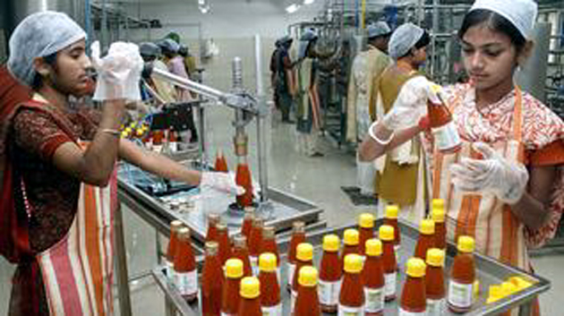
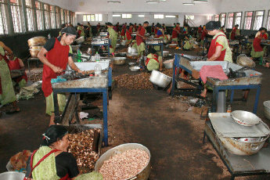
FOOD PROCESSING INDUSTRIES IN INDIA:
Importance & prospects
Shankara M.H
III Ph.D

Slide 2
Introduction
Food processing is now regarded as the sunrise sector of the Indian economy
In developed countries, up to 14 per cent of the total work force is engaged in Food-processing sector directly or indirectly
In India, only about 3 per cent of the work force finds employment
Properly developed, Food-processing sector can make India a major player at the global level for marketing and supply of processed food products.

Slide 3
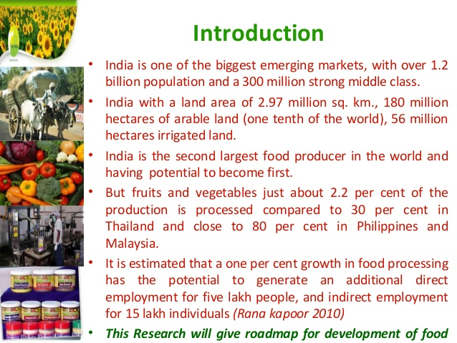

Slide 4
Objectives
To understand the concept of Agro processing
and its importance
To discuss the present scenario of Agro
Processing Industries (API)
Government support to promote API
To review the research evidences of Agro
processing industries

Slide 5
Agro processing could be defined as set of techno economic activities carried out for conservation and handling of agricultural produce and to make it usable as food, feed or industrial raw material.
Kachru (2014)
FAO (2008), A common and traditional definition of agro processing industry refers to the subset of manufacturing that processes raw materials and intermediate products derived from the agricultural sector.
Agro processing industry thus means transforming products originating from agriculture, forestry and fisheries

Slide 6
Historical Perspective
Middle of the nineteenth century, common food processing industries included hand pounding units for rice, water power driven flour mills, bullock driven oil ghanies, bullock operated sugarcane crushers
In British India, during the year 1863, a note was written by the Governor of Madras state, Sir William Denison to the government of Madras state for laying greater stress on agriculture and food processing
Based on this, a set of improved machinery was brought from England for demonstration and adoption

Slide 7
It included threshing machines, winnowers, chaff cutters, besides steam ploughs, steam harrows, cultivators, seed drills and horse hoes
Post independence era in India witnessed rapid growth in agro food processing sector
It followed the first phase of the Green Revolution that had resulted in increased agricultural production and the need for its post harvest management

Slide 8
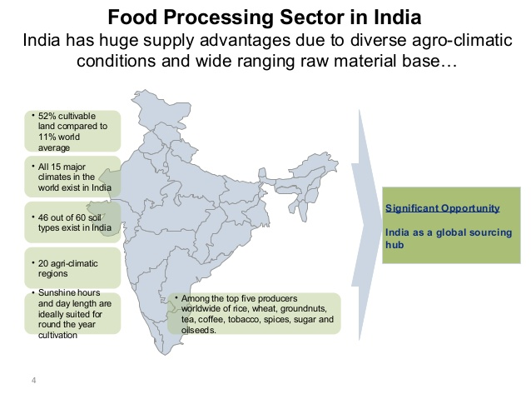

Slide 9
Indian food processing industry: Significance
Size : Has more than 35000 registered units
Output : of ~5-6 lakh crores
Food processing contributes about 9-10% of GDP, in Agro-Mfg. sector
Location wise: Maximum factories in (ie. more than 1000 in given state) Coastal states: Andhra, Maharashtra, Karnataka, Kerala, Gujarat, Punjab, WBNon-coastal States: UP, Punjab
Observe majorities of the food processing factories are concentrated in the coastal states.

Slide 10
Increasing Employment
Food processing industry provides plenty of direct and indirect employment opportunities, because it acts as bridge between Agriculture and Manufacturing
12th Five year plan (FYP) wants to create more than 50 million jobs. Out of that, Food processing sector is to create one million jobs.

Slide 11
Curbing Migration
When food processing plants are setup near agro/rural regions, they reduce
Poverty among villagers
Disguised unemployment
Exploitation of farmers
Rural- Urban migration

Slide 12
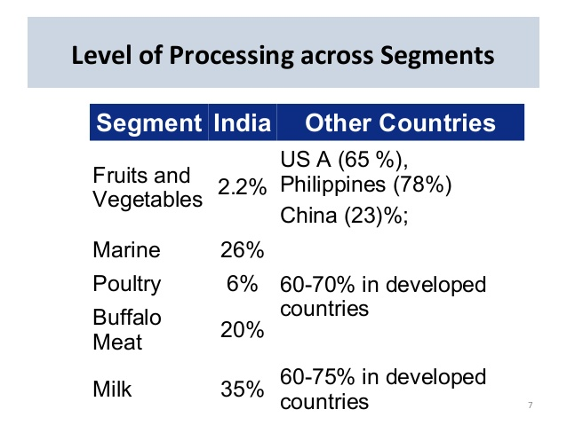

Slide 13
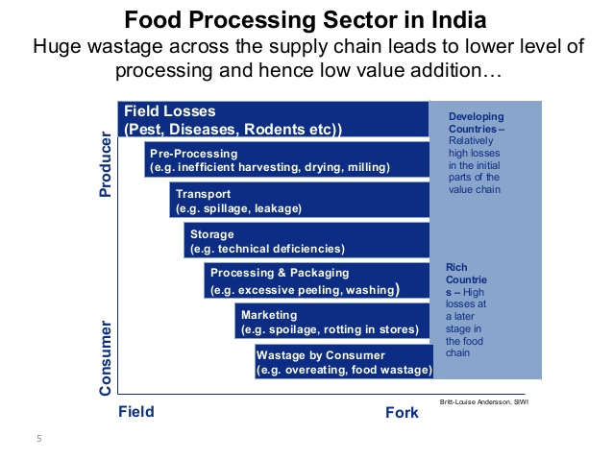

Slide 14
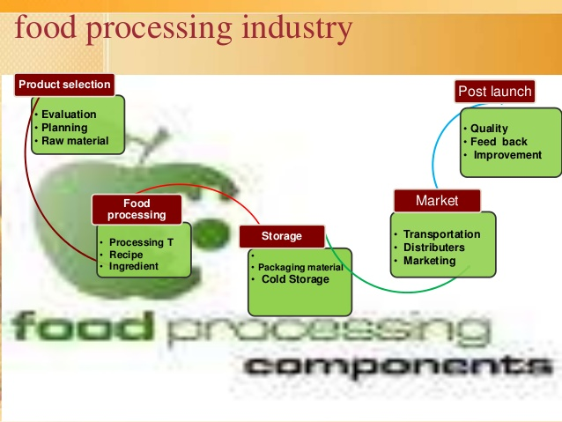

Slide 15
Processing Levels for Key Segments in the FPI
India’s food processing levels are significantly low compared to other developing nations such as Brazil, Malaysia and China

Slide 16
Processing Stages for Various Products
Primary
processing
Secondary processing
Tertiary
processing
Fruits & Vegetables
Cleaning, sorting and cutting
Slices, pulps and paste
Ketchups, jam, juices and pickles
Milk
Grading and refrigerating
Cottage cheese, cream, simmered & dried milk
Processed milk, spreadable fats, yoghurt
Meat & Poultry
Sorting and refrigerating
Cut, fried, frozen and chilled
Ready-to-eat meals
Marine products
Chilling and freezing
Cut, fried, frozen and chilled
Ready-to-eat meals
Grain and seeds
Seeding and grading
Flour, malt and milling
Biscuits, noodles, flakes, cakes, savory
Beverages
Sorting, bleaching and grading
Leaf, dust and powder
Tea bags, flavored coffee, soft drinks, alcoholic beverages

Slide 17
Food Processing Demand Drivers
Increasing spending on food products
Increasing urbanization – lifestyle and aspirations
Growing nuclear families and working women
Food Processing Demand Drivers
Changing demographics – Rise in disposable incomes
Rising demand for functional food (oatmeal, etc)
Increasing modern trade formats and private label penetration

Slide 18
Developments in Processed Food Industry

Slide 19
Infrastructure Development in FPI
Plan of MoFPI aims to double the size of food processing industry to US$ 200B,
Increase processing of perishables to 20%, increase value addition to 35% (from 20%), and enhance India’s share in global food trade to 3% (from 1.5%)
Scheme for Infrastructure Development, implemented by MoFPI, during 11th Five Year plan (2007-12) include—
  Mega food parks
  Cold chain, value addition and preservation infrastructure
  Setting up / modernization of abattoirs
Funds allocated for infrastructure development in FPI
Funding in 12th Five Year plan (2012-17), $M
Modernization of abattoirs
Cold chains
Mega food parks
Source: MOFPI Annual Report 2011-12

Slide 20
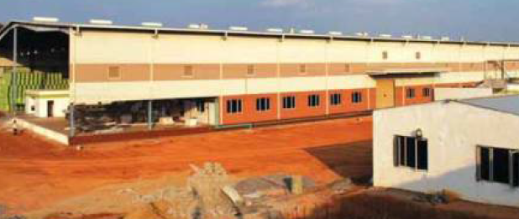
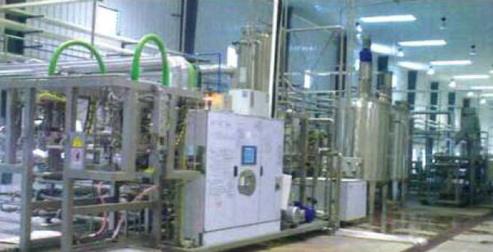
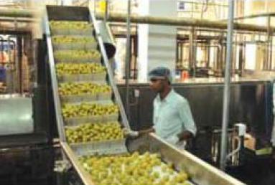
Mega Food Parks (MFPs)
It aims to bring together farmers, processors, and retailers to link agricultural produce to the market place and to ensure maximum value addition, minimum wastage, increase farmers’ income and create employment in rural sector
These parks will have state-of-the-art processing facilities and well-established supply chain
Under the scheme, a total of 30 MFPs will be established in a phased manner (10 parks in phase I, 5 in phase II, and 15 in phase III)
* Refer to Appendix for list
Source: MOFPI Annual Report 2011-12

Slide 21
Cold chain, value addition, and preservation infrastructure
The infrastructure scheme will provide financial assistance in setting up integrated and complete cold chain facilities, preservation infrastructure facilities, value addition facilities, and irradiation facilities
Financial assistance of up to 75% of the total project cost is provided by the government
Total of 49 projects have been planned across the country, of which 10 are in progress
These projects are expected to add 2,32,628 MT of cold chain to the existing infrastructure
Setting up / modernization of abattoirs
Lack of basic infrastructure facilities such as water, electricity, and carcass handling mechanism result in tremendous wastage and contamination / deterioration of meat
The FPI infrastructure scheme plans to set up 10 new abattoirs and modernize several existing facilities in the coming years
An amount of US$6.8 million have been disbursed to set up the 10 new facilities
So far, 2 abattoirs have been completed at Dimapur, Nagaland and Ahmednagar, Maharastra

Slide 22
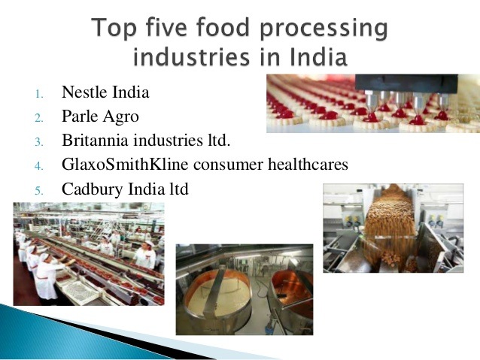

Slide 23
Competition in Dairy Processing
Dairy market is largely dominated by regional cooperatives in Gujarat, Karnataka, Maharashtra, Tamil Nadu, Rajasthan and Punjab; Amul (Gujarat Cooperative) has ~26% India market share in liquid milk; Nandini (Karnataka Cooperative) has significant presence in South India
Amul captures nearly 85% of the butter market and ~70% of the cheese market, while other players such as Nestle manage rest of the market; Unilever has strong presence in ice cream segment
Company name (Brand) | Country | Major products
Gujrat Cooperative Milk Marketing Federation (Amul) | India | Milk, cheese, butter and other value-added products
Karnataka Milk Federation (Nandini) | India | Milk, ghee, whitener, butter, milk power, and ice cream
National Dairy Development Board (Mother Dairy) | India | Milk, cheese, butter, ice cream, buttermilk, pro-biotic products
Nestle (Milkmaid, Everyday) | Switzerland | Pro-biotics, Raita, condensed milk, milk powder, ghee, infant nutrition
HUL (Kwality Wall’s) | Anglo-Dutch | Frozen desserts
Danone (Danone) | France | Yoghurt, value added products

Slide 24
Competition in Fruits & Vegetables Processing
Processed forms of fruits & vegetables in India include jams, juices, pickles, chutney, and fruit concentrates
While the fresh fruits & vegetables market in highly unorganized with local farmers, wholesalers, and intermediaries selling directly to customers, the processed F&V market is somewhat organized with presence of national and international players
Company name (Brand) | Country | Major products
HUL (Kissan) | Anglo-Dutch | Jams, ketchup, sauces, spreads, fruit juices
Mother Dairy (Safal) | India | Frozen F&V (peas, carrots, etc)
Priya Foods (Priya) | India | Pickles, chutney, fruit pulp
Cremica (Mrs. Bectors) | India | Sauces, condiments, spreads, dips, syrups
Namdhari Fresh | India | Packaged fruits and vegetables, exotic vegetables
Adani Agri Fresh | India | Fresh and processed fruits
Heinz | USA | Ketchup

Slide 25
Competition in Meat, Poultry and Marine Processing
Highly fragmented industry with only a handful of large players
Uttar Pradesh, Andhra Pradesh, Maharashtra, Delhi are the key areas of processed meat and poultry production
Within this industry, poultry is the fastest growing segment owing to strong domestic consumption
Company name | Country | Major products
Allanasons | India | Frozen buffalo meat, marine products, canned corned beef, tropical fruits and vegetables, etc
Hind Agro | India | Frozen boneless buffalo meat, offals and processed buffalo meat
Venky’s | India | Ready-to-cook and Ready-to fry products
Godrej Agrovet | India | Poultry
Al Kabeer | UAE | Beef and poultry, ready-to-fry products
Suguna Foods | India | Broiler chicken, value added eggs

Slide 26
Competition in Grains & Seeds processing
Grain processing includes milling of rice, wheat and pulses; seed processing include extraction of oil for edible and industrial purposes
A highly fragmented industry with thousands of rice hullers, flour and pulse mills, and ghanis and oil refineries operating in every part of the country; competition in the organized segment is intense
Though primary processing is the most important activity in this segment, secondary and tertiary processing is limited to few large players
Company name (Brand) | Country | Major products
HUL (Annapurna) | Anglo-Dutch | Wheat flour
Kellogg’s (Kellogg’s) | USA | Oats, bran wheat flakes, corn flakes, RTE breakfast cereals, Muesli
ITC (Aashirvaad) | India | Wheat flour, multi-grain flour
ConAgra Foods (Sundrop) | USA | Sunflower oil, corn products
Cargill (Nature Fresh) | USA | Edible oils, flour,
REI Agro (Raindrop) | India | Rice (Basmati)

Slide 27
Competition in Consumer Foods Processing
Consumer foods is a highly competitive industry in India with presence of large national and international companies
Britannia, Parle and ITC capture ~90% share of biscuit industry, while Perfetti has over 70% market share in confectionery market; Nestle, with its Maggie brand, is a market leader in noodles segment, while Coca Cola and Pepsi has over 90% market share in aerated beverages segment
Company name (Brand) | Country | Major products
HUL (Kissan) | Anglo-Dutch | Soups, bakery,
Nestle (Maggie, Nescafe) | Switzerland | Pasta, RTC, cooking aids (masalas), coffee and tea, chocolate powder,
Parle Agro (Parle) | India | Biscuits, beverages
Perfetti Van Melle | Italy | Confectionery
Britannia Industries (Britannia) | India | Biscuits, bakery and dairy
Mondelez International (Cadbury) | USA | Chocolate
PepsiCo (Pepsi, Frito-Lay) | USA | Snack food, beverages
Coca-Cola | USA | Beverages
ITC (Sunfeast) | India | Biscuits, noodles, snack food, confectionery, RTE

Slide 28
Snapshot of Meat Processing Industry
Meat processing (including poultry and marine) is the fastest growing segment with 25% growth rate, of which buffalo meat processing is the biggest segment; India exported 1.8 million tons or US$ 3.2B worth beef in 2012-13
Unlike the restrictions on cow slaughter, buffalo slaughter does not have any restrictions; however, domestic consumption of buffalo meat is very less in India and majority of it is exported
Meat processing machinery market is estimated to be around 300-400 crores and is growing at a much faster rate of 30-40%
Imported machinery use is currently less; however, it is growing at a very strong pace
  ~25% of the machinery in meat segment and ~35% of machinery in poultry segment is currently imported in India
  In 2012-13, India exported 796 MT of processed meat in the form of sausages, canned meat, meat extracts and preserved poultry meat

Slide 29
Expansion Plans in Meat Processing Industry
Suguna Foods, one of the largest players in poultry processing, has huge plans for expansion
  To become a 10,000 crores company by 2017; planning to invest Rs 150 crores annually
  To expand its Suguna Daily Fresh retail outlets, which offers fresh and RTC poultry products, to 500 from the current 150 by 2016
Allana Group, one the largest players in meat processing, has been consistently investing in world class integrated food processing infrastructure
Godrej Agrovet’s subsidiary Godrej Tyson Foods, which recently upgraded its chicken processing plants in Karnataka and Maharashtra, plans to expand its RTC poultry products to 60 cities (from its current 50 cities)

Slide 30
Snapshot of Ice Cream Industry
Ice cream market in India is estimated to be around 3,500 crores, and is growing at a rate of 15-20% year-on-year
By 2016-17, the market is expected to double to 7,500-8,000 crores
Highly seasonal industry with almost all the sales (retail) happening in the summer period (April-August); institutional sales provide cushion during lean periods
Presence of 7,000-10,000 players
  Small unorganized players go off market during the lean periods
Indian consumers are actively storing ice creams at home which is leading to higher consumption
Ice creams as desserts during marriages and innovative products (such as Ice cream Sandwich) are boosting sales
Ice cream Industry in India, 2014-15
100% = 3,500 crores (US$570M)
Unorganized
45%
Organized
55%
Per capita ice cream consumption is only 300ml (2013-14) which is expected to double by 2016-17
Source: Primary research

Slide 31
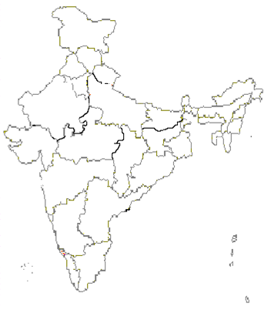









Ice Cream Industry – Key Players
~80% of ice cream market is captured by top 5-7 players
Regional players have strong presence in respective regions
Top 5 brands have pan-India presence
Leading players market share
Baskin-Robbins is the biggest foreign player in India

Slide 32
SWOT analysis of Food and Food Processing Industry in India
Strengths
Huge domestic consumption market
Large production base of raw material
Breadth in crop base offering scope for varied processing activities
Weaknesses
Inadequate infrastructure facilities
High upfront capital investments
Lack of adequate quality control & testing protocols
Large number of intermediaries resulting in inefficient supply chain and increase in prices
Seasonal variability of crops
Low packaging aesthetics

Slide 33
Opportunities
Government incentives (priority sector, tax relief, R&D support, etc)
Increasing western influence on Indian palate (cheese, pasta, sauces, cereals, aerated drinks, juices, yoghurt, etc) which is driving the demand for processed foods
Increase in nuclear families and working women who prefer ready-to-use food items
Threats
Traditional preference for freshly cooked food especially in rural areas
Affordability (e.g., processed fruits are significantly higher than fresh fruits)
High supply chain costs

Slide 34
Government Incentives for FPI Sector
The Ministry of Food Processing has taken several initiatives to promote the growth of the industry
Incentive | Description
Tax relief | 100% tax exemption for first 5 years followed by 25% tax exemption for the next 5 years for food & vegetables processing businesses Preferred tax exemption for companies operating in perishable food items such as milk, meat and poultry Investment-linked tax incentive to businesses setting up and operating cold chains or warehouse facilities Full excise duty exemption for goods that are used in installation of cold storage facilities Excise duty waived on fruits & vegetables processing from 2000 – 01 Income tax holiday for fruits & vegetables processing from 2004 – 05 Customs duty reduced on freezer van from 20% to 10% from 2005 – 06 Central sales tax reduced from 4% to 3%
Relaxed FDI norms | 100% FDI under automatic route, except for items reserved for micro, small and medium enterprises
Easy funding | Assigned food processing industry as priority sector for easy securing of bank funding
Source: MOFPI Annual Report 2011-12

Slide 35
Government Incentives for FPI Sector
Incentive | Description
Focus on infrastructure | Strong focus in infrastructure development (as discussed in earlier slides), particularly on setting up Mega Food Parks, Agri Export Zones (AEZ), cold chains, warehouses and modernization of abattoirs
Push for R&D | Weighted deduction on expenditure incurred on in-house R&D has been increased from 150% to 200% Weighted deduction on payments made to R&D laboratories increased from 125% to 175%
Private sector friendly | 100 per cent export-oriented units are allowed to sell up to 50% of their produce in the domestic market Export earnings are exempted from corporate taxes
Apart from these, the state governments have also taken initiatives such as lowering of VAT rates to promote the industry in respective states

Slide 36
APEDA
Agricultural and Processed Food Products Export Development Authority (APEDA) was established by the Government of India under the Agricultural and Processed Food Products Export Development Authority Act passed by the Parliament in December, 1985.
The Act (2 of 1986) came into effect from 13th February, 1986 by a notification issued in the Gazette of India

Slide 37
Functions
Development of industries relating to the scheduled products for export by way of providing
financial assistance or otherwise for undertaking surveys and feasibility studies,
participation in enquiry capital through joint ventures and other reliefs and subsidy schemes
Registration of persons as exporters of the scheduled products on payment of such fees as
may be prescribed
Fixing of standards and specifications for the scheduled products for the purpose of exports
Carrying out inspection of meat and meat products in slaughter houses, processing plants,
storage premises, conveyances or other places where such products are kept or handled for
the purpose of ensuring the quality of such products
Improving of packaging of the Scheduled products
Improving of marketing of the Scheduled products outside India
Promotion of export oriented production and development of the Scheduled products
Collection of statistics from the owners of factories or establishments engaged in the
production, processing, packaging, marketing or export of the scheduled products or from
such other persons as may be prescribed on any matter relating to the scheduled products
and publication of the statistics so collected or of any portions thereof or extracts there from
Training in various aspects of the industries connected with the scheduled products

Slide 38
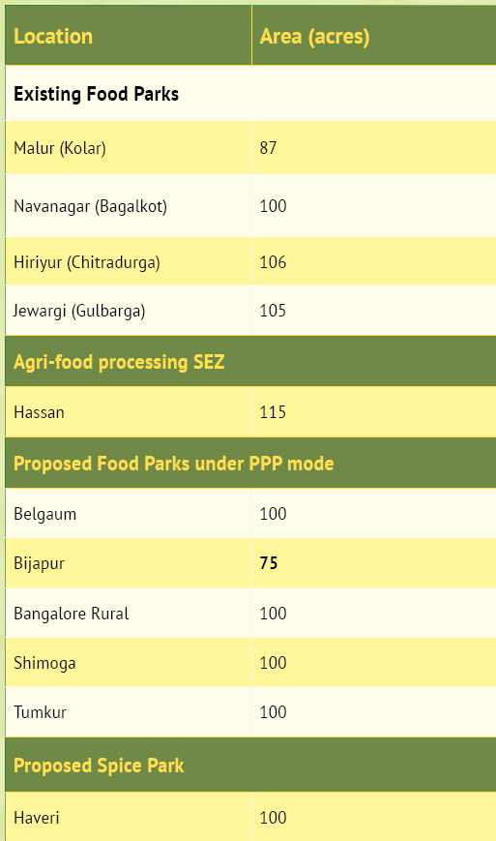
Food parks and food processing Special Economic Zones(SEZ) demonstrate investor interest and industry efforts to increase influence of agriculture and food processing sectors on state’s economy

Slide 39
Policies: facilitating investments and growth in industries
• Exemption from Stamp Duty & Concessional Registration, Large and Mega
agro based industries and agri-infrastructure.
• Exemption from Entry Tax, Exemption of APMC cess / fees and Incentives for
Export Oriented units.
• Interest Free Loan on VAT for Large and Mega agro based industries.
• Exemption from electricity duty for agro units & agri-infrastructure.
• Special incentives in selected zones.

Slide 40
Declaration of Wineries as “Horticultural & Food Processing Industries”
• Simplification of rules for getting lands for production of grape wine
varieties, production of wine and for issuing License and Permit to the
Wineries
• Capital Investment Subsidy and Subsidy for Grape Processing
• Incentives for marketing and distribution of wines and establishment of
Wine Parks.
A Tur Technology park in Gulbarga district, Maize Technology Park at
Ranebennur, and a Coconut Technology Park in Tumkur district have been
proposed
An Oceanarium of international standard is proposed at Mangalore under
public private partnership

Slide 41
Research Evidences

Slide 42
Arjuman et al (2012)
Return from desiccated coconut units of different sizes
Sl. No. | Particulars | Size of DC unit |  |  | Pooled
 |  | Small | Medium | Large
1 | Quantity of coconut processed (tonnes/year) | 1200 | 2400 | 3120 | 2256
2 | Quantity of desiccated coconut obtained (tonnes) | 300 | 600 | 780 | 564
3 | Quantity of byproduct obtained (tonnes)
 | Parings | 60 | 120 | 156 | 112.8
 | Shell | 240 | 480 | 624 | 451.2
 | Total (tonnes) | 300 | 600 | 780 | 564
4 | Price of DC realized (Rs./tonnes) | 78000 | 156000 | 202800 | 146640
5 | Price of parings realized (Rs./tonnes) | 30000 | 60000 | 78000 | 56400
6 | Price of shell realized (Rs./tonnes) | 5500 | 11000 | 14300 | 10340
7 | Value of main product (lakh Rs.) | 234 | 468 | 608.4 | 439.9
8 | Value of by-product
 | Parings | 18 | 36 | 46.8 | 33.8
 | Shell | 13.2 | 26.4 | 34.3 | 24.8
 | Total (lakh Rs.) | 31.2 | 62.4 | 81.1 | 58.6
9 | Gross returns (lakh Rs.) | 265.2 | 530.4 | 689.5 | 498.5
10 | Total cost / day (lakh Rs.) | 77694.1 | 149735.5 | 191652.4 | 149294.6
11 | Total cost (lakh Rs.) | 233.0 | 449.2 | 574.9 | 447.8
12 | Net returns (lakh Rs.) | 32.1 | 81.1 | 114.5 | 50.6
Desiccated coconut units were utilizing 78.9 per cent of their installed capacity

Slide 43
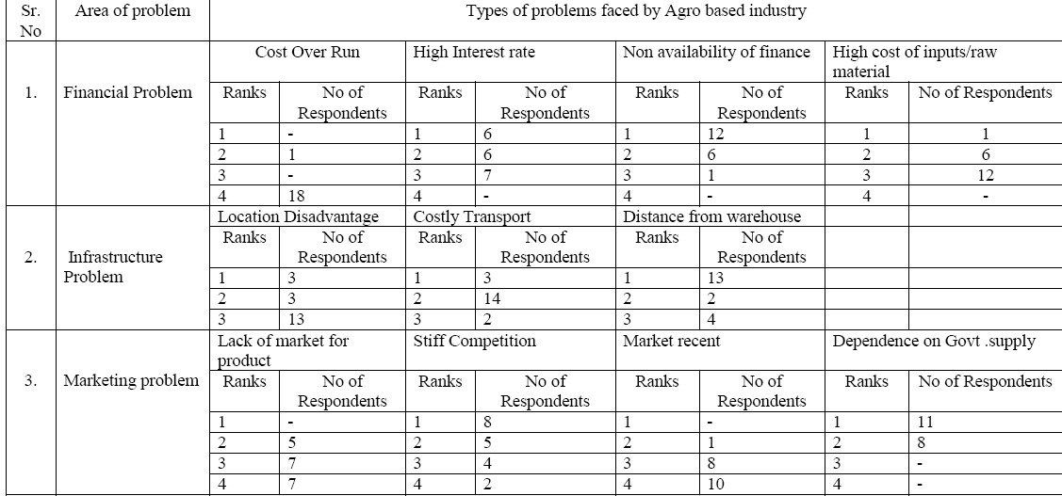
Pawan and Amita (2011)

Slide 44
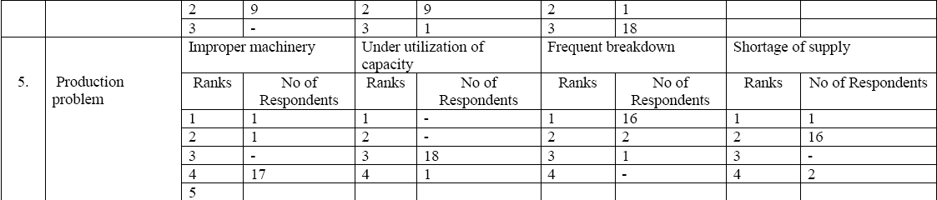

Slide 45
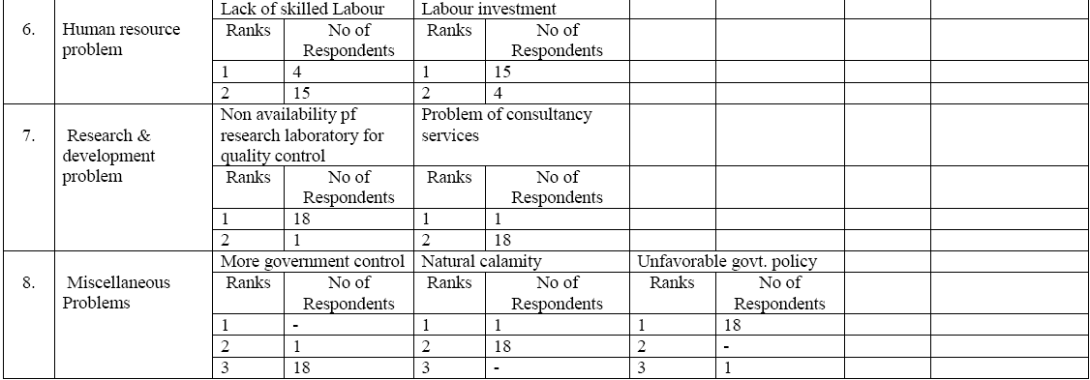

Slide 46
Conclusion
India is one of the largest food producers in the world and offers vast opportunities to food processing companies; the sector has been growing at 15% CAGR and is expected grow at a much faster rate of 25% in the coming years. Its priority sector status and significant support from the government (setting up mega food parks, etc) makes it a very attractive sector for investment.
Competition within the food processing sector is intense with few large players in each segment competing for organized market share, however, companies with robust and innovative product offerings, customized to suit Indian palate, have good potential to become leading players in the Indian market

Slide 47
Thank You

Slide 48
List of Importer-Distributors
Specified HS Codes Duties
Marketing Events Listing

Slide 49
List of Mega Food Parks Implemented in Phase I and II
Name | State | Location | Investment ($M)
Patanjali Food & Herbal Park | Uttarakhand | Haridwar | 17.4
Srini Food Park | Andhra Pradesh | Chittoor | 23.2
North East Mega Food Park | Assam | Nalbari | 13.9
Jharkand Mega Food Park | Jharkaand | Ranchi | 20.9
Tamil Nadu Mega Food Park | Tamil Nadu | Dharmapuri | 24.5
Jangipur Bengal Food Park | West Bengal | Jangipur | 20.4
Integrated Food Park | Karnataka | Tumkur | 26.5
International Mega Food Park | Punjab | Ferozpur | 28.2
Keventer Food Park Infra | Bihar | Bhagalpur | 28.2
Sikaria Infra Projects | Tripura | Agartala | 15.6
Anil Mega Food Park | Gujrat | Vadodara | 32.9
Shaktiman Mega Food Park | Uttar Pradesh | Sultanpur | 31.0
Paithan Mega Food Park | Maharastra | Aurangabad | 22.2
MITS Mega Food Park | Orissa | Rayagada | 21.4
Madhya Pradesh MFP | Madhya Pradesh | Khargon | 29.7
Source: MOFPI Annual Report 2011-12

Slide 50
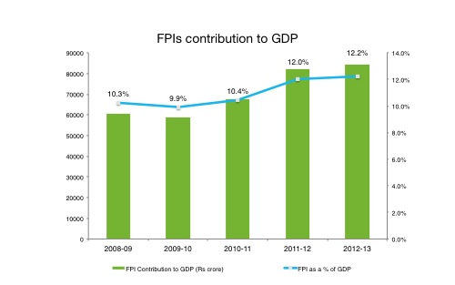

Slide 51
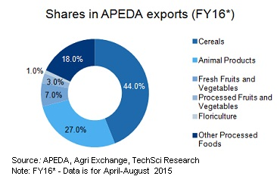

Slide 52
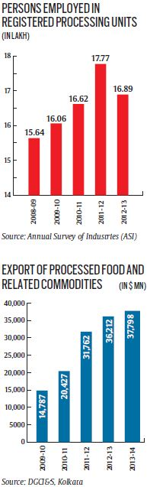

Slide 53
AGRO PROCESSING INDUSTRIES IN INDIA: Importance & prospects
Shankara M.H
III Ph.D
PA 0019
Dept. of Agril. Extension,
UAS, Bengaluru

Slide 54
Agro-Processing - Related web links
 | The Agricultural and processed food products export development authority (APEDA)
 | Central Food Technological Research Institute
 | The Central Institute of Fisheries Technology (CIFT)
 | The Post Harvest Technology Center (PHTC)
 | Central Plantation Crops Research Institute
 | The Defense Food Research Laboratory (DFRL)
 | Federation of Indian Chambers Of Commerce and Industry
 | Ministry of Food Processing Industries
 | Indian Institute of Crop Processing Technology (IICPT)
 | Agricultural Engineering College & Research Institute
 | National Research Centre for Banana (NRCB)
 | National Dairy Research Institute
 | Indian Institute of Sugarcane Research

Slide 55
Curbing Food Inflation
In the last few years Food inflation has been a major problem. Food inflation is eventually passed through into manufactured goods through higher money wages.
Therefore persistent high food inflation= bad for general macroeconomic stability.
well-developed food industry + compact supply chain=reduces food inflation via:
  Disintermediation (meaning no middlemen/commission agents)
  less wastage/spoilage of perishable products
Thus food industry is significant for reducing food inflation

Slide 56
Abundant Raw Material
India’s world Rankin production of1milk, ginger, chickpea, banana, guava, papaya, mango, buffalo meat2rice, wheat, potato, garlic, cashew nut, groundnut, dry onion, green peas, pumpkin, gourds, cauliflowers, sugarcane, teaamong top fivecoffee, tobacco, spices, oilseeds

Slide 57
New Demand
In the upcoming years, there will be good demand for healthy, modern food products due to following reasons:
Youth population (age group 15 – 25): doesn’t shy away from trying new food products.
More Nuclear families: usually working couple => less cooking time + expensive maids=need ready to eat / ready to cook food.
Rising incomes, middle class and rich families=can afford processed food.
Emergence of Tier 1 and Tier 2 cities, shopping mall culture.
Growing migration from rural to urban India + rising income = demand for bread, butter etc.
Media penetration, advertisements=> “demand” is created for health-drinks, noodles, cream-biscuits, cornflakes etc.
Celebrity chefs, cookery channels= new dishes, international cuisines introduced=>demand for their ingredients, vegetables in India.
Diabetes, obesity, Blood pressure, lifestyle diseases =>demand for healthy food.
As a result, food processing industry is expected to reach
yearturnover USD2015>250 billion2020>300 billion

Slide 58
When you produce something on large scale, the unit production cost decreases. How / Why?
When you purchase raw material in large bulk, you negotiate/bargain with supplier.
Fixed cost remains same (building rent, cost of lights, initial cost of buying machinery etc.) e.g. you bought a ice cream machine for 10 lakh- whether you make 100 liters ice cream or 1000 liters ice-cream per day- its upto you but the more ice cream you produce, the average unit cost decreases. (think of 100/5 vs. 100/50)= hence bigger the plant, cheaper to produce.

Slide 59
Most of Indian food processing units/companies/enterprises/factories are small sized meaning = poor economies of scale. It leads to following problems:
Aspect | problems of small company / poor economies of scale
Pricing | Since unit production cost is high, he can’t sell his products cheap unlike a big MNC, and Indian consumers are price sensitive.
Brand-Building | Small players=small profit, seasonal business. In global market they can’t establish themselves as a long-term player – they only do opportunistic businesses, undercut each other.
Low Technology | Can’t invest in R&D to develop new products (e.g. chilli chewing gum or tomato cream biscuit!) Can’t do marketing research / survey to find out what consumers want?
Marketing | Can’t invest in advertisement campaigns to create new demand. e.g. Kellogs is aggressively advertising its cornflakes in India, highlighting ‘weightloss’ benefits. but on the other hand, an Indian Halwai (sweet maker) can’t do same level of marketing in USA to create demand for jalebi or peda.
Un-Export Quality | can’t do backward linkage e.g. contract farming: giving seeds/fertilizer/pesticide to farmer. Instead small company relies on multiple small supplier hence Raw material=non-uniform in quality. Then their products are rejected in US/EU market for not meeting the Codex/HACCP standards. (e.g. mango juice rejected for stone weevil, buffalo meat rejected for food-n-mouth disease, fish rejected for heavy metal contamination and so on.)
retailing | Can’t do forward linkage e.g opening its own factory retail outlet like Nike, Adidas or Apple => small company has to rely on third party retailers and need to give them margin from sales= profit decrease and poor economies of scale continues.

Slide 60
But why do we have this poor economies of scale?
For long, many food processing items were reserved for Small scale industries only.
High input costs due to multiple taxes, middle men. Profit level is low=can’t expand.
Government schemes, subsidies, grants have ‘low-ceilings’ =Individual person can’t setup big plants
Hard to get bank loans. (more elaboration in later article)
Bigger the plant, bigger the headache in terms of tax-liabilities. Creative Indian entrepreneurs rather setup multiple small plants to get subsidies/tax benefits of MSME-industries, and sell unbranded food products.

Slide 61
Anyways, some more obstacles for Indian food processing industry:

Slide 62
High packaging cost
Packaging cost is ___ % of total production costPotato Chips :20%
Fruit Juice 19%
Jam12%
Chicken Nuggets8%
Branded Atta6%

Slide 63
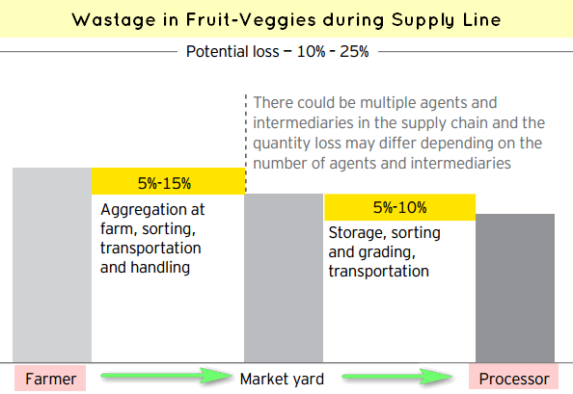
A recent ICAR study on Status of Post-Harvest losses

Slide 64










Slide 65
Mega Food Parks
The Scheme of Mega Food Park aims at providing a mechanism to link agricultural production to the market by bringing together farmers, processors and retailers so as to ensure maximizing value addition, minimizing wastage, increasing farmers’ income and creating employment opportunities particularly in rural sector. The Mega Food Park Scheme is based on “Cluster” approach and envisages a well-defined agree/ horticultural-processing zone containing state-of-the art processing facilities with support infrastructure and well-established supply chain.
8 Mega Food Parks namely Patanjali Food and Herbal Park, Haridwar, Srini Food Park, Chittoor, North East Mega Food Park, Nalbari, International Mega Food Park, Fazilka, Integrated Food Park,Tumkur, Jharkhand Mega Food Park, Ranchi, Indus Mega Food Park, Khargoan and Jangipur Bengal Mega Food Park, Murshidabad are functional as on 31.05.2016.
With a view to promote investment in Mega Food Park, Ministry of Finance has covered Food Park including Mega Food Park under Infrastructure category.

