Slide 1
Educational Psychology
Teaching, Learning and Attitude
Ganesamoorthi, S.
Asst. Professor (Agril. Extn.)
aex201@gmail.com
9448418102
9731876687

Slide 2
Psychology
Educational Psychology
Concepts / Methods of Psychology
Intelligence
Personality
Extension Teaching
Learning

Slide 3
Psychology
Greek roots Psyche & Logos
Study of Soul
Focus moved to various processes and behaviour of organisms
Definitions
Scientific study of behaviour and mental process of organism
Science of activities of an individual in relation to the environment (Woodsworth)
Positive science of behaviour (Watson)
Science of human behaviour and experience (Guilford)
Deals with responses to any and every kind of situation that life presents (Charles)
Biological
Human, animal, group

Slide 4
Scientific study
Observations
Descriptions
Experimental investigations
Collect and Organise information
Mental Processes
Private and cognitive processes
Attention, perception, memory, problem solving, reasoning, decision making, feelings, thinking, motives, etc.

Slide 5
Behaviour
All actions and reactions in response to the External / internal stimuli
Anything an individual does
What an individual knows (K), what Indl. can do (S), What indl. Thinks (A) and What indi. Actually does (A)
Types
Simple Vs Complex
Short Vs Enduring
Introvert Vs Extrovert
Overt Vs Covert
Overt – Expressed outside – Use Adoption
Covert – Expressed inside – Symbolic Adoption
Specialised Fields of Psychology
Cognitive, biological, health, developmental, social, educational, clinical, environmental, industrial, organisational, sports

Slide 6
Education
Education
Latin Educare & Educere
Leading an individual from ignorance to knowledge
Definitions
Process of bringing desirable changes into the behaviour of human beings
Process of imparting or acquiring knowledge and habits through instruction / study
Process of modifying behaviour so as to be in closer agreement with some model or ideal determined by the values of society

Slide 7
Educational Psychology
Combination / overlapping of separate fields of study
Distinct discipline
Focus on understanding the processes of teaching and learning that takes place in formal environments
Study what people think and do as they teach and learn a particular curriculum in a particular environment
Developing instructional methods / material
Research on issues of relevance for education, counselling and learning problems
Definitions
Branch of psychology which deals with teaching and learning. It takes its meaning from education, social process and psychology (Skinner).
Discipline concerned with teaching and learning processes; applies the methods and theories of psychology and has its own as well (Woolfolk).

Slide 8
Scope of Educational Psychology
Human Learning is the central core of educational psychology
To identify various psychological factors affecting teaching and learning process
Describes and explains the learning acc. to scientifically determined principles and facts concerning human behaviour
Answers the questions
Why do some individuals learn more than others?
What can be done to improve that learning?

Slide 9
Subject matters revolved around teaching and learning process and educational psychologists attempts to discover:
Extent to which factors of heredity and environment contribute to L
Nature of the learning process
Educational significance of individual difference in rate/ limit of L
Inner change that occur during learning
Relation of teaching procedures to learning outcome
Most effective techniques for evaluating progress in learning
Relative effect upon individual of Formal L Vs incidental / Informal L
To value scientific attitude towards education
Psychological impact upon learners attitude of sociological condition

Slide 10
Importance of Educational Psychology in Agril. Extn.
Both disciplines deal with human behaviour in educational environment
Helps to know the learners’ variables:
interest, attitude, aptitude, aspiration, intelligence, behaviour in group, etc.
Formulating training programmes to improve K / S of E / F
Selection of teaching aids / methods to suit the situations & suggest techniques of learning
Helps in organising the subject matter of learning experience, preparation of text books, assessment patterns for heterogeneous L.
Helps in problem solving skills among farmers
Helps to find causes of prejudices, habit of sticking, ways of doing things.
Helps to clear doubts and build confidence
Helps to deal the factors affecting motivation
Helps to know the emotions and feelings of farmers

Slide 11
Concepts and Methods of Psychology
CONCEPTS
Stimulus
Response
Behaviour
Environment
Subject
Norms
METHODS
Case study
Naturalistic observation
Tests
Interviews
Survey
Census
Tools
Sampling
Interview schedule
Questionnaire

Slide 12
Concepts in Psychology
Stimulus - any factor that initiates some activity of the organism
Response – any activity that is known to be dependant upon the stimulus
Behaviour – total response which an individual makes to a stimulus
Environment – all influences that shape an individuals behaviour
Subject – organism on whom an psychological experiment is conducted
Norms – established behavioural patterns or standards shared by a group of individuals and against which the appropriateness of behaviour is evaluated

Slide 13
Methods of study of Psychology
Case study – intensive study of an individual to find out as much as possible about certain problem – abnormal
Naturalistic observation – systematic method of observation and recording events as they occur naturally in the real world
Artificial observation may destroy characteristic
No way of making controlled observation
Tests – no. of questions about some aspect or behaviour
Pattern of answer reveal their personality traits / ability
Interviews – structured / unstructured set of questions administered to group of people based on which some general conclusion is made

Slide 14
Methods of study of Psychology
Survey – set of questions administered to a section of people on a particular issue or problem
Census – set of questions administered to all the members of the population
Tools
Sampling – selection of people from the population based on scientific sampling techniques
Interview schedule – set of questions used by the prepared by the researcher and administered personally by the enumerator
Structured / Unstructured
Questionnaire – set of questions administered to selected members who enter their response themselves.
Mailed questionnaire / online questionnaire & Structured / Unstructured / Semistructured

Slide 15
Intelligence

Slide 16
Intelligence Exercise
Form a Group

Slide 17
Intelligence Exercise
Decide a Gift for your Sisters Wedding (Budget : 1 Lakh)

Slide 18
Intelligence Exercise
Describe the Features of Gift and Rationale Behind those features

Slide 19
Intelligence
Important concept – controversial / misunderstood
Key construct
Differ – Adaptation
Abilities to cope with Environment
Composite of organization
Subtle Facts & Abstract Facts
Alertness & Accuracy
Characterizes whole behavior and sum of abilities
Product of heredity and environment

Slide 20
Definitions
Ability to judge well, reason well and act well (Binet)
Global aggregate capacity of an individual to think rationally, act purposefully, and to deal effectively with his environment (Weschsler)
Capacity to learn and adjust to relatively new and changing conditions (Wagnon)
Ability to adapt, to shape and select environment to accomplish one’s goals and those of one’s society and culture (Sternberg)

Slide 21
Definitions
Capacity to do something useful in the society in which we live. Ability to respond successfully to new situations and the capacity to learn from one’s past experiences (Gardener)
Ability or abilities to acquire and use knowledge for solving problems and adapting to the world (Woolfolk)
It is the cognitive ability of an individual to learn from experience, to reason well, to remember important information, and to cope with the demands of daily life.

Slide 22
Theories
Uni/One Factor Theory
Basic ability that affects performance on all cognitive tasks
Compute mathematical problems
analyse poetry
take history essay examination and
solving riddles
Spearman - Two factor Theory G & S
G- Mental operations that are primary and common to all performance
S- Abilities that allow them to excel in their respective domains
Multiple Theory of Intelligence (Gardner)
Not a single entity – distinct types of intelligence – interact and Work Together

Slide 23
Types of Intelligence (Gardner)
Linguistic
Logical /mathematical
Spatial
Musical
Bodily – Kinesthetic
Naturalistic
Interpersonal
Intrapersonal

Slide 24
Types of Intelligence (Gardner)
Linguistic – production & use - fluency and Flexibility
Logical /mathematical – Scientific Thinking and problem solving
Spatial – forming visuals images and patterns
Musical – produce, create & manipulate musical patterns
Bodily – Kinesthetic – whole/parts for display or problem solving
Naturalistic – awareness and relationship with natural world
Interpersonal – understand others behaviors
Intrapersonal - internal strengths and limitations

Slide 25
Triarchic Theory (Sternberg)
Product of applying thinking strategies – Analytical
Handling new problems creatively and quickly – Creative
Adapting to contexts by selecting and reshaping our environment – Practical
Analytical – Componential Intelligence
Learning & Acquisition
Planning
Performance
Creative – Experiential Intelligence
New ideas, combine unrelated facts, past experiences
Practical - Contextual Intelligence
Optimise opportunities
Street Smartness / Business Sense

Slide 26
Intelligence Quotient (William Stern)
Ratio Between Mental Age / Chronological Age
Mental Age : measure of person’s intellectual development relative to people
of his age group
Chronological Age : actual age in
year from birth
Bright Student MA>CA
Dull Student MA<CA
Idiot : 0-25
Imbecile : 26-50
Moron : 50-70
Below Normal : 70-90
Normal : 90-110
Superior : 110-120
Very Superior : 120-140
Genius : > 140

Slide 27
Intelligence Quotient (William Stern)
IQ Facts
Varies within 3 years
Change as a result of environment
Relatively stable
No direct relationship with success
Relationship with intelligence and parents occupation

Slide 28
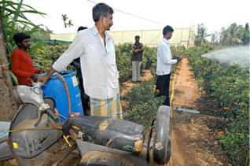
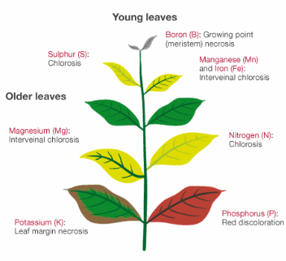
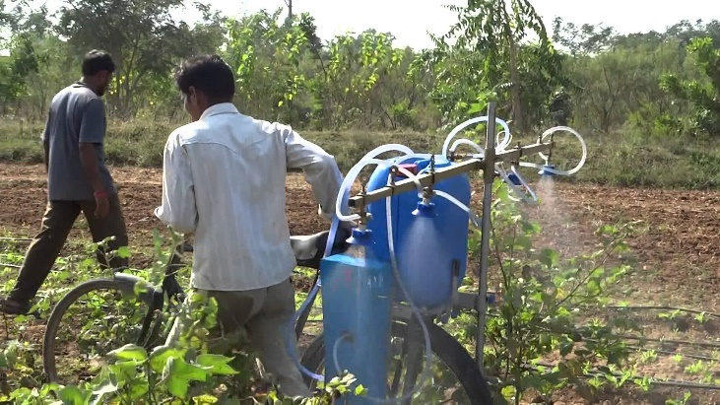

Types of Intelligence (Psychologists)
Abstract Intelligence
Ability to deal with verbal and mathematical symbols
Mechanical Intelligence
Ability to deal with things, objects – skills of individuals
Social Intelligence
Understand and deal with persons, to apply psychological principles in human relationship.

Slide 29
Factors Affecting Intelligence
Heredity and Environment
Age
Health and Physical Development
Race
Sex
Culture
Socio Economic Condition

Slide 30
Importance of Intelligence in Extension Education
Farmers
Extension Agents
Extension Personnel / Officials

Slide 32
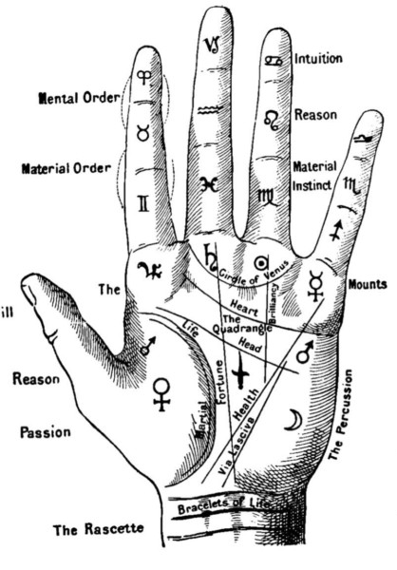
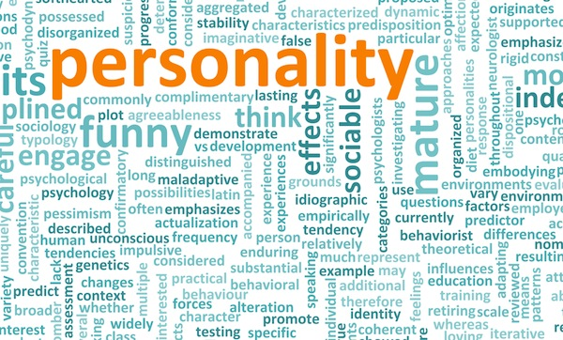

Slide 33
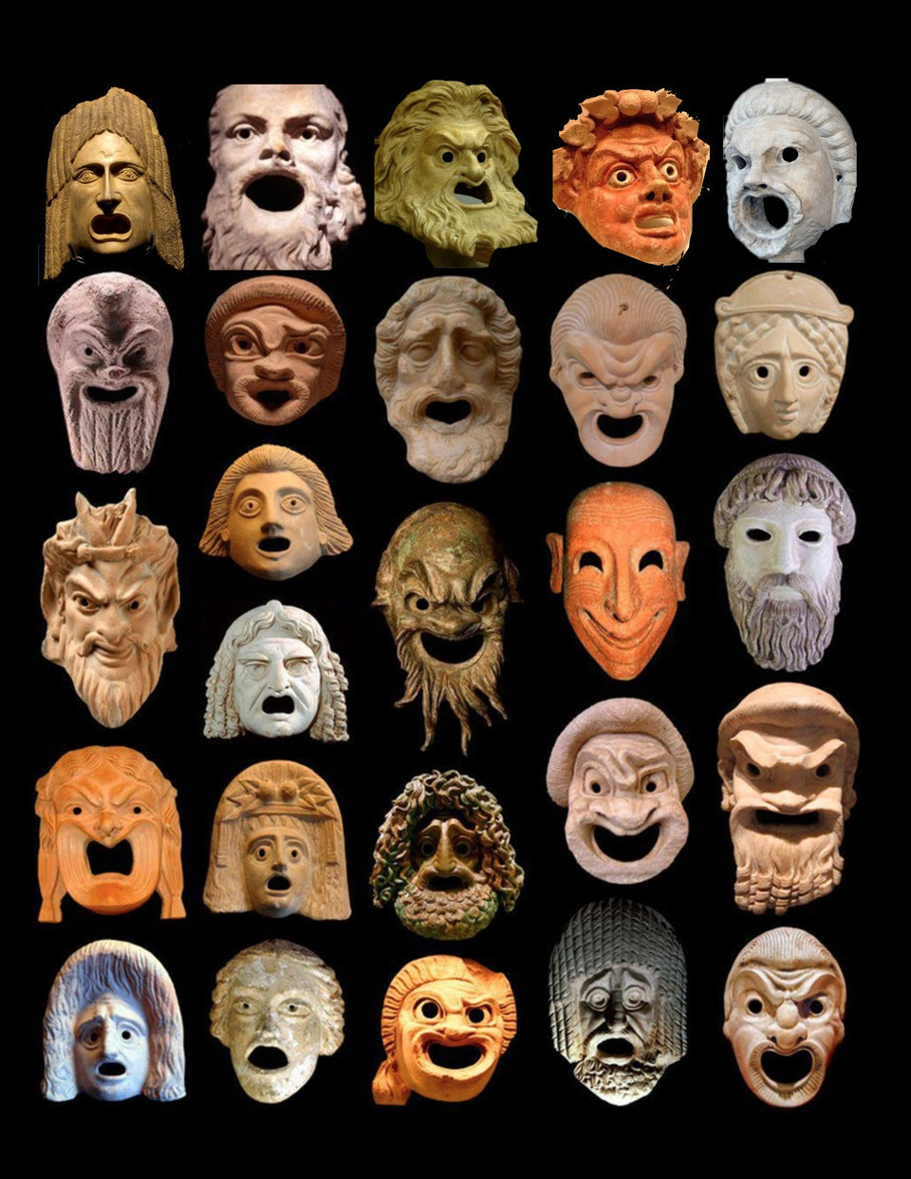
PERSONALITY: MEANING AND DEFINITIONS
Persona means mask
physical or external appearance of an individual
dynamic concept describing the growth and development
looks at some aggregate whole that is greater than the sum of the parts
our characteristic ways of responding to individuals and situations

Slide 34
Personality (Allport, 1930)
is the dynamic organisation within the individual of those psychophysical systems that determine his unique adjustments to his environment

Slide 35
Personality (Woodworth)
Personality as the quality of an individual’s total behaviour; that is, how he reacts when his activity is considered as a whole.
Personality comprises an individual’s experience, his knowledge, skill, temperament, attitude, habits, character, and physical traits.

Slide 36
Carver and Scheier (2000)
dynamic organisation, inside the person, of psychophysical systems that create a person’s characteristic patterns of behaviour, thoughts, and feelings.

Slide 37
Personality (Robbins, 2001)
Personality is the sum total of ways in which individual reacts to and interacts with others.
It is most often described in terms of measurable traits that a person exhibits.

Slide 38
Personality (Ryckman, 2004)
Personality can be defined as a dynamic and organised set of characteristics possessed by a person that uniquely influences his or her cognitions, motivations, and behaviours in various situations.

Slide 40
Personality Characterisation
Catchwords - Shy, Sensitive, Quiet, Concerned, Warm
Unique and Relatively Stable qualities that characterise an individual’s behaviour across different situations over a period of time
Consistency in Behaviour, thought and emotion of an individual across situations and across time periods characterises her/his personality.
Characterisation
we can predict how that person will probably behave in a variety of circumstances
deal with people in realistic and acceptable ways
Unique Pattern of psychological and behavioural characteristics that distinguishes each of us from everyone else
Personality characteristics are relatively stable and enduring, often developed in childhood, and affect the way we think, act, feel, and behave.

Slide 41
TYPES OF PERSONALITY - INTROVERT
Acquaintance
Conservative and suspicious
Not social and prefers to remain in the background
Avoids embarrassment and public speaking
Very reserved, Self-centred, Introspective, absent minded, Remains worried & is always day Dreaming
Slow and Hesitant to take the initiative
Philosophers, Poets and scientists

Slide 42
TYPES OF PERSONALITY - EXTROVERT
Socially adaptable and interested in people
Likes to make friends and very soon creates a circle of friends
Prefers working in company with other people, is talkative and fond of talking.
Self assertive and generally takes things lightly.
Never feels embarrassed
keen sense of observation & attentive
Eg. Reformers and social workers

Slide 43
TYPES OF PERSONALITY - AMBIVERT
Placed in between extrovert and introverts
behaviour is balanced
Psychic energy is partially directed inwards and partly outwards
Interested in their own thoughts and emotions and also in other persons and their action.
Most of us

Slide 44
FACTORS AFFECTING PERSONALITY
Heredity
Environment
Situation

Slide 45
FACTORS AFFECTING PERSONALITY - HEREDITY
Physical Stature, Facial Attractiveness, Gender, Temperament, Muscle Composition and Reflexes, Energy Level and Biological Rhythms
individual’s personality is the molecular structure of the genes, located in the chromosomes.
Shyness, Fear & Distress are most likely caused by inherited genetic characteristics.
Not possible to change those characteristics.

Slide 46
PERSONALITY : ENVIRONMENT
Environment to which we are exposed plays a substantial role in shaping our personalities.
Culture establishes the norms, attitudes, and values that are passed along from one generation to next and create consistencies over time.
Exert pressures on our personality formation are:
culture in which we raised, our early conditioning, the norms among our family, friends, social groups, social interaction, etc.
Heredity sets the parameters or outer limits, but, an individual’s full potential will be determined by how well s/he adjusts to the demands & requirements of Env.

Slide 47
Personality : Situation
It influences the effects of heredity & environment on personality.
An individual’s personality, although generally stable and consistent, does change in different situations
Situations seem to differ substantially in the constraints they impose on behaviour.
Some situations constraints many behaviour
e.g., Interview, ISRO, Metro, External Exam, ID Card
Other situations constrain relatively few
e.g., picnic, public park, Holiday, Office Hours, Classroom

Slide 48
ROLE OF PERSONALITY IN AGRICULTURAL EXTENSION
To judge and follow the method
To understand the values and value systems
To have clear idea about farmers traits
sociability (key communicator)
empathy, sympathy, generosity (CI distribution)

Slide 49
Personality Inventories
Empathy:
the ability to understand and share the feelings of another.
ego-ideal:
the part of the mind which imposes on itself concepts of ideal behaviour developed from parental and social standards.
Pessimism:
a tendency to see the worst aspect of things or believe that the worst will happen
Introversion:
the act of directing one's attention toward or getting gratification from one's own interests, thoughts and feelings

Slide 50
Personality Inventories
Neuroticism:
Is a long-term tendency to be in a negative emotional state.
Need for achievement (N-Ach):
Refers to an individual's desire for significant accomplishment, mastering of skills, control, or high standards.
Self-confidence:
A feeling of trust in one's abilities, qualities, and judgement.
Dogmatism:
The tendency to lay down principles as undeniably true, without consideration of evidence or the opinions of others.
Dominance:
Power & influence over others

Slide 52
EXTENSION TEACHING: MEANING, DEFINITION & STEPS
Teaching
It is the purposeful direction and management of the learning process.
What is extension teaching?
process of creating situations that facilitate the learning process
includes providing activities, material and guidance
arranging situation in which the things to be learnt are brought to the attention of the learners, their interest is developed, desire aroused, conviction created, action promoted and satisfaction ensured.
Ultimate purpose
inform to transform for desired change

Slide 53
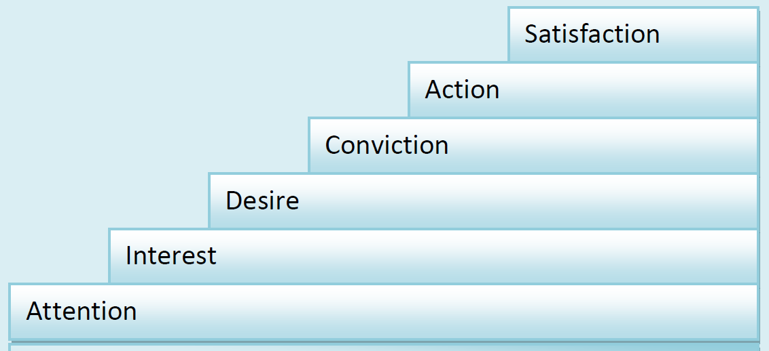
Steps in Extension Teaching
planed and deliberate act
Clients – F, W, Y, L, EP
Role : facilitator & motivator
procedure varies
6 Basic Steps (Wilson and Gallup (1955)

Slide 54
Getting the ATTENTION of the learner
Attention
IPO –
IFS, Mixed, Direct Marketing, Futures Contract
UHDP, Top Grafting, Topping
Transplanter, seed drill, Processor
No recognition of a problem / want
Teaching Methods
Radio, TV, Exhibition etc. and Personal Contacts, contact through Local Leaders

Slide 55
Stimulating the learner’s INTEREST
Furnish more info. in a way they will be able to understand and use
Present one idea at a time, relevant to their needs
Methods
Personal contact
Contact through Local leaders
Farm Publications
Radio
TV, etc.

Slide 56
Arousing the learner’s DESIRE for information
Unfreezing and motivating
emphasise on the advantage of IPO
ET Methods
Visit to Demos
Farm Publications
Personal Contacts
Group discussion etc.

Slide 57
CONVINCING the learner for action
Strong Persuasion to convince applicability of IPO in their own situation and beneficial
Furnish with Adequate Information and how it works.
ET Methods
Field day or farmers’ day
Slide Show
Personal Contact
Training

Slide 58
Getting ACTION by the learner
Putting the IPO into operation
Small Scale Demonstration with supply of Critical Inputs
Individuals who come forward.
Opportunity for direct experience
Collect Evidence of Change
yield, income, employment etc.
ET Methods
Demos.
Personal Contact
Critical Inputs & Ensuring Essential Services

Slide 59
Making sure that the learner obtains SATISFACTION from his action
Lasting change >> produce satisfying results
Satisfaction come from high yield, more income, better health etc.
Reinforces Learning
Develops Confidence
Generates Motivation for further change
Furnish New and Relevant Information (on a continued basis)
ET Methods
Mass media
Local leaders
Personal contact
Critical inputs and Essential Services

Slide 60
AIDCAS : Remember
Six steps often blend
All methods are not equally effective
One method may even contribute to several steps.

Slide 61
Teaching Steps and suitable Methods
Attention | Interest | Desire | Conviction | Action | Satisfaction
Radio | Radio |  |  | C. inputs | Mass Media
Television | Television |  |  | Trials, Demos | Local Leaders
Personal Contact | Personal Contact | Personal Contact |  | Personal Contact | Person. Cont.
Local Leaders | Local Leaders | Demos |  | E. Services | Inputs
Exhibition | Farm Publications | Visits |  |  | Essl. Services
 |  | Group Discussion
 |  |  | Field Day
 |  |  | Krishimela
 |  |  | Slides Show
 |  |  | Training

Slide 63
LEARNING AND LEARNING EXPERIENCE
What is learning?
All complex behaviours are learned
theoretical concept
not directly observable
Inferring learning
individual behaves, reacts as a result of experience in a manner different from the way formerly behaved
no universally agreed definition
many definitions & theories

Slide 64
Definitions of Learning
Learning is a process of progressive behaviour adaptation (Skinner, 1960).
Learning is a process by which a person becomes changed in his behaviour through self-activity (Leagans, 1961).
Learning is the process whereby knowledge is created through the transformation of experience (Kolb, 1984).
Van den Ban & Hawkins (1988) defined learning as the acquiring or improving the ability to perform a behavioural pattern through experience and practice.
Learning is any relatively permanent change in behaviour that occurs as a result of experience or practice (Weiss, 1990) (Atkinson et al, 1993).
According to Woolfolk (1995), learning occurs when experience causes a relatively permanent change in an individual’s knowledge or behaviour
Any relatively permanent change in behaviour or behavioural potential produced by experience.

Slide 65
Features of Learning
It involves change.
good or bad, desirable or undesirable
The change must be relatively permanent.
Reflexive Vs permanent
drugs, habituation, illness, fatigue, hunger or temporary adaptations
The change must be the result of experience
deliberate or unintentional, for better or for worse
Change due to maturation

Slide 66
Learning Experience
Enabling learners to have an effective learning experience
Results in a maximum of desirable change in behaviour
takes place through the experience
reactions to the content
what the learner does not what instructor does
not like merely attending a meeting or a class or a demo

Slide 67
LEARNING SITUATION
Presence of all the essential elements for promoting learning- TLSTP
Teacher, learner, subject matter, teaching materials & physical facilities, relevant to a particular situation.
are present in a dynamic relationship with one another.
Role of the extension agent
To create learning situations that stimulate and guide learning activity.
To manage learning situations in which learners have effective learning experiences

Slide 68
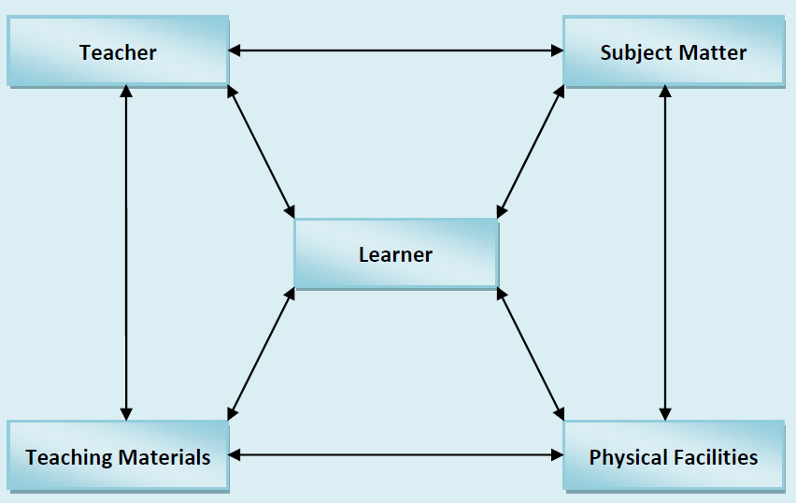
Elements of learning situation and their characteristics

Slide 69
Learner
Person who wants and needs to learn
occupies the most important central position
all efforts are directed towards him/her
Characteristics
be capable of learning
have interest in the subject
have need for the information offered
be able to use the information once it is gained
Learners in EE
Farmer, F. Women, F.Labourers, and Rural Youth

Slide 70
Teacher
Extension agent who imparts training and motivates the learner.
knows what to teach, but also knows how to teach
Characteristics
have a clear cut and purposeful teaching objectives
knows the subject-matter and have it well organised
be enthusiastic and interested about the learners and the subject-matter
be able to communicate and skilful in using teaching aids
be able to encourage participation of the people
Eg. Veterinary Doctor, Agril. Officer

Slide 71
Subject Matter
Content or Topic - Useful to the learner
Subject matter should be
pertinent to the learner’s needs
applicable to their real life situations
well organised and presented logically and clearly
Consistent with the overall objectives
challenging, satisfying and significant to the learner.
Eg. Water Use Efficiency, Market Intelligence

Slide 72
Teaching Materials
Appropriate instructional material, Equipments and aids.
Teaching material should be
suitable to the subject matter and physical situation
adequate in quantity and available in time
skilfully used
Examples
Breeds, Seeds, Chemicals, Specimens, audio-visual aids, relevant to the topic etc.

Slide 73
Physical Facilities
Appropriate physical environment in which teaching learning can take place.
Characteristics
compatible with objective
Hall Size, Disturbance free, Lighting /Darkness
Representative of the area and situation
Crops, Mobile Labs
adequate & easily accessible.
Examples
Suitable land, irrigation, Problem Soils, Infested Fields
Place easily accessible, free from outside distractions, adequate seating arrangements, electricity for projection, etc.

Slide 74
PRINCIPLES OF LEARNING
principles are generalised guidelines which form the basis for taking action
1. Principle of association
growth-like and continuous
result of the kind of experience
Previous learning always sets the stage for further learning
New learning may be associated with previous successful and satisfying responses
Example
If the farmers have obtained profitable return by the application of nitrogenous fertilizer, they may be motivated to use balanced fertilizers containing phosphate and potash, for still higher return.
Implications
Begin at the level of the learner.
New must be related to the old.
Adjust the pace to the learner’s capacity, one idea at a time.
Bring the idea to the attention of the learner repeatedly (in a variety of ways) and over a period of time.

Slide 75
PRINCIPLES OF LEARNING
2. Principle of clarity of objectives
Learning is more effective when it is purposeful.
The learning must be useful to the learners.
Objectives must be clear and meaningful to the learners.
What is to be learnt must be important to a relatively large number of participants in the group and must be attainable
Implications for teaching
Learning must make sense to the learners.
Progress must be constantly appraised and redirected.
Purpose must be kept in sharp focus (objectives must be clear to the learner and teacher).

Slide 76
PRINCIPLES OF LEARNING
3. Principle of self activity
active process
instructor creates a situation and stimulates
“locked on the inside”
Use appropriate activities
learning by doing
Implications for teaching
Activities appropriate to specific learning situation must be used.
Learning activities should engage a maximum number of senses.

Slide 77
PRINCIPLES OF LEARNING
4. Principle of motivation
To learn, people need to feel the need for learning. When this desire exists, the learner will exert a high level of effort. The learning experience, therefore, should be designed so learners can see how it will help them achieve those goals they have set for themselves.
Implications for teaching
Teacher motivation of the student is essential in making learning more challenging.
Standards demanded of the learner should be suitable to their ability or capacity.
Appropriate and timely Recognition should be given to student achievement.

Slide 78
PRINCIPLES OF LEARNING
5. Principle of practice
gain confidence and are less likely to make errors or to forget
Implications for teaching
Course content should be organised into meaningful units.
Theory should be related to practice.
Provide activities that stimulate actual use situation

Slide 79
PRINCIPLES OF LEARNING
6. Principle of disassociation
Learning is affected by emotions. The most effective way of eliminating an undesirable response is to set up a desirable substitute that must be more satisfying than the original reaction.
For example, when planting a crop in lines gives better yield, the farmer may be advised not to practise broadcasting.
Paddy – Flooded– SRI - Aerobic
Implications for teaching
Strive to increase pleasant emotions and decrease unpleasant emotions of students in connection with the learning process.
Train the expression of emotions in the right direction

Slide 80
PRINCIPLES OF LEARNING
7. Principle of readiness
Learning takes place more effectively when one is ready to learn.

Slide 81
PRINCIPLES OF LEARNING
8. Principle of set or attitude
An unfavourable attitude or set retards learning and a favourable attitude accelerates it.

Slide 82
PRINCIPLES OF LEARNING
9. Principle of reinforcement
Behaviours that are positively reinforced (rewarded) are encouraged and sustained. When the behaviour is punished, it is temporarily suppressed but is unlikely to be extinguished.

Slide 83
PRINCIPLES OF LEARNING
10.Principle of transfer of learning
It does not make much sense to perfect a skill in the classroom and then find that you cannot successfully transfer it to the job. Therefore, learning should be designed to foster transferability
Eg. Honey Bee Colony Transfer

Slide 84
PRINCIPLES OF LEARNING
11.Principle of feedback
Learning is facilitated when the learners are provided with knowledge of progress of learning.

Slide 85
PRINCIPLES OF LEARNING
12.Principle of abilities
Learning abilities varies widely among individuals. The level of communication and the level of understandability of the subject matter taught must be in line with the learner’s ability.

Slide 86
MOTIVATION

Slide 87
Motivation
1. Is a desire or need which directs and energizes behaviour that is oriented towards a goal.
2. It is the influence of the needs and desires on the intensity of behaviour and direction it will follow.
3. Motivation is the arousal, direction, as well as persistence of one’s behaviour.

Slide 88
1) Behavioral : This is either to obtain desirable and pleasant consequences or to avoid undesirable and unpleasant consequences
2) Social : This is related to the need to be a part of a group
3) Biological : This is related to the need to fulfill all biological needs such as
hunger, thirst; satisfy the senses, etc.
4) Cognitive : This is satisfy the various intellectual needs
5) Affective : This relates to the emotional needs
6) Conative : This pertains to achieving personal goals and do away with any threats that come in the way of achieving goals
7) Spiritual : This relates to the goal of self-realization

Slide 89
Motivation Classification
Intrinsic motivation
refers to motivation that is driven by an interest or enjoyment in the task itself, and exists within the individual rather than relying on any external pressure.
Extrinsic motivation
comes from outside of the individual. Common extrinsic motivations are rewards like money and grades, coercion and threat of punishment.
Security
Achievement
Social Recognition

Slide 90
TYPES OF MOTIVATION
Achievement Motivation
Affiliation Motivation
Competence Motivation
Power Motivation
Attitude Motivation
Incentive Motivation
Fear Motivation

Slide 91
Theories of Motivation

Slide 92
Learning Behaviour

Slide 93
Behaviour : Cognitive

Slide 94
Behaviour : Affective

Slide 95
Behaviour : Psychomotor

Slide 96
Attitude
a settled way of thinking or feeling about something
A predisposition or a tendency to respond positively or negatively towards a certain idea, object, person, or situation
An expression of favour or disfavour toward a person, place, thing, or event (the attitude object).
Gordon Allport "the most distinctive and indispensable concept in contemporary social psychology.
"Attitude can be formed from a person's past and present.

Slide 97
Definition of Attitude
Sarnoff (2000) identifies the attitude of willingness to respond (disposition to react) positively (Favorably) or negatively (unfavorably) to the object - a particular object.
D.Krech and RS Crutchfield (in Sears, 1999) found that the attitude of the organization that is settled from the motivational, emotional, perceptual, and cognitive aspects of the world of the individual.
a pattern of behaviour, tendencies or anticipatory readiness, predisposition to adapt in social situations, or simply, the attitude is a response to social stimuli that have been conditioned. While La Pierre (2003)
View or feelings that accompanied the tendency to act on a particular object. Soetarno (1994)
The attitude is always directed to something means nothing without an attitude. Attitude is directed to objects, people, views, institutions, norms, and others.
Attitude is a state in which man moves to act or do in social activities with certain feelings in response to a situation or condition of the objects in the surrounding environment. In addition it also provides readiness posture to respond to the positive or negative nature of the object or situation.

Slide 98
Attitude Components - CAB
Cognitive component
The cognitive component of attitudes refer to the beliefs, thoughts, and attributes that we would associate with an object. Many times a person's attitude might be based on the negative and positive attributes they associate with an object.
Affective component
The affective component of attitudes refer to your feelings or emotions linked to an attitude object. Affective responses influence attitudes in a number of ways. For example, many people are afraid/scared of spiders. So this negative affective response is likely to cause you to have a negative attitude towards spiders.
Behavioural component
The behavioural component of attitudes refer to past behaviours or experiences regarding an attitude object. The idea that people might infer their attitudes from their previous actions.

Slide 99
Factors Affecting Attitude Formation
Through social interaction, individuals form different patterns of attitudes toward psychological object faces.
Personal experience
In order to be the basis of attitudes, personal experiences have left a strong impression. Therefore, the attitude will be more easily formed when personal experience involves emotional factors. In situations involving emotions, appreciation will be more in-depth experience and longer trace.
Culture
B.F. Skinner (in, Azwar 2005) emphasized the influence of the environment (including culture) in shaping one's personality. No other personality than a consistent pattern of behaviour that illustrate the history of reinforcement (reinforcement, reward) owned. The pattern of reinforcement from the public to the attitude and behaviour, rather than to the attitudes and behaviour of others.
Other people are considered important – Trend
In general, the individual being conformist or the direction of the attitude of the people it deems important. The trend is partly motivated by a desire for affiliation and the desire to avoid conflict with the people considered important.

Slide 100
Factors Affecting Attitude Formation
Media
As a means of communication, the mass media such as television, radio, has a major influence in shaping people's opinions and beliefs. There is new information on something that provides the foundation for the emergence of new cognitive attitudes towards it. Suggestive messages that carry information, if strong enough, will provide basic affective in assessing something empirical and forming attitudes toward certain.
Educational Institutions and Religious
As a system, educational and religious institutions have a strong influence in shaping attitudes because they lay the foundation of understanding and moral concepts within the individual. Understanding the good and the bad, the dividing line between something that can and can not do, is obtained from the centre of the educational and religious activities and teachings.
Emotional factors in themselves
Not all forms of attitude is determined by environmental circumstances and personal experiences. Sometimes, a form of attitude is a statement that is based on emotion which serves as a sort of channelling frustration or transfer form ego defence mechanisms. Such an attitude is temporary and goes away so frustrating was lost but could also be more persistent attitude and more durable. example form attitudes based on emotional factors are prejudice.

Slide 101
LEARNING AND LEARNING EXPERIENCE
Cognitive theories of learning
which emphasise the thought process and the role of the mind in learning, view it as the mind’s ability to acquire, process, and retain new knowledge and information.
Cognitive psychologists
unobservable mental activities such as thinking, remembering, creating, and solving problems
Behavioural psychologists
outcome of learning is change in behaviour and emphasises the effects of external events on the individual.
Experiential theories
Emphasise the role of action and experience in learning, conceptualise it in terms of competencies generated among learners.

