Slide 1




RAWE 2023-24
COLLEGE OF AGRICULTURE, GKVK, BENGALURU

Slide 2
Tentative schedule of events B.Sc. Hons. (Agri.) 2023-24
Period | Item of work | Duration | Prog.
04.10.2023 to 10.10.2023 | Student READY Programme orientation | 1 week | Agri., ABM & Engg.
11.10.2023 to 09.01.2024 11.10.2023 to 10.11.2023 10.12.2023 to 09.01.2024 | Placement in RSKs and Villages for practical experience Agri. Engg. ABM | 13 weeks 4 weeks 4 Weeks | Agri., Engg. & ABM
11.01.2024 to 01.02.2024 | Agro-Industrial Placement/Attachment | 3 weeks | Agri.
02.02.2024 to 16.02.2024 | Placement in Krishi Vignana Kendras (KVK)/ Agricultural Research Station (ARS) and Other Units | 2 weeks | Agri. & ABM
17.02.2024 to 02.03.2024 | Project report preparation, Presentation, Exam and Evaluation | 2 weeks | Agri., ABM & Engg.
Total |  | (21 weeks)

Slide 3
RSK Placements & Exams
Period | Programme | Duration
04.10.2023 to 10.10.2023 | Agriculture, Agril. Engineering & ABM | 1 Week
11.10.2023 to 09.01.2024 | Agriculture | 13 Weeks
11.10.2023 to 10.11.2023 | Agril. Engineering | 4 Weeks
10.12.2023 09.01.2024 | ABM | 4 Weeks
02.02.2024 to 16.02.2024 | Agriculture & ABM | 2 weeks
17.02.2024 to 02.03.2024 | Agriculture, Agril. Engineering & ABM | 2 weeks
Total |  | (21 weeks)

Slide 4
Tentative List of Students
Programme | Students | Boys | Girls
B.Sc. (Hons.) Agri. – A | 93 | 58 | 35
B.Sc. (Hons.) Agri. – B | 91 | 36 | 55
B.Sc. (Hons.) Agri. – C | 92 | 42 | 50
B.Sc. (Hons.) Agri. | 276 | 136 | 140
B.Tech. (Agril. Engg.) | 68 | 40 | 28
B.Sc. (Hons.) ABM | 59 | 18 | 41
Total | 403 | 194 | 209
Students / Village First Month (Agri. + B. Tech.) | 20 | 10 | 10
Students / Village Last Month (Agri.+ ABM) | 19 | 9 | 10
Students / Village Second Month (Agri.) | 15 | 8 | 8
Students / Village | 23-24 | 11-12 | 11-12

Slide 5
Monitoring Options
No. of clusters & Villages | No. of Agri Students / Village | No. of Engg. Students / Village | No. of ABM Students / Village | No. of Total Students / Village | No. of Extn. Teachers Required | No. of Expert Teachers Required | No. of Extn. Teachers Available for RAWE | No. of Extn. Teachers Additionally required
6 Clusters 18 Villages | 15-16 (7-8 Boys 7-8 Girls) | 3-4 (2-3 Boys 1-2 Girls) | 3-4 (1 Boy 1-2 Girls) | 23-24 (10-11 Boys 11-12 Girls) | Coordinator – 1 Associate Coordinator – 1 Cluster Teachers – 6 | Expert Teachers – 44 | 3+2 (Contr.) | 3
5 Clusters 15 Villages | 18 (9 Boys 9 Girls) | 5 (2-3 Boys 1-2 Girls) | 4 (1-2 Boys 2-3 girls) | 26-27 (12-13 Boys 13-14 Girls) | Coordinator – 1 Associate Coordinator – 1 Cluster Teachers – 5 | Expert Teachers – 38 | 3+2 (Contr.) | 2
276/18 = 15-16 Agri. Students per Village (Each 7-8 Agri. Boys / Girls per village)
59/18= 3-4 ABM Students / Village (1boy/village & 2-3 girls/Village)
68/18= 3-4 B. Tech. Students / village (2-3boys/village & 1-2 girls/Village)
Total 403/18 = 23-24 Students / Village
No. of Visits to the Cluster / Week – 2
13 Weeks X 4 Teachers X 2 Visits X 6 Clusters = 624 Visits
12-13 Visits / Teacher if (44+6 = 50) Teachers deputed
No. of Visits to the Cluster / Week – 2
13 Weeks X 4 Teachers X 2 Visits X 5 Clusters = 520 Visits
11-12 Visits / Teacher if (38+6= 44) Teachers deputed

Slide 6
Villages
Availability of Two Accommodations for 15 students each
Within 10 km radius from Hobli RSK
Around 300 farm families
Significant area under horticultural Crops
Scope / Interest for Secondary Agriculture
Reference of Agri/Horticultural Departments & Progressive / Awardee Farmers
Presence of Agro-industries
Presence of FPOs & SHGs
Villages not covered in earlier RAWEs

Slide 7
Districts & Taluks
Chikkaballapura Bangalore Rural
Sl. No. | Taluk Name
1 | Bagepalli
2 | Chikkaballapur
3 | Chintamani
4 | Gowribidanur
5 | Gudibande
6 | Sidlagatta
Sl. No. | Taluk Name
1 | Dodballapura
2 | Devanahalli
3 | Hoskote
4 | Nelamangla

Slide 8
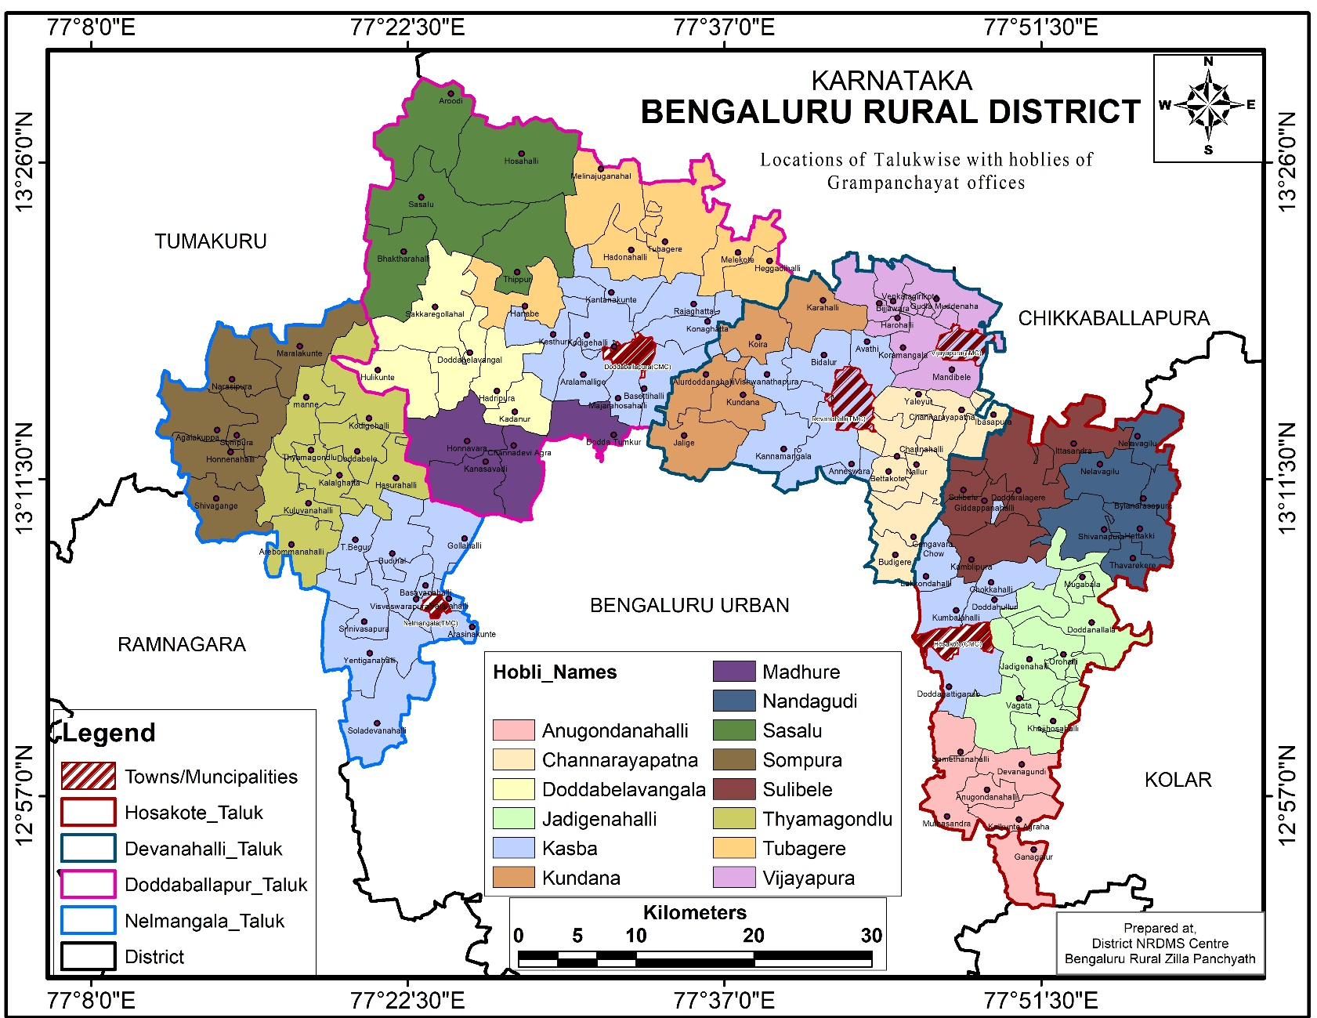
Bengaluru Rural : 4 Taluks & 14 Hoblis
Sl. No. | Hobli Name
1 | Anugondanahalli
2 | Channarayanapatna
3 | Doddabelavangala
4 | Jadigenahalli
5 | Kasaba
6 | Kundana
7 | Madhure
8 | Nandagudi
9 | Sasalu
10 | Sompura
11 | Sulebele
12 | Thyamagondlu
13 | Tubagere
14 | Vijayapura
Sl. No. | Taluk Name
1 | Dodballapura
2 | Devanahalli
3 | Hosakote
4 | Nelamangla

Slide 9
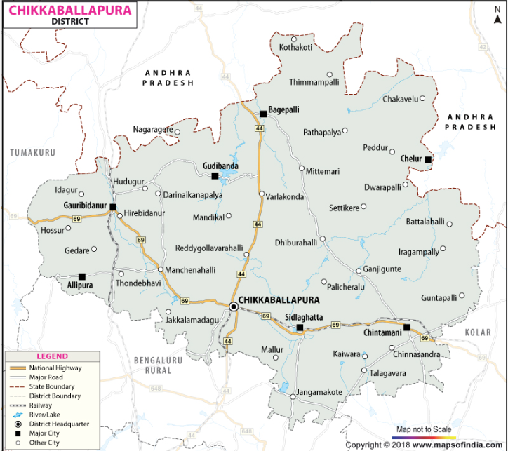
Chikkaballapura Dist.
Taluks - 6
Bagepalli
Chikballapur
Chintamani
Gowribidanur
Gudibande
Sidlagatta
Hoblis - 26
Chelur (Bagepalli)
Guluru (Bagepalli)
Kasaba ( Bagepalli)
Mittemari (Bagepalli)
PathaPalya (Bagepalli)
Kasaba (Chickballapur)
Mandikal (Chickballapur)
Nandi (Chickballapur)
Ambaji Durga (Chintamani)
Chilakalanerupu(Chintamani)
Kasaba (Chintamani)
Kaiwara (Chintamani)
Mungnahalli (Chintamani)
Muragamalla(Chintamani)
D Palya (Gowribidanur)
Hosur(Gowribidanur)
Kasaba (Gowribidanur)
Manchenahalli(Gowribidanur)
Nagaragere(Gowribidanur)
Thondebavi (Gowribidanur)
Kasaba (Gudibande)
Somenahalli(Gudibande)
Bashettihalli(Shidlaghatta)
Jangamkote(Shidlaghatta)
Kasaba (Shidlaghatta)
Sadali(Shidlaghatta)

Slide 10
Budget
Sl. No. | Head | Amount 10,00,000+8213500
1 | Animal Health Camp | 50000
2 | Banners | 50000
3 | Exhibition | 250000
4 | Public Address System | 70000
5 | Hiring | 200000
6 | Software & Schedule | 50000
7 | Demonstration Material | 100000
8 | POL | 100000
9 | Stationary | 130000
10 | Transport (Additional Hiring)
11 | Stipend – GOK @ 9000 for Agri. 3000 each for ABM / Engg. | 24,84,000 – Agri. 204000 – Engg 177000 – ABM
12 | Stipend – ICAR @2500 X 6 Months X 276 – Agri. POL/TADA – ICAR @500 X 6 Months – Agri. Stipend – ICAR @2500 X 1 Month X 59– ABM. POL/TADA – ICAR @500 X 1 Month – ABM. Stipend – ICAR @2500 X 1 Month X 68– Engg.. POL/TADA – ICAR @500 X 1 Month – Engg. | 4140000 828000 147000 29500 170000 34000
 |  | 92,13,500

Slide 11
RAWE 2022 Feedback (Students)
Providing quality seed material on time for crop museum sowing
Providing essential farm equipment for field operations
Providing Portable public address systems and projectors for conducting programmes
Selecting villages with crop diversity and youth
Re-scheduling AIA & RS/KVK placement before RSK placements
Increasing frequency of visits by pathologists/ entomologists
Participation of RAWEP teachers in night meetings
Providing RAWEP stipend before RSK Placements
Extending transport facilities for AIA and KVK placements

Slide 12
RAWE 2022 Remarks of VC
Students need to explore the solutions for the problems under RAWE
NSP to involve the RAWE students in identifying farmers for seed production in RAWE villages
Providing 60 % stipend before RSK Placements
Clubbing activities of Directorate of Research / Extension with RAWE
Sparing Public Address System & LCD projectors for rawe villages (Directorate of Extension)
Arranging one day exclusive interaction session of student-farmers-scientists well before final exhibition
Stating the problems of the village precisely with proportion / percentages of affected / requirement
Interpreting & training soil test reports to the farmers for soil test based nutrient application
Gearing up for planning and conduct of the RAWE programmes well in advance
Deputing required number of teachers to the RAWE programme based on the needs and problems of the farmers

Slide 13

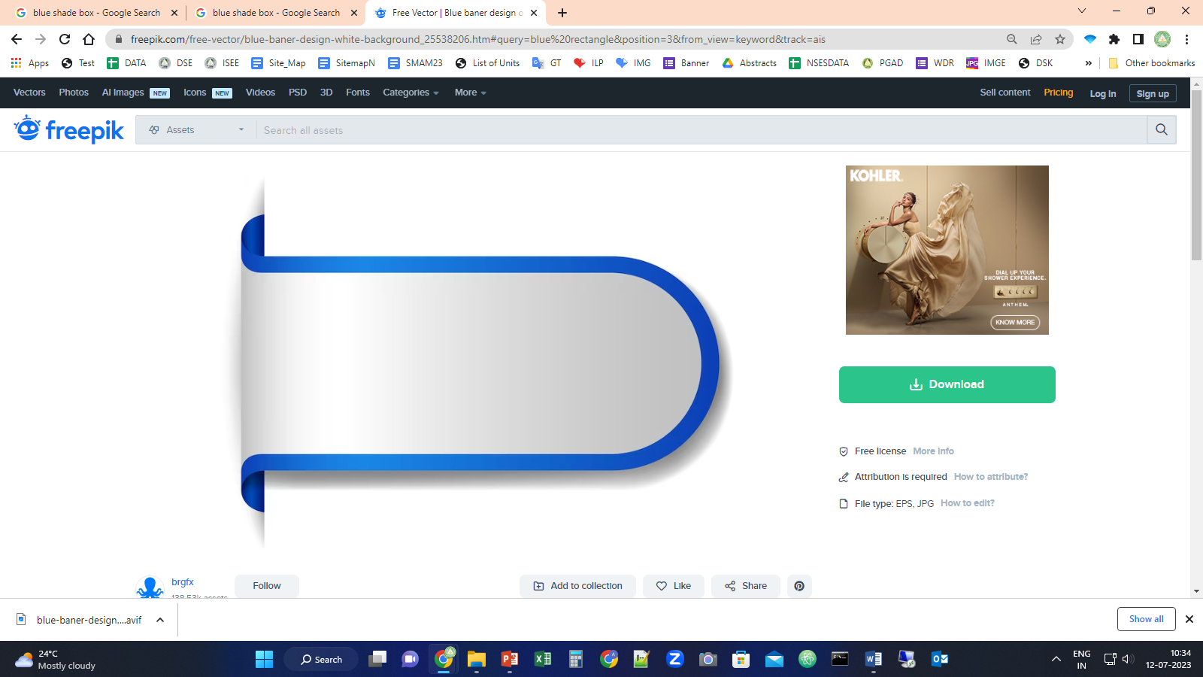



RAWE 2023-24
COLLEGE OF AGRICULTURE, GKVK, BENGALURU
RAWE 2023-24
COLLEGE OF AGRICULTURE, GKVK, BENGALURU

Slide 14
Tentative List of Students
Programme | Students | Boys | Girls
B.Sc. (Hons.) Agri. – A | 93 | 58 | 35
B.Sc. (Hons.) Agri. – B | 91 | 36 | 55
B.Sc. (Hons.) Agri. – C | 92 | 42 | 50
B.Sc. (Hons.) Agri. | 276 | 136 | 140
B.Tech. (Agril. Engg.) | 68 | 40 | 28
B.Sc. (Hons.) ABM | 59 | 18 | 41
Total | 403 | 194 | 209
Students / Village First Month (Agri. + B. Tech.) | 20 | 10 | 10
Students / Village Last Month (Agri.+ ABM) | 19 | 9 | 10
Students / Village Second Month (Agri.) | 15 | 8 | 8
Students / Village | 23-24 | 11-12 | 11-12
276/18 = 15-16 Agri. Students per Village (Each 7-8 Agri. Boys / Girls per village)
59/18= 3-4 ABM Students / Village (1boy/village & 2-3 girls/Village)
68/18= 3-4 B. Tech. Students / village (2-3boys/village & 1-2 girls/Village)
Total 403/18 = 23-24 Students / Village

