Slide 1


Slide 2

Department of Agricultural Extension
SEMINAR -1
UNIVERSITY OF AGRICULTURAL SCIENCE BANGLORE
Presented by,
Amrutha Basavaraju,
PAMB1142,
Sr. M.Sc.,

Slide 3

EXODUS OF YOUTH FROM AGRICULTURE-BOON OR BANE?

Slide 4

Flow of Presentation
Introduction
Exodus Concept and Types of Migration
Objectives
Reasons for Migration
Why youth moving out of agriculture
Why we need youth in agriculture
Strategies and Schemes to Check Out the Migration
Has agriculture extension profession any role to play?
Case studies
Conclusion

Slide 5
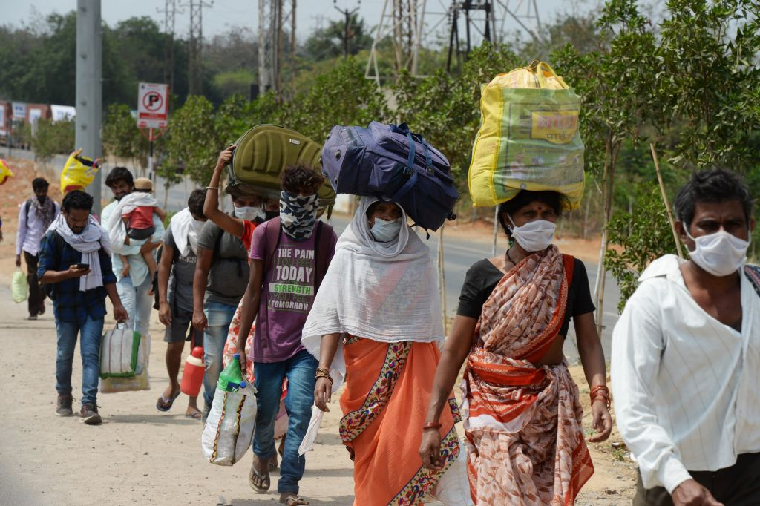
INTRODUCTION
Agriculture in India has been the base of Indian economy and its contribution to GDP is 18.8 Per cent. FAO reported that though 68 per cent of Indian population is dependent of agriculture however the economically active population in agriculture is 57 percent
The trend of rural population and cultivators is decreasing from 82.7 per cent (1951) to 72.2 % (2001) and 71.9 (1951) to 54.4 (2001), respectively

Slide 6
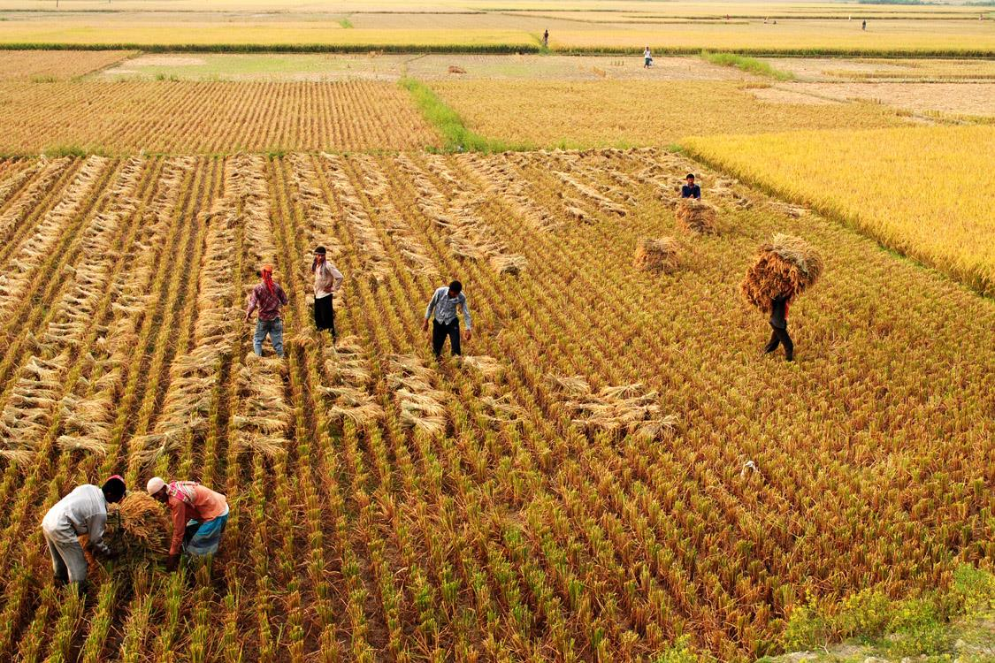
India is losing more than 2,000 farmers every single day and that since 1991, the overall number of farmers has dropped by 15 million (Sainath, 2013).
There are several implications for the future of Indian agriculture and India’s food security.
Over the past few years, rural youth have been staying away from agriculture (IFAD, 2012; Paisley, 2013).
Young farmers can play an important role in ensuring food security if they are encouraged to involve in farming and the challenges they face are addressed.

Slide 7

OBJECTIVES
To understand the concept of exodus of youth from agriculture.
2. Advantages and Disadvantages of exodus of youth from agriculture.
3. To review related case studies.

Slide 8
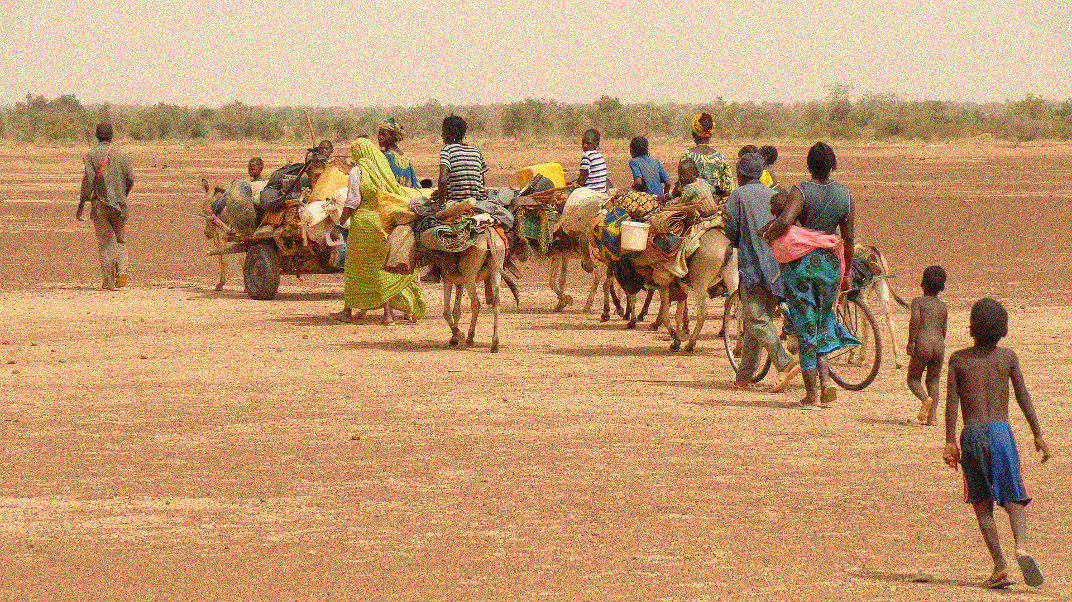
EXODUS MEANING
A going out, departure or migration, usually of a large
number of people or a mass departure of people.
CONCEPT OF MIGRATION
Movement of people from one place to another temporarily, seasonally or permanently, for a host of voluntary or involuntary reasons.”
( According to the United Nation's 2008)

Slide 9


1.Rural to Rural
Traders
Agricultural workers.
Total migrates are
53.3 million
TYPES OF MIGRATION
2.Rural to Urban
Due to poverty,
Low agricultural productivity, Population growth,
Environmental degradation,
Lack of economic opportunities 20.5 million migrates
3.Urban to Urban
Employment purpose.
Total migrates are 14.3 million
4.Urban to Rural
“New settlement" plan some return to their rural homes after having migrated to cities. 6.2 million
Source: Census of India 2011

Slide 10
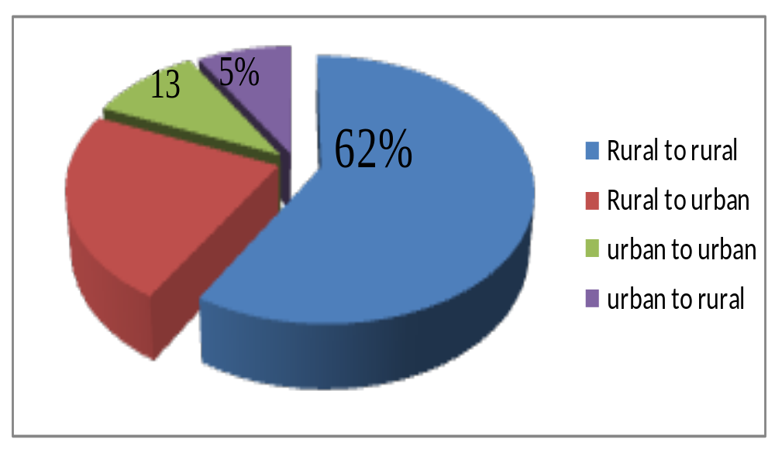
Types of Migration
20%
Source: NSSO ,2010.

Slide 11
Migration Streams in Karnataka
Source: Census 2011

Slide 12
YOUTH MIGRATION IN INDIA BY SEX , 2011 CENSUS
 | Total (millions) | Male (millions) | Female (millions)
Total migrants in India | 315 | 93 | 221
Youth migrants in India | 92 | 25 | 66
Percentage of youth migrants to total migrants in India | 29% | 27% | 30%
Source: computed by the author based on 2011 Census

Slide 13
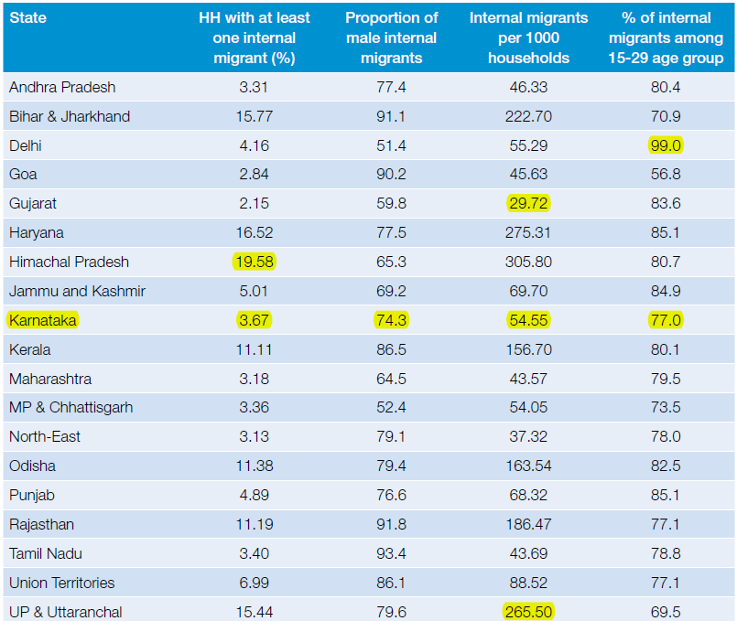
YOUTH MIGRANTS IN INDIA BASED ON THE 64TH ROUND OF
THE NSSO,2007-08

Slide 14

Reasons for Migration/Exodus
Migration is mostly influenced by social structure and pattern of development. Uneven development is the main reasons for migration and this can be grouped has a push and pull factors.
Push factors: The rural situation push the individuals towards urban areas
Pull factors: Pull factors are reinforced by a variety of factors, ranging from the high wages and workers protectionism offered by urban sectors

Slide 15

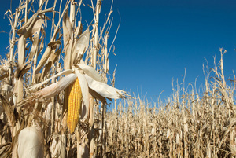
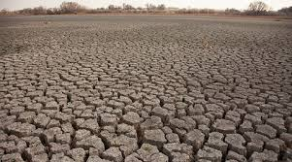
IMPORTANT PUSH FACTORS
Low Agricultural Productivity
Unemployment
Landlessness
Poverty
Depleting Rural Employment Opportunities
Seasonality Of Agriculture
Medical Treatment
Children’s Education
Natural Calamites and Lack of Basic Infrastructural Facilities.

Slide 16

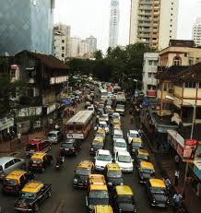
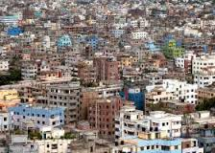

IMPORTANT PULL FACTORS
Rapid urbanization
Industrialization
Expanding transport sector
Employment Opportunities
Higher wages
Better opportunities for education
Better health facilities and
Sources of entertainment. etc.

Slide 17
Reasons for Migration
Reason for migration | Number of migrants(million) | % to total migrants
Work/Employment | 43.1 | 42.8
Moved with household | 20.6 | 20.0
Business | 15.5 | 15.8
Education | 7.9 | 6.0
Moved after birth | 6.5 | 6.7
Other | 9.5 | 8.7
Source : Census of India ,2011

Slide 18
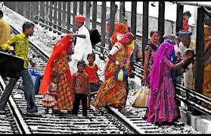
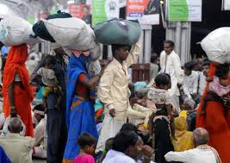
Consequences of Migration
Economic Consequences
Demographic consequences
3. Social consequences
4. Environmental consequences

Slide 19

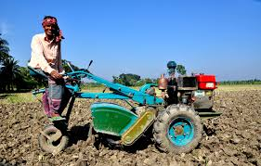
1. Economic Consequences
A) Positive consequences:
The remittance (payments) sent by migrants to their homes help in the growth of economy of the region.
This money is mainly used by the family for purchasing food, repayment of debts, medical treatment, marriages, children’s education, purchasing agricultural inputs, etc.
Many poor villages of Bihar, Uttar Pradesh, depend on this money for their survival.

Slide 20
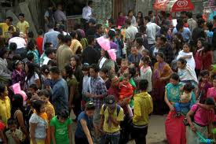
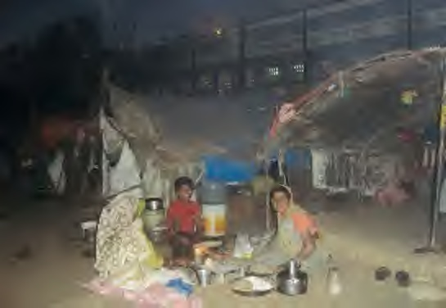
B) Negative consequences:
Unregulated migration to the metropolitan cities of India has caused overcrowding.
Development of slums in industrially developed states such as Maharashtra, Gujarat, and Delhi is the result of unregulated migration.
The under-development gets even worse due to out migration of
skilled people.

Slide 21

2. Demographic consequences
A) Positive consequences:
Migration leads to the redistribution of the population within a country.
It results in balanced distribution of people according to resources.
Rural-urban migration is one of the important factors contributing to the
population growth of cities.

Slide 22
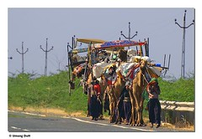
B) Negative consequences:
It results in imbalances in sex composition due to selective male or female migration. Large cities have unfavourable sex ratio as compared to rural areas due to high male immigration.
Shortage of skilled people in rural areas because most of skilled and semiskilled people migrate to urban areas.

Slide 23

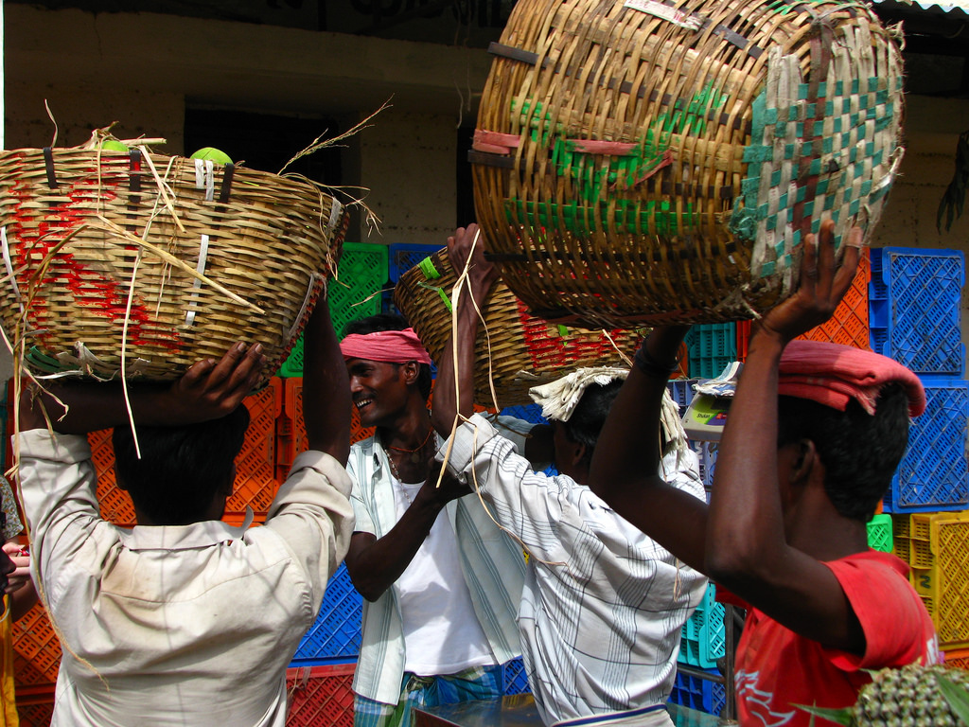
3. Social consequences
Positive consequences:
Migration also leads to intermixing of people from diverse cultures and results in the evolution of composite culture.
Migrants act as agents of social change. The new ideas related to new technologies, family planning, girls’ education, etc. get spread from urban to rural areas through them.
The mind set of people changes. They start thinking broadly and the narrow views changes.

Slide 24
B) Negative consequences:
It also causes anonymity, which creates social vacuum and sense of dejection among individuals.
Continued feeling of dejection may motivate people to fall in the trap of antisocial activities like crime and drug abuse.
Migration affects the women more. In the rural areas, male selective out migration leaving their wives behind puts extra physical as well mental pressure on the women which increases their vulnerability.

Slide 25
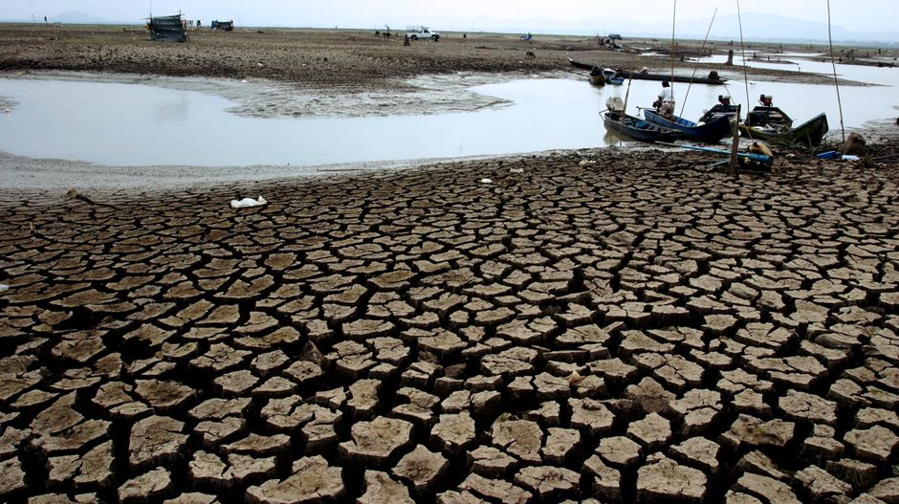
4. Environmental consequences
Overcrowding of people due to rural-urban migration has put pressure on the existing social and physical infrastructure in the urban areas.
This ultimately leads to unplanned growth of urban settlement and formation of slums shanty colonies.
Apart from this, due to over-exploitation of natural resources, cities are facing the acute problem of depletion of ground water, air pollution, and disposal of sewage and management of solid wastes.

Slide 26

Poverty reduction
Increasing share of household income
Improvement in social status
Skill development
Empowerment of women
Improvement in the standard of living

Slide 27

Reduced use of potential in one’s own native area
Reduced agricultural production
Scarcity of labour
Split in rural joint families
Development of prejudices about a section of people
Loss of harmony

Slide 28
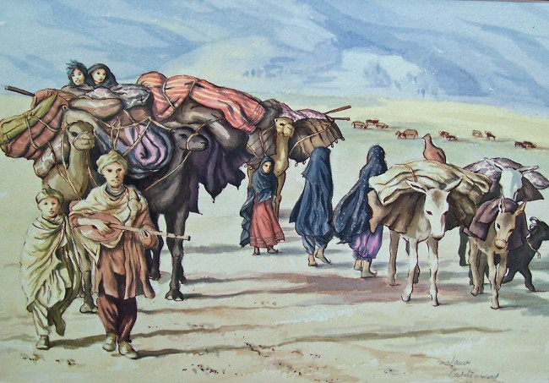
WHY YOUTH MOVING OUT OF AGRICULTURE?
Young people are three times more likely to be unemployed than adults and more than 75 million youth worldwide are looking for work, according to the UN International Labour Organization (ILO). Due to their limited access to assets (in particular land), markets, finance and education and skills training, youth are often unemployed or work informally – often in unpaid, very low-skilled, insecure and sometimes hazardous jobs (IFAD, 2012).

Slide 29
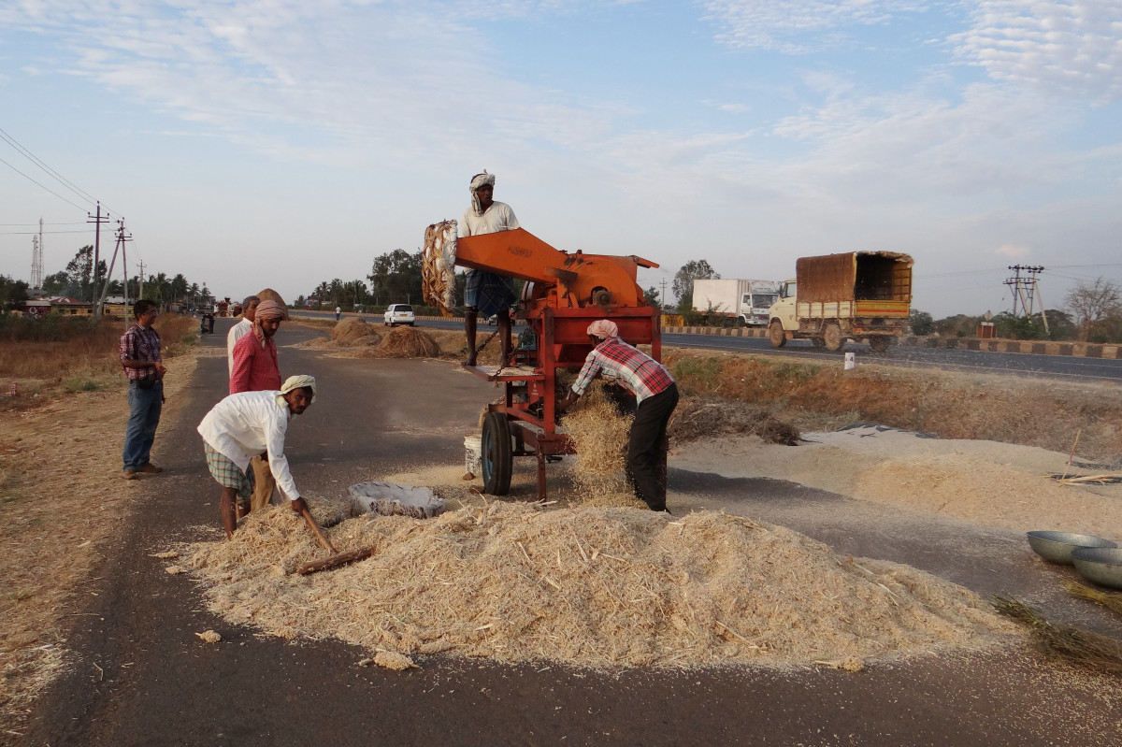
Most of the educated youth find agriculture as an unattractive preposition, especially the way it is practiced traditionally by their parents.
When specific youth policies do exist in developing countries, they often do not cater for poor rural youth but tend to be biased towards non-poor males living in urban areas.
Consequently, there is growing disenchantment among rural youth towards agriculture vocation and they find it much lucrative to migrate to cities to do even menial jobs.

Slide 30
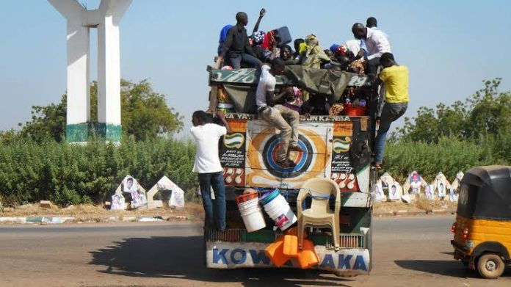
Large-scale migration of rural youth from farming to urban areas has caused concern among the agricultural policy makers, since, such a trend, if not checked, is likely to affect agricultural activities in the future. Thus, checking migration and retaining youth in agricultural sector is currently a big challenge.

Slide 31

WHY YOUTH IN AGRICULTURE?
Aged farmers are in farming , Their efficiency is reducing
Youth are capable of adapting new concepts, ideas, technology, which are vital for increasing production
Active participation of youth will reduce their unemployment in rural areas

Slide 32
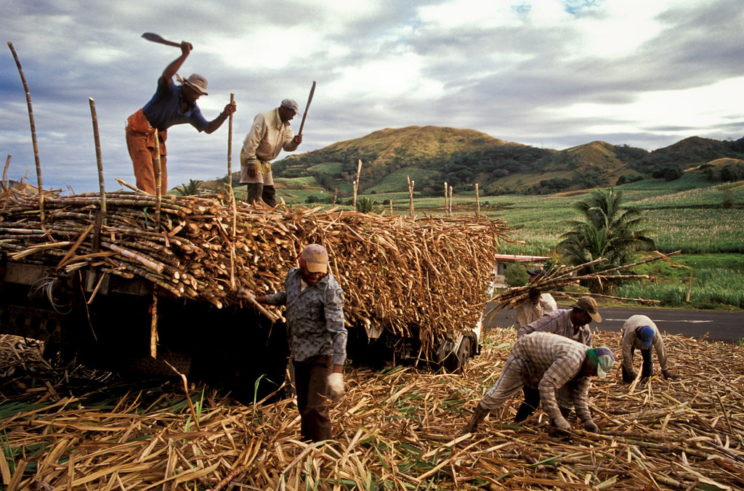
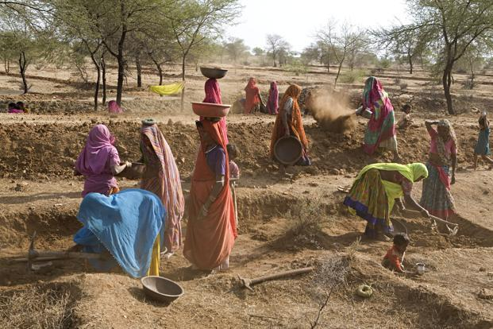
Youth who are in sizeable number in rural areas possess the required energy to increase farm production
Increased participation of youth in agriculture is necessary and important to facilitate Food and nutritional security

Slide 33
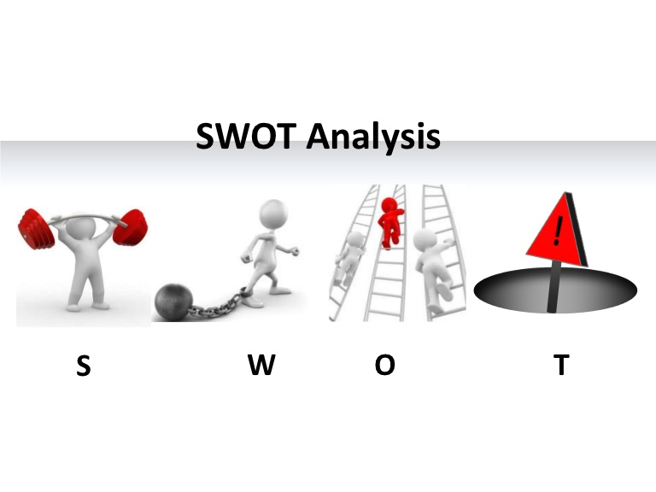
S Energy, interested in technologies, vocational education, good climate
W Lack of experience, lack of knowledge, poor access to resources
O Machinery, high yielding varieties, communication between younger and older
farmers
T Scarcity of water, uncertain climatic conditions, good year/bad year, price crashes,
globalization, lack of arable land

Slide 34
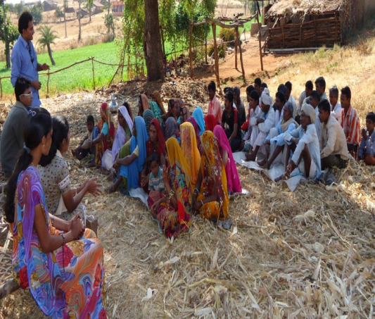
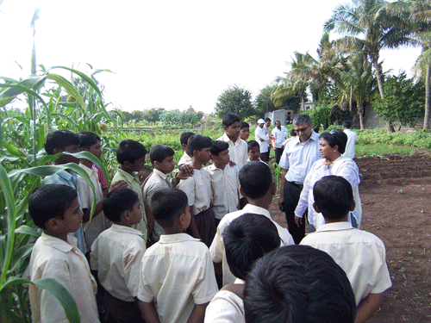
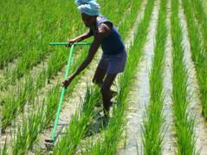
STRATEGIES FOR INCREASED PARTICIPATION OF
YOUTH IN AGRICULTURE
Training and capacity building of youth
Inclusion of lessons in agriculture in the curriculum of secondary schools to infuse interest in agriculture at the young age
Training in entrepreneurship development programme
Easy access to land and capital, technology and information

Slide 35
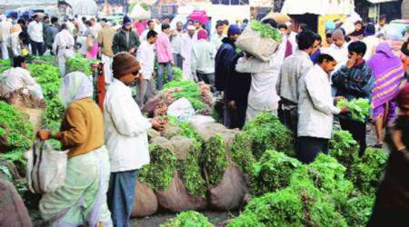
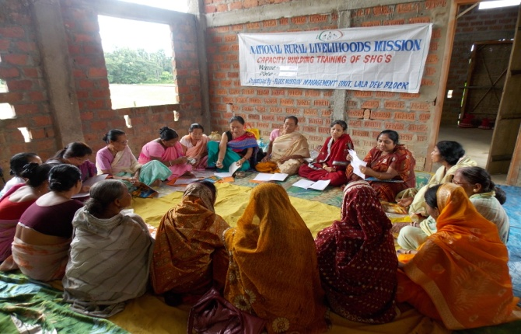
Better market opportunity for the farm produce
Motivation-improving the image of agriculture profession.
Starting rural youth associations and self-help groups.
Rewarding youth achievers in farming.

Slide 36


Slide 37
Imparting need based vocational training to farmers, farm women & rural youth to change their knowledge, skill & attitude as a result uplift the standard of living, is the main mandate of the KVKs.
Krishi Vigyan Kendra
KVKs numbering over 731. A total of 4.86 lakh extension programmes/activities were organized by the KVKs during 2012-13, Attracted the participation of 170.16 lakh farmers and 2.61 lakh extension personnel.

Slide 38
These KVKs organized 65,314 training programmes under capacity building with the participation of 18.8 lakh farmers/farm-women, rural youth and extension personnel during 2012-13.
8,486 skill-oriented training courses (both on-campus and off-campus) were organized exclusively for 1.91lakh rural youth, of which 69,163 (36.17%) were young women.
These trainings were organized on various vocations viz. crop production and management, post-harvest technology and value addition, nursery management, livestock, fisheries, income generation activities, capacity building and group dynamics etc.

Slide 39

Nehru Yuva Kendra Sangathan(NYKS):
Established in 1987-88 as an autonomous organization under the Ministry of Youth Affairs and Sports, it has been channelizing the power of youth (13-35 yrs.) on the principles of voluntarism, self-help and community participation.
Over the years, NYKS has established a network of youth clubs in villages, where (501 at the moment) have been set up, harnessing youth power by forming Youth Clubs, which are village level voluntary action groups at the grassroots level to involve them in nation building activities, working for community development and youth empowerment.

Slide 40
NABARD Farmers’ Clubs: NABARD’s policy support for Farmers’ Club Programme emphasizes on linking technologies with farmers’ club members, while facilitating market access through capacity building of members of Farmers’ Clubs including leadership training, linkage with technology/markets, Self Help Groups (SHGs).
Under this programme, the NABARD has so far (March 2013) assisted formation of 1.27 lakh farmers’ clubs across the country. These clubs are organized by rural branches of banks with the support and financial assistance of NABARD for the mutual benefit of the banks concerned and the village farming community/rural people.

Slide 41

The broad objective of setting up Farmers’ Clubs is to achieve prosperity for the farmers with overall agricultural development in its area of operation by facilitating credit counselling, technology counselling and market counselling.
The NABARD provide a financial assistance of Rs. 10,000 to each club per annum for three years. The club members are expected to utilize this amount to meet routine expenses for formation, maintenance, and organising awareness meets. Most of these farmers’ clubs have a good representation of rural youth.

Slide 42
PURA (PROVISION URBAN AMENITIES IN RURAL AREAS): 2004
It is the central sector scheme launched by ministry of Rural development During 11th FYF
This scheme is under a Public Private Partnership frame work between Grama panchayat and private sectors partners with active support of state government
Objective of this scheme is provision of livelihood opportunities and urban amenities in rural areas

Slide 43
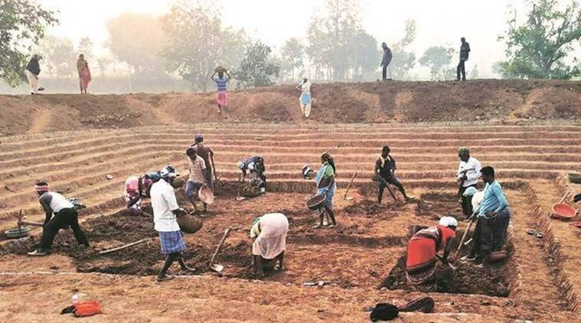
MGNREGA: AN ALTERNATIVE TO MIGRATION : 2006
MGNREGA will provide significant impact on seasonal migration by providing employment during lean season
It provides 100 days employment within their native places
This is more useful to landless labours in rural areas
Before MGNREGA rural peoples had no option so they move from place to place during the off agriculture season.

Slide 44
ARYA (Attracting and Retaining Youth in Agriculture)
The Indian Council of Agricultural Research (ICAR) has constituted a seven-member expert committee, to suggest ways of attracting youth to agriculture.
The committee is working on issues such as providing training to farm youth on innovative and sustainable agricultural practices to help make agriculture a profitable venture.
It involves a series of activities, including exploring opportunities in secondary agricultural such as value addition of crops and hiring, and servicing of mechanized farm implements. This is going to be an important strategy of the ICAR focused on rural youth mobilization for agricultural transformation during 12th plan (ICAR Reporter (October-December-2012).

Slide 45

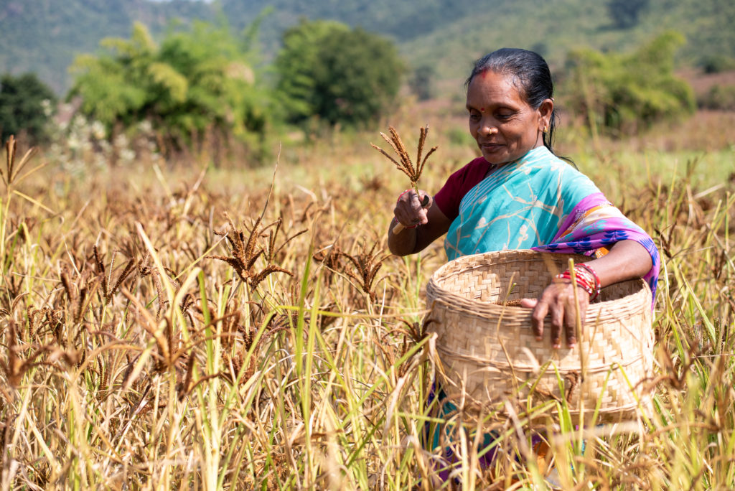
National Rural Livelihood Mission (NRLM)
NRLM aims at creation of opportunities for both wage employment and skill development for the rural youth, who lack skills in many areas of agricultural production and processing.
National Skill Development Mission and the National Skill Qualification Framework are, thus, aggressively pushing the agenda of skill development to build the capacity of rural youth so that they are meaningfully employed in rural areas itself.

Slide 46

AGRICULTURAL SKILL COUNCIL OF INDIA (ASCI)
Considering the need for skilling the work force in agricultural sector, the Agricultural Skills Council of India (ASCI) has been recently proposed by National Skill Development Corporation (NSDC), which could be one ideal institution to train rural youth.
The ASCI proposes to train, certify and accredit 56.5 million workforce comprising of farmers, wage workers, entrepreneurs and extension workers, over 10 years through its training partners.
WAYS FORWARD
Farm Youth Policy
Extension Programme for Youth
Beyond technical skills
Farm Youth Clubs
Use of Media

Slide 47
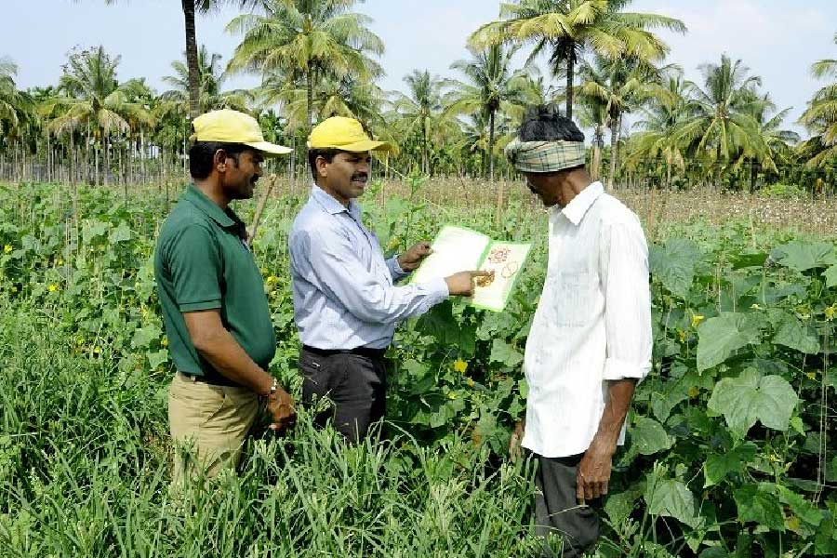
Has agricultural Extension Profession any role to
play?
Agricultural extension profession should tap the energy and creativity of rural youth to transform agricultural sector.
Adult education was the main focus for extension due to rural Illiteracy after the independence. Now rural youth are more literate, aware, educated many are looking for new livelihood options which has resulted exodus to urban areas. Hence there is importance for development of agricultural extension programmes for youth.

Slide 48
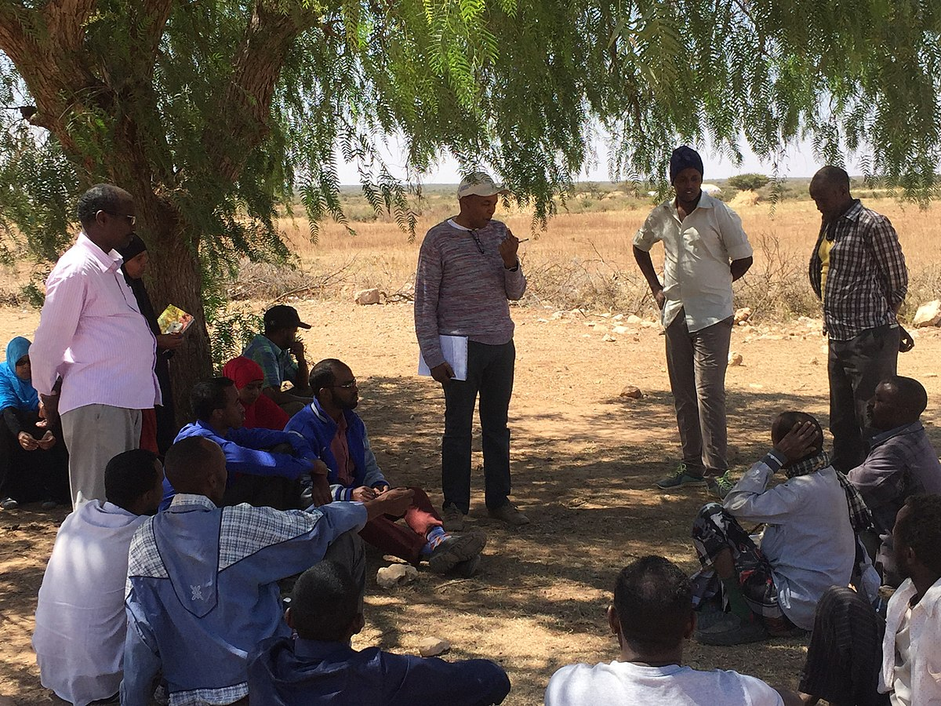
Most of the agricultural extension programmes which were implemented since independence in India traditionally targeted the head of families for training and technology transfer. In extension studies too, we consider the head of family, mostly male as the respondent, though in every diffusion-adoption study we found the early adopters to be younger.
Young farmers often have greater capacity for innovation, imagination, initiative and entrepreneurship than older adults and these characteristics should be effectively harnessed by extension services to provide better livelihood opportunities for youth in agriculture.

Slide 49


Slide 50
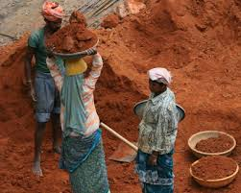
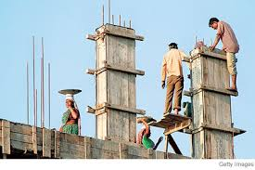
Case Study-1
CASE STUDIES ON REASONS FOR MIGRATION OF
RURAL YOUTH TO URBAN AREAS
Kiran, M ., Mutturaj Yadav etal

Slide 51
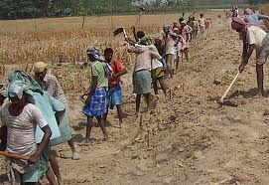
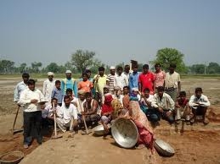
Study: 16 districts of Karnataka namely Ramanagara, Mandya, Haveri, Hassan, Utara Kannada, Bangalore, Mysore, Tumkur, Davanagere, Chikamanglore, Chikabalapura, Chamarajanagara, Chitradurga, Bellary, Vijayapura and Kolar were selected.
Objective: To investigate the reasons for rural urban migration, especially amongst rural youth of Karnataka state.
Sample – 50 Respondents belonging to 16 districts.

Slide 52
RESULTS:
The major reasons of rural-urban migration of youths were identified as,
To improve their standard of living (76%)
Availability of more remunerative employment in urban areas (72%)
Modernization and industrialization in urban areas (72%)
Higher education of youth in rural areas (54%)
Encroachment of farming areas by real estate with attractive prices (54%)
Lack of remunerative price for the agricultural output/produce (52%)
Lack of proper educational facilities in the villages (52%) and
Division/partition of family type from joint to nuclear (50%).

Slide 53
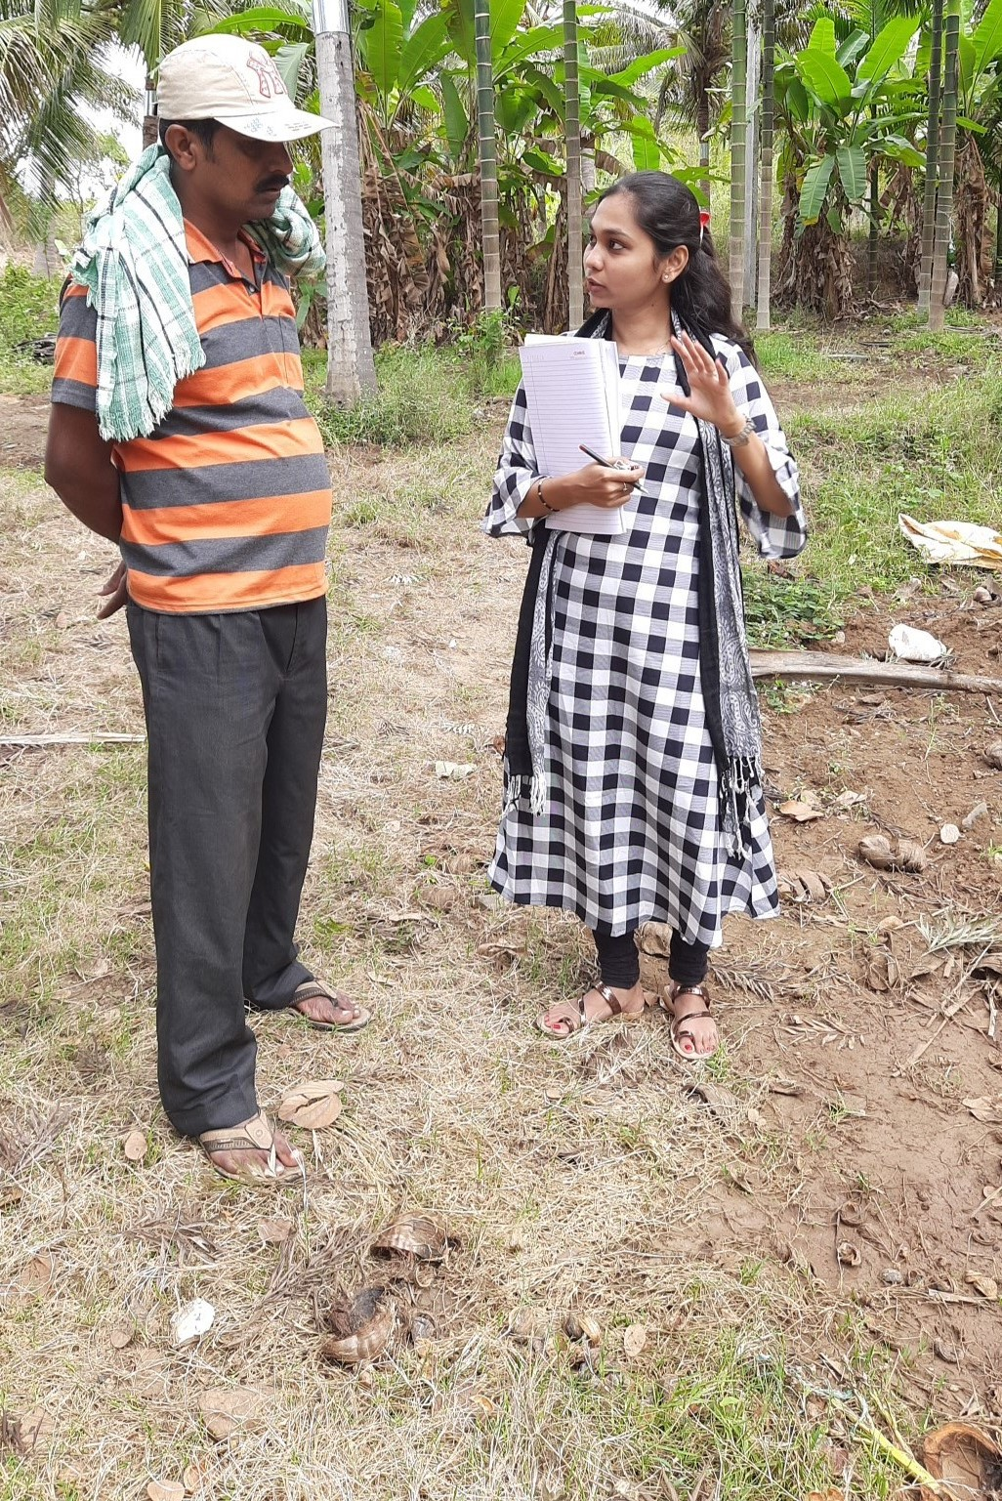
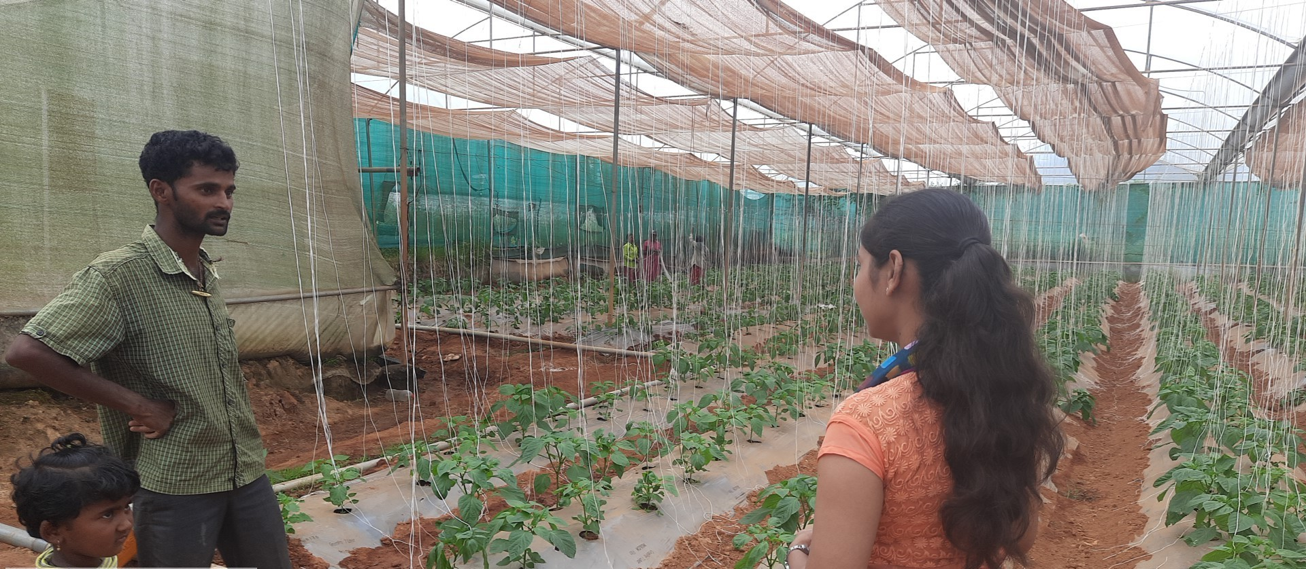
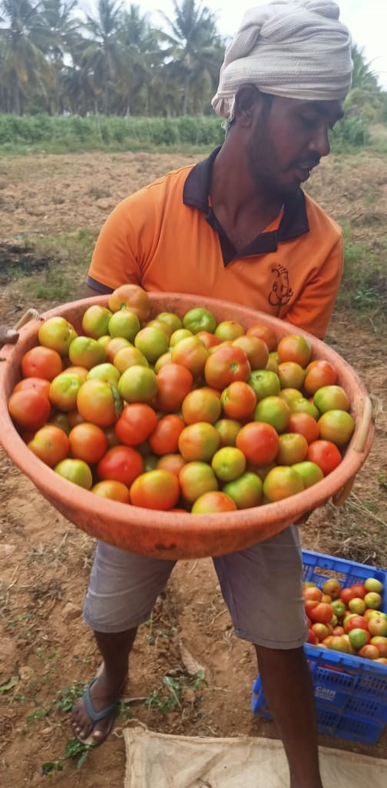
Case Study-2
EXODUS OF YOUTH FROM AGRICULTURE - BOON OR BANE
AMRUTHA BASAVARAJU ,2023

Slide 54
Study – Tumkur district, Turuvekere taluk
Objectives – To analyse the exodus of youth from agriculture
Sample – 25 respondents
TABLE 1 :
Socio personal characteristics f %
AGE CATEGORIES (YEARS)
15-20 | 2 | 08
21-24 | 5 | 20
25-29 | 12 | 48
30-35 | 6 | 24
EDUCATION STATUS
HIGH SCHOOL | 8 | 32
PUC | 13 | 52
GRADUATE | 3 | 12
POST GRADUATE | 1 | 04

Slide 55
Socio personal characteristics f %
Family main occupation
Agricultural farming only | 14 | 56
Agriculture + Allied sectors | 03 | 12
Agriculture labour | 04 | 16
Non agriculture occupation | 04 | 16
Marital status
Married | 12 | 48
Unmarried | 13 | 52
Family Size
Small (2-5) | 19 | 76
Medium (6-9) | 05 | 20
Large (10-13) | 01 | 04
Family type
Joint | 03 | 12
Nuclear | 22 | 88

Slide 56
Socio personal characteristics f %
Land Holdings
Small (< 2.5) acres | 08 | 32
Medium (2.5-5.0) acres | 12 | 48
High (> 5.0) acres | 05 | 20
Status of the respondents
Student | 02 | 08
Dropped out of school | 08 | 32
Never attended school | 00 | 00
Involved in farming activities | 21 | 84
Engaged in off farm wage activities | 04 | 12

Slide 57
TABLE : 2
Statements f %
 | Yes | No | Yes No
It is better to stay idle than to opt farming | 03 | 22 | 12 88
Only people of the lower stratum of society will take up farming | 06 | 19 | 24 76
Scientific farming is always be profitable | 07 | 18 | 28 72
Farming is the most laborious profession | 10 | 15 | 40 60
Educated youth should come to farming sector | 12 | 13 | 48 52
Farmer require high intelligence | 16 | 09 | 64 36
With farming a person can be his own boss | 14 | 11 | 56 44
Low price for agriculture produce along with high production cost has made farming uneconomical in present age | 21 | 04 | 84 16
No female will want a farmer as her groom | 16 | 09 | 64 36
It is very difficult for a farmer to attend social functions | 06 | 19 | 24 76
Agriculture is a dominated by adults and youth have no say in it | 18 | 07 | 72 28
Farming is the only solution to limit the unemployment rate of the country | 15 | 10 | 60 40

Slide 58
Statements f %
Peer pressure moves the youth out of agriculture | 13 12 | 52 48
Farming restricts urban contact and recreational enjoyment | 04 21 | 16 84
There is no quick return of money in agriculture | 18 07 | 72 28
Results :
From the Table 1 it shows that majority of the respondents belonged to 25-29 years of age i.e. 48% , and majority of them have completed their puc i.e. 52% , majority of respondents are involved in farming activity i.e. 56% , 52% of the respondents are unmarried , 88% of them belong to nuclear family.

Slide 59
From Table 2 it shows that 88% of the respondents denied to the statement i.e. It is better to stay idle than to opt farming, 52% of the respondents expressed that educated youth should opt for better secured opportunities than agriculture, Majority 84% of the respondents agreed that Low price for agriculture produce along with high production cost has made farming uneconomical in present age , 64% of the respondents expressed that No female will want a farmer as her groom, 52% agreed that Peer pressure moves the youth out of agriculture ,72% responded that there is no quick returns from agriculture.

Slide 60


Slide 61


