Slide 1

Welcome

Slide 2


Meghanan.N
PAMB1147
Senior M.Sc
Seminar-1

Slide 3

Eco Labelling

Slide 4

Sequence of Presentation
Introduction
Objectives
Origin of Eco labelling
Concept of Eco labelling
Types and importance
Scenario of Eco labelling
Advantages and Disadvantages
Case study
Conclusion

Slide 5

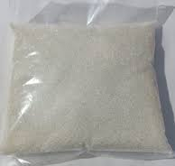



Labelling

Slide 6
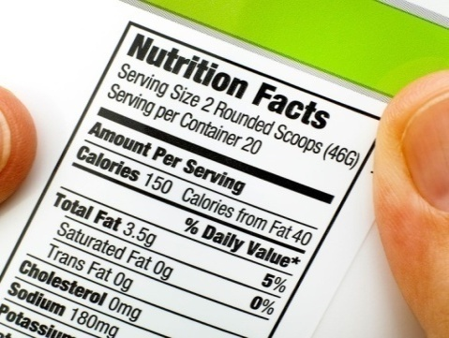
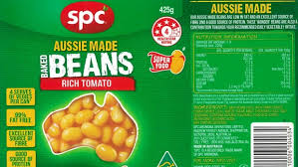
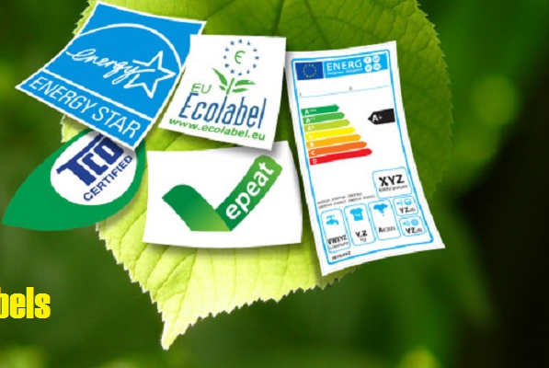
Label contains information about a product on its container, packaging, or the product itself.
Eco labelling is a voluntary method of environmental performance certification

Slide 7

To understand the concept of Eco labelling
To know about the scenario and advantages and disadvantages of Eco labelling
To review the related case studies

Slide 8
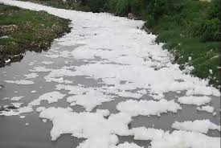
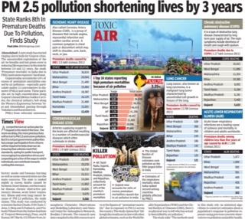
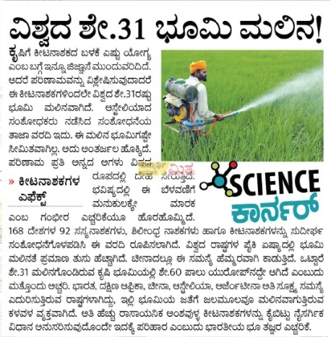
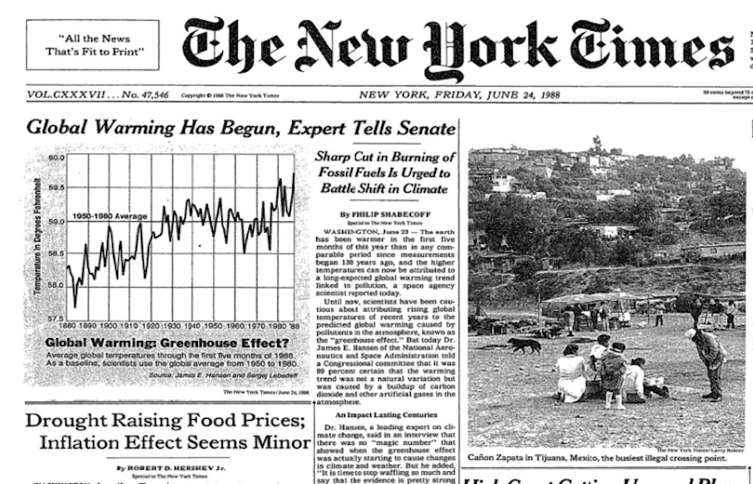
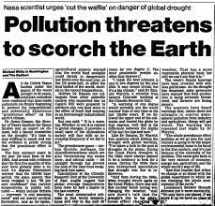

Slide 9
Origin of Eco labelling
Eco-labelling has been applied since the late 1970s
The Blue Angel is an environmental label in Germany (1978).
United Nations Conference on Environment and Development (UN Earth summit ) held in the year 1992 (Agenda 21)
Currently 455 ecolabels in 196 countries, and in 25 industry sectors. (Ecolabel Index )

Slide 10









Called as ‘Environmental labelling’
Voluntary method of environmental performance certification.
1
2
Eco labelling
3
4
Private, market-based and public policy instrument.
Third-party organisations independently

Slide 11

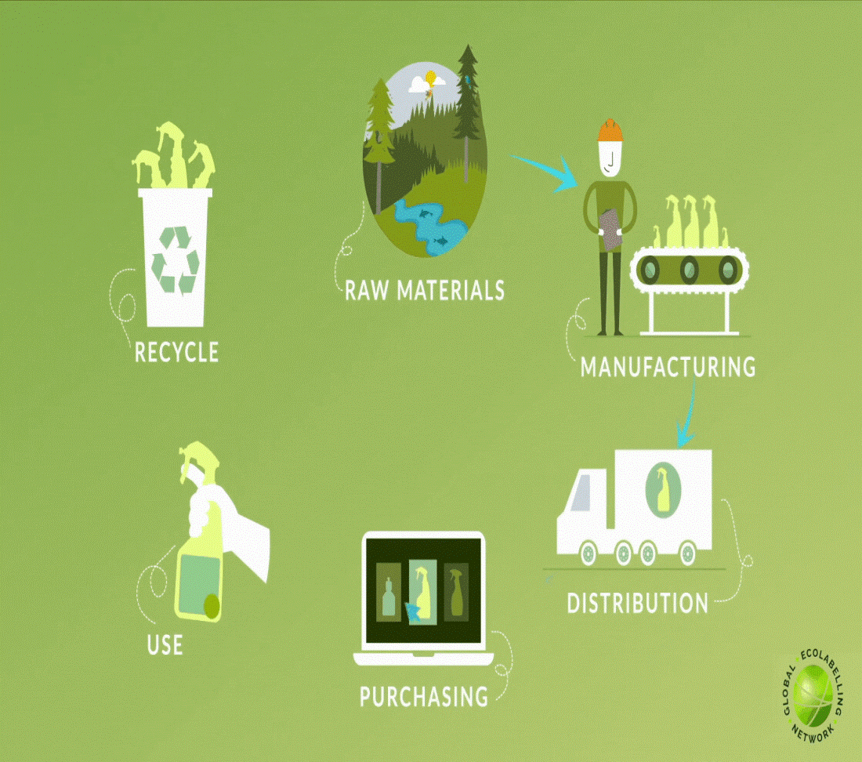
Useful tool for governments in encouraging sound environmental practices
Follows a life cycle approach for certifying a product
Eco labels commonly known as green stickers. They are tool and a source of credibility of product being a greener one to the consumers.
These included labels with such claims as "recyclable", "eco-friendly", "low energy", and "recycled content"

Slide 12

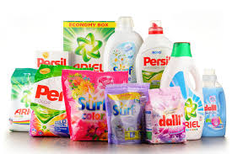

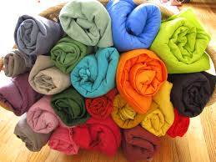


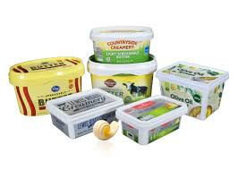

Product categories
Paints and coatings
Cosmetics
Soaps& detergents
Textiles
Fisheries
Papers
Electronics
Food Item

Slide 13





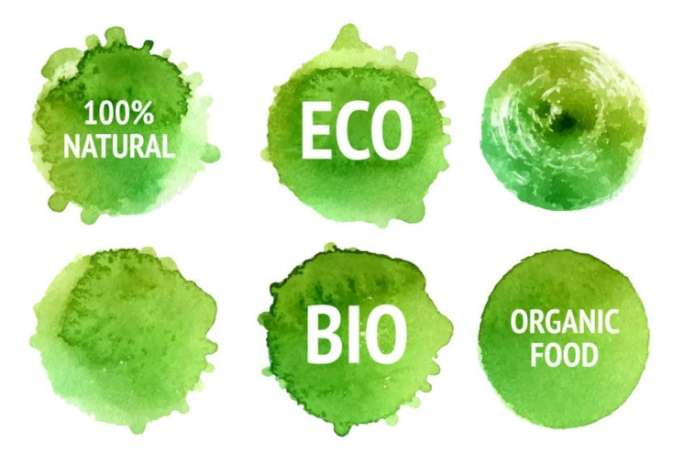
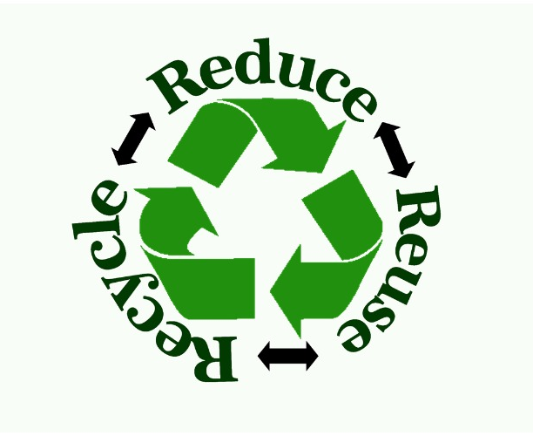
OBJECTIVE of eco-labeling
1.Protecting the Environment
2. Encouraging environmentally sound innovation
3.Building consumer awareness of environmental issues

Slide 14

Types of Environmental Performance Labelling -- International Organization for Standardization (ISO)

Slide 15
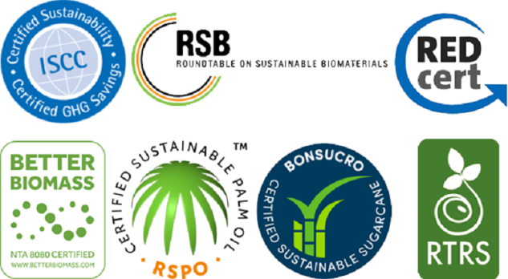
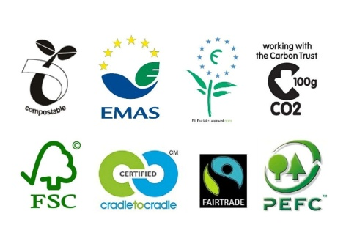
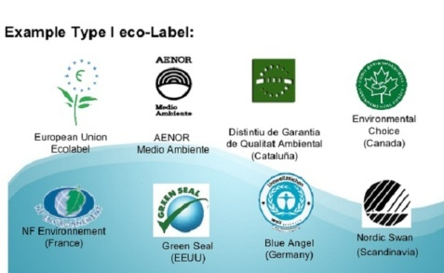
Type I
Type II
Type III
Voluntary programs that provide quantified environmental data of a product, under pre-set categories of parameters set by a qualified third party.
A voluntary, multiple-criteria based, third party programme that awards a license which authorises the use of environmental labels on products..
self-declaration claims through signs, symbols and information is on product.

Slide 16





3
Reducing the negative impact environment, health, climate and natural resources
4
Allows consumers to make informed to take decisions.
2
sustainable consumption &production policies
IMPORTANCE
5
1
“Going
green”
Used as a tool for sustainable development

Slide 17




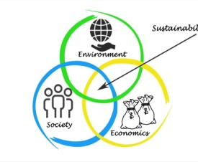

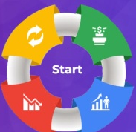
Guiding Principles for Eco labelling
1
Voluntary participation
2
3
Clarity
Open and accountable
4
Flexibility
8
5
6
7
Sustainability
Independence
Transparency
Life Cycle Approach

Slide 18

Technological Development
Market dynamics
1
5
Dimensions of
Eco labelling
Environmental Regulation and Policy
Organizational strategy
2
4
Social Environmental
awareness
3

Slide 19




Participants
Participants
(stake holders)
Government
Consumer
Industry
Scientific Agency

Slide 20
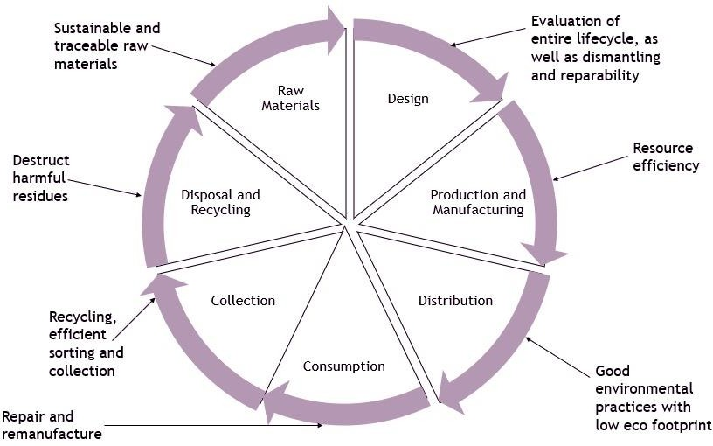
Key parameters of eco-labeling

Slide 21
Approaches to Eco labelling in agriculture
Integrated agriculture
Organic farming
Regional product
01
02
03

Slide 22
ECO LABELLING SCHEMES AROUND WORLD
COUNTRY | NAME | YEAR
Germany | Blue angel | 1978
Canada | Environmental Choice | 1988
Japan | Ecomark | 1989
Nordic Countries | White Swan | 1989
New Zealand | Environmental Choice | 1990
Sweden | Good Environmental Choice | 1990
United States | Green Seal | 1990
Austria | Austrian Eco Label | 1991
India | Ecomark | 1991
European Union | European Flower | 1992
France | NF-Environment | 1992
Singapore | Green Label | 1992
Netherland | Stichting Milieukeur | 1992
Malaysia | SIRIM Eco-Labelling Mark | 2011
Kenya | Eco Mark Africa | 2015

Slide 23

BLUE ANGEL
Good for me, Good for Environment
The Blue Angel is an environmental label in Germany (1978).
Awarded to particularly environmentally friendly products and services.
The label is give by the Federal Ministry

Slide 24


International networks
Global Ecolabelling Network
Focused on encouraging and promoting type I label
More than 50 territories and 37 member countries
Sustainable public procurement
Founded in 1994
Aim to foster cooperation and information exchange across members
International non-profit network

Slide 25

International Social and Environmental Accreditation and Labelling Alliance
Set up to advance and develop
sustainability standards for products across the globe
Created in 2002
Meet the ISEAL Codes of Good Practice
Its membership is open to all multi stakeholder
Single attribute focused for eco labelling
Forest Stewardship Alliance(FSA), Fair Trade, Rainforest Alliance, Alliance for Water

Slide 26



Prominent eco-labels in India
Eco mark
Green Pro
India Organic
GOTS

Slide 27






Eco mark
Objectives of the program
To provide an incentive for manufacturers and importers
Started by Central Pollution Control Board (CPCB)
To improve the quality of the environment
1991, cradle-to-grave approach
To assist consumers to become environmentally responsible
Identified 17 categories of consumer products
Issued by MoEF &CC and monitored by BIS
To encourage the sustainable management of resources.

Slide 28
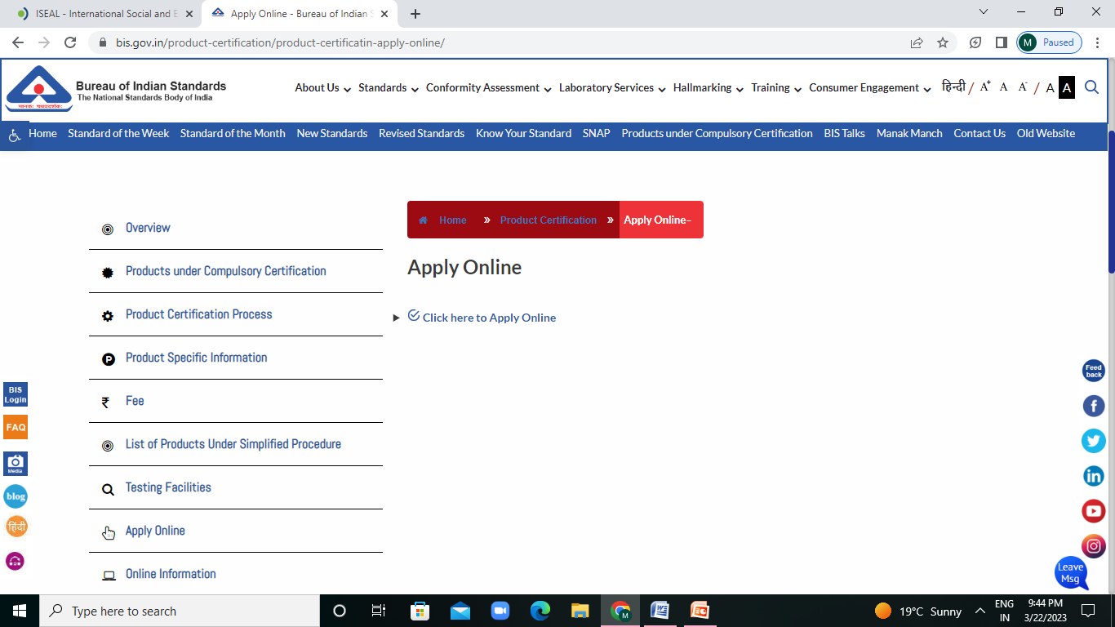
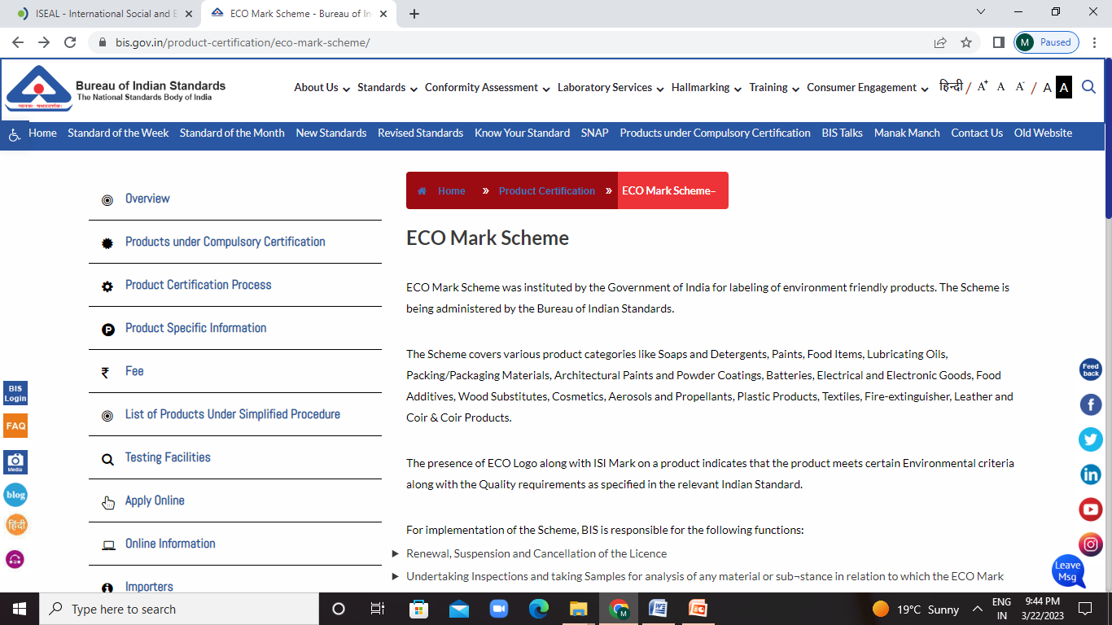

Slide 29
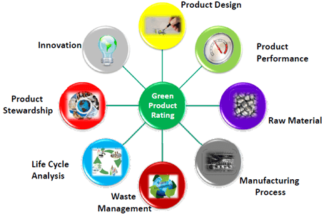
It is not awarded for the services.
Product Categories identified in the Ecomark Scheme
Aerosol Propellants
Batteries
Dry Batteries
Cosmetics
Electrical/Electronic Goods
Fire-extinguisher
Food Additives
Food Items: Edible Oils, Tea and Coffee
Leather
Lubricating Oils
Packaging Materials
Paints and Powder Coatings
Paper
Plastic Products
Soaps & Detergents
Textiles
Wood Substitutes

Slide 30
PRODUCT SPECIFIC REQUIREMENTS
Production process along with information about source of raw materials
impact on the environment
Energy conservation in the production of the product
Disposal of the product and its container
Utilization of "Waste" and recycled materials
Suitability for recycling or packaging
Biodegradability
Effect and extent of waste arising from the production process

Slide 31
ECO PARAMETERS
Eco labels are awarded on the basis of compliance of certain eco parameters by the product.
pH
Formaldehyde
Heavy metals (As, Pb, Cd, Cr, Co, Cu, Ni, Hg)
Pesticides
Chlorinated phenols
Dyestuffs
Chlorinated organic carriers
Biocidal finishes
Flame retardent finishes
Emission of volatiles
Odours

Slide 32
DOCUMENTS REQUIRED FOR ECO-MARK
If the industry is a company then certificate of incorporation.
Memorandum of Association and Articles of Association.
Environmental clearance certificate from the concerned State
Pollution Control Board.
Product details and catalogue.
Details and information obtained from the lab.
Samples information.
Separate application for all types of products.

Slide 33
FEES REQUIRED FOR ECO-MARK
Non-refundable application fee of Rs.500/ per application.
Testing fee charged by independent laboratories for samples taken
prior to the grant of a license.
Annual license fee at the rate of Rs.500/ per license.
Renewal Application fee of Rs.300/ per application is charged
when the license is due for renewal.
Marking fee (depending upon the volume of the annual
production)

Slide 34

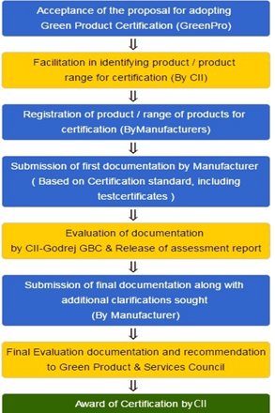
Green Pro
Product certification
Confederation of Indian Industry (CII)
Aims at helping environmentally conscious customers to make a greener choice
Follows a complete lifecycle approach for certifying products
It covers around 36 product categories under certification
Focuses on green building products and industrial equipment.

Slide 35
India Organic
Developed by the Government of India
Granted to organically formed food
The certification mark came into existence in 2002
Certification standards ensure that the product or its raw materials used were grown only through organic farming, without any use of chemical fertilizers, pesticides.

Slide 36

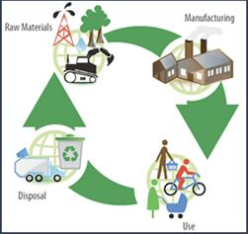
Global Organic Textile Standard (GOTS)
The Global Organic Textile Standard (GOTS) was developed with the aim to unify the various existing standards and draft standards in the garment manufacturing sector.
GOTS defines worldwide recognized standards that ensure organic status of textiles from harvesting of the raw materials through environmentally and socially responsible manufacturing up to labeling.

Slide 37

Advantages and Disadvantages of Eco-labelling

Slide 38




ADVANTAGES
1
Reliability
2
New Market Opportunities
3
Stimulation of innovation
4
Encourage sustainable business
Economic support
for sustainability
Influencing consumer behavior
5
6

Slide 39

Disadvantages
Difficulty in proving a positive impact
1
Potential green-washing from private unregulated ecolabels are use
2
Prohibitive costs for certification especially for smaller producers
3
Potential redundancy if a number of ecolabels certify the same characteristics
4
5
Consumer disinterest​ in paying a premium for sustainable products

Slide 40
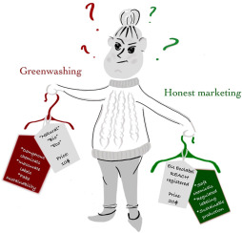

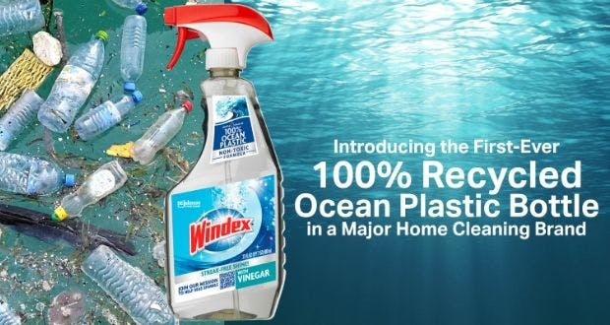

Greenwashing
Greenwashing is the process of conveying a false impression or misleading information.
Jay Westerveld in 1986
Windex
H&M

Slide 41

Challenges
Finding a balance between the needs and demands of various stakeholders.
Unawareness of the customer about those seal, sign and symbol.
The costs to conduct environmental impact and life-cycle assessments drive up production costs.
Difficult in market penetration.
Convincing consumer to pay higher prices than conventional goods
Existence of confusion among buyers due to availability of large number of labels.
Low government efforts and media coverage.

Slide 42


Slide 43



01.A Study of Consumer Perspective towards Eco- Labelling in Delhi NCR, India
Shruti Jain,2019
Delhi
N=148
Primary data through structured interview questionnaire

Slide 44
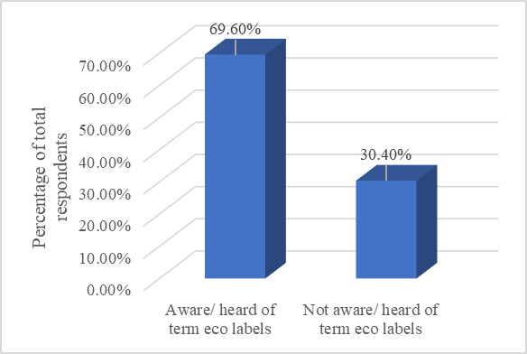
Figure 1 :Awareness of the term ‘eco labels’
103
45

Slide 45
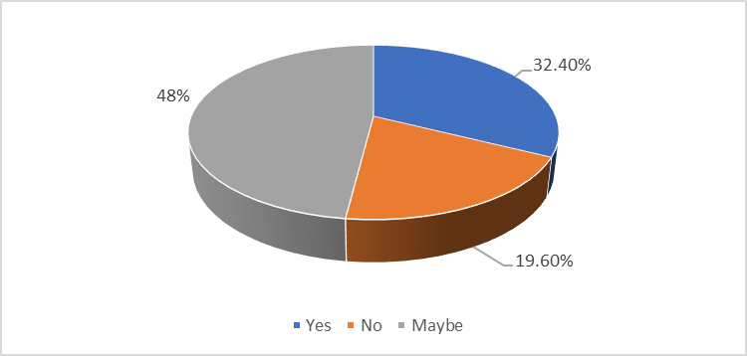
Figure2:Perception of respondents on price of
Eco labelled products
Have higher price(48)
Unsure about the effect of price(71)
Products are not expensive(29)

Slide 46
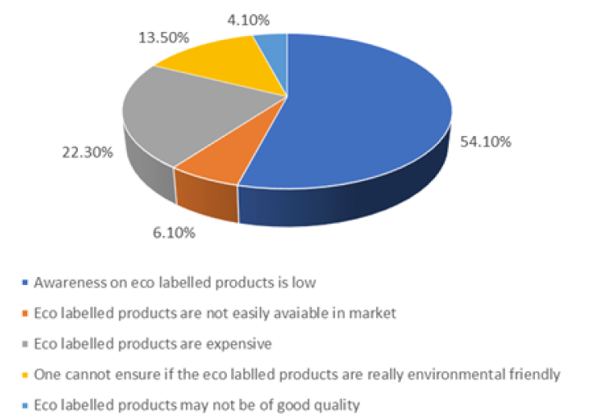
Figure3: Respondent’s view on factors that prevents consumers from buying Eco labelled products
54.10%
6.10%
22.30%
13.50%
4.10%

Slide 47
CASE STUDY 02
A STUDY ON IMPACT OF ECO-LABELLING ON CONSUMER BUYING BEHAVIOUR
CONDUCTED BY
Consumer Education & Research Centre - Environmental Information System Centre on Environment Literacy - Eco-labelling and Eco-friendly Products (CERC-ENVIS), 2019

Slide 48
KEY FINDINGS
N=292
Overall 82% of respondents were aware of environmentally friendly products and they were concerned about environmental issues.
Fifty two per cent of the respondents were aware and willing to pay more for the Eco labelled products. Respondents are willing to pay more for Eco-labelled products.
The product with less impact on the environment were preferred by 59% of respondents. But, 60% respondents are not aware of such product categories in the market.

Slide 49
Many respondents (87%) preferred products with eco- labelling because of its quality.
Sixty nine per cent respondents opined that price is much more important when it came to an actual purchase decision.
Social Media has an influence on more than seventy per cent of respondents which is the main source of the awareness of eco-friendly products.
Purchase behaviour varied depending on product category with eco label like organic food (29%), food items (25%), clothes/apparel (22%) and electrical/electronic items (21%).
Some respondents have proposed that the Government should bear the cost to promote eco friendly products.

Slide 50


Slide 51


