Slide 1
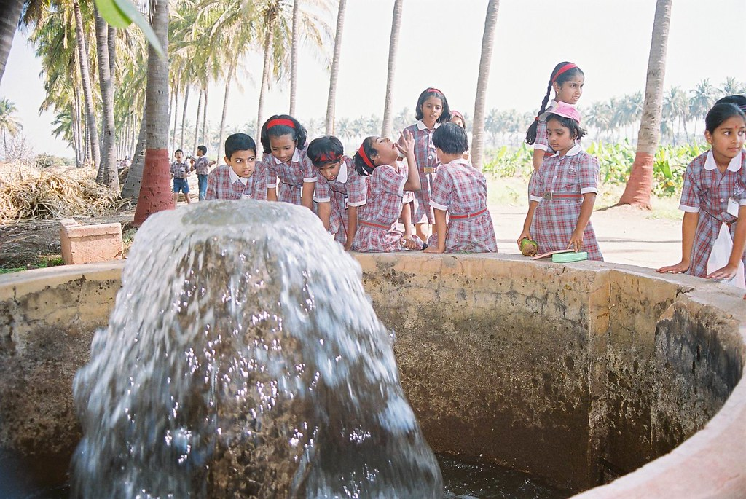
WELCOME

Slide 2
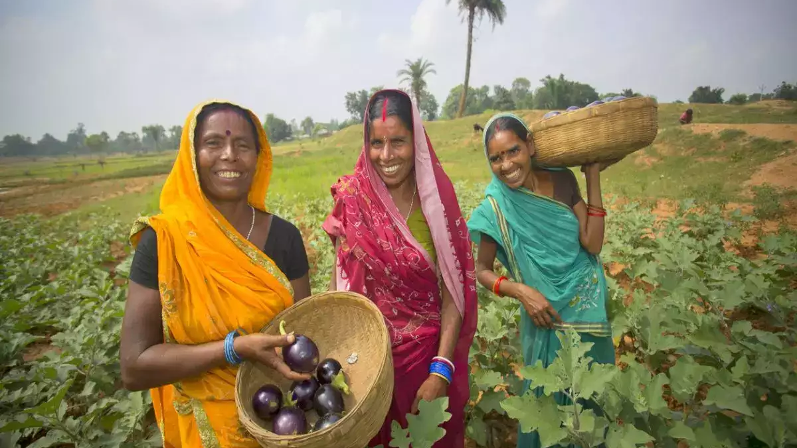
AGRI-TOURISM:
AN EMERGING SECTOR
Major Advisor,
Dr. K. Shivaramu
Professor and Head,
Staff Training Unit,
UAS, Bangalore
Presented by,
Lakshmi Muralikrishna
PAMB0030
III PhD.
Dept. of Agril. Extension
UAS, Bangalore

Slide 3
Objectives
To understand the different types of tourism and their characteristics
To understand the emerging concept of agri-tourism and its defining characteristics
To understand the need and scope of agri-tourism in developing countries like India
To review the research related to agri-tourism

Slide 4

FLOW OF PRESENTATION
Introduction to tourism
Types of tourism
Types of tourism in India
Agri-tourism
Advent of agri-tourism in India
Need, scope and benefits of agri-tourism in India
Related research studies
Conclusion

Slide 5
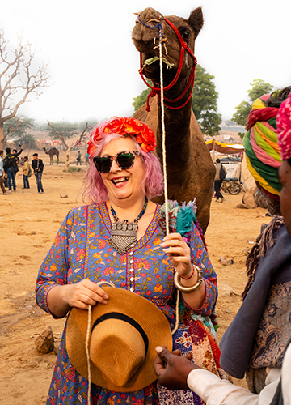
TOURISM
Tourism is travel for pleasure or business
The World Tourism Organization defines - "travelling to and staying in places outside their usual environment for not more than one consecutive year for leisure and not less than 24 hours, business and other purposes".
Tourism can be domestic or international
International tourism has both incoming and outgoing implications on a country's balance of payments.

Slide 6
Declining of tourism….
Strong economic slowdown (the late-2000s recession) between the second half of 2008 and the end of 2009
Outbreak of the 2009 H1N1 influenza virus
Slowly recovered until the COVID-19 pandemic put an abrupt end to the growth.
The United Nations World Tourism Organization - global international tourist arrivals decreased by 58% to 78% in 2020
Potential loss of US $ 0.9–1.2 trillion in international tourism receipts

Slide 7
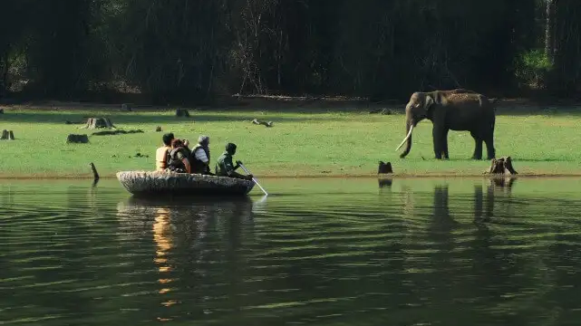
Sustainable tourism
Tourism including concern for economic, social and environmental issues
Environmental protection, social equity, and the quality of life, cultural diversity, and a dynamic, viable economy delivering jobs and prosperity for all.
In fact, all forms of tourism have the potential to be sustainable
To mitigate negative effects caused by the growing environmental impact of tourism

Slide 8
Contd….
The United Nations World Tourism Organization - promoting sustainable tourism as part of the Sustainable Development Goals
International Year for Sustainable Tourism for Development in 2017
SDG 8 ("decent work and economic growth"), SDG 12 ("responsible consumption and production") and SDG 14 ("life below water") implicate a sustainable economy.
According to the World Travel & Tourism Bureau, tourism constituted 10.3 per cent to the global gross domestic product
International tourist arrivals hitting 1.5 billion marks (a growth of 3.5 percent) in 2019" and generated $1.7 trillion export earnings

Slide 9
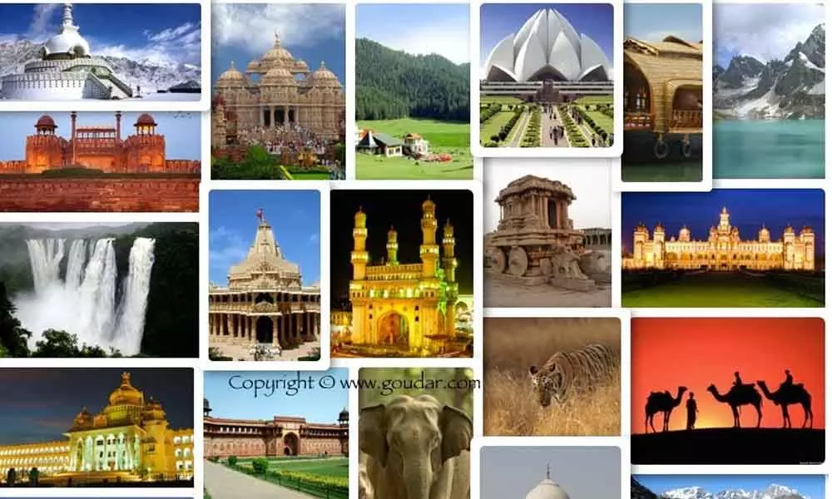
TYPES OF TOURISM

Slide 10
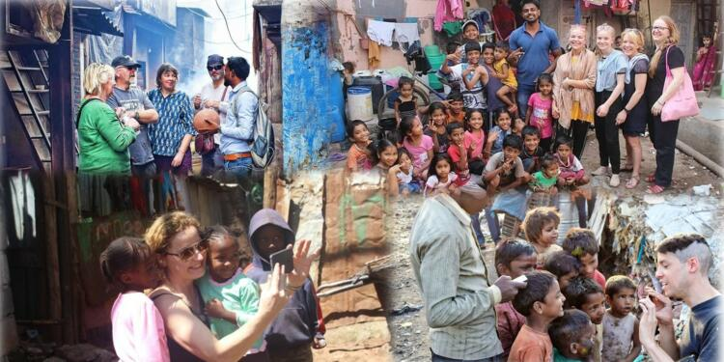
1. Pro poor tourism
Seeks to help the poorest people in developing countries
The issue has been addressed through small-scale projects in local communities
Attempts by Ministries of Tourism to attract large numbers of tourists
Research by the Overseas Development Institute - only 25% of money or less (far less in some cases) reaching the poor
There is also the possibility of pro-poor tourism principles being adopted in centre sites of regeneration in the developed world

Slide 11
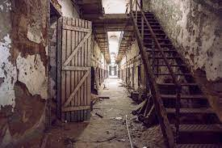
2. Dark tourism
One emerging area of special interest has been identified by Lennon and Foley (2000) as "dark" tourism
Involves visits to "dark" sites, such as battlegrounds, scenes of horrific crimes or acts of genocide, for example concentration camps
Its origins are rooted in fairgrounds and medieval fairs

Slide 12
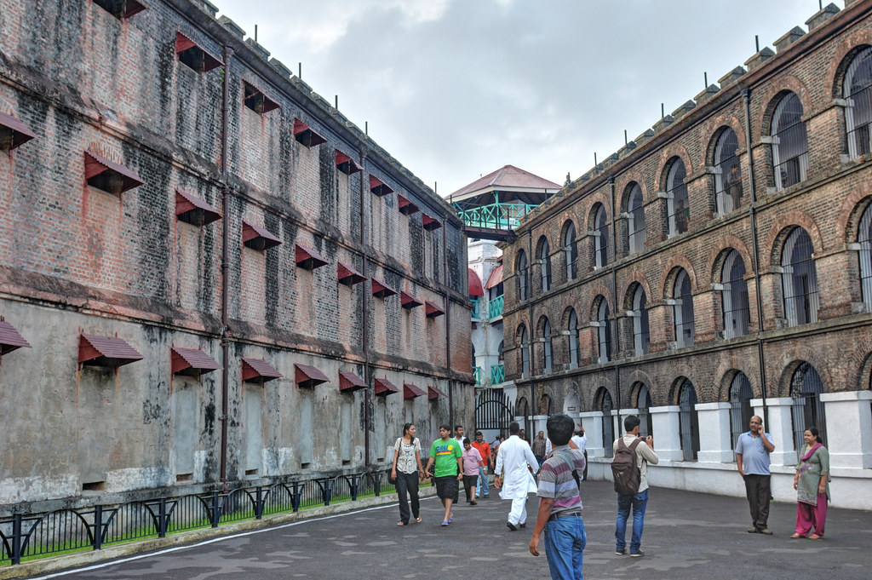
CELLULAR JAIL, ANDAMAN AND NICOBAR ISLANDS

Slide 13
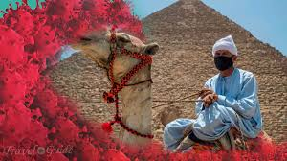
3.Doom tourism
“Tourism of doom," or "last chance tourism“
Travelling to places that are environmentally or otherwise threatened (Ice caps of Mount Kilimanjaro, the melting glaciers of Patagonia, or the coral of the Great Barrier Reef) before it is too late
Related to sustainable tourism or ecotourism
Considered threatened by environmental factors such as global warming, overpopulation or climate change

Slide 14
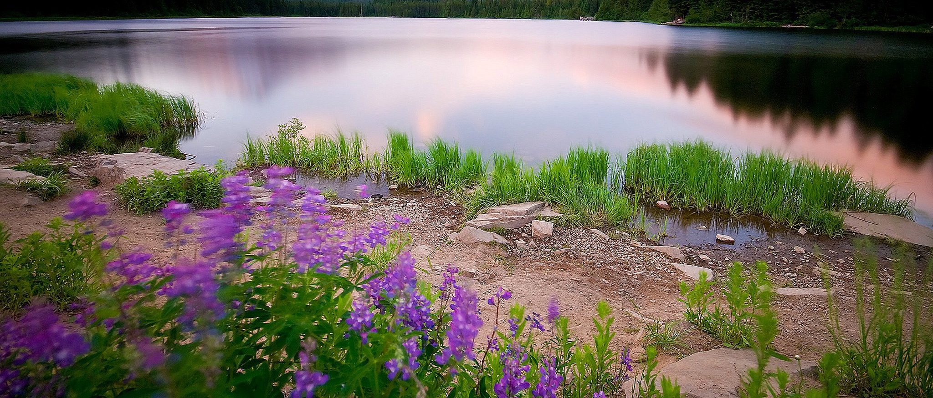
THE FAST DISAPPEARING WULAR LAKE IN KASHMIR

Slide 15
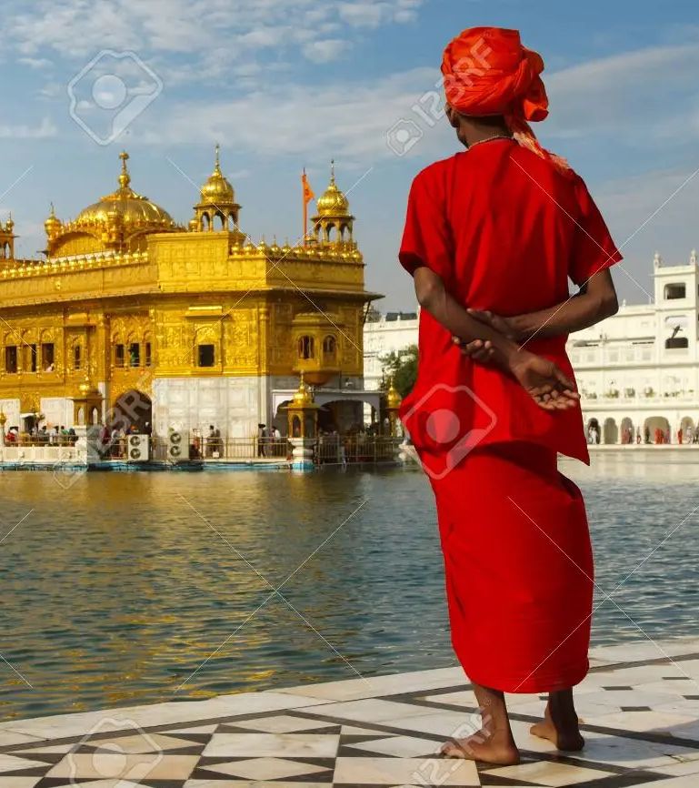
4. Religious tourism
Religious tourism/pilgrimage can serve to strengthen faith and to demonstrate devotion
Religious tourists seek destinations whose image encourages them to believe that they can strengthen their self-identity in a positive manner
Perceived image of a destination may be positively influenced by whether it conforms to the requirements of their religious self-identity or not

Slide 16
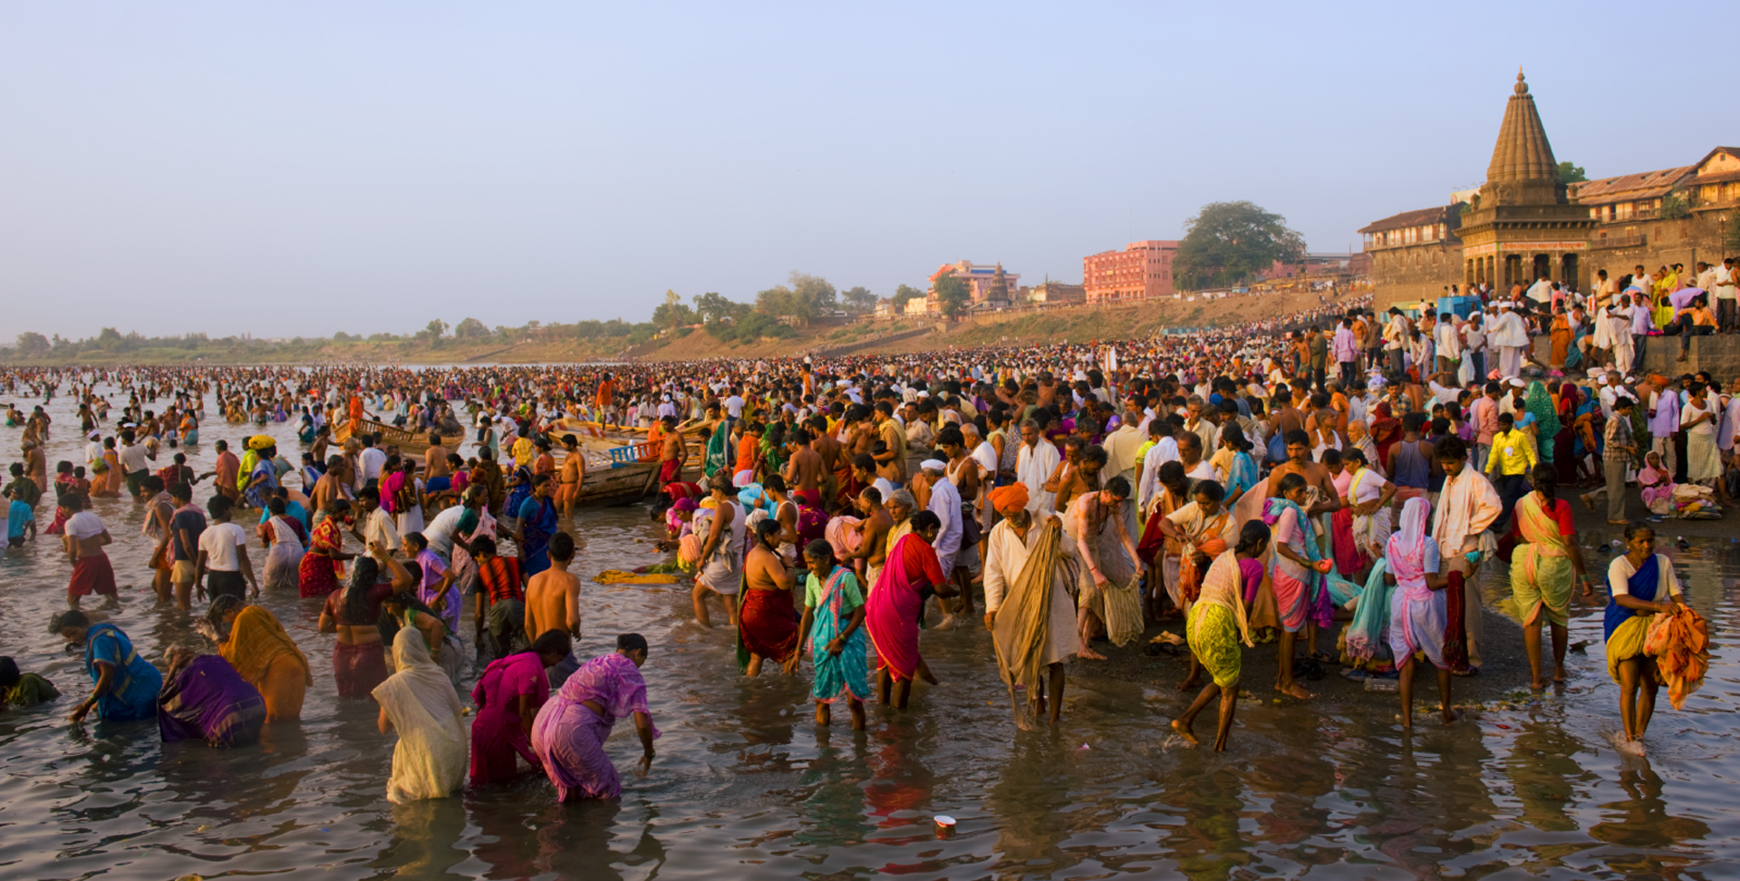
RELIGIOUS TOURISTS/PILGRIMS IN VRINDAVAN, INDIA

Slide 17

5. DNA Tourism
DNA tourism, also called "ancestry tourism" or "heritage travel", is tourism based on DNA testing
These tourists visit their remote relatives or places where their ancestors came from, or where their relatives reside, based on the results of DNA tests
DNA tourism became a growing trend since 2019

Slide 18
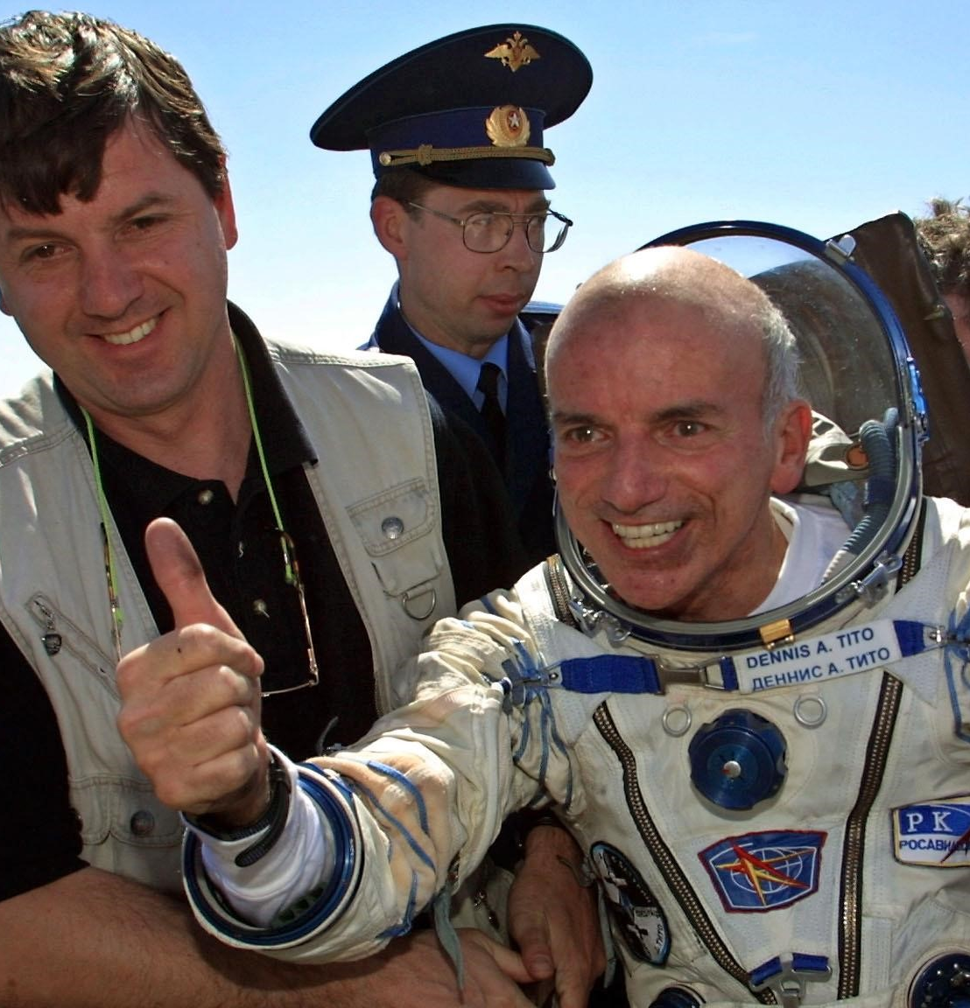
6.Space tourism
Only the Russian Space Agency provides transport to date
A 2010 report into space tourism - a billion-dollar market by 2030
Russian Space Agency - Soyuz and the Chinese Shenzhou - two spacecrafts suitable for human travel
In April 2001, Dennis Tito, a customer of the Russian Soyuz - first tourist to visit space.
In May 2011, Virgin Galactic launched its SpaceShipTwo plane that allows people to travel 2 hours space - $200,000 per seat
A 2010 report into space tourism - 18% - 26% per year during 2020 to 2030.

Slide 19
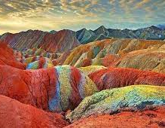
7. Geotourism
Knowledge-based tourism
Interdisciplinary integration of the tourism industry with conservation and interpretation of abiotic nature attributes
It promotes tourism to geosites and the conservation of geo-diversity
Visits to geological features, use of geo-trails and viewpoints, guided tours, geo-activities and geosites

Slide 20

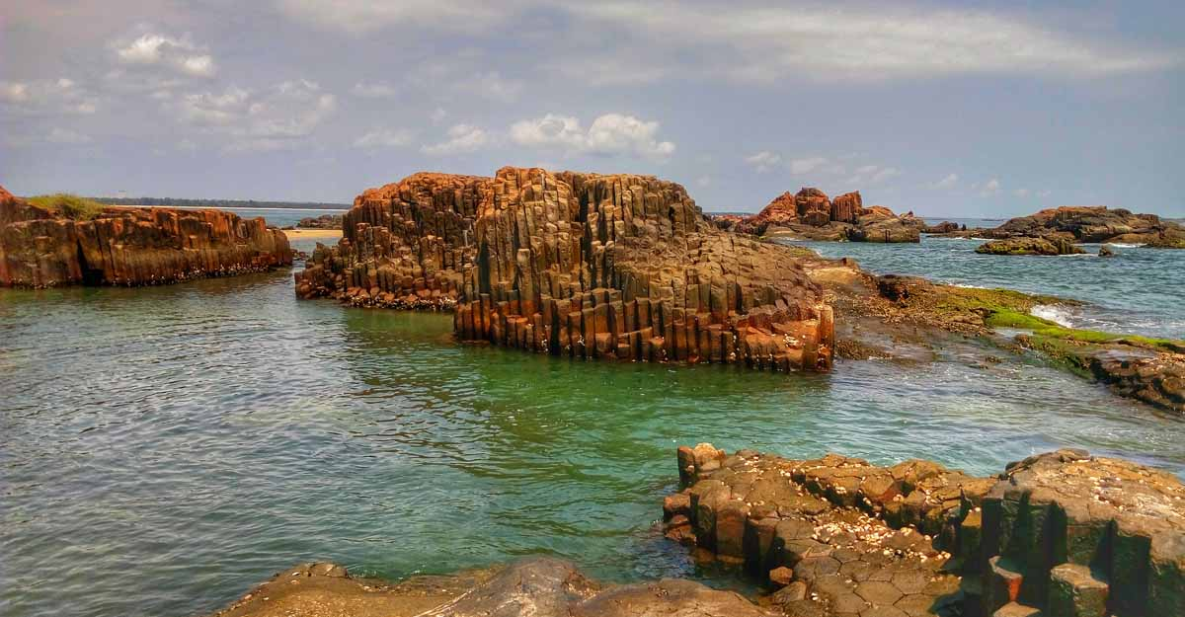
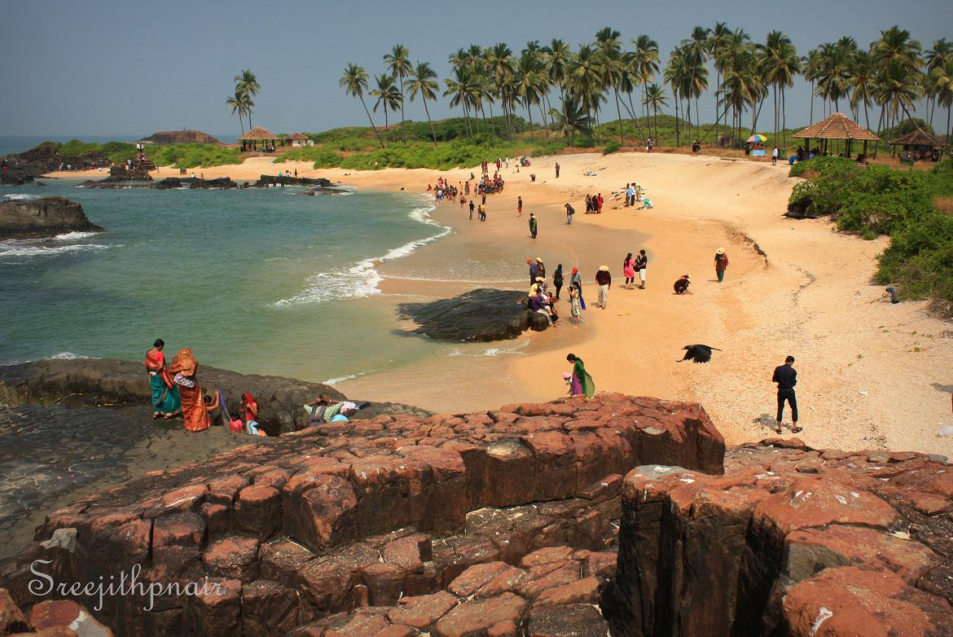
ST MARY’S ISLAND, UDUPI, KARNATAKA

Slide 21
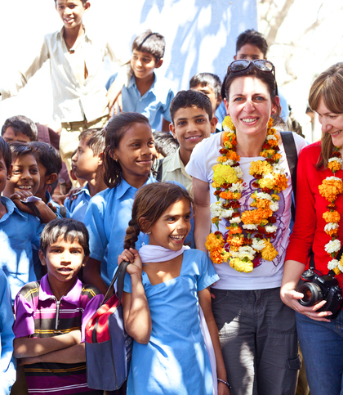
8. Social tourism
Making tourism available to people who otherwise could not afford
Includes youth hostels and low-priced holiday accommodation run by church and voluntary organisations, trade unions, or in Communist times publicly owned enterprises
"Social tourism is a type of tourism practiced by low-income groups, and which is rendered possible and facilitated by entirely separate and therefore easily recognizable services

Slide 22
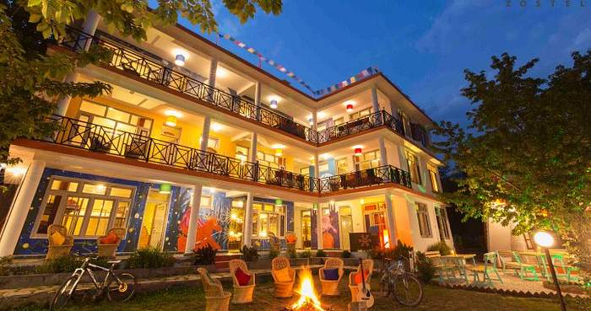
ZOSTEL IN MANALI, HIMACHAL PRADESH

Slide 23

Tourism security
A subdiscipline of tourist studies
Explores the factors that affect the ontological security of tourists
Risks are evaluated by their impact and nature
Methodologies, theories and techniques oriented to protect the organic image of tourist destinations
Terrorist groups looking to destabilize governments, geopolitical tensions between delivery-country and receiving-tourist countries, armed robbery, assaults, kidnapping tourists for ransom etc.

Slide 24
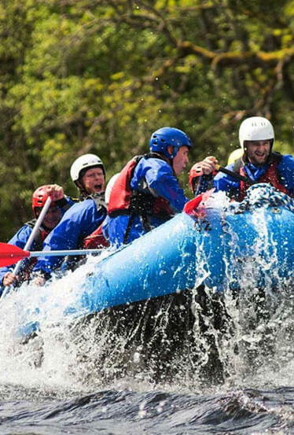
Major types of Tourism in India
Adventure tourism
Adventure tourism has recently grown in India
This involves exploration of remote areas and exotic locales and engaging in various activities
Ladakh, Sikkim, and Himalaya. Himachal Pradesh and Jammu and Kashmir are popular for the skiing facilities they offer
Whitewater rafting in Uttranchal, Assam, and Arunachal Pradesh etc

Slide 25
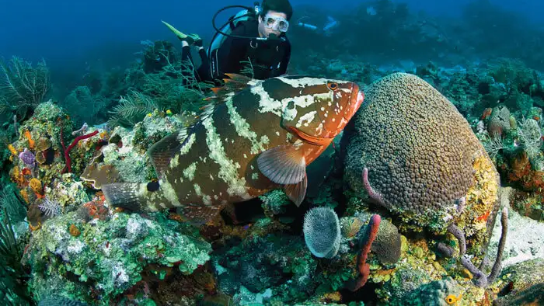
SCUBA DIVING IN ANDAMAN AND NICOBAR ISLANDS

Slide 26

Beach Tourism
India’s vast coastline and islands provides ample opportunities for beach tourism.
Kerala, Goa, Andaman& Nicobar Islands, Lakshadweep islands attract tourists in large numbers all around the year.

Slide 27
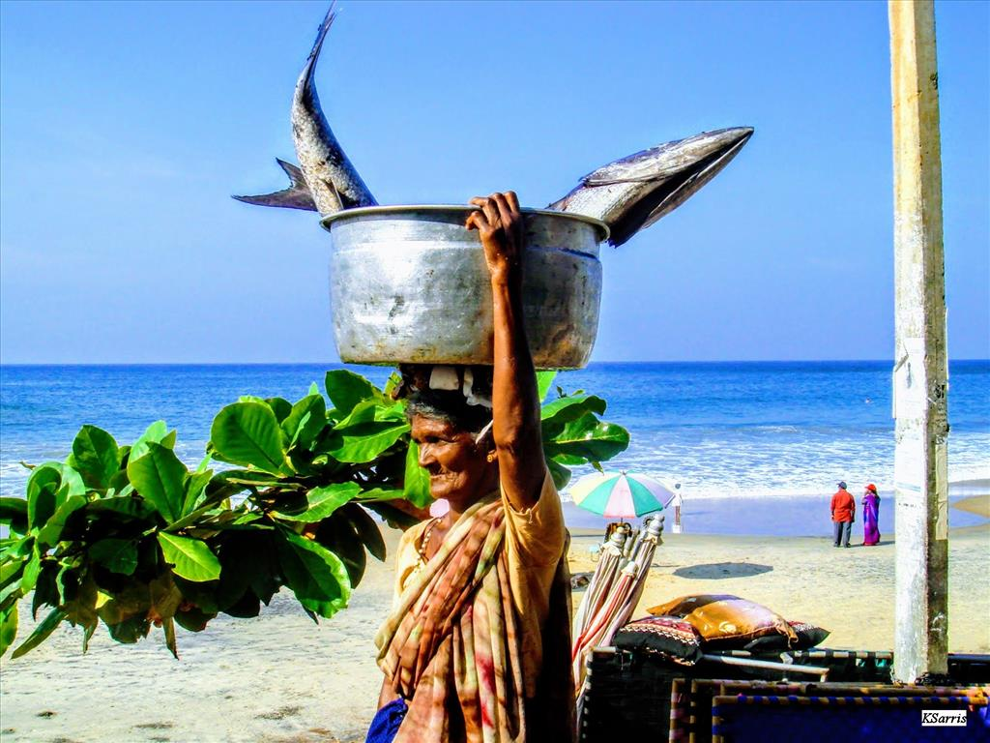
LAKSHADWEEP ISLANDS

Slide 28

Cultural tourism
India is known for its rich cultural heritage and an element of mysticism
Tourists come to India to experience it for themselves
The various fairs and festivals that tourists can visit in India are the Pushkar fair (Rajasthan), Taj Mahotsav (Uttar Pradesh), and Suraj Kund mela (Haryana)
Sites like Ajanta & Ellora caves (Maharashtra), Mahabalipuram (Tamil Nadu), Hampi (Karnataka), Taj Mahal (Uttar Pradesh), Hawa Mahal (Rajasthan).

Slide 29
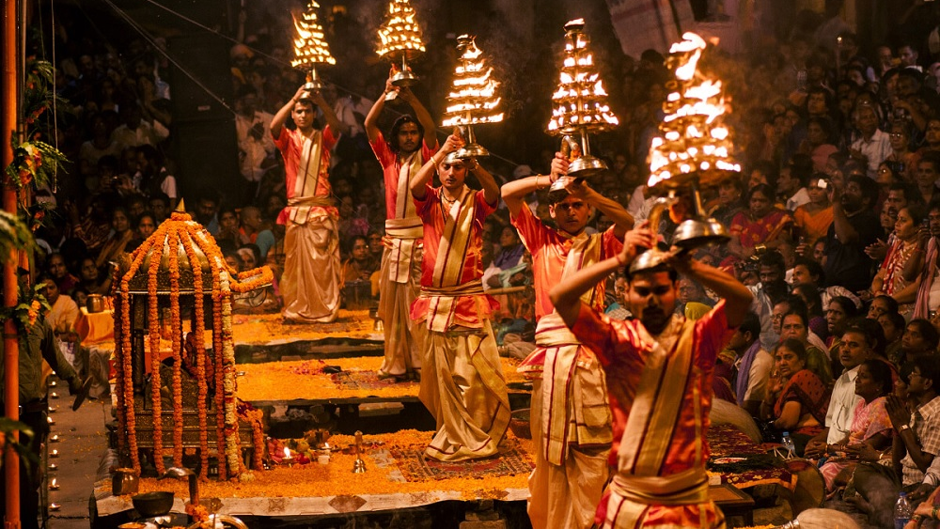
VARANASI, UTTAR PRADESH, INDIA

Slide 30
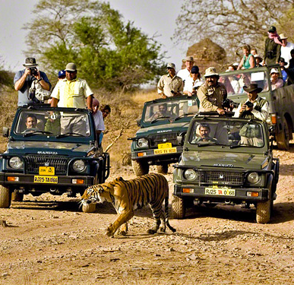
Wildlife tourism
India has a rich forest cover which has some beautiful and exotic species of wildlife
Some of which that are even endangered and very rare.
This has boosted wildlife tourism in India
Sariska Wildlife Sanctuary, Keoladeo Ghana National Park (Rajasthan), and Corbett National Park (Uttarkhand).

Slide 31
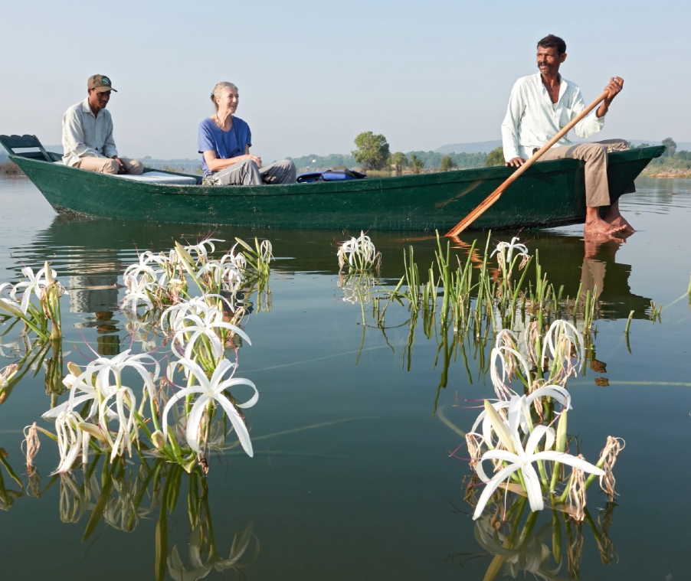
WILDLIFE TOURISM IN BUNDELKHAND, MADHYA PRADESH

Slide 32
MEDICAL TOURISM
Tourists from all over the world have been thronging India to avail themselves
Cost-effective but superior quality healthcare in terms of surgical procedures and general medical attention
Cater to foreign patients and impart top-quality healthcare at a fraction of what it would have cost in developed nations such as USA and UK.
The city of Chennai attracts around 45% of medical tourists from foreign countries.

Slide 33
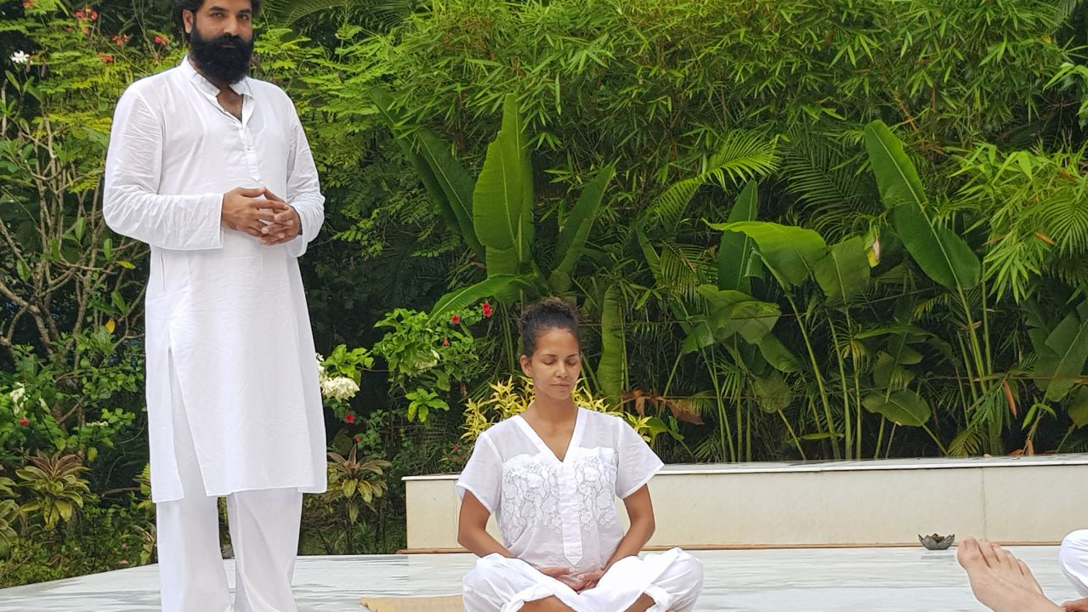
AYURVEDIC RETREATS IN INDIA

Slide 34
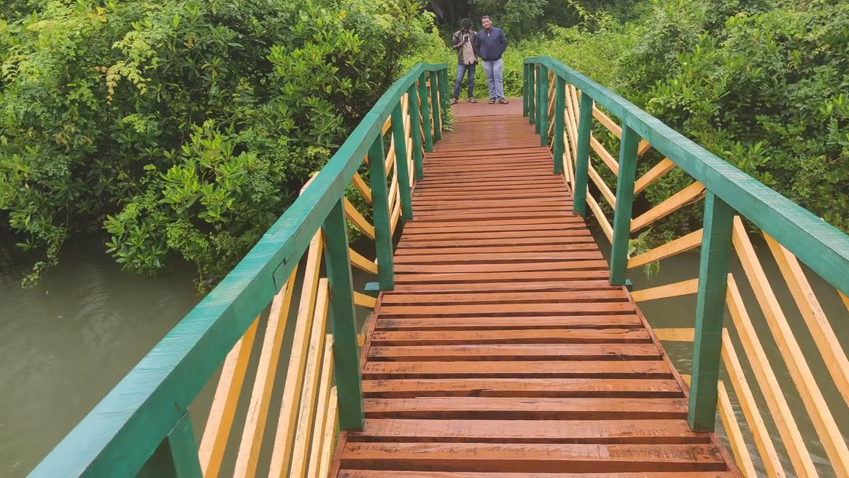
Eco tourism
A form of tourism involving responsible travel to natural areas, conserving the environment, and improving the well-being of the local people
Its purpose may be to directly benefit the economic development and political empowerment of local communities
Ecotourism may focus on educating travelers on local environments and natural surroundings with an eye to ecological conservation.
Effort to produce economic opportunities that make conservation of natural resources financially possible.

Slide 35
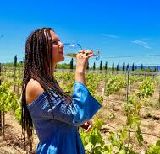
Enotourism
Enotourism, oenotourism, wine tourism, or vinitourism
Tourism whose purpose is or includes the tasting, consumption or purchase of wine, often at or near the source
Consists of visits to wineries, tasting wines, vineyard walks, or even taking an active part in the harvest.

Slide 36
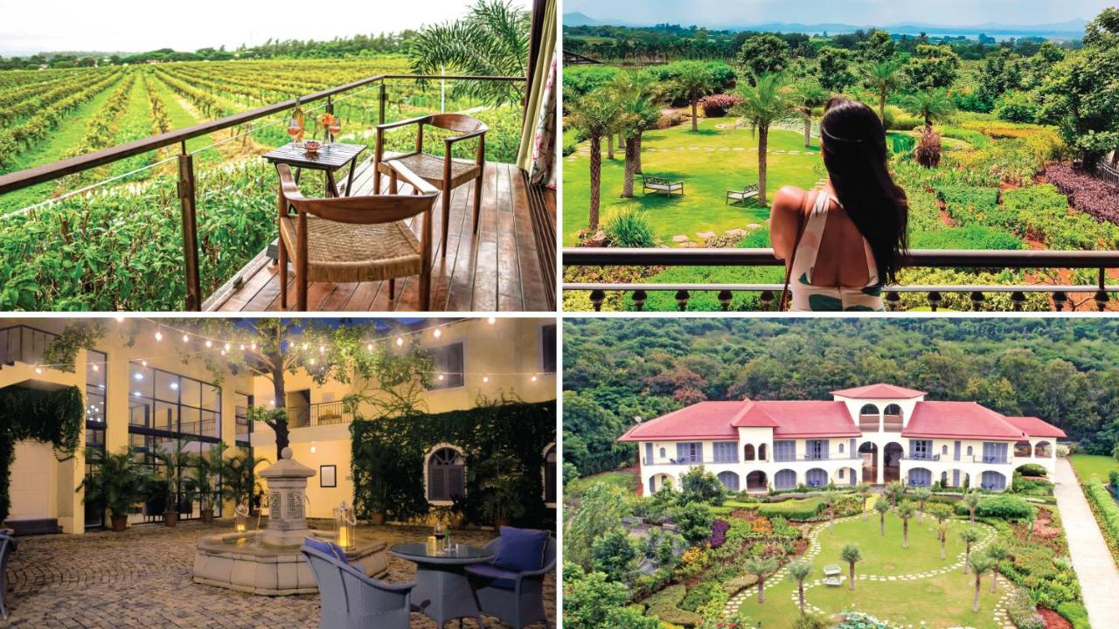
SULA VINEYARDS, NASHIK, MAHARASHTRA

Slide 37
AGRI-TOURISM
Agricultural Tourism is the Holidays concept of Visiting a working farm or any agricultural, horticultural, or agribusiness operations for the purpose of enjoyment, education, or active involvement in the activities of the farm or operation

Slide 38
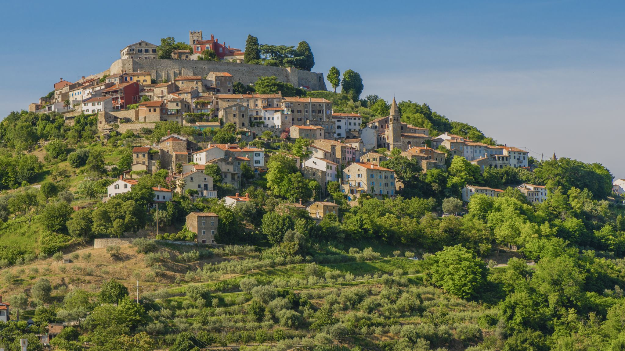
Definition
Agri-tourism is the branch of tourism that involves accommodation being offered in the farmhouse or in a separate guest house, providing meals and organising guests activities in the observation and participation in the farming operations (World Tourism Organization, 1998).

Slide 39
Principles of Agri tourism
The appeal to the tourists should be both visual and physical
Participation and involvement of the tourists
Provision of sales counter

Slide 40
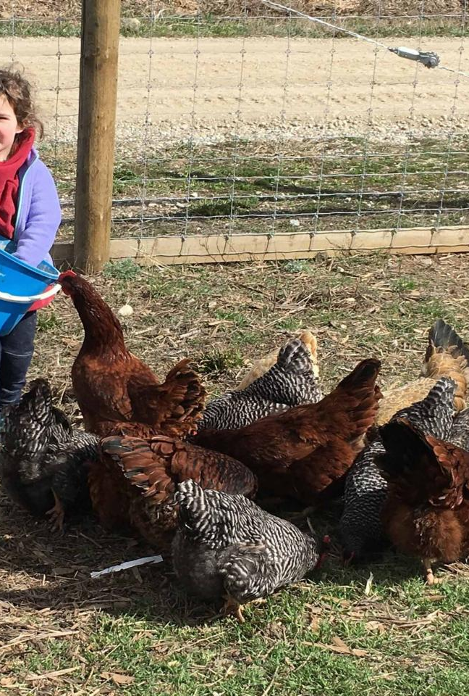
Activities or services included in agricultural tourism
Ride On Bullock Cart
Bullock Ploughing
Buffalo Riding
Riding On A Horse Back
Watching The Animals Which Are Grown On The Farm For Domestic Use
Fishing In Rivers Or Lakes Or Ponds
Camping
Riding In Jeeps
Playing Games In The Rural Areas
Tours With Schools
Tours To Gardens Or Nurseries

Slide 41
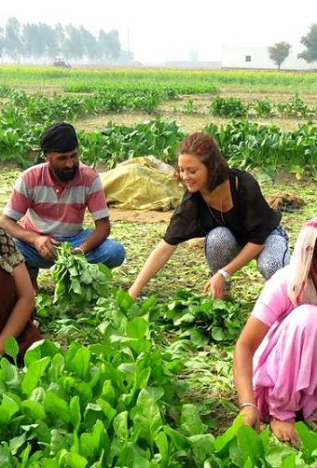
Agro Technological Tours
Exhibitions Of Agriculture In History
Tours To Microbreweries
Visits To Poultry Farm
Visits To Sugar Factory
Visits To Wine Or Liquor Factory
Visit To Silk Production Unit
Entertainment In The Form Of Festivals Or Harvest
Services Of Hospitality Include Stay On The Farm Guides For The Tourists
Sale Of The Farm Produce For The Tourist Directly

Slide 42
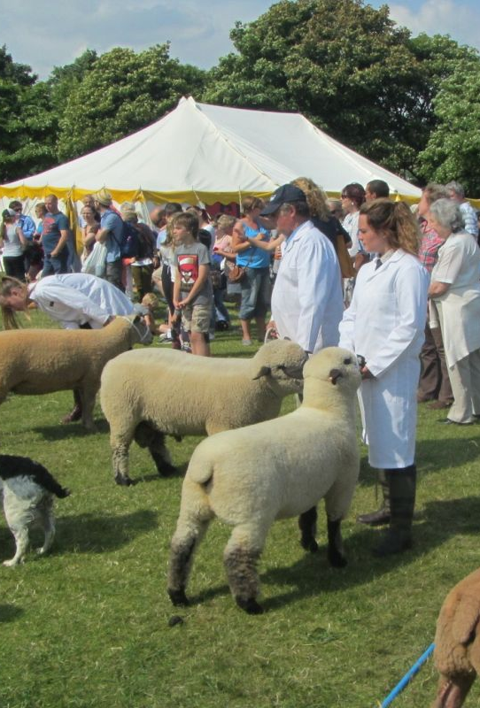
Agricultural shows
AGRI-TOURISM INCLUDES
An agricultural show is a public event exhibiting the equipment, animals, sports and recreation associated with agriculture and animal husbandry.
The largest comprise a livestock show (a judged event or display in which breeding stock is exhibited), a trade fair, competitions, and entertainment.
The work and practices of farmers, animal fanciers, cowboys, and zoologists may be displayed.

Slide 43
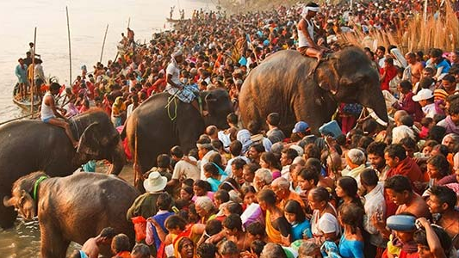
SONEPUR CATTLE FAIR, INDIA

Slide 44
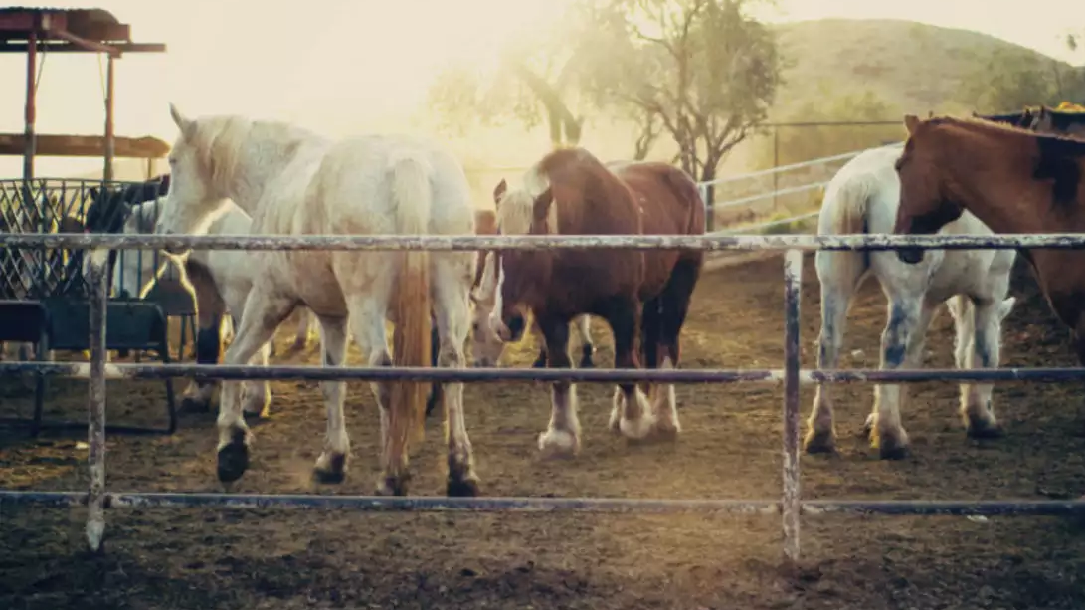
Guest ranch
A type of ranch oriented towards visitors or tourism
Some guest ranches cater to hunters
Others feature exotic species imported from other regions and nations such as Africa and India.
The introduction of non-native species on ranches is more controversial
Advocates of hunting ranches argue in turn that they help protect native herds from over-hunting
Provide important income for locals and nature conservation

Slide 45
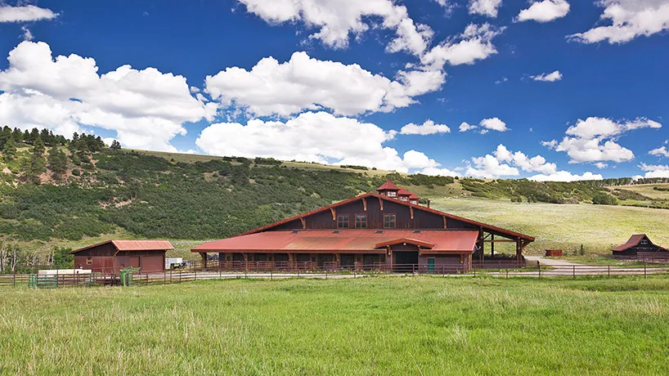
Rural Ramble
The Rural Ramble is an annual summer farm tour made up of showcasing many aspects of the local agricultural operations
It is an example of agritourism which provides opportunities for non-farm people to learn first hand where their food comes from
Host farms and rural businesses are listed in a "passport" booklet, which contains information about the sites and a map of the farm showing how to find each place.
Wristbands sold provide admission for children and adults.

Slide 46
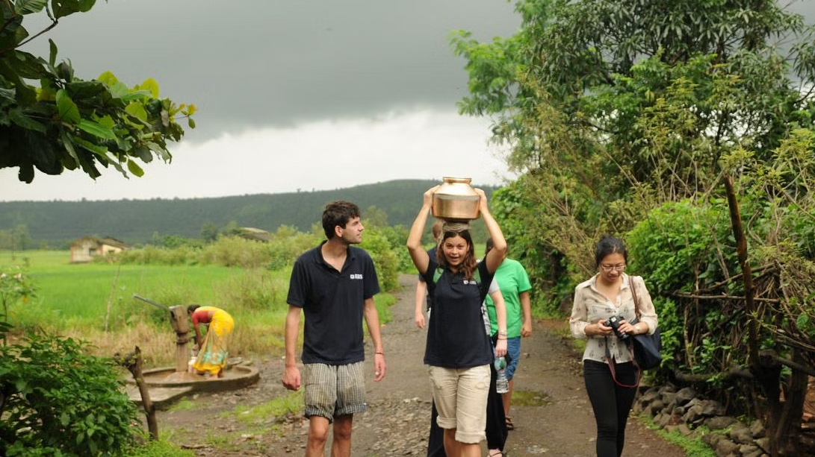
Rural tourism
Rural tourism is agri-tourism that focuses on actively participating in a rural lifestyle.
Many villagers are hospitable and eager to welcome or host visitors
Build environmental and cultural awareness and respect
Provide positive experiences for both visitors and hosts
Provide direct financial benefit for conservation
Provide financial benefits and empowerment for local people
Raise sensitivity to host countries' political, environmental, and social climate.

Slide 47
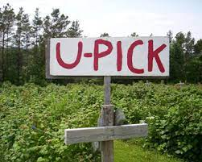
You-Pick
A You-Pick ("U-Pick") or Pick-Your-Own (PYO) farm operation is a type of farm gate direct marketing (farm-to-table)
Strategy where the emphasis is on customers doing the harvesting themselves
A PYO farm might be preferred by people who like to select fresh, high quality, vine-ripened produce themselves at lower prices

Slide 48

Advantages of You-Pick or Pick-Your-Own marketing
Alternative selling method that can supplement other marketing strategies
Direct sales to the consumer
Lowers operating costs and brings a profit even if prices may be lower
There are no transportation costs and no need for seasonal labor.
Lower packaging costs because customers are encouraged to bring their own bags
An entry fee usually covers any produce customers may eat on the farm while picking from the farm

Slide 49
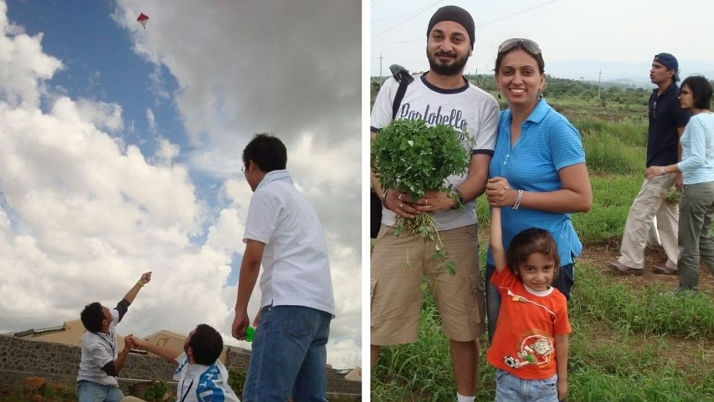
Advent of agri-tourism in India
The state of Maharashtra is the pioneer state to develop and promote agri-tourism in the country
Mr. Pandurang Taware
Agri Tourism Development Corporation (ATDC)- 2005
Owns the pilot agri-tourism project of 28 acres in Palshiwadi, Pune

Slide 50
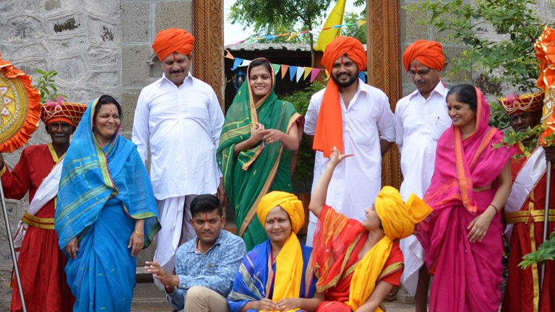
Activities of ATDC
Operating its Agri tourism centre, encouraging more farmers, conducting training and research programs
An umbrella platform wherein most of the tourist reservations are booked and then tourists are sent to different centers
Saves money on the marketing cost of the farmers
They may themselves also take the bookings. ATDC provides a helping hand
ATDC is the umbrella organization for the Agri tourism

Slide 51
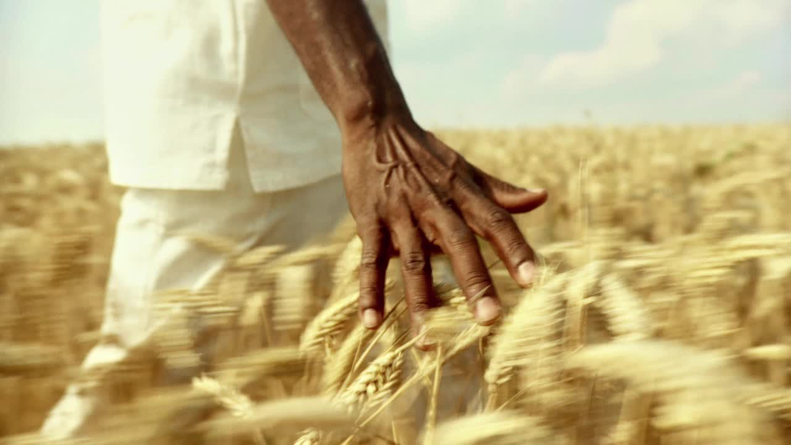
In 2007, ATDC launched training and skills development programmes with Maharashtra State Agri Tourism Vistar Yojana
The first 52 farmers were selected in Maharashtra
The Agri-tourism model has been replicated in 328 Agri tourism centres across 30 districts in Maharashtra
Helped to conserve, enhance the village environment, village traditions and culture customs village arts and handicrafts.
Gives the authentic experience to the visitors by showcasing village culture some agriculture traditions
Helped gain sustainable supplementary income source and generated local employment

Slide 52
The objectives of ATDC
Projects’ training and support is a potential vehicle for diversifying in stabilising the rural economies
Creating jobs, providing a broader market based opportunities for on farm employment so they do not have to migrate to urban areas
Agri-tourism income to improve their livelihoods traditional forms of art and music in rural areas
Increasing awareness of local agricultural products
Enhancing understanding of the importance of maintaining agricultural lands thereby strengthening the long term sustainability of small firms

Slide 53
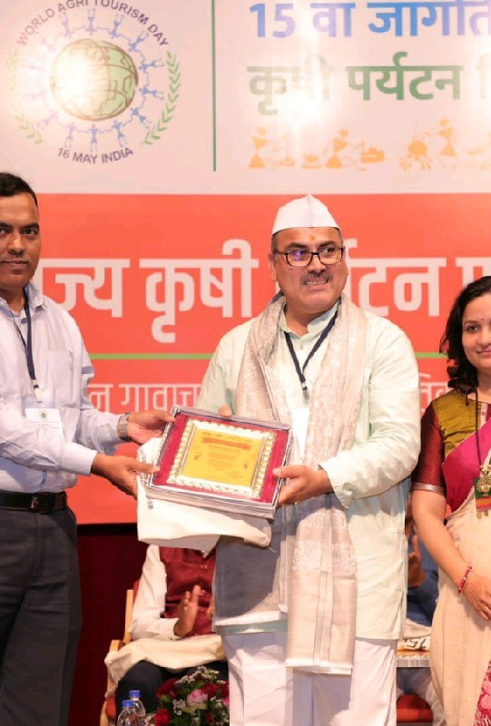
Awards and recognitions of Mr. Pandurang Taware
Maharashtra State Agri Tourism Award 2022 by Department of Tourism
Lakbay Bukid Award 2019, for Development & Promotion of Farm Tourism in Asia, Philippines
National Innovative Farmer Award 2018 by Indian Council of Agriculture Research, Ministry of Agriculture, Government of India
50 Most Influential Rural Marketing Professionals of India Award 2017
Responsible Tourism Award 2011, by Responsible Travel, London
National Tourism Award 2008-09,by Ministry of Tourism Government

Slide 54
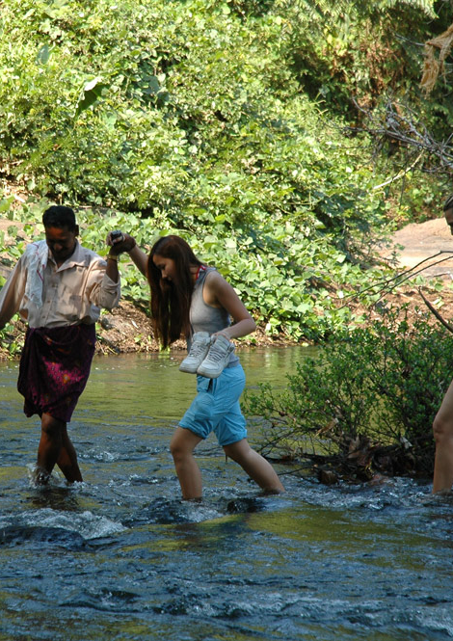
Some of the popular farm stays providing agricultural tourism in India are
DEVALOKAM FARMSTAY RETREAT, KERALA
Devalokam is the organic ancestral form of a welcoming Syrian Christian family.
Fruits vegetables spices milk and honey are all produced
Spiceworks, village walks bamboo rafting, temple visits, cow milking and swimming.
Located only 90 minutes drive from Kochi airport in the spice belt of Kerala
Yoga ayurveda and cooking holidays are also offered
The main guest house is air conditioned room overlooking the river and forest

Slide 55
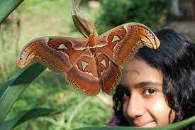
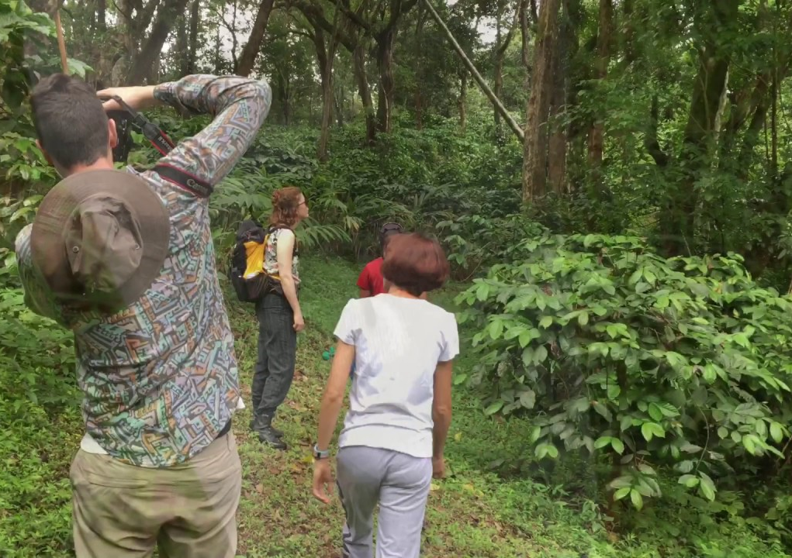
Rainforest Retreat, Coorg, Karnataka
Combines agri-tourism with sustainable agriculture and environmental education
Visitors can experience the biodiversity of Western Ghats, idyllic valleys and tropical forests
Visit coffee, cardamom and vanilla plantations
Learn how they are sustainably cultivated under the shade of rainforest trees
Birdwatching and trekking is also provided
Supports WAPRED, an environmental NGO that promotes organic farming and biodiversity conservation

Slide 56
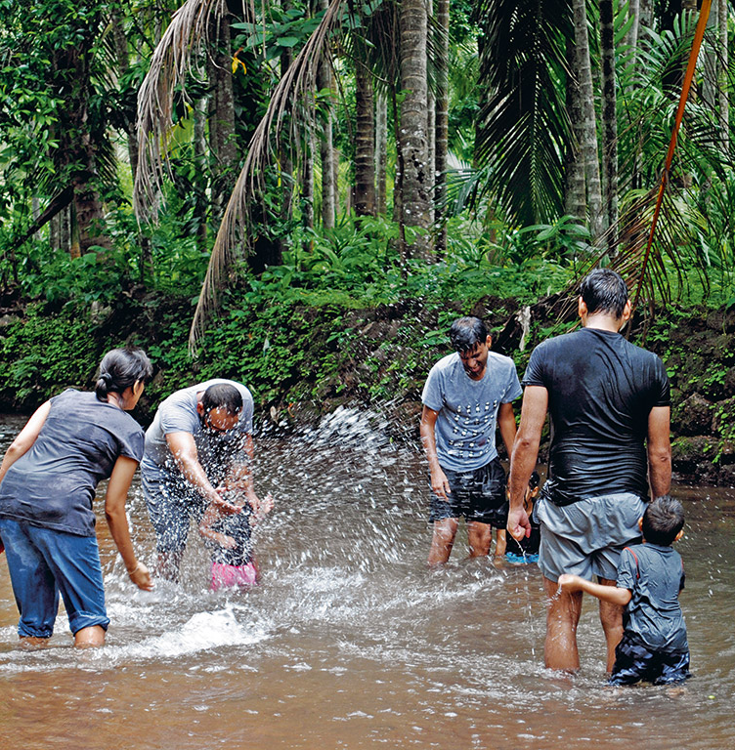
Maachli, Maharashtra
Maachli is the divine farmstay situated in Parul village on the far South konkan coast of Maharashtra
The name maachli means elevated huts in the local Marwari language
There are 4 architecturally designed Hut style accommodations on the property come built deep within nature
Amidst coconut betelnut banana and spice plantation.
Everything revolves around nature and there is a sweet water stream flowing through the property.
Activities include village walks cooking lessons pharming experiences and trekking.

Slide 57
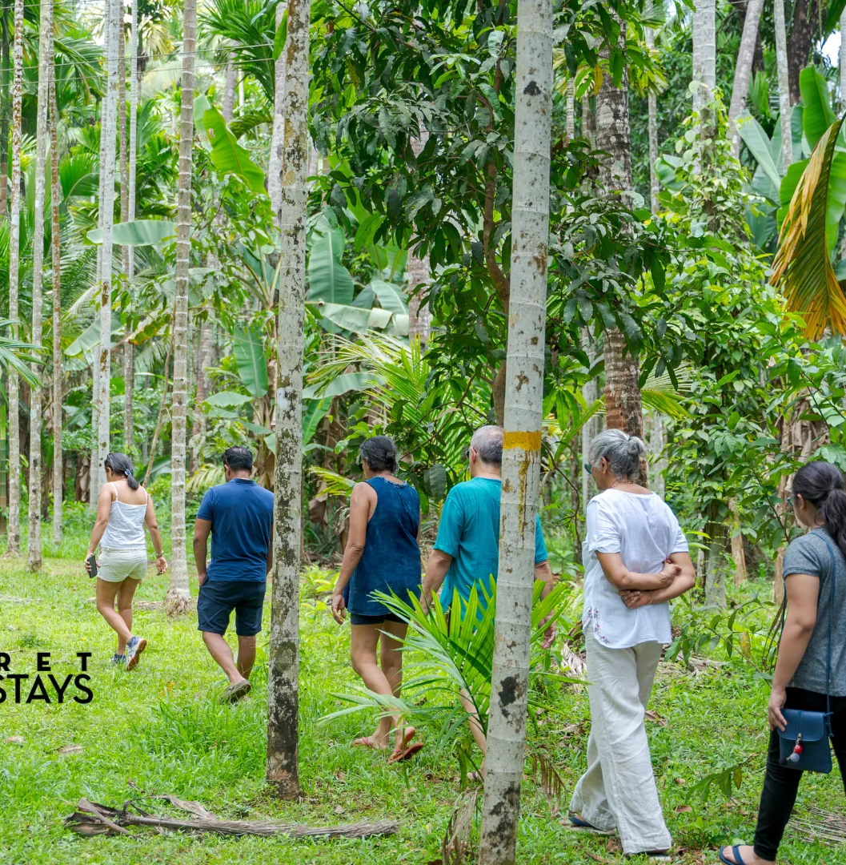
Dudh Sagar Plantation and Farm Stay, Goa
Dudhsagar plantation is set on 50 lush acres
Grows everything from pineapples to cashew
It has also its own cashew fenny distillery with production from March to May each year
It is a farm stay with 5 jungle cottages for guests
The farm stay is located on the way to Goa is famous Dudh Sagar waterfall

Slide 58

Konyak Tea Retreat, Nagaland
This is one of the most notable form houses to visit tea plantations in India.
This farm stay is in Nagaland, in India’s northeast region
Has orange tree orchard in organic vegetable garden
Guests can pick and eat during harvesting season
Other activities include milking cows and goats, working with locals in their paddy fields, going on nature hikes, learning how to traditionally smoke meat, and visiting local Konyak tribal villages.

Slide 59
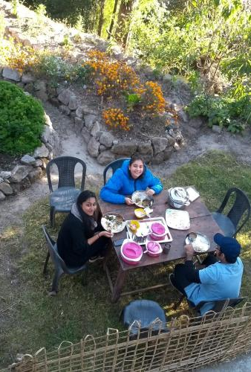
Tieedi Earthy Dwelling, Darjeeling, West Bengal
The hosts in this farm stay quit their lucrative corporate careers
Regenerative permaculture principles to revive a forest and create a sustainable way of living for themselves
Minimalist earth dwelling and shared it with guests
They also offer a cook and dine experience on their farm featuring traditional cooking methods and home grown produce
The hosts stake guests on a forest walk
Concept of permaculture and organic farming along with foraging that is called as forgac farming, composting process that upcycles the waste generated by the local village

Slide 60
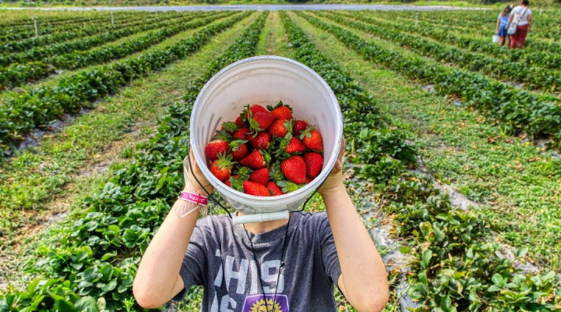
The need for Agri tourism
Living in urban area people have not enjoyed the beauty of Mother Nature
Agri Tourism Development Corporation did the research in 2014 and found that 43% of urban population did not have any relative left in the village.
97% of urban population want to experience the rustic beauty of village life.
This gives an opportunity to develop tourism centres in the village based on agricultural activities
Farmers of India are engaged in farming activity throughout the year

Slide 61

Main factors of agriculture tourism
THE FARMER - He is the one who is supposed to treat the guests with the utmost respect and with complete heart. He should not only entertain the guest but he should also entertain himself while explaining to the tourist or visitors about farming process. The farmer is not the businessman which itself makes the touristy atmosphere clean and pure and enriching.
THE VILLAGE - is the one which is very far from the cities and has very few facilities which are provided in the urban areas. The investment for Agri tourism is made by nature itself in the form of water bodies mountains crops etc.
THE AGRICULTURAL FIELD - the resources of agriculture which are in the form of land water will be unique and will be changing from place to place. Each agricultural field is different which attracts tourists in a different way.

Slide 62

STAKEHOLDERS OF AGRI-TOURISM
Ministry of Agriculture
Line Departments At The State And Central Government And Farmers
Indian Institute Of Tourism And Travel Management
Tourism Development Corporation
Foreign Embassies
Travel Agents Association Of India
Indian Association Of Tour Operators
Transport Operators Association
India Convention Promotion Bureau
Pacific Asia Travel Association
State and Central Department of tourism

Slide 63
Benefits of Agritourism
1. FOR FARMERS - Acts as a secondary source of income for farmers
Helps in making the tourists or visitors aware of the lifestyle of the rural people
• Helps in creation of employment in rural areas.
• A spirit of entrepreneurial behaviour can be inculcated in rural youth.
2. FOR COMMUNITY: • Generating employment opportunities will strengthen the rural economy.
• Locally produced agricultural goods and services can be promoted.
• Provides opportunities to the communities to enhance their local tax bases.
• Traditional knowledge and wisdom of India can be preserved and promoted.
• An improvement in terms of protection and aesthetic value

Slide 64
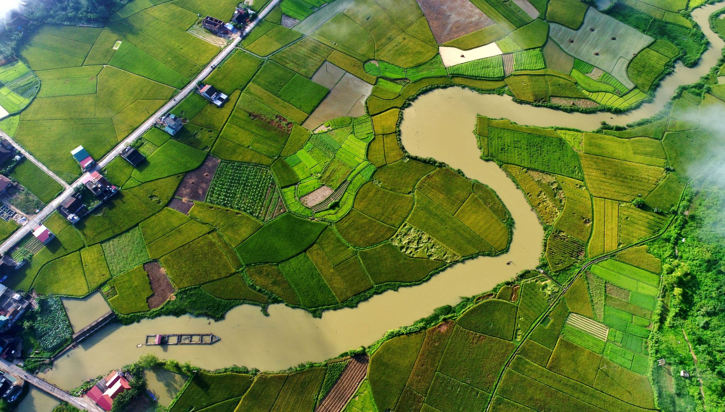
3. For Tourism Operators
Tourism market can be strengthened in the rural areas
It will provide an opportunity for the flow of non-local currency in the rural economy
4. For Tourists/Visitors
It will provide a first-hand experience about the various farming activities carried on in a farm
It will also provide an opportunity to the visitors to interact directly with the nature

Slide 65
Scope of Agri- tourism in India
Agri tourism is important in India as agriculture is the backbone of Indian economy.
Around 75% of the population is directly or indirectly dependent on agriculture and almost 26% of India GDP comes from agriculture.
90,000,000 farmers are dwelling in 5,00,000 villages producing food grains for feeding the country
Hence adding additional income generating activities to existing agriculture
India's share in the world tourism market is just 0.38% and the foreign exchange earned is ₹14,475 crores.
To promote domestic tourism.
Thrust areas identified by Government of India- development of infrastructure, product development and diversification, cultural presentations, inexpensive accommodation, HRD, creating awareness in public participation and facilitation of private sector participation.

Slide 66

POTENTIAL IN KARNATAKA
Karnataka has a great potential to the development of agro-tourism
Natural conditions, agricultural products, variety of rural traditions and festivals.
Problem of low awareness about this business in the farmer
Karnataka can also be agri-tourism hub of India
It can utilise and implement technological tools to improve effectiveness and efficiency of agro-tourism (Online booking, services etc.)
Required support from local community and government for a sustainable growth

Slide 67
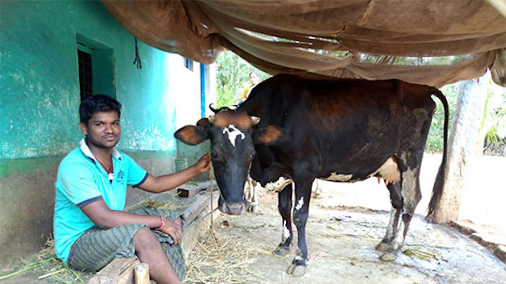
Socio-economic impacts of Agri-tourism
1. Employment to youth
2. Boost to the Handloom and Cottage industry
3. Preservation of natural resources
4. Exchange of revenue
5. Exposure to their religion

Slide 68

RELATED RESEARCH STUDIES

Slide 69
HOMESTAYS PROMOTING ECOTOURISM IN COFFEE FARMS OF WESTERN GHATS, INDIA: A SOCIO-ECONOMIC EXPLORATORY STUDY (Chengappa et. al., 2015)
METHODOLOGY
The study was conducted in Kodagu district located in Karnataka state, India. State tourism department has classified Kodagu under the eco-sensitive zone (Government of Karnataka, 2009).
There are three taluks in Kodagu: Madikeri, Virajpet and Somarpet
The sample for study consisted of 45 homestay operating farmers drawn at random from all the three taluks.
The Coorg Homestay Association (CHSA) has registered 200 homestays in Kodagu as its members
Respondents were interviewed using a structured and pretested questionnaire
The survey was conducted over a three month period from January to March 2015.

Slide 70
Table 1: Classification of homestay operating coffee farmers based on their size of holding
Sl. No. | Size of land holding in ha | Average net Income from homestay (INR) | Average net income from coffee farming (INR) | Average net income from others (INR) | Average total net income (INR)
1. | Small holdings (<2) | 2,33,050 (49.14) | 2,41,187.5 (50.86) | 0 | 4,74,237 (100)
2. | Small holdings (2-5) | 2,47,420 (37.47) | 3,41,450 (51.71) | 71,500 (10.82) | 6,60,370 (100)
3. | Small holdings (5-10) | 2,08,386 (17.59) | 9,18,678 (77.52) | 58,000 (4.89) | 11,85,064 (100)
4. | Large holdings (10-25) | 7,12,518 (37.80) | 11,72,652 (62.20) | 0 | 18,85,170 (100)
5. | Large holdings (>25) | 2,72,250 (9.63) | 24,91,250 (88.15) | 62,500 (2.22) | 28,26,000 (100)
6. | Total | 3,77,835.87 (28.46) | 9,09,200.64 (68.48) | 40577.78 (3.06) | 13,27,614.29 (100)

Slide 71
Table 2: Reasons to start homestay by the sample homestay operating farmers
Sl. No. | Reason | Mean(%)
1. | Earn alternative income | 63.27
2. | Marketing environmental value and landscape | 36.73
3. | To meet diverse people | 18.37
4. | Others | 2.04

Slide 72
AGRI TOURISM – PERCEPTION OF FARMERS (Chande, 2016)
Objectives
To explore the importance of Agri tourism in view of farmers
To analyse the barriers faced by the farmers in Baramati District.
To find out their future plans and implications.
Methodology - A multi-stage purposive random sampling was followed for the selection of blocks
About 25 groups were selected from Baramathi district of Maharashtra and about 100 farmer respondents were interviewed.
Information/data was collected by interviewing the respondent farmers by using a pre-tested, well-structured schedule.

Slide 73
Table 1. Perception of farmers on the importance of agri-tourism (n=100)
Sl. No. | Importance of agri tourism | Mean | Status
1. | To preserve farms and farmland | 3.77 | Agree
2. | To educate the visitors and public about agriculture | 4.87 | Strongly Agree
3. | To increase the standard of living of the farmers | 3.15 | Neutral
4. | To share agricultural heritage and rural lifestyles with visitors | 4.25 | Agree
5. | To generate additional income for farmers | 3.85 | Agree
6. | To provide quality local products and produce | 3.35 | Neutral
7. | It creates employment opportunity in the rural areas | 4.65 | Strongly Agree

Slide 74
Table 2. Perception of farmers on the importance of agri-tourism (n=100)
Barriers of Agri Tourism | Mean | Status
Involvement of capital for building infrastructure and marketing | 4.88 | Strongly Agree
Difficult in attracting customers | 3.32 | Neutral
Less knowledge to handle promotion activities | 4.74 | Strongly Agree
Difficult to obtain the permission from local authorities for local advertisement | 4.18 | Agree
Difficult to identify the target customers | 3.67 | Agree
Co operation of family members | 3.65 | Agree
Difficult to obtain the license | 3.53 | Agree

Slide 75
Farm Tourism in Punjab - A Case Study on the Concept and Its Sustainability (Pandey and Lakhawat, 2019)
Strengths
• Relatively good infrastructure in Punjab
Perception and image of Punjab as a hospitable place
Global awareness about Punjab’s culture, cuisine and traditions
•Overall prosperity of villages in Punjab and thereby availability of modern facilities
•Colorful nature and large heartedness of locals

Slide 76

Weaknesses
Extreme climatic conditions in the form of harsh winter and scorching summer
• Marketing of farm tourism is relatively difficult compared to popular destinations.
• Non-availability of skilled staff affects the overall quality of service
• Relatively poor medical facilities in rural India are a deterrent for tourists

Slide 77

Opportunities
• Large number of NRIs from Punjab will help the marketing of destination
• Increasing urbanization will lead to charm for rural and farm life
• Increasing rush at destinations of mass tourism will create market for exclusive niche tourism • Relatively low cost of a farm holiday will attract budget travelers , as well

Slide 78

Threats
Unscrupulous activities by some elements may create a negative image for farm tourism
Language barrier may deter foreign tourists.
Any revival of insurgency in Punjab will badly impact the industry
May lead to excessive commercialization of otherwise simple rural canvas.

Slide 79

Conclusion
To overcome problems like lack of social recognition and respect, lack of adequate incentives, etc
A large portion of farmers are resorting to suicide every year due to several reasons indebtedness, crop failure, etc.
According to the NCRB reports, nearly 3.5 lakh farmers have committed suicide since 1995 to 2018
Thus, the time has come for the policy-makers to successfully harness the potential of agritourism to boost up the rural economy of the nation.
Lack of proper credit facilities, lower literacy rate and lack of proper market orientation, fragmented land-holdings and lack of Govt. support.
Initiatives on the part of the Government is the need of the hour to harness the immense potential that lies in it.
Creates awareness on agriculture to general public along with entertainment enabling them to live along with nature

Slide 80


THANK YOU

