Slide 1

W
E
L
C
O
M
E

Slide 2






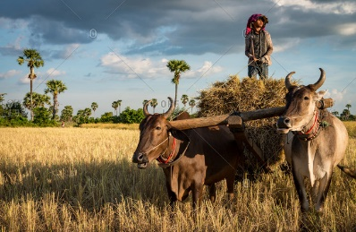

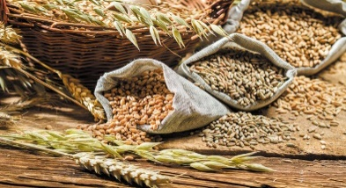
UNIVERSITY OF AGRICULTURAL SCIENCES, BANGALORE
COLLEGE OF AGRICULTURE, GKVK, BENGALURU
SEMINAR - I
NEW GENERATION DELIVERY SYSTEMS FOR SCALING UP
AGRO - TECHNIQUES
Presented by,
ABHINEETH R HARTHIKOTE
PAMB 1141
Sr. M.Sc. (Agri.)
Dept. of Agril. Extension

Slide 3


FLOW OF SEMINAR
Objectives
Scaling up - Concept
Types of Scaling up
Strategies for scaling up
New generation delivery systems for scaling up agro techniques
Research Studies
Introduction

Slide 4


INTRODUCTION
Economic Survey 2022-23: GDP contribution by the agriculture sector in India is 19.9% in 2022-23.
Extension worker to farmer ratio - 1:2879 (Mukherjee and Maity, 2015).
Mobile telephony is considered to be the alternative and the best option to delivery services to farmers.
(Annual report 2021-22, DAC & FW).

Slide 5

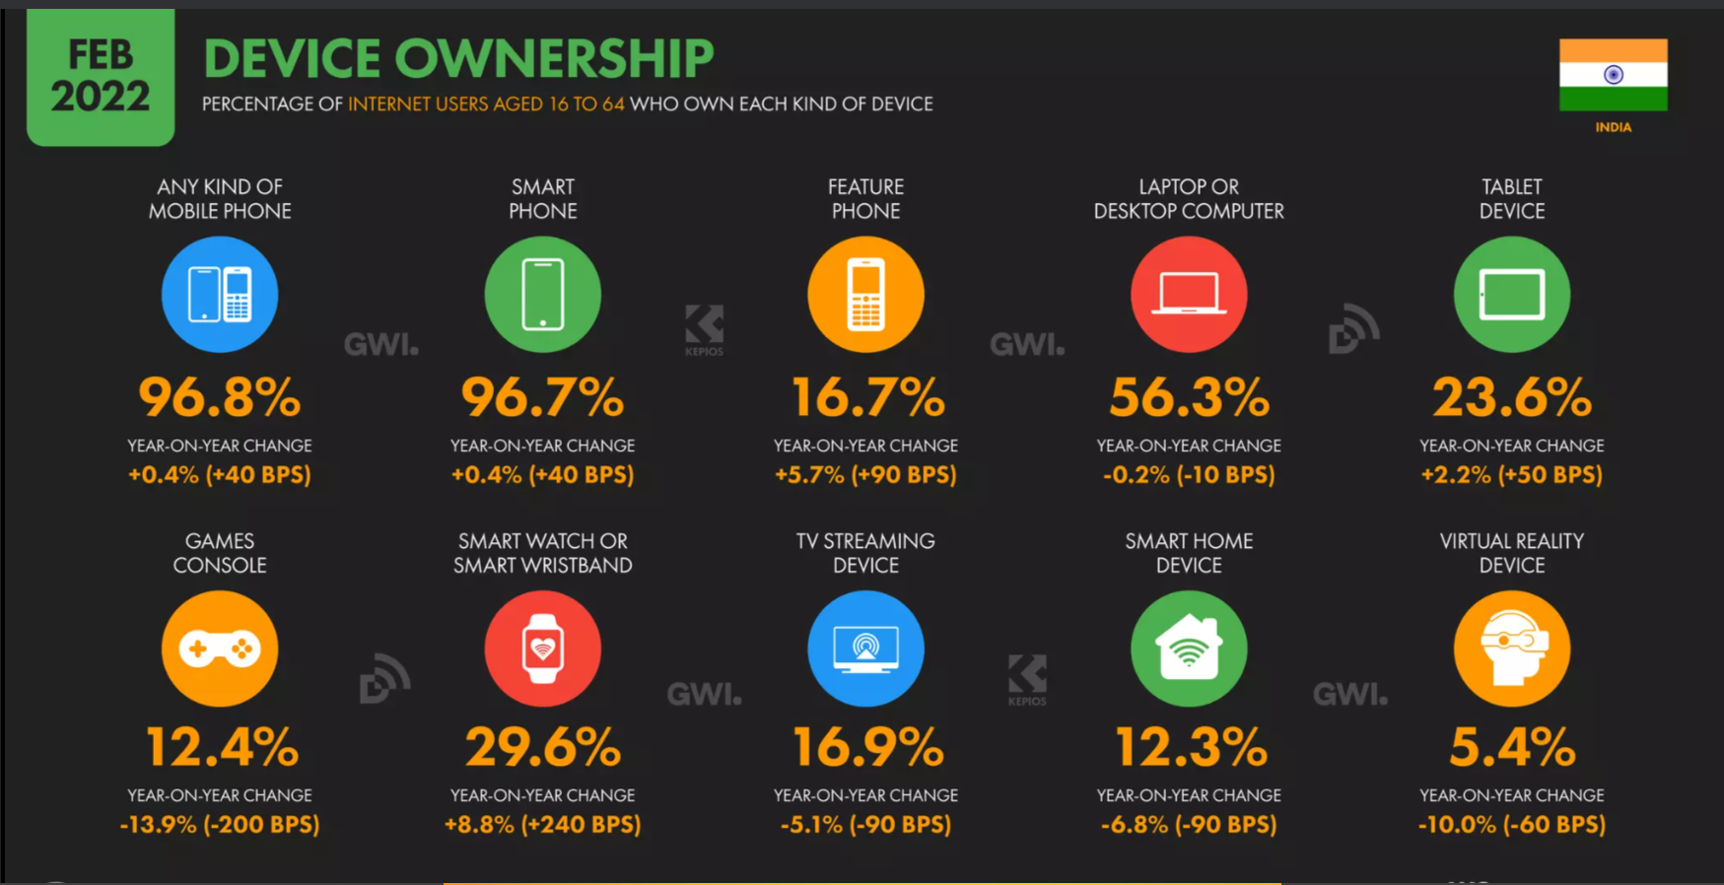
MOBILE CONNECTIONS IN INDIA
658.0 million internet users in India (January 2022).
India’s internet penetration rate stood at 47.0% of the total population at the start of 2022.
The number of mobile connections in India increased by 34 million between January 2021 and January 2022.
Source: datareportal.com
94 percent of farmers are using a mobile phone
(2017 Farm Journal Media mobile research survey )

Slide 6

1) To understand the concept of scaling up
2) To get the insights of new generation delivery system for scaling up of agro techniques
3) To review the existing literature

Slide 7
World health organisation has defined scaling up of technologies as the deliberate efforts to increase the impact of innovations, successfully tested in pilot or experimental projects so as to benefit more people and to foster policy and programme development on a lasting basis.
Foremost priority should be given to strengthening the innovation.
CONCEPT OF SCALING UP
Knowledge
generation
Dissemination
Adoption at full scale

Slide 8
Attributes of technologies for the potential scaling up
1
CREDIBLE
SUPERIOR TO EXISTING PRACTICES
COMPATIBLE
OBSERVABLE
RELEVANT
EASY TO UNDERSTAND
TESTABLE
2
3
4
5
6
7

Slide 9
Drivers of Change
Proven ideas
There has to be an idea or model that works on a small scale or has been promoted successfully elsewhere
Incentives
Incentives and accountability for results are needed to drive actors and organisations.
Empowered rural community
Empowered rural community can promote scaling up and hold public agencies accountable.
Vision and leadership
External catalyst
A vision is needed to recognize that the scaling up is necessary, desirable and feasible.
Political and economic crises from outside actors may drive the scaling process

Slide 10
Types of Scaling up
Horizontal Scaling up- It is when innovations are replicated in different geographical sites or are extended to serve a larger or new set of beneficiaries.
Vertical Scaling up- It takes place when formal organisational decision are made to adopt the innovation on a national or subnational level, and it is institutionalized through national development plans. In this case, the system and structures are adapted and resources redistributed to build the institutional mechanisms that can ensure sustainability.
Functional scaling up- It involves testing and adding interventions to existing packages. The strategy may be when an innovation has attained a sufficient degree of coverage and support to indicate that it is likely to continue to expand and the programme could benefit from new or additional interventions.

Slide 11
Two concepts of scaling up
Development of an integrated chain, as primary products are scaled up to create higher value goods and taken to market
Value chains are taken to a larger scale by increasing the amount of goods produced, processed and sold.
Increased interest in market-oriented agriculture, value chains are also used as pathways for scaling

Slide 12
APPROACHES TO DISSEMINATE AND ADVOCACY
For scaling up, information needs to be disseminated to the ultimate beneficiaries and other stakeholders-
Identifying key audiences and learning their different information needs
Tailoring messages and format to each audience
Presenting data clearly, concisely and in a timely manner.
Integrating repeated messages into the established internal communication networks of the users organisations.
Making use of skills of communication specialist who can mediate the information flow

Slide 13
Provide location specific
information
Provide information about the complete package of practices of latest technologies.
04
05
03
Training and message through mobile phones and other associated gadgets
Development of model plan
06
STRATEGIES
FOR
SCALING UP
Establishment of forward and backward linkages
Blending of traditional and latest methods for communication
02
07
01
Identification of potential areas
Encourage progressive farmers to help extension agents in delivering the latest message to fellow farmers.
08
SOURCE : Indian farming,2020

Slide 14
NEW GENERATION DELIVERY SYSTEMS FOR SCALING UP AGRO-TECHNIQUES
01
EXPERT SYSTEMS
MOBILE APPLICATIONS
02
03
AGRI STARTUPS
FPOs
04
05
TOLL FREE NUMBERS
SOCIAL MEDIA
06
08

Slide 15


01
EXPERT SYSTEM

Slide 16
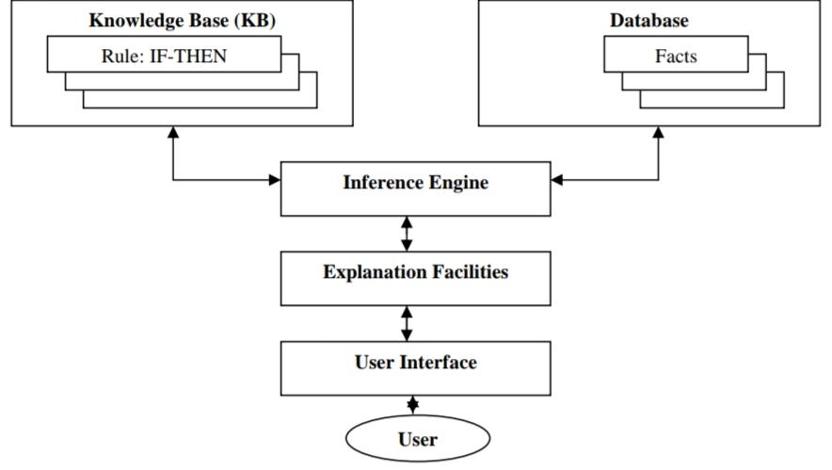
EXPERT SYSTEM
02
Expert system is defined as “ a computer program designed to model the problem solving ability of a human expert”(Durkin,1994).
EXPERT SYSTEMS
Components of an expert system

Slide 17
(ii) Database: It is the data or a set of facts
which is specific to a problem being solved.
(i) Knowledge Base: It is a declarative
representation of the expertise, often in IF-
THEN rules.
(iii) Inference Engine: It carries out the
reasoning by interplaying the information or
facts obtained from the user.
(iv) Explanation Facilities: It explains about how
a particular conclusion is reached
(v) User Interface: It provides communication
between the user and expert system.

Slide 18

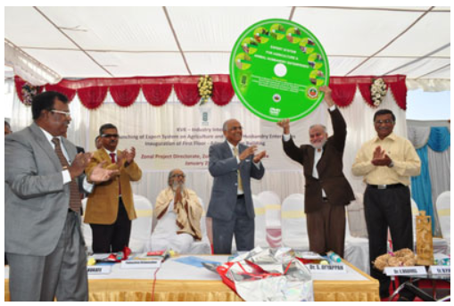
EXPERT SYSTEM ON AGRICULTURE AND ANIMAL HUSBANDRY ENTERPRISES - ICAR
January 25, 2013
Network partners
Directorate of Research on Women in Agriculture, Bhubaneshwar,
Zonal Project Directorate – Zone VIII, Bengaluru,
Tamil Nadu Agricultural University, Coimbatore
Tamil Nadu Veterinary and Animal Sciences University, Chennai
Major outcome
Decision support system
Information system
Plant Doctor
Health Advisor

Slide 19
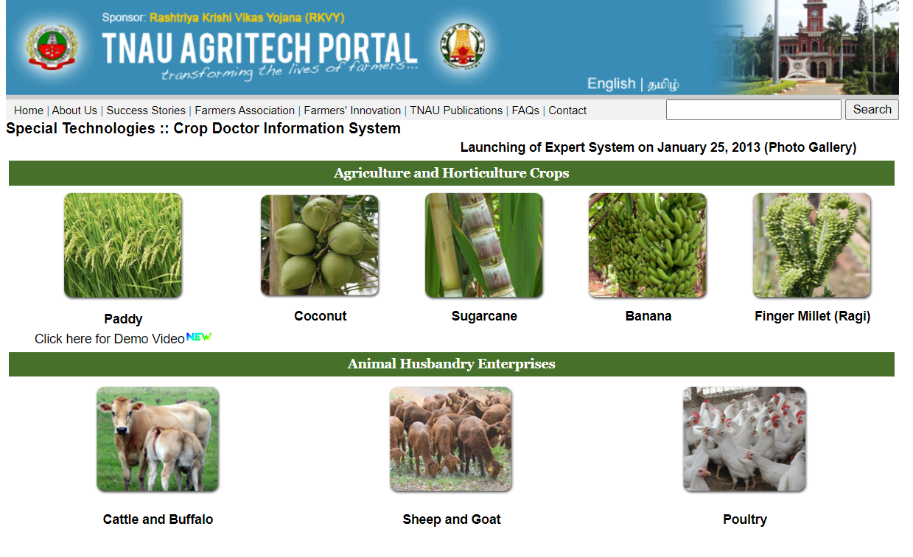

Slide 20
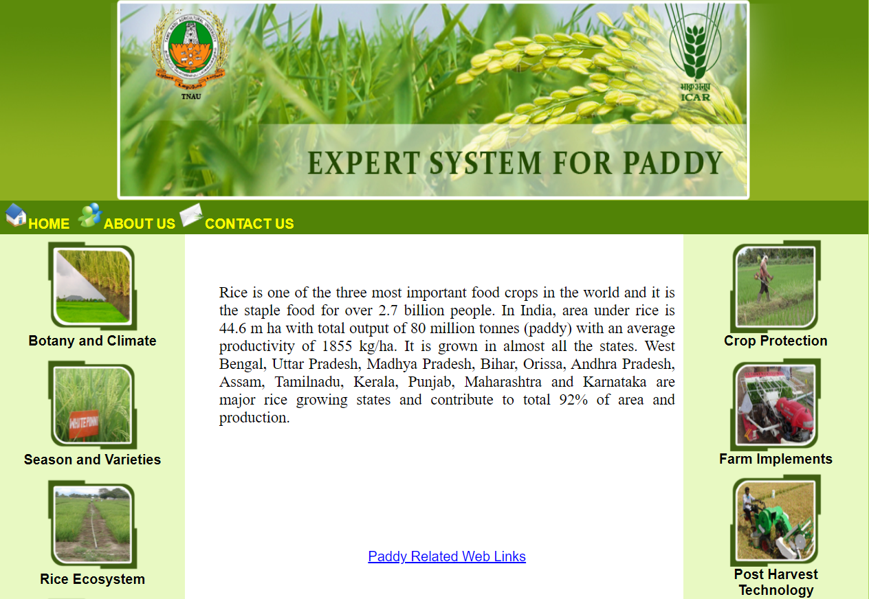
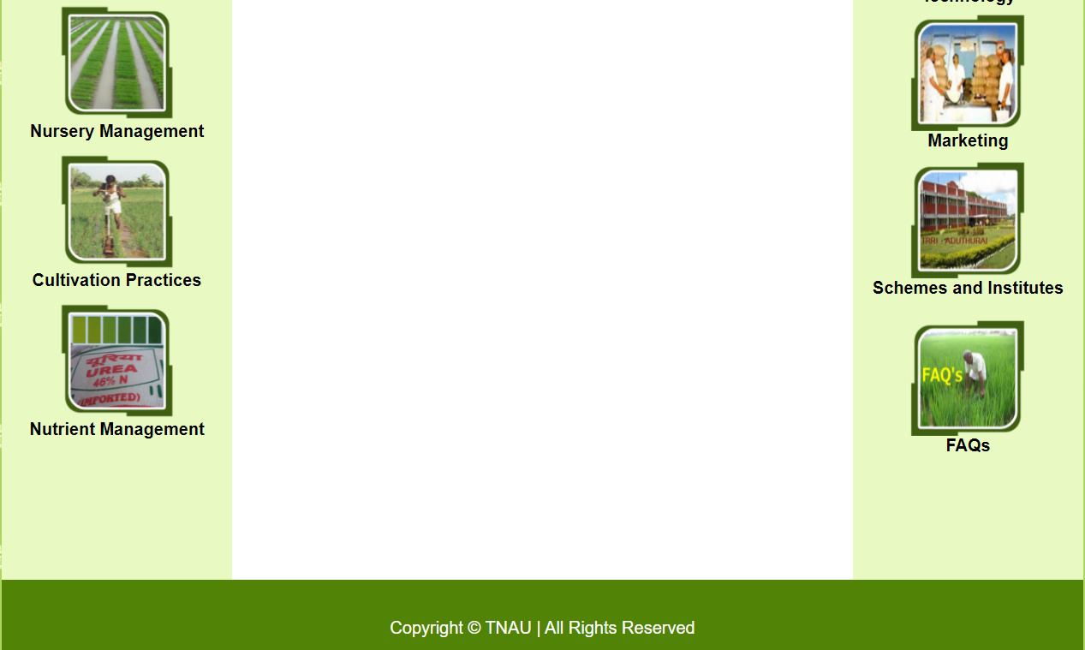
http://www.agritech.tnau.ac.in/expert_system/paddy/Index.html

Slide 21
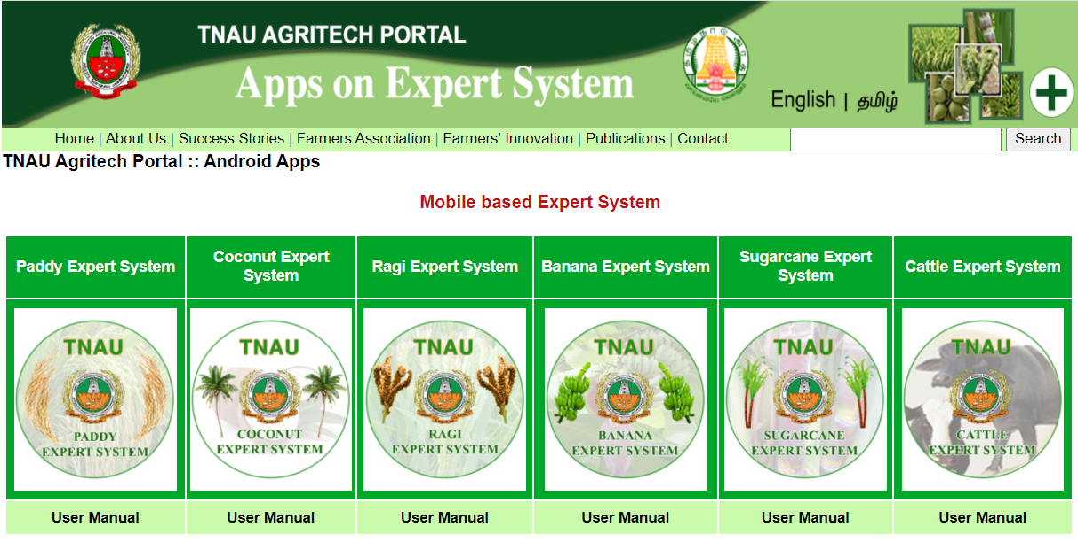
No.of downloads
English : 5K+
Tamil : 10K+
No.of downloads
English : 5K+
Tamil : 10K+
No.of downloads
English : 500+
Tamil : 500+
No.of downloads
English : 5K+
Tamil : 10K+
No.of downloads
English : 10K+
Tamil : 1K+
No.of downloads
English : 10K+
Tamil : 10K+
Source : https://play.google.com/

Slide 22
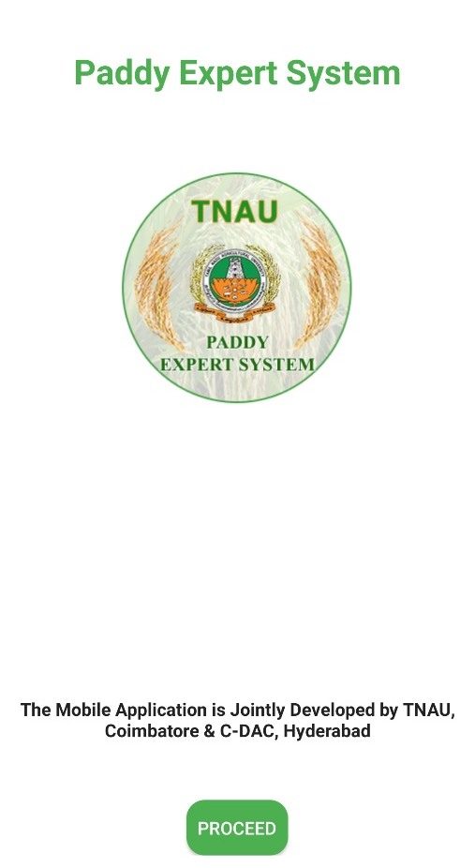
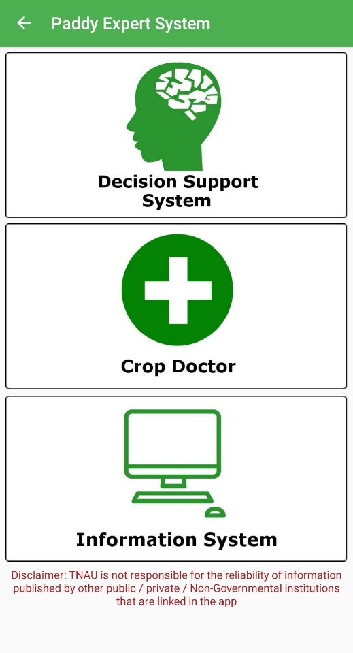
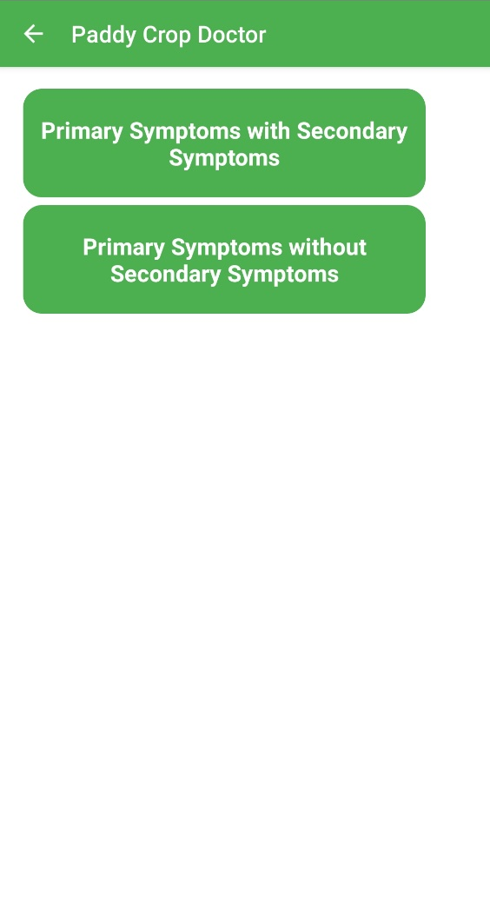
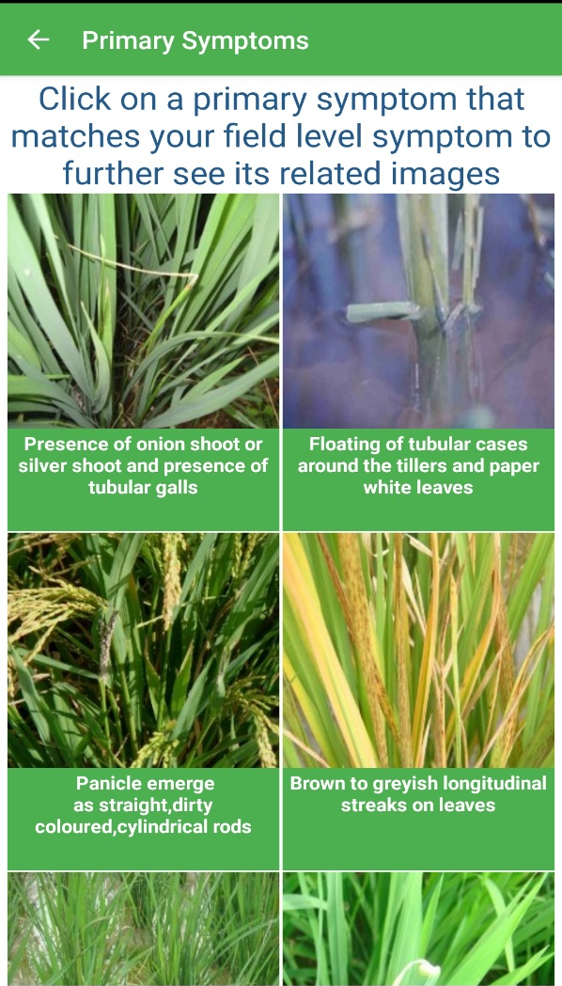
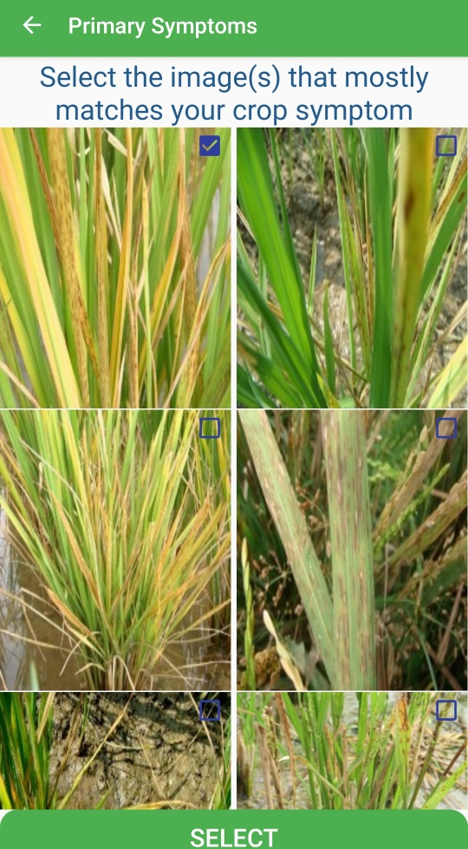

Slide 23
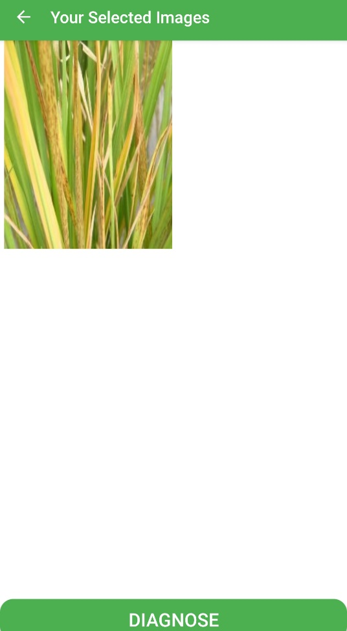
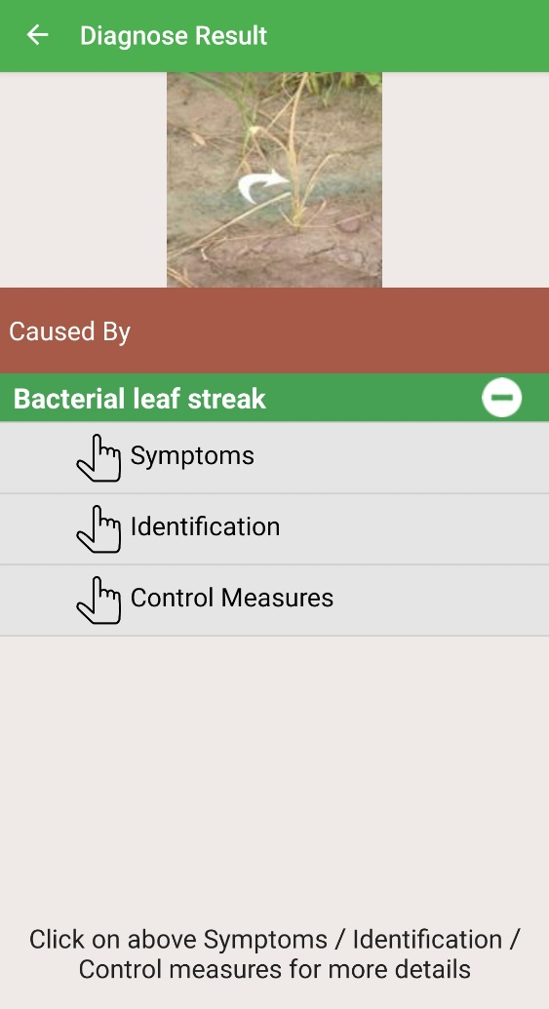
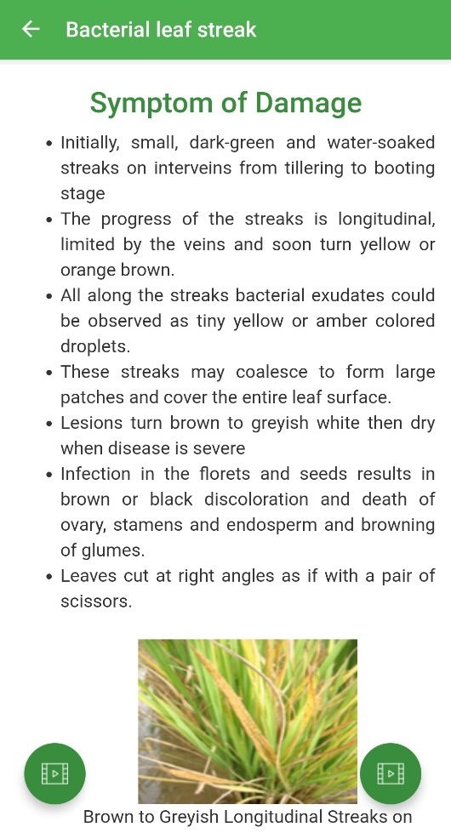
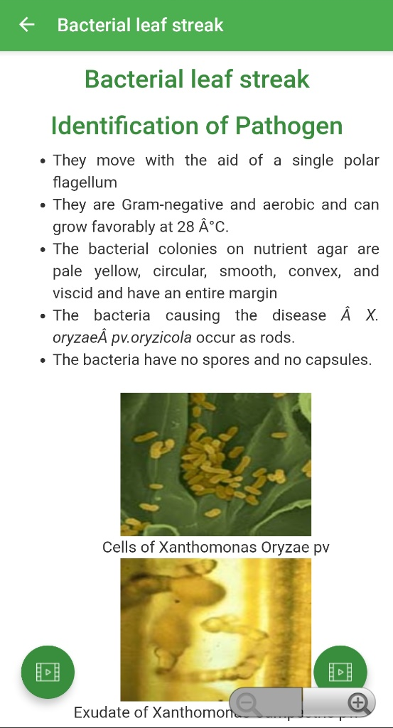
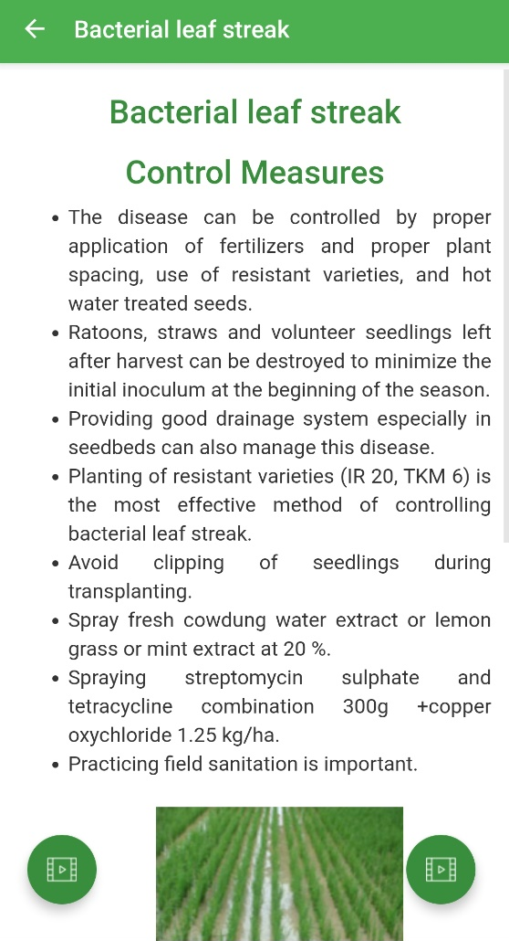

Slide 24
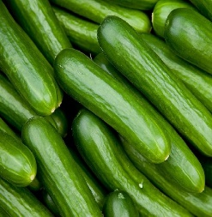
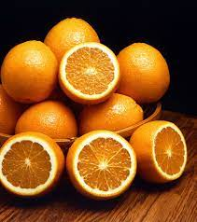

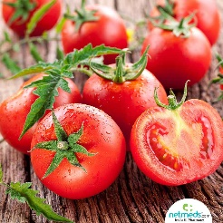
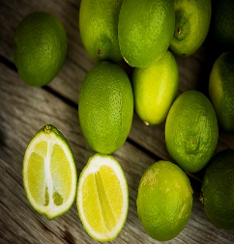
EXPERT SYSTEM ON CROP MANAGEMENT
CUPTEX- Cucumber crop production
CITEX- Orange Production
NEPER WHEAT- Irrigated Wheat management
TOMATEX- Tomato Production
LIMEX- Lime Production
COMAX- Cotton Production
GRAPE- Grape Production

Slide 25
CROP DISEASE AND INSECT PEST EXPERT SYSTEMS
Expert System
Rice-Crop doctor (MANAGE)
RUBEXS-04
AMRAPALIKA
D-CAS
POMME
Dr. WHEAT
COMAX
CALEX
VEGES
EXSYS
PESTICIDE ADVISOR
ESPDDFCI
ICOTIPM
ESMMDM
PCEST
Expert System
MyPEST
DDIS
SEMANGI
DIANA
PIEX
SOYBUG
ESAGU
COUNCELLOR
PREDICT
PULSEXPERT
CROPLAN
SMART SOY
SOURCE : https://agritech.tnau.ac.in/pdf/14.pdf

Slide 26



ADVANTAGES
DISADVANTAGES
Easy identification of disease
Provide consistent answers for repetitive decisions.
Hold and maintain significant levels of information
Combine multiple human expert intelligences
User friendly software
Cannot make creative responses
Errors may occur in the knowledge base, and lead to wrong decisions.
Cannot adapt to changing environments

Slide 27

MOBILE
APPLICATIONS
02

Slide 28
A mobile application is a software on a mobile phone handset or tablet computer that enables a user to access specific information
The information is stored in the mobile handset itself for easy access
Dynamic information requires Internet connectivity to fetch the data from the back-end server databases.

Slide 29
-There are mobile applications that provide latest agricultural information about trends, equipment, technologies and methods being used.
-Farmers can also interact and get guidance from agriculture experts across the country via the apps.
-These apps help in providing market information, facilitating market links, providing access to extension services, farm related information etc.

Slide 30
SUBJECT MATTER WISE DISTRIBUTION OF APPS AVAILABLE IN AGRICULTURE
S.No | CATEGORIES | No.of Apps |  | TOTAL
 |  | Free | Paid
1 | Livestock | 67 | 23 | 90
2 | Crops | 94 | 14 | 108
3 | Technology | 100 | 18 | 118
4 | Weather | 20 | 02 | 22
5 | Pest | 27 | - | 27
6 | Education | 38 | 12 | 50
7 | Business | 139 | 09 | 148
8 | News | 53 | - | 53
9 | Machinery | 44 | 02 | 46
10 | Spraying | 30 | 05 | 35
11 | Events | 25 | - | 25
12 | Gardening | 17 | 07 | 24
 | TOTAL | 654 | 92 | 746
SOURCE : Aravindkumar et al., 2019

Slide 31
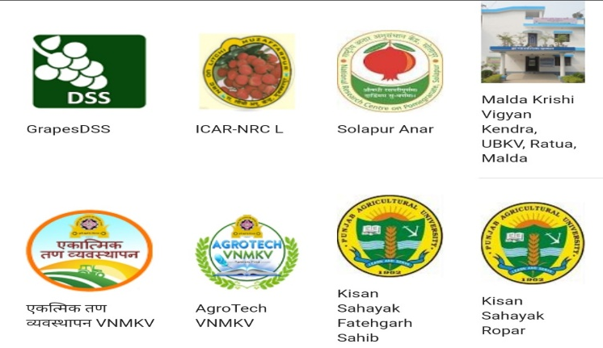
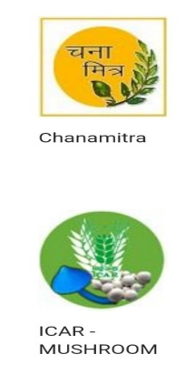
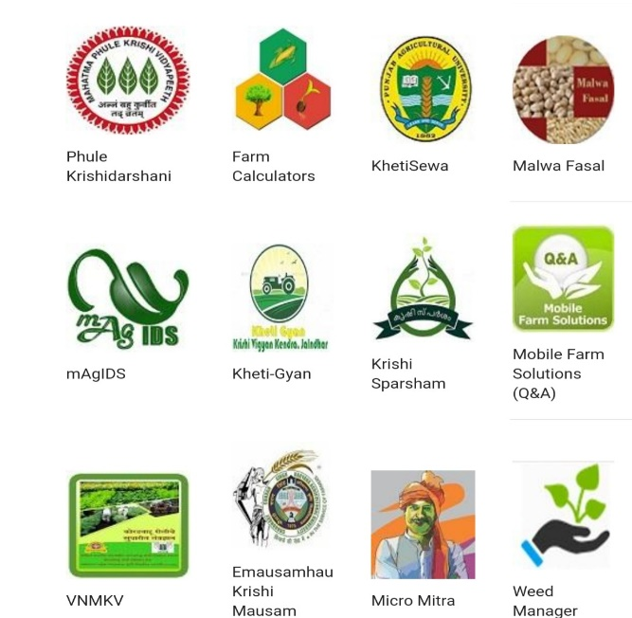
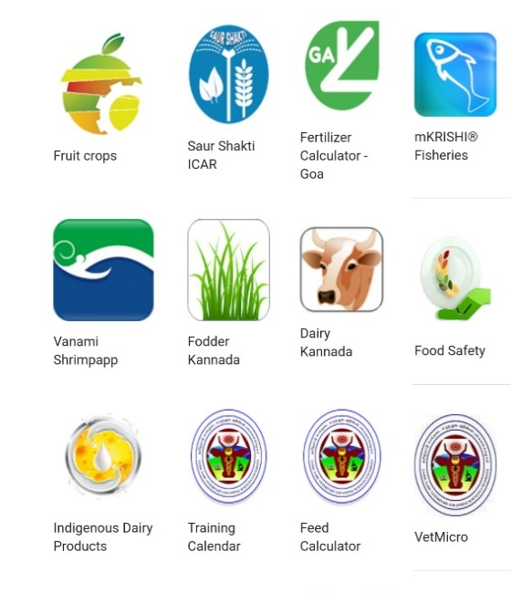

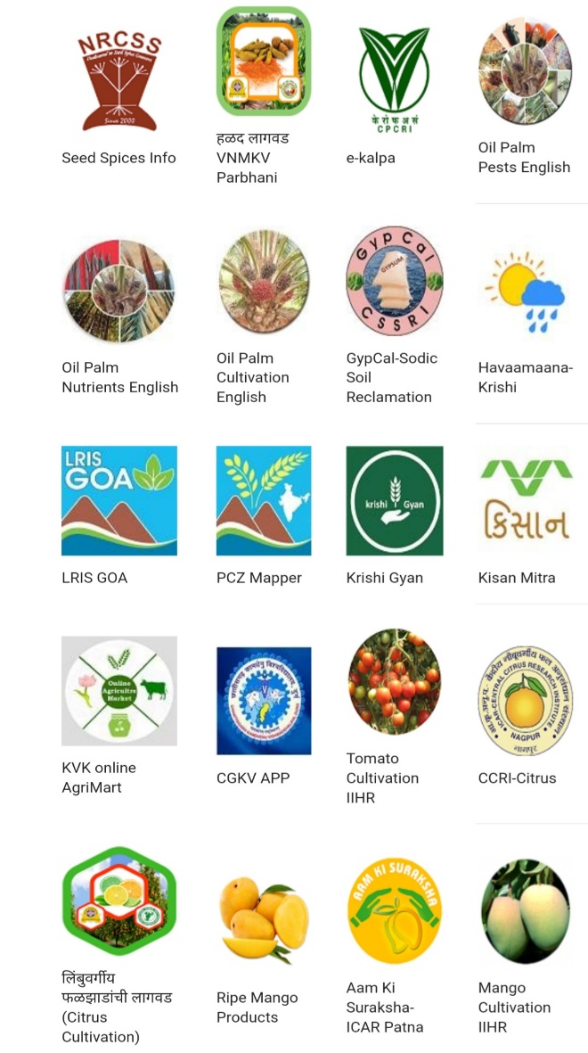

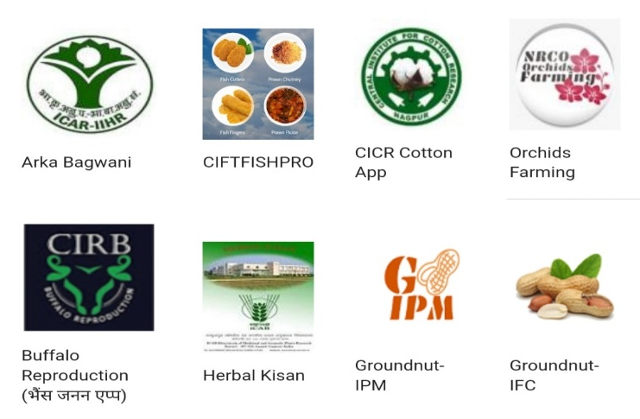








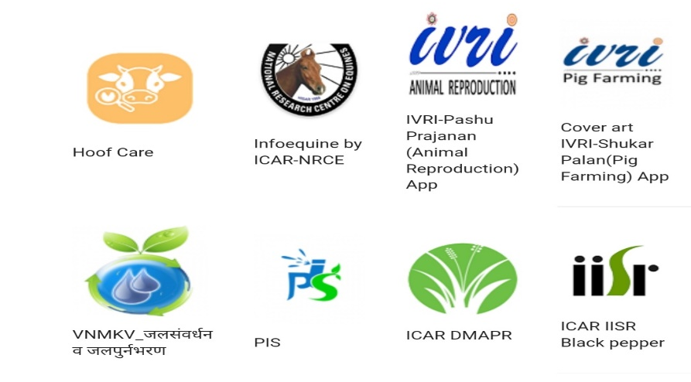
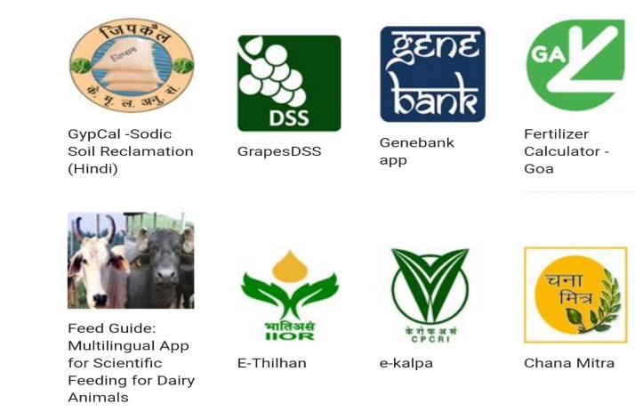

113
Mobile applications
Source: icar.org.in

Slide 32

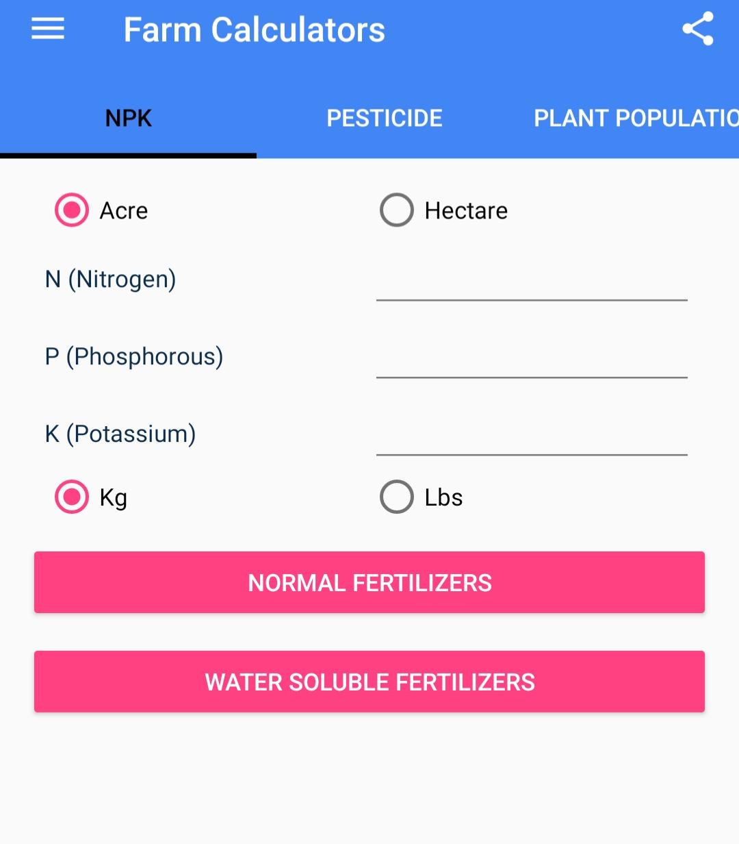
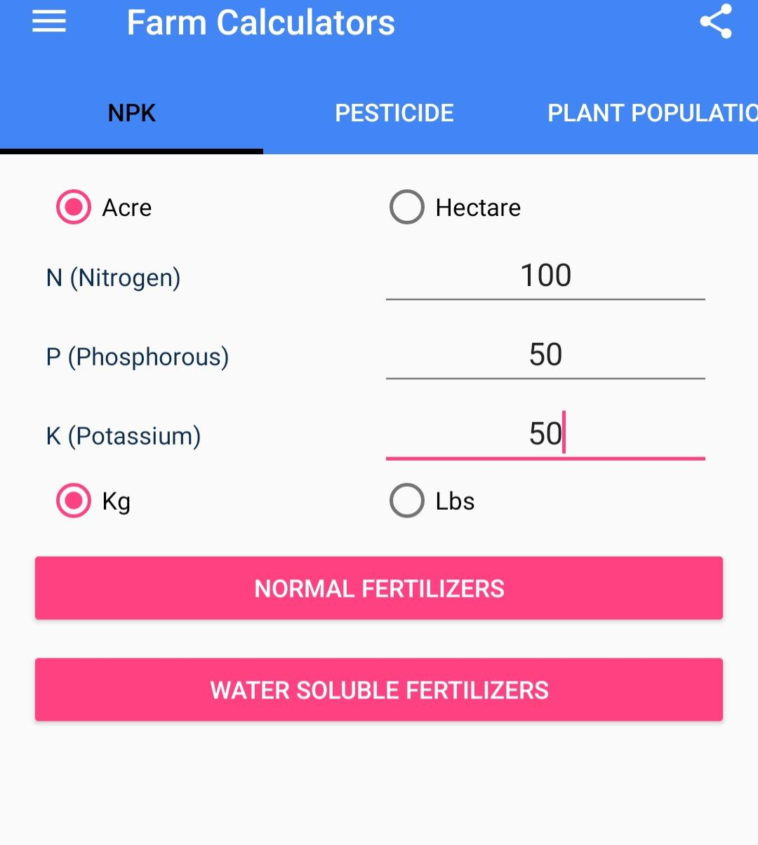
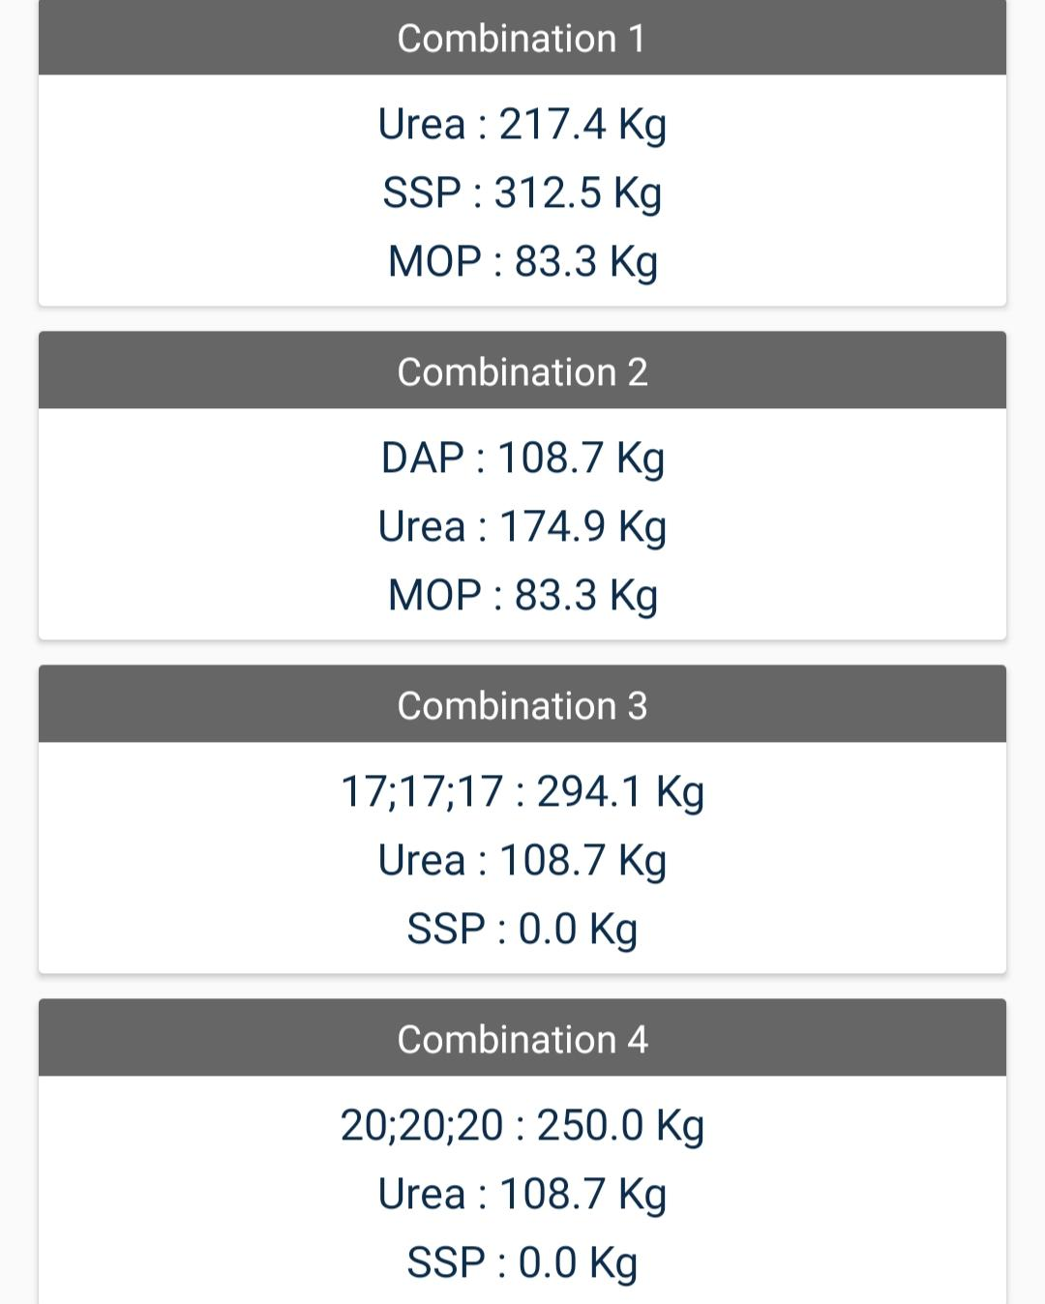
FARM CALCULATOR

Slide 33
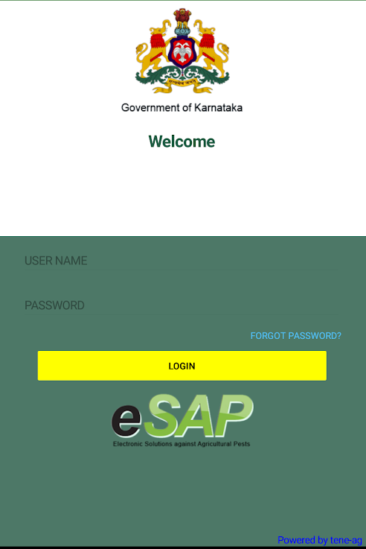

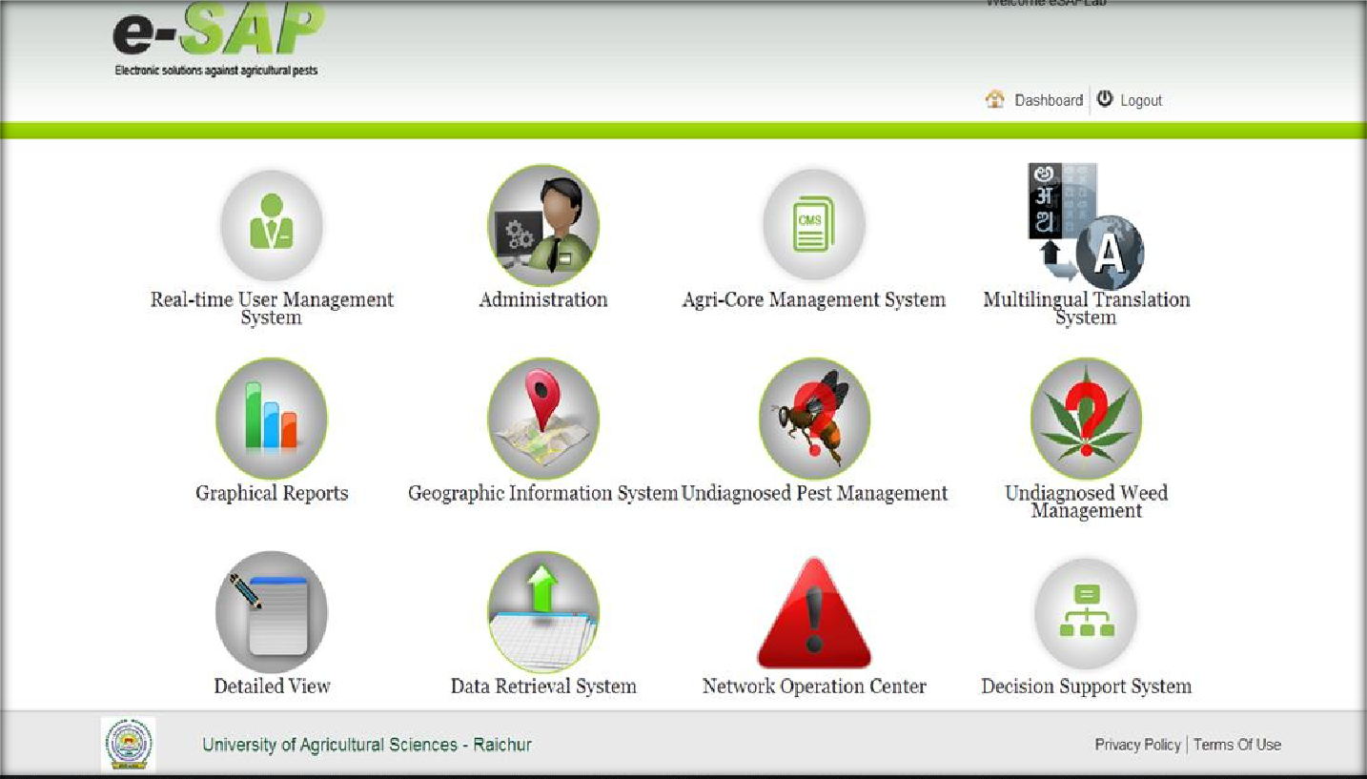

Slide 34
OTHER MOBILE APPLICATIONS DEVELOPED IN KARNATAKA
Mobile application | No.of downloads
Dishaank App | 1M+
Bhoomi (Karnataka) | 100K+
Bele Darshak Karnataka-2021-22 | 100K+
KKISAN | 50K+
Diary Kannnada | 10K+
Krishi Yantradhaare Driver app | 1K+
Source : https://play.google.com/

Slide 35
PRODUCTION TECHNOLOGY AND AGROADVISORY SERVICES
POPULAR MOBILE APPLICATIONS IN AGRICULTURE
MARKETING
9. IFFCO Kisan Agriculture
APEDA Farmer connect
Krishi Vigyan
12. Havaamaana Krishi (UASD)
Bhoomi Karnataka
eSAP
1. Kisan Suvidha
2.Pusa Krishi
3.Soil Health Card(SHC) Mobile App
4. CCE AGRI
5. Bhuvan Hailstorm
6. Crop Insurance
7. Plantix
1. eNAM
2. AgriMarket
3. Digital Mandi
4. Loop
ALLIED SECTOR APPS
CROP SPECIFIC APPS
1. Rice Xpert
2. Mobile App on Castor (ICAR-IIOR Castor)
3. Solapur Anar
4. Cane Advisor
Pashu Poshan
Diary Telugu and Diary Kannada
mKrishi Fishery App
Fisher Friendly Mobile Application (FEMA)
Source: Krishi gyan

Slide 36
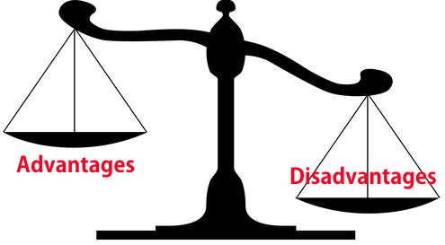
ADVANTAGES | DISADVANTAGES
All types of information on crops, soil, weather, climate, rainfall, seeds, animals and machinery at any point in time, and any number of times is available on finger tips of farmers (World Bank 2012). Information available is localized, thereby increasing the comfort and precision as required. Information is updated on regular basis Time saving Commodity prices can be delivered in a real time mode. | Non availability in regional languages. Farmers may not get updated and complete information due to : Network issues Speed of the data delivery Legal restrictions 3. Farmers may not be adequately equipped to afford and use the applications.

Slide 37

03

Slide 38

STARTUP
According to Department of Industrial Policy and Promotion (DIPP), an entity shall be considered as a Startup :
Up to 10 years from the date of its incorporation.
Incorporated as a private limited company or registered as a partnership firm or a limited liability partnership.
Turnover should be less than INR 100 Crores in any of the previous financial years
Working towards innovation/ improvement of existing products, services and processes and should have the potential to generate employment/ create wealth.
An entity formed by splitting up or reconstruction of an existing business shall not be considered a "Startup".

Slide 39
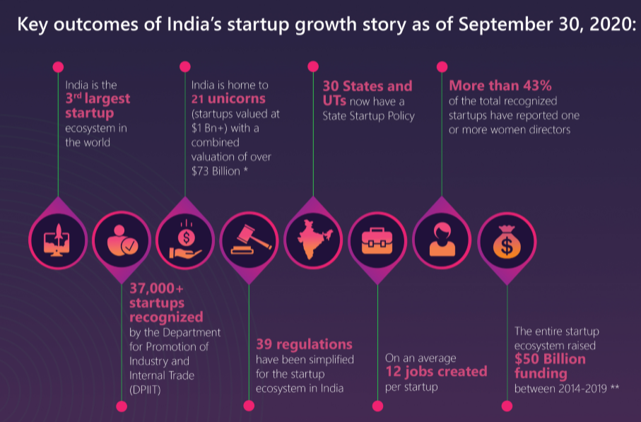
KEY OUTCOMES OF INDIA’S STARTUP GROWTH STORY
India
3rd largest
startup ecosystem in the world
India is home to 83 unicorns ( startups valued at$ 1Bn+) with a combined valuation of over $277.7 Billion*
30 States and UTS now have State Startup policy
More than 43% of the total recognized startups have reported one or more women directors
64,029
startups recognized by DPIIT
On an average 12 jobs created per startup
The entire startup ecosystem raised $50 Billion funding between 2014-20
39 regulations have been simplified for the startup
eco system in India
SOURCE: www.startupindia.gov.in ,National Startup Awards 2020 report, Economic survey report 2020-21

Slide 40


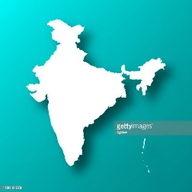

SCENARIO OF AGRI STARUPS
ECONOMIC SURVEY
2021-22.
INDIAN AGRITECH SECTOR– NASSCOM REPORT NASSCOM,2019
NO.OF AGRO TECH STARTUPS IN INDIA
(2022)
3.8% AGRI –STARTUPS
IN INDIA
EVERY 9TH AGRITECH STARTUP IN THE WORLD IS FROM INDIA
1822
Source:https: www.startupindia.gov.in, https://tracxn.com/explore/AgriTech-Startups-in-India

Slide 41


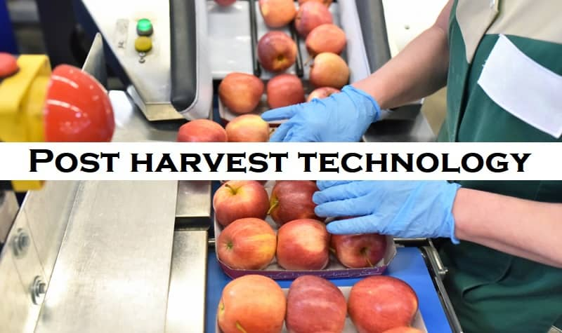
Agritech Startup opportunities in Indian agriculture
Provides them financial, agricultural and government-related services based on their crops and crop cycle
Offering farming services and machinery on rent for reducing capex and increasing affordability
-Offering technologies and machineries for cleaning, sorting and processing crops at farm
-Cold storage to reduce wastage and increase shelf life of food items

Slide 42

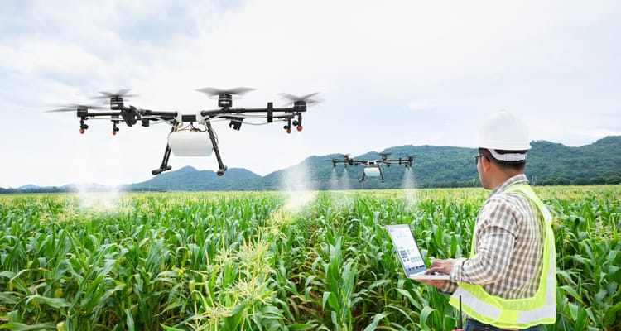

Providing remotely operated machines, operating with greater precision
Providing facilities such as use of nanoparticles
Facilitating application of precise amount of inputs

Slide 43
Startups connecting farmers with output market
Big basket (Unicorn) Udaan Ninja cart (Soonicorn) Zopnow Jumbo tail Aibono Clover ventures Teabox Daily ninja Smerkato Atomaday LivLush Brownsoil Grofers (Soonicorn) Waycool DeHaat Bijak Shop Kirana Tokri Milkbasket
Startups enabling procurement of quality inputs
Agrostar (Soonicorn) Kethinext Gramophone Marut Drones LeanAgri BharatAgri BigHaat A-One seed wholesale Terra Agro biotech Agriapp Smartfarms FarmGuru Behtar Zindagi Unnati
Startups helping efficient mechanization, irrigation and financial services
Mechanisation Farmart EM3Agriservices RAVGO Trringo Irrigation Flybird Intech harness Sense It Out Kisan Raja Satyukt Kritsnam technologies Financial Services Jaikisan SG Agtech Innovations Safal Fasal Niruthi Technology Gramcover Satsure
Source : Indian Journal of Agricultural economics, 2020

Slide 44
Startups helping in Post Harvest Management & FAAS
Post Harvest Management Ecozen solutions SaptaKrishi New Leaf Dynamic technologies AgriGator Star Agriware housing and collateral management Arya collateral Warehousing services
Startup for crop health and output
CropIn Intello Labs Jivabhumi AS agri system Tartan Sense FarmERP Agricx qZenselab AgNext RAAV techlabs Onewater AmviCube Farmbee AgTech Namma-Uzhavan Agrojay My crop technologies
Startups helping in Animal husbandry
Licious (Soonicorn) Fresh to home (Soonicorn) INCEVE Krishimanshi Zappfresh Caprabook Eggoz PoultryMon Aquaconnect Stellapps Country delight PromptACMS Meri Dairy Farmery Eruvaka TAG
Source : Indian Journal of Agricultural economics, 2020

Slide 45

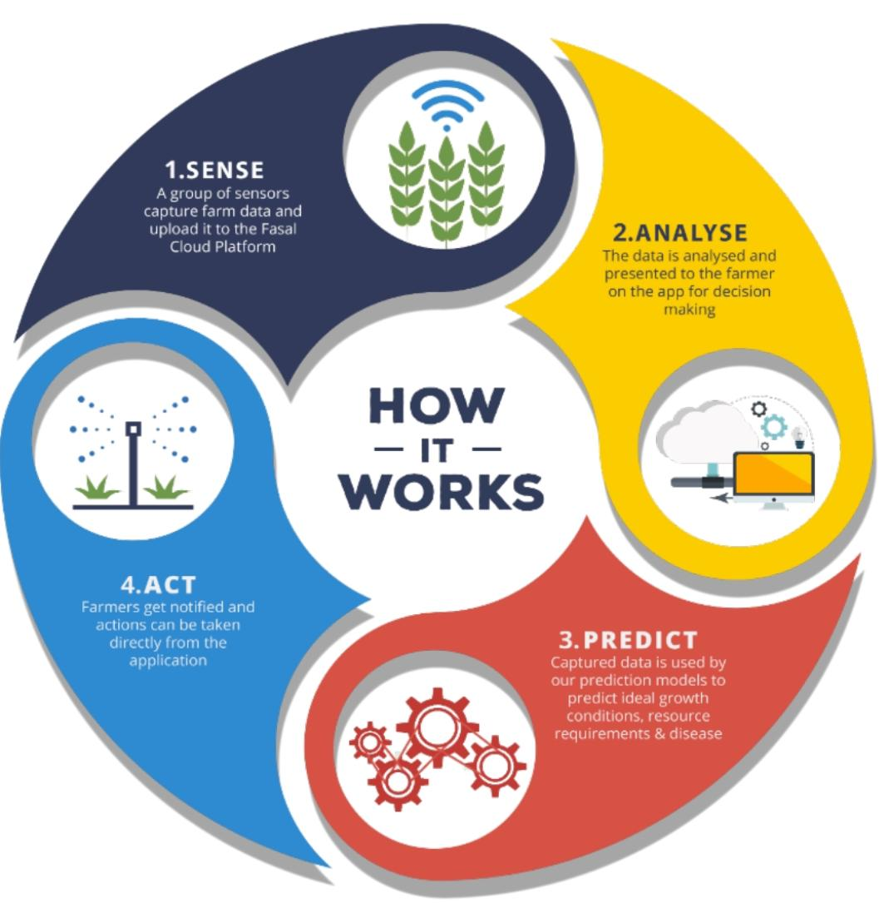
FASAL- CLIMATE SMART PRECISION AGRICULTURAL SOLUTION
Founded- 2018
Headquarters- Bengaluru, Karnataka
Objective- To increase and improve the quality of per acre yield

Slide 46

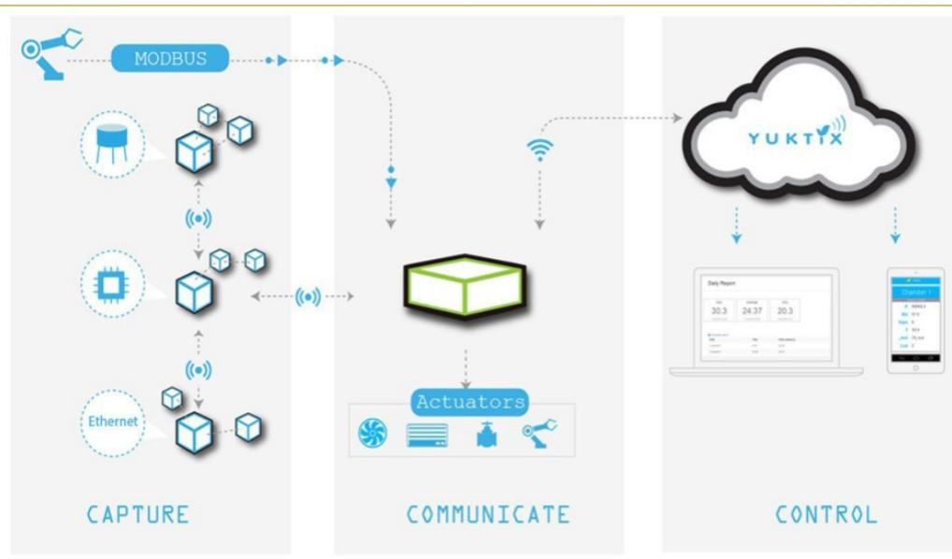
YUKTIX Technologies
Founded- 2013
Headquarters- Bengaluru, Karnataka
Objective- Providing hardware to farmers to reduce the post harvest losses by measuring indoor environment of cold storages and warehouse

Slide 47
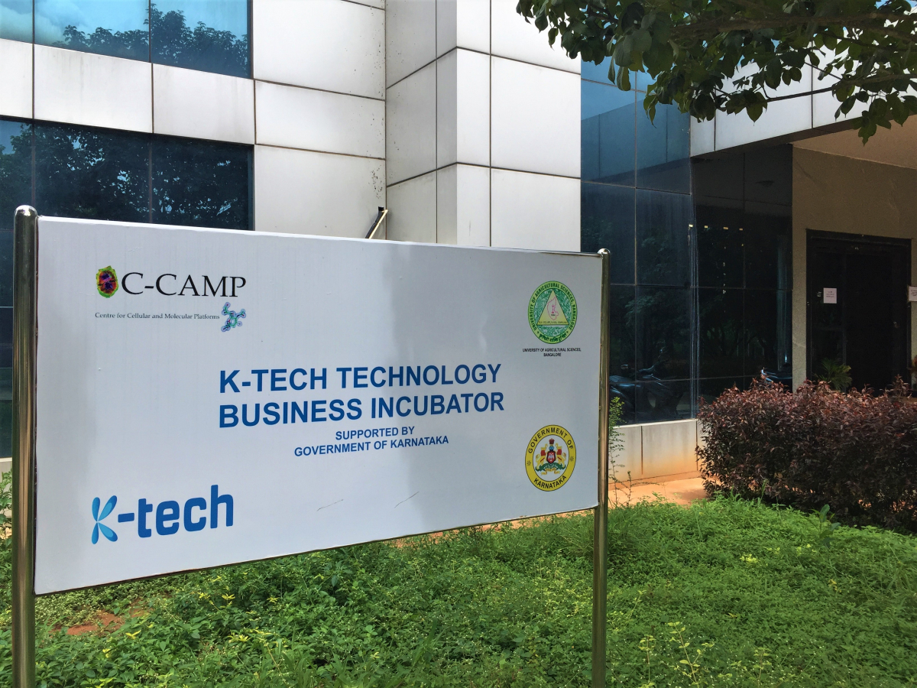
UAS(B) - C- CAMP
Agri Innovation centre
Nurture agricultural innovation and entrepreneurship
Foster cutting-edge innovations in the agri-sector leading to economic development
Enable innovative research with commercialization potential in the agri-sector
Serve as knowledge centre and repository of Biological materials
OBJECTIVES

Slide 48
Four models of the incubation centre
In-House Incubates with requirement of lab facilities
In-House Incubates without requirement of lab facilities
In-House student Incubates with requirement of lab facilities
External registrant incubates

Slide 49
FUNCTIONS OF AGRI INNOVATION CENTRE
UASB Agri Innovation centre
C-CAMP (Ktec, TBI, GoK)
UAS-B initiatives
Collaborations with other Incubation center
BBC
SID, IISc
Common Incubation Center Rural Agripreneurship through sub campuses
Rural Incubation Centre NABARD (under process)
Mandya
BioNEST AIC ( Funded by BIRAC, GOI)
Hassan
Chintamani
Chamarajanagara

Slide 50
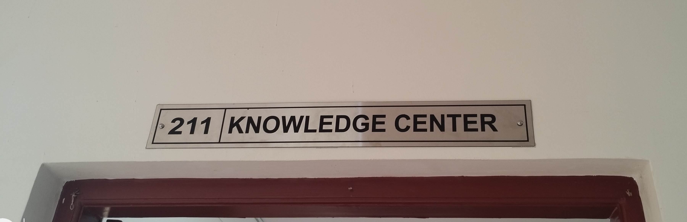
KNOWLEDGE CENTRE AND ITS FOCUS
Data Mining
Data linking and Enrichment
Storage and Repository
Querying and Interfacing
National wide access and effectiveness
Visualizing and authorizing

Slide 51
Thematic areas of the Centre
Organic farming
Training and skill development
Biotechnology, tissue culture, diagnostics, transgenic, molecular breeding
Agricultural microbiology- biocontrol, bio fertilizers, composting
Plant breeding and seed production, mushroom cultivation
Nutrient formulations and agro chemicals
Value additions in food products
Agricultural equipment's

Slide 52



AGRIBUSINESS INCUBATORS IN INDIA
No.of agri business incubators in India : 100
PUSA KRISHI INCUBATOR
(ICAR-IARI)
iHUB
(ICRISAT)
a- IDEA
(NAARM)
CIIE
(IIM, Ahemedabad)
CrAdLE
(EDII, Ahmedabad)
ISEED
(IRMA)
NSRCEL
(IIM,BANGLORE)
C-CAMP
(BANGLORE)
Source: Indian Farming,2020

Slide 53

Rate of return on technology investment has not been proven very profitable
Facilitating the adoption of proven technologies through subsidy is yet to gain momentum
High-priced technology solutions are unaffordable
Difficult to retain technical
talent working
Making farmers adaptive to the required skills for working on advanced technologies requires significant effort
Technology adoption and penetration is a very slow process which certainly diminishes investors’ interest.

Slide 54



04
UNION BUDGET OF 2019-20
Central Sector Scheme of “Formation and Promotion of 10,000 Farmer Producer Organizations(FPOs)” to form and promote 10,000 new FPOs till 2027-28.
YEARS | Total budgetary provision
2019-20 to 2023-24 | Rs.4,496 crore
2024-25 to 2027-28 | Rs. 2,369 crore
TOTAL | Rs. 6,865 crore

Slide 55
STATE WISE FARMER PRODUCER ORGANIZATIONS
S.No | STATE | Registered FPOs
1 | Karnataka | 578
2 | Maharastra | 569
3 | Madhya pradesh | 550
4 | Telangana | 460
5 | Uttar Pradesh | 450
6 | Odisha | 447
7 | Tamil Nadu | 410
8 | West Bengal | 404
9 | Andhra Pradesh | 399
10 | Bihar | 356
 | TOTAL | 7059
SOURCE : PIB 2022

Slide 56


INPUT SUPPLY SERVICES
TECHNICAL SERVICES
SERVICES
MARKETING SERVICES
NETWORKING
SERVICES
FINANCIAL
SERVICES

Slide 57
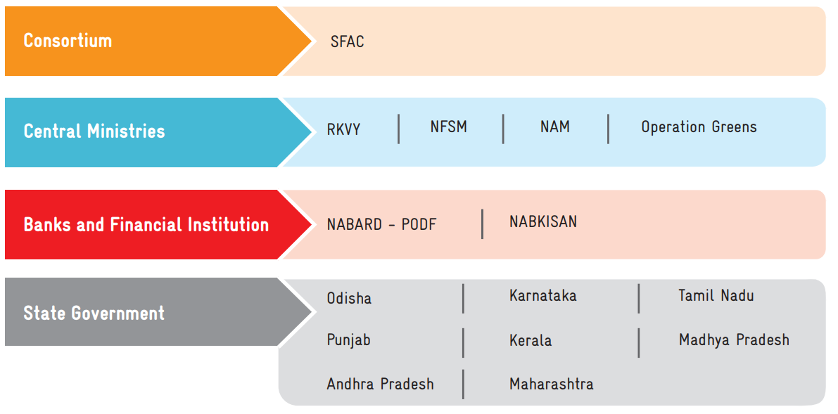

SCHEMES FOR SUPPRTING FPO
Equity Grant Fund Scheme
Credit Guarantee Fund Scheme
Venture Capital assistance scheme
CONSORTIUM
SFAC
CENTRAL MINISTRIES
RKVY-RAFTAAR
NFSM
NAM
OPERATION GREENS
STATE GOVERNMENT

Slide 58

Reduction of cost of production
Reduce marketing cost.
Access to modern technology, extension services and joint training on Good Agricultural Practices (GAP).
Post-harvest losses can be minimised through joint storage and value addition facilities.
Adverse price fluctuations and distress sale can be managed.
Ease in communication for dissemination of information about farming-related advisories.
Access to institutional credit against stock, without collateral.
Greater bargaining power to farmers and greater quality orientation in production and processing activities.

Slide 59

Difficulty and delay in mobilization of farmers
Limited organizational and management capacity
Need for incubation and handholding support to FPOs
Membership base
Limited capability to autonomously invest in primary/ secondary processing, storage and custom hiring facilities.
Inability to access institutional credit sans collateral.

Slide 60

KISSAN CALL CENTRE | 1800-180-1551
ATIC- IARI | 1800-11-8989
ATIC - BENGALURU | 1800-425-0571
IMD Weather on Web | 1800-180-1717
Crop Insurance Schemes -ICICI Lombard | 1800-2666
Crop Insurance Schemes-IFFCO | 1800-103-5499
Crop Insurance Schemes-Reliance general | 1800-3009
Crop Insurance Schemes-Royal Sundaram | 1860-425-0000
Crop Insurance Schemes -TATA AIG Insurance | 1800-266-7780
National helpline for farmers by Bayer-Crop science | 1800-120-4049
Karnataka State Department of Agriculture Helpline Number | 1800 425 3553
All India Agri Transport Call Centre | 1800 180 4200 and 14488
05
02
TOLL FREE
NUMBERS

Slide 61
-Launched on January 21, 2004 by Ministry of Agriculture to deliver extension services to the farming community
-The purpose of call centers is to respond to issues raised by farmers, instantly in the local language.
K
C
C
Facilitation skill
Speak in farmers language
Diagnose the problem by probing into details
Computer skills
Basic knowledge of key board and mouse
Basic knowledge of internet
Communication skill
Answering the query at level of farmers knowledge
Empathize with the farmer
Listen actively for the content
Avoid defensiveness in conversation
Avoid use of unnecessary and complex words
Close call with greetings
Sending and receiving emails
SKILLS

Slide 62
Kissan Call Centres Locations And Languages
Sl.No | Location | States/ Uts Covered | Language
1 | Guntur | Andhra Pradesh | Telugu
2 | Hyderabad | Telangana | Telugu
3 | Patna | Bihar | Hindi
4 | Ranchi | Jharkhand | Hindi
5 | Jaipur | Delhi, Rajasthan | Hindi
6 | Ahmedabad | Gujarat, Dadra &Nagar Haveli, Daman & Diu | Gujarathi
7 | Chandigarh | Punjab, Chandigarh Haryana | Punjabi Hindi/Haryanvi
8 | Solan | Himachal Pradesh | Hindi
9 | Jammu | Jammu & Kashmir | Dogri, Kashmiri, Ladakhi
10 | Bengaluru | Karnataka | Kannada
11 | Trivandrum | Kerala, Lakshadweep | Malayalam
12 | Jabalpur | Madhya Pradesh | Hindi
13 | Raipur | Chattisgarh | Hindi
14 | Pune | Maharashtra Goa | Marathi Konkani,Marathi
15 | Coimbatore | Tamil Nadu, Pondicherry | Tamil
16 | Kanpur | Uttar Pradesh | Hindi
17 | Dehradun/ Pant Nagar | Uttarakhand | Hindi
18 | Kolkata | West Bengal Sikkim Andaman Nicobar | Bengali Sikkimese, Nepali, Hindi Bengali, Tamil, Hindi
19 | Bhuvaneshwar | Odisha | Oriya
20 | Guwahati | Arunachal Pradesh Assam Manipur Nagaland | Adi Assamese Manipuri Nagamese
21 | Agartala | Tripura Mizoram Meghalaya | Bengali Mizo Khasi, Garo, Jayantia
SOURCE:agricoop.nic.in

Slide 63
LIST OF NODAL AGENCIES
Sl. No | Locations | Nodal agency
1 | Mumbai | The director Incharge, Director of Cotton Development
2 | New Delhi | Managing Director, National Cooperative Development cooperation
3 | Cochin | Coconut development officer, Coconut development Board
4 | Bangalore | Director, Coconut development board
5 | Hyderabad | Director General, MANAGE
6 | Chennai | Director, Coconut development board
7 | Ghaziabad | Director, Director of Wheat development, Ghaziabad
8 | Jaipur | Director General, NIAM
9 | Gurgaon | Managing director, NHB
10 | Bhopal | Director In-charge, Directorate of pulse research
11 | Kolkata | Director, Directorate of Jute development
12 | New Delhi | Managing director, SFAC
13 | Guwahati | Central Integrated Pest Management Centre, Guwhati

Slide 64
No.of calls received in KCCs from 2018 -19 to 2020-21
Sl.No | State | 2018-19 | 2019-20 | 2020-21
1 | Andaman & Nicobar | 37 | 2035 | 3301
2 | Andhra Pradesh | 92658 | 149356 | 171230
3 | Arunachal Pradesh | 816 | 744 | 1198
4 | Assam | 27287 | 26028 | 23189
5 | Bihar | 263799 | 379166 | 336394
6 | Chandigarh | 764 | 0 | 0
7 | Chattisgarh | 41798 | 82642 | 87039
8 | Dadar & Nagar Haveli | 25 | 0 | 0
9 | Daman & Diu | 13 | 6090 | 334
10 | Delhi | 34536 | 71287 | 90109
11 | Goa | 155 | 1 | 0
12 | Gujarat | 204323 | 299257 | 283866
13 | Haryana | 305446 | 391973 | 343793
14 | Himachal Pradesh | 50299 | 52834 | 43829
15 | Jammu Kashmir | 78918 | 100158 | 77635
16 | Jharkand | 16091 | 52220 | 43703
17 | Karnataka | 219037 | 230125 | 211608
18 | Kerala | 22976 | 34599 | 33866
19 | Lakshadweep | 7 | 4 | 0

Slide 65
20 | Madhya Pradesh | 369550 | 445027 | 459337
21 | Maharashtra | 528241 | 713790 | 560854
22 | Manipur | 1300 | 772 | 1691
23 | Meghalaya | 573 | 355 | 763
24 | Mizoram | 147 | 261 | 621
25 | Nagaland | 114 | 261 | 621
26 | Orissa | 172606 | 168918 | 185280
27 | Pondicherry | 876 | 0 | 0
28 | Punjab | 264549 | 355577 | 275590
29 | Rajasthan | 670883 | 680711 | 553193
30 | Sikkim | 1512 | 2607 | 2702
31 | Tamil Nadu | 190984 | 186054 | 191048
32 | Telangana | 99454 | 111498 | 124832
33 | Tripura | 2816 | 2012 | 3940
34 | Uttar Pradesh | 1034906 | 1292154 | 1180640
35 | Uttarakhand | 34010 | 60956 | 63619
36 | West Bengal | 117118 | 152092 | 118779
 | TOTAL | 4848624 | 6052767 | 5474446
source:PIB

Slide 66
Agricultural Technology Information Centre (ATIC)
To render farm advisory services to solve problems
To offer single window system
To disseminate technical information through ICT tools
To establish mechanism to get the feedback
To provide agriculture improved technologies through publications
MANDATES

Slide 67

07 SOCIAL MEDIA

Slide 68


SOCIAL MEDIA IN SCALING UP OF AGRO-TECHNOLOGY
Posts on new technologies and information
Technical platform for agricultural trade
Regular information on modern technological development may be shared and tagged with other related accounts for wider access.
Live telecast of different activities of the departments may be done.

Slide 69
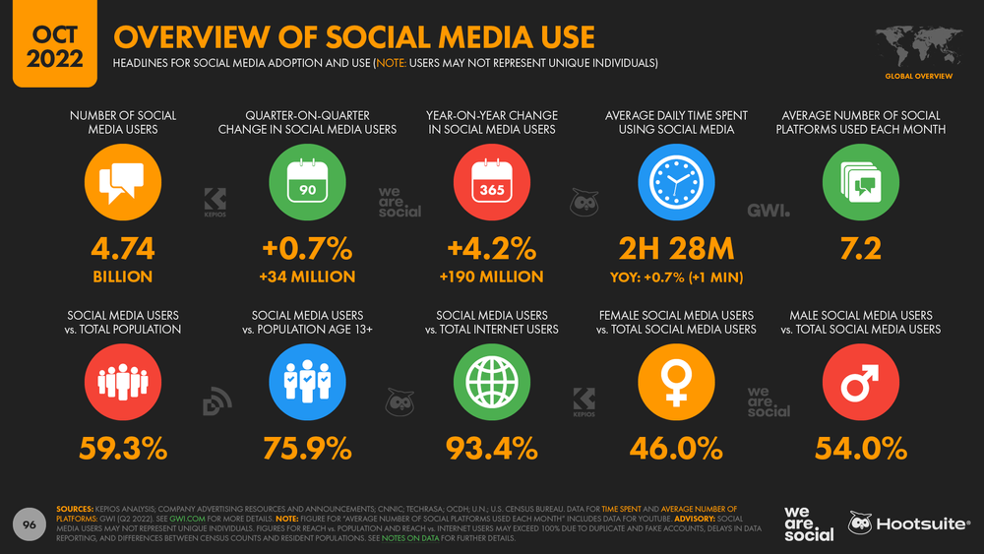

Slide 70
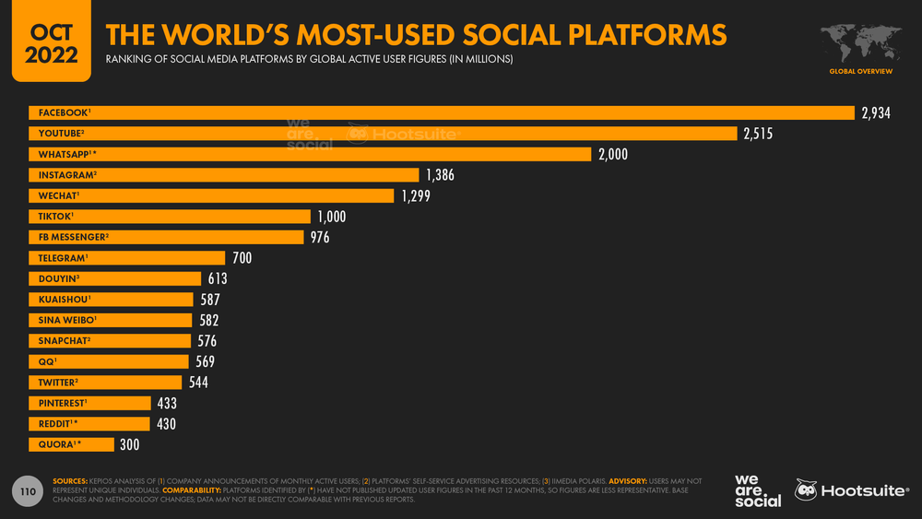

Slide 71



FAO
(https://www.facebook. com/UNFAO/?ref=mf)
ICRISAT
(https://www. facebook.com/ICRISAT )
CIMMYT
(https://www.facebook. com/CIMMYT)
CIP
(https://www.facebook.com/ifpri.org/)
Bioversity International
(https://www.facebook.com/bioversityinternational)
World Food Programme
(https://www.facebook.com/WorldFoodProgramme)
YPAR
(https://www.facebook.com/ YPARD/)
GRFAS
(https://www.facebook.com/groups/ gfras/)
World Farmers Organisation
(https://www.facebook.com/worldfarmersorg)
SAARC Agriculture Centre
(https://www.facebook.com/saarcagri/)
Agricultural Extension in South Asia
(https://www.facebook.com/ groups/428431183848161/)
Peterson Farm Bros
(https://www.youtube.com/user/ThePetersonFarmBros)
Kissan Kerala
(https:// www.youtube.com/user/ kissankerala)
Digital Green
(https:// www.youtube.com/user/ digitalgreenorg)
Green TV
(https:// www.youtube.com/user/ Greentvindia1)
e-Agriculture (https://twitter.com/e_ agriculture)
YPARD (https://twitter.com/YPARD)
AgChat (https://twitter.com/ agchat)
IFFCO (https://twitter.com/ IFFCO_PR)
Agriculture India (https:// twitter.com/AgriGoI)
SOURCE : Extension Next, MANAGE, 2017

Slide 72
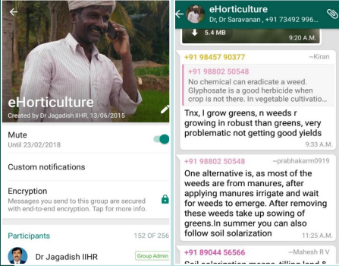

13th June, 2015
Indian Institute of Horticulture Research (IIHR), Bengaluru
152 members and two administrators.
Experts of IIHR generally reply to the queries posted by farmers.
Pictures were the most used media followed by URLs to web contents, documents, videos and audio files

Slide 73
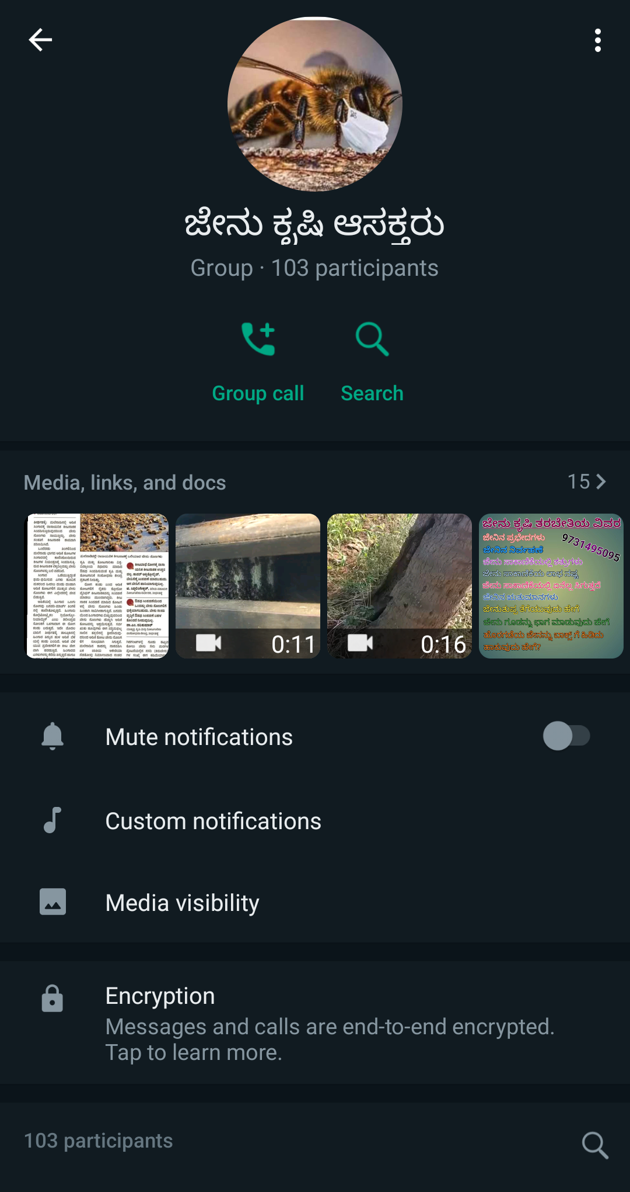

December, 2020
Videos and images are the most popular media used followed by URL to web contents, documents and audios

Slide 74


ADVANTAGES OF SOCIAL MEDIA
Highly cost effective
Location and client specific, problem-oriented
User-generated content
Easily accessed from mobile phones
Increases internet presence of extension organizations and their client reach
Democratization of information by making it accessible to all
Can measure reach and success by tracking number of visitors, friends, followers, mentions, Facebook ‘likes’, conversation index and number of shares

Slide 75


Ensuring participation
Quality control and monitoring of posts
Internet and IT infrastructure issues
Satisfying heterogeneous users
Difficulty in measuring the impact.
Allocating time to update content.
Continuous engagement
CHALLENGES

Slide 76

RESEARCH STUDIES
ON DELIVERY SYSTEM

Slide 77

IMPACT OF KISAN CALL CENTRE (KCC) SERVICES IN KOLAR DISTRICT
Srikanth Chowadry, L.V., 2016
Kolar, Karnataka
Ex post facto research design
Simple random sampling
SAMPLE SIZE
90
RESEARCH STUDY 1

Slide 78
Table 1 : Statements-wise analysis of knowledge gained by the farmers with respect to agriculture (n=90)
Sl.No | Benefits | Before | After | Gain
1 | Do you have knowledge about Rragi threshing and dehusking machine | 42.2 | 75.5 | 33.3
2 | Disease and pest management practices in Ragi | 35.5 | 80.0 | 44.5
3 | Information about blast management in ragi | 40.0 | 84.4 | 44.4
4 | Knowledge about bio-pesticide and bio-fertilizer usage | 23.3 | 76.6 | 53.3
5 | Information about high yielding varieties in ragi and pigeon pea | 47.7 | 84.4 | 36.6
6 | Information on crops to be taken up in a particular season | 10.00 | 37.7 | 27.7
7 | Knowledge on late blight disease management practices in potato crop | 20.00 | 53.3 | 33.3
8 | Information on crops to be taken up in a particular season | 70.00 | 84.4 | 14.4
9 | Information on sources of credit availability | 25.5 | 74.4 | 48.9
10 | Do you know about crop insurance scheme | 42.2 | 74.4 | 32.2
11 | Knowledge on land preparation and cultural practices | 67.7 | 85.5 | 17.8
12 | Do you know the exact seed rate and recommended depth of sowing | 65.0 | 75.0 | 10.0
13 | Knowledge about availability and optimum fertilizer usage | 21.1 | 42.2 | 21.1
14 | Knowledge regarding split application of N fertilizers | 17.7 | 63.3 | 45.6
15 | Do you possess any informations regarding organic farming | 14.4 | 33.3 | 18.9
16 | Knowledge about weather conditions | 37.7 | 66.6 | 28.9
17 | Knowledge about prevailing market practices | 41.1 | 62.2 | 21.1

Slide 79
Table 1 : Statements-wise analysis of knowledge gained by the farmers with respect to horticulture (n=90)
Sl.No | Benefits | Before | After | Gain
1 | Do you have knowledge about beekeeping | 20 | 57.7 | 37.7
2 | Information about cold storage facilities | 14.4 | 45.5 | 31.1
3 | Do you know about floriculture and landscaping | 17.7 | 54.4 | 36.6
4 | Knowledge regarding different government schemes | 35.5 | 74.4 | 38.9
5 | Do you possess knowledge regarding mushroom production | 13.3 | 37.7 | 24.4
6 | Do you have knowledge regarding nursery management practices | 41.1 | 72.2 | 31.1
7 | Knowledge of late blight disease management practice in tomato crop | 17.7 | 47.7 | 30
8 | Knowledge about fruit borer management in tomato | 12.2 | 76.6 | 64.4
9 | Do you have knowledge about diamond back moth management practices in cucurbits | 24.4 | 46.6 | 22.2
10 | Do you have knowledge about using trap crops in pest management | 21.1 | 30.00 | 11.1
11 | Do you know the management practices of bunchy top and panama wilt disease in banana crop | 12.2 | 41.1 | 28.9
12 | Do you have knowledge about stem bleeding and its control measure in coconut | 21.1 | 52.2 | 31.1
13 | Knowledge of coconut mite and its management | 11.1 | 57.7 | 35.5
14 | Knowledge about vegetative propagation and tissue culture | 52.2 | 35.5 | 24.4
15 | Do you know about post harvest management practices | 41.1 | 57.7 | 16.6
16 | Do you have knowledge about micro and drip irrigation | 52.2 | 64.4 | 12.2
17 | Information regarding grading and value addition | 34.4 | 63.3 | 28.9
18 | Do you have knowledge about marketing medicinal and aromatic products | 7.77 | 35.5 | 27.73

Slide 80
Table 3 : Statements-wise analysis of knowledge gained by the farmers with respect to animal husbandry (n=90)
Sl.No | Benefits | Before | After | Gain
1 | Do you have knowledge about artificial insemination | 34.4 | 87.7 | 53.3
2 | Information about animal breeding | 41.1 | 77.7 | 36.6
3 | Do you know about high yielding milch animal breeds | 48.8 | 84.4 | 35.5
4 | Disease management practices in goat and sheep | 22.2 | 70.00 | 47.8
5 | Information on foot and mouth disease control in cattle | 12.2 | 76.6 | 64.4
6 | Do you have knowledge regarding cattle shed planning and its management | 71.1 | 92.2 | 21.1
7 | Do you have knowledge about animal insurance | 32.2 | 46.6 | 14.4
8 | Knowledge on sources of credit availability | 31.1 | 40.00 | 8.9
9 | Information about animal nutrition | 54.4 | 63.3 | 8.9
10 | Do you have knowledge about processing of livestock products | 10.00 | 23.3 | 13.3

Slide 81
Table 4: Overall gain knowledge of farmers through KCC services (n=90)
Sl.No | Overall benefit categories | Before |  | After |  | Gain In knowledge | Paired t value
 |  | Mean | SD | Mean | SD
1 | Agriculture | 6.21 | 1.05 | 8.93 | 0.97 | 44.08 | 18.21**
2 | Horticulture | 4.42 | 0.59 | 6.72 | 0.77 | 52.08 | 19.88**
3 | Animal husbandry | 4.83 | 0.51 | 6.95 | 0.60 | 51.76 | 25.34**
**- Significant at 0.001 level

Slide 82
ANALYSIS OF STAKEHOLDERS TOWARDS E-SAP-AN ICT TOOL FOR PEST MANAGEMENT- AN EMPERICAL STUDY
Marradi et al., 2019
Northeastern region of Karnataka (NEK)
Ex post facto research design
Simple random sampling
SAMPLE SIZE
384
RESEARCH STUDY 2

Slide 83

Table 1 : Overall perception of farmers towards e-sap
(n=384)
(< 42.04)
(42.04 - 45.95)
(> 45.95)

Slide 84
(n=384)
Table 2: Statement wise perception mean score of farmer and field facilitator about e-sap
Sl. No | Statements | Mean score
 |  | Raichur | Gulbarga | Yadgir | Bellary | Total
1 | e-sap makes the pest and disease identification and diagnosis easier | 2.29 | 2.59 | 2.77 | 2.75 | 2.58
2 | e-sap provides latest and updated information in pest management | 2.04 | 2.50 | 2.00 | 2.39 | 2.26
3 | When new pest or disease is observed it is difficult to get timely solution through e-sap | 1.93 | 2.14 | 1.66 | 2.03 | 1.96
4 | e-sap provides timely information for the pest or disease identified | 2.28 | 2.56 | 2.68 | 2.59 | 2.52
5 | e-sap provides reliable and specific information on pest and disease management | 2.41 | 2.32 | 2.59 | 2.57 | 2.45
6 | e-sap is user friendly as it contains multimedia content | 2.23 | 2.26 | 2.61 | 2.63 | 2.40
7 | e-sap reduces the injudicious use of pesticides by farmers | 2.27 | 2.73 | 2.50 | 2.52 | 2.52
8 | e-sap provides opportunities for interaction with experts | 2.33 | 2.32 | 2.62 | 2.72 | 2.47
9 | e-sap provides opportunity for expressing opinion of farmers | 1.90 | 2.29 | 2.22 | 2.52 | 2.22
10 | e-sap provides information in local language and recommendations from e-sap are easy to understand and adopt | 2.34 | 2.48 | 2.59 | 2.67 | 2.51
11 | It reduces the cost of pest and disease management through relevant solution | 2.22 | 2.60 | 2.51 | 2.58 | 2.48
12 | e-sap enhances the rapid dissemination of pest management technologies | 2.31 | 2.40 | 2.70 | 2.63 | 2.49
13 | Information available from e-sap is credible in nature | 2.08 | 2.29 | 2.48 | 2.41 | 2.30
14 | Information on pest and disease can be accessed from anywhere and anytime | 2.26 | 2.33 | 2.59 | 2.67 | 2.43
15 | e-sap should be extended to all parts of the state | 2.16 | 2.35 | 2.66 | 2.67 | 2.43
16 | e-sap helps in increasing the yield level of identified crops | 2.13 | 2.58 | 2.41 | 2.43 | 2.40
17 | e-sap helps to reduce the extent of damage by the identified pest | 2.22 | 2.59 | 2.59 | 2.65 | 2.51

Slide 85
A STUDY ON THE IMPACT OF FARMERS PRODUCER ORGANISATIONS ON ITS MEMBER RESPONDENTS IN PURI DISTRICT OF ODISHA
Dash., and Mazhar S. H, 2021
Puri
Odisha
Ex post facto research design
Proportional random sampling
SAMPLE SIZE
131
RESEARCH STUDY 3

Slide 86
Table 1 : Descriptive statistics of the development parameters
Sl.No | Overall benefit categories | Knowledge development | Technical development | Economic development | Social development
1 | Mean | 2.113 | 1.828 | 1.888 | 1.983
2 | Standard Deviation | 0.091 | 0.109 | 0.117 | 0.116
3 | Coefficient of variance | 0.192 | 0.199 | 0.220 | 0.231

Slide 87
Table 2 : Level of knowledge development, technical development, economic development and social development of respondents
(n=131)
Sl.No | Overall benefit categories | Level of Knowledge development |  | Level of technical development |  | Level of economic development |  | Level of Social development
 |  | Freq | % | Freq | % | Freq | % | Freq | %
1 | Low (<Mean-SD) | 15 | 11.45 | 19 | 14.50 | 19 | 14.50 | 28 | 21.37
2 | Medium (Mean± SD) | 86 | 65.65 | 100 | 76.34 | 89 | 67.94 | 85 | 64.89
3 | High (>Mean+SD) | 30 | 22.90 | 12 | 9.16 | 17.56 | 17.56 | 18 | 17.34

Slide 88

CONCLUSION

Slide 89

Thank You

