Slide 1
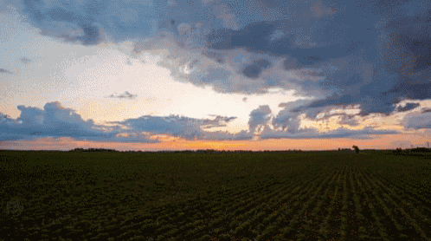
WELCOME
1

Slide 2

CBBOs – Game Changer in Formation and Promotion of FPOs
Shalini R
PAMB 1152 (Sr. M.Sc.)
Department of Agricultural Extension
UAS , GKVK , Bengaluru - 560065
2

Slide 3

OBJECTIVES
To know the concept of CBBOs
2. To understand the implementation mechanism of Central sector scheme of 10,000 FPOs.
3.To review Case studies on CBBOs
3

Slide 4

INTRODUCTION
4

Slide 5


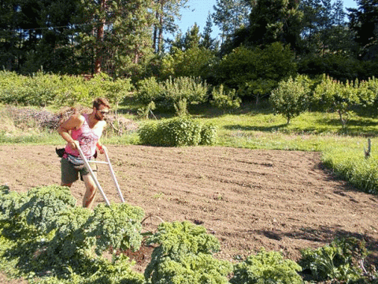

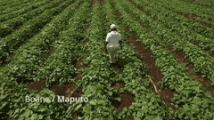
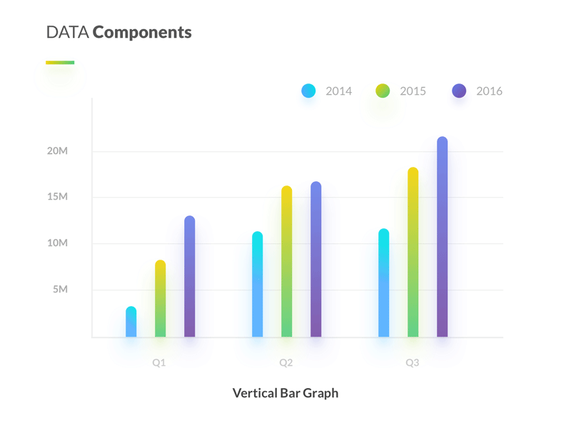

5

Slide 6



Reduce cost of production, processing & marketing
Cushion impact of price fluctuation
Improve market access
Significant influence on policy to ensure access to funds
Likely benefits of Aggregation
Minimize post harvest losses
Likely Benefits of Aggregation
Bring in professional management
Ensure regular supply of produce
Quality control
Mitigate risk
Improve bargaining power
Build social capital
Improve access to financial resources against stock & collaterals
6

Slide 7
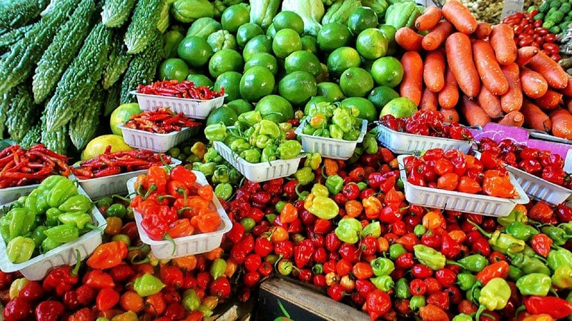
Mode of aggregation
SHGs
FPOs
Federation
JLGs
7

Slide 8
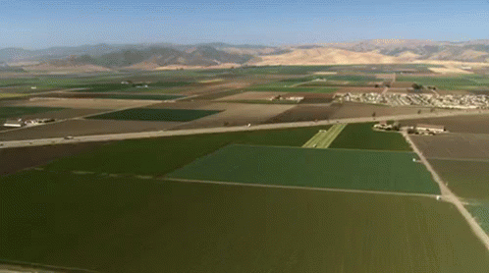

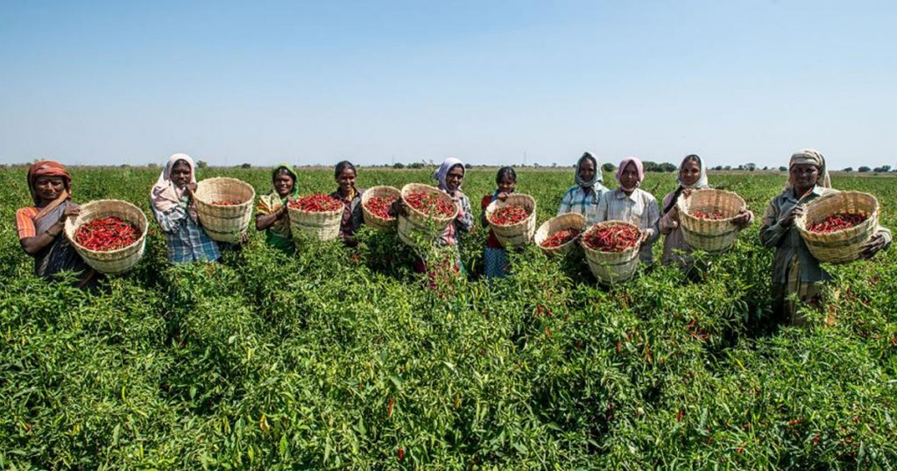
PRODUCER ORGANIZATION
8

Slide 9
Other legal forms
PACS
SHGs
FIGs
Producer companies
Farmers club
CBAs
9

Slide 10
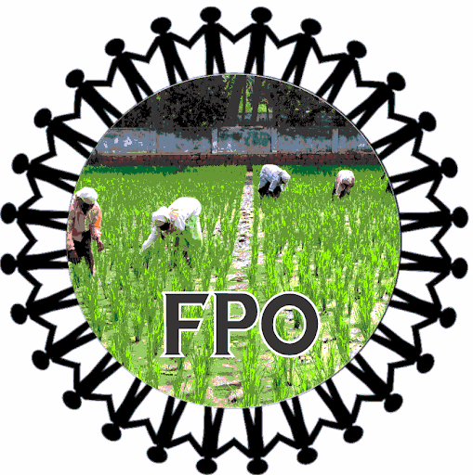
Central govt project initiative
Y K Alag committee - Alternative to Co-operatives
Hybrid b/w Co-operative societies & pvt ltd companies
Enhance Agril. Production , Productivity & Profitability
Values of self-help, self-responsibility, democracy, equality, equity & solidarity
Mainstream the idea of promoting & strengthening
10

Slide 11


FPO Legal forms
Producer Company under Section 581(C) of Indian Companies Act, 1956, as amended in 2013
Section 25 Company of Indian Companies Act, 1956, amended as Section 8 in
2013
Public Trusts registered under Indian Trusts Act, 1889
Multi–State Co–operative Society act , 2002
State
Co-operative Societies Act
11

Slide 12
Differences between FPO’s registered under Cooperative Act verses Producer Company Act
Particulars | Cooperative Societies Act | Companies Act
Objectives | Single Object | Multi-object
Area of Operation | Restricted, Discretionary | Entire Union of India
Membership | Individuals & cooperatives | Any individual, Group, Association, Producer of the goods or services
Share | Non-tradable | Not tradable but transferable limited to members on par value
Profit sharing | Limited dividends on share | Commensurate with volume of business
Voting rights | One member one vote but Govt. and Registrar of Cooperatives hold veto power | One member one vote. Members not having transaction with the company cannot vote
12

Slide 13
Particulars | Cooperative Societies Act | Companies Act
Government. Control | Highly patronized to the extent of interference | Minimal, limited to statutory requirements
Extent of Autonomy | Limited in real world scenario | Fully autonomous within the provisions of the Act
Reserves | Created, if there are profits | Mandatory to create every year
Borrowing Power | Restricted | More freedom and alternatives
Relationship with other corporates/ business houses/ NGOs etc. | Transaction based | PCs may subscribe to the share capital of, or enter into any agreement
13

Slide 14
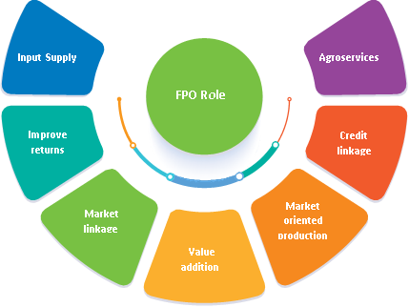
Role of FPO
FPO Role
Agro - services
Input supply
FPO Role
Input returns
Credit linkage
Market Oriented Production
Market linkage
Value
Addition
14

Slide 15
Activities of a Producer Organization
Production
Harvesting
Procurement
Marketing & Selling
Grading
Processing produce
Manufacture, sale /supply
Revitalization
Insurance
Transmission & distribution
Export of primary produce
Import of goods / services
Other allied or ancillary activities including financing there off
15

Slide 16
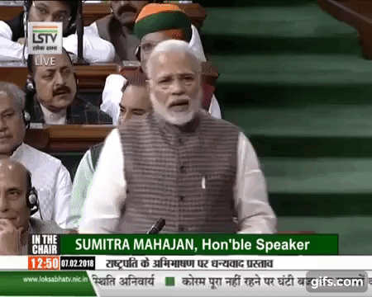

Government Initiatives
1. Equity Grant Scheme
Operated by the Small Farmers’ Agri-Business Consortium (SFAC).
Provide equity grants up to a maximum of Rs 15 lakh in two tranches.
2. Credit Guarantee Scheme
The scheme provides risk cover to banks that advance collateral-free loans to FPCs up to Rs 1Crore.
3. Central Sector Scheme of Formation and Promotion of 10,000 FPOs
16

Slide 17
Formation & Promotion of 10,000 FPOs
Central Sector Scheme of Rs. 4496.00 crore
For a period of 5 years (2019-20 to 2023-24)
CBBOs are set up by Implementing Agencies
FPOs are Formed & Promoted by CBBOs
Produce - Cluster area approach
Specialized – Commodity based approach
17

Slide 18
IAs
CBBOs
FPOs
FPOs
CBBOs
FPOs
N-PMAFSC
FPOs
NPMA
Formation & Promotion of FPOs
18

Slide 19
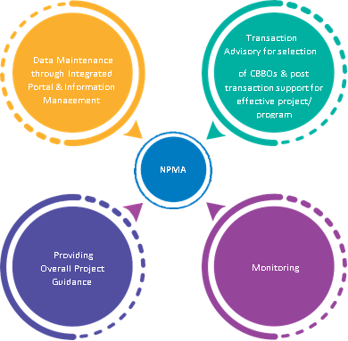
Data Repository
Transaction Advisory for selection of CBBOs
NPMA to be equipped with a technical team comprising five categories of specialists viz. Agriculture / Horticulture,
Marketing & Processing,
Incubation Service Provider,
IT/MIS and
Law & Accounting for providing overall guidance at All India level
NPMA
Providing overall project guidance
Monitoring
19

Slide 20

Functions of NPMA
Identification of target value chains.
Detailed SOPs for each stakeholder in the value chain.
Clusters to be choosen for FPO formation
National level Data Repository.
Serve as National platform for FPOs
Assist in facilitating and identifying National & State level Institutes.
Assist in linking /Undertaking MOUs with these institutes
20

Slide 21
IAs
CBBOs
FPOs
FPOs
CBBOs
FPOs
N-PMAFSC
FPOs
NPMA
Formation & Promotion of FPOs
21

Slide 22
Implementing Agencies (IAs)
    i. For promoting FPOs in uniform and effective manner three Implementing Agencies viz. NABARD, SFAC & NCDC have been identified.
NABARD
SFAC
NCDC
Promote FPOs registered under part IX A of companies act as also under Co -operative Societies Act of states.
Promote FPOs registered only under Co -operative Societies Act of states.
Promote FPOs registered only under part IX A of companies act
22

Slide 23




N
A
B
A
R
D
S
F
A
C
N
C
D
C
N
A
F
E
D
N
E
R
A
M
A
C
T
N
S
F
A
C
S
F
A
C
H
W
D
D
F
D
R
V
C
23

Slide 24
Role of Implementing Agencies
A. Identification of CBBOs
B. Provide fund to CBBOs & FPOs
C. Monitoring of CBBOs
D. Integrated National Level Data Repository
F. Developing tools for FPOs to assess
G. Coordination with concerned Value-Chain Organizations
24

Slide 25
Support available under the scheme for Implementing Agencies
Upfront amount computed @ 3% of estimated annual expenditure in the form of supervision changes.
Additional amount computed @ 2% based on their performance assessment
SFAC & NCDC
During 1st four quarters, No. of FPOs registered will be basis for assessment
After 1 year, Activeness of FPOs exhibited by their activities.
Sustainability of FPOs
Performance assessment criteria
25

Slide 26
IAs
CBBOs
FPOs
FPOs
CBBOs
FPOs
N-PMAFSC
FPOs
NPMA
Formation & Promotion of FPOs
26

Slide 27
Implementation & Monitoring Mechanism
National Level Project Management Advisory & Fund Sanctioning Committee (N-PMAFSC)
(Secretary, DAC&FW as Chairperson and JS (Mkt.), DAC&FW as Mem.Sec)
State Level Consultative Committee (SLCC)
(Addl. CS/Sec. Agri./Agri. Mkt. as Chairperson & Rep. from NABARD as Mem. Sec.)
Monitoring Committees
District Level Monitoring Committee (D-MC)
(With District Collector as Chairperson and DDM, NABARD as Mem. Sec.)
27

Slide 28
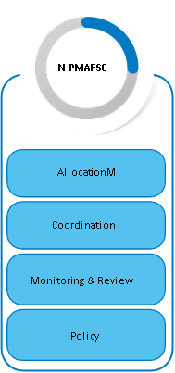
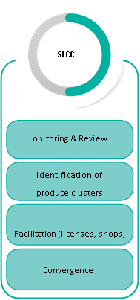
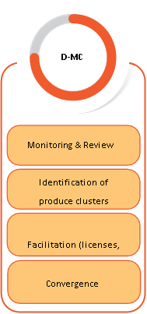
Roles & Responsibilities of Committees
N-PMAFSC
SLCC
D-MC
Allocation
Monitoring & Review
Monitoring & Review
Monitoring & Review
Co-Ordination
Identification of produce clusters
Identification of produce clusters
Monitoring & Review
Facilitation (Licenses etc.)
Facilitation (Licenses etc.)
Policy
Convergence
Convergence
28

Slide 29

CLUSTER
BASED BUSINESS ORGANIZATIONS
(CBBOs)
29

Slide 30

DEFINITIONS AND TERMINOLOGY
A group of similar things or people positioned or occurring closely together.
Cluster
Business Organization
An entity formed for the purpose of carrying on commercial activity/enterprise.
30

Slide 31
BUSINESS CLUSTER
Geographic concentration of interconnected businesses, suppliers, and associated institutions in a particular field.
wThe term business cluster, also known as an industry cluster, competitive cluster, or Porterian cluster, was introduced and popularized by Michael Porter in The Competitive Advantage of Nations (1990).
Clusters are considered to increase the productivity with which companies can compete, nationally and globally.
31

Slide 32




ADVANTAGES
01
Increased Productivity
02
More Customers
03
Increases Business Visibility
04
Improved Brand Perception
05
Broader Range of Products or Services
32

Slide 33




DISADVANTAGES
01
Loss of Proprietary Knowledge
02
May Limit Access to Businesses
03
Poor knowledge of Employees
04
Increased Competition
33

Slide 34
Cluster Based Business Organizations (CBBOs)
Implementing Agencies will set up Cluster- Based Business Organizations (CBBOs) as per their requirements
The initial engagement of CBBOs will be for a period of maximum three years for the purpose of formation of new FPOs.
Implementing Agency will review the performance of CBBOs from time to time.
Interested State and Central Government Agriculture Universities and KVKs promoting FPOs may be empaneled as CBBOs as may be relevant in consultation with N-PMAFSC on nomination basis.
CBBOs will be the platform for an end to end knowledge for all issues related to FPO promotion.
34

Slide 35
Criteria for Identification
The professional organization will be identified to function as CBBO.
The Committee may consider minimum requisite qualification experience of experts of CBBO, area of expertise & minimum experience as well as net worth of organization.
The CBBOs should be supported with five categories of specialist
Finalization of criteria for selection will be with approval of DAC&FW.
SFAC
NABARD
NCDC
Committee
36

Slide 36
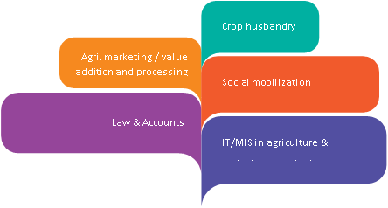
Crop Husbandry
Agri – Marketing
Social Mobilization
Law and Accounts
IT / MIS in Agriculture
37

Slide 37

Duties and Responsibilities
01
Implementation of the programme
02
IAs in cluster identification
03
Community mobilization
04
Registration of FPOs
05
Training & Capacity buildings of FPOs
06
Preparation & Execution of Business Plans
38

Slide 38
Conti…..
07
Regular interface with stakeholders
08
Traceability & global market connectivity
09
Progress report - specified target activities
10
IAs and NPMA in rating of FPOs
11
FPO in proper financial management
12
Data collection and generating MIS reports
39

Slide 39
Minimum Eligibility Criteria
A. Pre-Qualification
Any legal entity / any institution should be in existence for past 3 years.
Minimum average turnover / utilization of funds
INR ≥ 2 crore for plain areas
INR ≥ 1 crore for Himalayan and N-E Region
Not have been barred / blacklisted at any time.
Should have professionals/experts in at least 3 of the 5 domains i.e., Crop Husbandry, Social Mobilization, IT / MIS in Agriculture, Agri – Marketing / Value Addition and Processing, Law and Accounts
40

Slide 40
B. Technical Qualification
Minimum 3 years of experience
Experience in establishing Market and Credit linkages of FPOs.
Experience in providing Capacity Building Trainings, Pre and Post-harvest Trainings / Demonstrations for FPOs.
Experience in facilitating establishment of Pre harvest / Post harvest Infrastructure facilities.
41

Slide 41
Empanelment process :
Shortlisting
Presentation
Scrutiny
Empanelment letter
Formal Agreement
42

Slide 42
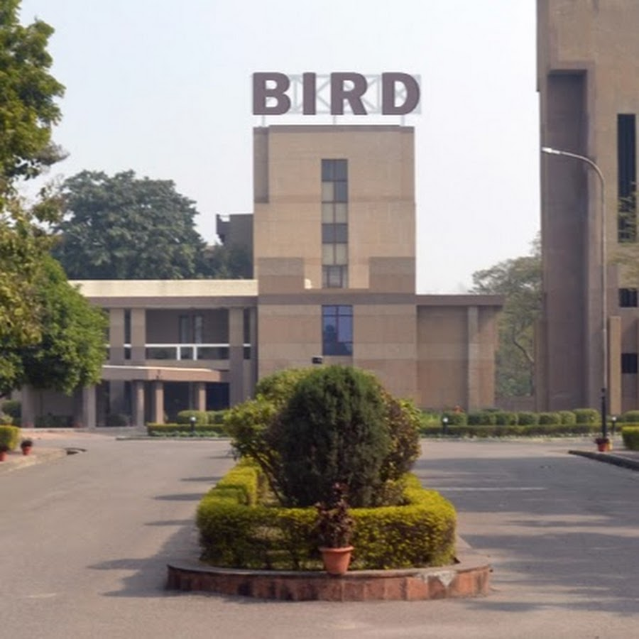
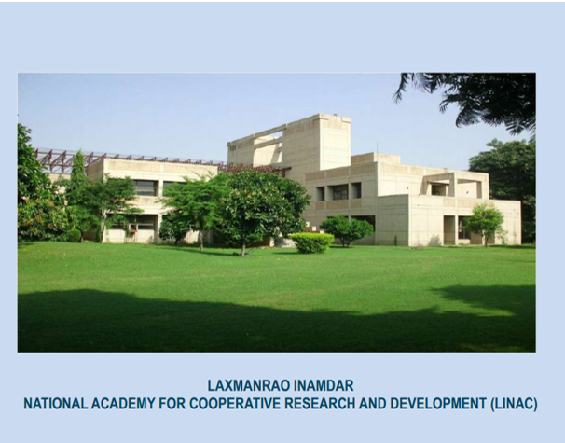
Nodal Training Institutes @ National level
43

Slide 43
CBBO Approach for FPO Formation
Cluster Identification
Diagnostic study
Feasibility study
Business Planning
Resource mobilization
Business Operation
44

Slide 44
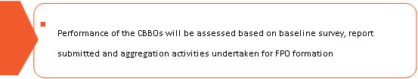
Incentive to Cluster based business organizations
The formation and incubation cost of CBBO, limited to maximum of Rs. 25 lakh / FPO of support or actual whichever is lesser, is to be provided for five years from the year of formation.
Performance of the CBBOs will be assessed based on baseline survey, report submitted and aggregation activities undertaken for FPO formation
First 6 Months
45

Slide 45
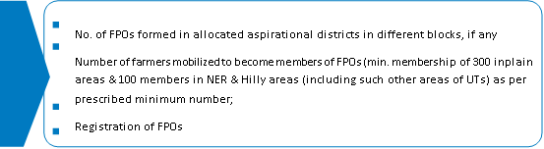
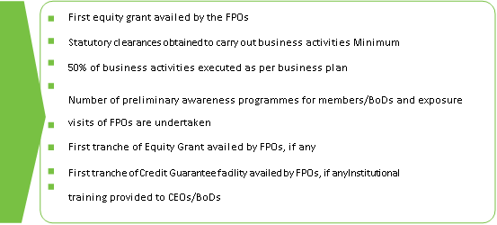
No. of FPOs formed in allocated aspirational districts in different blocks, if any
No. of farmers mobilized to become members of FPO (min 300 – plains, 100 - NER & Hilly areas)
6 Months to 1 yr.
First equity grant available by the FPOs.
Statutory clearances obtained to carry out business activities minimum.
50 % of business activities executed as per business plan
No. of preliminary awareness programmes for members/ BoD & exposure visits of FPOs are undertaken
1 yr. to 2 yr.
46

Slide 46
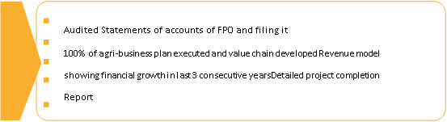
Issuing share certificates to each member in third year, if any
Trading/uploading of produce in e-NAM/other sources, if any
2 yr. to 3 & 4 yr.
31
Audited statements of accounts of FPO and filling it
100 % of Agri-Business plan executed and value chain developed Revenue model
Showing financial growth in last 3 consecutive years, detailed project completion report
4 yr. to 5 yr.
47

Slide 47
Sl.No. | Name of State | Name of CBBO | Name
1 | Andhra Pradesh | Grant Thornton Bharat LLP | Mr. V. Padmanand (Partner) Mr. Prakhar (Manager)
2 | Arunachal Pradesh | Indian Grameen Services (IGS) | Mr. Dilip Gupta (Associate Vice President)
3 | Assam | Grant Thornton Bharat LLP | Mr. V. Padmanand (Partner) Mr. Prakhar Katiyar (Manager)
4 | Bihar | Professional Assistance for Development Action (PRADAN) | Mr. Satyabrata Acharya (Integrator, PRADAN)
5 | Chhattisgarh | National Institute of Women Child and Youth Development (NIWCYD) | Mr. Anil Nimbhorkar (Project Director) Mr. Vimal Dubey (Project Director)
State-wise list of Nodal CBBOs under Central Sector Scheme for Formation and Promotion of 10,000 FPOs
48

Slide 48
Sl.No. | Name of State | Name of CBBO | Name
6 | Gujarat | Samarth Agro | Mr. Ashish Patel (Team Leader)
7 | Haryana | Indian Society of Agribusiness Professional (ISAP) | Mr. Gaurav Vats (Director)
8 | Himachal Pradesh | Himalayan Organization for Organic Agri- Product Research & Development | Dr. R S Minhas (Project Director)
9 | Jammu & Kashmir | Actech Information System Ltd. | Mr. Arvind Pachouri (Director-Projects)
10 | Jharkhand | Price Waterhouse Coopers Pvt. Ltd. (PwC) | Mr. Shashikant Singh (Director) Mr. Shreesh Tripathi Manager)
49

Slide 49
Sl.No. | Name of State | Name of CBBO | Name
11 | Karnataka | Indian Institute of Millet Research (IIMR) | Dr. Sangappa Scientist (Agricultural Extension)
12 | Kerala | Centre for Innovation in Science & Social Action (CISSA) | Dr. Sureshkumar C (General Secretary)
13 | Madhya Pradesh | Madhya Bharat Consortium of Farmers Producer Company Limited | Mr. Yogesh Dwivedi (Chief Executive Officer)
14 | Maharashtra | Krushi Vikas Va Gramin Prashikshan | Mr. Amit Naphade (CEO) Mr. Ravi Patil Project Coordinator)
15 | Manipur | Vitro Biotechnologies Ltd | Mr. Himanshu Manwani (Manager)
50

Slide 50
Sl.No. | Name of State | Name of CBBO | Name
16 | Mizoram | Margdarshak Development Projects and Consulting Pvt Ltd. | Mr. Gongdinag Momit (Sr. Manager- Cluster)
17 | Meghalaya | Vitro Biotechnologies Ltd. | Mr. Himanshu Manwani (Manager)
18 | Nagaland | Vitro Biotechnologies Ltd. | Mr. Himanshu Manwani (Manager)
19 | Odisha | Basix Krishi Samruddhi Limited | Mr. Tapas Kumar Patil (Vice President)
20 | Punjab | Star Agriwarehousing and Collateral Management Limited | Mr. Vivek Swami (SPOC - Star Agri warehousing)
51

Slide 51
Sl.No. | Name of State | Name of CBBO | Name
21 | Rajasthan | Access Development Services (ADS) | Mr. Vipin Sharma (Chief Executive Assistant) Mr. Sudipto Saha Vice President)
22 | Tamil Nadu | Erode Precision Farm Producer Company Limited | Dr. E. Vadivel (Project Coordinator)
23 | Telangana | Andhra Pradesh Mahila Abhivruddhi | Dr. N Madhumurthy (Managing Director) Mr. Vedprakash Singh Project Manager)
24 | Tripura | Basix Krishi Samruddhi Limited | Mr. Tapas Kumar Patil (Vice-President)
25 | Uttar Pradesh | Basix Krishi Samruddhi Limited | Mr. Tapas Kumar Patil (Vice-President)
52

Slide 52
Sl.No. | Name of State | Name of CBBO | Name
26 | Uttarakhand | Synergy Technofin Pvt Ltd. | Mr. Sunil Kumar Sihag
27 | West Bengal | Access Development Services (ADS) | Mr. Vipin Sharma (Chief Executive Assistant) Mr. Sudipto Saha Vice President)
53

Slide 53
List of CBBOs Empaneled under Central Sector Scheme for Formation and Promotion of 10,000 FPOs
KARNATAKA
Sl. No. | Name of the Agency | Correspondence Address | Name
01. | Vyakti Vikas Kendra, | India No. 19, 39th 'A' Cross, 11th Main, 4th 'T' Block, Jayanagar, Bangalore-560041, Karnataka | Mahesh Rajput, Chief Operating Officer (COO) Prasana Prabhu, Chairman
02. | Shri Kshethra Dharamasthala rural Development project BC Trust(R). | Dharamshree Building, Dharamasthala Building, Belthangady TQ-574216 | Dr. D. Veerendra Heggade
03. | Sus Agri Development Private Limited | Ground Floor, 48, National Games Housing Project, 8th Block, Koramangala Village, Bangalore, Karnataka - 560047 | Saurabh Chaudhry
54

Slide 54
Sl. No. | Name of Agency | Correspondence address | Name
04. | APOF Organic Certification Agency | 117/C JHBCS Layout Turahalli 2nd Stage, Behind Mantri Bengaluru, Karnataka, Pin-560061 | Mr. Sachin Lambe
05. | Indian Foundation for Humanistic Development | 91 Springboard 1st Floor, Gopala Krishna Complex,45/3, Residency Road,Karnataka-560025 | Mrs. Hemalatha.D
06. | Sahyadri Community Development & Women Empowerment Society | Savinilaya Building Main Road Marathikoppa, Karnataka, Pin-581402 | Mrs Saraswathi Naik,
07. | Sri Sri Rural Development Programme Trust | 21st K.m, Kanakpura Road, Village Udayapura, Bangalore, Karnataka Pin-560082 | Mr Siva kanchibothla
55

Slide 55

Convergence Model
Customers
Scheme implementing agencies
FPO
Industries
Banks
56

Slide 56
Potential Farmer Activities/ Services required at intermediary level
Identify services needed by farmers
01
Increase the scope of service package to atleast 4-5 services
02
Undertake cost benefit analysis to study intermediaries profitability
03
Marketing their services (field days, messages, e-extension)
04
Infrastructure assessment & arrangement for providing services
05
Training of intermediaries in service
06
Build intermediary capacity in business skills & linkage to credit institutions
07
58

Slide 57
Standard Business Model
Supply quality inputs at reasonably lower wholesale rates
Undertake aggregation of smaller lots of farmer-members produce; add value
Facilitate market information for judicious decision in production & marketing
Pre & post production machinery & equipment
Facilitate logistics services on shared cost basis
Undertake higher income generating activities
Make available value addition & farm level processing facilities on user charge basis
Market the aggregated produce with better negotiation strength
Develop Storage and transportation facilities
57

Slide 58

COMPARATIVE ANALYSIS
59

Slide 59
NABARD
Corporates
Domestic & International aid agencies
SFAC
Govt. Depts
Financial & / Technical support
POPI
RI
60

Slide 60

Fig 1:Timeline-Evolution concept of FPOs
61

Slide 61


CASE STUDIES
62

Slide 62
New Innovative Activities of VMFPCL-CBBO
1. Drumstick (Moringa) Based value added products like, Beauty drops, Hair oil, Drumstick Shampoo, Seed oil, Gum paste and receipies like Drumstick rice mix powder, Idly Mix powder, Tablets, Capsules, High rich nutritive value food supplementary and Drumsticks herbal Tea.
2. Black Turmeric: Paste, Bindhi, Beauty drops, Tablets and capsules.
3. Banana Based Value Added products like Dehydrated Powder, Banana fig, Banana peel pickles, Banana pseudo stems, crushes etc…
4. Rice Bran Oil and local rice like Mapillaisamba, Gownirices, Poongar etc…
5. Chilli olio Resin oil, Masala powder with other spices ingredients.
6. Hill vegetables.
7. Maize starch and corn oil.
63

Slide 63
1. CASE STUDY
Background information
Name of the farmer : S.Rajendran
Village name :Mannarnayakkanpatti
Mr. S. Rajendran learnt a lot about alternative farming practices in VMFPCL trainings viz. Treating seeds with biologicals prior to sowing, such as phosphobacteria and azospirillum before sowing, Pest management by growing trap crops like marigold and bhendi and the role of useful insects like Trichograma, an egg parasite on heliothis. Prior to his FIG enrolment he had no idea like, that there could be some insects, which could benefit his crop.
The earlier practice was to spray pesticide whenever a larva or an insect was noticed in the field. These new measures helped in reducing the pesticide sprays and reduced a major expenditure in the farming. These knowledge and traditional farming practices with improved modern techniques and utilities saved him from severe financial crisis.
64

Slide 64
Plan
For developing community oriented farming activity among the farmers of Virudhunagar district which is highly rain fed dependent farming system hence improving farmers income and livelihood through sustainable approach will be a better option to start.
Intervention
Introducing community oriented farming system.
Training to adopt organic farming in a sustainable manner Empowering rain fed farmers
Involving women SHG in activities like bio pesticide production, etc.
Income
Redgram yield : 408 Kg
Rate per Kg :43.00
Total income : 43 x 408 =17544.00
Loan amount from VMFPCL -30000
65

Slide 65
2. CASE STUDY
Background information
Name : M.Mariyammal
Village : Chinnapparediyappatty
Mrs.M.Mariyammal, aged about 45 born in Tamil Nādu, a middle-class family and studied up to only elementary education. Since her childhood she is interested in agriculture and its allied activities as well as she is self-motivated and also taught about self-respect and self-sustainability by her parents. She took indigenous cow which used to give 5-6 litres of milk per day.
That made her to look after her animal properly and she used to pour nearly 5 litres of milk per day in the nearby houses which is two kilometres surrounding from her home. Per litre 40rupees is the amount fixed by her which seems to be a handful of income for her. With the availability of fodder in her land she used to feed those animals properly.
67

Slide 66
She said that comparing her production cost income in dairying seems to be quite sustainable, regular and profitable. She is also quite happy with the support extended by the Viruthai Millets Farmer Producer Company limited for providing Rs.1,00,000/- as start-up loan for her activity.
Income
Per day 5 litres x 40 = 200.00
Per month 200 x 30 = 6000.00
Additional benefit female calf one number
Conclusion
Out of her expenses and repayment of loan she is saving 10000 for one year through dairy farming. She explains proudly that I am not dependent on my husband or with my children. I earn with my own effort and no one in my family opposes me. I have been given enough support by my family members because of the sustainable income from dairying.
68

Slide 67

CONCLUSION
69

Slide 68

70

Slide 69
Indian agriculture is dominated by small and marginal farmers with average land holdings size of less than 1.1 ha.
These small and marginal farmers constituting more than 86 % of the total land holdings are facing tremendous challenges both in production and post-production scenarios.
Collectivization of farmer producers through formation of FPOs is very important to address such challenges and enhance their incomes. More than 5.87 lakh farmers have been mobilized under the Scheme.
About 3 lakh farmers have been registered as shareholders of the FPOs.

Slide 70
Number of FPO’s registered in India
Sl.no | State/UTs | Number of FPOs registered by respective agencies
 |  | Small Farmers' Agri- Business Consortium | NABARD | FPOs registered by IAs under CSS for formation & Promotion of 10,000 FPOs | Total
1 | Andaman & Nicobar | 0 | 3 | 0 | 3
2 | Andhra Pradesh | 16 | 295 | 88 | 399
3 | Arunachal Pradesh | 6 | 10 | 12 | 28
4 | Assam | 18 | 72 | 95 | 185
5 | Bihar | 38 | 217 | 101 | 356
6 | Chhattisgarh | 26 | 57 | 61 | 144
7 | Delhi | 4 | 1 | 0 | 5
8 | Goa | 2 | 2 | 1 | 5

Slide 71
Sl.no | State/UTs | Number of FPOs registered by respective agencies
 |  | SFAC | NABARD | Other IA’s under CSS | Total
9 | Gujarat | 25 | 190 | 140 | 355
10 | Haryana | 23 | 85 | 93 | 201
11 | Himachal Pradesh | 8 | 99 | 67 | 174
12 | Jammu & Kashmir | 2 | 23 | 64 | 89
13 | Jharkhand | 10 | 150 | 96 | 256
14 | Karnataka | 125 | 287 | 166 | 578
15 | Kerala | 0 | 134 | 36 | 170
16 | Ladakh | 0 | 0 | 3 | 3
17 | Madhya Pradesh | 149 | 254 | 147 | 550
18 | Maharashtra | 105 | 291 | 173 | 569
19 | Manipur | 8 | 12 | 16 | 36
20 | Meghalaya | 3 | 12 | 10 | 25

Slide 72
Sl.no | State/UTs | Number of FPOs registered by respective agencies
 |  | SFAC | NABARD | other IA’s under CSS | Total
21 | Mizoram | 1 | 19 | 14 | 34
22 | Nagaland | 2 | 5 | 16 | 23
23 | Odisha | 41 | 241 | 165 | 447
4 | Punjab | 7 | 93 | 22 | 122
5 | Puducherry | 0 | 0 | 2 | 2
6 | Rajasthan | 50 | 166 | 135 | 351
27 | Sikkim | 30 | 8 | 2 | 40
28 | Tamil Nadu | 13 | 264 | 133 | 410
29 | Telangana | 26 | 335 | 99 | 460
30 | Tripura | 7 | 1 | 23 | 31
31 | Uttarakhand | 7 | 90 | 57 | 154
32 | Uttar Pradesh | 57 | 183 | 210 | 450
33 | West Bengal | 89 | 305 | 10 | 404
Total |  | 898 | 3904 | 2257 | 7059
Posted On: 15 MAR 2022 5:30PM by PIB Delhi MoA&FW

Slide 73
1. Cluster Identification
Builds further on organization building efforts already made with the primary groups
With strong primary groups in place, their participation in the process of FPO formation will be effective resulting in better leadership & governance of
the FPO

Slide 74



2. Diagnostic study
Process involved in conducting Diagnostic Study
Collection of primary data in the identified cluster, resource mapping, and problem tree analysis
Collection & Analysis of secondary data
Feasibility analysis of the identified activities

Slide 75
i. Collection of Secondary data
Preparation of Block map
Occupational structure of cultivators
Rainfall Pattern
Seasonality, cropping pattern
Land use pattern and productivity assessment
Natural Resources
Irrigated area in the Block
Infrastructure facilities
Market details

Slide 76
Infrastructure Facilities
Storage Facilities
Transport Facilities
Marketing Co-operatives & PACS
Approach Road b/w villages
Markets
Road and Rail Connectivity
No. of bank branches & distance b/w villages
Irrigation sources
Internal Connectivity

Slide 77
ii. Collection of Primary data
Dominant crop or the activities identified in the area
Cluster Map with village details
Household details with name of the head of HH

Slide 78
Outreach of formal / informal
credit system
Marketing (Supply chain system)
Input Management
Technology transfer
Risk mitigation measures

Slide 79
iii. Feasibility analysis
General Rules for elimination of unviable economic activities
First Elimination
Eliminate the activities which are done on a lower scale & are not fit for undertaking on business lines.
Second Elimination
Eliminate the products with low demand, margin constraints and limited potential for future.
Third Elimination
Eliminate the products/activities which have negative impact on environment.

Slide 80
Assessment of economic viability of identified activities
Working out annual cost of operation incl. capital cost
Financial appraisal of the identified activity
Step I
Step III
Step V
Step II
Step IV
Name of the economic activities to be undertaken
Estimate the benefit to be accrued
Recommendation/ Decision for selection/ rejection

Slide 81
  “Copy-cat” syndrome : There are FPOs who choose a given opportunity because others have taken it up and are seen to be doing well. They do not realize that there is no room for too many entrepreneurs in a particular product line.
  Fallacy of Numbers : Many persons have a tendency for accepting and relying upon income and profitability estimates. Other factors such as location, local competition, risks involved which may affect profitability are not considered.
  Mismatch in hard/soft skill competencies of entrepreneur
  Undifferentiated products/services : A large number of small enterprises are not performing well or closing down because they are too identical. There are several similar products in the market. The competition rests on price and the price comes down to an unprofitable label.

Slide 82
4. Business Plan
Cover sheet
Executive Summary
Business description
Marketing plan
Competition analysis
Production plan
Orientation & Management plan
Financial plan
Documents

