Slide 1



Welcome
​

Slide 2



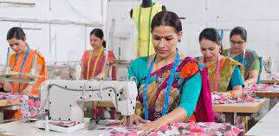

SEMINAR 1
SKILL DEVELOPMENT IN INDIA – A WAY FORWARD
Presented By:
Muhammed Arif
PAMB 1149, Sr. M.Sc.
Agricultural Extension
UAS GKVK, Bangalore -65

Slide 3
Challenges
Conclusion
Introduction
Research studies
Initiatives in skill development
Scenario of skill development
Objectives
Flow
Of
Seminar

Slide 4
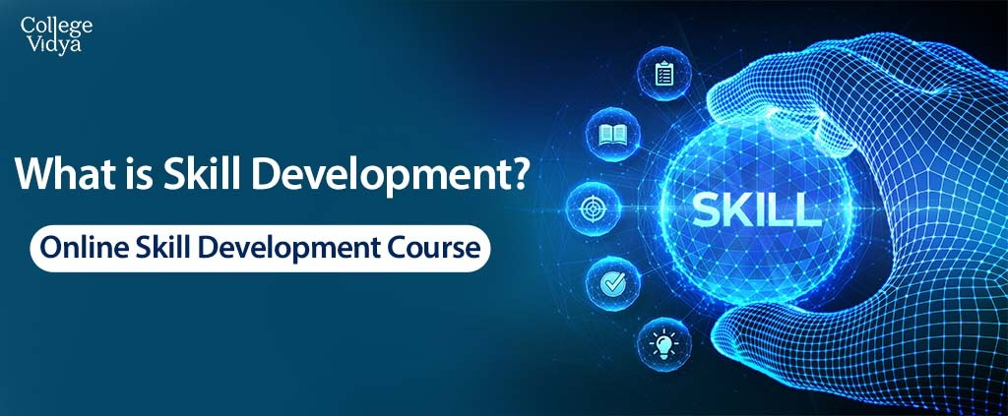
INTRODUCTION
Skill development includes several attributes, including identifying one’s skill gaps and enabling one to develop those skills to achieve their goal.
It enables individuals to become fully and productively engage in livelihoods and to have the opportunity to adapt these capabilities to meet the changing demands and opportunities of economy and labour market.

Slide 5

Skills
According to Merriam Webster dictionary skill is the ability to use one's knowledge effectively and readily in execution or performance.
The ability to do something well or the technique of doing things.
To succeed in the 21st century labor market, one needs a comprehensive skill set composed of
Cognitive skills
Socio-emotional skills,
Technical skills,
Digital skills

Slide 6
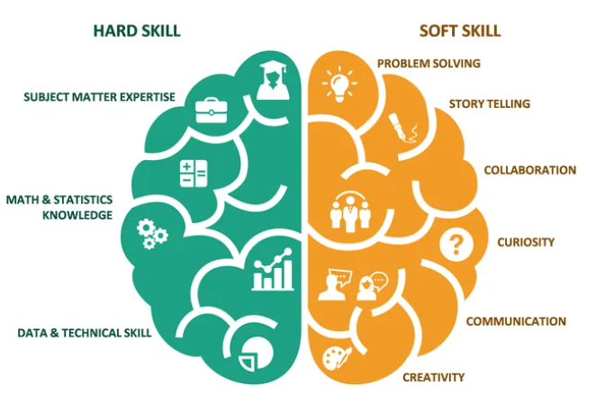
On a broader scale, skills can be divided into two types, namely soft skills and hard skills.
Hard skills can involve specific knowledge acquired in a subject, certification, training, technical skills etc.
Soft skills refer to personality traits, including communication, leadership, problem solving, decision making, etc.,
Both skills support a person to perform successfully at work and advance in most jobs. Skill development programs reflect positively on both employers and employees.

Slide 7
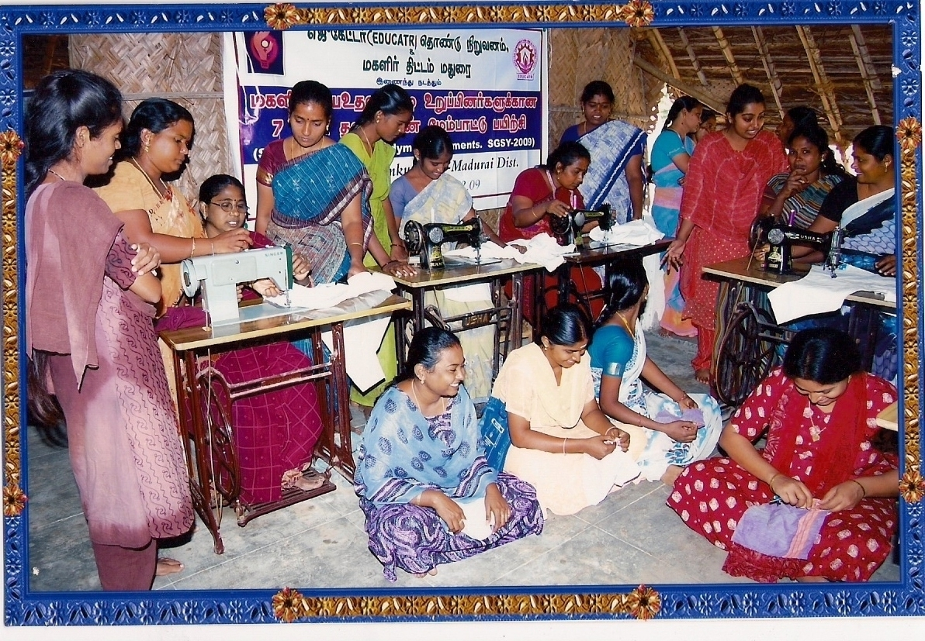
Skill development methods
Training –
This method includes developing employee skills through a combination of lectures, hands-on-exercises, videos, podcasts, simulations, and individual/group-based assignments.
It includes both formal (classroom-based, instructor-led, e-learning courses) and informal approach (watching YouTube videos, reviewing educational blogs and posts on peer-group forums like LinkedIn or chat rooms, self-study)
2. Task/job rotations
3. Coaching
4. Mentoring
5. Workshops/Committees/Working-Groups
6. Simulations
7. Conferences
8. On-the-job training
9. Self-study

Slide 8


Importance of skill development
Individual can increase their employability, enhance career prospects,
The performance level improves and so does self-confidence and efficiency.
In agriculture cognitive skills are required to make better decisions, technical skills required for handling various implements and interpersonal skills required for exchange of farm related information
For India to become the skill capital of the world, skilling of rural India assumes great importance so as to enable the rural workforce in realizing their potential and become part of the country’s progress

Slide 9
Objectives of the Seminar
1
To know the scenario of skill development in India
2
To have brief insight of the initiatives in skill development
3
To discuss the issues and challenges in skill development
4
To review related research studies

Slide 10
Early Approaches
In India, the concept of Skill Development was introduced post-independence in 1956 with the first Industrial Policy with focus on Technical and Vocational Education and Training (TVET) sector with dedicated institutions.
In 1961, the Apprenticeship Act was framed for providing practical training to technically qualified persons in various trades.
In 1968, the first National Policy on Education was framed.
The first Industrial Training Institute (ITI) was set up in 1969 by the Ministry of Labour & Employment.

Slide 11
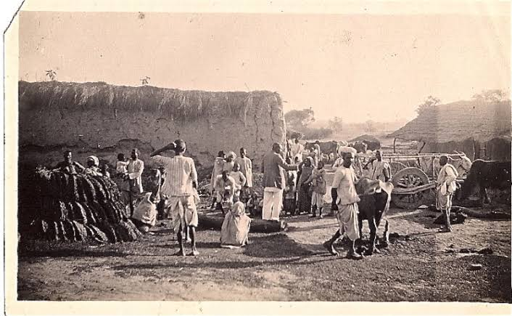
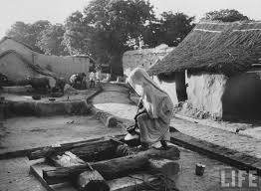
Post independence efforts like IRDP, HYVP, KVK and programs with development with social justice like DWRCA, TRYSEM, WYTEP focused on rural development by training the rural people in income generating activities
In the 1990s and after, SGSY and NATP also started focusing on capacity building of both change agents and rural stakeholders

Slide 12
1990s also witnessed the opening up of the economy with substantial growth in IT industry and service sector and relative slowdown in manufacturing and engineering sector.
It was felt that there might be potential employment for skilled category. With this objective, the National Skill Development Corporation (NSDC) was established in 2008.
These paradigm shift resulted in framing of the first National Policy on Skill Development in 2009 and effort was made to enhance the private partnership to expand the capacity of skills training sector.
The National Skills Development Agency (NSDA) was established in 2013 and a vision was casted for a National Qualification Framework (NQF)

Slide 13

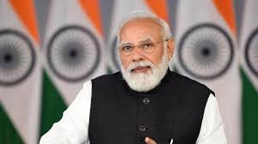
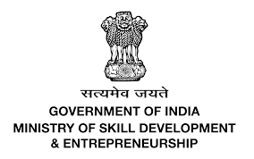
Recent Approaches In Skill Development
As the world steps into a new decade, India stands on the cusp of becoming a global power, with a favorable demographic and increased percentage of youth in the workforce
It is crucial for the country to take advantage of this opportunity and bring the nation on the path of rising socio economic progress
To achieve this aim, skill development is vital for enhancement of the workforce and to bring in the unused resources into the mainstream
Addressing this issue, hon’ble Prime Minister launched Skill India Mission on July 15, 2015 and formulated a Ministry Of Skill Development And Entrepreneurship to oversee, implement and coordinate various initiatives

Slide 14
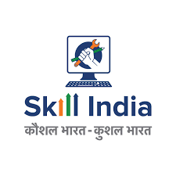

Contd..
Under the aegis of MSDE, flagship scheme like Pradhan Mantri Kaushal Vikas yojana(PMKVY), National Skill Development Fund (NSDF), Sector Skill Council (SSC) among others were launched for holistic skill enhancement.
The union cabinet also approved the National Policy for Skill Development & Entrepreneurship in 2015 to “ to create an ecosystem of empowerment by skilling on a large scale and to promote a culture of innovation based entrepreneurship which can generate wealth and employment”

Slide 15

Scenario of skill development in India

Slide 16

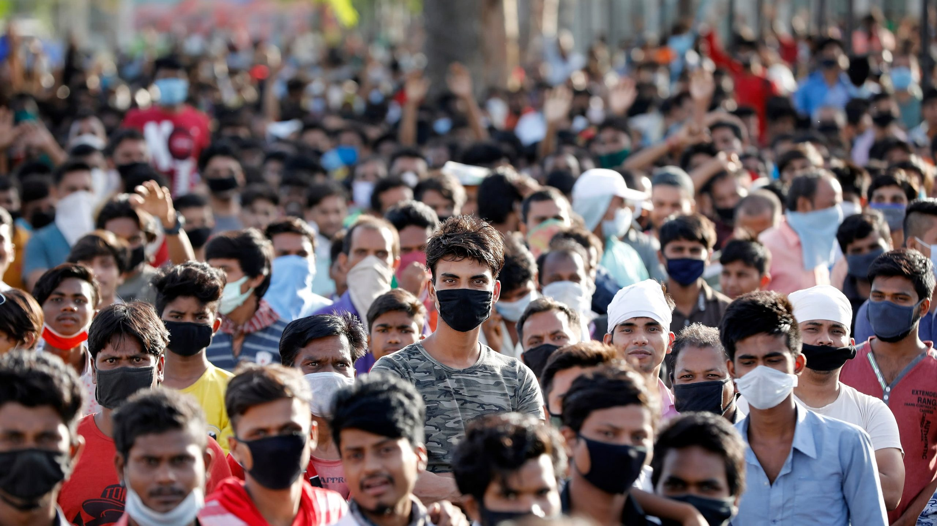
An overview
Skill development, especially in a country like India with large young population, which is estimated to be 27.33 per cent of total population in 2021, assumes greater importance.
With majority of population living in rural areas, the need for sustained skilling and reskilling assumes great importance
Skilling the growing workforce would improve their productivity and employability which, in turn, will improve income and the quality of life.

Slide 17
According to a 2015-16 report released by MSDE, less than 5 per cent of India's workforce is formally skilled.
Compare this to South Korea (96 per cent), Japan (80 per cent), Germany (75 per cent), the United Kingdom (68 per cent) and the United States (52 per cent), and we have a lot of ground to cover.
The total requirement of manpower for the Agriculture sector in 2022 is estimated to be around 2156 lakh. Of this, about 1733 lakhs are expected to be skilled
Significant demands on skill are expected in two categories
‐ Higher education (graduate and above) for specialist roles
‐ Diploma and short term vocational training for on ground support roles focusing on the direct farmer interface
-KPMG & NSDC

Slide 18
Human Resource Requirements
Sl.no | Sector | Human resource requirements estimates(in millions)
1 | Agriculture | 215.5
2 | Building Construction & Real Estate | 91
3 | Retail | 56
4 | Logistics, Transportation & warehousing | 31.2
5 | Textile & Clothing | 25
6 | Education & Skill Development | 18.8
7 | Handloom & Handicraft | 18.1
Source: Annual Report of MSDE 2022

Slide 19
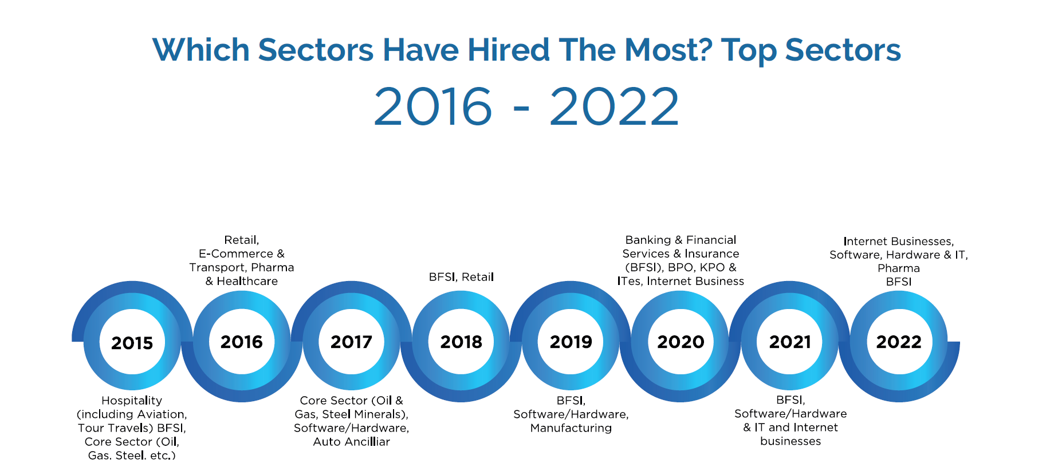
Source: India Skills Report 2022

Slide 20
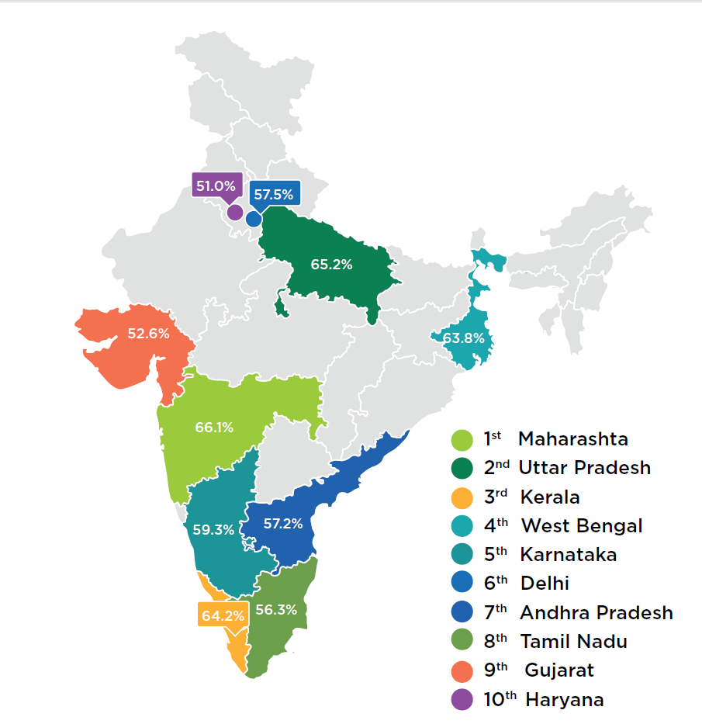
Among the employable youth population, 51.44% of females were found highly employable while 45.97% of males were found highly employable
Among the surveyed students and aspiring professionals, B.tech graduates and MBA graduates were found to be the most employable talent from the various domains.
Source: India Skills Report 2022

Slide 21


MINISTRY OF SKILL DEVELOPMENT & ENTREPRENEURSHIP
The Ministry is responsible for co-ordination of all Skill Development efforts across the country,
The Ministry aims to skill on a large scale with speed and high standards in order to achieve it's vision of a 'Skilled India’.

Slide 22

It is aided in these initiatives by its functional arms – Directorate General of Training (DGT),
National Council for Vocational Education and Training (NCVET),
National Skill Development Corporation (NSDC),
National Skill Development Fund (NSDF) and
37 Sector Skill Councils (SSCs) as well as
33 National Skill Training Institutes (NSTIs),
About 15000 Industrial Training Institutes (ITIs) under DGT
The Ministry also works with network of Skill Development centres, universities. Further, collaborations with relevant Central Ministries, State governments, international organizations, industry and NGOs have been initiated.

Slide 23
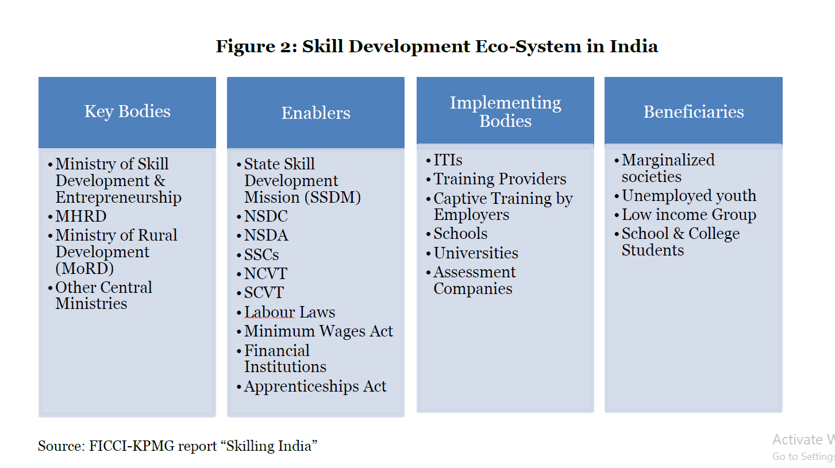
Skill Development Eco-system In India
Key Bodies | Enablers | Implementing agencies | beneficiaries
Ministry of Skill Development & Entrepreneurship Ministry of Human Resource Development Ministry of Rural Development Other Central Ministries | State Skill Development Mission (SSDM) NSDC SSC NSDA NCVT SCVT Labour Laws. Minimum Wages Act | I.T.I.s Training partners N.G.O.s Universities K.V.K.s Schools | Marginalized society Unemployed youth School and college students labours

Slide 24

Scenario in Karnataka
To address the issue of skill development in the State, the Government of Karnataka has made education and skill up-gradation as the corner stones of its policy.
It has opened 289 polytechnic institutes throughout the State, in addition to setting up of 1,507 Industrial Training Institutes (ITIs).
Assistance is also provided to private players for setting up training institutes within the State.
In 2008, the State Government set up the State Skill Commission with a mission at empowering all individuals through improved skills and knowledge
Karnataka Vocational Training and Skills Development Corporation (KVTSDC) has also been set up for furthering the agenda of skill development in Karnataka.

Slide 25
Given the above background and the growing importance of skill development in Karnataka, the National Skill Development Corporation (NSDC) mandated ICRA Management Consulting Services (IMaCS) to conduct the district wise skill gap study for the State of Karnataka.
Based on its forecasts, it has been estimated that between 2012 and 2022, an incremental demand for 8.47 million people will be generated in Karnataka.
Maximum demand will be generated from sectors such as tourism, travel and hospitality; agriculture and allied (mainly allied such as horticulture, fishery, animal husbandry, poultry and sericulture); building, construction and real estate; IT & ITES, transportation, logistics, warehousing and packaging; healthcare and education services.

Slide 26
The supply side numbers have also been forecasted. It has been estimated that upto 2022, about 8.16 million persons will join the workforce in Karnataka.
To meet the demand and supply gap in the State, IMaCS has made recommendations for four types of stakeholders: (1) Government, (2) Industry, (3) Private training institutes, and (4) NSDC
NSDC state report 2017-2022

Slide 27
INITIATIVES IN SKILL DEVELOPMENT

Slide 28
SKILL INDIA MISSION
Skill India Mission is a flagship initiative launched by the Government of India in 2015 to improve the skills of the country's workforce and make them employable.
The primary objective of the Skill India Mission is to provide training and certification to the youth of the country
The initiative seeks to train over 40 crore people in India in various skills by 2022
It focuses on creating opportunities for skill development, entrepreneurship, and job placement, particularly for youth, women, and disadvantaged sections of the society.

Slide 29
Who can avail training courses under Skill India:-
All Skill India training courses are open to every citizen of this country, regardless of age, gender and location.
The qualifications in some cases include working knowledge of some industry and literacy.
Skill India courses are available in various Indian languages to benefits to all ethnic groups of the country.

Slide 30

Aspirant candidates to register for skill training and employment opportunities through the online portal:-
https://skillindia.gov.in/

Slide 31

PRADHAN MANTRI KAUSHAL VIKAS YOJANA (PMKVY)
PMKVY is a Skill Certification Scheme that aims to encourage the youth population of the country to take up training which is industry- relevant.

Slide 32
Phases of PMKVY:
PMKVY 1.0 (2015-16)- providing free short duration skill training and giving them encouragement by providing monetary rewards for skill certification.
During its pilot phase in 2015-16, 19.85 lakh candidates were trained.
PMKVY 2.0 (2016-20)- encourage youth for skill development in industrial and digital demand for employment.
Launched for scaling up sectors, geographies and by greater alignment with other missions such as MAKE IN INDIA, DIGITAL INDIA, and SWACCH BHARAT etc.
The number of candidates trained is 1.09 crore

Slide 33
PMKVY 3.0 (2020-21) - shifted from a supply-based approach to a demand-based approach.
PMKVY 3.0 will encourage skill development throughout the country to address industry needs, meet market demands and impart skills in services and in new-age job roles that have become crucial with the advent of the COVID-19 pandemic.
Implemented in a more decentralized structure with greater responsibilities and support from States/UTs and Districts
PMKVY 4.0 (2023)- inclusion of new age courses for industry 4.0, on the job training, skill hubs

Slide 34
Components of PMKVY
Component | Description
Short Term Training | ● The National Skills Qualifications Framework (NSQF) and different training centres will provide training. ● They’ll also grant Soft Skill training, Digital & Financial Literacy sessions, Entrepreneurship, etc. depending upon the requirements of the industry.
Recognition of Prior Learning (RPL) | ● Individuals having prior learning experiences/skills are certified and assessed under the Recognition of Prior Learning (RPL).
Special Projects | ● This component of PMKVY aims to encourage training in the groups of society that are marginalized and vulnerable. ● These Special projects can be defined as projects that have some deviation in the Terms and Conditions from the Short Term Training projects.

Slide 35
Components of PMKVY
Component | Description
Kaushal and Rozgar Mela | ● They are events organized every six months in order to provide assistance for individuals who have taken PMKVY training and have been certified.
Placement and Monitoring Guidelines | ● Creating and Providing placement opportunities to trained and certified individuals. ● Maintaining high-quality training standards through the Skills Development Management System (SDMS).
Training Partners (TPs)

Slide 36


THE NEW EDUCATION POLICY (NEP)
It was announced by the Government of India in July 2020, with the aim of transforming the education system in India to meet the needs of the 21st century.
Some of the key features of the NEP include:
Early Childhood Care and Education (ECCE)
School Education
Higher Education
Vocational Education
Teacher Education

Slide 37
The New Education Policy (NEP) in India recognizes the importance of skill development and aims to promote it through various means.
Integration of vocational education: The NEP aims to integrate vocational education into mainstream education.
Multiple entry and exit points: The NEP allows students to enter and exit from educational programs as per their choice, creating more flexibility in the education system
National Skills Qualification Framework (NSQF): The NEP emphasizes the implementation of the NSQF, which is a competency-based framework that enables students to acquire skills and get certified for the same.
Internship and apprenticeship: The NEP proposes to promote internships and apprenticeships as a part of the curriculum.
Industry-academia partnership: The NEP emphasizes the need for closer collaboration between industries and academic institutions.

Slide 38

Skill Development in Science And Technology
The technological Innovation has experienced exponential growth in last two decades.
New age skills like artificial intelligence, Internet of Things (IoT), 3D printing, Virtual Reality (VR), fraud detection, smart sensor, cloud computing and Robotics process automation.
These skills will equip youth to take up high-paying jobs in the domestic and international market.
All the major skills development programmes in India like PMKVY, SHREYAS (Scheme for Higher Education Youth in Apprenticeship and Skills) cover this aspect.

Slide 39


Skill Development Training Through Science & Technology (STST)
Developing special curricula and creation of models for innovative skilling areas.
Student Startup NIDHI award takes forward the student innovation in IEDC to commercialization and accelerate the journey of idea to prototype by providing initial financial assistance.
AWSAR Augmenting writing Skills for Articulating Research (NCSTC)
Disseminate Indian research stories among masses in an easy to understand and interesting format, it aims to empower and endow popular science writing skills among young PhD scholars.
Knowledge Involvement in Research Advancements through Nurturing (KIRAN)
Exclusive scheme for women, providing opportunities to women scientists who had a break in their career primarily due to family issue
One year internship in the domain of Intellectual Property Rights

Slide 40
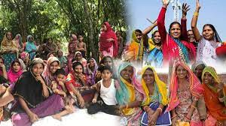
Skill Development in Women
According to National Sample Survey (68th round), women constitute almost half of the demographic dividend.
The key challenge here is to increase their participation in the country’s work force,
Skill development initiatives under MSDE need to work in synergy with policies of Ministry of Women and Child Development (MWCD).

Slide 41

Ujjawala scheme for prevention of trafficking and rescue, rehabilitation.
This scheme intends to provide rehabilitation services, The rehabilitation initiatives of this scheme can be integrated with the skill development initiatives of MSDE so that the women rescued from difficult conditions can be re-integrated into the society in respectable skill-based remunerative professions.
Similarly other schemes of MWCD such as Support to Training and Employment Programme for Women (STEP), Swavalamban, Kishori Shakti Yojana, etc., focus on skilling of women by synergistically integrating with programmes of MSDE

Slide 42
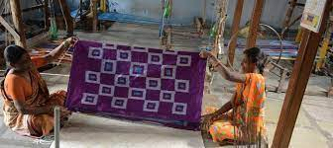
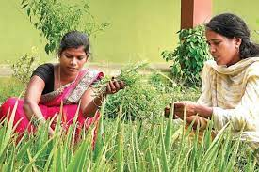
Potential Skilling areas for women entrepreneurship
Handloom, handicraft and fashion industry – ethnic wear, embroidery, pottery, bamboo worker
Agriculture – Agri-clinics, cold chain management, pickle making, spice processing, livestock feed production, rice mill, vermicomposting unit, honey processing
Beauty and wellness industry – beauty clinics, hair stylists, yoga and fitness professionals and spa therapists.

Slide 43
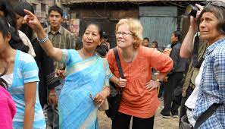

Potential Skilling areas for women entrepreneurship
Tourism: event planning, taxi & bus business, blogging on travels
The education sector – pre nursery education, supplementary education, vocational training institute
Logistics- supply chain consultancy, packers, courier services

Slide 44
Other initiatives by the MSDE are
Short Term Training Schemes/Initiatives Pradhan Mantri Kaushal Kendras (PMKK) School Initiatives and Higher Education Pre Departure Orientation Training (PDOT) | Long Term Training Schemes/Initiatives: Craftsmen Training Scheme (CTS) Crafts Instructor Training Scheme (CITS) Advanced Vocational Training Scheme (AVTS) Vocational Training Programme For Women Schemes for Upgradation of ITIs Flexi MoUs STRIVE Initiatives in the North East and LWE Regions Dual System of Training (DST) Polytechnics
Apprenticeship Training: National Apprenticeship Promotion Scheme (NAPS) Other Schemes/Initiatives: Aspirational Skilling Abhiyan Rozgar Mela Indian Institute of Skills (IISs) Skill Loan Scheme

Slide 45

NATIONAL SKILL DEVELOPMENT CORPORATION (NSDC)
National Skill Development Corporation (NSDC) is a not-for-profit public limited company incorporated on July 31, 2008 under section 25 of the Companies Act, 1956
NSDC strives to:
Develop ultra low-cost, high-quality, innovative business models.
Attract significant private investment.
Ensure that its funds are largely “re-circulating” i.e. loan or equity rather than grant.

Slide 46
NSDC plays three key roles
Funding and incentivising : This involves providing financing either as loans or equity, providing grants and supporting financial incentives to select private sector initiatives
Enabling support services : A skills development institute requires a number of inputs or support services such as curriculum, faculty training standards, quality assurance, technology platforms, student placement mechanisms and so on. NSDC plays a significant enabling role in these support services,
Shaping/creating NSDC will identify critical skill groups, develop models for skill development and attract potential private players and provide support to these efforts.

Slide 47
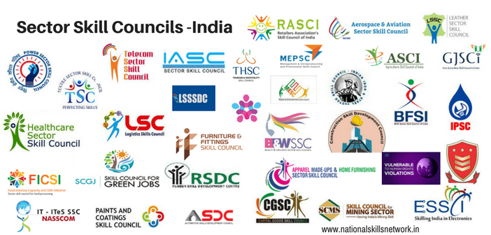
SECTOR SKILL COUNCILS
The SSCs operate as an autonomous body and registered as a Section 8 Company. NSDC is mandated to initiate and incubate SSCs with initial seed funding to facilitate their growth and enable them to achieve self-sustainability in a time bound manner.
It plays a vital role in bridging the gap between what the industry demands and what the skilling requirements ought to be.

Slide 48
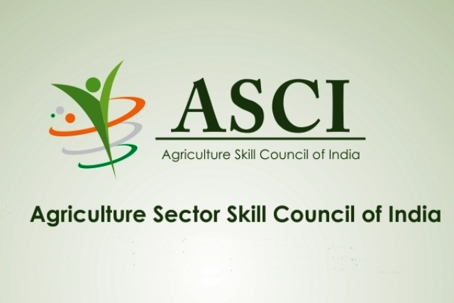
AGRICULTURE SKILL COUNCIL OF INDIA
Agriculture Skill Council of India (ASCI) is a Section 8 Not for profit concern working under the aegis of Ministry of Skill Development & Entrepreneurship (MSDE).
ASCI works towards capacity building by bridging gaps and upgrading skills of farmers, labors & extension workers engaged in Agriculture & Allied Sectors.

Slide 49

What does ASCI do?
Affiliation & Accreditation
Certification
Development of Qualification packs(QPs) / NOS
Assessment Of Training Programs
Training partners
Placements

Slide 50
With the development of 182 Qualification Packs, ASCI has covered segments:
Farm Mechanization and Precision Farming Agri-Information Management Dairy Farm Management Poultry Farm Management Fisheries Animal Husbandry Post-Harvest Supply Chain Management Forestry and Agro Forestry Watershed Management | Amenity Horticulture and Landscaping Production Horticulture Seeds Industry Soil Health Management Commodity Management Agri Entrepreneurship & Rural Enterprises Other Allied

Slide 51

KARNATAKA SKILL DEVELOPMENT CORPORATION (KSDC)
Set up in 2008, KSDC, under the aegis of the Skill Development, Entrepreneurship and Livelihood (SDEL) Department, Government of Karnataka,
KSDC provides skill training in multiple sectors, including automotive, IT & ITeS, logistics, apparel, and electronics, to name a few.
It provides short-term vocational training to more than 60,000 candidates annually under the Pradhan Mantri Kaushal Vikas Yojana (PMKVY) and the Chief Minister’s Kaushalya Karnataka Yojane (CMKKY).
Through its network of more than 800 accredited training centres spread across the state,

Slide 52

KARNATAKA SKILL CONNECT PORTAL
https://skillconnect.kaushalkar.com
Karnataka Skill Connect is an initiative by the Government of Karnataka, to connect job seekers with potential employers through a centralized online platform.
The Karnataka Skill Connect platform also offers various features to job seekers, such as skill assessments, training programs, and career counseling services.
Additionally, the platform also provides information on job fairs, job openings, and other employment-related events.

Slide 53
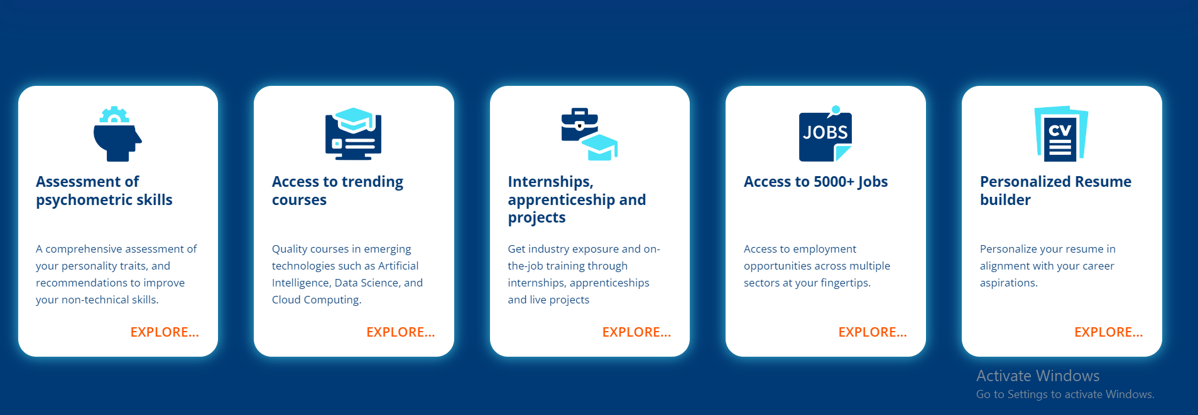

Slide 54


Slide 55
RURAL DEVELOPMENT AND SELF EMPLOYMENT TRAINING INSTITUTE (RUDSETI)
Rural Development and Self Employment Training Institute (RUDSETI) has its roots in Karnataka, India, and the first RUDSETI was established in 1982 in the town of Ujire in the Dakshina Kannada district of Karnataka.
In Karnataka alone, there are currently over 50 RUDSETI centers located in different districts across the state.
The RUDSETI centers in Karnataka offer various training programs and courses to rural youth and women in different areas such as agriculture, animal husbandry, handicrafts, and other trades that are relevant to the local economy.
The training programs also include soft skills development, financial literacy, and entrepreneurship development.

Slide 56
KRISHI VIGYAN KENDRAS (KVKs)
KVKs also offer vocational training programs and courses in areas such as food processing, dairy farming, poultry farming, beekeeping, and other trades that are relevant to the needs of rural communities.
These vocational training programs are aimed at creating new job opportunities and promoting self-employment among rural youth.
In addition, KVKs collaborate with various institutions and organizations to provide certification courses and skill development programs in specialized areas such as organic farming, precision farming, and value chain development.

Slide 57
UNIVERSITY of AGRICULTURAL SCIENCES BANGALORE
Some of the ways in which the university promotes skill development are:
Hands-on training: UASB provides hands-on training to its students through various programs like experiential learning, internships, and industrial training. This helps students to acquire practical skills in their chosen field of study
Entrepreneurship development: UASB has a Centre for Agri-entrepreneurship Development
Industry collaborations: The university collaborates with various industries and organizations to provide real-world exposure to its students.
Skill-based courses & Research opportunities
Offers skill training though bakery training unit, farmes training institute, STU etc.,

Slide 58

SKILL DEVELOPMENT CENTRE, UAS BANGALORE
The University has established Skill Development Center (SDC) under ICAR- SC-SP: 2019-20 at UAS, GKVK, Bengaluru.
An amount of Rs. 204 lakhs has been released by ICAR, New Delhi during the year 2019-20.
It covers the 10 districts in university jurisdiction, with focus on SC, ST beneficiaries both farmers, students and other stakeholders

Slide 59
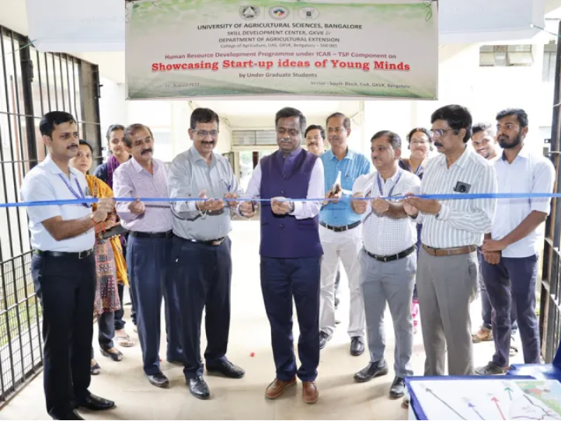
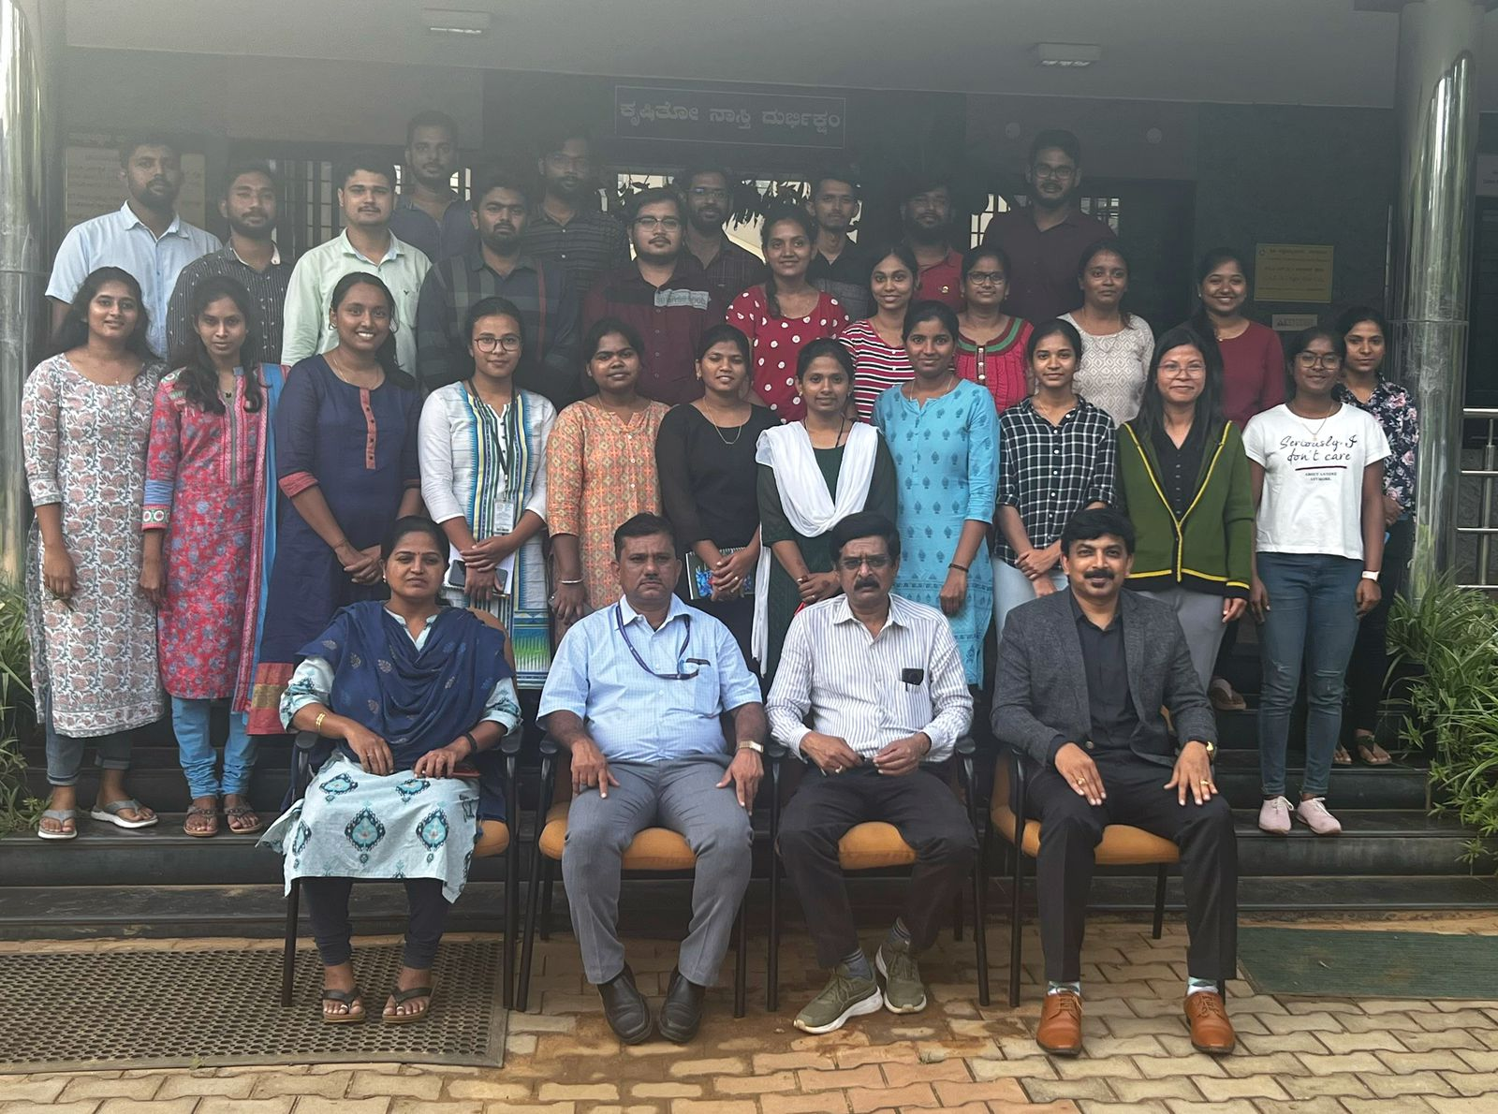
The SDC trainings consist of the following components:
EDP entrepreneurship Development Programme(26)
Training and capacity building programme(5)
Human Resource Development(13)
Tutorials(1)
Livestock Management(1)
The duration of training programs vary from 1 day to several weeks.
The training is purely based on proposal from Scientist, Subject matter specialists.

Slide 60

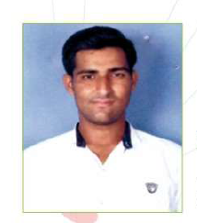
SUCCESS STORY
Name | Ankitbhai
Age | 25 years
Nodal training institute | KVK Kheda
Scheme | Rashtriya Krishi Vikas Yojane
Course duration | 200 hours
Annual income before training | ₹ 6.8 lakhs
Annual income after training | ₹ 22 lakhs
Key Skills Gained: | Construction and maintenance of cattle shed, feed and live stock management, work place hygeine

Slide 61
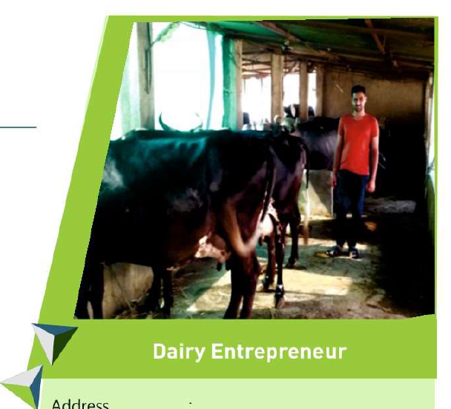
Mr. Ankitbhai is from a small village called Tranja in Kheda district of Gujarat.
He was doing dairy farming on 3ha of land, following the traditional methods.
He had 10 dairy animals and he provided 65 liters of milk approximately to the village milk cooperatives every day.
After getting to know about the skill training programme in dairy management, he enquired and got selected for training in KVK
At the end of the training, a project report was prepared by him for the purpose of obtaining a loan
Mr.Ankitbhai got a loan of ₹ 4.5 lakhs from a bank and purchased more dairy animals. Mr Ankitbhal now has 17 dairy animals and the milk yield has gone up from 65 litres to 150 litres per day.

Slide 62

ISSUES & CHALLENGES IN SKILL DEVELOPMENT

Slide 63


Awareness, mindset and perception issues
Skill development in India is way below the requirements due to a lack of awareness on the type of courses as well as information on the career aspects.
Skilling is often viewed as the last resort meant for those who have not been able to progress in the formal academic system.
Skill development is often associated with blue collar jobs, which is largely perceived to be of low dignity and provides low wages.
The perceived 'stigma' associated with skill development has resulted in low enrolments in vocational education courses.

Slide 64


Cost concerns
Skill development initiatives in India continue to be largely dependent upon the government funds or public-private ventures.
Owing to high capital requirements and low return on investments, skill development is often looked at as a non-scalable model and remains underinvested.
Additionally, a fee-based model also faces challenges as prospective students are often unwilling or unable to pay high fees for training.

Slide 65


Quality concerns
There is a serious mismatch between the industry’s requirements and the skills imparted in educational and training institutes, especially for the mid-level skills requiring some expertise on handling of machinery.
In terms of infrastructure, the institutes often lack appropriate machinery to give students hands-on training.
Even the course curricula often are outdated, redundant and non-standardised
The availability of good quality trainers is also a key concern. The quality of trainers is affected due to limited efforts towards re-training and skill improvement of trainers.

Slide 66

Mobility concerns
In India, educational qualification is generally preferred over vocational training as former is associated with better employment opportunities, in terms of pay as well as quality of work.
There is limited mobility between formal education and vocational training in India due to lack of equivalent recognition for the latter;
A student enrolled in vocational training often cannot migrate to institutes of higher education due to eligibility restrictions.

Slide 67
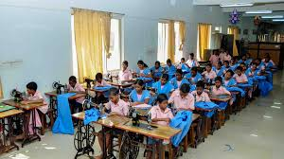
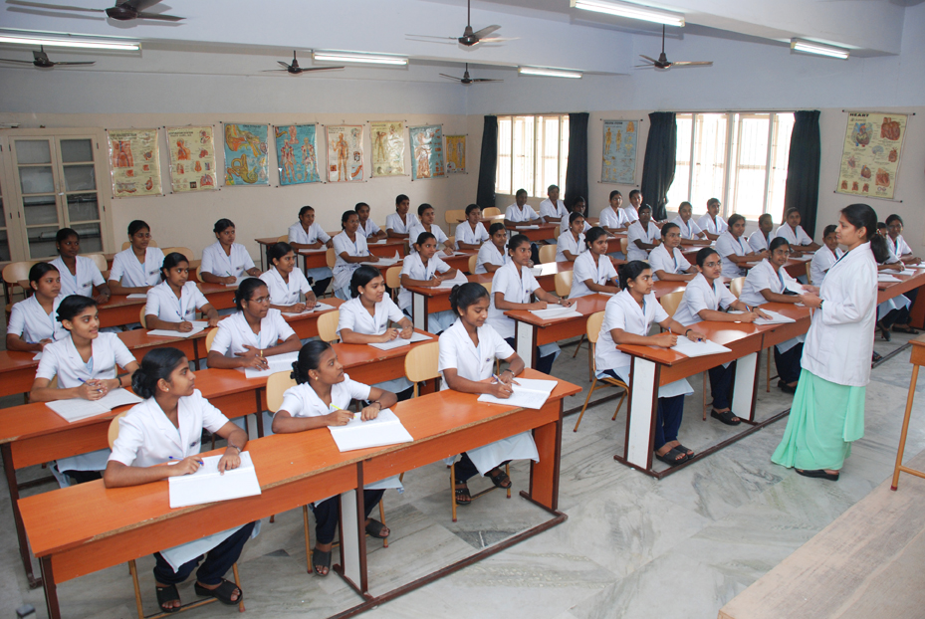
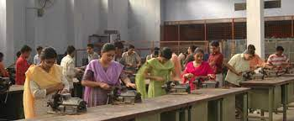
>

Slide 68
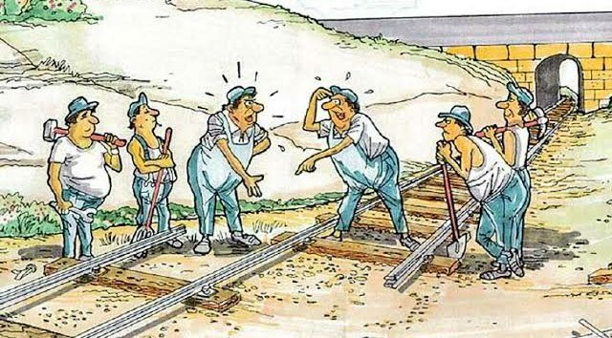

Other challenges include:
Skill development programmes of the Central Government are spread across more than 20 Ministries/Departments without any robust coordination and monitoring mechanism to ensure convergence.
Multiplicity in assessment and certification systems that leads to inconsistent outcomes and causes confusion among the employers.
Insufficiency of trainers, inability to attract practitioners / experts from industry as faculty.
Very low coverage of apprenticeship programme.

Slide 69
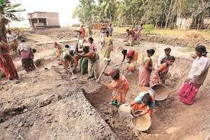

Declining labour force participation rate of women.
Pre-dominant non-farm, unorganized sector employment with low productivity but no premium for skilling.
Non- inclusion of entrepreneurship in formal education system.
Inadequate impetus to innovation driven entrepreneurship.
Lack of mentorship in entrepreneurship

Slide 70

RESEARCH STUDIES

Slide 71
Research
Study
1
TRAINING EFFECTIVENESS OF SKILL DEVELOPMENT TRAINING PROGRAMMES AMONG THE
ASPIRATIONAL DISTRICTS OF KARNATAKA
G. S. Arun Kumar et al. 2021
Raichur, Yadgiri
Ex post facto research design
Size of the sample 120

Slide 72
RESULTS
Distribution of respondents based on skill development training effectiveness
Training effectiveness | Agricultural labourers (%) | Farmers (%) | Total (%)
Low | 28 | 13 | 21
Medium | 50 | 52 | 51
High | 22 | 35 | 28
total | 100 | 100 | 100

Slide 73
Effectiveness of different aspects of skill development trainings
Sl.No | Training Aspects | Low | Medium | High | WMS | Rank
1 | Quality | 21 | 82 | 17 | 1.966 | VII
2 | Utility | 24 | 73 | 23 | 1.991 | VI
3 | Coverage | 19 | 67 | 34 | 2.125 | I
4 | Physical facilities | 20 | 77 | 23 | 2.025 | III
5 | Competency of trainers | 14 | 90 | 16 | 2.016 | IV
6 | Skill development aspects | 28 | 63 | 29 | 2.008 | V
7 | Appropriateness of trainee | 12 | 82 | 26 | 2.116 | II
8 | Need assessment of trainees | 27 | 75 | 18 | 1.925 | VIII

Slide 74
Benefits of training programmes as perceived by the respondents
Sl.no | Training benefits | Highly |  | Moderately |  | Low |  | WMS | Rank
 |  | Freq | % | Freq | % | Freq | %
1 | Increase in knowledge | 54 | 45.00 | 53 | 44.16 | 13 | 10.83 | 2.32 | II
2 | Gain in Skills | 68 | 56.66 | 35 | 29.16 | 17 | 14.16 | 2.42 | I
3 | Increase in income | 32 | 26.66 | 50 | 41.66 | 38 | 31.66 | 1.95 | IV
4 | Enhancement in entrepreneurial ability | 44 | 36.66 | 56 | 46.66 | 20 | 16.66 | 2.30 | III

Slide 75
Research
Study
2
AN ANALYSIS OF SUCCESS RATE OF ENTREPRENEURSHIP DEVELOPMENT PROGRAMME OF ENTREPRENEURS OF RUDSETI OF NORTH KARNATAKA
Geeta P. Channal and K.V. Natikar 2022
North Karnataka
Ex post facto research design
Size of the sample 300

Slide 76
RESULTS
Comparison between trained and untrained respondents on types of enterprise adopted
Types of enterprise | Trained (n=150) |  | Untrained (n=150)
 | No. | % | No. | %
Agriculturally based enterprises | 33 | 22.00 | 1 | 0.67
Product based enterprise | 76 | 50.66 | 93 | 62.00
Process based enterprise | 25 | 16.68 | 10 | 6.66
general | 16 | 10.66 | 46 | 30.67
Financial assistance to entrepreneur
Types of assistance | Trained (n=150) |  | Untrained (n=150)
 | No. | % | No. | %
Own money | 17 | 11.33 | 26 | 17.33
Borrowed from others | 28 | 18.67 | 95 | 63.34
Bank loan | 105 | 70.00 | 29 | 19.33

Slide 77
Success rate of EDP trainings given by RUDSETI
Categories | Vijayapura | Bagalkot | Uttar Kannada
Total no. of trainees trained | 3496 | 2663 | 2127
Total no. of trainees settled | 2260 | 2036 | 1146
Success rate (%) | 64.64 | 76.45 | 53.87
Time lag in establishing an enterprise by trained entrepreneurs (N=150)
Categories | No. | %
0-3 months | 29 | 19.33
4-6 months | 48 | 32.00
7-9 months | 24 | 16.00
10-12 months | 19 | 12.67
More than 12 months | 30 | 20.00

Slide 78
CONCLUSION

Slide 79

Thank You

