Slide 1
Diffusion and Adoption of Agricultural Innovations

Slide 2
Diffusion and Adoption
Goal of Extension – TOT / AT
30-40%
Reasons
Lack of effective diffusion
Poor understanding of diffusion and adoption process
Function of Extension is to Bridge the gap > through inform and accelerate adoption
Known Vs Adoption
No. of new practices adopted
No. Farmers / Communities adopted

Slide 3
Questions
Why there is a time Lag in technologies Known Vs Adopted?
Where do farmers get new idea?
Why Some villages/ people are faster in adoption
Why some innovations are adopted speedier?
Answer : Needs good understanding of
Diffusion
Adoption
Processes of D & A and
Innovation Characteristics

Slide 4
Adoption & Adoption Process
Adoption
is a decision to make full use of an innovation as the best course of action available.
Adoption Process
Mental process through which and individual passes from hearing about an innovation to final adoption
There are five important stages (AIETA)
Awareness
Interest
Evaluation
Trial
Adoption

Slide 5
Diffusion
DIFFUSION
process by which an innovation is communicated through certain channels over time among the members of social system.
DIFFUSION OF INNOVATIONS
special type of communication, in that the messages are concerned with new ideas.
DIFFUSION PROCESS
Process by which the spread of new idea from its source of innovation / creation to its ultimate user/ adopters

Slide 6
Diffusion Vs Adoption Invention Vs Innovation
INNOVATION
an idea, practice or object that is perceived as new by an individual or other unit of adoption.
Eg. AI, Sensor based Fertigation, RG Transplanting, AR VR Gadgets
DIFFUSION :
Process related to adoption of innovation by entire social system
Adoption:
Sequence of thoughts and actions which individual goes through before he finally adopts
Invention:
Creation of new idea / concept
Innovation:
Turning concepts into commercial sources / widespread use

Slide 7
Communication Vs Diffusion
 | Communication | Diffusion
Type of message | Any | Innovation
Process | Routine | Specific / Specialised
Risk in message | Less / Nil | Degree of risk involved
Resistance among users | Less | More resistance
Timing | Any time | Specific
Results in | Change in KASA | Adoption / Rejection
Rejection is a decision not to adopt an innovation

Slide 8
INNOVATION - DECISION PROCESS
is the process through which an individual (or other decision - making unit) passes from first knowledge of an innovation, to forming an attitude towards the innovation to a decision to adopt or reject, to implementation of the new idea, and to confirmation of this decision.
Four elements of Innovation – Decision Process (ICTS)
First Knowledge
Forms Attitude
Decides
Implements
Confirms
Innovation
Communication. Channel
Time
Social System

Slide 9
Innovation
The perceived newness of the idea for the individual determines his or her reaction to it.
The "newness" aspect of an innovation may be expressed in terms of knowledge, persuasion or a decision to adopt.
First time Aware
Farmers innovation

Slide 10
Perceived Attributes Of Innovation
Relative Advantage
Compatibility
Complexity
Trialability
Observability
Predictability

Slide 11
a. Relative advantage
is the degree to which an innovation is perceived as better than the idea it supersedes.
The degree of relative advantage may be measured in economic terms, but social-prestige factors, convenience and satisfaction are also often the important components.
Varieties Vs Hybrid ( More Yield)
Manual Vs Machine Operated (Less Labour/Drudgery)
Prestige / Cost / Comfort / Time / Labour / Yield / Income / Investment / Multiple Use / Drudgery / consumption / easiness

Slide 12
b. Compatibility
is the degree to which an innovation is perceived as being consistent with the existing values, past experiences and needs of potential adopters.
Increase security by minimizing risks
(Plastic Vs Mud/Iron implements/Containers) Tractor Drawn Seed Dril, Harvester Vs. Panchagavya, Mudpot Storage, Solar Cooker, Organic Production/Consumption
Plough Mounted seeder/ Tractor Mounted Equipments Vs Ariel Vehicle Mounted

Slide 13
c. Complexity
is the degree to which an innovation is perceived as difficult to understand and use.
New ideas that are simpler to understand will be adopted more rapidly
than innovations that require the adopter to develop new skills and understandings
Types of Complexity
Simple change – Change of Seeds / Fertilizers
Improved practice – change in operation – Intercrop / Rotation / Hybrid Seed Production
Innovation – entirely new practice / operation contour/ Shade net / Transplanter
Change enterprise – Dairy > Sheep > Poultry > Emu

Slide 14
d. Trialability
is the degree to which an innovation may be experimented with on a limited basis.
An innovation that is trialable represents less uncertainty to the individual who is considering it for adoption, as it is possible to learn by doing
Examples
Use of New Varieties / Hybrids
Redgram Transplanting
Direct marketing
Export
Poly house Cultivation
Cloud Seeding
Harvesters / HSP

Slide 15
e. Observability
is the degree to which the results of an innovation are visible to others.
The easier it is for individuals to see the results of an innovation, the more likely they are to adopt
Eg.
Balanced Fertilizers Vs Nitrogen only
Pesticide Application Vs. Foliar Micronutrient Application
Life Irrigation Vs Seed Treatment

Slide 16
Predictability
Degree of certainty of receiving expected benefits from adoption of an innovation
Cultivation of Ragi instead of Pulses by resource poors
Preventive innovation
Idea that an individual adopts at one point in time in order to lower the probability that some future unwanted event will occur
Eg. Crop Insurances / Non Smoking / Futures Trading / Contract Farming

Slide 17
2) Communication channels:
Interpersonal channels
Mass media channels
Localite channels
Cosmopolite channels

Slide 18
Channels of Communication
i) Interpersonal Channels –
It refers to those which are used for face to face communication between two or more individuals.
Eg. Relatives – Friends – Neighbours – Extension Personnel
ii) Mass Media Channels -
These enable the messages to reach a larger, diverse audience simultaneously in a relatively shorter time.
Eg. Radio, TV, Social Media
iii) Localite Channels
They originate within the social system of the receiver.
Eg. Neighbours, Relatives, Opinion leaders etc.
iv) Cosmopolite Channels
They originate outside a particular social system.
Eg: Extension worker, sales personnel etc.
Personal Cosmopolite
Impersonal Cosmopolite
Personal Localite

Slide 19
3. Time
Time is an obvious aspect of any communication process. Time does not exist independently of events, but it is an aspect of every activity.
The time dimension is involved in diffusion
Innovation - decision process
Mobile Phones 10 yrs Vs Smart Phone 3 Yrs
TV – 30 Yrs. Cable – 10 Yrs DTH - 5Yrs
Innovativeness of an individual or unit of adoption
Govt. of Karnataka Implemented e-governance on land records
Agritech Portal Launched by TNAU in 2009
BMTC introduced electronic ticketing in 2005
innovation's rate of adoption in a system
Adoption of Helmet Voluntary Vs Compulsion
Bangalore > 15 Yrs Chennai <5 Yr.
Coastal / Season

Slide 20
4. Social System
Set of interrelated units that are engaged in joint problem solving to accomplish a common goal.
Members or units of a Social System
Individuals – Farmers
Informal groups – Youth Groups / Women Groups / Particular crop growers
organisations and / subsystems – Cooperatives / NGOs
The social system constitutes a boundary within which an innovation diffuses.

Slide 21
Stages in the Innovation-Decision Process
1. Knowledge stage:
i). Awareness - knowledge
ii). How-to knowledge
iii). Principles knowledge
2. Persuasion stage
3. Decision stage
4. Implementation stage:
5. Confirmation stage:
Confirms
Implementation
Decision
Persuasion
Knowledge Stage

Slide 22
Knowledge Stage
Awareness - knowledge
Drone Sprayer
How-to do knowledge
Operational skills in manual / motorized
Operating drone sprayer, Cleaning & Maintenance
Principles knowledge
Principles of flight/ air flow/ spray droplets / PPT Sci.
Repairing / Modifying / devising / cusomising better drones
Leaflets / posters / Notices

Slide 23
Persuasion
Knowledge & Persuasion are mental activity
Knowledge is Cognitive Vs Persuasion is Affective
Persuasion occurs when an individual / Unit forms a favourable or unfavourable attitude toward the innovation
a general perception of the innovation is developed
individual becomes more psychologically involved with the innovation &
seeks information about the new idea
Cost / Companies / Loans

Slide 24
Decision Stage
occurs when an individual / DM unit engages in activities that lead to a choice to adopt or reject the innovation
Adoption is a decision to make full use of an innovation as the best course of action available.
Small scale trial / Contact Companies / Applying loans / Ordering installs
The small - scale trial
is part of the decision to adopt, and is important as a means to decrease the perceived uncertainty of the innovation for the adopter.
Rejection is a decision not to adopt an innovation.

Slide 25
Implementation stage
occurs when an individual / DM unit puts an innovation into use.
Implementation involves overt behaviour change as the new idea is actually put into practice.
Problems of implementation
Individual Vs Organisation
more serious in an organisation rather than individual.
Number of individuals involved in ID Process
implementers are often a different set of people

Slide 26
Confirmation stage
occurs when an individual / DM unit seeks reinforcement or reverse decision
Reinforces if exposed to encouraging messages
Reverses if exposed to conflicting messages
continues after the decision to adopt or reject for an indefinite period in time.
change agents have the additional responsibility of supporting messages – follow up

Slide 27
Discontinuance
Decision to reject an innovation after having previously adopted it.
Two types
Replacement discontinuance
Varieties – Hybrid – Bt Cotton-
Sprinkler / Drip / sensor
Disenchantment discontinuance
Drum Type Biogas Plants

Slide 28
Over adoption
Adoption of an innovation, rather vigorously when experts feel that it should not be done so.
Insufficient knowledge
Inability to predict its consequences
Eg. Borewells, Pomegranate Pesticide Application
Extension agent has to prevent over adoption
Adequate knowledge
Awareness of consequences

Slide 29
Adopter Categories
Innovators (Venturesome)
Early adopters (Respectable)
Early majority (Deliberate)
Late majority (Skeptical)
Laggards (Traditional)

Slide 30
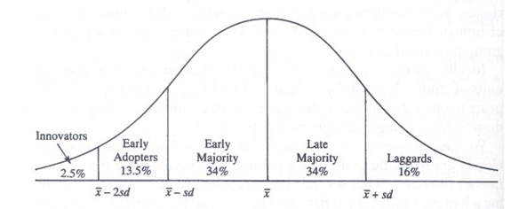
Adopter Categories

Slide 31
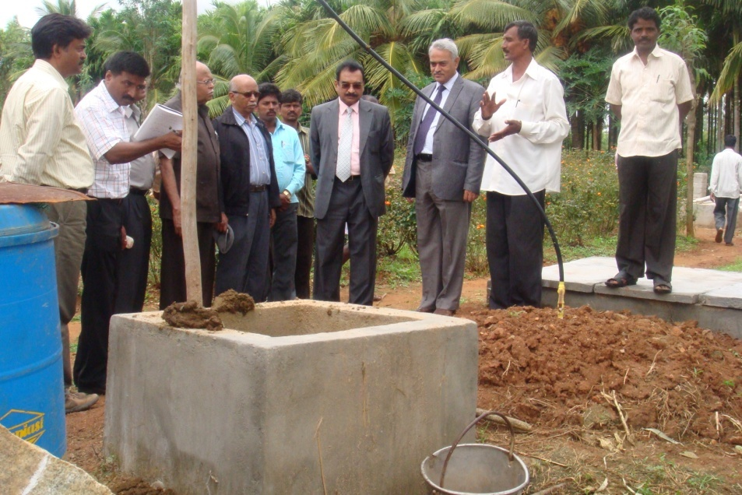
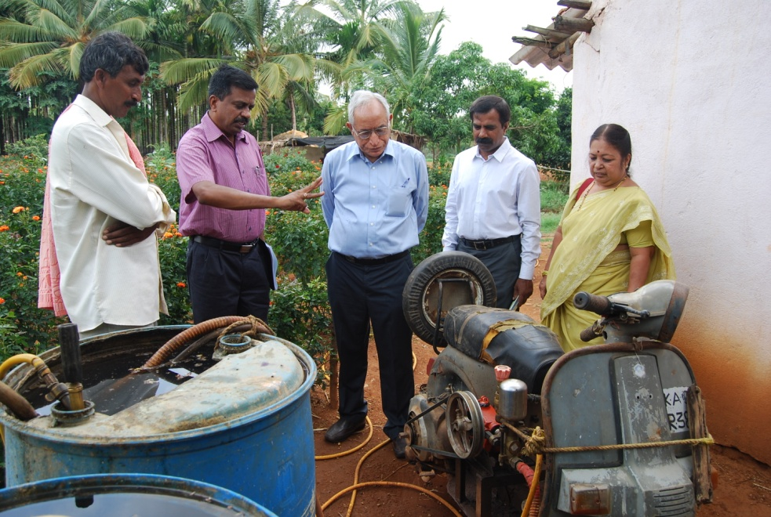
Innovators
Venturesome & first to adopt, Much ahead of other
Very few in number
May deviate social norm, Viewed as deviants
Oriented to development of Good contact with Research / Extension
Sadananda
Veerbhadraiah
Raghunath

Slide 32
Characteristics
Cosmopolite
Formal and informal contacts outside
Large enterprise
Young to Middle Aged
Well Educated
Mentally Alert
Respect /Prestige among progressive community
Actively seek new ideas
By-pass extension worker
Risk oriented
Financial resource
subscribe to publications
Not a source of information for neighbours and friends

Slide 33
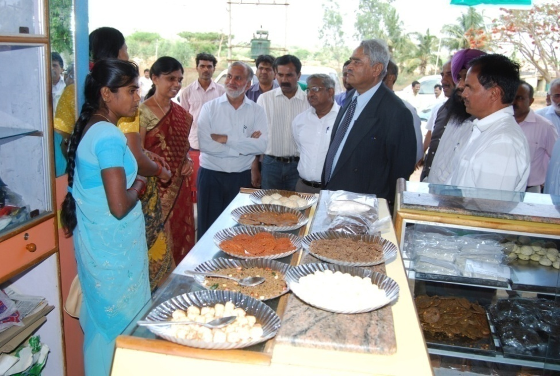
Early Adopters
Respectable
Localite & more integrated part of community
Average members of the community
Have opinion leadership and potential adopters look to them
"the man to check with"
Maintain leadership /prestige in community
Sought by change agents to be a local missionary
Role model for many other members
continue to earn esteem

Slide 34
Characteristics of Early Adopters
Literate
Large enterprise
High income
Participative & good cosmopolite contact
Don’t test untried ideas
Quickest to use tried ideas
Source for "Neighbours and Friends"

Slide 35
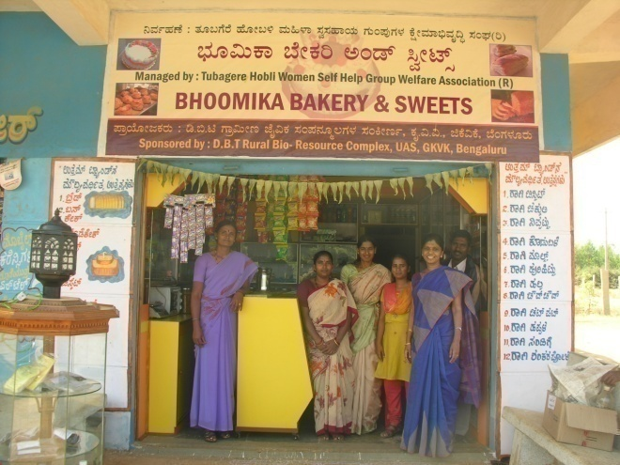
Early Majority
Adopt just before the average members of community
Neither very early nor relatively late to adopt
Deliberate and take longer time to decide

Slide 36
EM: Characteristics
No leadership but have active extension participation
Above average in education, socio-economic status, Experience
Limited resources
avoid hasty / poor decisions
Less cosmopolite channel contact
Neighbours and friends – majority seek information
Important link in Diffusion
"Be not the last to lay the old aside, nor the first by which the new is tried“
Few Publications
Less active in formal groups
attend extension Programmes
They are "Neighbours and Friends"

Slide 37
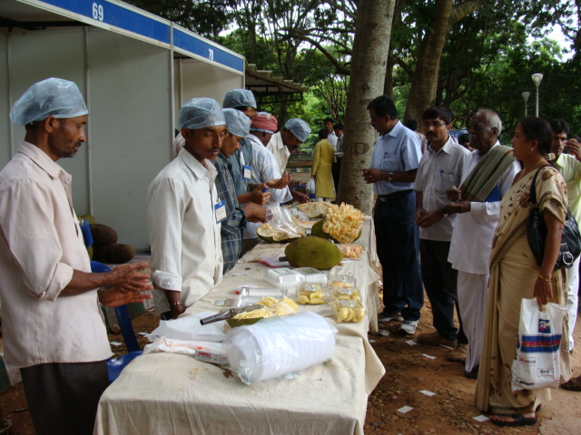
Late Majority
Cautious and Skeptical
Adopt just after the average members
Adopt since other people have adopted and benefitted
economic necessity /social pressures
Need to be persuaded and motivated for adoption

Slide 38
Late Majority
Characteristics
Low level education
Low level participation
Contact Localite channels
fewer leadership roles
read fewer publications
do not participate outside

Slide 39
Laggards
Traditional
Last to adopt innovation
Innovation gets superseded by more new ideas

Slide 40
Characteristics of Laggards
Localite and interact with people have traditional values
Many are near isolates
Decisions are based on previous generations.
Frankly suspicious of innovation, innovators and Extension agents
Fast moving world shocking and difficult to adjust
Slows the process of innovation decision to a crawl
Do not have opinion leadership and forgotten people
Little / no education, hardly contact
Share croppers/ labourers, little / no land
Live in areas have least urban influence
Most disadvantaged socio-economic
Least Participate in formal organizations / programmes
Hardly read Publications

Slide 42
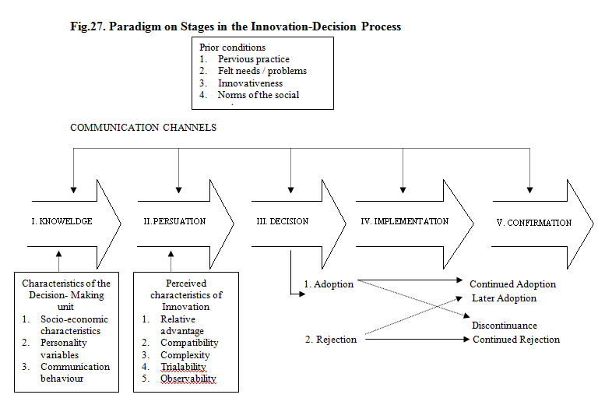
Model of Innovation Decision Process

Slide 43
Model of ID Process
Antecedents
Variables present in the situation prior to introduction
Practice, felt needs, problems, innovativeness & Norms
Process
Characteristics of DM unit
SE Status, Personality Variable, communication behaviour
Cosmopolite and mass media channels – Pers. L/IP Channel
Consequences
KPDICD

Slide 44
Stages in Adoption Process
Rogers
Knowledge
Persuasion
Decision
implementation
Confirmation
Discontinuance
North Central Rural Sociology Subcommittee (1955)
Awareness
Interest
Evaluation
Trial
Adoption
Need
Awareness
Interest
Deliberation
Trial
Evaluation
Adoption

Slide 45
Criticism on AIETA (NCRSS)
Stages – dynamic not static
Not all 5 stages occur with all
Sequence
One stage appears more than one
Stages are so short
Stages can be skipped
Lacks clear-cut difference

Slide 46
Stages in Adoption Process (Singh and Pareek 1965)
Need
Change, dissatisfaction, compromise
Awareness
Something related to need
Interest
Tries to know more
Deliberation
Mental examination
possibility, seek advice, observes performance, discuss with FnF
Trial
Applies on limited scale on own condition
Evaluation
Considers Various dimensions
Adoption
Extends in terms of time and extent

Slide 47
Social Factors
Factors Influencing Adoption Process
Social values
Material gains
Prestige
Tradition
established customs
Local Leadership
Look for leaders nod
Informal Leaders
Opinion Leaders
Lay leaders
Social Contacts : within and outside the community
Nature of social contact – Organisational contact Vs Individual contact
Extent of Social Contact – Immediate Localite Vs outside Contact
Innovative/Progressive Farmers >> Institutes/ Informative Persons
Social Distance – social status differences
Tenant Vs Large owners
Low/High Cast individuals
Rigid class structure
Culture
Man made environment
Behavior is modeled

Slide 48
Personal Factors
Personal
Age
Education
Psychological characteristics
Rationality
Mental Flexibility
Change Proneness
Attitude
Education / Science / traditionalism, isolationism, and security

Slide 49
Situational Factors
Nature of the practices
Complexity
Simple change
Improved practice
Innovation
Change in total enterprise
Cost
Net returns
Compatibility
Divisibility (Trialable)
Communicability (Observable)
Farm income
Size of Farm
Tenure Status
Sources of information used
No. of sources used
Formal Vs Informal Sources
Dependence on Friends and Relative
Mass media use
Standard of living

Slide 50
Types of Innovation Decisions
Optional Decisions
Norms of social system and his need to confirm
Family Planning, Hybrid/Bt
Collective Decisions
Decisions are made by consensus – Adherence
Organic village
Authority Decisions
Forced upon by person in power
Contingent Decisions
Choice to adopt / reject d/o systems ID

Slide 51
Models of Diffusion
Hypodermic Model
One step Model
Magic Bullet Theory
Stimulus –Response
Exerting powerful and direct influence
Rapid and Uniform effect on passive audience
Audience connected to MM and not among themselves
Mass Media
Audience

Slide 52
Models of Diffusion Two step Flow Model
Katz and Lazerfeld Theory
MM invariably mediated by opinion leaders
Radio / print > opinion leaders > less active sections
OL interpret message to groups
OLs are message specific
Agriculture, Politics, Finance
Interaction among audience
Limits
Activeness / No. of Steps / Other Sources
Mass Media
Opinion Leaders
Followers

Slide 53
Models of Diffusion Multistep Flow Model
Posses all characteristics
Sequential process
Relayed through Different agencies
Source
Mass Media
Message
Agency 1
Agency 2
Agency 3
Agency 4

Slide 54
Related Concepts in Diffusion and Adoption of Innovations
Consequences of Innovation
Functional Vs Dysfunctional
Desirable - undesirable
Vary from one system to another
Direct Vs indirect
Manifest Vs Latent
Recognised & Intended
Adoption
Complete adoption - Entire
Non adoption - Never
Partial adoption – few / lesser
Symbolic adoption – Mental
Over adoption –
Adoption Quotient – Ratio Scale > quantifies adoption behaviour

Slide 55
Related Concepts in Diffusion and Adoption of Innovations
Rate of Adoption
Relative speed of adoption by members
No. of indl. Adopt / unit of time
Innovation – Decision Period
length of time required to pas through ID process
Awareness knowledge to decision to adopt
Idea ferments in the mind
Adoption period
Awareness to physical adoption
Personal Localite / Personal Cosmopolite / Impersonal Cosmopolite
Person who are influencing are
Direct / indirect influence
inside / outside social system

