Slide 1
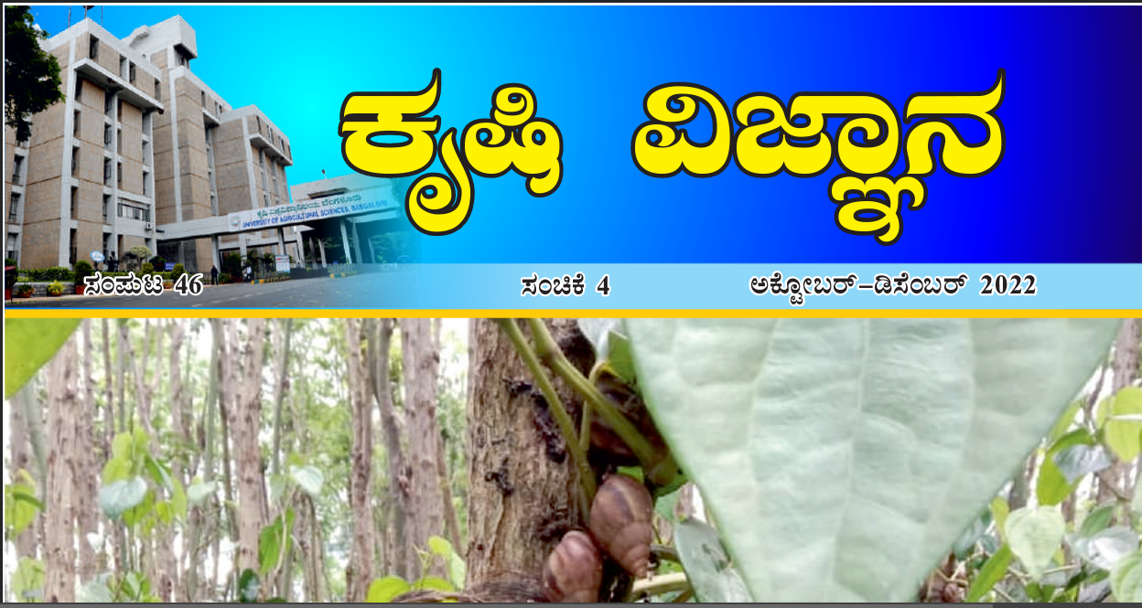
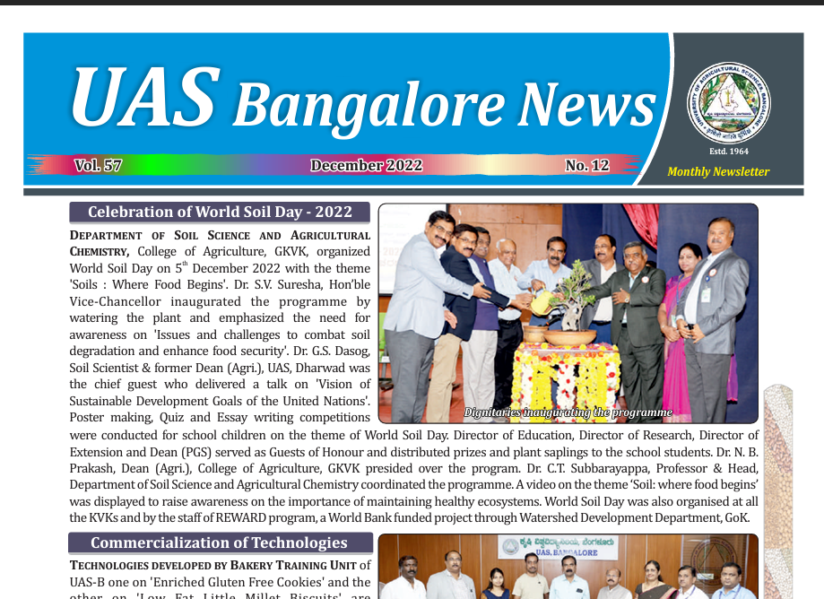
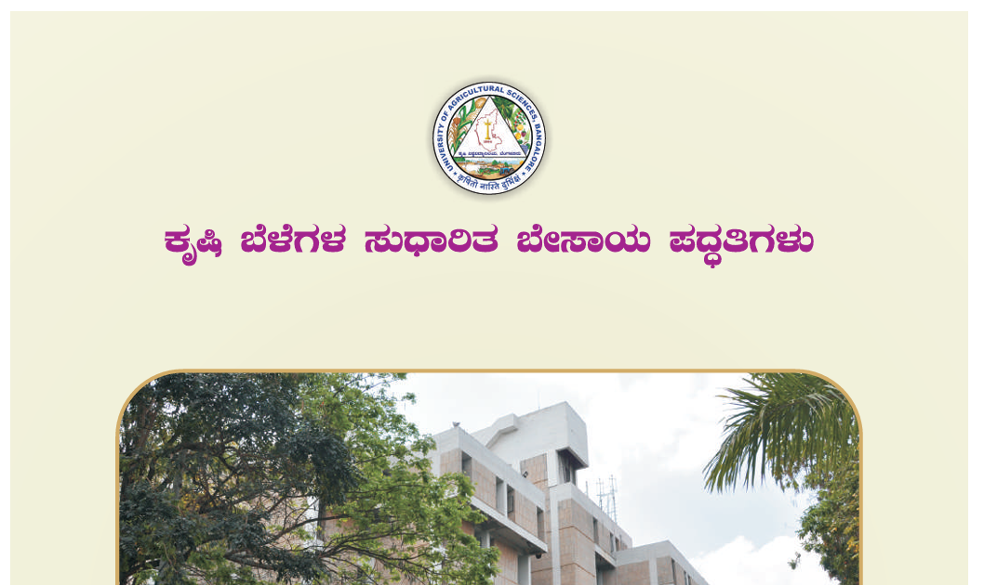
Agricultural Journalism – Meaning, Scope and Importance. Sources of news, Types, Merits and Limitations.

Slide 2
Printing machine – pace of communication
Goa – 1550
Doctorine Christna – 1557
Bengal Gazette – Calcutta General Advertizer - English 1780
Dig Dharshan (Bengali) – News paper 1818 – Oldest and Existing in Asia
Ananda Bazar Patrika – Culcutta
Times of India – Mumbai
Hindustan Times – Delhi
Malayala Manorama – Weekly 11.40 Lakh Copies 1966
1.2% Farm periodicals

Slide 3
JOURNALISM
Journalism is the systematic and reliable dissemination of public information, public opinion and public entertainment by modern mass media of communication.
journalism has become the media of mass education

Slide 4
JOURNALISM
All activities concerned with the communication of mass media is not journalism but the part of that activity involving writing, preparation and production of the communication messages is journalism.
journalists are writers, authors, reporters, correspondents, editors, sub-editors, interviewers, storywriters, scriptwriters, scenario editors and allied specialists.

Slide 5
JOURNALISM
Policies, Decisions, Needs, Reactions, events
Modern Journalism : Political, Entertainment & Economic
literary, political, economic and scientific, household or industrial magazines
Freedom of Press
Editorial : Spirit of Journalism

Slide 6
Elements of Journalism
Obligation to truth
Loyalty
Discipline of verification
Independent Monitor of power
Forum – public criticism and compromise
Strive for interest and relevant
Comprehensive and proportional
Excise personal consciousness

Slide 7
AGRICULTURAL JOURNALISM - Meaning
Agricultural Journalism is the task of collecting, writing, editing and publishing of agricultural information, scientific facts, agricultural technology, events or agricultural news through newspaper, magazine, radio, television, Websites or any other media of communication.

Slide 8
AGRICULTURAL JOURNALISM - Meaning
Agricultural journalism is a specialized branch of journalism which deals with the techniques of receiving, writing, editing and reporting farm information through the media like newspapers, periodicals, radio, TV, advertising, Websites, Social media, etc. and the management processes connected with such production.

Slide 9
AGRICULTURAL JOURNALISM - Meaning & Audience
It is the timely reporting and editing with words and photography of agricultural news and information for newspaper, magazine, radio and television.
This audience may be
farmers, traders, extension workers, policy makers, planners etc.

Slide 10
Comparison
Features | Journalism | Farm Journalism
Purpose | Awareness building | Awareness Plus TOT
Target group | Mass | Rural & farming community in particular
Content Specificity | All types | Agriculture & RD
Temporal consideration | Responsive to events than time | Responsive to time rather than events
Regional consideration | Not necessary | Necessarily cater to regional information need

Slide 11
Principles of Rural Journalism
Use simple language
Short sentences, common words, concrete meanings
Avoid abstract, jargons
Structure and arrange arguments clear
Main Vs. Side issue
Make main points briefly
Keep important information at top
Use lively pictures / photos
Stimulating write up
Interesting, inspiring, diversified, ABC

Slide 12
Rules / Steps to be followed by a journalist
Study the field and have an estimate of what type of articles is published in newspapers, magazines, books etc.
Look for ideas / Develop the idea
Keep an unbiased mind
Write clearly and meaningfully
Remember the people to whom the articles are written

Slide 13
Rules / Steps to be followed by a journalist
Write with a purpose
Write on timely subjects
Keep in touch with editors
Watch out for important events / occasions
Establish credibility, politeness and do not assume familiarity
Understand the communication process and the elements of communication.

Slide 14
SCOPE AND IMPORTANCE OF AJ
In the modern age there is a need to inform millions of people quickly and accurately about scientific, technical and recent developments.
The popular publications are showing desire to publish news of interest of the people. One can develop his ability to get information and write for the people. The scope for news writing is increasing day-by-day. The knowledge (past and present) of the people will be increased by journalism.
The agricultural journalism will help in spreading technical knowledge.
This knowledge will help in increasing agricultural production, irrigation facilities, drinking water facilities, public health and sanitation, increase and development of rural industries, spread of education, communication, animal husbandry, child welfare, youth and women welfare work. By developing these areas good and well developed community can be created.
There is large population in India which is unemployed.
New knowledge and technology can help in solving unemployment and increasing per capita income. With agriculture cottage and small industries can also flourish.

Slide 15
SCOPE AND IMPORTANCE OF AJ
There is need to increase the productivity by the use of modern techniques and methods.
This will improve the economic conditions of the people.
The cultural development can be brought out
by removing the old outdated customs and traditions.
New thinking in line with the modern trends is necessary.
In order to maintain good health, balanced diet, cleanliness etc. people need to be educated.
There is great scope for agricultural journalism in bringing these new technologies to the attention of the farmers.
They can write and publish material for changing the insight of the people. Thus agricultural journalism will help in educating the people and boosting the development of the area. Publicity to the development programmes will help in increasing participation of the people.

Slide 16
Sources of news, Types, Merits and Limitations.
Persons
Publications
Records
Documents
Official Records
Broadcasts
Officials in government or business
Organizations or Corporations
Witnesses of crime / Incidents
Accidents
Events
People involved with or affected by a news event or issue

Slide 17
Types of News
Different Levels
International News
National News
National News Papers, Websites, National Radio
Regional news
is most important in Germany, Finland, and Spain reflecting the relative importance of devolved political power in those countries – and the media systems that have grown up around this.
City and State
Cable tv, Satellite TV, DTH, Community Radio, FM Stations, Local Channels,
Local news
matters more in a vast country like the United States where city newspapers and local TV stations remain a core part of the media diet.
Hyperlocal
LISTSERV®
social media tools
enabled citizens to self-organize, and connect in ever more dynamic ways.
Hyperlocal blogs

Slide 18
Types of News
Entertainment and celebrity news
The Japanese are most interested in, with the Spanish, Danes, French, and Germans showing the least interest
Business news
The Irish take a particular interest in the business news and the economy – as do the Japanese and Australians.
Arts and Culture news
Italians and Spanish are interested in arts and culture news while our sample from urban Brazil is far more interested in health and education than are the rest of our countries.

Slide 19
Hard news & Soft News
Hard News involves time-sensitive news, which is severe and is reported as breaking news immediately.
Political Journalism, Investigative Journalism, Business Journalism, Crime Journalism, Global news, Sports Journalism etc
Soft news is defined as information that is primarily entertaining or personally useful.
New Film, Fashion Show, Exotic Festivals, etc.

Slide 20
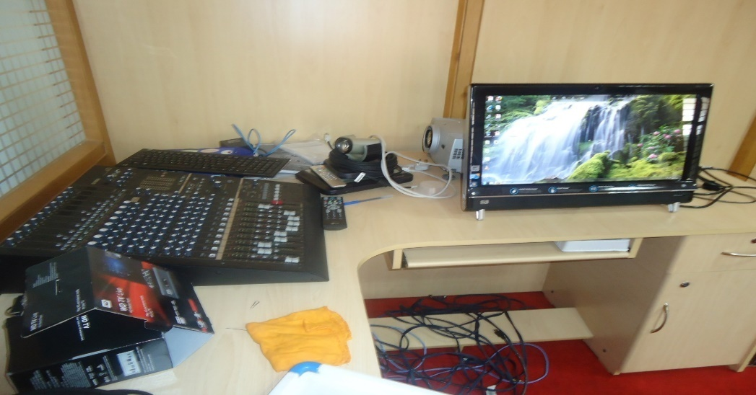
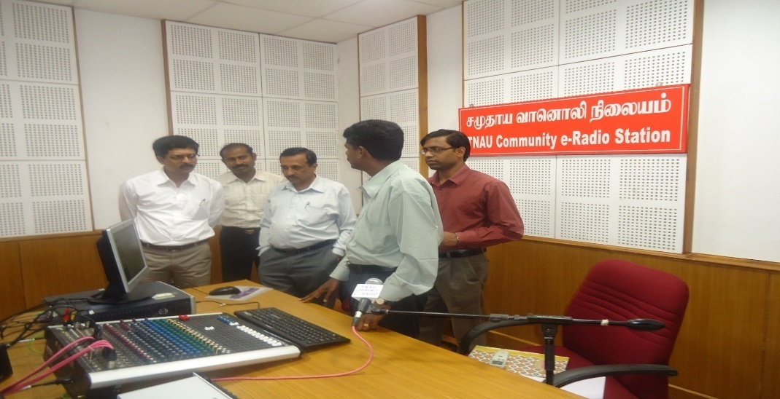
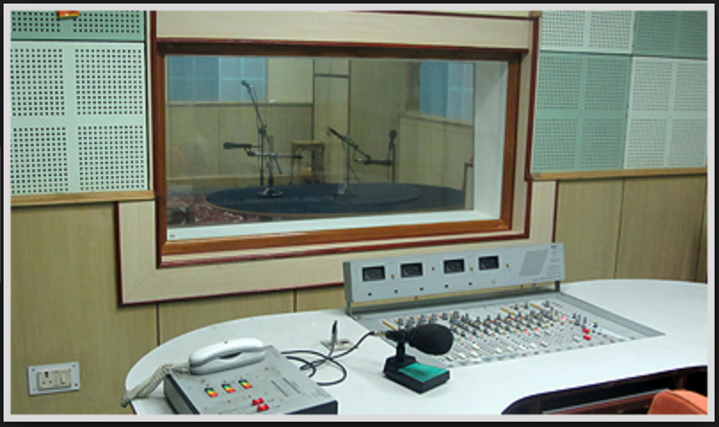
Radio

Slide 21
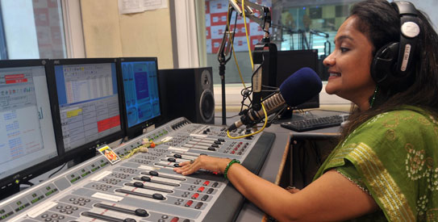
Radio
Electronic audio medium for broadcasting programme to the audience
Reach Audience : Millions – dispersed – remote
Companion Medium
Low cost
Public / Private / community
Programme types
Field Recording / deliver talk / Discussion
Importance
Disseminate information
Motivate farmers on achievement
Inform extension activities / programmes
Indicate functioning of institutions
Information on improvement in life

Slide 22
Radio
Planning and Preparation
Clear thinking on topic
Assemble facts and data
Consult research
Implementation
Script – introduction - body – logical/step by step, conclusion
Revise draft
Until no more addition / deletion
Arrange in Short paras
Contact FRO– approval
Rehearse – Time
Reach in-time
Remain Calm
Deliver in good voice

Slide 23
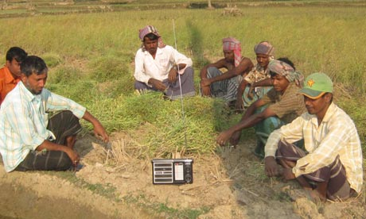
Followup – adv. & limits
Follow up
Inform and encourage to listen
Reply to Queries
Advantages
More coverage, quick
Cheap
Urgent / emergency
Enthusiasm and maintenance
Educational
Disadvantages
Radio sets
Generalised recos.
Stations / slots inaccessible
Less time allocation
Entertainment Vs sustainability
Skilled persons can handle

Slide 24
Radio Programmes
Rural Farm Broadcasting
Farm and Home units 1966 – Wonder Seeds – IADP
Broadcast technical info. On continuous basis in alignment with package of practices in respect of important crops of a particular area along with information about services
To inform and educate the rural women on their effective partnership in traditional to modern farming and home making
Objectives
Inform the farming community about latest scientific techniques of increasing production in all important farm enterprises
To inform the non – agricultural rural population about the subsidiary and agro based enterprises for improving their earnings
To help the rural people to participate in constructive agricultural and social programmes for betterment of rural life
To inform the rural women on important home making on supporting their male counterparts on improved farming and to encourage them to participate in decision making for progress of scientific farming

Slide 25
Radio Rural Forum
Mass media + interpersonal
Small organised group – meet regularly – receive and Discuss its content
Canada > India, Nigeria, Ghana, Costa Rica and Brazil
UNESCO Sponsored - 1956
Biweekly broadcast – discussion – forwarding queries - Expert answering
Chairperson – Convenor – 12-20 members
Convenor – records, attendance, report, format, actions
Advantages
Group Pressure >> Attendance, interest, participation
Change of attitude
Group decisions
High credibility of medium

Slide 26
Farm School on Air
Method of providing systematic education on farming to the farmers through the process of distance learning / radio broadcasting
Steps
Comprehensive syllabus, selection of topics by committee
Trainer Selection – 15-20 lessons
Registration – trainee listeners – radio station
Broadcast – weekly + Repeats
Lecture cum discussion and Q&A
Studio – trainer, extension agent and few farmers
Summary, questions, answers at end
Mail answer sheet, evaluates and marks
Results, participation certificates

Slide 27
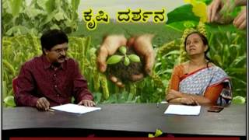
Television
An electronic AV medium which provides pictures with synchronized sound
Cosmopolite
Instant awareness
Immediacy & mobility
Low cost
Multimedia

Slide 28
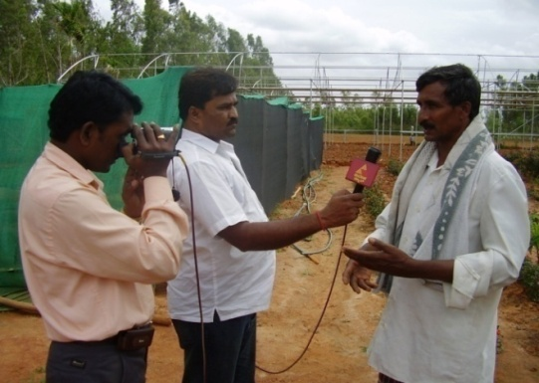
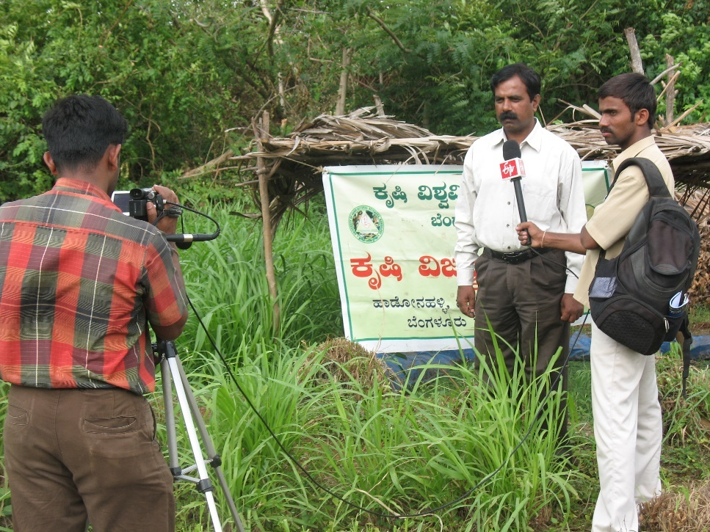
Television
Commercial Vs Non commercial
AIR - Delhi
Sep. 15, 1959 – UNESCO grant
1 hr/ day & Twice a Week
Krishi Dharsan
Pilot programme 1967
Dr. Vikram Sarabhai
Teleclubs
1st April 1976
Doordharshan
Aug. 15, 1982
National Network – INSAT 1A
Colour Television
Asian Games
1984
Cable television Maharashtra / Gujarat
Satellite CNN / Star
1990-92
DD Kisan
26 May 2015

Slide 29
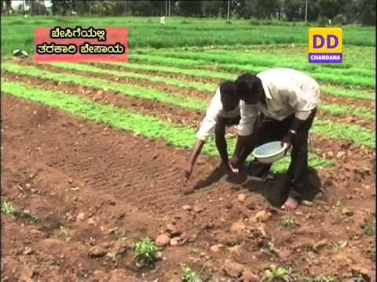
TV - Objectives
Create general awareness among people on agri/RD programmes
Provide need based programme to rural audience
To show rural people /farmers what to do, how to do and with what results

Slide 30
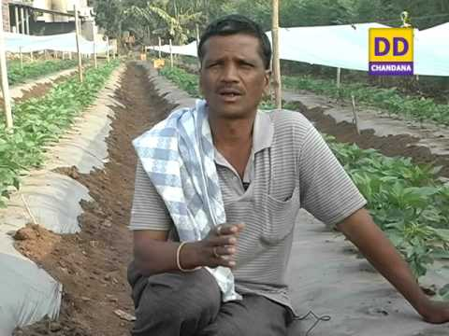
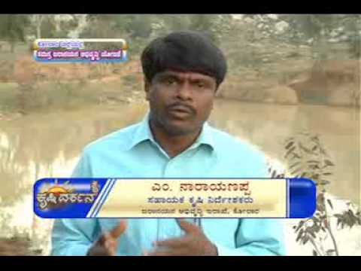
Types
Producer, Agril. Programmes
Publicizing
Field recording of prog/activities / achievements
Recording of research based how to do
Publicizing
Trainings, field day, exhibition, campaign, seminar, symposium, workshop, etc.

Slide 31
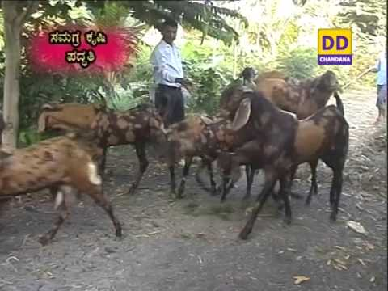
Field / Research (how to do) recordings
Preparation
Decide topic, location & persons
Date, time, itinerary, conveyance
Materials, spots
Script & Cue Sheet
Labels & lettering
2-3 locations / day

Slide 32
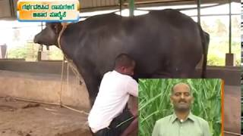
TV Recording - Implementation
Producer, staff, equipment, location in time
Sunlight & time management
Highlight expectations
Cooperate & avoid interference
Follow up
Incorporate Studio based recordings & Editing
Obtain and intimate Date of telecast & Publicise
Reply to queries
Limitations
Lots of planning, preparation, training, personnel
Availability of sets & power
Limitations on attitude, skill

Slide 33
Mobile & Social Media
Applications
convert pictures into video
Record & Add voice
Edit & Update
Training / Courses
Publish in YouTube / social media
Originality
Courtesy / Copywrites
Earnings
Team Management

