Slide 1
AEX 211 Communication and Diffusion of Agricultural Innovations (1+1) I Semester 2020-21 II B.Sc. (Agri.) “B” Section Wednesday : 1.00 - 2.00 PM
1
2
3
4
5
6
Course Teacher:
Dr. Ganesamoorthi, S.,
Associate Professor (Agril. Extension),
Department of Agricultural Extension,
College of Agriculture, UAS, GKVK, Bangalore – 560065.
Email: aex201@gmail.com Mobile: +91-9731876687

Slide 2
Course Outline
Sl. No. | Lecture Title
 | Communication: meaning and definition. Principles and Functions of Communication Informative, Command/Instructive, Influencing & Integrating
 | Models and barriers to communication Aristotle, Shannon-Weaver, Berlo, Schramm, Leagans, Rogers & Shoemaker Related to Communicator, Transmission of Message, Receiver.
 | Extension teaching methods: meaning, classification, individual, group and mass contact methods Individual contact methods – Farm and Home visit, Field trials – Meaning, Objectives, Steps, Merits and Demerits. Group contact methods – Group discussion, Method demonstration, Result Demonstration, Field Trips – Meaning Objectives, Steps, Merits and Demerits. Small group discussion techniques – Lecture, Symposium, Panel, Debate, Forum, Buzz group, Workshop, Brain Storming, Seminar and Conference. Mass contact Methods – Meetings, Campaign, Exhibition, Kisan Mela, Radio and Television – Meaning, Importance, Steps, Merits and Demerits.
 | ICT Applications in TOT (New and Social Media), Media Mix Strategies Internet, Cyber Cafes, Video and Tele conferences, Kisan call centers, Consultancy Clinics. Factors influencing the selection of Extension Teaching Methods and Combination (Media Mix) of Extension Teaching methods.

Slide 3
Course Outline
Agriculture Journalism Meaning, Scope and Importance. Sources of News & Types Merits and Limitations
Diffusion and adoption of innovation: Meaning, Concept, Definition and, process and stages of adoption. Models and adoption Process. AIETA, NAIDTEA
Adopter categories and their characteristics, Factors influencing adoption process Innovators, Early adopters, Early Majority, Late Majority, Laggards Personal, Situational and Social
Innovation – Decision Process – Elements of ID process Innovation (RCCTO), Communication (PC, PL, IC), Time and Social System
Capacity Building of Extension Personnel and Farmers - Meaning, Definition, Types of training Pre-in-induct-ongoing/refresher Extension personnel, Farmers, Youth, Women Vocational, On Campus, Off campus
Training of Farmers, Farm Women and Rural Youth – FTC and KVK. Areas, Institutes, Mandates

Slide 4
Practical
PRACTICALS
Simulated Exercises on Communication
Identifying the Problems, Fixing the Priorities and selecting the most important problem for preparation of a project.
Developing a Project based on identified problem in a selected village.
Organization of Group Discussion and Method demonstration.
Visit to KVK / FTC.
Planning and Writing of scripts for Radio and Television.
Audio Visual aids – Meaning, Importance and Classification.
Visit to community radio and television studio for understanding the process of programme production.
Planning & Preparation of visual aids - Charts, Posters, Over Head Projector (OHP) Transparencies, Power Point Slides.
Planning and Preparation of Agricultural Information materials – Leaflet, Folder, Pamphlet, News Stories, Success Stories.
Field diary and lab record; indexing, footnote and bibliographic procedures.
Handling of Public Address Equipment (PAE) System, Still camera, Video Camera and Liquid Crystal Display (LCD) Projector.
Development of schedules, Questionnaires and field visits for Data Collection.

Slide 5
References
AdarshK.Varma, 2007, Communication as a management tool. Kalyani publications, New Delhi.
Adivireddy A., 1997, Extension Education, Sree Lakshmi press, Bapatla, A.P.
Anandaraja, N., Chandrakandan, K. and Ramasubramanian, M., 2008, Extension of Technologies from Labs to farms – New India Publishing Agency, New Delhi.
Berlo, D.K., 1961, The process of Communication, Holt, Rinchart and Winston, Inc. USA.
Birendrakumar and Hansra B.S., 2000, Extension Education for Human Resource Development, concept publishing company, New Delhi.
Dahama, O.P. and Bhatnagar C.P., 1965, Education and Communication for development Oxford & IBH Pvt. Co., New Delhi.
Deepak Nayar, 2007, Communication (Concepts and process). Oxford Book Company. Jaipur.
HilariaSoundari, M. 2011, Indian Agriculture and Information and Communication Technology, New Century Publications, New Delhi.
Indu Grover et al., Extension Management, Agrotech publication academy, Udaipur.
Kelsey, L.D. and Hearne. C.C. (1966), Co-operative Extension Work (3rd Edition). Comstock Publishing Associates, Ithaca, New York, U.S.A.
Meenakshi, R. and Sangeeta, S., 2011, Technical Communication Principles and practice. Oxford University Press, New Delhi.
MuthiahManoharan and Arunachalam, 2003, Agricultural Extension. Himalaya publishing house.
Radakrishnan, T., Israel Thomas M and Niramala, L., 2010, Communication Techniques in Farm Extension, Scientific Publishers, Jodhpur.
Ray, G.L., 2008, Extension Communication and Management, Kalyani Publishers, Bangalore.
Saravanan R. Kaathiresan, C. & Indradevi, 2011, Information and Communication Technology for Agriculture and Rural Development, New India Publishing Agency, New Delhi.
Singh A.K., Lakhan Singh and Burman R.R., 2006, Dimensions of Agricultural Extension, Rama Publishing House Meerut. U.P.
Supe, S.V., 1984, An Introduction to Extension Education, Oxford and IBH Pub. Co., New Delhi.
Bhatia, R.C., 2009, Business Communication Ane Books Pvt. Ltd., New Delhi.

Slide 6
SCHEDULE OF EXAMINATION
Sl. No. Examination Marks
Midterm Theory Examination 30
Practical Examination 10
Final External Examination 50
Record and Assignments 5
Attendance and Diligence 5
-----
Total 100
-----
Note:
Examinations will be conducted as per the dates fixed by the Dean (Agri.), College of Agriculture, GKVK, Bangalore.
Additional References shall be indicated as and when required.

Slide 7
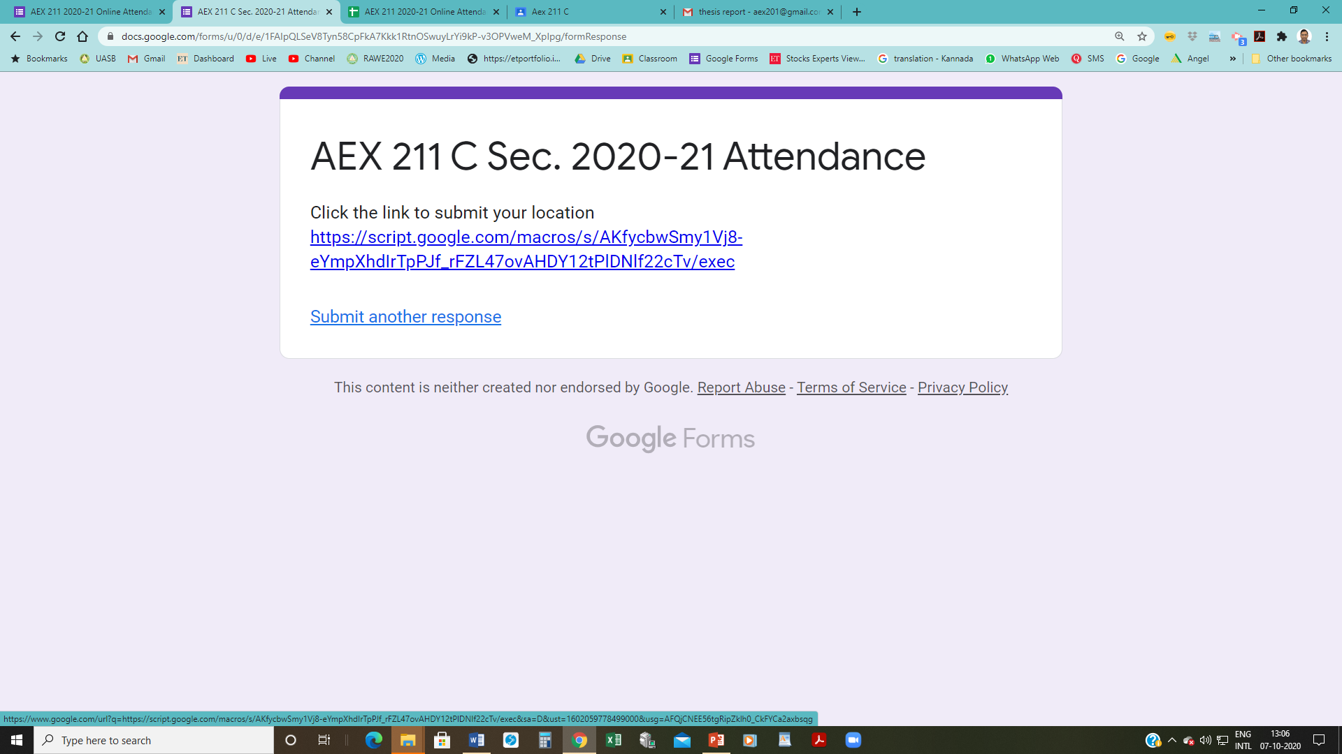



Slide 8
Lecture 2 : Communication – Meaning, Definition, Principles and Functions

Slide 9
Communication Meaning
Communication
Latin word communis - Common
Commonality
Message
Conscious attempt to establish commonality over some idea, fact, feelings and the like, with others.
process of getting a source and a receiver tuned together for a particular message or a series of messages.
Definitions

Slide 10
Definitions of Communication
Communication is the discriminatory response of an organism to stimulus – Stevens (1942)
Communication is anything that conveys meaning, that carries a message from one person to another – Brooker (1949)

Slide 11
Definitions of Communication
Communication encompasses the teacher- the message or material to be taught- the means or media used to carry the message -the treatment given by those media- the learning achieved by the audience or student- and the actions by which the learning is put into practice - Winfield, 1957.

Slide 12
Definitions of Communication
Communication is a process by which two or more people exchange ideas, facts, feelings, or impressions in ways that each gains a common understanding of meaning, intent and use of message
Leagans (1961)

Slide 13
Definitions of Communication
Communication is the process by which an individual – the communicator, transmits (usually verbal symbols) to modify the behaviour of other individuals – communicatees - Hovland (1964)

Slide 14
Definitions of Communication
Communication has its central interest on those behavioural situations in which a source transmits a message to a receiver(s) with conscious intent to affect the latter’s behaviour.

Slide 15
Definitions of Communication
Communication is all of the procedures, by which our mind can affect another – Weaver (1966)
Communication is the control of behaviour through descriptive and reinforcing stimuli – Hartman (1966)

Slide 16
Definitions of Communication
Communication is any occurrence involving a minimum of four sequential ingredients: 1) a generator of a 2) sign-symbol system which is 3) projected to 4) at least one receiver who assigns meaning – Rober Goyer (1967)

Slide 17
Definitions of Communication
Thayer (1968)
Communication is the mutual interchange of ideas by any effective means
process of effecting an interchange of understanding between two or more people
arrangement of environmental stimulus to produce certain desired behaviour on the part of the organism

Slide 18
Definitions
Andersch et al. (1969)
Communication is a purposeful process, which involves sources, messages, channels and receivers.
Communication as the process by which messages are transferred from a source to receiver - Rogers and Shoemaker

Slide 19
Definitions
Process of sending and receiving messages through channels which establishes common meanings between source and receiver - Van Den Ban and Hawkins (1988)

Slide 20
Summary of Definitions
Conscious attempt to share information, ideas, attitudes and the like with others.
Act of getting a sender and a receiver tuned together for a particular message/series

Slide 21
Summary of Definitions
Movement of knowledge to people in such ways that they act on that knowledge to achieve some useful result.
small improvement
generation of unity and strength
includes the whole learning process.
Good communication does not consist merely of giving orders, but of creating understanding.

Slide 22
Summary / Implications of Definitions
It does not consist merely of imparting knowledge, but of helping people gain a clear view of the meaning of knowledge.
Most of the progress in the future will stem from better technology and greater skill in communicating it to others.

Slide 23
Summary / Implications of Definitions
Too many people saying the wrong things at the wrong time, in the wrong way, to the wrong people, slows down progress.
WHAT IS NEEDED IS
more people saying the right things at the right time, in the right way, to the right people.
Formula for good communication

Slide 24
Importance of Communication
Communication establishes a favourable climate in which development can take place.
Communication has multiplier effect
Communication varies the aspirations of the people
Communication is essential for all human activities
Communication is essential for good leadership

Slide 25
Communication – Functions
Communication may take place by Authority / Persuasion
Functions of communication - Informative - Instructive - Influencing - Integrative
1. Informative function
information - environment - concerns the people
Getting or giving of information underlies all communication functions (directly or indirectly).
2. Command or instructive function
People hierarchically superior in the family, society or organization often initiate communication for the purpose of informing their subordinates to tell them what to do, how to do and when to do, etc. it is more observable in formal organisations than informal one.

Slide 26
Communication – Functions
3. Influence or persuasive function
Berlo says the sole purpose of communication is to influence people. This function is important in extension to change the behaviour towards desirable direction.
4. Integrative function
Continuously offsetting any disintegration at the interpersonal or at organizational level.
This helps to maintain individual, societal or organizational stability and identity.

Slide 28
Lecture 3
Models
Elements
Barriers

Slide 29
Models
Model is a tentative description of a social process or a system, very often in a diagrammatic form, to show how the various elements of a situation being studied relate to each other.
Replica of the real phenomenon and indicates the relationships that are said to be existing between the elements
Not statements of reality
After further research and testing – VIABLE - THEORY.
Theories Vs Model >> Explanation Vs Representation.

Slide 30
Models
Relatively well-developed Analogy
Extent of representing physical or logical structure among two dissimilar objects or processes
Usually incomplete & Represented only & Don’t show every part of system
Give us general idea of complicated objects / events.
Allows to account for different Variables of communication
Enables to see how a particular communication event fits into a General Pattern…

Slide 31
Models of Communication Helps
Communication situations
Common elements
Universal Acceptance
Developing locally Acceptable Model

Slide 32
Classification of Models of Communication
 | Verbal model |  | Structural |  | Explanatory
1 | Aristotle's Model | 1 | Shannon and Weaver | 1 | Osgood’s
2 | Plato’s Model | 2 | Westly & Maclean | 2 | Johnson’s
3 | Lasswell’s Model | 3 | Berlo’s Model | 3 | New comb’s
4 | Gerbner’s Model | 4 | Leagan’s Model | 4 | Jan’s model

Slide 33
Models of Communication / Communication Skills
SSA – Aristotle
STSRD – Shanon & Weaver
SEMCDR – Berlo
SESDD - Shramm
CMCTA – Leagans
SMCRE – Rogers
Aristotle
Shanon –Weaver
Berlo
Schramm
Leagans
Rogers & Shoemaker
Osgood
Agee et. al.
Speaker
Speech
Audience
Source
Transmitter
Signal
Receiver
Destination
Source
Encoder
Message
Channel
Decoder
Receiver
Source
Encoder
Signal
Decoder
Destination
Communicator
Message
Channel
Treatment
Audience
Source
Message
Channel
Receiver
Effects
Encoder
Interpreter
Decoder
Message
Effects
Source
Commentator
Message
Channel
Audience
Feedback
Distortion
33

Slide 34
Aristotle - Speaker – Speech – Audience
Speaker – the person who speaks
Speech – the speech that the individual produces
Audience- the person who listens

Slide 35
Shannon-Weaver model Source – Transmitter – Signal – Receiver – Destination.
consistent with Aristotle’s proposition
source is speaker
signal is the speech
destination is the audience
plus two added ingredients
a transmitter which sends out the source’s message and
a receiver which catches the message for the destination.
Aristotle :
Speaker – Speech – Audience

Slide 36
Berlo : Source – Encoder – Message – Channel – Decoder – Receiver
Code is a system of signal for communication.
Encode means to put the message into code.
Channel means the medium through which the signals move
Decoder means which converts the message
in the code into ordinary language which may be easily understood.

Slide 37
Schramm : Source – Encoder – Signal – Decoder – Destination
This model of communication is particularly relevant for the Mass Media
Radio
Television
Online

Slide 38
Leagans : Communicator – Message – Channel – Treatment – Audience - Response
Here the task of communication is to provide powerful incentives for change.
Success at this task requires thorough understanding of six elements of communication
a skilful communicator
sending useful message through
proper channel,
effectively treated,
to an appropriate audience
that responds as desired

Slide 39
Rogers & Shoemaker Source – Message – Channel – Receiver – Effects
source sends the message
via certain channels
to the receiving individuals
which causes some effects
i.e. changing the existing behaviour pattern of the receiver.

Slide 40
Lasswell’s
Who says what
in which channel
to whom
with what effects?

Slide 41
Osgood (1955)
a) Encoder
b) Interpreter
c) Decoder
d) Message

Slide 42
7) Agee et .al (1980)
a) Source
b) Commentator
c) Message
d) Channel
e) Audience
f) Feedback
g) Distortion

Slide 43
Elements of Communication

Slide 44
Elements of Communication
Successful communication involves six key elements
a skillful communicator
sending a useful message
careful selection of messages - relevant to the audience
through proper channels
choose the channel compatible to the cultural pattern
effectively treated
make treatment of the message appropriate to the levels of interest and understanding
to an appropriate audience
to evoke the desired response.

Slide 45
The Communicator
Who starts the process of communication in operation.
He is the source or originator of messages.
He is the first to give expression to messages intended to reach an audience in a manner that results in correct interpretation and desirable response.
Village Development Officer
a Principal / Instructor in a Training Centre
a Block Development Officer
a villager
an administrator or
any other person.

Slide 46
Characteristics of Good Communicator
1. Should have knowledge of message, objective & the audience.
2. People should have faith on the communicator.
3. Should have interest in his audience &their welfare.
4. Should select and treat the message properly.

Slide 47
Characteristics of Good Communicator
5. Prepare a plan for communication
6. Knows how to organize his message.
7. Language & cultural compatibility should be in the line with the receiver.
8. Should have positive attitude towards the message & the audience.

Slide 48
The Message
It is the information a communicator wishes his audience to receive, understand, accept and act upon.
May consist of
statements of scientific facts about agriculture, sanitation or nutrition
description of action being taken by individuals, groups or committees
reasons why certain kinds of action should be taken
or steps necessary in taking given kinds of action.
The key objective of communication
To transmit useful message so that all receivers understand clearly and successfully.

Slide 49
Characteristics of Good Message
1. In line with the objectives to be attained.
2. Clear & understandable by the audience.
3. In line with capabilities of the audience
Mental, Socio-economic & Physical
4. Related to economic and social needs, interests & values of the audience.

Slide 50
Characteristics of Good Message
5. Specific, factual, correct & no irrelevant material.
6. Appropriate to the channel selected.
7. Relevant to the audience.
8. Cover only one point at a time.

Slide 51
Channels of Communication
Channels are the physical bridges between the sender and the receiver of messages
The avenues between a communicator and an audience on which messages travel to and fro.
They are the transmission lines used for carrying messages to their destination.
Channels serve as essential tools of the communicator.

Slide 52
Channels of Communication
A channel may be anything used by a sender of message to connect him with intended receivers.
The crucial point is that he must get in contact with his audience. The message must get through.
Common channels of communication in the extension situation are the 'Extension Teaching Methods'.

Slide 53
Characteristics of Channel
1. It specifies the direction of message flow
2. It gives the message accuracy.
Low (in interpersonal) and high (in mass media)
3. It selects the recipient depending upon the channel
4. It produces feedback to the sender of the message
5. It overcomes the selectivity processes
6. It is capable of bringing desirable effects as the part of the audience.

Slide 54
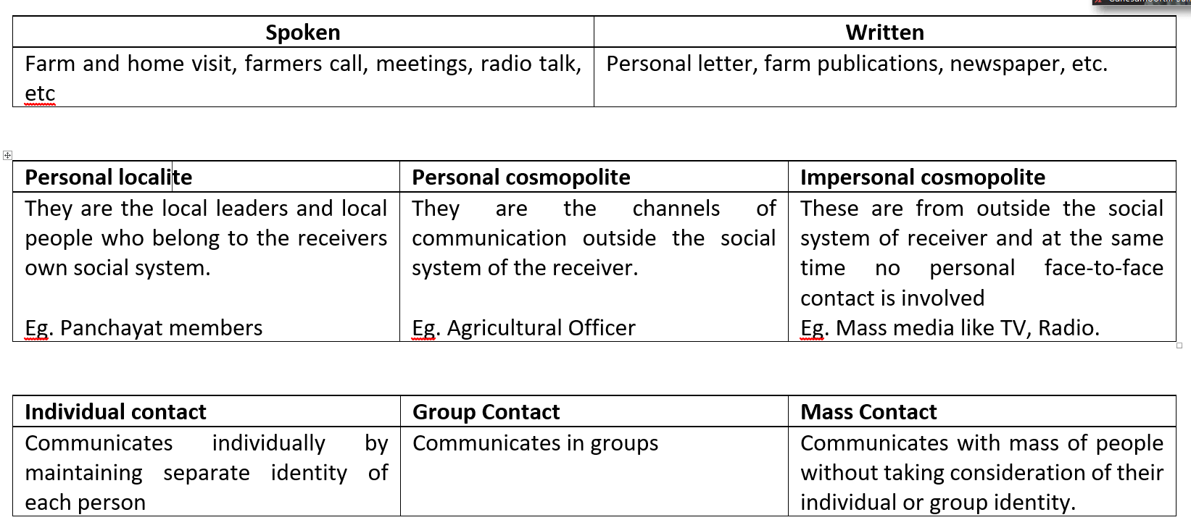
Classification of channels of communication

Slide 55
4. Treatment of Messages
It is the way of handling the message in such a way that the treated message be sent over the channels with the maximum probability of reaching the destination effectively.
It relates to the techniques or details of procedure or manner of performance essential
Treatment deals with the design of method for presenting the message.

Slide 56
4. Treatment of Messages
Purpose is to make the message clear, understandable and realistic to the audience.
Requires original thinking, deep insight into the principle of human behaviour and skill in creating and using refined techniques of message presentation.
The effective teacher is separated from the less effective one & the art of teaching comes into play.

Slide 57
Methods of Treatment of Messages
a. Method of general organization
1. Repetition of ideas and concepts.
2. Contrast of ideas (positive and negative things).
3. Chronological – Compared to logical and psychological.
4. Presenting one side compared to two sides of an issue.
5. Emotional compared to logical appeals.
6. Starting with strong arguments compared to saving them until the end of presentation.
7. Let the audience draw the conclusion.

Slide 58
Methods of Treatment of Messages
b. Use of symbols, variation & devices for presenting the ideas.
c. Message should be treated by giving quotation, jokes and contrary against the common opinion during the communication process.

Slide 59
5. Audience
An audience is the intended receiver of messages. It is the consumer of messages.
An audience may consist of one person or many.
It may comprise men, women, or both; youth groups, villagers or their leaders.
An audience may be formed according to occupation groups as farmers or artisans; professional groups, as engineers, educators, administrators etc.
More the homogenous an audience, greater will be the chances of successful communication.

Slide 60
5. Audience
Likewise, the more a communicator knows about his audience and can pinpoint its characteristics the more likely he is to make an impact.
To be successful, Communication must be target oriented.
The communicator must know the Target
Needs, interests, resources, facilities, constraints and even their approximate number & location.

Slide 61
5. Audience
exact nature of an audience and how to reach it.
1. Communication channels established by the social organization.
2. The system of values held by the audience.
3. Individual personality factors.
4. Original & Acquired abilities.
5. Educational, social and economic LEVELS.
6. ATTITUDE of the audience.
7. How the audience VIEW the situation.

Slide 62
6. Audience Response
Response by an audience to messages received is in the form of some kind of action to some degree
Mentally or Physically
Action, therefore, should be viewed as a PRODUCT
not as a process
it should be dealt with as an END
not as a means

Slide 63
6. Audience Response - Determinants
1. Mass communication intensifies propaganda conflicts
2. Much available information is imperfectly absorbed
3. Lack of primary experience affects communication
4. Communication builds on existing attitudes

Slide 64
6. Audience Response - Determinants
5. Mass communication increases the commonality of experience
6. Communication devices have the ability for thought control
7. Books, Newspapers, Magazines, Leaflets have effects like instrumental, prestige, reinforcement, enriched aesthetic experience and respite.
8. Cultural values and the social organisation are determinants of communication.

Slide 65
Feedback
Extension communication is incomplete without feedback information.
Carrying some significant responses of the audience back to the communicator
Voluntary / Responsive action from Audience

Slide 66
Barriers of Communication
a. RELATING TO COMMUNICATOR
1. In-effective environment
2. Unorganized efforts to communicate
3. Standard of correctness
4. Standard of social responsibility
5. Cultural values and social organisations
6. Incorrect concept of communication process

Slide 67
Barriers of Communication
b. Relating to the transmission of message
1. Incorrect handling of the channels
2. Wrong selection of channels
3. Physical distraction
4. Use of inadequate channels in Parallel

Slide 68
Barriers of Communication
c. Relating to receiver
1. Attention of the listeners
2. Problems of cooperation, participation and involvement
3. Problem of homogeneity
4. Attitude of the audience towards the communicator

Slide 70
Communication Effectiveness
Complete
Clarity
Concise
Courtesy
Correct
Concrete
Consideration
Communication Effectiveness
Clear understanding of Comm. Process
Conscious Efforts to accurately communicate
Follow the significant factors / Principles – 7Cs

Slide 71
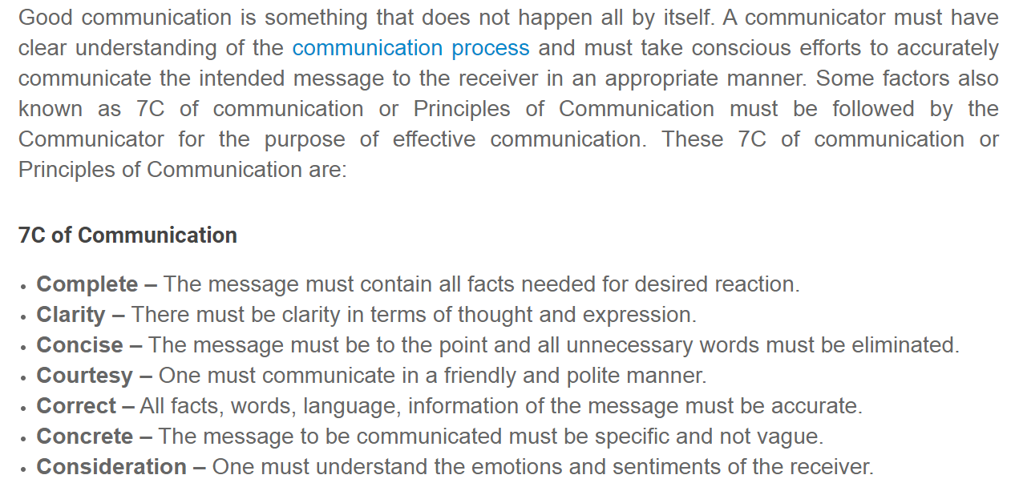
Principles / 7Cs of communication

Slide 72
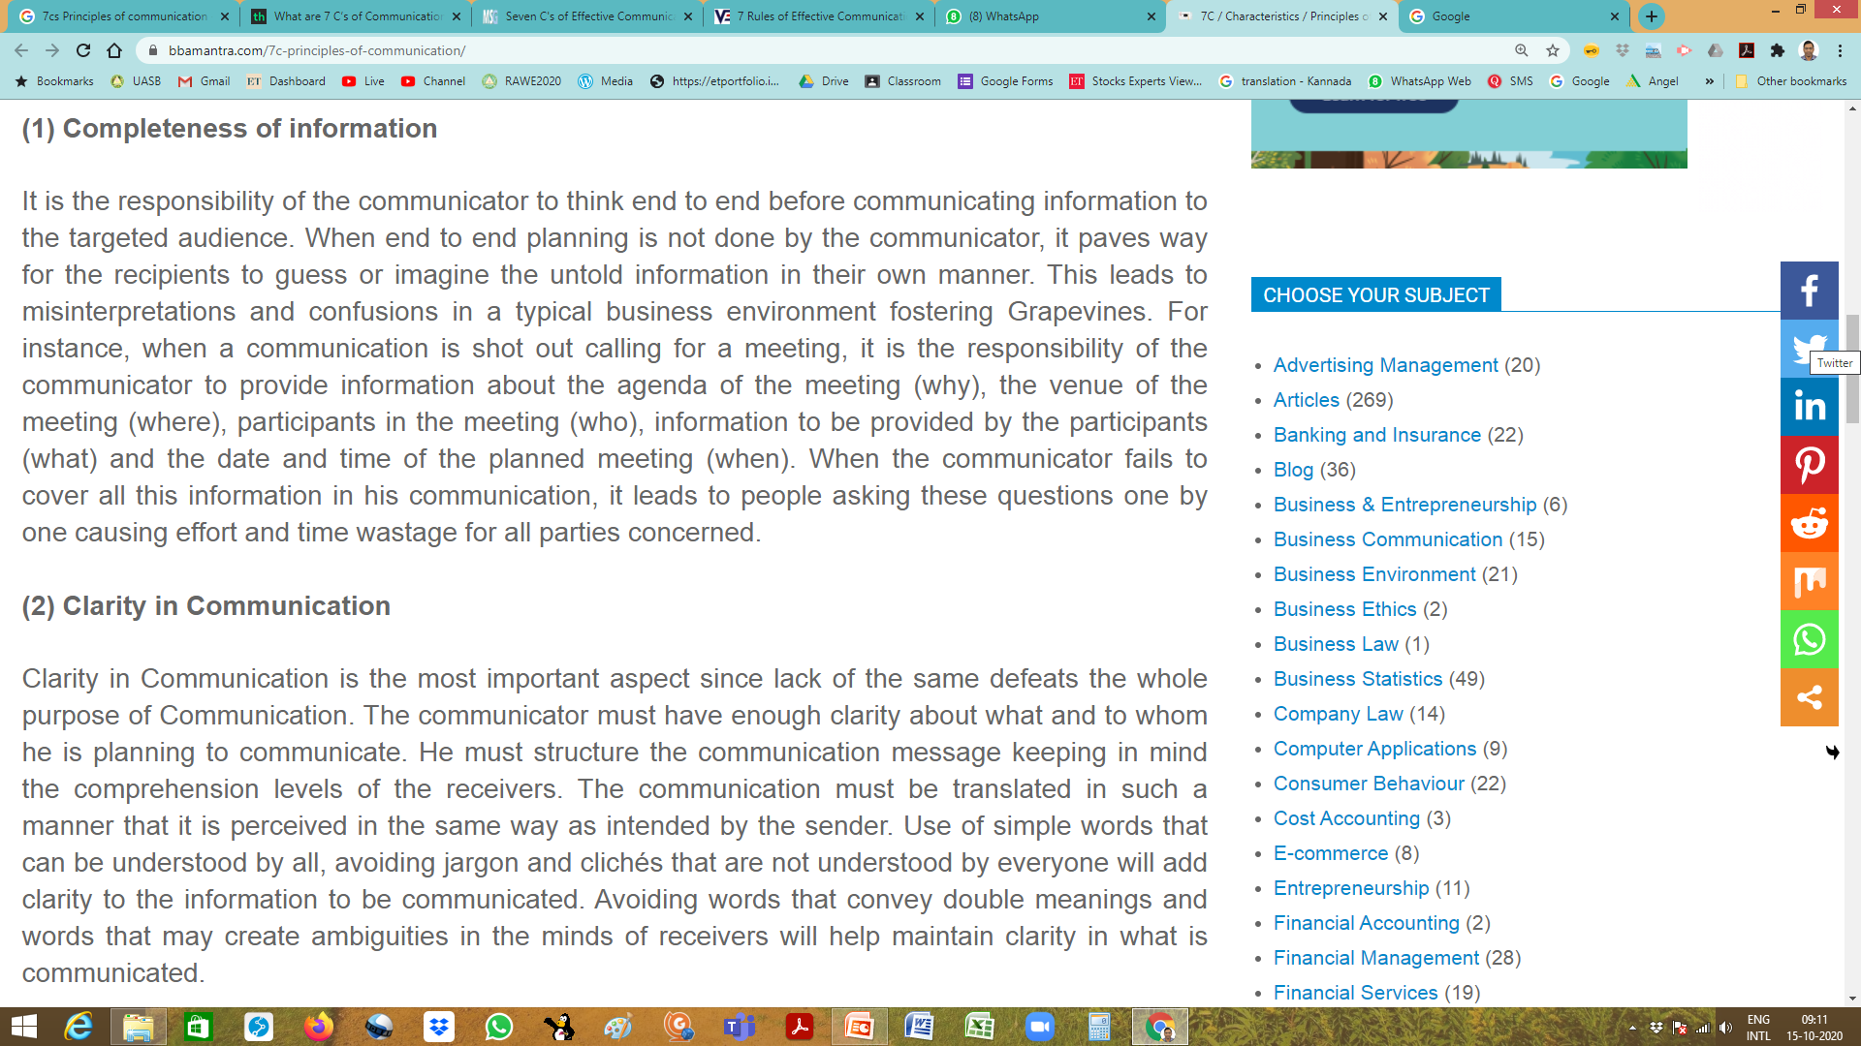
Principles / 7Cs of communication: Completeness
Think end to end
Guess / Imagine
Confusion/ Misinterpretation / Grape Vine
Answer all WH Questions
Agenda, Venue, Participants, information, date/time, Method
Clarity – Queries

Slide 73
Principles / 7Cs of communication: Clarity
Lack of clarity defeats whole purpose
Structure b/o comprehension level
Translated into the audience understandability
Use of simple words , Avoid Jargons / Clichés, Multiple meanings
Carbon sequestration
Only time will tell
Social Safeguards
Artificial Intelligence & Machine learning

Slide 74
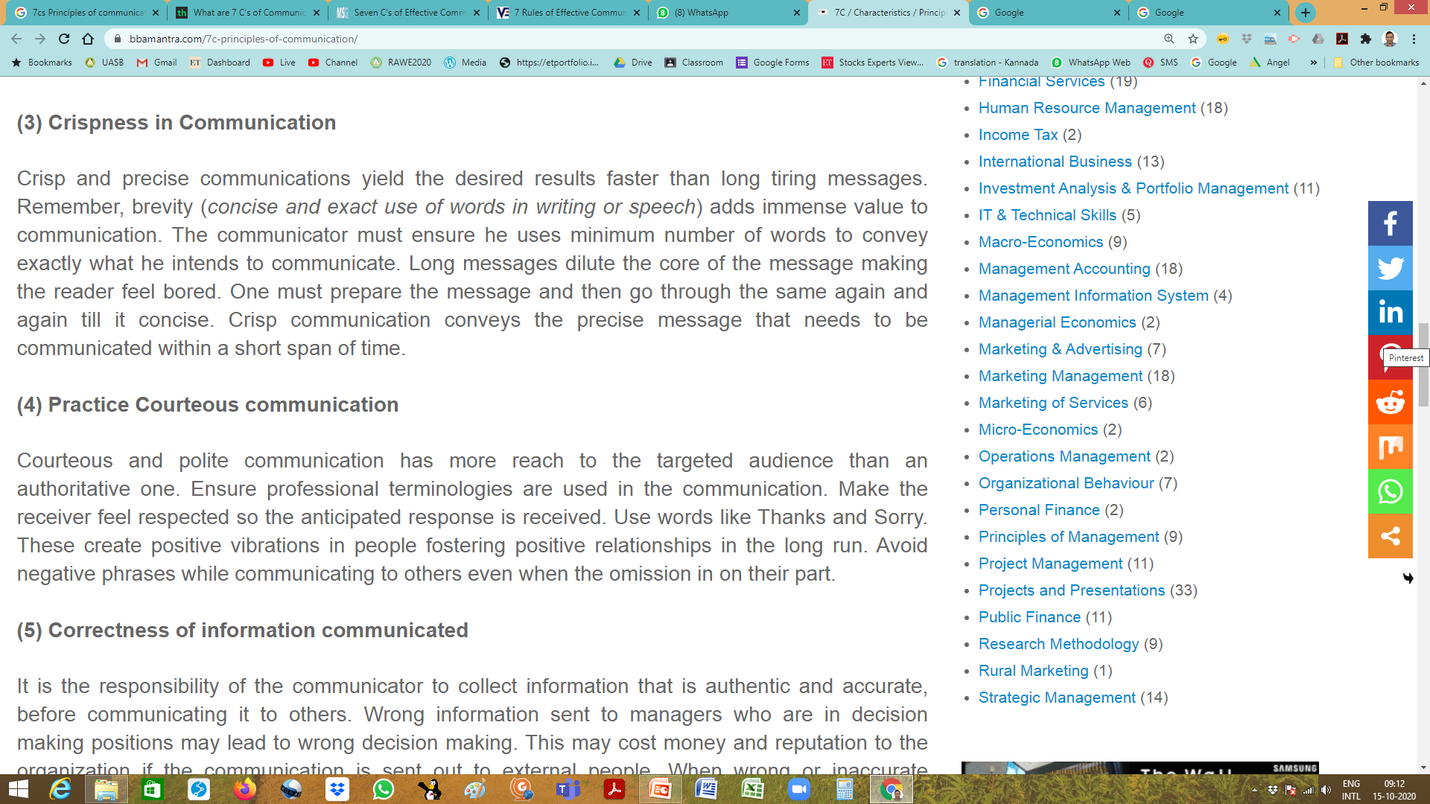
Principles / 7Cs of communication - Crispness
Precise / Brevity
Concise & exact word in writing / speech
Long Message
Dilute core message
Boring audience
Prepare – Go through, Revise- Concise
Helps to convey in Short span

Slide 75
Principles / 7Cs of communication : Courteous
Polite Vs. Authoritative
Decides the Reach
Use Professional Terminologies
Positive vibrations
Receiver should feel respected & anticipated response
Thanks / Sorry
Avoid negative phrases

Slide 76
Principles / 7Cs of communication - Correctness
Responsibility
Authentic & Accurate
Wrong information
Wrong decisions, Loss, Credibility

Slide 77
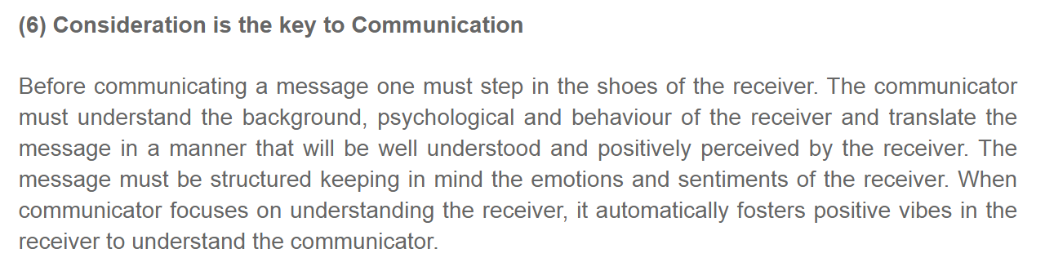
Principles / 7Cs of communication - Consideration
Step into the shoes of receiver
Background, psychology, behaviour
Translate the massage
Manner in which receivers could positively perceive
Value emotions and sentiments

Slide 78
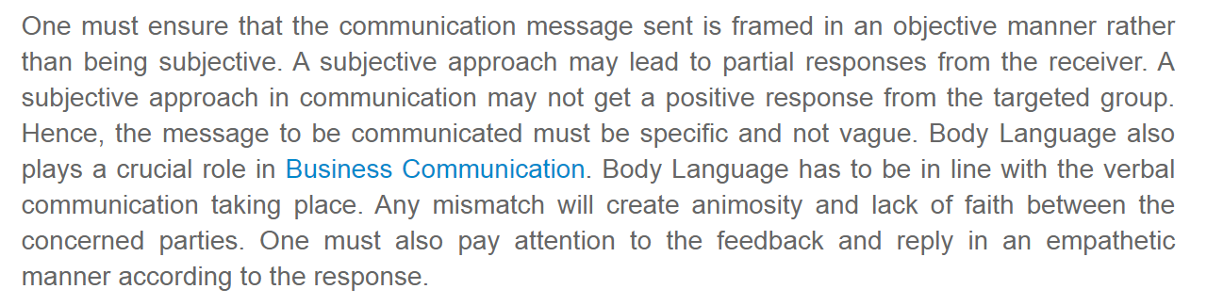
Principles / 7Cs of communication - Correctness & Conscious use of Body Language
Ensure that objective messages is sent
Subjective message – partial response
Body Language
In line with the verbal communication
Mismatch – animosity & lack of faith
Pay attention
Feedback & Reply with emphatic

Slide 80
Classification of channels of communication

Slide 81
Extension Teaching methods – Meaning, Definition, Functions and Classification.
Workshop
Farm and Home Visit
Lecture
Charts
Modules
Symposium
Individual contact methods – Farm and Home visit, Field trials – Meaning, Objectives, Steps, Merits and Demerits.
Group contact methods – Group discussion, Method demonstration, Result Demonstration, Field Trips – Meaning Objectives, Steps, Merits and Demerits.
Small group discussion techniques – Lecture, Symposium, Panel, Debate, Forum, Buzz group, Workshop, Brain Storming, Seminar and Conference.
Mass contact Methods – Meetings, Campaign, Exhibition, Kisan Mela, Radio and Television – Meaning, Importance, Steps, Merits and Demerits.
Puppets
Slides
Specimen
Meetings
Poster
Methods
Techniques
Tools & Aids
Office Call
Tours
Television
Field Trip
Bulletin Board
Exhibition
Field Trials
Circular Letters
Group Discussion
Folder
Panel Discussion
Satellite
Syndicate
Result Demonstration
Leaflet
Kisan Mela
Symposium
Method Demonstration
Radio
Film Strips
Debate
Case study
Buzz Group
Field Visits
Films
Lecture
Conference
Games
Forum
Community Radio
Newspaper
Farm and Home Visit
Seminar
Flannel Graph
Field trips
Brainstorming Session
Front Line Demonstration
Flash Cards
Result demonstration
Field days
Folk Media
Exposure Visit

Slide 82
MEANING AND DEFINITION related to ETMs
A method is a way of doing something, an orderly arrangement of a set of procedures.
Thus it involves a sequence of progressive steps in an orderly and logical regularity in order to accomplish some task or purpose.
An extension teaching method defined as a sequence of progressive steps, undertaken to create situations that are conducive to effective learning.
Extension Teaching Methods are the devices used to create situations in which communication can take place between an instructor and learner - Leagans (1961),
Extension worker can become efficient in the use of methods, he must know what methods are available, when to use a given method, and become effective in using each - Ensminger (1957)

Slide 83
Media Mix (Combination of Media)
Normally
No extension worker has ability to use all methods with equal skill.
No one method that is best for all situations alike
No one method can reach all the audience
Behavioural changes required on the part of the learners – No. of Exposures /Combo
Research : Combination of methods or media-mix is required for effective TOT

Slide 84
Functions of Extension Teaching Methods
To provide communication so that the learner may see, hear and do the things to be learnt.
To provide stimulation that causes the desired mental and or physical action on the part of the learner.
To take the learner through one or more steps of teaching-learning process, viz. AIDCAS

Slide 85
Extension Teaching Methods

Slide 86
Extension Teaching Methods / Communication Methods
According to Use / Nature of Contact (Wilson & Gallop)
Individual Contact Methods
Group Contact methods
Mass Contact Methods
Individual Contact | Group Contact | Mass Contact
Farm and home visits Farmer's call Personal letter Telephone call Adaptive trial | Result demonstration Method demonstration Group meeting Small group training Field day Study tour | Farm publications Mass meeting Campaign Exhibition Newspaper Radio Television Posters

Slide 87
Individual Contact Methods
No. of farmers to be contacted – Few
Audience Location - Near
Time Availability – Plenty
Examples :
Farm & home visits / Office calls / Telephone calls / Personal letters

Slide 88
Individual Contact Methods
Advantages
Building Rapport
First Hand Knowledge
Selection of demonstrators / leaders
Changing attitude
Teaching complex practices
Enhances effectiveness of Group / mass methods
Getting feedback
Limitations
Time consuming
Expensive
Low coverage
Favourism / Bias

Slide 89
Group Contact Methods
Group
Small number of people in reciprocal communication and interaction around common interest
Small group 15-25 / Medium25-50 / Large group 50-100
When to use
No. of farmers to be contacted – simultaneously many
Audience Location – Not far off
Time Availability – Reasonably Good time

Slide 90
Group Contact Methods
Examples
Method Demonstration
Result Demonstration
National Demonstration
Leader-training meetings
Conferences
Discussion meetings
Workshops
Field trips

Slide 91
Group Contact Methods
Advantages
Face to face contact with number of people
Reach select part of target group
Opportunities for interaction and feedback
exchange of ideas
discussions on problems &
technical recommendations &
deciding the future course of action
Satisfies basic urge
Accept change due to group influence
Stimulates action
Less expensive
Limitations
Diversity in the interest of group
Holding itself is an objective
Hindrance : undue interaction & decision making
Vested interests, caste groups, village factions

Slide 92
Mass Contact Methods
When to use
To communicate with vast and heterogeneous mass of people
No consideration for individuals / groups identity
Large and widely dispersed audience
Few communicators
Size of audience few hundreds – few millions.
Examples
Bulletins / Leaflets / Circular letters / Radio/ Television /News Paper
Exhibitions / Melas(Fairs) / Posters

Slide 93
Mass Contact Methods
Advantages
Creating General awareness
Transferring knowledge, forming / changing opinion
Short time – Large audience reach
Quick communication during emergency
Reinforces previous learning
Less expensive / more coverage

Slide 94
Mass Contact Methods
Limitations
Less intensive
No personal contact
Little interaction
Generalized recommendations
Little control over audience responses
Difficult to get feedback / evaluation

Slide 95
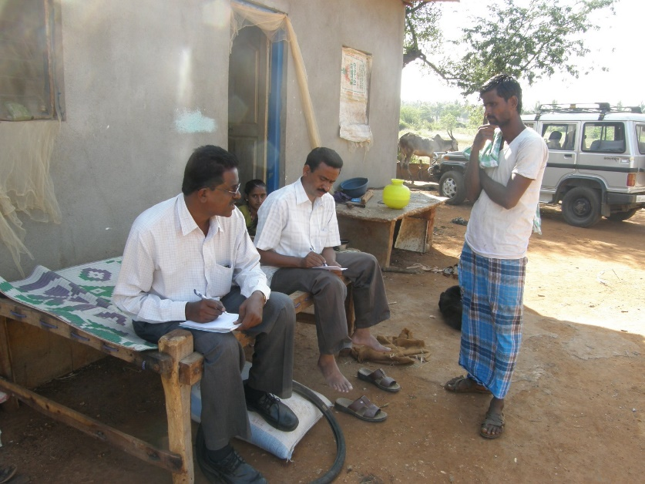
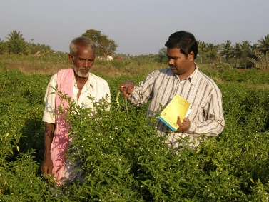
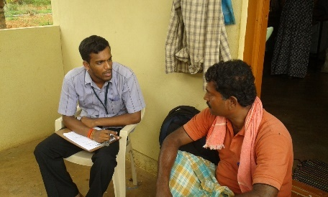
ICM: Farm and Home Visit

Slide 96
ICM: Farm and Home Visit
Direct, face to face contact by the extension agent with the farmer or home maker at their farm or home for extension work
Objectives
Acquaint – Confidence
<First hand information>
Advise / Assist on problem / skill
Sustain interest
Planning /Preparation
Decide whom to meet & What for
Collect adequate info., relevant publication
Make schedule of visit
Send adv. Info.

Slide 97
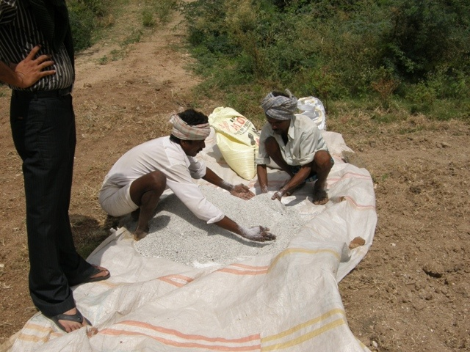
Farm and Home Visit
Implementation
Visit on schedule date/time
Create interest & allow to talk
Present message & explain satisfactorily
Answer to Q, handover publications
Get assurance for action
Follow up
Keep Record of visit
Send info/material
Make subsequent necessary visits
Limitations
Limited number of contacts
Time consuming / costly
Attention to few – big/progressive
07 Fertilizer Preparation

Slide 98
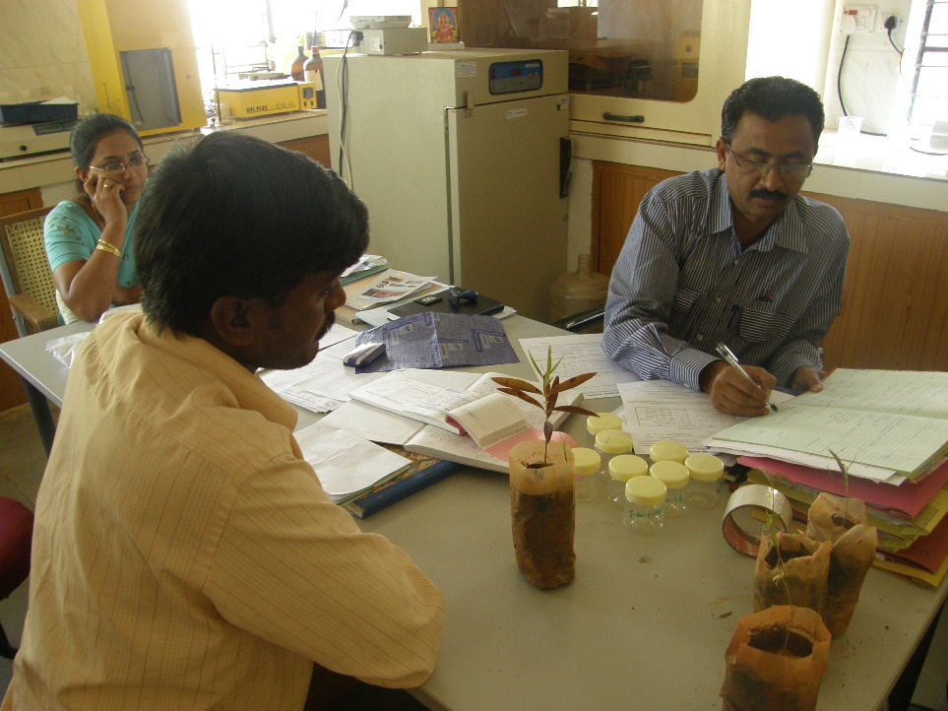
Farmers Call / Office Call

Slide 99

Farmers Call / Office Call
Call made by a farmer / home maker at the working place of the extension agent for obtaining information and assistance
Objectives
Quick solution
Bring specimens for diagnosis
Ensure timely inputs / services
Reminder to Extn. Agent
Planning / Preparation
Neat, order & attractive
Present on fixed date / time
Alternate arrangement
Information centre

Slide 100

Farmers Call / Office Call
Implementation
Allow to talk
Discuss and suggest
Take to SMS
Satisfactory Departure
Follow up
Keep Record of call
Refer to Research
Supply further info / material
Limitations
Difficult to understand situation in proper perspective
Agent may not be available all the time

Slide 101
Personal Letter
Written by extension agent to particular farmer in connection with extension work
Not a substitute for IC
Objectives
Answer queries on problems
Send / seek => information / cooperation
Technique
Send/ reply in time
Clear, complete, to the point and applicable to Situation
Simple / courteous language

Slide 102
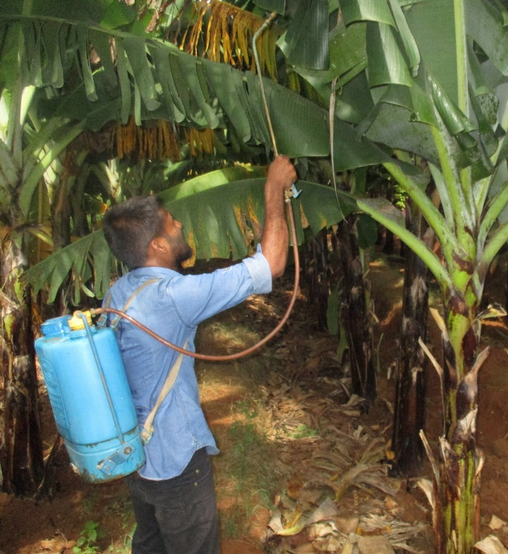
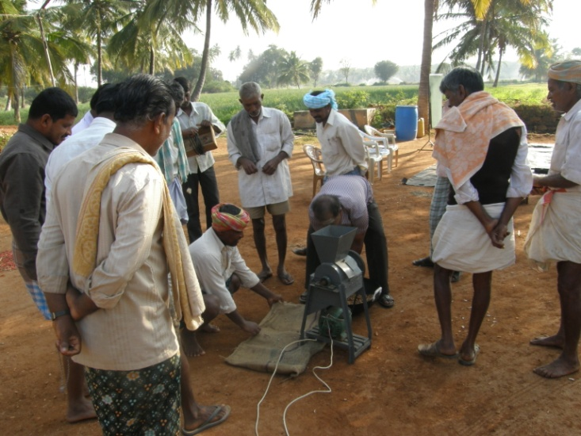
Adaptive Trial / Minikit trial / Farm trial / On Farm Testing / Field Trial

Slide 103
Adaptive Trial / Minikit trial / Farm trial / On Farm Testing / Field Trial
Method of determining the suitability or otherwise of a new practice in farmers situation
On farm PTD
Farmers Choice / Opinion
New / improved practices passes >> before MD / RD / FLD
Objectives
Test new and promising – Resource / Ability / Constraints
Compare benefits over existing
Build confidence – EA / F / RW
Act as precaution against Insane / Fast /Hasty Recommendations
Planning / Preparation
Select new / promising – suitable – consult Scientists /Farmers
Select small number of Innovative Farmers

Slide 104

Adaptive Trial / Minikit trial / Farm trial / On Farm Testing / Field Trial
Implementation
Explain objective
Simple, Portion, Risk
Supply Critical Inputs
Supervise Important Steps
Assist in Maintaining Accurate Records
Follow up
Get reactions
Discuss with R/F on suitability
Repeat for one / two years
Make a Decision to Recommend / Discard
Limitation
Scattered > inadequate supervision
Satisfactory results d/o Clarity, Selection of Practice/ Farmers
Eg.
Mini Kits for IPM
Mini Kits for Redgram Transplantation

Slide 105
Farm Clinics Plant Health Clinic / SWPTL – Mobile / AHC
Facility developed and extended to the farmers for diagnosis and treatment of farm problems and to provide some specialist advise to individual farmers
Implementation
Village / institute / Sub Centers
SMS / EA
Discuss, Diagnose & Prescribe
Meet on Fixed day / time
Specialist visit to Plots
Treatment / Prevention of health problems
Plants / Animals / Soils
Follow ups
Call the farmers used the facility & get feedback
Document success stories / case studies
Devise related training programmes involving the beneficiary farmers cases.

Slide 106
Thank You

Slide 107
Terms
SSA – Aristotle
STSRD – Shanon & Weaver
SEMCDR – Berlo
SESDD - Shramm
CMCTA – Leagans
SMCRE – Rogers
Speaker
Destination
Message
Transmitter
Treatment
Encoder
Speech
Signal
Audience
Decoder
Communicator
Receiver
Source
Effects
Channel

Slide 108
