Slide 1


Slide 2
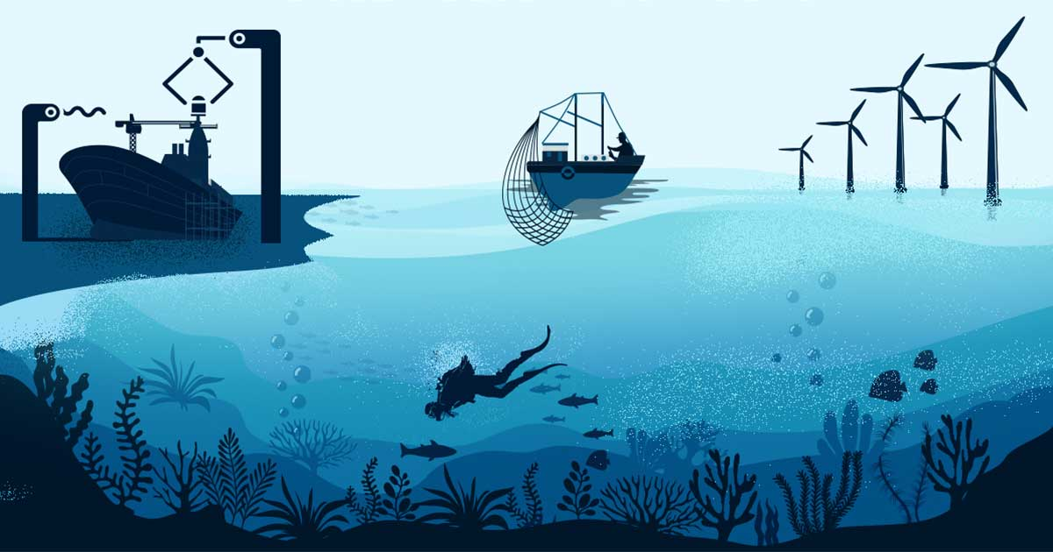
BLUE ECONOMY :An Overview

Slide 3
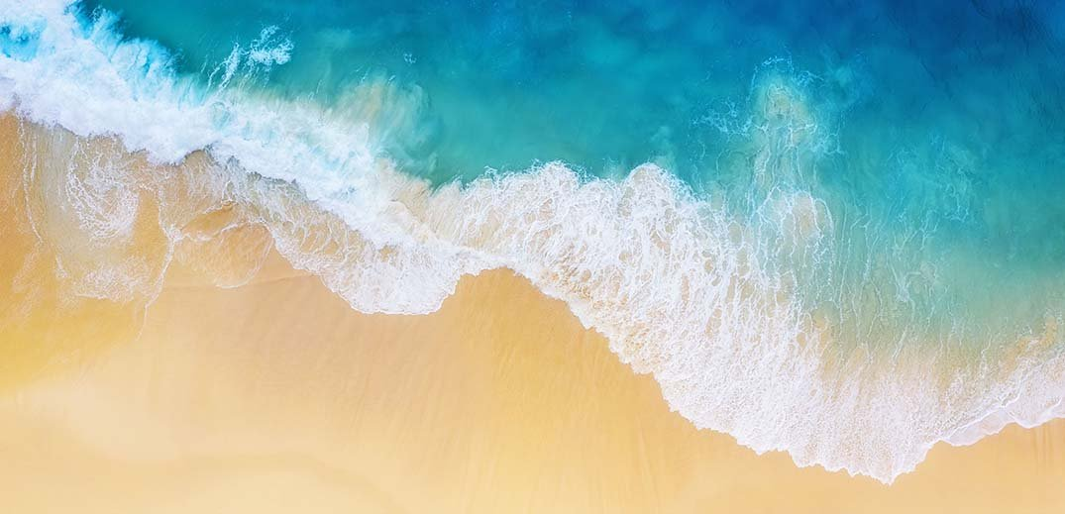
OBECTIVES
To understand the concept of blue economy.
To know the government initiatives in promoting blue economy
To review the related research studies.

Slide 4

Contents
INRODUCTION
CONCEPT OF BLUE ECONOMY
COMPONENTS OF BLUE ECONOMY
GOVERNEMNT INTIATIVES
REASEARCH STUDIES

Slide 5
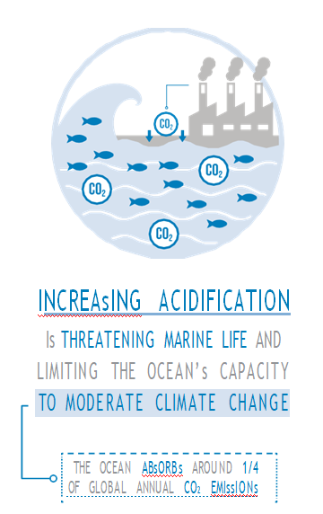
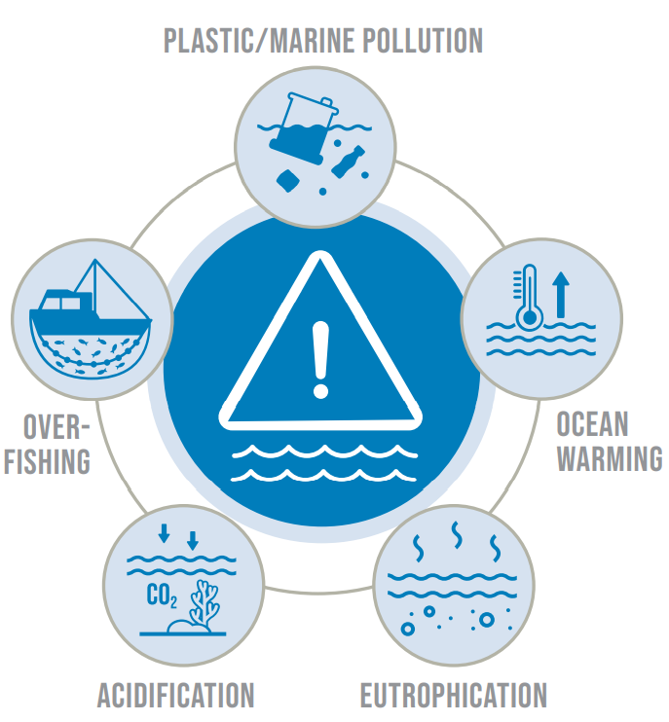
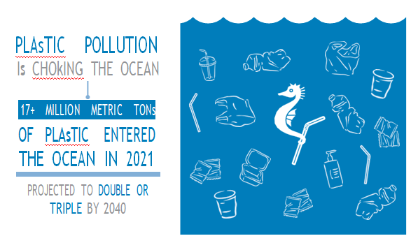
Ocean is suffering…
Notes:
We all know that 3/4th of earth is covered by water .
And many of us like beaches …I am sure many of you .. Did you ever realise that damage we are causing to them or ocean is also suffering
In order to avoid these Requires intensified protection efforts and the adoption of solutions for a sustainable blue economy.

Slide 6
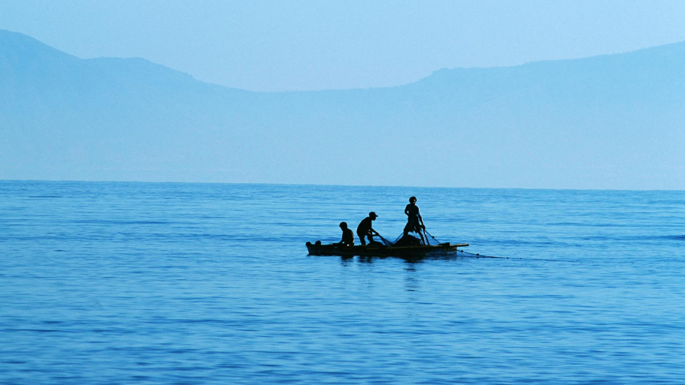
WHAT IS BLUE ECONOMY ?
According to the World Bank, the blue economy is the "sustainable use of ocean resources for economic growth, improved livelihoods, and jobs while preserving the health of ocean ecosystem
The National Maritime Foundation “Marine-based economic development that leads to improved human wellbeing and social equity, while significantly reducing environmental risks and ecological scarcitie
Center for the Blue Economy the overall contribution of the oceans to economies, the need to address the environmental and ecological sustainability of the oceans, and the ocean economy as a growth opportunity for both developed and developing countries.“
Notes:
There is no standard definition for blue economy usually it is a sustainable use of ocean resources with causing damage to the resouces.

Slide 7

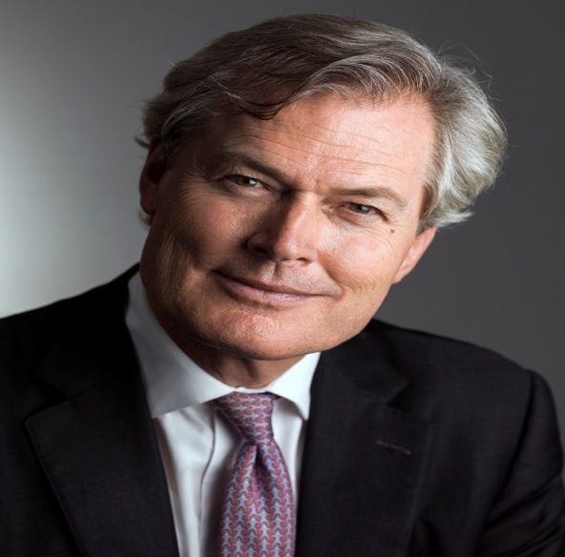
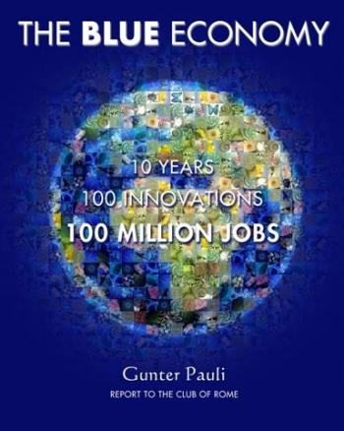
Emergence of blue economy …..
FATHER OF BLUE ECONOMY
The economic philosophy of the Blue Economy was first introduced in 1994 by Professor Gunter Pauli at the United Nations University (UNU)
And later he also published the book named “The Blue Economy: 10 years, 100 innovations, 100 million jobs” in 2010.
Notes:
Let us see how blue economy concept emerged..
Professor gunter pauli as the one who introduecd the concept in 1994.but that time it wasn’t famous
Later he also published the book called……people are some what familiar with the concept

Slide 8
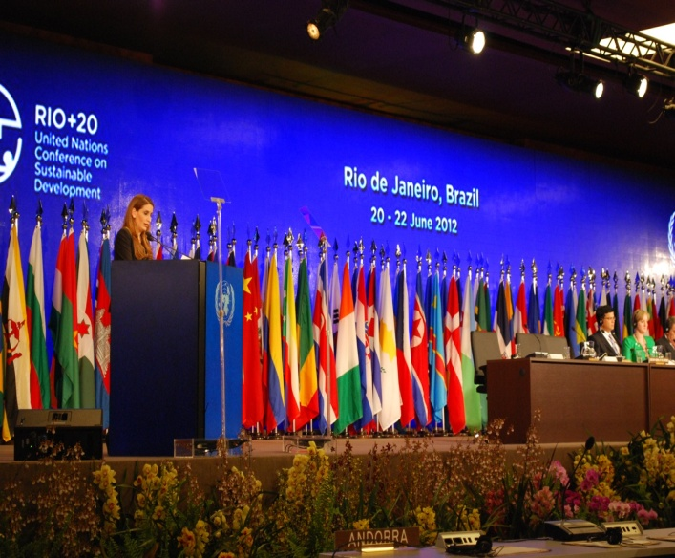

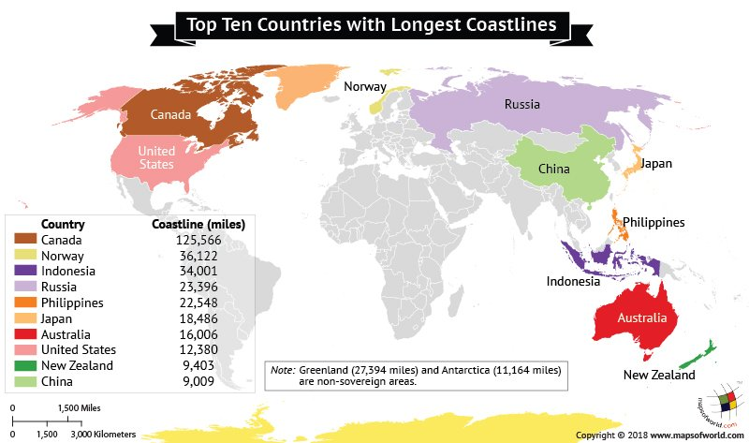
The idea of the “blue economy” was conceived at the Rio+20 United Nations Conference on Sustainable Development, held in Rio de Janeiro in June 2012.
This conference Sustainable Development and the advancement of the “green economy” concept.
Many coastal countries presented strong positions for a “blue economy” approach to be more prominent.
Notes:
But concept concevied at earth summit 2012.where the conference is about green economy n sustainable development
And many coastal countries questioned how it is related to them…presented a strong point of blue economy

Slide 9
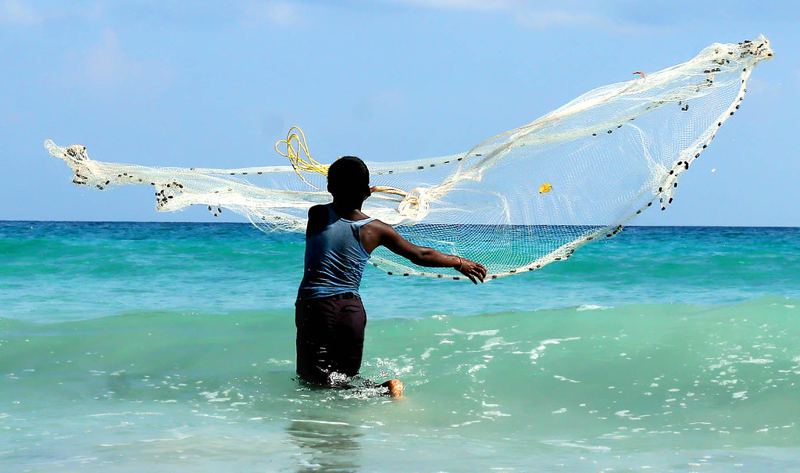
Aim of blue economy
According to Gunter Pauli: “To allow ecosystems to maintain their evolutionary path so that all can benefit from nature’s endless flow of creativity. adaption and abundance.
Notes:
We have alllow the ecosystem to maintain their evolution and can be benefitied by those endless creativity .

Slide 10
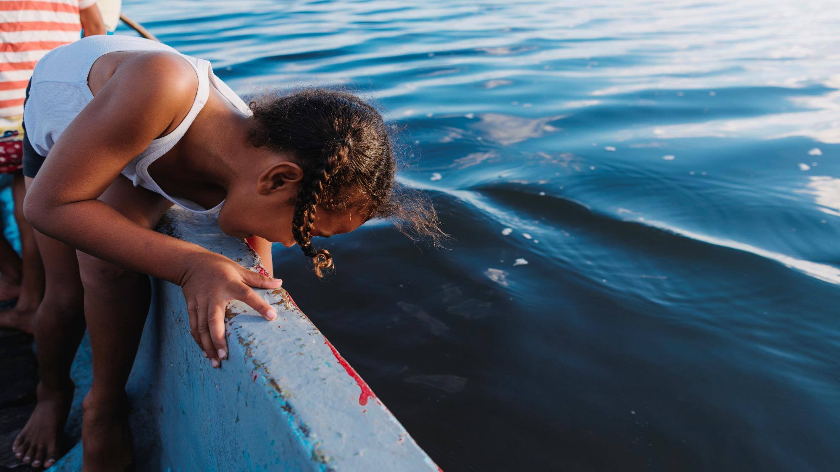
Principle of Blue economy
Provide social and economic benefits for current and future generations.
Ensure ecosystem integrity which improves biodiversity and productivity
Recognize marine ecosystems as natural capital and protect and maintain them
Aspire for social and economic stability through the use of clean technology and renewable energy
Notes:
The principle behind the blue economy

Slide 11
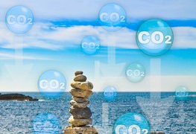
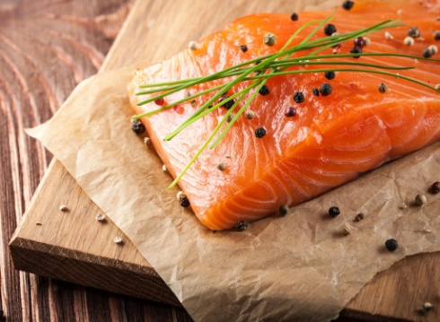
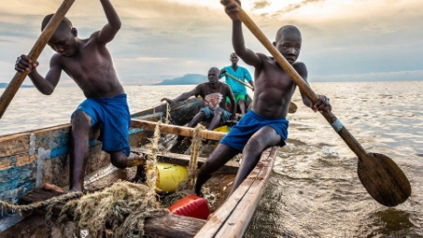
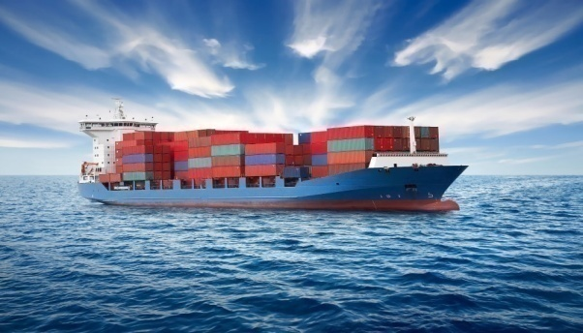
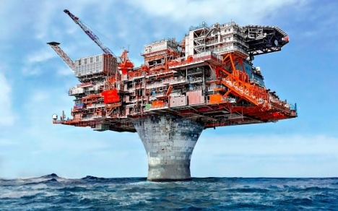
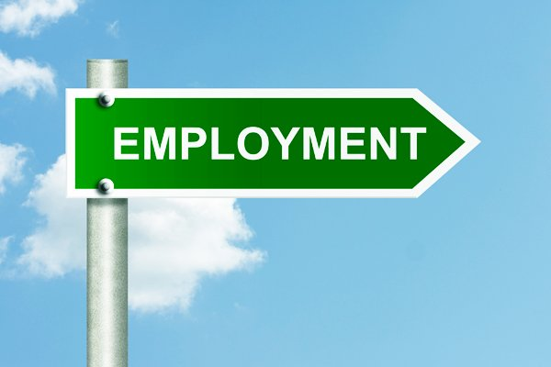
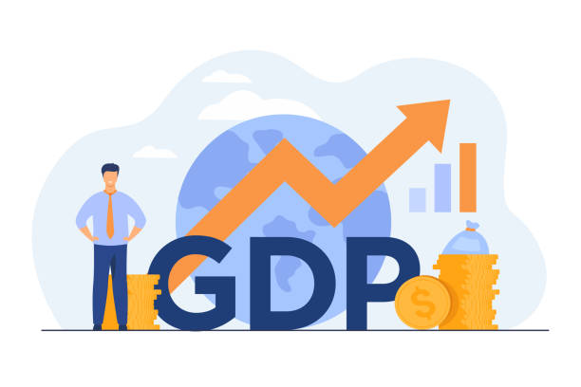
Significance of blue resources
15% of Protein needs
Absorb 30%of CO2 emissions
90 % of internationally traded goods
10% of people for livelihood and sustence
Source for millions of jobs
30 % of world’s oil and gas resources
Contributes to GDP
Notes:
Ocean have a capacity to contribute more to the human kind.
One fish can 15% of protein needs .30%of world oil and gas resources from ocean
It is a source for million jobs
10% of people depends on ocean
90%of trading done throught marine.

Slide 12
KEY DEVELOPMENT AT INTERNATIONAL LEVEL
YEAR | CONFERENCES /SUMMITS
2012 | UN Conference on Sustainable Development, (Rio de Janeiro ,June 2012) | “Green Economy in a Blue World” or the Blue Economy itself
2014 | The Global Action Summit for Food Security and Blue Growth | Numerous steps for the promotion of fisheries and habitat protection and pollution reduction.
2015 | UN Sustainable Development Summit | SDG 14 entitled “Life below Water”
2017 | UN Conference | To Support the Implementation of SDG 14
 | Indian Ocean Rim Association (IORA)- first-ever Leaders' Summit | commitment to promote the development of the Blue Economy.
 | First IORA Ministerial Blue Economy Conference (BEC), | focus on “Financing the Blue Economy”.
Notes:
Let us see some key conferences and summits which are actually concentrated on BE.

Slide 13
YEAR | CONFERENCES /SUMMITS
2018 | BRICS | The vast potential in cooperation and collaboration in multiple sector in blue economy
 | BIMSTEC summit, held in (Kathmandu, August 2018 ) | Commitment to promote the development of the Blue Economy.
 | Sustainable Blue Economy Conference (Nairobi in November 2018) | Advancing the Global Sustainable Blue Economy”.
2019 | Australian Marine Sciences Association conference | Protect marine life and sustainable economic and societal benefits.
 | 7th Sustainable Ocean Summit (Paris November 20-22) | Investing in Ocean Futures: Finance and Innovation for the Blue Economy
 | African Conference on Blue Economy (September 10-13) | To achieve the African Agenda 2063 for Sustainable Development

Slide 14
Component
Fisheries and aquaculture
Seawater desalination
Marine Tourism
Deep sea mining
Maritime Transport
Renewable Energy
Maritime construction
Marine Biotechnology

Slide 15
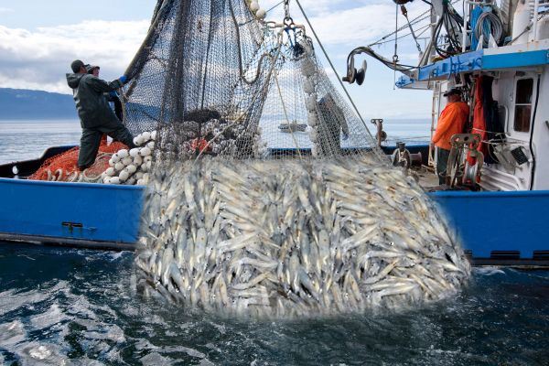
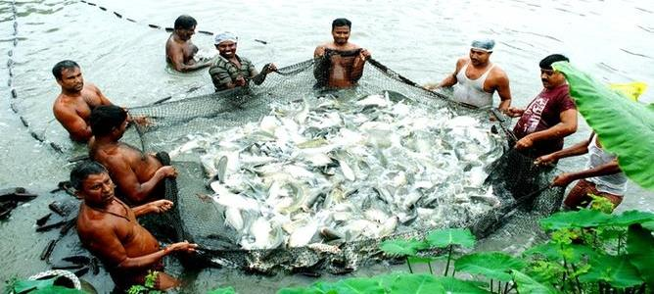
Fisheries and Aquaculture
Capture Fisheries
Marine
Inland
Coastal fishing
Reservoirs
Riverlines
Deep sea fishing

Slide 16
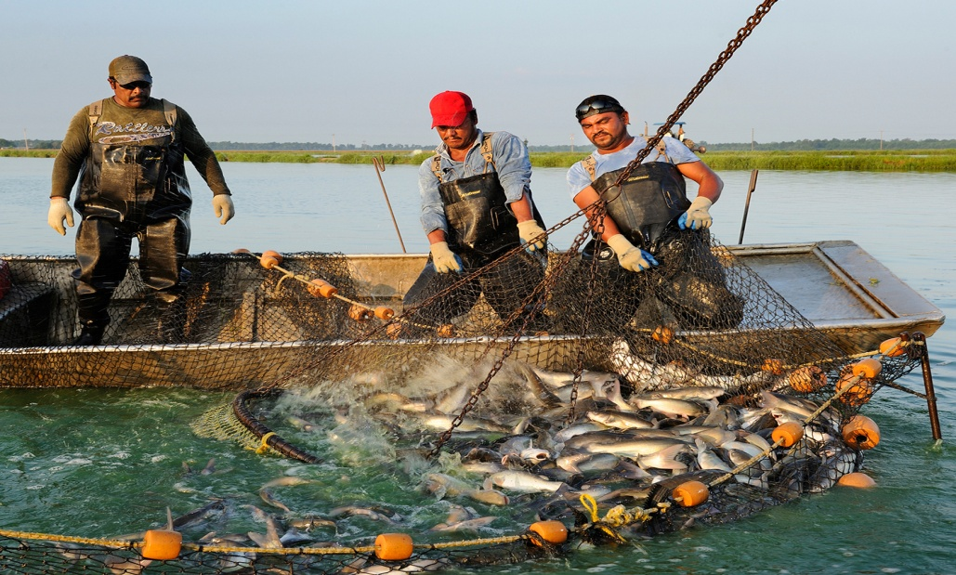
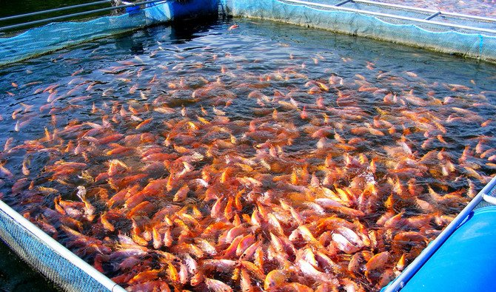
z
Aquaculture
Marine
Brackish water
Cold water
Ornamental fishes
Freshwater

Slide 17
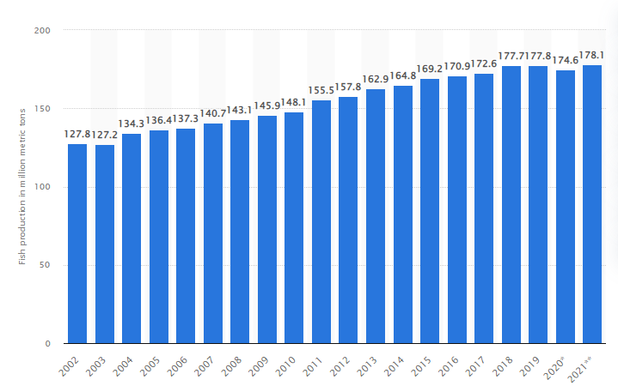
Global scenario of fisheries and aquaculture
Fig. 1: Global fish production from 2002 to 2021
Source: www.statista.com

Slide 18
World Fish Production
Sl. No. | Country | Total Fish Production ( million metric tonnes) | Percentage share of each country
1 | China | 58.80 | 55.86
2 | India | 9.04 | 8.58
3 | Indonesia | 6.10 | 5.79
4 | Peru | 5.80 | 5.50
5 | USA | 5.30 | 5.03
6 | Chile | 5.02 | 4.76
7 | Japan | 4.81 | 4.56
8 | Thailand | 3.74 | 3.55
9 | Vietnam | 3.36 | 3.19
10 | Russia | 3.30 | 3.13
Source: FAO , 2020

Slide 19
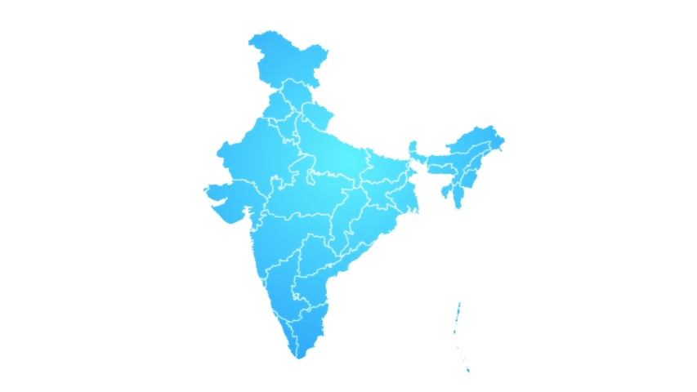
livelihood to about 16 million fishers and fish farmers
3rd largest fisheries and 2nd largest aquaculture nation
Gross Value Added (GVA) of fisheries sector 2019-20 Rs 2,12,000 crores
Average annual growth rate 10.88 % (2015 to 2020)
Forcasted cumulative growth 24.6 % by 2030

Slide 20
Contribution of India to World Fish Production
Period | World Fish Production (Million Tonnes) | Fish Production in India (Million Tonnes) | Contribution Of India To World Fish Production (%)
1960-61 | 43.60 | 1.16 | 2.66
1970-71 | 66.20 | 1.76 | 2.66
1980-81 | 72.30 | 2.44 | 3.37
1985-86 | 85.60 | 2.88 | 3.36
1990-91 | 97.97 | 3.84 | 3.92
2001-02 | 129.00 | 5.96 | 4.62
2010-11 | 156.00 | 8.40 | 5.38
2017-18 | 170.09 | 10.2 | 6.29
Source: www.indiastat.com, 2019

Slide 21
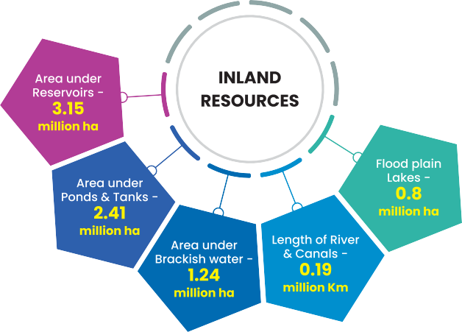
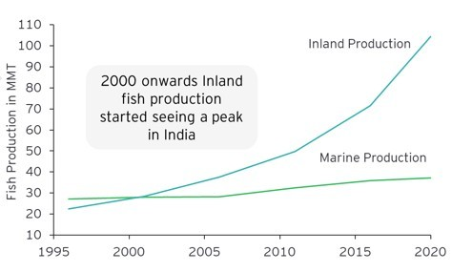
Inland fish production
Shift from marine dominated fishing to inland fisheries.
Presently has a share of 72% in total production of the country
Source: Ministry of fisheries, 2020

Slide 22
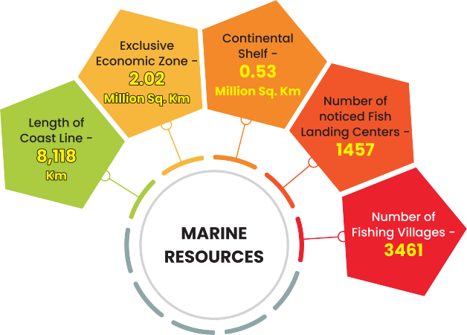
MARINE FISH PRODUCTION
The marine fishery potential in the Indian waters have been estimated at 5.31 million MT
provides direct employment to over 1.5 million fisher people
Total marine fisher folk population was about 4 million

Slide 23
State wise fish production in India (in lakh tonnes)
 | 2016-17 |  | 2017-18 |  | 2018-19 |  | 2019-20
State/UT’s | Inland | Marine | Inland | Marine | Inland | Marine | Inland | Marine
Andhra Pradesh | 21.86 | 5.80 | 28.45 | 6.05 | 33.91 | 6.00 | 36.10 | 5.64
Goa | 0.04 | 1.14 | 0.06 | 1.18 | 0.05 | 1.15 | 0.04 | 1.01
Gujarat | 1.17 | 6.99 | 1.38 | 7.01 | 1.42 | 6.99 | 1.58 | 7.01
Karnataka | 1.59 | 3.99 | 1.88 | 4.14 | 1.98 | 3.90 | 2.29 | 4.03
Kerala | 1.61 | 4.31 | 1.89 | 4.84 | 1.92 | 6.09 | 2.05 | 4.75
Maharashtra | 2.00 | 4.63 | 1.31 | 4.75 | 1.00 | 4.68 | 1.18 | 4.43
Odisha | 4.55 | 1.53 | 5.34 | 1.51 | 6.00 | 1.59 | 6.60 | 1.58
Tamil Nadu | 1.97 | 4.72 | 1.85 | 4.97 | 1.70 | 5.20 | 1.74 | 5.83
West Bengal | 15.25 | 1.77 | 15.57 | 1.85 | 16.19 | 1.63 | 16.19 | 1.63
India | 78.06 | 36.25 | 89.48 | 37.56 | 97.2 | 38.53 | 104.37 | 37.27

Slide 24
Brackish and saline Aquaculture
Brackish and Saline water aquaculture has gained a great momentum in India
Brackish water aquaculture contributes 86 % by volume and 84 % by value of the export.
Brackish water shrimp aquaculture production has risen from 20 MT in 1970 to 7 lakh MT in 2020

Slide 25

key areas of sustainable growth of fisheries and aquaculture
Market expansion
Promote high-value species in aquaculture
Sustainable aquaculture practices
High rejection rate
New technologies
Big data applications
Application of Block chains

Slide 26
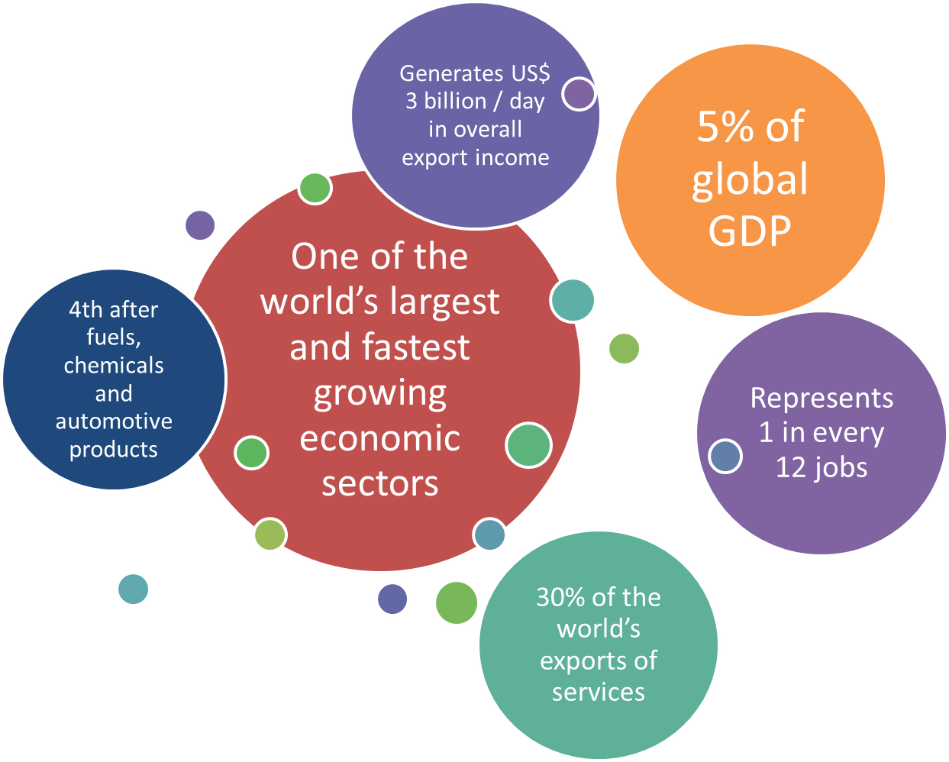

Marine tourism
One of the world’s top job creators
main export for 1/3 of developing countries

Slide 27
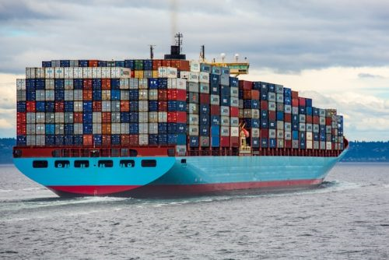
Coastal and marine tourism
Marine and coastal tourism will become the largest component of the overall ocean economy by 2030
42 million jobs are created in the tourism sector
Predicted annual rate to 32 lakh crores by 2028.
World Travel and Tourism Council reports India generates 9 % of India’s GDP

Slide 28
Intiatives of INDIA
Promoting cruise tourism
By2030,expected to attract 1.2 million tourists
To develop light housetourism,
Taking advantage of 189 light-houses located both on mainland and islands.
To develop a range of ecotourism projects at Andaman-Nicobar and Lakshadweep islands.

Slide 29
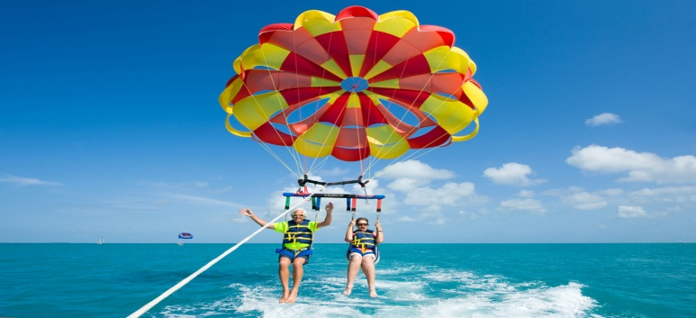
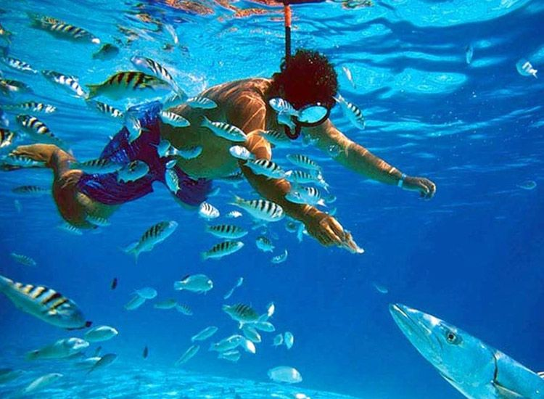
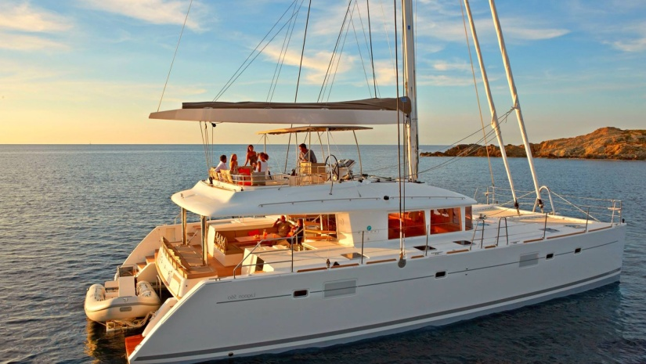
Marine leisure and recreational industry
Numerous segments such as water sports, recreational fishing, island visits etc.,
Yachting important segment of the marine leisure industry
Kochi International Marina have Luxury yachts.

Slide 30
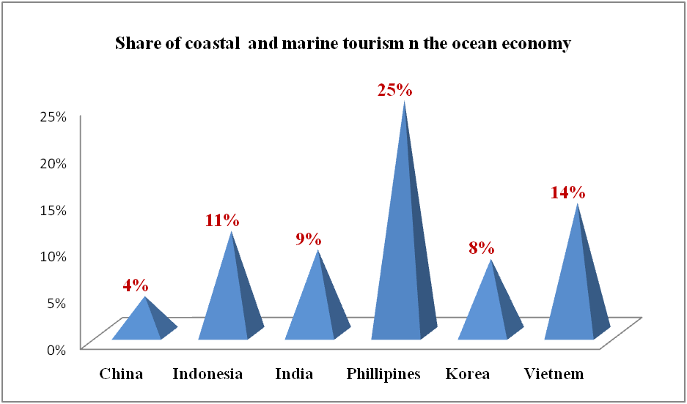
Coastal and Marine tourism in the Ocean economy
Source: Annual report, National Fisheries Development Board, 2020

Slide 31
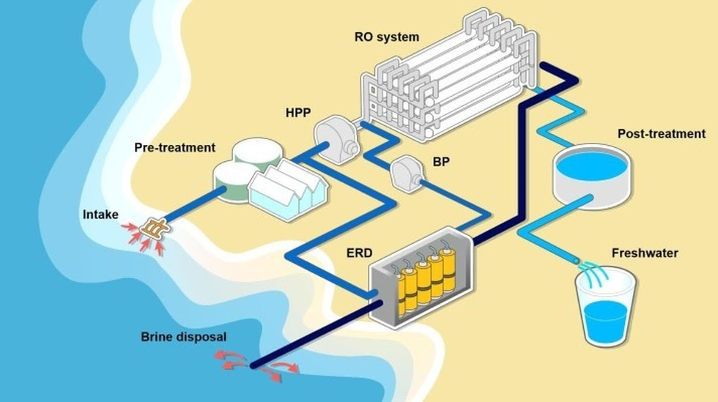
Seawater desalination
Desalination is the process of removing salts from water
Done by Reverse Osmosis
Advantage of Desalination
Extend water supplies
provide drinking water in deficit areas
Reduce pressure on freshwater supplies.
Disadvantage
Costly to build and operate
Energy costs 1/3 rd one-third of the total cost.

Slide 32
Use of Desalination Plants in India
Tamil Nadu pioneer in setting up two desalination plants 2010 and 2013.
In 2021, the Mumbai Municipal Corporation planned to setup plant with 200 million liters per day
First seawater reverse osmosis desalination plant in Karnataka - supply desalinated water to a refinery owned by Mangalore Refinery and Petrochemicals Limited (MRPL)

Slide 33
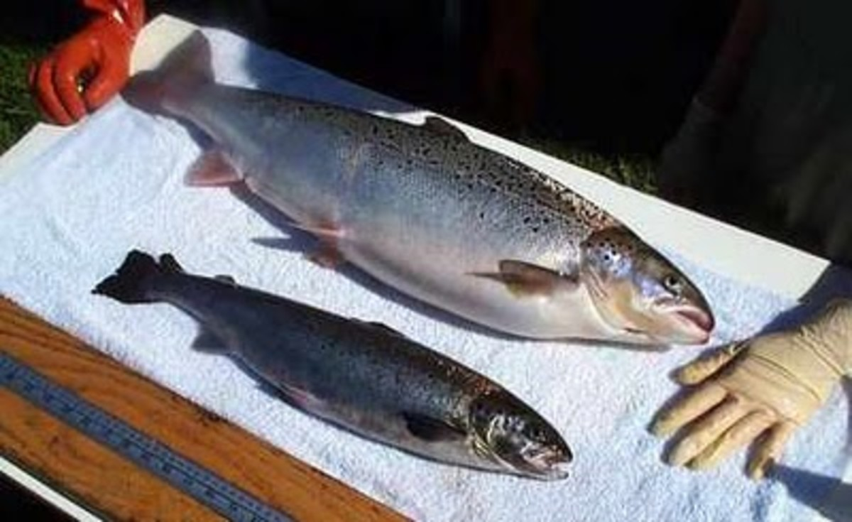
Marine biotechnology
Blue biotechnology is the application of molecular methods to marine and fresh water organisms.
Advantages
Helps in securing food supply
Provides alternative source of renewable
energy
Securing human health
Producing industrial products
Securing environmental health

Slide 34
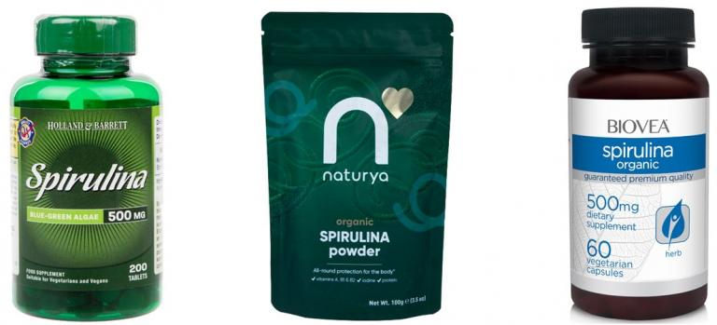
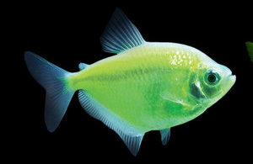
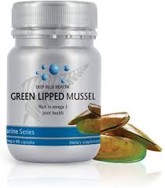
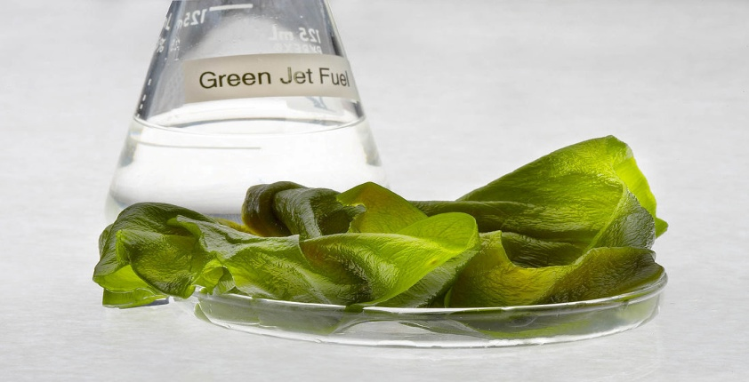
Examples of biotechnology applications
Glo fish
Single cell protein from algae
Green mussels extracts for arthritis
Fuel from algae

Slide 35
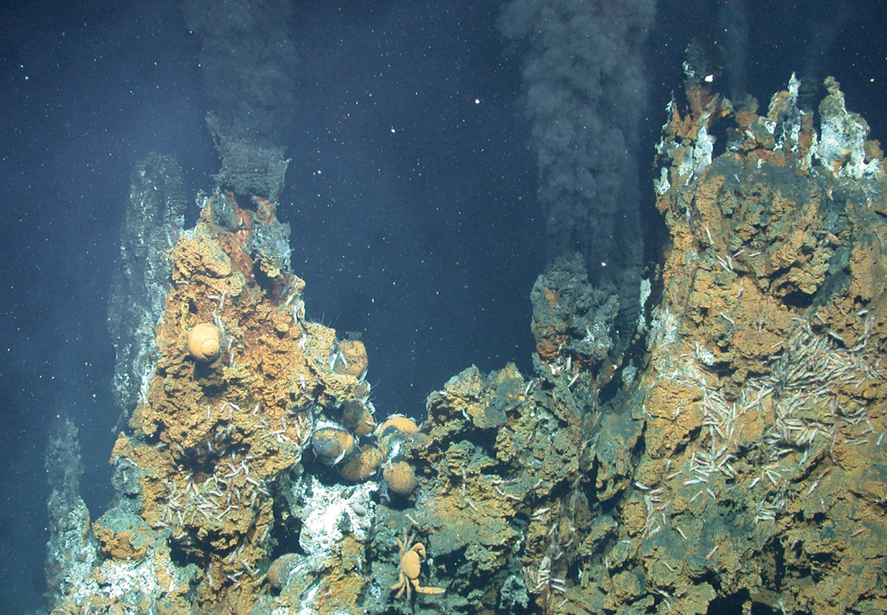
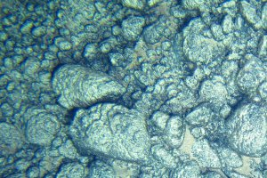
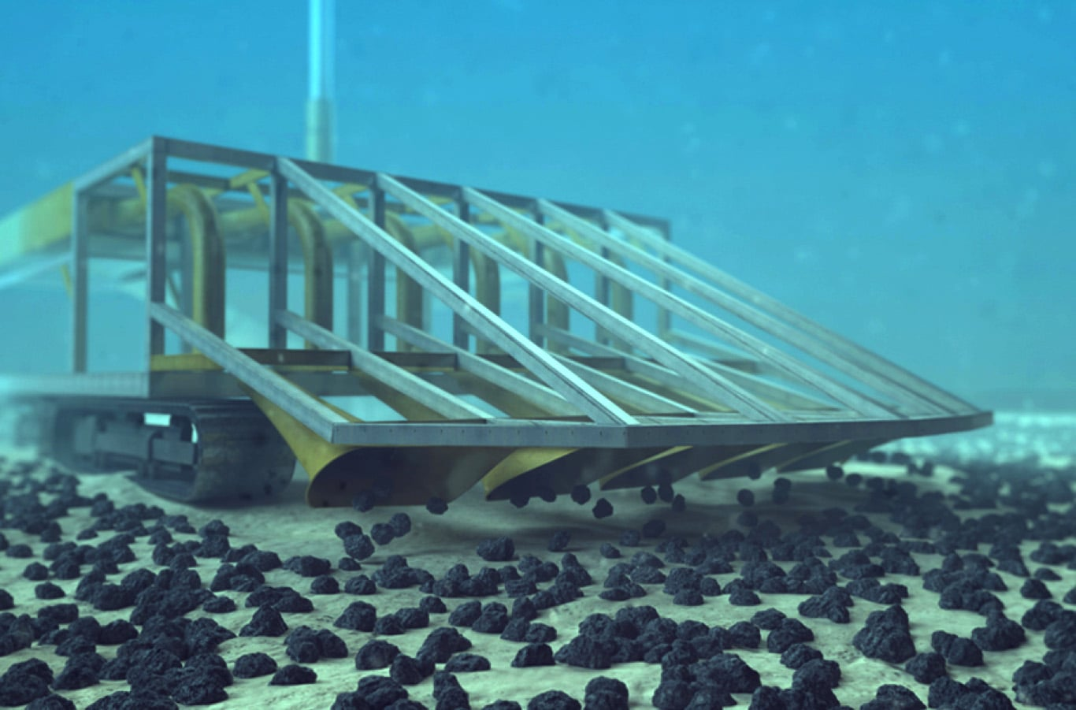
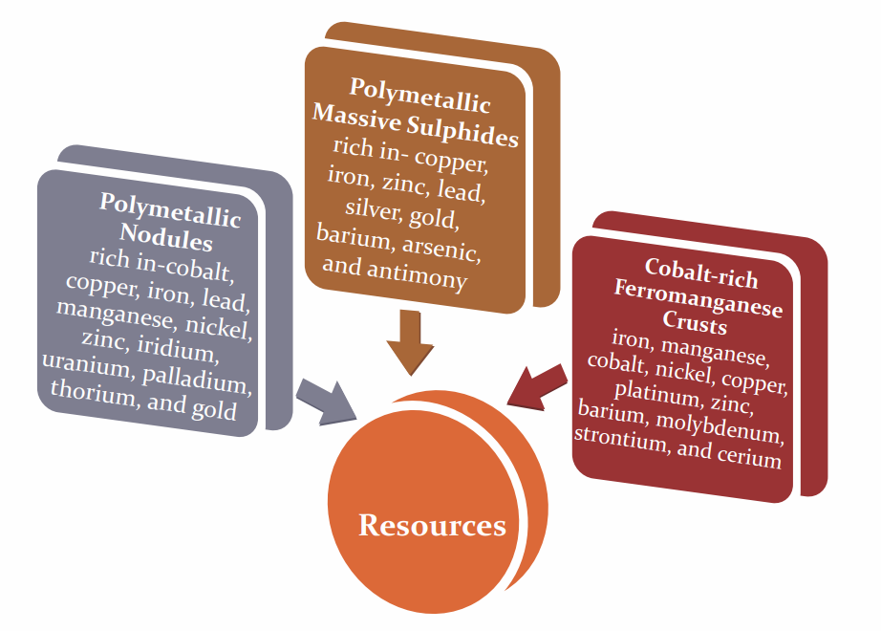
Deep-Sea Mining
Refers to exploration and exploitation of mineral resources lying in the seabed and ocean floor and subsoil
Depths ranging from 3000 to 6000 metres
Three types of resources have been identified

Slide 36
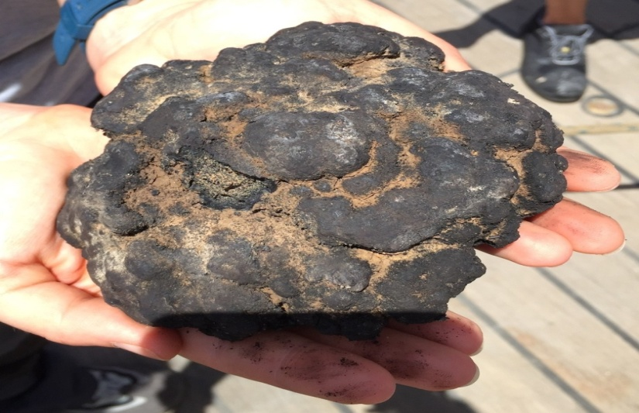
Effect
Destruction of natural habitats
Endangerment or extinction
Fragmentation of ecosystem
Disruption of marine life
Disruption of the food chain
Global warming

Slide 37
Polymetallic nodules exploration programme by Regional Research Laboratory (Bhuvneshwar), National Metallurgical Laboratory (Jamshedpur)
Pioneer Investor in 1982 for extraction of polymetallic nodulles
In 2016
15-year contract for exploration of polymetallic sulphides in the Central Indian Ocean area
800 Crores announced under ocean mission
Survey and exploration in the Central Indian Ridge sites for identification of potential sites of hydrothermal deposits

Slide 38
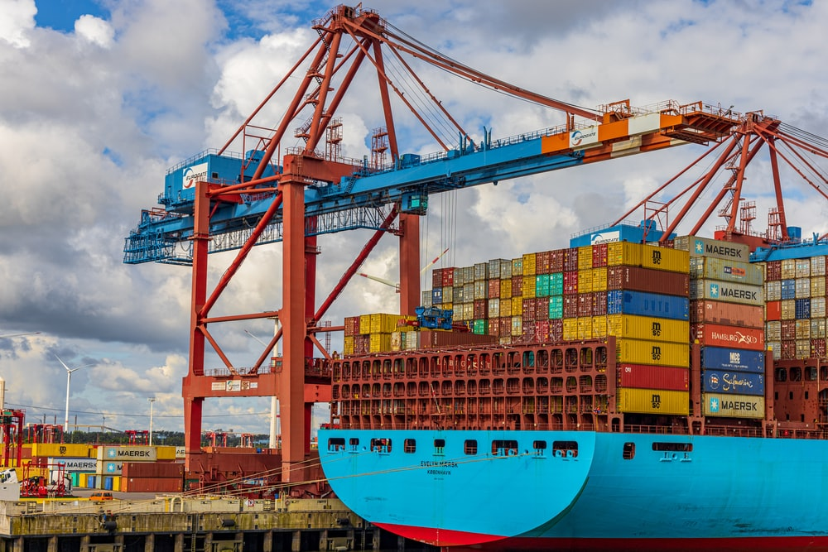
Port and Shipping
Ports as a key component of the logistics chain
It impact on economic variables:
Export competitiveness and final import prices.
Ease of doing business.
95% of India's trading by volume and 70% by value is done through maritime transport

Slide 39
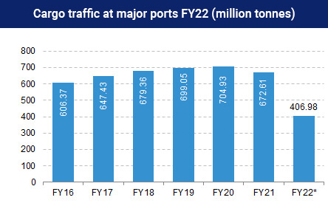
Cargo traffic at major ports in India (million tonnes)
Source: Ports Industry Report, Feb 2022

Slide 40
India has 13 major ports and 200 non major ports-major ports.
Foreign Direct Investment (FDI) of up to 100% for port and harbour construction and maintenance projects
Focusing of Port led development under Sagarmala project
India’s key ports capacity in FY21
1600 million tonnes per annum
Cargo traffic handled by key ports in India in FY22
650 million tonnes
India’s merchandise exports in October 2021
US $ 33.65 billion
India’s merchandise exports in FY22
US $ 417. 8 billion

Slide 41
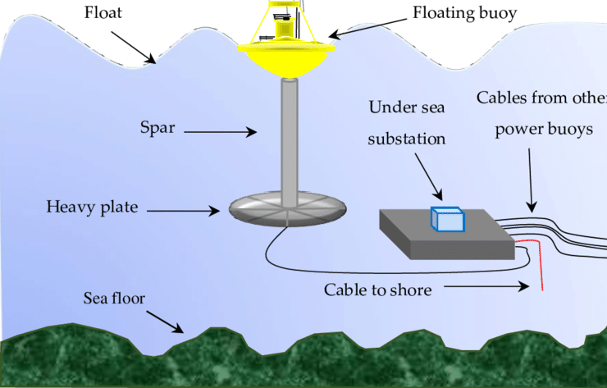
Ocean energy
All forms of renewable energy derived from the sea.
WAVE ENERGY: generated by converting the energy within ocean waves (swells) into electricity
First wave energy project
Capacity 150MW
Trivandrum.
Total theoretical potential of wave energy is estimated to be about 40,000 MW

Slide 42
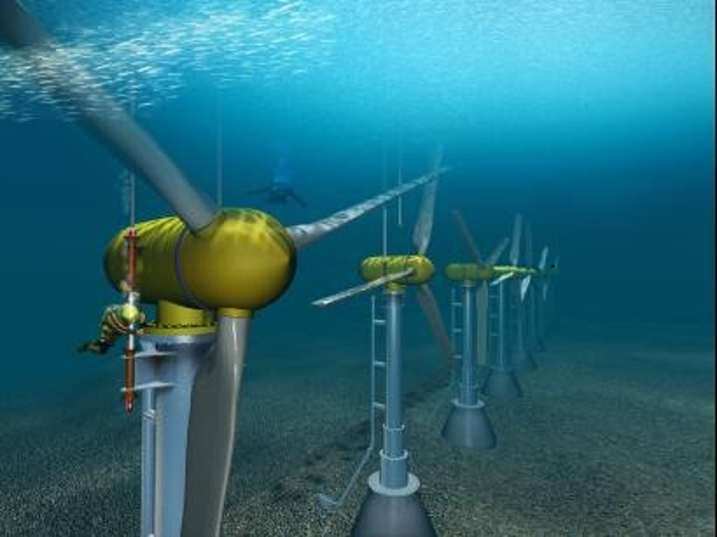
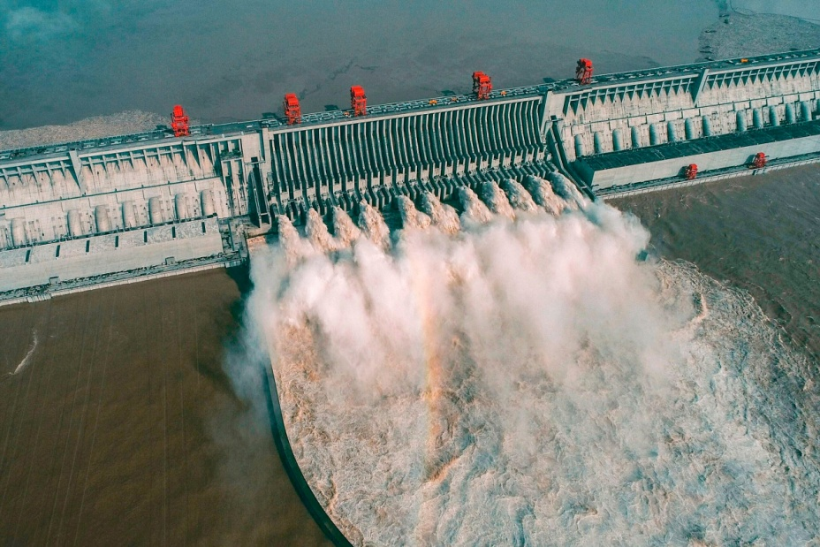
CurrentEnergy: Underwater turbines, large propellers to the seabed, are moved with the marine currents to generate electricity.
Few examples being the Gulf Stream, North Atlantic Drift, etc.
Theoretical potential of 180,000 MW
potential of Tidal Energy is about 12455 MW, at Kutch regions
Tidal Energy-
conventional hydroelectric dams, power plants.
India is expected to have 9,000 MW of tidal energy potential.
major tidal wave power project costing of Rs.5000 crores, at Gulf of Kutch in Gujarat

Slide 43

Government Initiatives
for promoting blue economy

Slide 44


Deep Ocean Mission
Founded :2018
Ministry of Earth sciences

Slide 45

SAMUDRAYAAN Project
Under phase -1(2021-2022) of DOM
Oct 29.2021
NATIONAL INSTITUTE OF OCEAN TECHNOLOGY
India’s first manned ocean mission
send 3 men into sea for deep-ocean exploration and mining of rare minerals.
submersible vehicle can reach Depth of 6000 meters

Slide 46


India-Norway Task Force on Blue Economy
Launched in 2019
Bilateral collaboration
Intends to manage the resources in the oceans in a sustainable manner
Desire to advance scientific knowledge about oceans
It also intends to mobilise relevant stakeholders from both Norway

Slide 47


O-SMART Scheme
Ocean Services, Technology, Observations, Resources Modelling and Science
Launched in 2018
Ministry of Earth Sciences
2021-26 period at a cost of Rs 2,177 crore
Providing forecast services
Development of technologies and exploratory surveys
Promotion of front-ranking research in ocean

Slide 48

Sagarmala Programme
announced in 2015
aims to turn the coastal areas into economic centers for regional and global maritime connectivity
Objective of promoting port-led development in India

Slide 49

The key areas of the Programme are
Port moderaisation
Port augmentation
Port connectivity
Coastal shipping and inland transport
Upgrading of rail /road ways
Port Industrialisation
Industrial clusters
New ports
Efficiency improvement
Logistic parks
Maritime Clusters
Coastal economic zones.
Costal community development
Skill development
Fishing harbours and fish processing units
Coastal tourism project

Slide 50
Integrated Coastal Zone Management Plan
Department of Forests and Environment
Assistance: World Bank +Ministry of Enviroment, forest and climate change
Scientific and Technical input: The National Centre for Sustainable Coastal Management (NCSCM), Chennai
West Bengal, Gujarat and Orissa have been selected under the ICZM plan.
Formulation of ICZM for the State
Lessen the coastal erosion
Reduce vulnerability to disaster
Biodiversity conservation
Livelihood security
environmental quality management
conservation of cultural assets

Slide 51

National fisheries Policy 2020
Ministry of Fisheries, Animal Husbandry and Dairying
objective
Vision
Mission
Develop,manage and regulate capture and culture fisheries in a sustainable manner based
To develop an ecologically healthy, economically viable and socially inclusive fisheries sector
To develop and manage fisheries resources and conserve of the country

Slide 52

Pradhan Mantri Matsya Sampada Yojana (PMMSY)
Launched:- 2020
Focused and sustainable development of the fisheries sector
Enhance fish production by an additional 70 lakh tonne
Increase fisheries export earnings to Rs.1,00,000 crore by 2024-25.
Double the income of fishers and fish farmers
Reduce post-harvest losses from 20-25% to about 10%.
Generate an additional 55 lakhs.

Slide 53








Achievements of PMMSY
Approved Activities under Pradhan Mantri Matsya Sampada Yojana till date:-

Slide 54









Slide 55
CHALLENGES TO THE BLUE ECONOMY
Unsustainable extraction from marine resource
Eg: Unsustainable fishing- according to (FAO 2016)
57% of fish stock | fully exploited
30% of fish stock | over-exploited, depleted, or recovering
roughly 11–26 million per annum tons of fish catch | illegal, unreported, and unregulated fishing
Marine pollution such as in the form of excess nutrients from untreated sewerage, agricultural runoff, and marine debris such as plastics.

Slide 56
Impacts of climate change: which leads to changes in sea temperature, acidity, and major oceanic currents, among others, already threaten marine life, habitats, and the communities.
Unfair trade
Ineffective goverment institutions,
Inadequate economic incentives,
Technological advancement
Lack of full implementation & other legal instruments
Insufficient application of management tools have often led to poorly regulated activities.

Slide 57
Role of extension organisation in blue economy
Area of Work | strategies
Technology transfer | Improved techniques of mariculture and aqua culture Introduction of modern craft and gear material for fishing Scientific post- harvest practices Diversified technology application in fisheries Introduction of innovative technology application methods
Information support service | Information support to fishermen about prices, types and availability of known and new fishing inputs
Marketing and distrubution | Provision of real time marketing information to fishermen. Strengthening the position of the fishermen against middlemen by organizational and financial support of marketing.
Sustainable fisheries | Advising and educating fishermen in resource conservation methods and responsible fishing practices

Slide 58
Area of Work | strategies
Credit and finance | Facilitating direct contact between banks and fishermen Facilitating indirect institutional finance through self help groups, co-operatives, credit societies etc. Implementing welfare schemes for the development of poorer fishermen Promotion of institutional savings
Organizational and capacity development | Facilitating the development of fishermen organization to promote collective action. Capacity development of various actors in the value chain.
Entrepreneurship development | Identification and promotion of entrepreneurial possibities Development of entrepreneurial capacity of students, rural youth , fishermen and women Incubation support to potential entrepreneurs Facilitating technology commercialisation
Safety measure | Awareness generation about life saving equipments, risk communication devises and survival strategies. Skill development on use of communication devises and survival techniques

Slide 59

RESEARCH STUDIES

Slide 60
Adoption of sustainable capture based aquaculture practices by traditional fishermen of Karnataka
DINESHBABU et al (2017)
Study conducted in Uppunda village in Byndoor
Methology : The 42 traditional fishermen of this village were purposely selected as the target group. A farmer sustainability index (FSI) was developed. The Cronbachs Coefficient Alpha worked out to be 0.97, indicative of the high consistency of the instrument. The data on FSI was collected through a well structured interview schedule

Slide 61

Seed collection - 65.83
Practice of rearing -72
Practice of feeding- 73.75
Fabrication of Netlon cages-82.91
Harvest -100
Overall mean score of 77.95- relatively high value
the CBA technology has made a major headway in the sustainable adoption of the fish farming practices.
CBA has provided an alternative source of income generation for the traditional fishermen during the lean fishing seasons.

Slide 62
Relationship between Gender and Opinion Leadership among the Fish Farmers of Chhattisgarh
Ratre etal . (2021)
study was conducted in the Jashpure district of Chhattisgarh
Methology : A total of 120 fishers were selected randomly from 60male fishers and 60 were fisherwomen. Total 28 opinion leaders were identified by fish farmers, of which 21 were male and 7 were female opinion leaders by sociometric method

Slide 63

Activity Profile of Fish Farmers (n=120)

Slide 64

Relations of opinion leaders with opinion seekers

Slide 65
Both male and female opinion seekers had contact with female opinion leaders, but less with compare to male opinion leaders.
The female farmer were following female opinion leaders, where the involvement of females is more like in processing, fish marketing and distribution.
The availability of opinion leaders was one of the major factors in the fish farmers’ community.
Need to select opinion leaders that women prefer inorder to empower women .

Slide 66

conclusion
The world is looking towards oceans for a number of new emerging sectors and opportunities, but the success of these new sectors, in addition to traditional marine employment, would solely depend on oceans' health and long-term sustainability of their fragile ecosystems for which it is important to boost blue economy and deduce the right plan of action to create the right balance between economy and environment.

Slide 67
THANK YOU

