Slide 1


SEMINAR 1

Slide 2

MOBILE APPLICATIONS IN DAIRY SECTOR
Presented by
C.V.Sai Bharath
PAMB 0144
Sr.M.Sc

Slide 3
Flow of presentation
Introduction
Mobile phone and applications
History of mobile applications
Classification of dairy apps based on its utility
Review of literature available/Research studies
Conclusion
Live demonstration of apps
Objectives of presentation

Slide 4


Slide 5
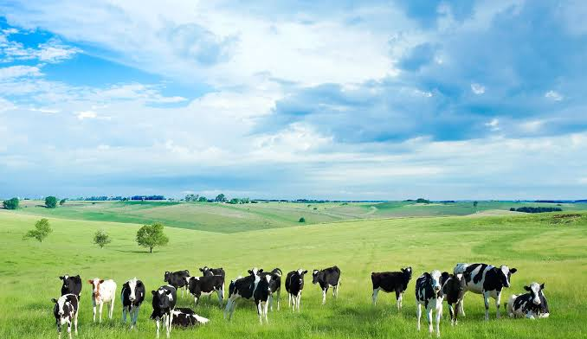
Livestock sector is an integral component of Indian Agriculture.It plays a predominant role in the Indian economy. It contributes about 4.11 per cent to India's GDP and 25.6 per cent towards total agriculture GDP.
Dairy farming dominates the livestock sector and is a cardinal pillar of agriculture. It alone claims a major share by contributing 67 per cent to total livestock output
In India, the total livestock population is 535.78 million of which dairy population is 438.8 million, therefore reaching millions of dairy farmers is a gigantic task for extension agents in country like India.(Source:National Accounts Statistics, 2019)

Slide 6
Lacunae in extension activities
  Traditional in nature
  Not reaching the needy farmers in the right form and at the right time
  Inability to cover all the farmers
  Farmers spend a lot of time and money to chase officials for seeking information, which affect their productivity (Singh and Misra, 2005).
The biggest hurdle that the farmers facing is to have access to updated and timely information.

Slide 7
Use of ICTs is one such solution that can meet the information requirements of all the farmers.
ICT enables one to overcome the limitations of physical distance and time lag in communication .
Among the ICT tools mobile is gaining much popularity and importance because of ease to access and faster information dissemination.
ICT has spread its wings through social media and mobile applications. ICT tools like Mobile Apps acts as Decision Support Tools (DST) and help users to make more effective decisions.

Slide 8
OBJECTIVES OF PRESENTATION
To understand the concept of Mobile applications and its services in dairy sector.
01
To know the advantages and disadvantages of mobile applications in dairy sector.
02
To review the relevant literature available/ research studies
04
To get insights into features of various mobile applications in dairy sector
03

Slide 9

What is Mobile Phone?
other features.
A mobile phone is a small wireless handheld device that allows users to make and receive calls, to send text messages and other features.

Slide 10
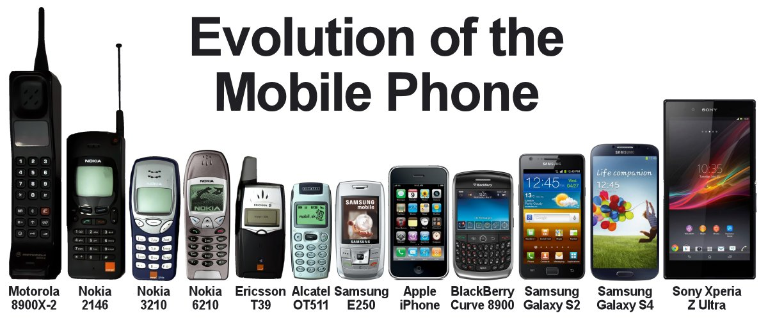
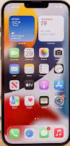
1995
2021
What next
?
Iphone 13 pro max

Slide 11
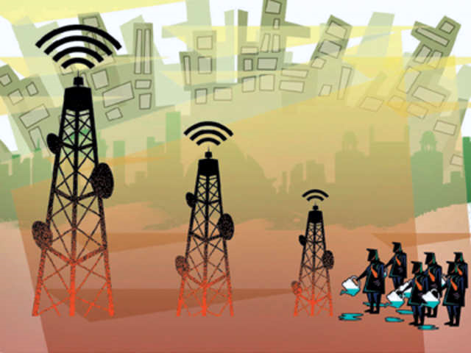
TELE DENSITY
Telephone density or teledensity is defined as the number of telephone connections for every hundred individuals living within an area.
It varies widely across the nations and also between urban and rural areas within a country.
The teledensity value of India is 88.51%.
It is also used as an indicator to define the purchasing power of the people of the country or specific region.

Slide 12
www.statista.com

Slide 13

Mobile Application
A mobile application is a computer program or software application designed to run on small, wireless computing devices such as smart phones and tablets rather than on desktop and laptop computers.

Slide 14

History of Mobile Applications
Mobile communication is so integrated into our lives that many people feel uncomfortable without a cell phone.
Once upon a time, the most popular functions of phones were calling and sending texts.
At present , smart phone is a multifunctional device that not only communicates, but also it helps to learn, earn, have fun and as a recreational tool through various apps.

Slide 15

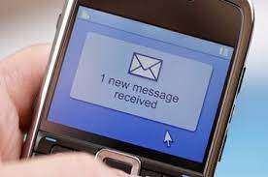




Communication
Learning
Earning
Fun @games
Recreation

Slide 16

This is made possible by the development of mobile applications.
Soon mobile phones were more than just a novelty.
These phones changed the way people thought about communication
Customers began pushing for more features and more games.
But mobile manufacturers lack the resources to build every application users wanted.
Even direct phone access to the Internet didn’t scale well in the initial days.

Slide 17



Slide 18
Wireless Application Protocol (WAP)
WAP standard was developed in 1999.
WAP was a stripped-down version of HTTP, which is the basic protocol of the World Wide Web.
WAP browsers were designed to run within the memory and bandwidth constraints of the phone.
The WAP solution was great for mobile operators.
They could provide a custom WAP portal directing their subscribers to the content they wanted.

Slide 19


Developers and content providers couldn't deliver everything what users wanted, except in a limited way.
Commercializing WAP applications was difficult, because there was no built-in billing mechanism. Payment was through various premium-priced delivery mechanisms such as Short Message Service (SMS) and Multimedia Messaging Service (MMS).
Users browsed a WAP site and requested a specific item, then fill a simple order form with their phone number and the model of their phone. It was up to the content provider to deliver an image or audio file compatible with the phone.
BUT……..
Wireless Application Protocol
WAP
Wait And Pay

Slide 20


Slide 21
Mobile Application Platforms
A variety of different platforms emerged and developers are actively creating applications from them.
One of the first was Palm OS
  RIM Blackberry OS.
  Java Micro Edition (Java ME).
  Binary Runtime Environment for Wireless (BREW).
Symbian OS was developed by Nokia, Sony Ericsson, Motorola and Samsung.
The Apple iPhone iOS joined the ranks in 2007.
Google’s Android came along a year later in 2008.

Slide 22
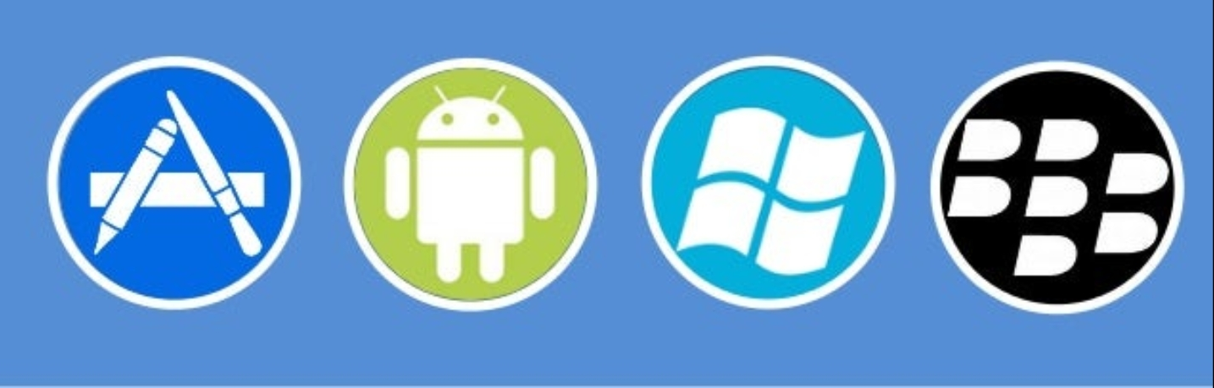
Mobile Application Platform
Mobile application platform is a suite of software tools used for designing ,creating and maintaining mobile applications.
Apps are available through application distribution platforms such as Apple App store ,Google Play store, Windows Phone store and BlackBerry app world etc

Slide 23
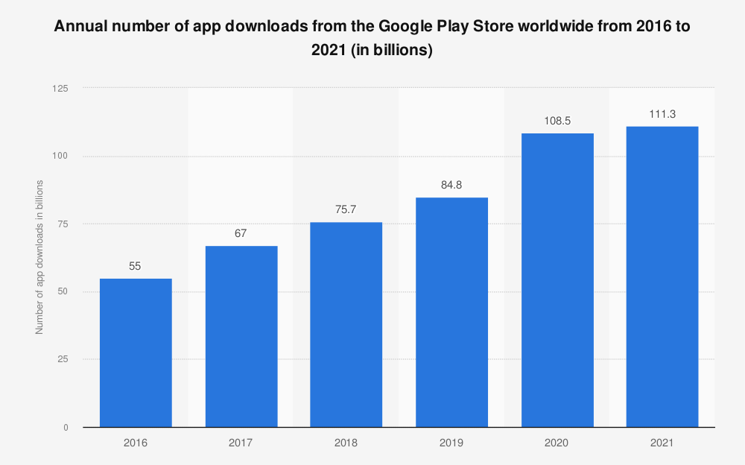
www.statista.com

Slide 24
Mobile phones and its applications in dairy sector
Among all the ICT tools, mobile phone has emerged as one of the widely accepted and adopted instruments for delivery of agriculture and allied sectors related information.
Mobile applications is a new phenomenon in seeking dairy related information related to supplying inputs, balanced ration, disease diagnosis, management and marketing of dairy products etc.
Mittal and Tripathi (2009) reported the key role played by mobiles in lowering transaction costs and raising the income levels of farmers, by efficiently addressing agricultural information requirements

Slide 25
Advantages of mobile apps in dairy sector
An effective ICT tool for information dissemination.
Easy to access information through mobile, affordability, instant and convenient service delivery.
Information on various dairy related activities are available at any point of time on through various apps.
The market connectivity is also improved with the visibility of the potential buyers and sellers in the locality with an opportunity to develop direct contacts.
The available information is compiled and very well organized that farmer does not have to waste time for searching the information.

Slide 26
Disadvantages of mobile apps in dairy sector
Lack of e-illiteracy among farmers
Wherever the information is dynamic in nature, like market prices of various products, advisory services, the mobile app requires internet connectivity to fetch the real-time data.
Diversity in languages, even if the best applications do not support regional languages, it reduces the acceptability and popularity among farmers
At times, due to network issues and technical glitches, farmers could not get the updated and complete information.

Slide 27

Mobile Apps in Dairy sector

Slide 28
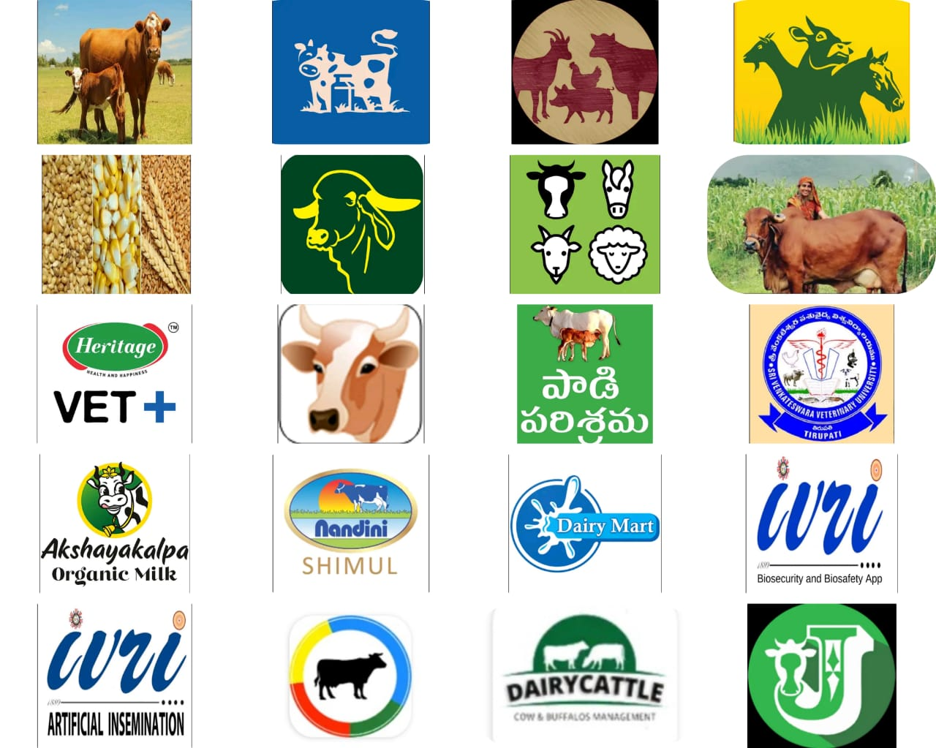

Slide 29
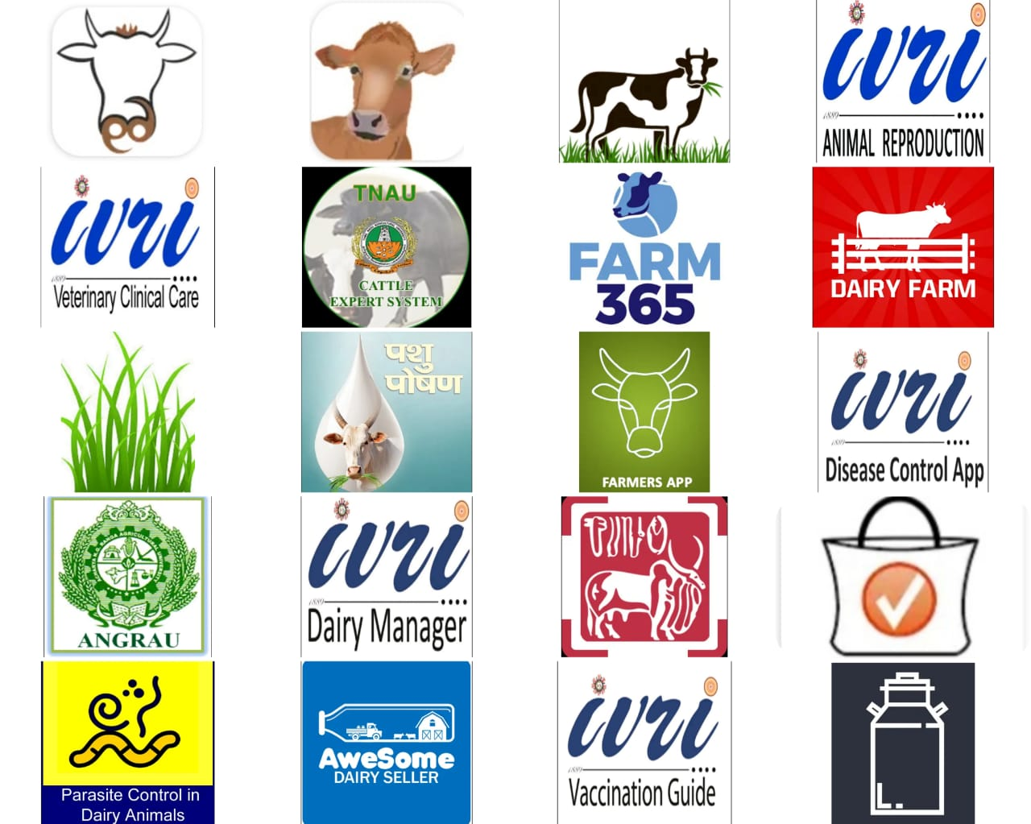

Slide 30

Classification of Dairy Apps based on its Utility

Slide 31
Apps related to Balanced ration and cattle feed
Apps related to Health and Disease diagnosis
Apps related to Dairy Management activities
Apps related to Vaccination and Artificial Insemination in Dairy animals
Dairy products Marketing Apps
Dairy Apps Providing Multiple Services

Slide 32
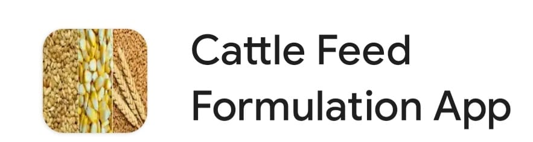



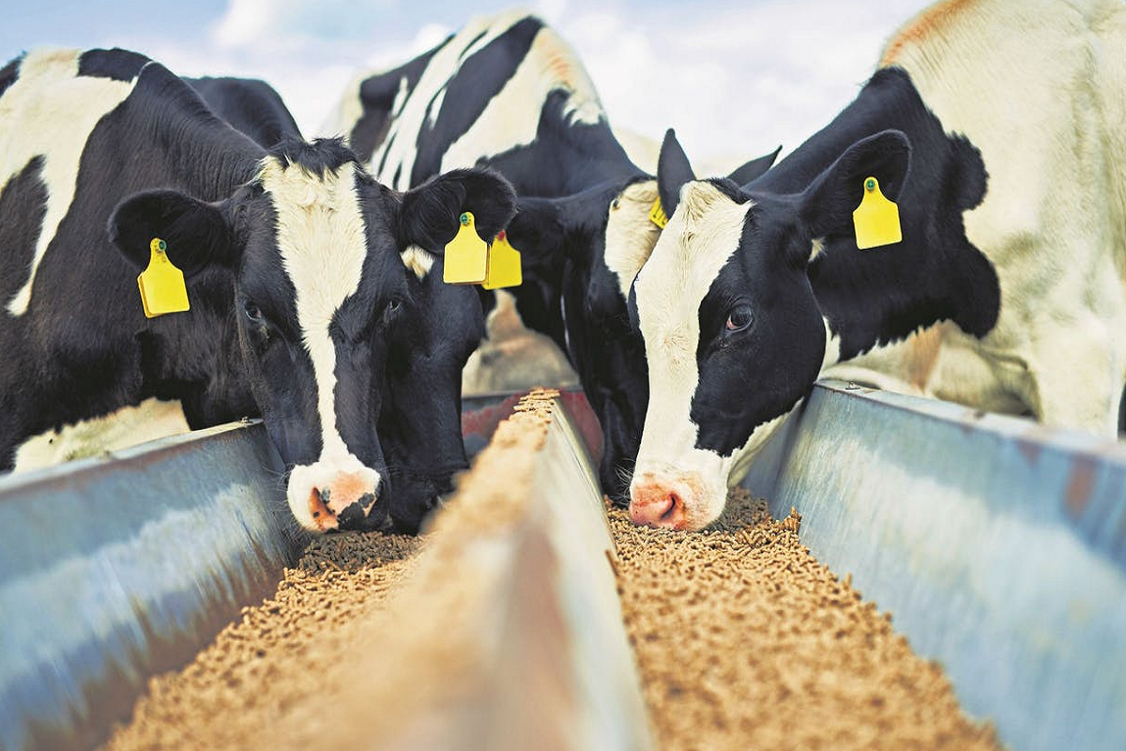

Apps related to Balanced ration and cattle feed

Slide 33

Pashu Poshan (Ration Balancer) app
The mobile application, named 'Pashu Poshan', was launched by National Dairy Development Board (NDDB) in association with the Union Agriculture Minister Radha Mohan Singh.
It is a mobile application that will recommend balanced diet for cows and buffaloes to boost farmers income by raising milk yield and cutting feed cost.

Slide 34
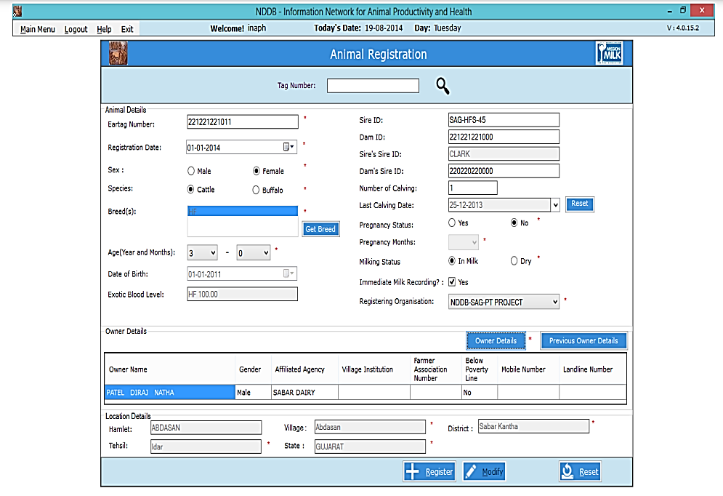
The application, which will be available on both web and android platforms, can be accessed by registering on the INAPH portal (http://inaph.Nddb.Coop).
To use this application, the farmer needs to provide complete animal profile, which includes
  breed,
  age,
  animal identification number,
  milk production quantity,
  fat content in milk.

Slide 35
In a press meet , NDDB Chairman told reporters that as a part of their experimental survey
  “They have already collected profiles of 6 lakh milch animals in 40,000 villages and farmers feedback about the balanced feed and fodder for their cattle.
  “App resulted in reducing the feed cost by Rs. 5-15 per animal per day and an average increase in milk production by 300 ml per animal per day”.
App available at: https://play.google.com/store/apps/details?id=coop.nddb.pashu_poshan&hl=en_IN&gl=US

Slide 36
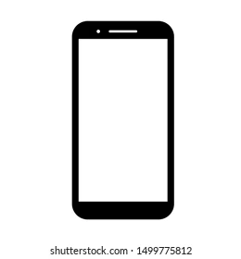
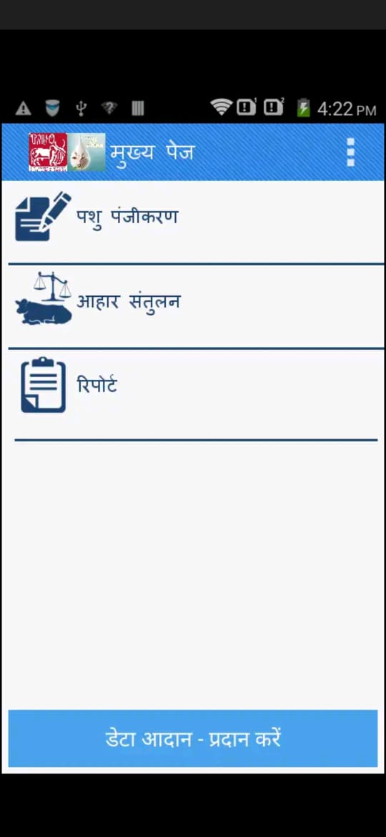
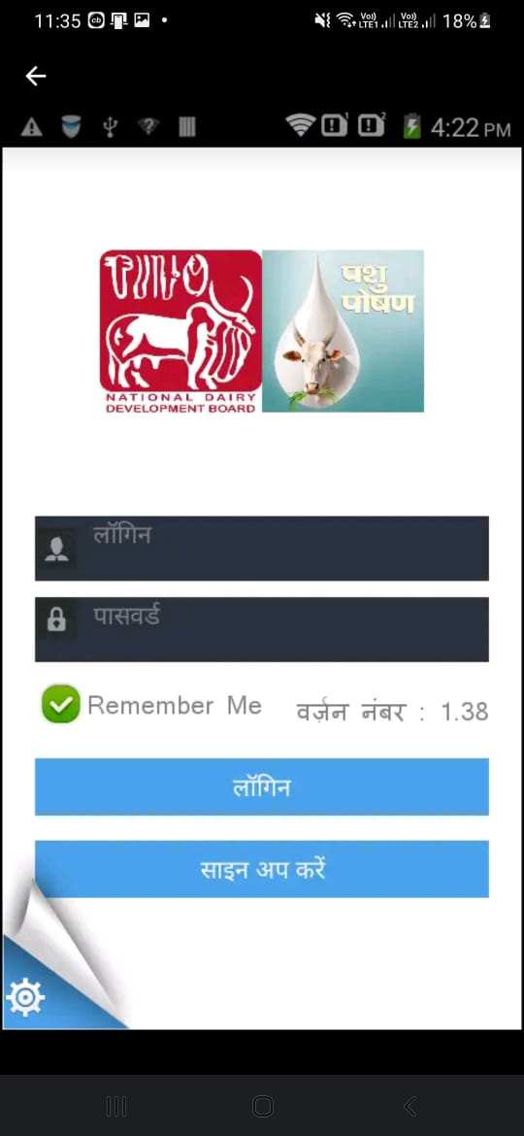


Slide 37
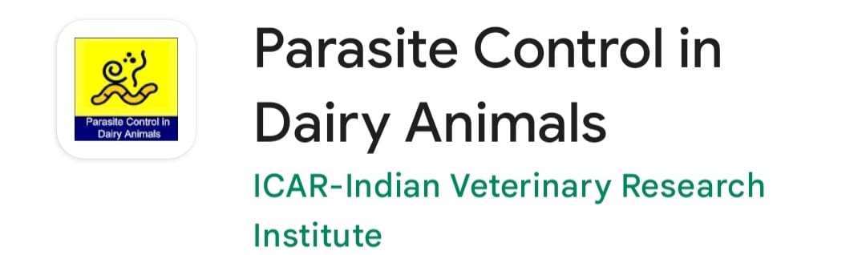
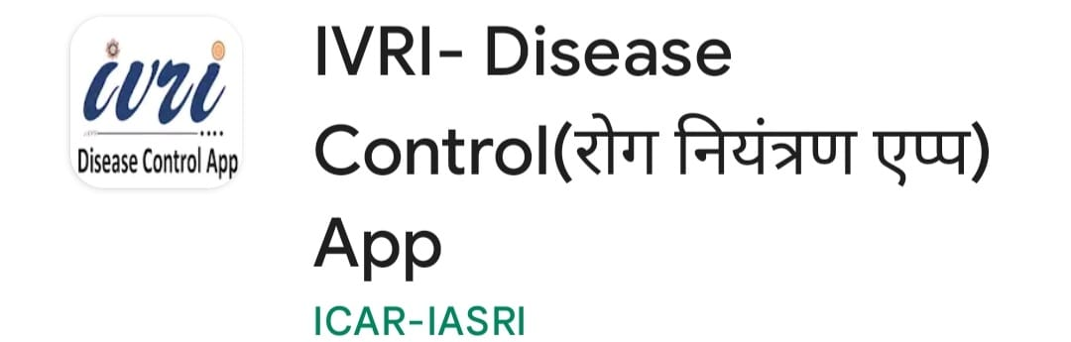
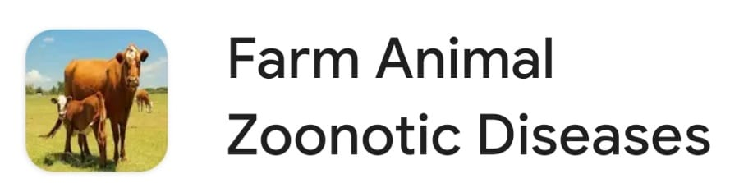
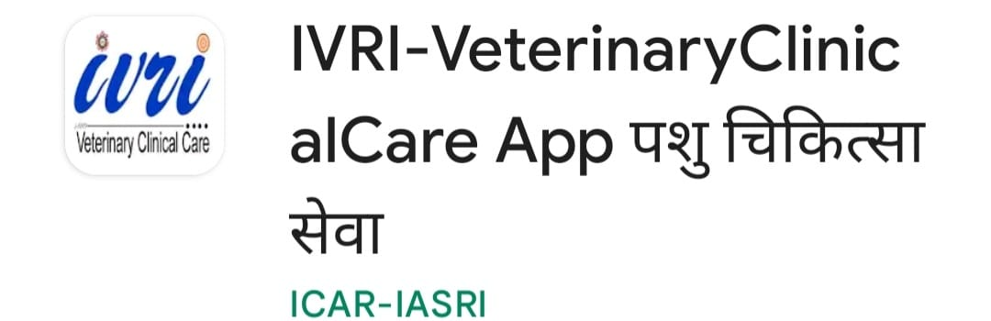
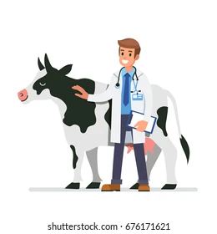
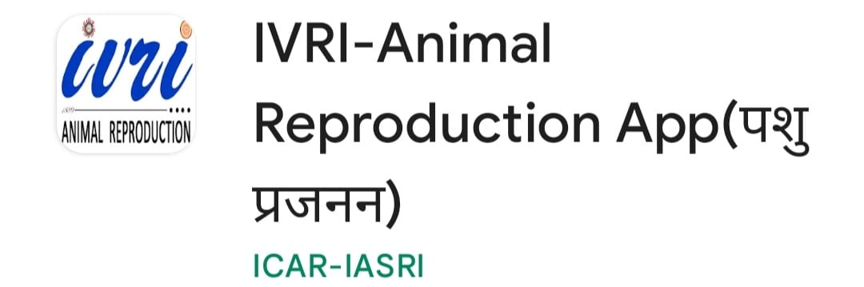
Dairy Apps related to Health and Disease diagnosis

Slide 38

IVRI – Disease control App
IVRI –Disease control app is designed and developed by ICAR-IVRI,Izatnagar and IASRI,New Delhi about important diseases of life stock ,poultry and dogs .
In addition to theory, it also provides pictures depicting the symptoms for identification, diagnosis, treatment and control.

Slide 39
This app provides information about the
  Exotic and emerging diseases
  Various diagnostic facilities offered by ICAR-IVRI
  Various diagnostic laboratories in India
  Important organizations involved in Disease Control and
  Government schemes and guidelines for Disease Control in India.
  App available at:
  https://play.google.com/store/apps/details?id=com.icar.ivri.iasri.diseasecontrolapp&hl=en_IN&gl=US

Slide 40
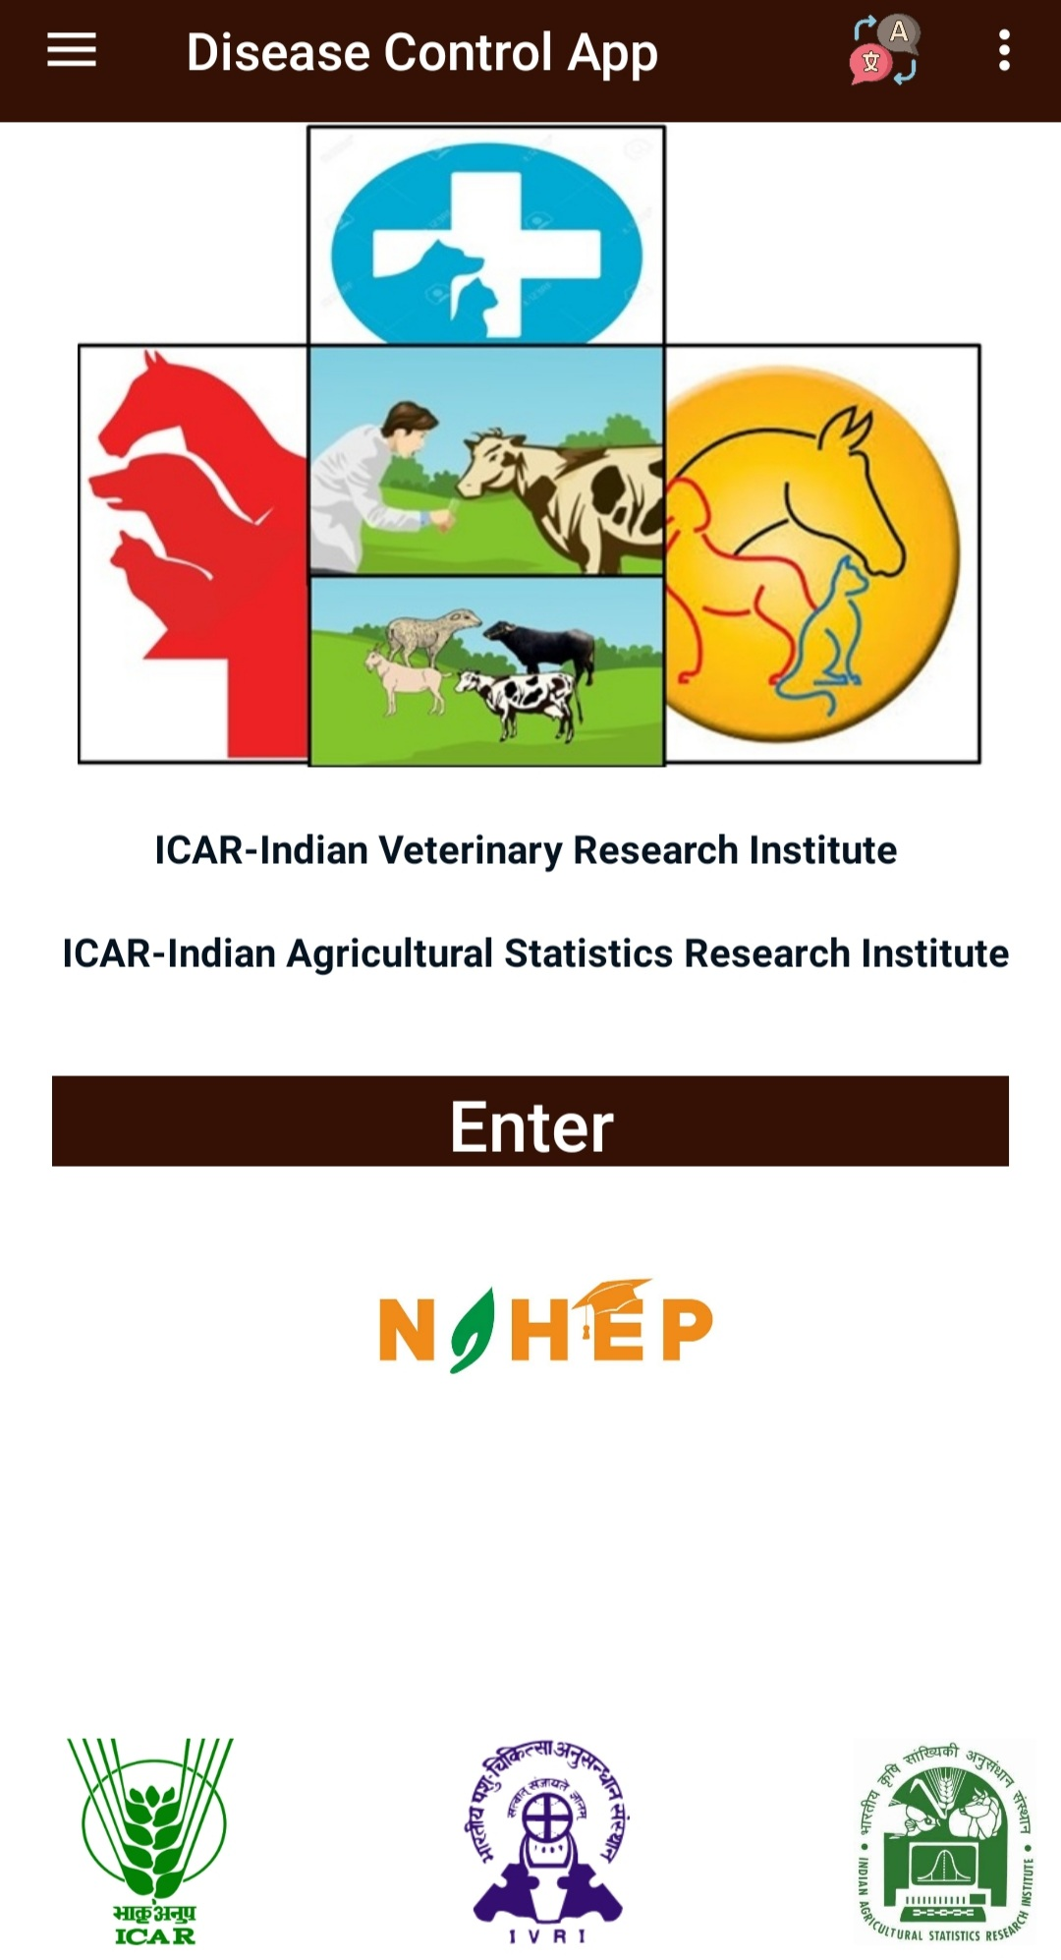
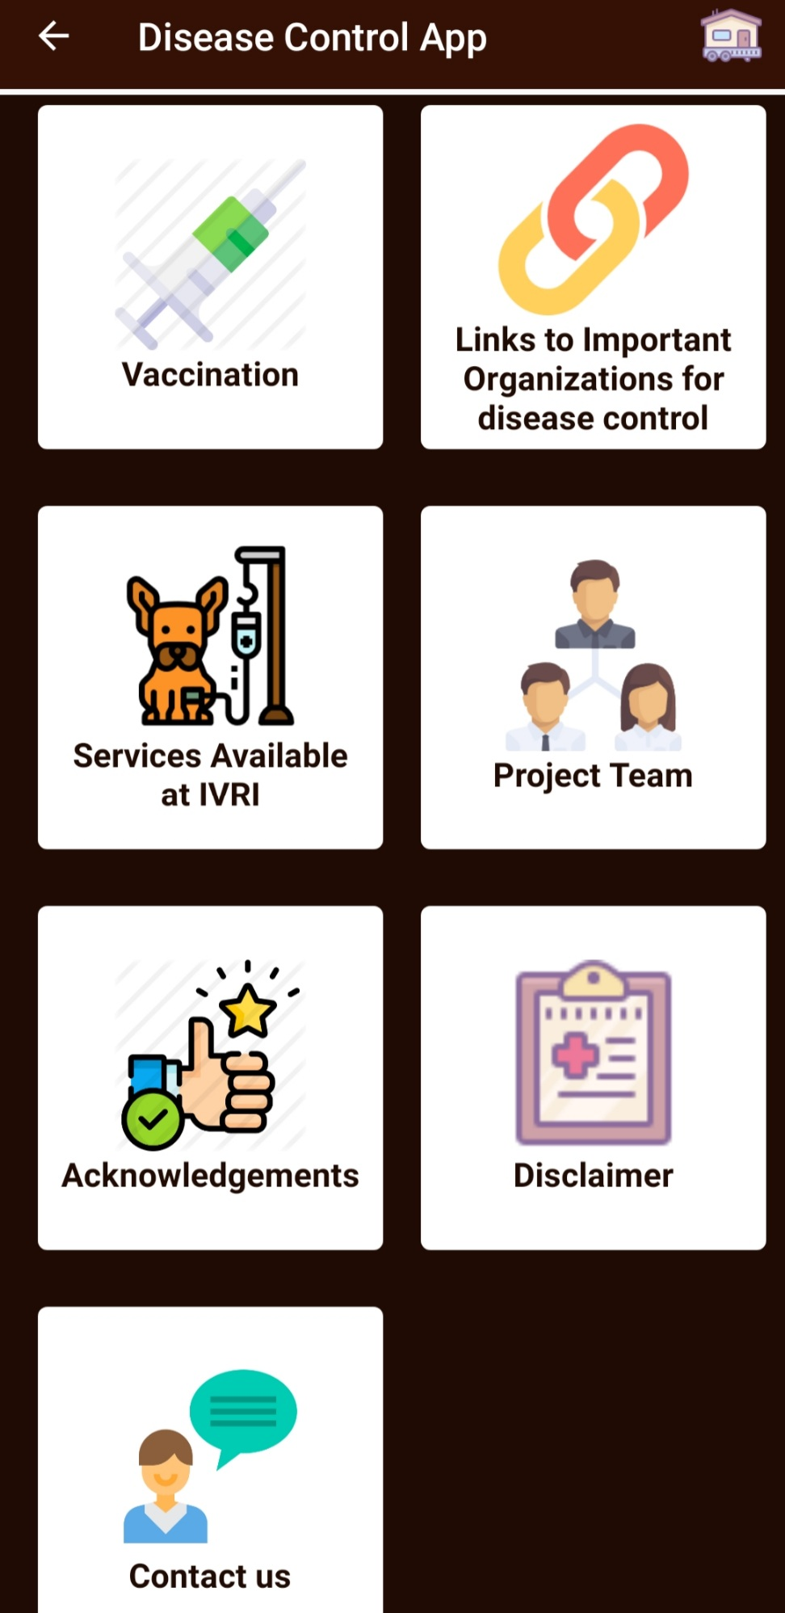
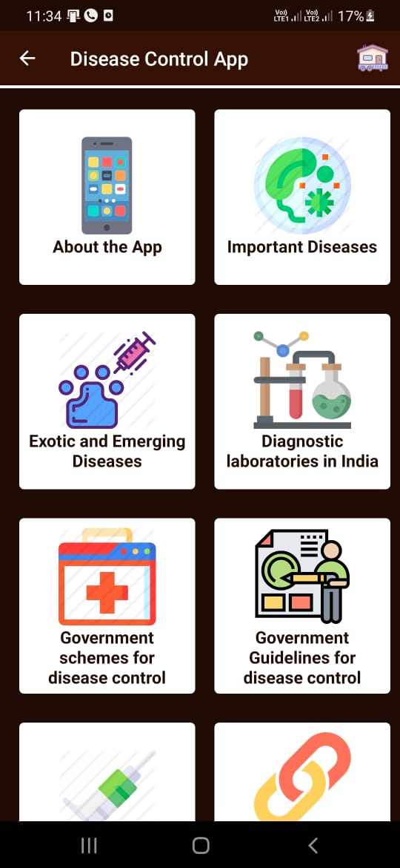

Slide 41
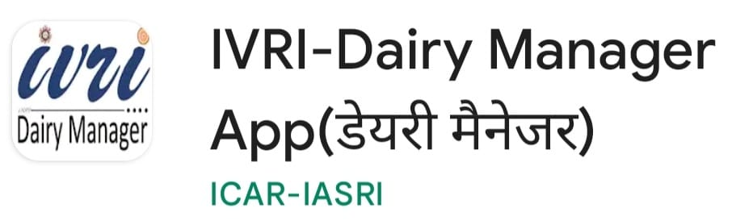

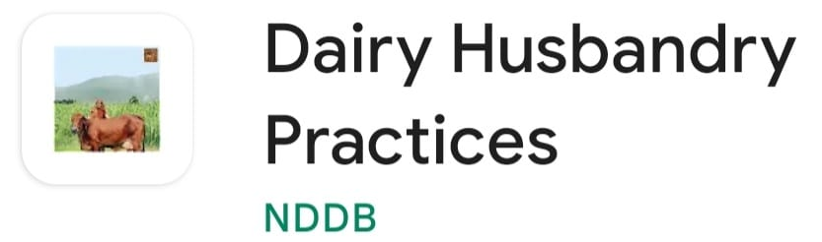

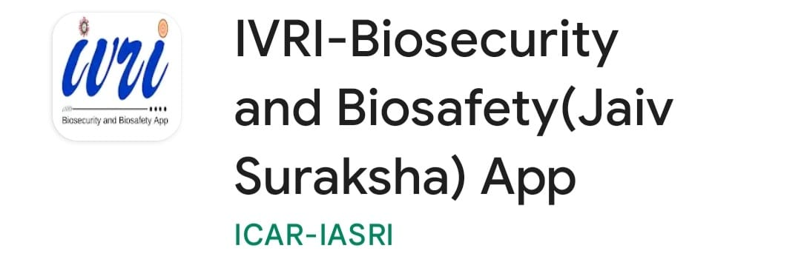


Apps related to Dairy Management activities

Slide 42

IVRI – Dairy Manager
IVRI-Diary manager app is designed and developed by
  ICAR-IVRI , Izatnagar
  NDRI -Karnal and
  IASRI, New Delhi .
App available at:
https://play.google.com/store/apps/details?id=com.ivri.iasri.dmapp&hl=en_IN&gl=US

Slide 43
This is an educational app providing information on
  Breeds and housing
  Feeding
  Calf and general management
  Clean milk production
  Animal identification and Vices in dairy animals
There are educational videos on clean milk production on neonatal calf management for enhancing the knowledge and skills of personnel involved in dairy farming

Slide 44
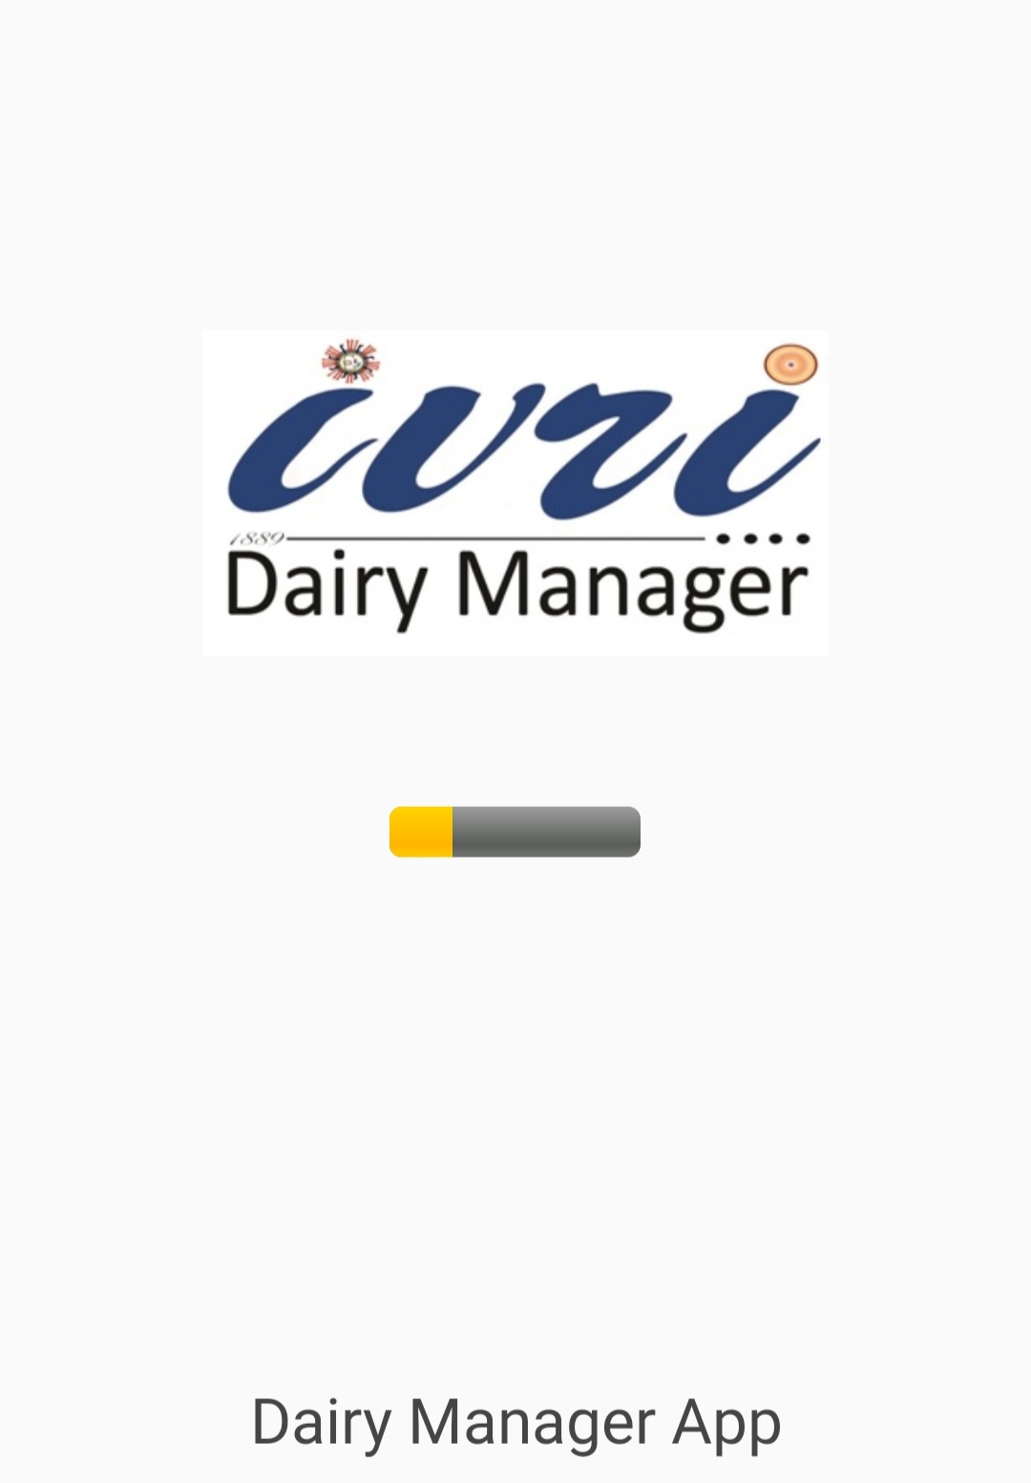
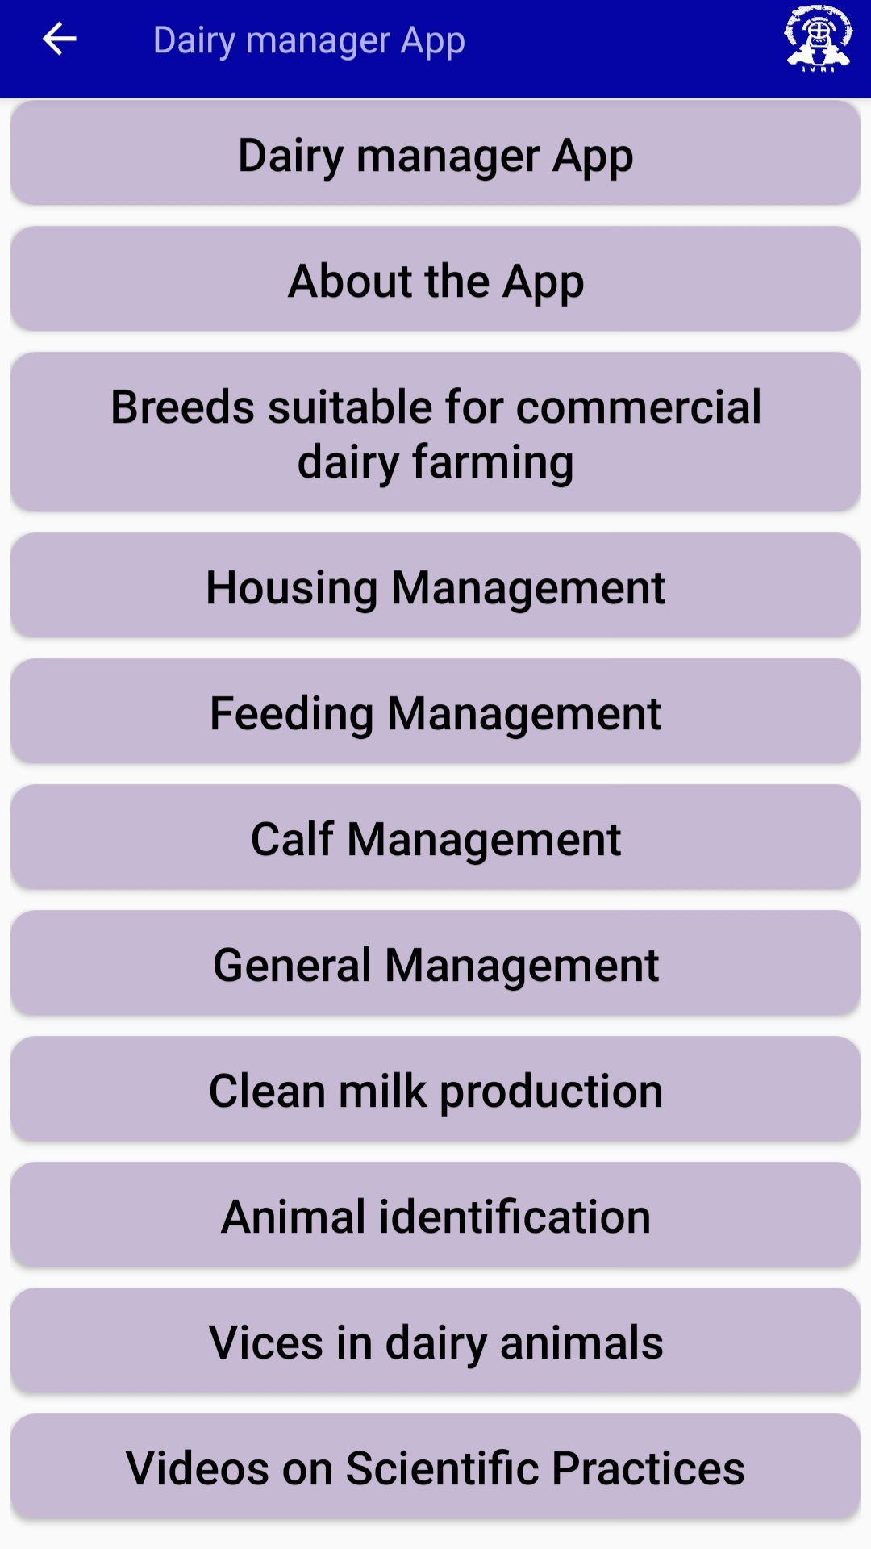
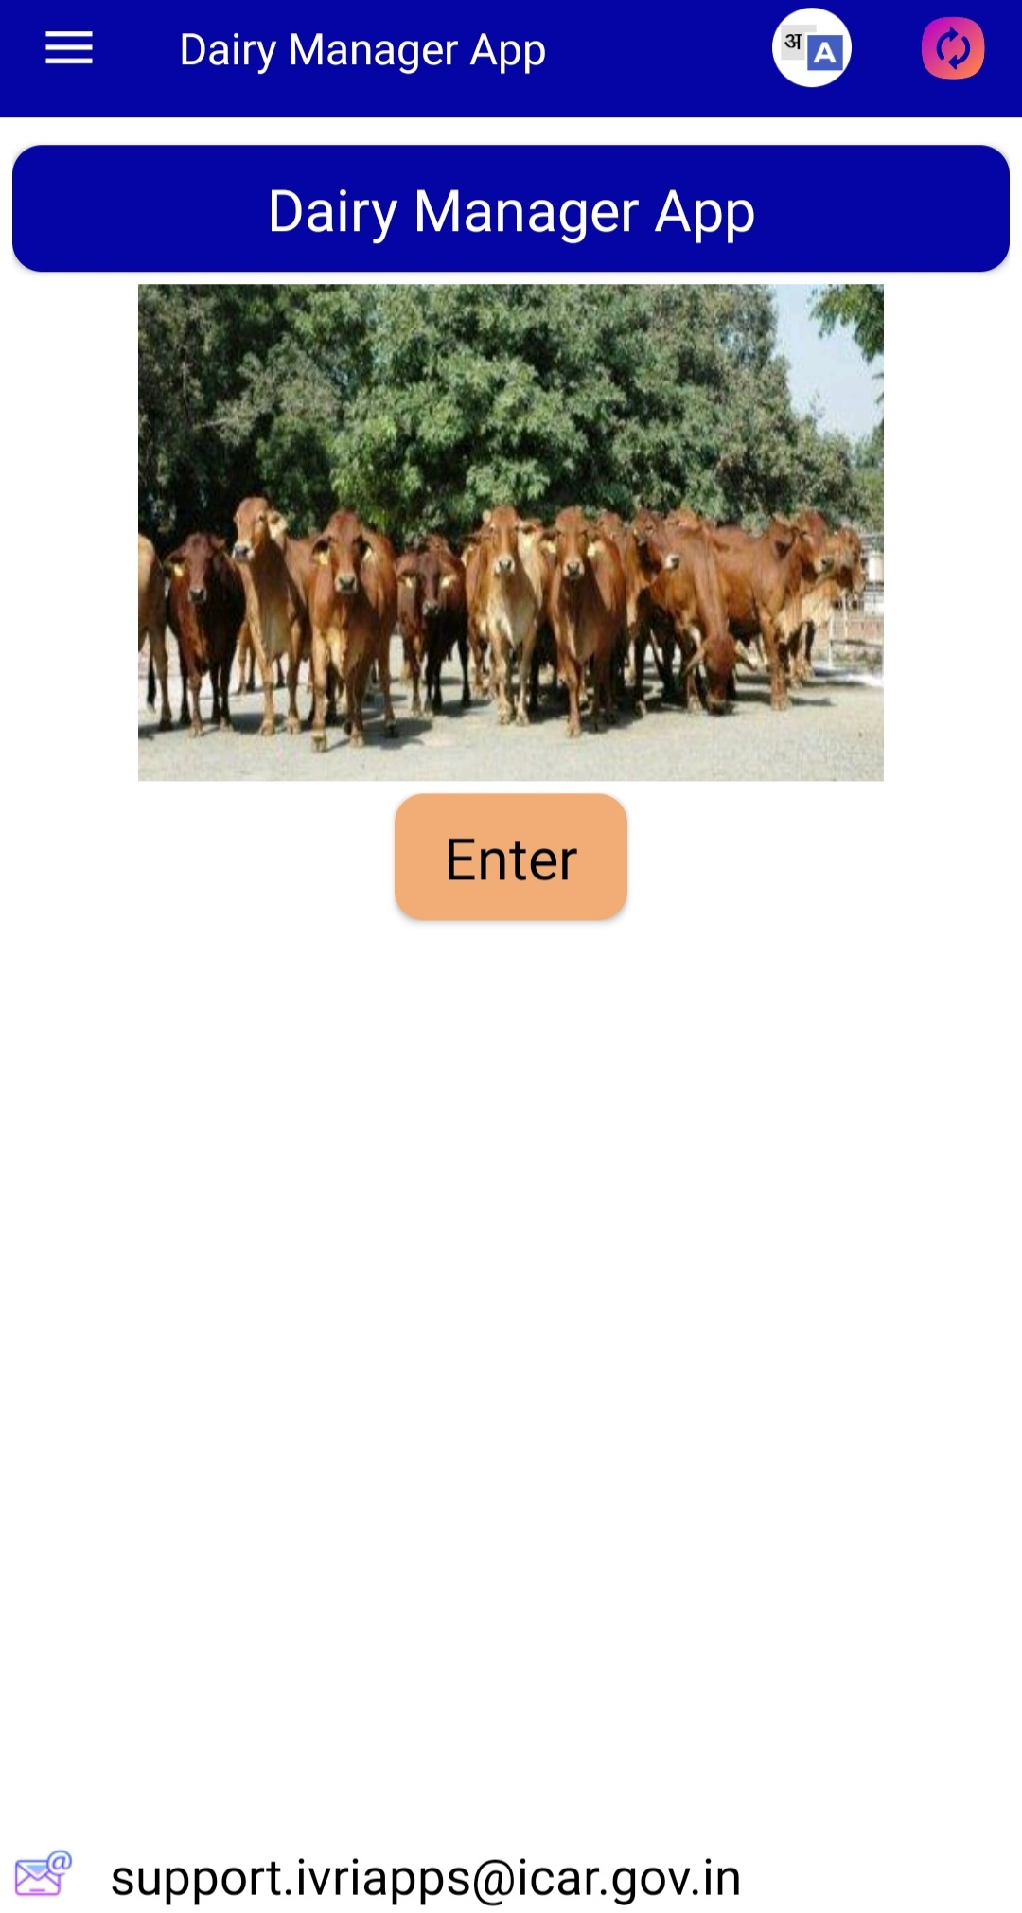

Slide 45


Apps related to Vaccination and Artificial Insemination
in Dairy animals

Slide 46

IVRI – Vaccination Guide
IVRI-Vaccination Guide app is designed and developed by ICAR-IVRI,Izatnagar and IASRI, New Delhi to educate about vaccination in domestic animals, poultry and pets.
This app provides
  basic information about vaccination in livestock, poultry and pets
  specific information about vaccination related to all major bacterial and viral diseases.

Slide 47
For each of the disease, following information is provided
  The causative agent
  Types of vaccine available
  Serotype used for the vaccines
  Vaccination schedule
  Commercially available vaccines
  Government and private institutions involved in vaccine production in country.
App available at:
https://play.google.com/store/apps/details?id=com.icar.ivri.iasri.vcguideapp&hl=en_IN&gl=US

Slide 48
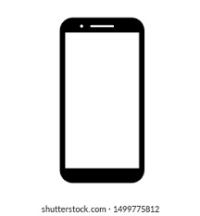
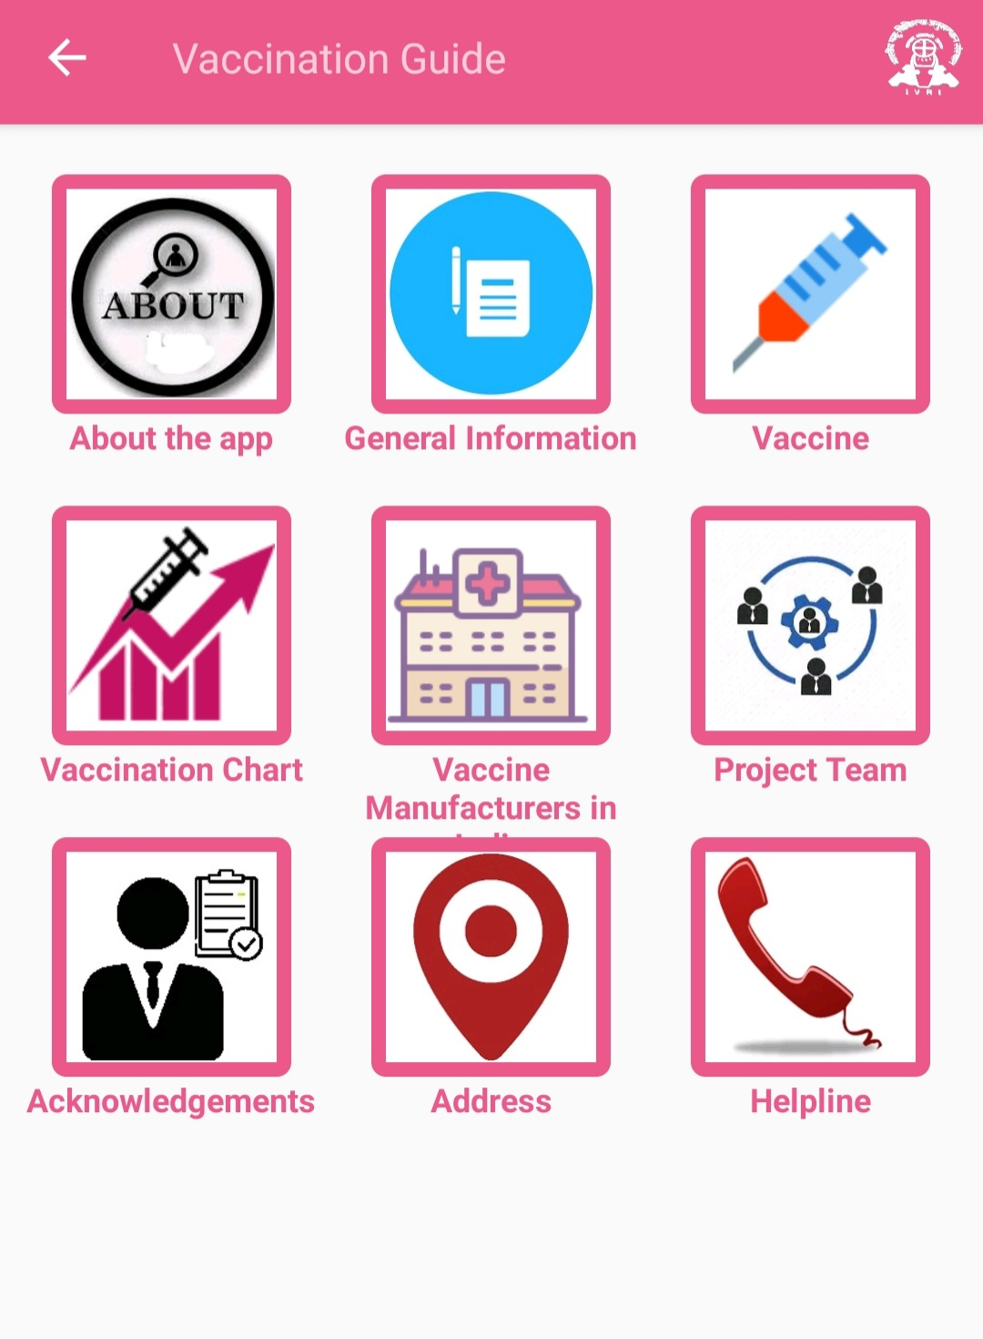
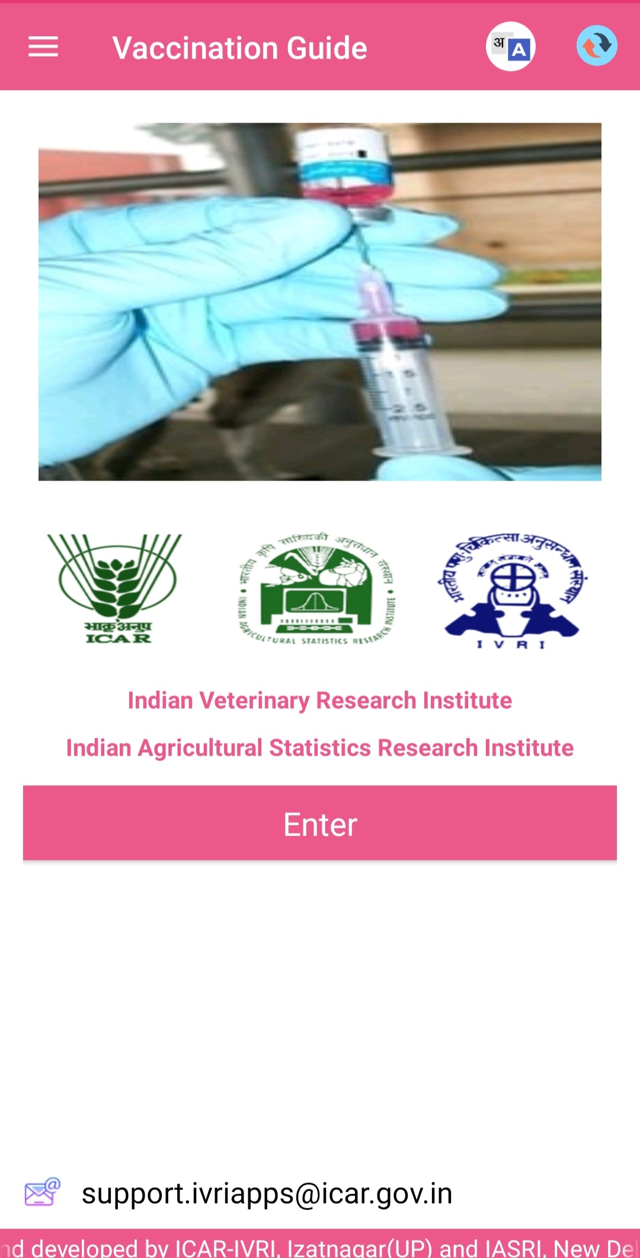

Slide 49







Dairy products Marketing Apps

Slide 50
Country Delight app
Country Delight is an initiative to disrupt India's online milk & grocery delivery market .
Order placements take place through mobile app that aids convenient online milk delivery.
With an focus on quality & testing, they test milk on more than 26 parameters by an FSSAI approved lab and deliver it under the best cold chain right up to your doorstep within 24-36 hours of milking.

Slide 51
Currently, it serves in Delhi, Gurgaon, Mumbai, Pune, Bangalore, Noida, Jaipur, Chennai and Hyderabad.
Country Delight Products:
Farm-fresh milk ,dairy products etc.
Their milk is sourced directly from the farmers and delivered to you without any intervention of middleman.
App available at:
https://play.google.com/store/apps/details?id=app.mycountrydelight.in.countrydelight&hl=en_IN&gl=US

Slide 52
Key Features of the App
1- Subscribe and forget
2- Manage your orders and subscription
3- Easy Recharge
4- Cashback and offers
5- Easy view bill

Slide 53
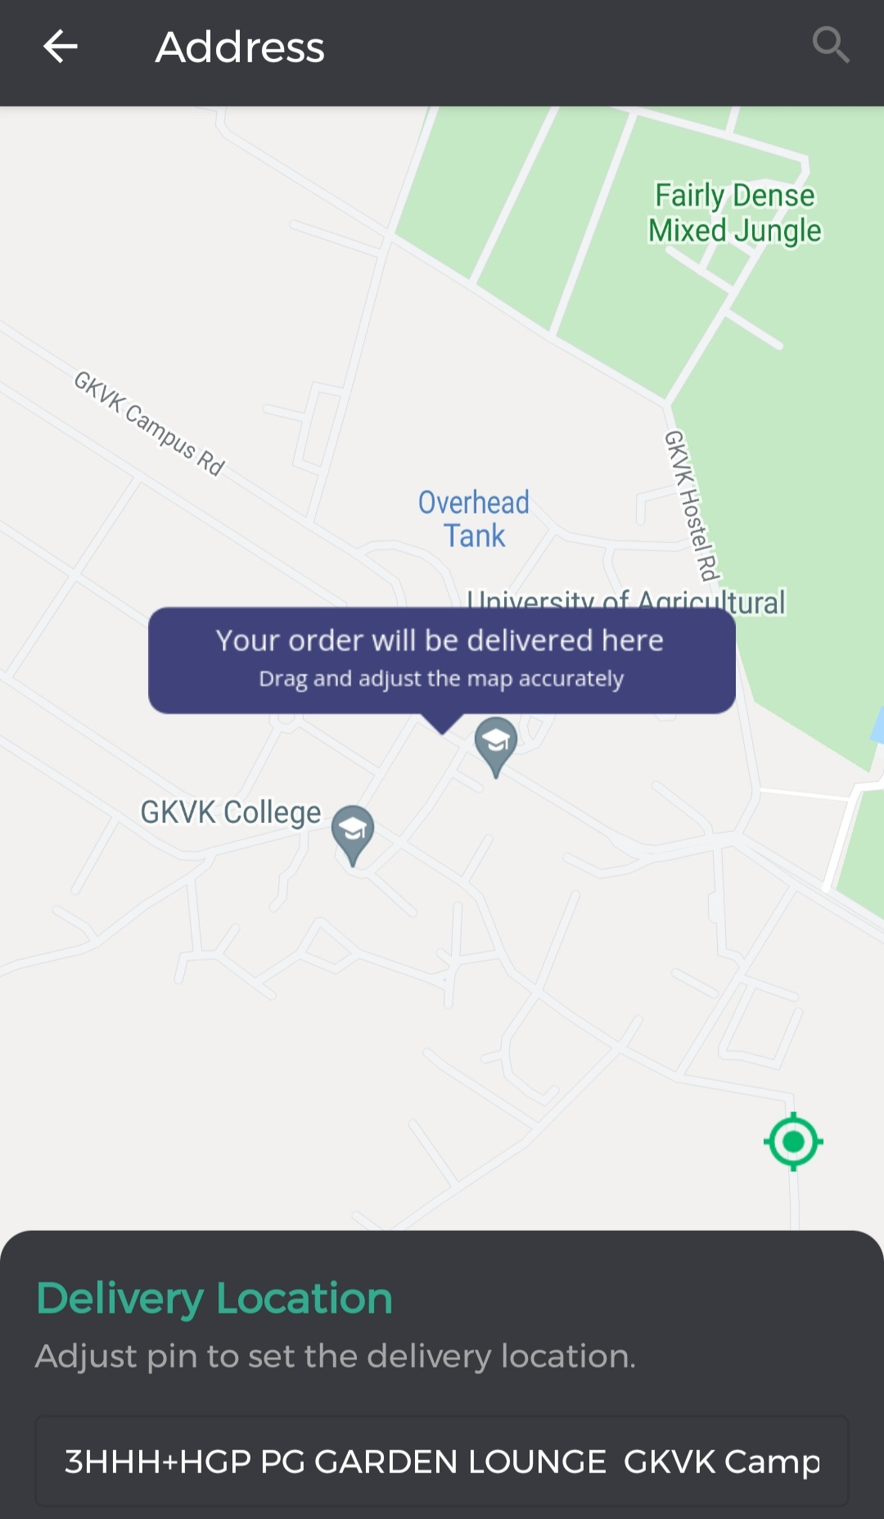
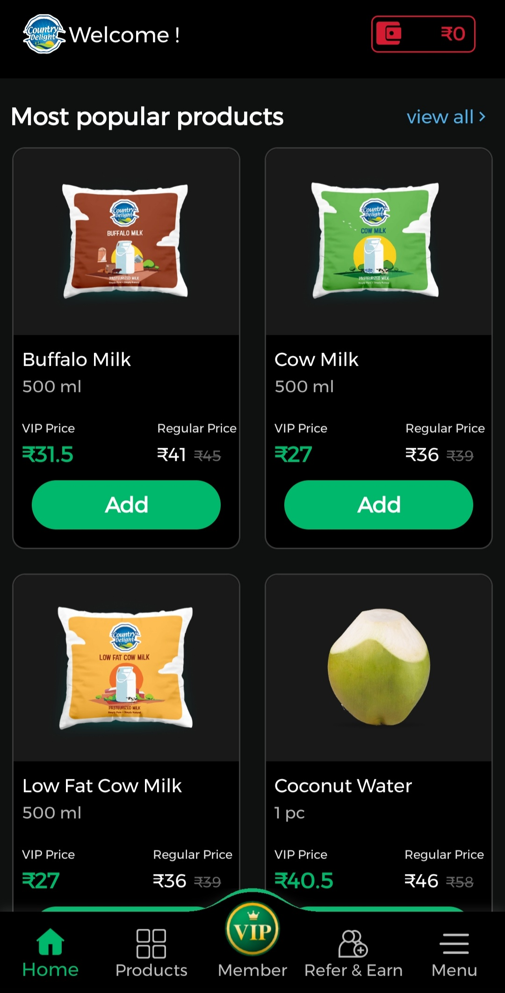

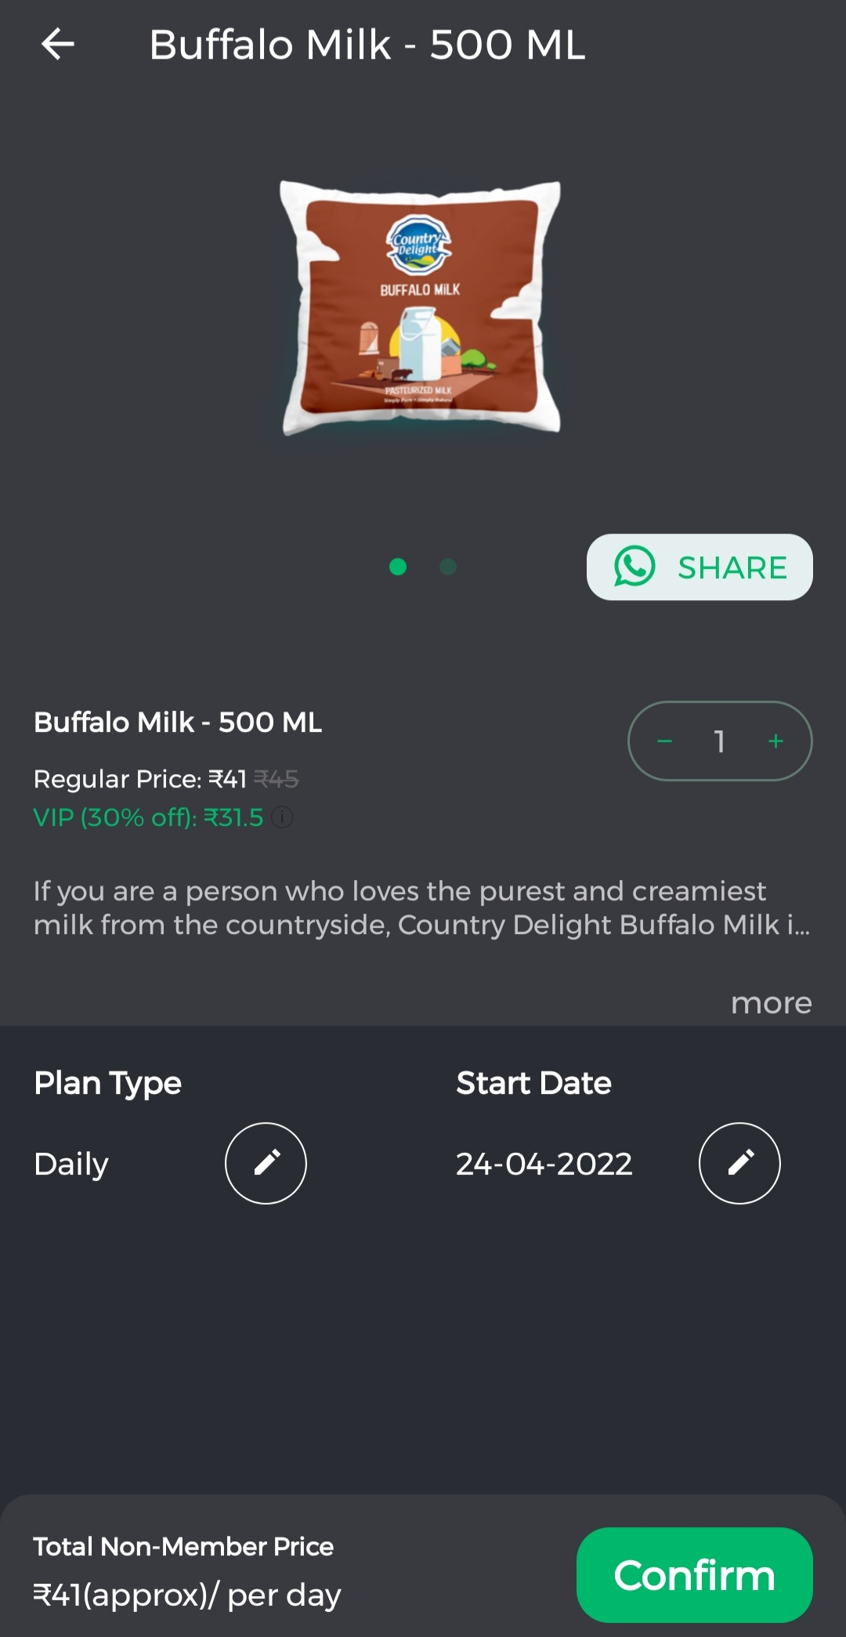

Slide 54
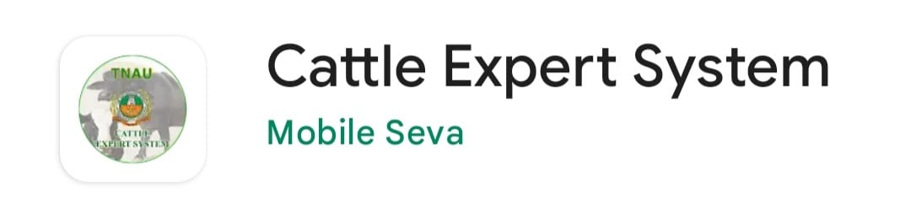












Dairy Apps
Providing Multiple Services

Slide 55

Dairy kannada app
This is an app designed and developed by
  Jayalaxmi Agro Tech Pvt Ltd in association with
  Karnataka Veterinary Animal and Fisheries sciences University(Bidar)
  Department of VAHE, Veterinary College(Hebbal, Bengaluru)
under ICAR Extra Mural Project 2016-17.

Slide 56
This app is equipped with decision support system with Kannada language support.
App is user friendly in nature with audio video content.
This is designed to deliver the information to the mainly to the dairy farmers by breaking literacy barrier.
App available at:
https://play.google.com/store/apps/details?id=com.agri.dairy&hl=en&gl=US

Slide 57
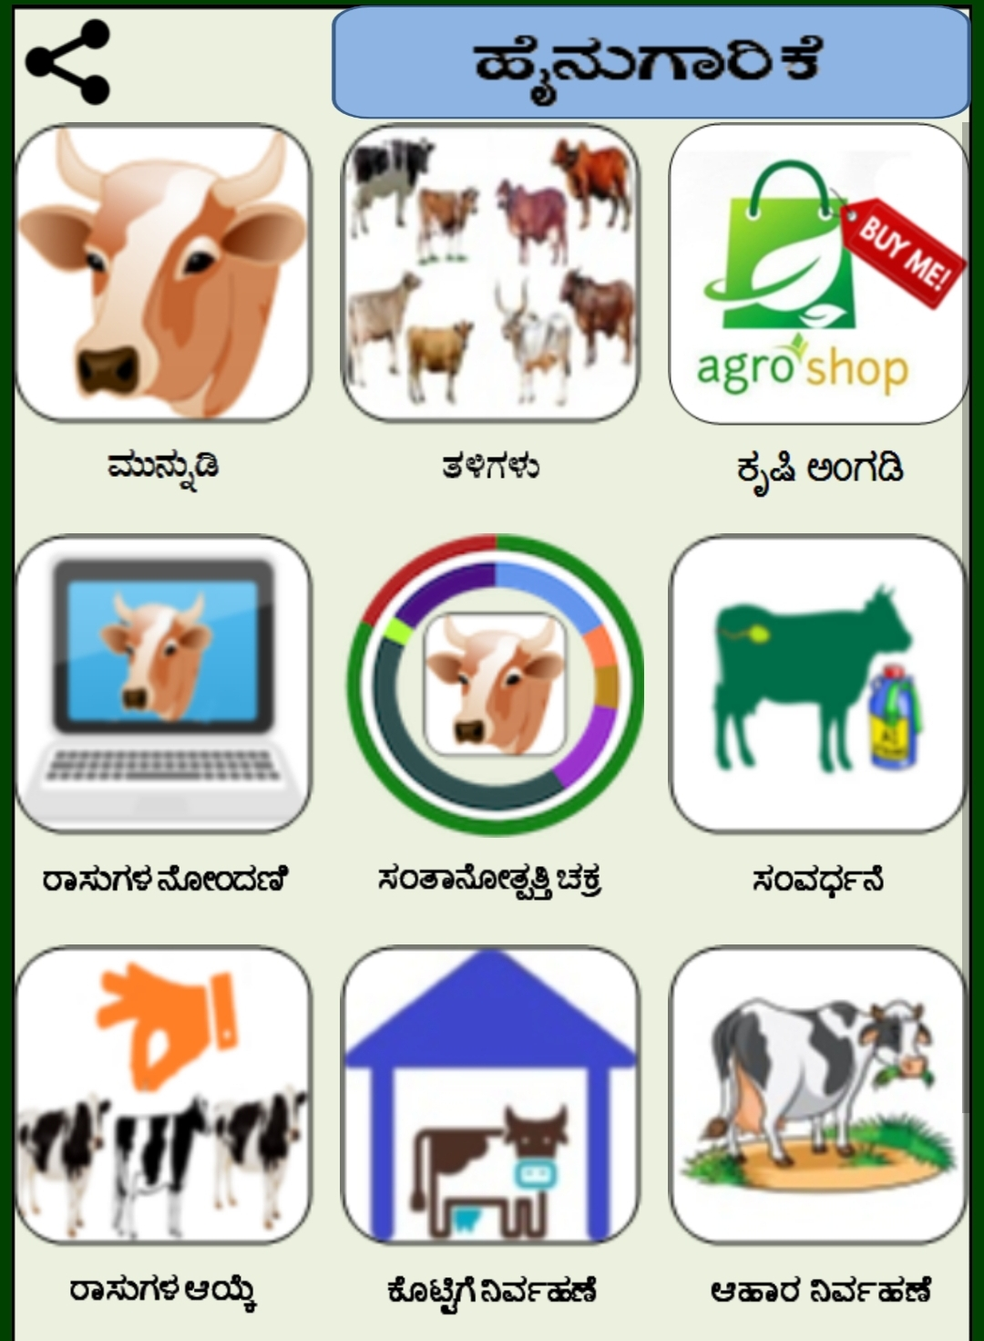
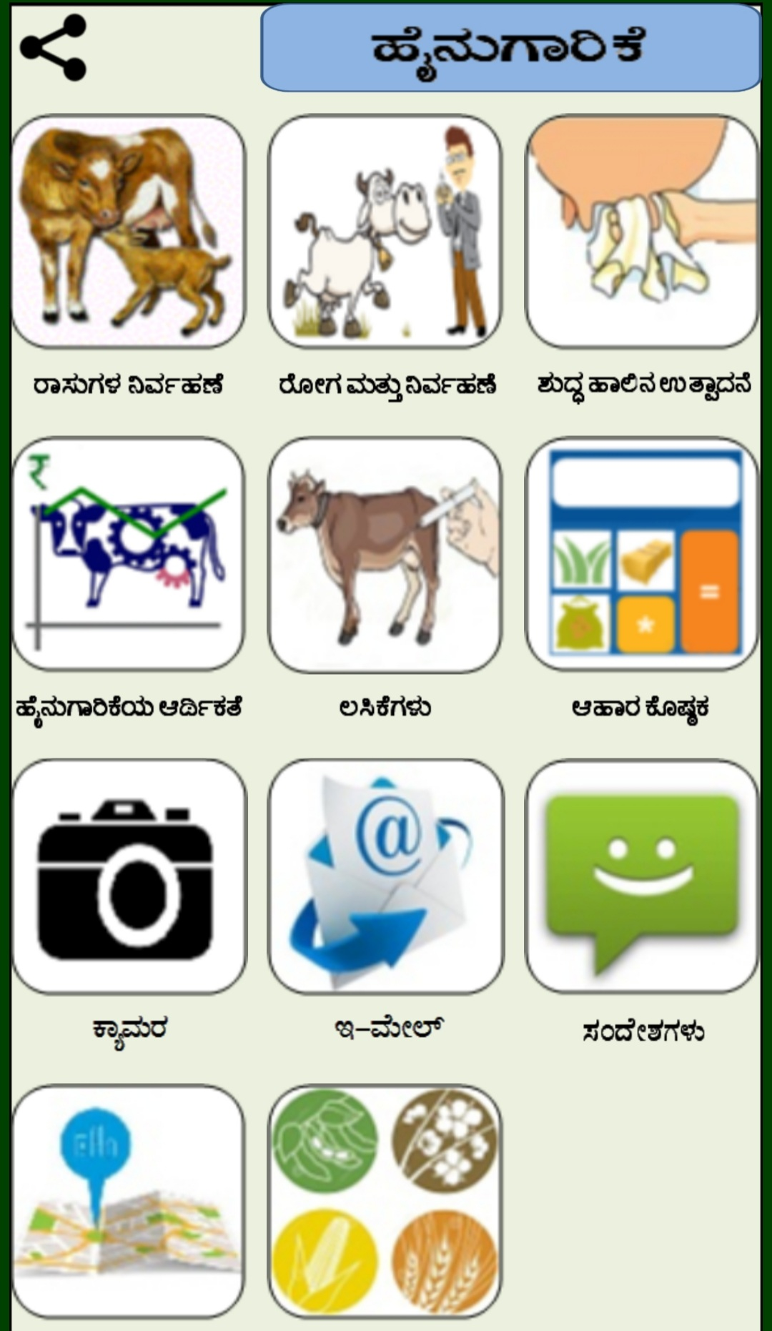

Slide 58
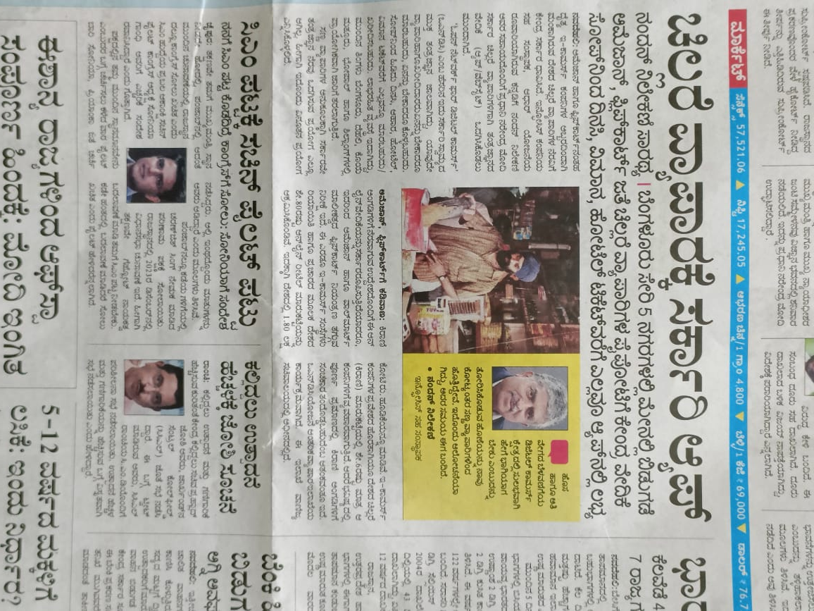

Strategies for effective utilization of mobile apps in dairy sector
Extension system
Providing training programs to farmers for improving digital literacy.
Integrating mobile apps while disseminating information.
Data service providers
Special internet packs for farmers
Establishing more towers especially in rural areas for good internet connectivity.
Government
Providing separate budget for content development.
Facilitating subsidy in purchasing mobile phones.
Service oriented apps can be developed from public sector apart from co-operatives and institutions.

Slide 59

Review of Literature

Slide 60
Research Study 1
Development of a Need Based IVRI-Dairy Manager App and its Perceived Utility
Sood et al., (2020)
Methodology:
Ex post facto research design was used.
Snowball sampling technique was used as no list of commercial dairy farmers was available.
Study was conducted purposely in Punjab state as it accounts for the highest milk productivity with sample size 60

Slide 61
Distribution of respondents according to the perceived utility of
IVRI-Dairy Manager App
Perceived utility | Dairy farmers (n=60)
 | Good | Fair | Poor | MS
Usefulness | 56 (93.3) | 04 (6.7) | 0 (0.00) | 2.93
User friendliness | 46 (76.6) | 14 (23.3) | 0 (0.0) | 2.76
Attractiveness | 48 (80.00) | 12 (20.00) | 0 (0.0) | 2.80
Compatibility | 52 (86.66) | 0 (0.00) | 08 (13.33) | 2.73
Complete coverage of content | 25 (83.33) | 08 (13.33) | 02 (3.33) | 2.80
Soundness of visuals | 40 (66.66) | 20 (33.33) | 0 (0.0) | 2.66
Credibility | 54 (90.00) | 06 (10.0) | 0 (0.0) | 2.90
Average Score | 19.58

Slide 62
Distribution of respondents according to information needs on dairy management
Kind of information needed | N = 60
 | Most Needed | Needed | Least Needed | Mean Score
Scientific way of shed construction | 15 (25.00) | 22 (36.66) | 23 (38.33) | 1.87
Breed Selection | 7 (11.66) | 20 (33.33) | 33 (55.00) | 1.56
Infertility problems | 7 (11.66) | 22 (36.66) | 31 (51.66) | 1.59
Preparation of balanced ration | 11 (18.88) | 11 (18.88) | 38 (63.33) | 1.54
Care of cow/ buffalo | 9 (15.00) | 16 (26.66) | 35 (58.33) | 1.56
Care of newborn calf | 14 (23.33) | 28 (46.66) | 18 (30.00) | 1.93
Clean milk production | 24 (40.00) | 25 (41.66) | 11 (18.33) | 2.21
Common cattle/buffalo diseases | 18 (30.00) | 21 (35.00) | 21 (35.00) | 1.95
Vaccination schedule | 9 (15.00) | 14 (23.33) | 37 (61.66) | 1.53
Prevention and control of diseases | 10 (16.66) | 11 (18.33) | 39 (65.00) | 1.51
Government schemes | 10 (16.66) | 20 (33.33) | 30 (30.00) | 1.66

Slide 63
Research Study 2
Exploring the Perceived Feedback of Commercial Dairy Farmers about Effectiveness of Android Mobile Apps ‘Brucellosis Advisor App’
Verma et al.,(2019)
Methodology:
The study was conducted in Haryana and Punjab state .
Six districts (3 from each state) were selected based on highest cattle population.
Among these selected districts, 20 commercial dairy farmers were selected from each district based on snowball sampling method. Then total of 120 respondents were interviewed to get primary information on brucellosis with the help of schedule. Out of which only sixty respondents were randomly chosen, ten from each selected district to explore the perceived feedback of the commercial dairy farmers.

Slide 64
Respondents‟ perceived feedback on effectiveness about different components of “Brucellosis Advisor App”
S.No | Component Of Application | Highly Satisfied | Satisfied | Least Satisfied | Weighted Mean Score | Rank
1. | Engagement | 43 (71.67) | 17 (28.33) | 0 (0.00) | 90.56 | I
2. | Functionality | 42 (70.00) | 14 (23.33) | 4 (6.67) | 87.78 | II
3. | Aesthetic Value | 32 (53.34) | 26 (43.33) | 2 (3.33) | 83.33 | IV
4. | Information Function | 39 (65.00) | 18 (30.00) | 3 (5.00) | 86.67 | III
5. | Subjective Quality | 22 (36.67) | 32 (53.33) | 6 (10.00) | 75.56 | V

Slide 65
Attitude, knowledge and constraints associated with the use of mobilephone applications by farmers in North-West Nigeria.
Research Study 3
Abdullahi et al., (2021)

Slide 66
Constraints | Frequency (%) Yes | Frequency (%) No | Very severe | Severe | Undecided | Not severe | Mean (SD) | Remark
Poor network | 298 (77.4) | 87 (22.4) | 61 (15.8) | 196 (50.9 | 87 (22.6) | 41 (10.7) | 1.6 (1.00) | Very serious
Poor power supply | 226 (69.1) | 159 (30.1) | 115 (29.9) | 103 (26.8) | 159 (41.3) | 3 (0.8) | 1.7 (1.20) | Very serious
No power supply | 21 (5.5) | 364 (94.5) | 6 (1.6) | 11 (2.9) | 364 (94.6) | 4 (1) | 0.2 (0.63) | Not serious
High cost of charging battery | 132 (34.3) | 253 (65.7) | 23 (6) | 51 (13.3) | 253 (65.7) | 58 (15.1) | 0.5 (0.94) | Not serious
Apps are too complex | 237 (61.6) | 148 (38.4) | 38 (9.9) | 175 (45.5) | 148 (38.4) | 0 (0) | 1.3 (1.08) | Not serious
Inability to operate apps | 216 (56.1) | 169 (43.9) | 21 (5.5) | 195 (50.7) | 169 (43.9) | 24 (6.2) | 1.2 (1.06) | Not serious
No access to apps | 126 (32.7) | 259 (67.3) | 15 (3.9) | 90 (23.4) | 259 (67.3) | 21 (5.5) | 0.7 (0.97) | Not serious
Lack of access to credit | 230 (60) | 155 (40) | 56 (14.6) | 155 (40.3) | 155 (40.3) | 19 (4.9) | 1.3 (1.14) | Not serious
Lack of access to education | 249 (65) | 136 (35) | 52 (13.5) | 180 (46.8) | 136 (35.3) | 17 (4.4) | 1.4 (1.11) | Not serious
Lack of access to extension | 194 (50.4) | 191 (49.6) | 60 (15.6) | 127 (33) | 191 (49.6) | 7 (1.8) | 1.2 (1.19) | Not serious
Lack of access to network | 40 (10.4) | 345 (89.6) | 1 (0.3) | 16 (4.2) | 345 (89.6) | 23 (6) | 0.1 (0.43) | Not serious
Lack of access to functional apps | 190 (49.4) | 195 (50.6) | 34 (8.8) | 81 (21) | 195 (50.7) | 75 (19.5) | 0.7 (1.07) | Not serious
Lack of time to practice app use | 171 (44.4) | 214 (55.6) | 45 (11.7) | 107 (27.8) | 214 (55.6) | 19 (4.9) | 0.9 (1.13) | Not serious
Lack of technical knowhow | 280 (73) | 105 (27) | 56 (14.6) | 205 (53.2) | 105 (27.3) | 19 (4.9) | 1.6 (1.04) | Not serious
Lack of information from radio | 174 (45) | 211 (55) | 23 (6) | 72 (18.7) | 211 (54.8) | 79 (20.5) | 0.6 (0.98) | Not serious
Lack of awareness of apps | 299 (77.7) | 86 (22.3) | 42 (10.9) | 228 (59.2) | 86 (22.3) | 29 (7.5) | 1.6 (0.95) | Very serious
Cost of training is high | 169 (43.9) | 216 (56.1) | 25 (6.5) | 53 (13.8) | 216 (56.1) | 91 (23.6) | 0.7 (0.88) | Not serious
Lack of social interaction | 215 (55.8) | 170 (44.2) | 29 (7.5) | 102 (26.5) | 170 (44.2) | 84 (21.8) | 1.2 (1.09) | Not serious
Lack of willingness to learn | 170 (44) | 215 (56) | 21 (5.5) | 100 (26) | 215 (55.8) | 49 (12.7) | 0.8 (1.02) | Not serious
Lack of demonstration of app use | 244 (63.4) | 141 (36.6) | 44 (11.4) | 178 (46.2) | 141 (36.6) | 22 (5.7) | 1.3 (1.09) | Not serious
Lack of app update technology | 111 (28.8) | 274 (71.2) | 13 (3.4) | 53 (13.8) | 274 (71.2) | 45 (11.7) | 0.5 (0.81) | Not serious
Lack of encouragement | 300 (77.9) | 85 (22.1) | 0 (0) | 275 (71.4) | 85 (22.1) | 25 (6.5) | 1.5 (0.82) | Serious
Problem of updating apps | 96 (24.9) | 289 (75.1) | 14 (3.6) | 43 (11.2) | 289 (75.1) | 39 (10.1) | 0.5 (0.84) | Not serious
High cost of apps | 185 (48.1) | 200 (51.9) | 27 (7) | 57 (14.8) | 200 (52) | 101 (26.2) | 0.7 (0.84) | Not serious
High cost of phones | 300 (77.9) | 85 (22.1) | 84 (21.8) | 204 (53) | 85 (22.1) | 12 (3.1) | 1.8 (1.03) | Very serious
Complexity in operating phones and apps | 279 (72.5) | 106 (27.5) | 60 (15.6) | 192 (49.9) | 106 (27.5) | 27 (7) | 1.5 (1.06) | Serious
Socio-religious values | 171 (44.4) | 214 (55.6) | 14 (3.6) | 29 (7.5) | 214 (55.6) | 128 (33.2) | 0.5 (0.70) | Not serious
Customary values | 184 (47.8) | 201 (52.2) | 18 (4.7) | 25 (6.5) | 201 (52.2) | 141 (36.6) | 0.6 (0.68) | Not serious
Political influence | 174 (45.2) | 211 (54.8) | 8 (2.1) | 29 (7.5) | 211 (54.8) | 137 (35.6) | 0.4 (0.71) | Not serious
Actions of association/grp | 57 (14.8) | 328 (85.2) | 2 (0.5) | 20 (5.2) | 328 (85.2) | 35 (9.1) | 0.2 (0.53) | Not serious
Problem of acceptance by local leadership | 224 (58.2) | 161 (41.8) | 12 (3.1) | 128 (33.2) | 161 (41.8) | 84 (21.8) | 0.6 (0.83) | Not serious
Table showing the Incidence and Severity of constraints in using of apps by respondents
(n = 385)

Slide 67
APPS LIVE DEMONSTRATION

Slide 68
CONCLUSION
Mobile technologies
Internet penetration
Emerging of new apps
ICT’s with traditional channels

Slide 69


