Slide 1
WELCOME

Slide 2

Flagship Schemes of South Indian states in Agriculture
Presented by
C.V.Sai Bharath
PAMB 0144
Sr.M.Sc

Slide 3
Flow of presentation
Introduction
Rythu Bandhu scheme
Rythu Bima scheme
YSR Rythu Bharosa scheme
Krishi Bhagya scheme
Krishi Yantra Dhare scheme
Uzhavar Santhai scheme
Research studies
Conclusion
Objectives of seminar

Slide 4


Slide 5
Flagship schemes of a government are those which are the main or most important and address major national concerns on health, education, environment, irrigation, urban and rural development, employment, agriculture and other sectors.
The ultimate objective behind the flagship schemes is to achieve broad-based improvement in the living standards of people and to ensure that growth is widely spread so the benefits are adequately shared by the all the people in the society.

Slide 6
OBJECTIVES OF PRESENTATION
To know the major flagship schemes implemented by South Indian states in Agriculture .
01
To get insights into the objectives, features and benefits under each flagship scheme in Agriculture.
02
To review the relevant research studies
03

Slide 7




South Indian States
Rythu Bandhu
Rythu Bima
YSR Rythu Bharosa
Krishi Bhagya Scheme
Krishi Yantra Dhare
Uzhavar Santhai

Slide 8


Telangana
In order to support Agriculture and Farmer , Government of Telangana launched two prestigious Agricultural schemes namely
1.Rythu Bandhu – 2018
(Agriculture Investment Support Scheme)
2.Rythu Bheema - 2018
(Farmer Life Insurance Scheme)

Slide 9


Slide 10
Introduction
Rythu Bandhu is an Agriculture investment support scheme providing financial assistance to the farmer for growing two crops in a year.It is the first ever Farmer Investment Support Scheme (FISS) to be launched by any Government (state or central) in India , where the cash is paid directly.

Slide 11

Objectives of the scheme
The main objective of the Rythu Bandhu scheme is to provide financial support of Rs.5000/- per acre per season per farmer for purchase of essential inputs and carry out other agricultural operations.

Slide 12
Timeline
The scheme was announced by the Chief Minister of Telangana , K. Chandrashekhar Rao garu at Farmers Coordination Committee (Rythu Samanvaya Samithi) at Professor Jayashankar Agriculture University on 25 February 2018.
A budget of Rs.12,000 Crores has been provided for the financial year 2018-19 by Government of Telangana.
The Government provides Investment Support for Agriculture and Horticulture crops by way of grant of Rs. 4,000/- per acre per farmer each season (8,000 per year). The amount was enhanced to Rs 10,000 per acre per year from 2019.

Slide 13
Government’s rationale behind this scheme
Farmers can take care of their initial investment needs and do not fall into a debt trap.
Investment enhances agriculture productivity and income to the farmers, besides breaking the vicious cycle of rural indebtedness.
The grant also helps them cover the expenses on input requirements such as purchase Seeds, Fertilizers, Pesticides, Labour and other investments in the field operations of Farmer’s choice for the crop season

Slide 14
Current status
Starting with farmers owning up to one acre land, the authorities are covering all beneficiaries in phases.
For Kharif season a total of Rs 7,521 crore will be deposited in a phased manner.
The government of Telangana on 5th July 2022 started disbursing financial assistance to farmers having more than five acres of land under Rythu Bandhu.
As of July 12, 2022 63.86 lakh farmers received Rs 6,764 crore under Rythu Bandhu

Slide 15
Details of Rythu Bandhu
COVERAGE
AMOUNT ALLOCATED
UNIT OF IMPLEMENTATION AND PATTERN
IDENTIFICATION OF BENEFICIARIES
MODE OF PAYMENT

Slide 16
Area Coverage
Land Extent | No. of farmers (approx)
under 1 acre | 18 lakhs
under 1-2 acres | 24 lakhs
under 3-5 acres | 11 lakhs
5-10 acres | 4.4 lakhs
> 10 acres | 94,000
> 25 acres | 6488
> 50 acres | 298
Agriculture land holdings

Slide 17

Amount allocated Year wise
Year | Fund allocated (crores)
2018-19 | Rs.12000
2019-20 | Rs.12000
2020-21 | Rs.14000
2021-22 | Rs.14800
It is purely state government scheme with 100% financial support by Telangana Government

Slide 18
Implementation of Rythu Bandhu
Unit - Per acre Per season Per farmer
Cheque distribution v. Direct benefit transfer
While the RBS is now a DBT scheme but for the first round of distribution, it was through cheques.
The cheques to be distributed will be “Order cheques”. To operationalise the cheque distribution to the beneficiaries, on an appointed day, village level agricultural officers distributed the cheques for the eligible farmers.

Slide 19
After the first season of cheque distribution, the government abandoned the method of cheque distribution by shifting to the DBTs method.
Like most other DBTs schemes of Telangana, the process of DBT in the RBS also involves transfer of money from the state consolidated account of Telangana with the RBI through the E-Kuber platform directly into the bank accounts of the beneficiaries.

Slide 20
Process flow for delivery of RBSs through cheques (Kharif 2018)
Bank Name | Mandals coverage
State Bank of India | 251
Andhra Bank | 130
Syndicate Bank | 38
Corporation Bank | 31
Indian Overseas Bank | 27
Canara Bank | 23
AP Grameena Vikas Bank | 35
Telangana Grameena Bank | 33
• Eight banks were designated for the purpose

Slide 21
IDENTIFICATION OF BENEFICIARIES
Land Records Updation Program (LRUP)
MODE OF PAYMENT :
Order Cheques- Kharif Season (2018) – First round
Direct Benefit Transfer (DBT) - Rabi Season (from 2018 to till date)

Slide 22
Benefits of Rythu Bandhu Scheme
It was supposed that over a period of five to ten years telangana farmers will get rid of all debts due to assistance from Rythu Bandhu scheme.
Transparency in terms of direct benefit transfer obtained through LRUP programme
Rythu Bandhu money provides support to the farmer because with that money the farmer can purchase seeds and fertiliser and start sowing.

Slide 23

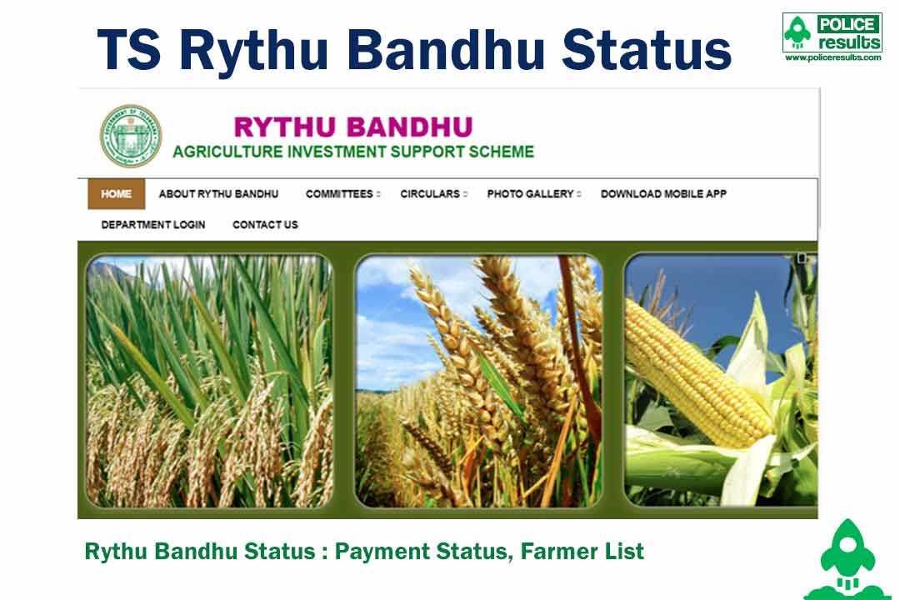
Online portal

Slide 24




Mobile App

Slide 25
IMPACT OF THE SCHEME ON THE FARMERS
Enhanced the investment capacity of the farmers.
Reduced the dependency of farmers on loans.
Telangana registered 10.9 per cent growth rate in agriculture sector and recorded a growth rate of 1.35 per cent. This is due to financial support provided to farmers under rythu bandhu.

Slide 26
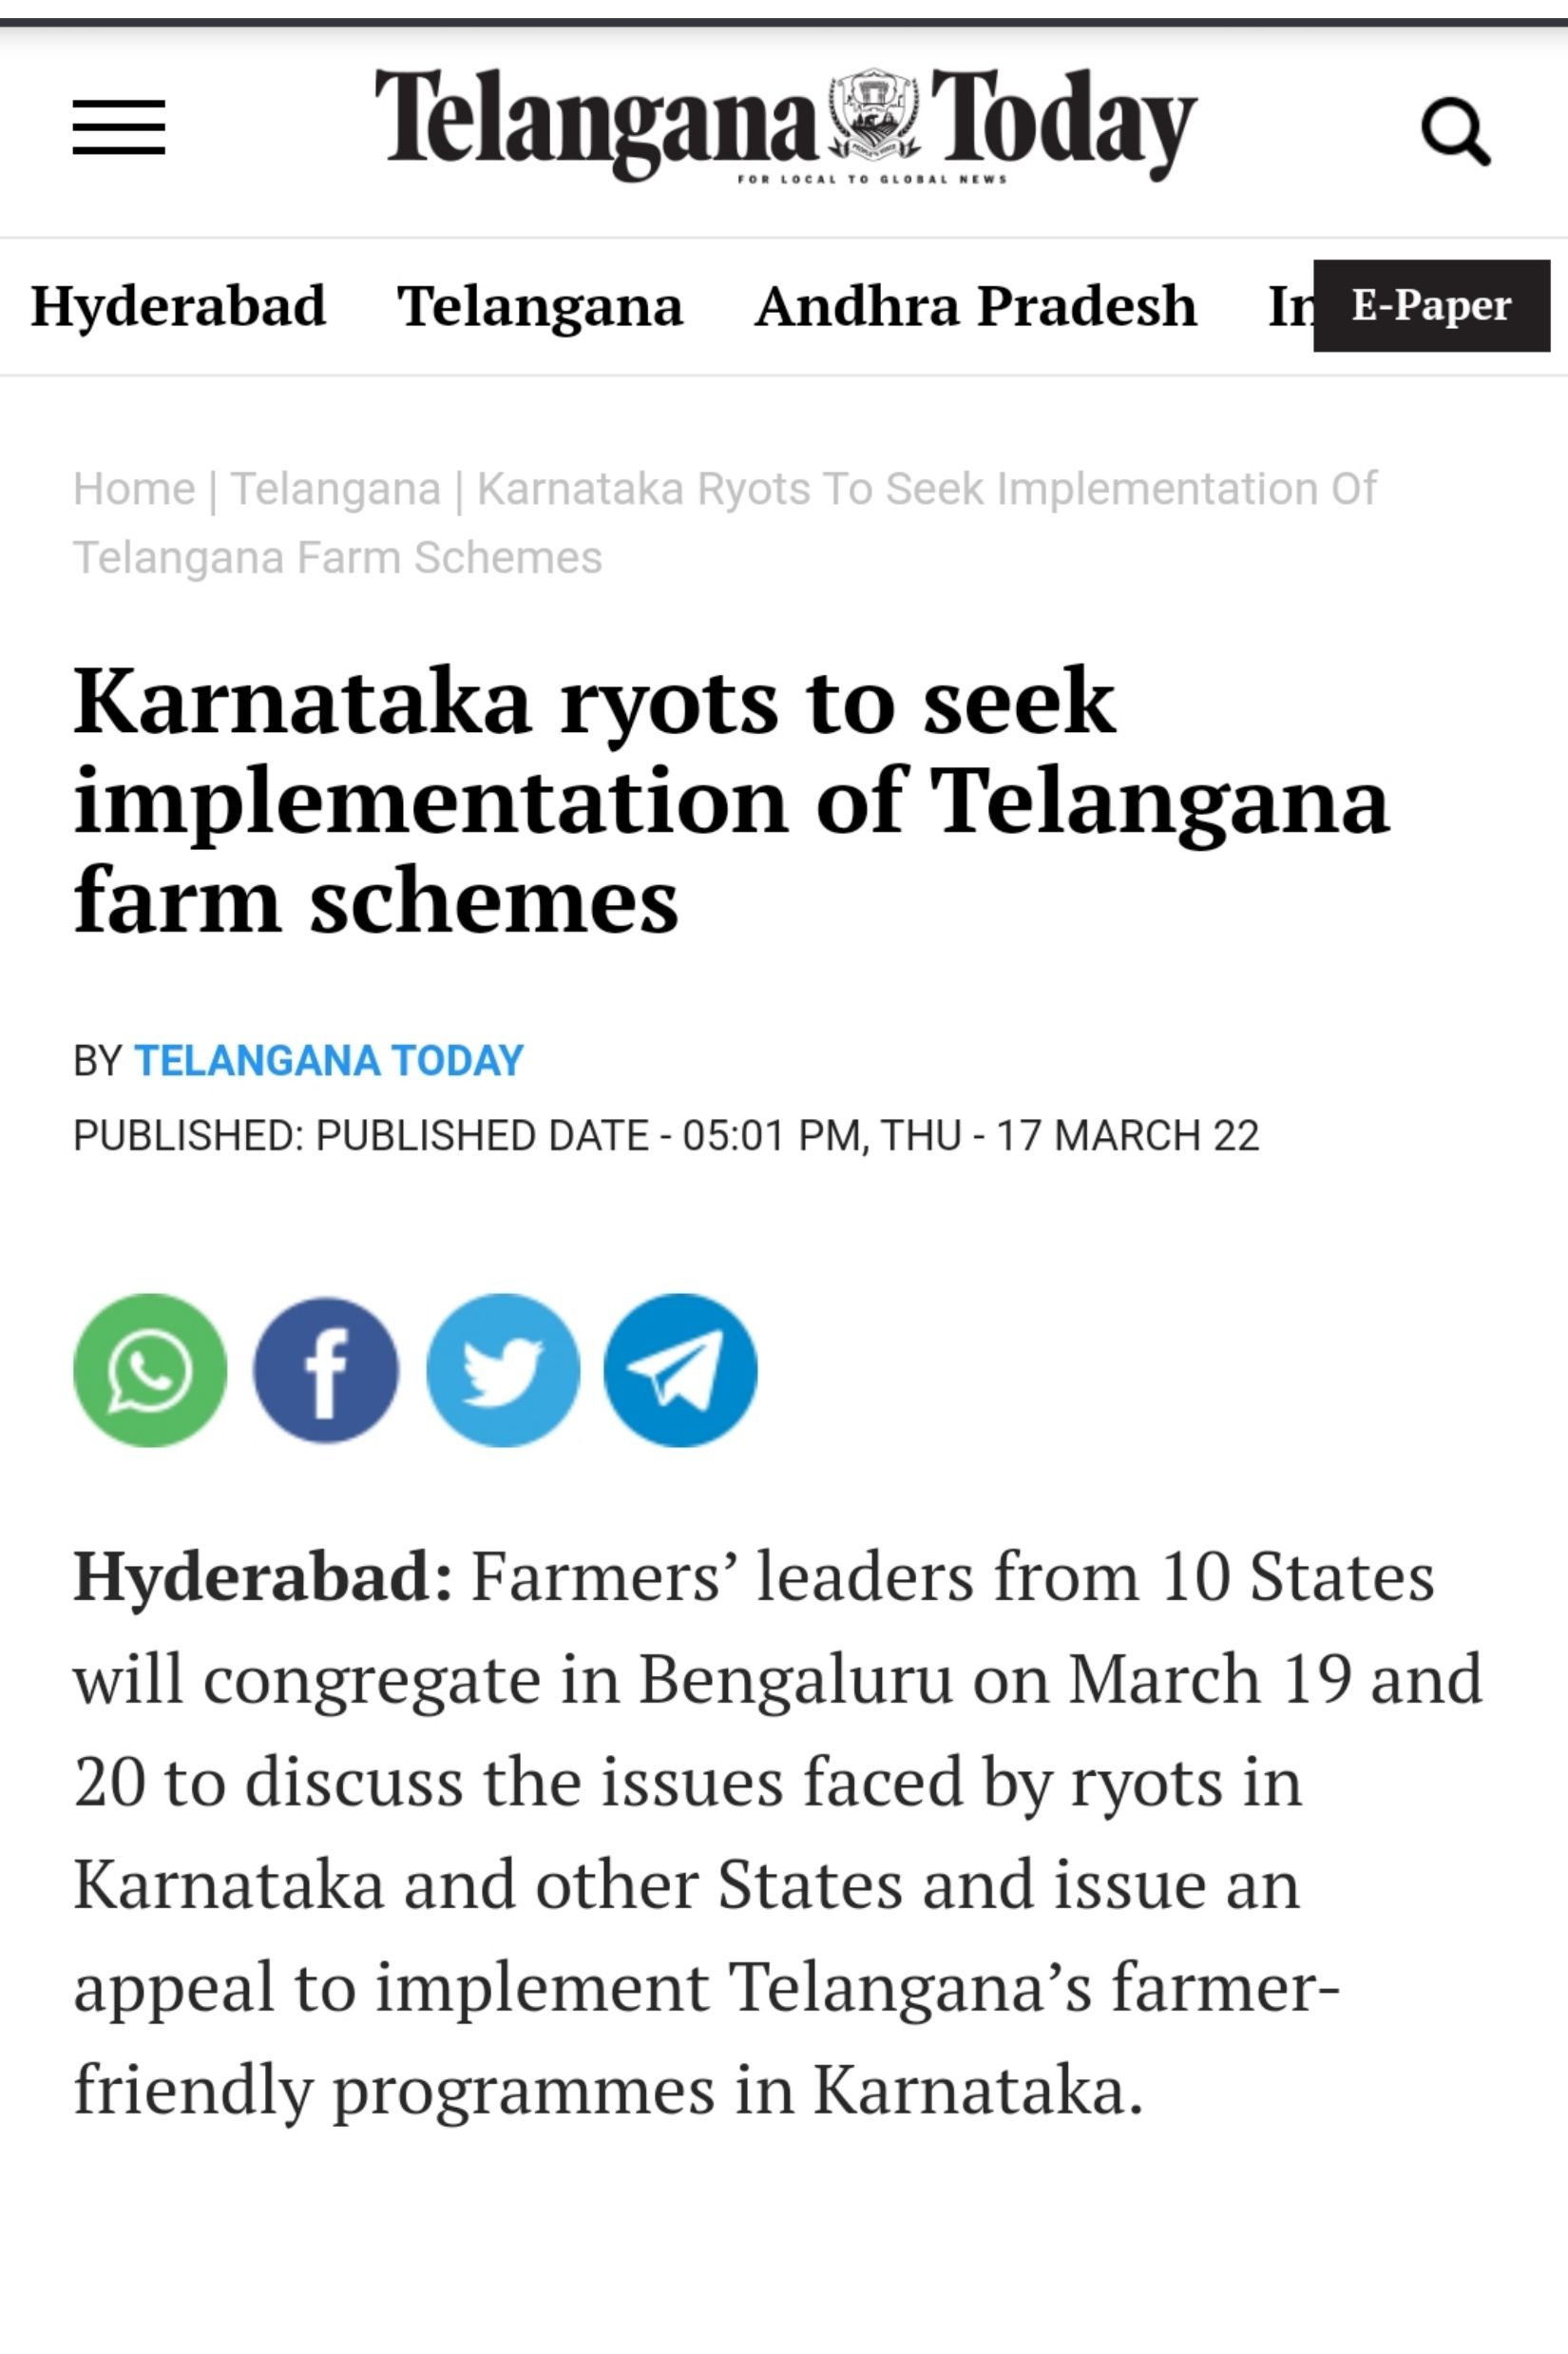
Impact of Rythu Bandhu on other states

Slide 27


Slide 28
Objective
The main objective of Rythu Bima is to provide financial relief and social security to the family members/ dependents, in case of loss of farmer’s life due to any reason.

Slide 29
Eligibility:
Farmers in the age group of 18 to 59 years are eligible for enroll under the scheme.
Amount paid:
In the event of the death of the enrolled farmer due to any cause , the insured amount of 5.00 Lakhs is deposited into the designated nominee account within (10) days.

Slide 30
Year | Farmers enrolled (lakhs) | Premium amount paid by State Government (crores)
2018-19 | 31.25 | 710.58
2019-20 | 30.81 | 1065.37
2020-21 | 32.73 | 1141.44
Number of beneficiaries:

Slide 31
Implementation pattern:
This scheme has been implemented through the Information Technology and MIS developed by National Informatics Centre (NIC).
Here, the nominee is not required to approach any office for the settlement of claim amount. The outreach officers at village level collects data from revenue department in the event of loss of life of any farmer and submitted to the LIC on behalf of designated nominee of the farmer.
Mode of payment:
The claimed amount would be transferred through RTGS into nominees account DBT.

Slide 32
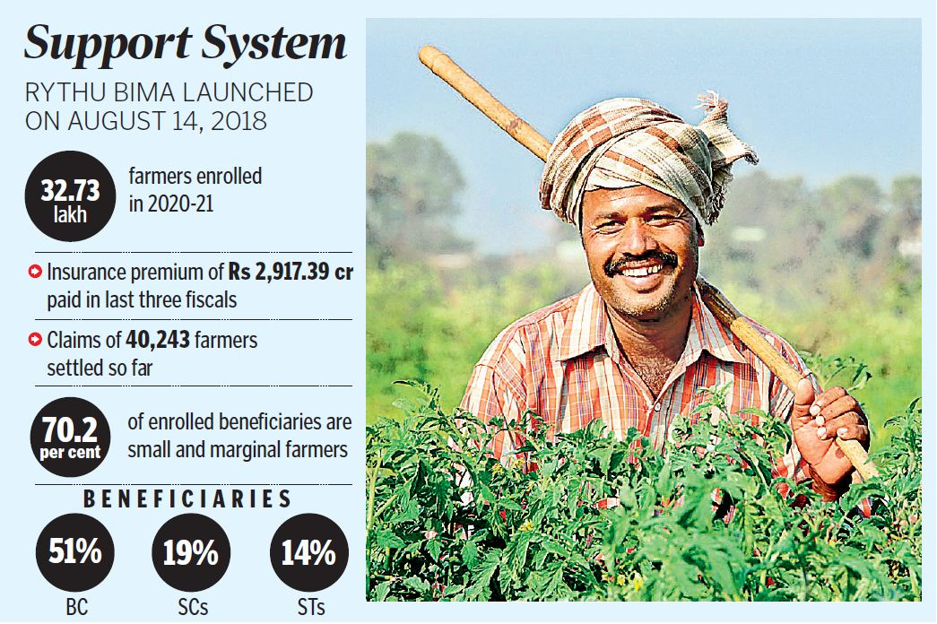
Current status

Slide 33
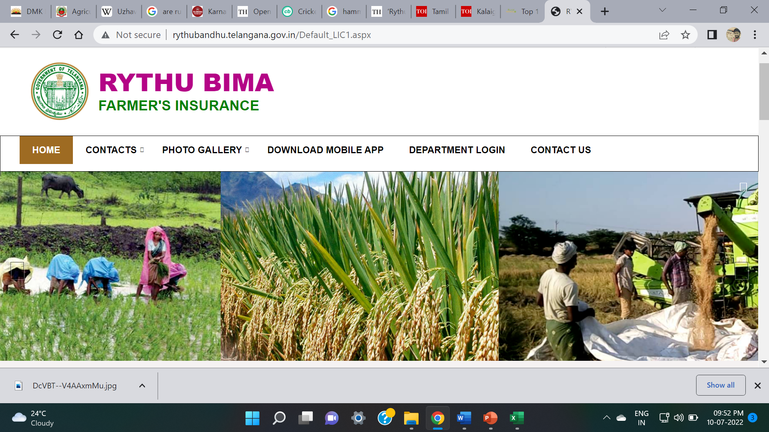
Online Portal

Slide 34
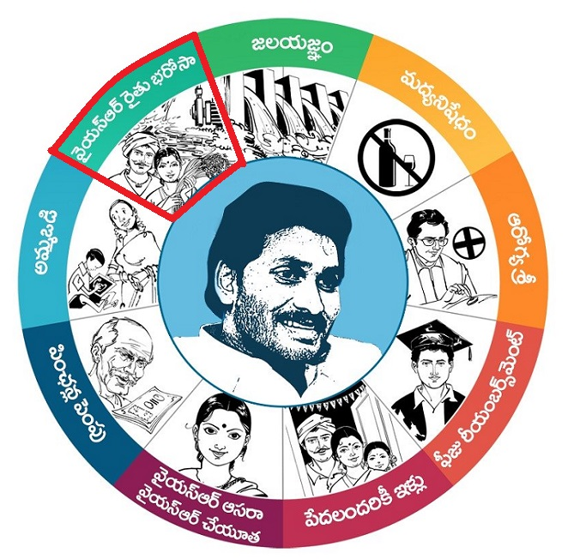
NAVA RATNALU
Andhra Pradesh

Slide 35
1. YSR Raithu Bharosa
2. Fee reimbursement, Youth Employment & Job Creation
3. Arogyasri
4. YSR Jalayagnam
5. Ban on Alcohol
6. Amma Vodi
7. YSR Asara, YSR Cheyuta
8. Housing for all poor
9. Pensions – Enhancement
NAVA RATNALU

Slide 36
Introduction
YSR Rythu Bharosa is a program launched by the Government of Andhra Pradesh in 2019 to financially assist farmers by depositing an amount of ₹13,500 per annum in three installments, in association with Pradhan Mantri Kisan Samman Nidhi .
State government contributing ₹7500 and the center ₹6000.
Tenant farmers were also considered eligible to the scheme.

Slide 37
Objective
The main objective of this scheme is to provide financial assistance to the farmer families, including tenant farmers across the State @ Rs.13,500/- per farmer per year, to support the cultivators in meeting the investment during the crop season with a view to enable them to timely sourcing of quality inputs and services for higher crop productivity.

Slide 38
Timeline
YSR Rythu Bharosa was launched by Chief minister of Andhra Pradesh Y. S. Jagan Mohan Reddy on 15th October 2019 releasing ₹3785 crore benefiting 38 lakh farmers in the state.
Rythu Bharosa Kendras were later established on 30th May 2020 to supply seedlings, fertilizers and seeds to horticulture, aquaculture and agriculture sectors.
A total amount of ₹6,173 crore was spent on the scheme for the year 2019-20 and ₹6,928 crore for 2020-21
As of now, 51.59 lakhs farmers are benefitted under this scheme.

Slide 39
Unit of Implementation and Mode of Payment
Unit is - Per Farmer.
Mode of Payment – Direct Benefit Transfer (DBT)
The benefit of Rs.13,500/- will be extended to the farmer in 3 installments as detailed below;
1st instalment @Rs.7500/- during the month of May (including Rs.2000/- from PM-KISAN)
2nd instalment @Rs.4000/- during the month of October (including Rs.2000/- from PM-KISAN)
3rd instalment @Rs.2000/- during the month of January (Exclusively of PM-KISAN scheme).

Slide 40
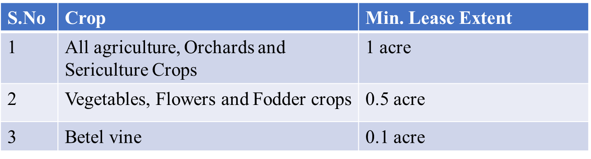
Eligibility conditions & Methodology for Identification
A.Land Owner Farmer Families:
Farmers of A.P who own cultivable land.
Farmers enrolled under the PM-Kisan Scheme are also eligible.
Farmer families Cultivating under ROFR lands are also eligible
B. Land Less Cultivators:

Slide 41
Not eligible or Exclusions
Persons who receive retirement monthly pension of Rs.10,000 or more.
Individuals who paid income tax or any other type of tax during the last assessment year.
Persons owning farmlands that are converted into aquaculture, house sites or any other non-agricultural usage.
Persons serving or retired, employee or officer of the Central or State government Ministry or officers or departments and their fields.
Persons or farmer families where one or more of its member is a former or present member of Lok Sabha or Rajya Sabha or State Legislative Assembly or State Legislative Council, former or present mayors of the municipal corporation and former or present Chairperson of District Panchayat

Slide 42
Benefits under YSR Rythu Bharosa
Under this scheme, financial assistance of Rs.13,500 per year for land owning farmers, landless tenant farmers and Recognition of Forest Rights (ROFR) Cultivators belonging to ST, SC, BC Minority categories in the state
In addition to cash transfer, farmers in the state are assured of services like help in purchasing farm inputs, training and capacity building activities through RBKs.
The farmers can purchase farm inputs through digital kiosks stationed at these kendras which reduces the transportation cost for the farmers for purchasing.

Slide 43

Online Portal

Slide 44
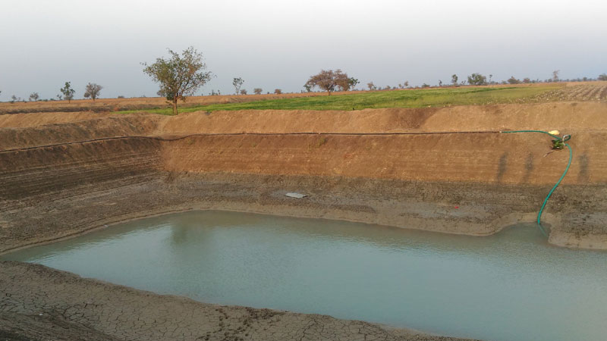
Karnataka
KRISHI BHAGYA SCHEME

Slide 45
INTRODUCTION
In Karnataka 70% of the land -rain fed area.
5 agro-climatic zones are facing deficit rainfall ,450-850mm.
Agriculture productivity is also decreasing day by day due to lack of timely irrigation.
Agricultural land holding in Karnataka has decreased from 2.56 ha to 1.55 ha.
Small and marginal farmers are falling in debt because of the failure of bore wells.

Slide 46
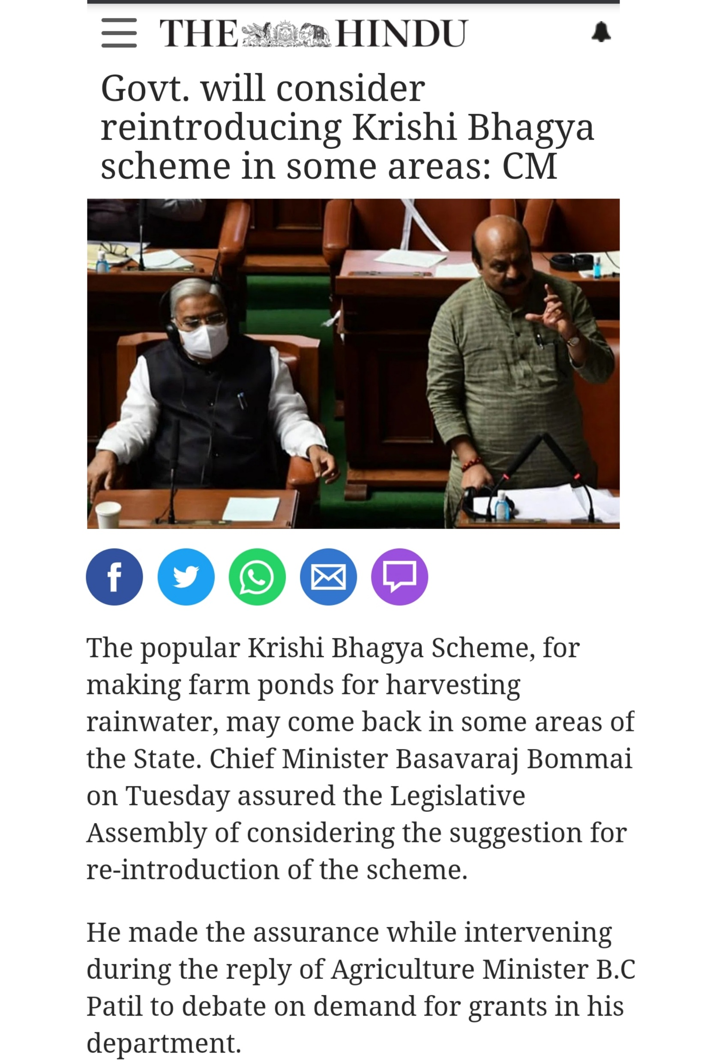
Timeline
Started in the year 2014.
Implemented in 5 Agro-climatic zones of Karnataka covering 23 districts ,107 taluks (45 lakh ha).
Each taluk approx. 210 beneficiaries are selected.
Recently on March 29 2022, Honourable Chief Minister of Karnataka took a mention about reintroducing Krishi Bhagya Scheme in some areas because of its utility.

Slide 47
Eligibility and selection of farmers
According to The Department of Agriculture, farmers who possess 1-acre land and more is applicable to avail the benefits of the scheme.
Farmers who have received subsidy for pump sets and drip irrigation system during the last three years are not eligible for the fund for them now. However, can avail fund for farm ponds.
Applications are issued in Raitha Samparka Kendra’s (RSK).

Slide 48
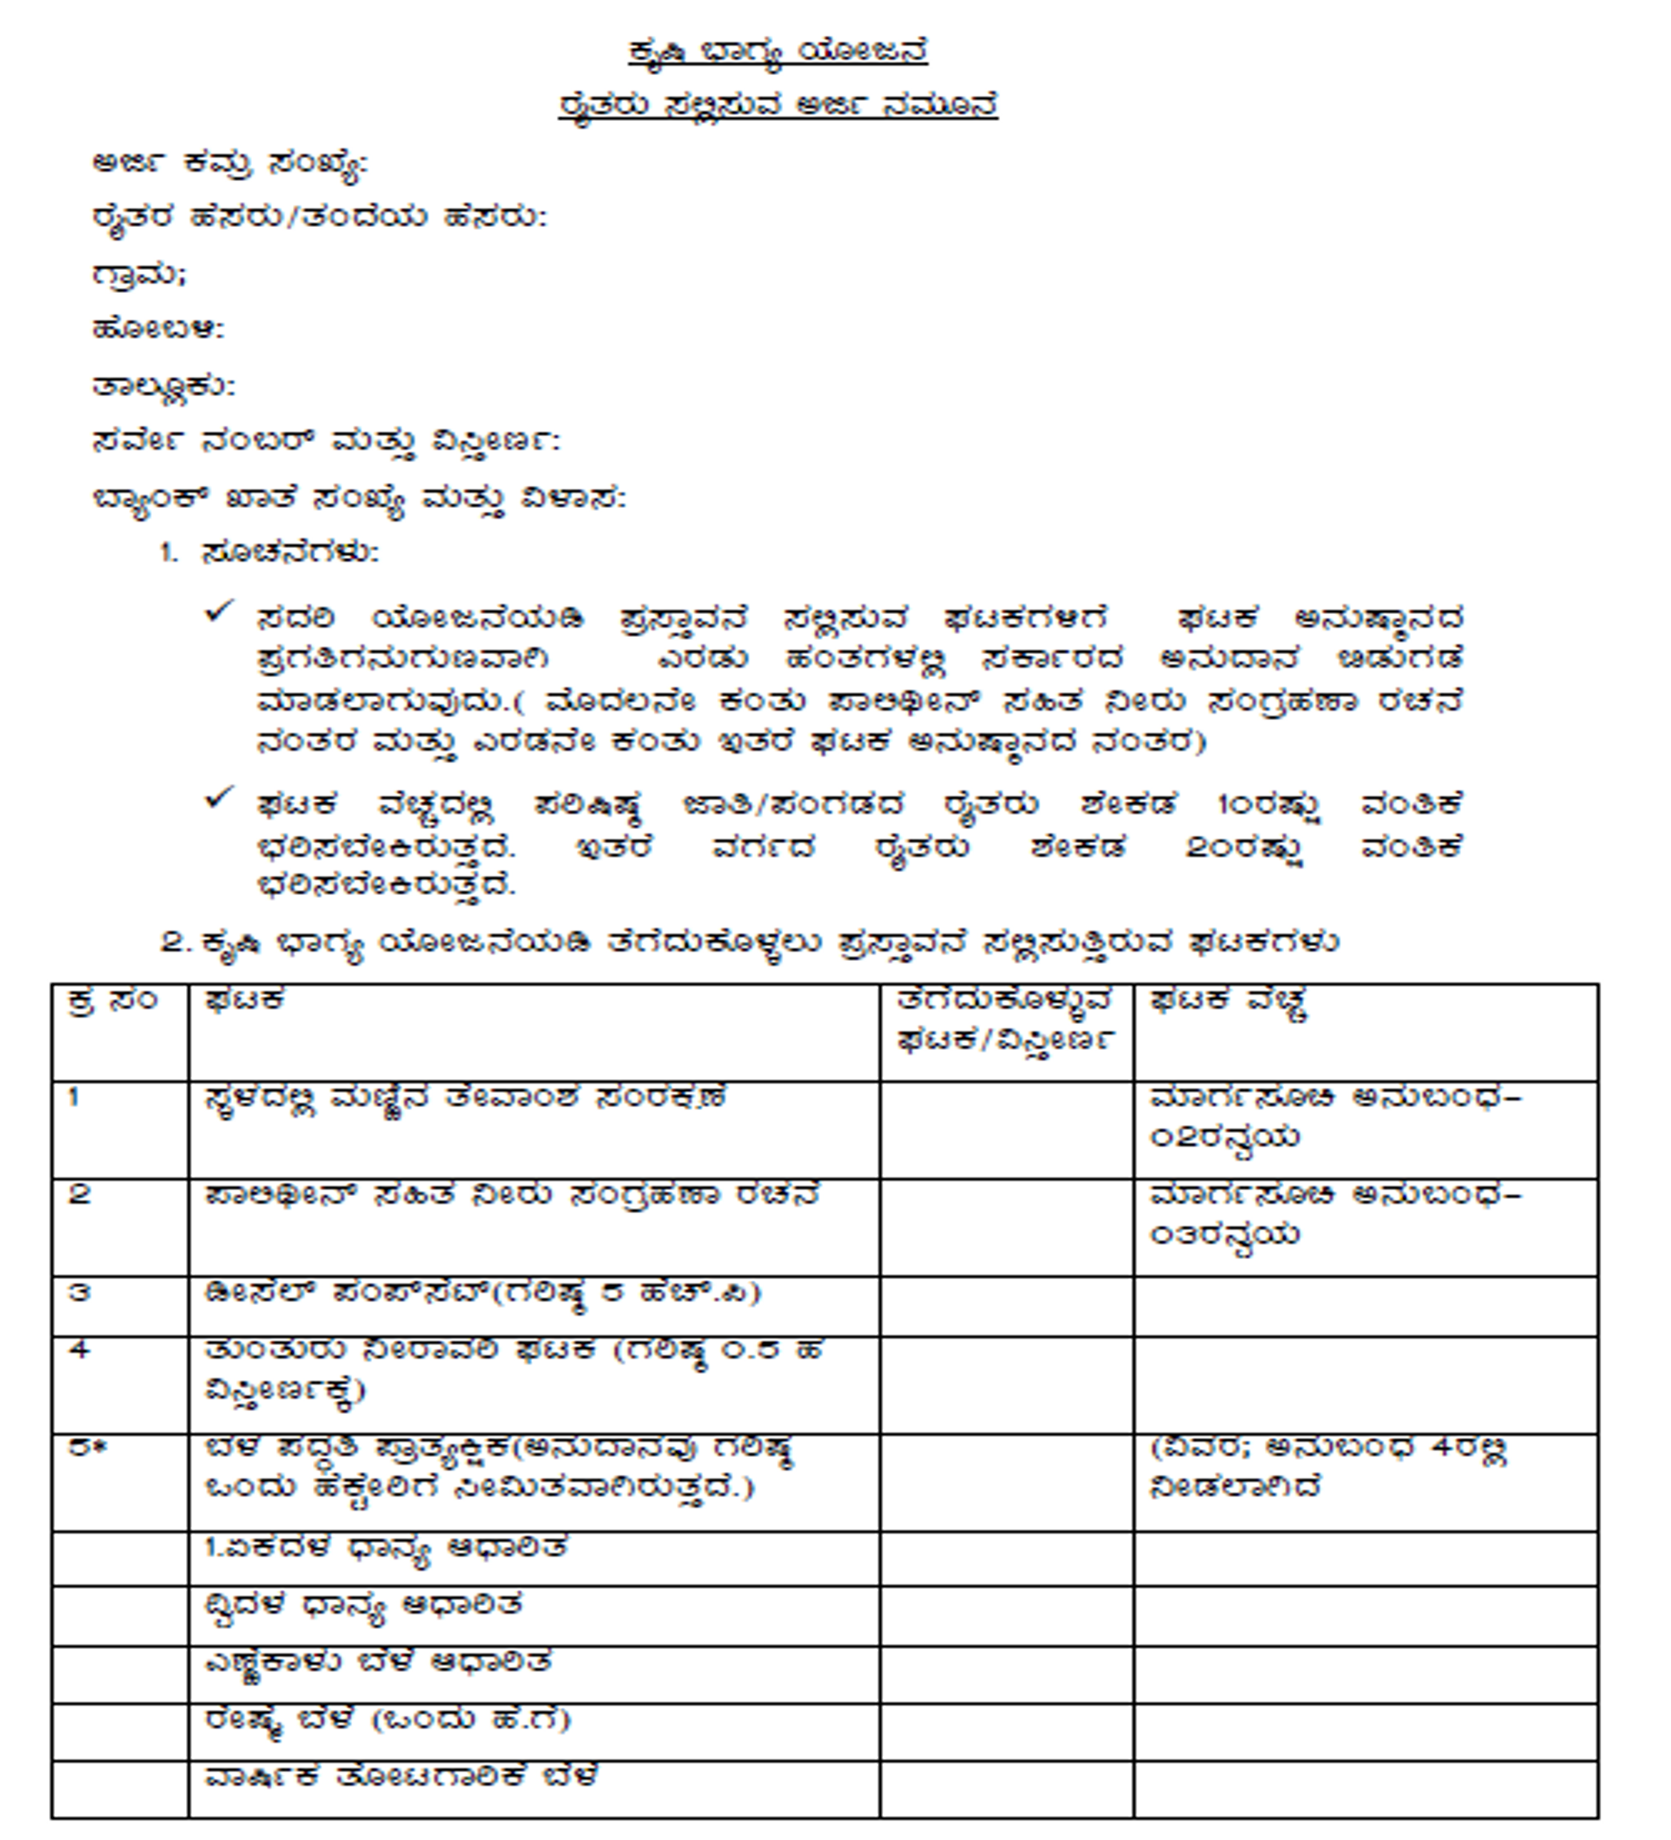

Slide 49

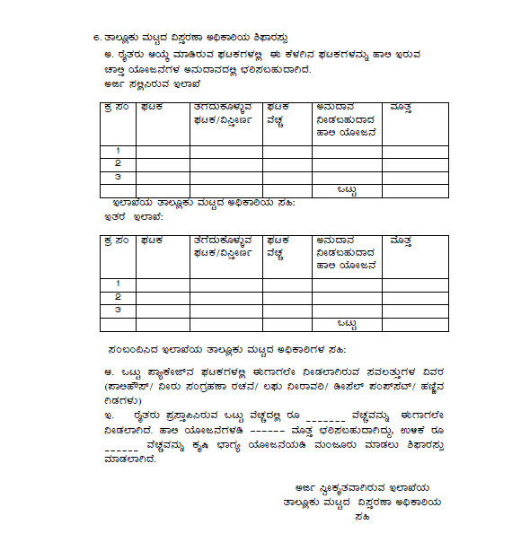

Slide 50
Features of Krishi Bhagya Scheme
The project will be implemented in 45 thousand hectares per year where more than one lakh farmers benefit every year.
Under the scheme, the farmers obtain grants for constructing farm ponds (Krishi Honda) to conserve rainwater and for buying lift pumps, diesel motors to draw water.
Moreover, this program assists the farmers to earn higher income by enabling them to construct polyhouses and put up shadenets to cultivate hybrid vegetables and flower crops.

Slide 51
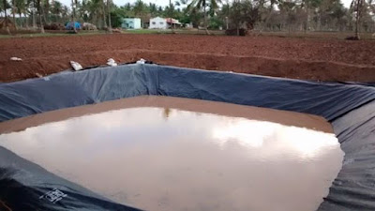
Components under this scheme
1.Construction of Farm ponds (KRISHI HONDA)
Water conservation by using polythene/ tarpaulin in farm ponds.
Krishi Honda in Krishi Bhagya Scheme is a farm pond dug to store rainwater that can help irrigate land during the dry spells. The scheme allocates funds for the purchase of polythene tarpal and fencing along with the other components , which approximately costs Rs.1.75 Lakhs.
The Government grants a subsidy up to 90 per cent for the Scheduled Castes and Scheduled Tribes and 80 per cent for other farmers

Slide 52
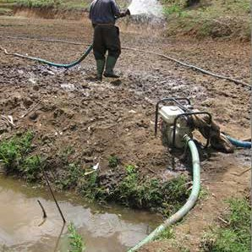
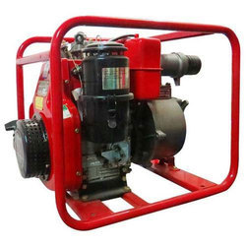
2.Diesel pump set
5hp diesel pump set 80% subsidy
2hp solar pump set 50% subsidy

Slide 53
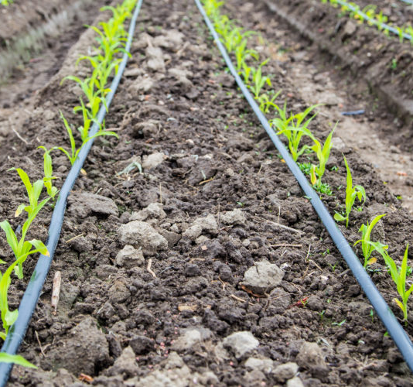
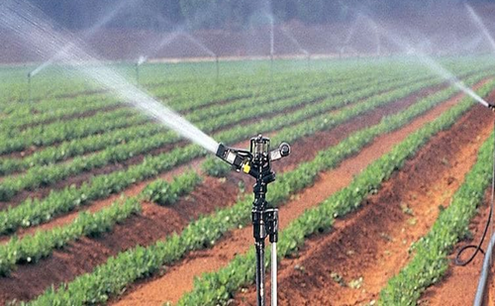
3.Micro irrigation
80% subsidy for general category
90% subsidy for SC/ST

Slide 54
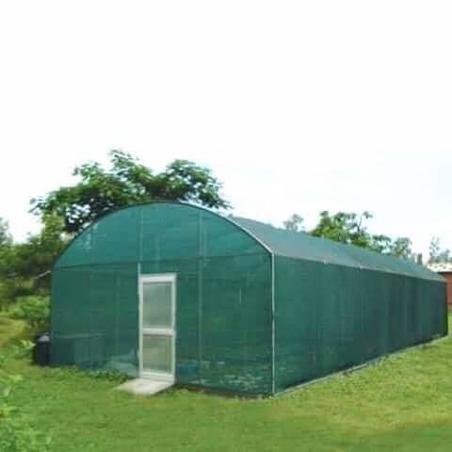
4.Protective Cultivation
Construction of green house units and shadenets.
The krishi Bhagya package has been divided into two groups
a. With poly house - 50% subsidy (10 to 13 lakhs)
b. Without poly house:
Horticulture crops: 80%(1.6 lakhs ) subsidy for general category and 90% (1.8 lakhs)for SC/ST.
Agriculture crops: 80%(1 lakh ) subsidy for general category and 90% (1.1 lakhs) for SC/ST.

Slide 55

Impact of Krishi Bhagya scheme
The fact that about more than one lakh farm ponds were constructed after KBS introduction is a commendable performance.
Cropping intensity and cropping pattern has been improved.
Further, the scheme emphasized on utilizing water effectively through micro irrigation facility to reap full benefits for crop production.

Slide 56
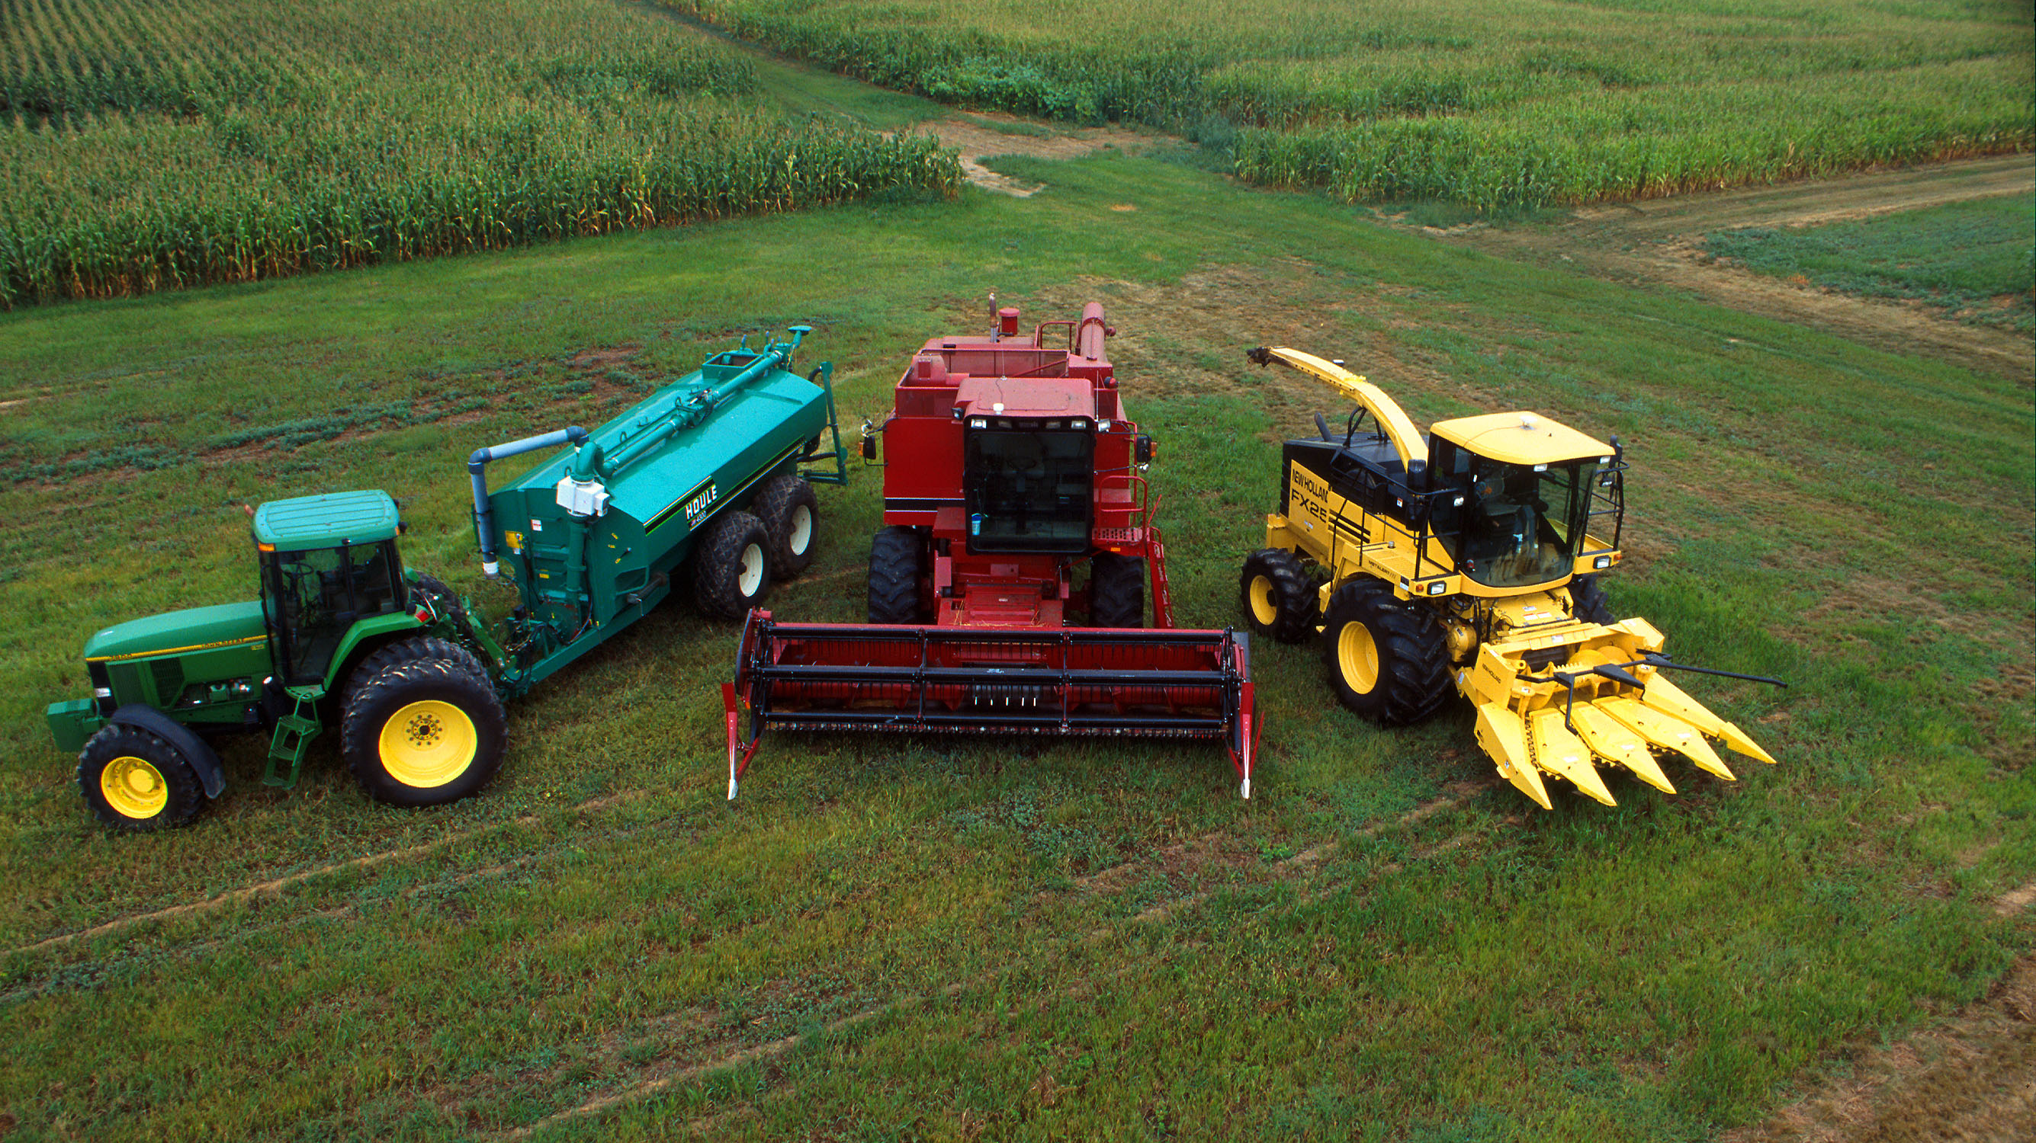
KRISHI YANTRA DHARE SCHEME

Slide 57
Indian agriculture is undergoing a gradual shift from dependence on human and animal power to mechanical power because of increasing cost and scarcity of labour.
Further, use of mechanical power has a direct bearing on the productivity of crops apart from reducing the drudgery and facilitating timeliness of agricultural operations. Thus there is a strong need for taking farm mechanization.
Under Krishi Yantra Dhare scheme ,Custom Hire Service Centre (CHSC) were established at hobli-level in the state.

Slide 58
Krishi Yantra Dhare scheme was started in the Year 2014-15.
Under Krishi Yantra Dhare, the districts have been divided into 3 Slabs viz., Slab -1 = Rs.40.00 lakhs , Slab-2 = Rs.75.00 lakhs & Slab-3 = Rs.100.00 lakhs.
The equipments of worth Rs.40.00 lakhs, Rs.75.00 lakhs & Rs.100.00 lakhs are shelved in the Krishi Yantra Dhare Centres..
Krishi Yantra Dhare centers are established through Service Providers in phased manner on a PPP model.
The Subsidy Pattern under CHSC is in 70:30 ratio, where 70% subsidy is given from Government and 30 % is borne by the Service Provider.
Out of 70% subsidy, 40% subsidy is given under SMAM and remaining 30% is being given by state govt.

Slide 59
Objectives
To provide machineries at farm gate.
To enhance the production and productivity of the crops
To provide High- Tech farm machinery services to small and marginal farmers in time
To mitigate problem of labour
To increase profitability of the farmers
To run the centres throughout the year effectively and efficiently.

Slide 60
Features
Availability of modern equipment.
Reasonable price.
Availability of timely service.
Quality service.
Advance booking facility.

Slide 61
The details of Service Provider wise CHSCs established.
Sl. No. | Service Providers | No. of CHSCs established
1 | Shree Kshetra Dharmastala Rural Development Project, Dharmastala. | 164
2 | Indian Society of Agricultural Professionals (ISAP), Kalburgi | 11
3 | V.S.T. Tillers Tractors Limited, Bengaluru | 79
4 | Mahindra & Mahindra Ltd., (FES), Punjab | 21
5 | Mahindra & Mahindra Ltd., (FES), Mumbai | 33
6 | John Deere India Private Limited, Pune | 34
7 | Rehman Engineering Works, Chikmagaluru | 06
8 | CLAAS Agricultural Machinery pvt ltd.,Bengaluru | 35
9 | Varsha Associates, Chitradurga | 284
10 | Balaji Agro Engineering, Kalburgi | 18
11 | Easy Life Enterprises, Udupi | 02
12 | Veeresh Enterprises, Hubbali | 02
13 | Gram Kiran Seva Samsthe, Kalburgi | 06
14 | Vidyashree Integrated Development Association, Koppala | 01
 | TOTAL | 696

Slide 62
Machinery & Equipment
Tractors/ Mini tractors
Plough
Tiller
Harvesting Machinery
Sprayers
Levelling Blade
Sowing & Planters
Arecanut Deoshker
Paddy trans planter
Power Cona Veeder
Diesel Pump
Kubota Rotavater
Seed cum fertilizer
Nursery Tray

Slide 63
S.NO | Name of the machinery | Hiring rate
1 | Multi crop thresher (Rs./quintal) | 500
2 | Hand sprayer (Rs./Day) | 100
3 | Power sprayer (Rs./Day) | 300
4 | Power tiller (Rs./hr.) | 250
5 | Harvester / reaper (Rs./hr.) | 1800
6 | Cultivator (Rs./Day) | 500
7 | Rotary (36 blades) (Rs./hr.) | 700
8 | Hole digger (Rs./dig) | 18
9 | Tractor operated seed drill (Rs./Day) | 350
10 | Tractor (Rs./8 hr.) | 1500
11 | Mini Tractor (Rs./8 hr.) | 800
12 | Disc Harrow | 1000
13 | Battery sprayer (Rs./8 hr.) | 100
14 | Rotary weeder (Rs./hr.) | 200
15 | Leveller (Rs./Day) | 350
16 | Rotavator (Rs./hr.) | 700
17 | MB plough (Rs./hr.) | 600

Slide 64
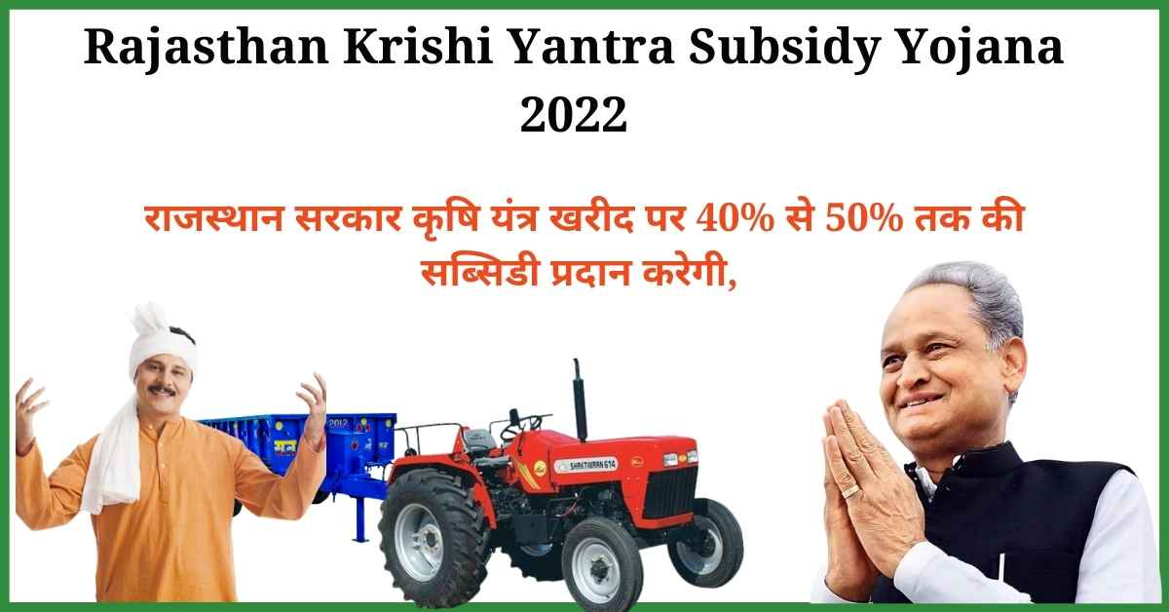
Impact of Krishi Yantra scheme of Karnataka
  Till date 696 centres have been established benefitting around 35 lakh farmers through out the State.
  Timely availability of Hi-Tech Farm Machinery at the Farmers door step.
  Nominal Hiring Charges upto 25-30% lesser than the market price which decreased farmers cost of production.
  Farmers became aware about Hi-Tech/advanced Farm Machinery which reduced drudgery and saved time.

Slide 65
Success story of CHSC at Sirwar, Raichur
Sirwar is around 35 Km from the district headquarters of Raichur established under SKDRDP.
The main crops grown in the jurisdictional area include paddy, jowar, cotton, redgram, bengal gram and some farmers also grow vegetables.
The beneficiary farmers of all the 34 villages under CHSC of Sirwar are fully aware of the availability of farm machines and necessity to use these machineries both under irrigated and rainfed conditions.
Farm activities requiring different farm machineries are distributed throughout the year in the jurisdictional area.
Source : Department Of Planning, Programme Monitoring And Statistics.

Slide 66
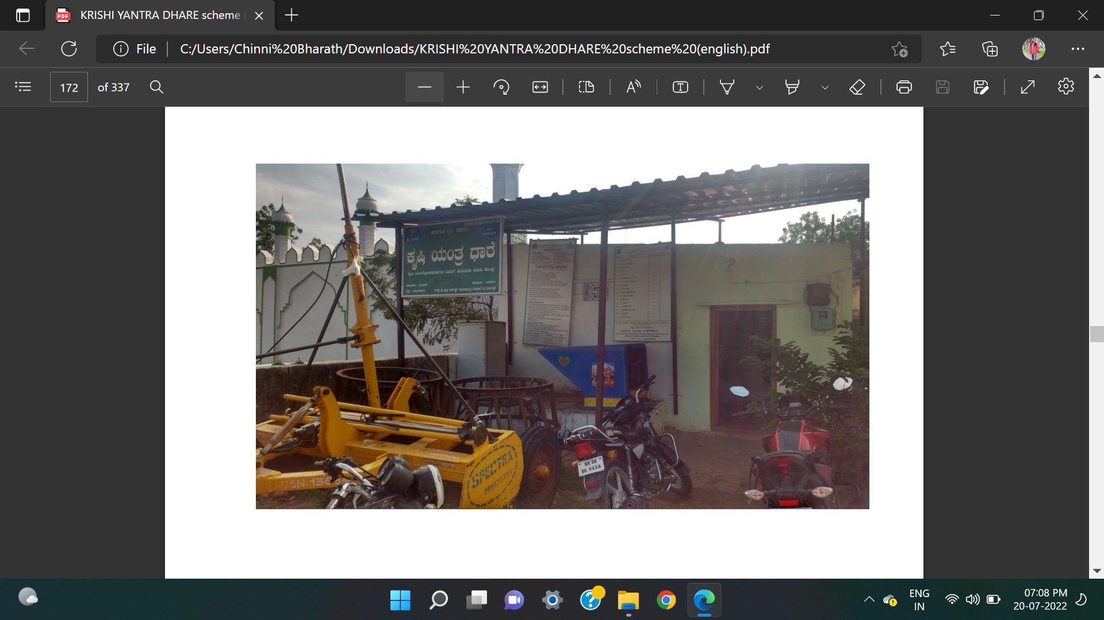
This centre recorded demand for machinery for 10 to 11 months in a year by fully aware farmers is an important factor for the success of the unit
The demand created for machines/ equipment is so high that CHSC has adopted advance booking of almost all machines/ equipment even up to one month.
This CHSC adopts another ideal practice of conducting demonstration of its machines in villages with relevant technical/ commercial information every year along with the registration programme.
As a result of all these ideal practices, CHSC of Sirwar has been earning profit consistently. Its profits made in very first year (Rs.1.88 lakh) it increased to more than Rs. 13.66 lakhs till date.

Slide 67
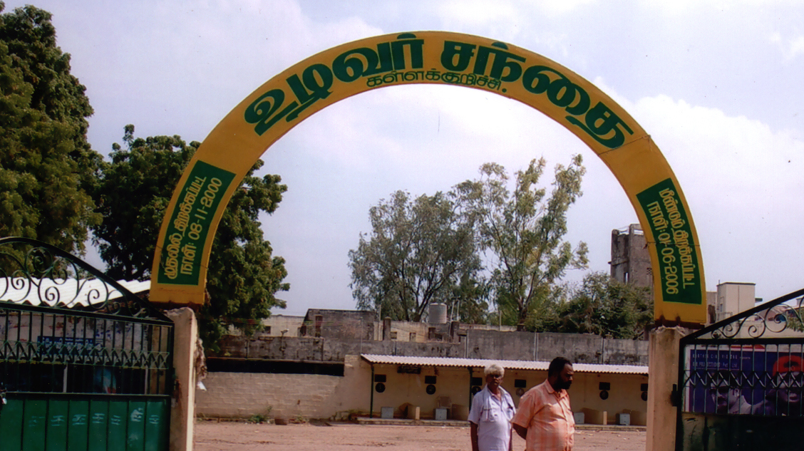
TAMIL NADU
UZHAVAR SANTHAI

Slide 68
Uzhavar Santhai
In the field of agriculture, marketing determines the value of the agricultural product in terms of money and delivers them to the final customer.
Most of the farmers sell their produce through village level markets, fairs, Mandies, Co-operative Societies etc. In the above process of agricultural marketing, the middlemen exploit farmers as well as consumers.
In order to eliminate the middlemen between farmers and consumers, the Government of Tamilnadu introduced “UZHAVAR SANTHAI”.

Slide 69
Objectives
To facilitate direct contact between the farmers and public.
To provide fresh vegetables and fruits at reasonable price daily without any interference of middlemen.
To provide correct measurement to the consumers.
To aim for providing higher price than that of wholesale price to the farmers for their vegetables and fruits.
The Uzhavar Santhai also functions as a Technical Information Centre to the farmers
Seeds and Other Inputs are also provided in some Uzhavar Santhais

Slide 70

Why Uzhavar Santhai?
No Middle men
The prices of the vegetables and fruits are daily fixed at the average of 20 % higher than the wholesale prices and 15% less than retail prices by the Committee consisting of the representatives of farmers and officials.

Slide 71
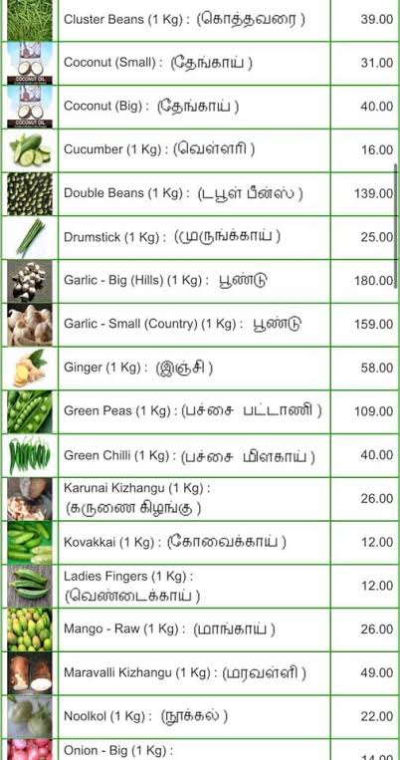

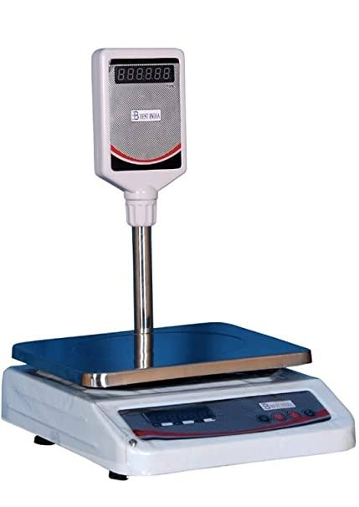
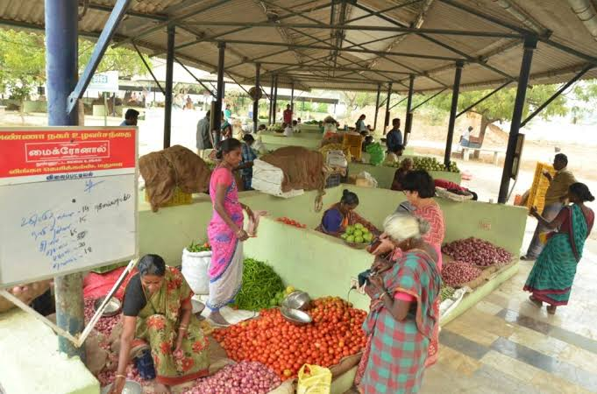
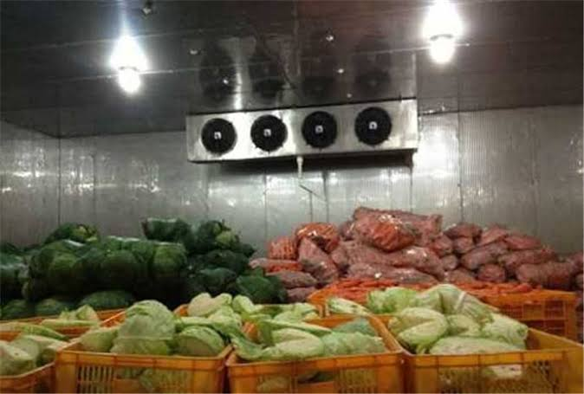
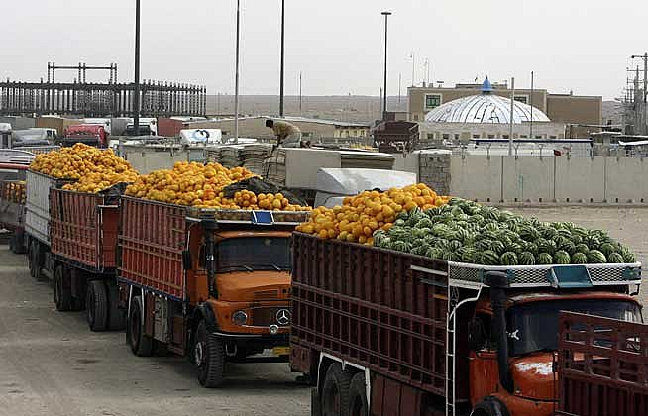
Facilities provided at Uzhavar Santhai (Farmer's Market)
Displaying of Price
Photo Identity Card
Transport Facility
Allotment of Stalls
Supply of weighing scales
Storage facilities

Slide 72
Other Facilities:
Drinking water facilities
Toilet facilities
Canteen facilities for food and tea
Plastic boxes to collect rotten fruits and vegetables.
25 Uzhavar Sandhais have been supplied with computers.

Slide 73
Tamil Nadu Budget 2021
A facelift will be given to around 50 Uzhavar Santhais (farmer’s markets) spending Rs 12.50 crore.
As many as 10 new Uzhavar Santhais will be set up in town panchayats and other urban areas of Tamil Nadu and an amount of Rs 6 crore will be spent for this.
As of now there are 180 Uzhavar Santhais functioning in Tamil Nadu

Slide 74
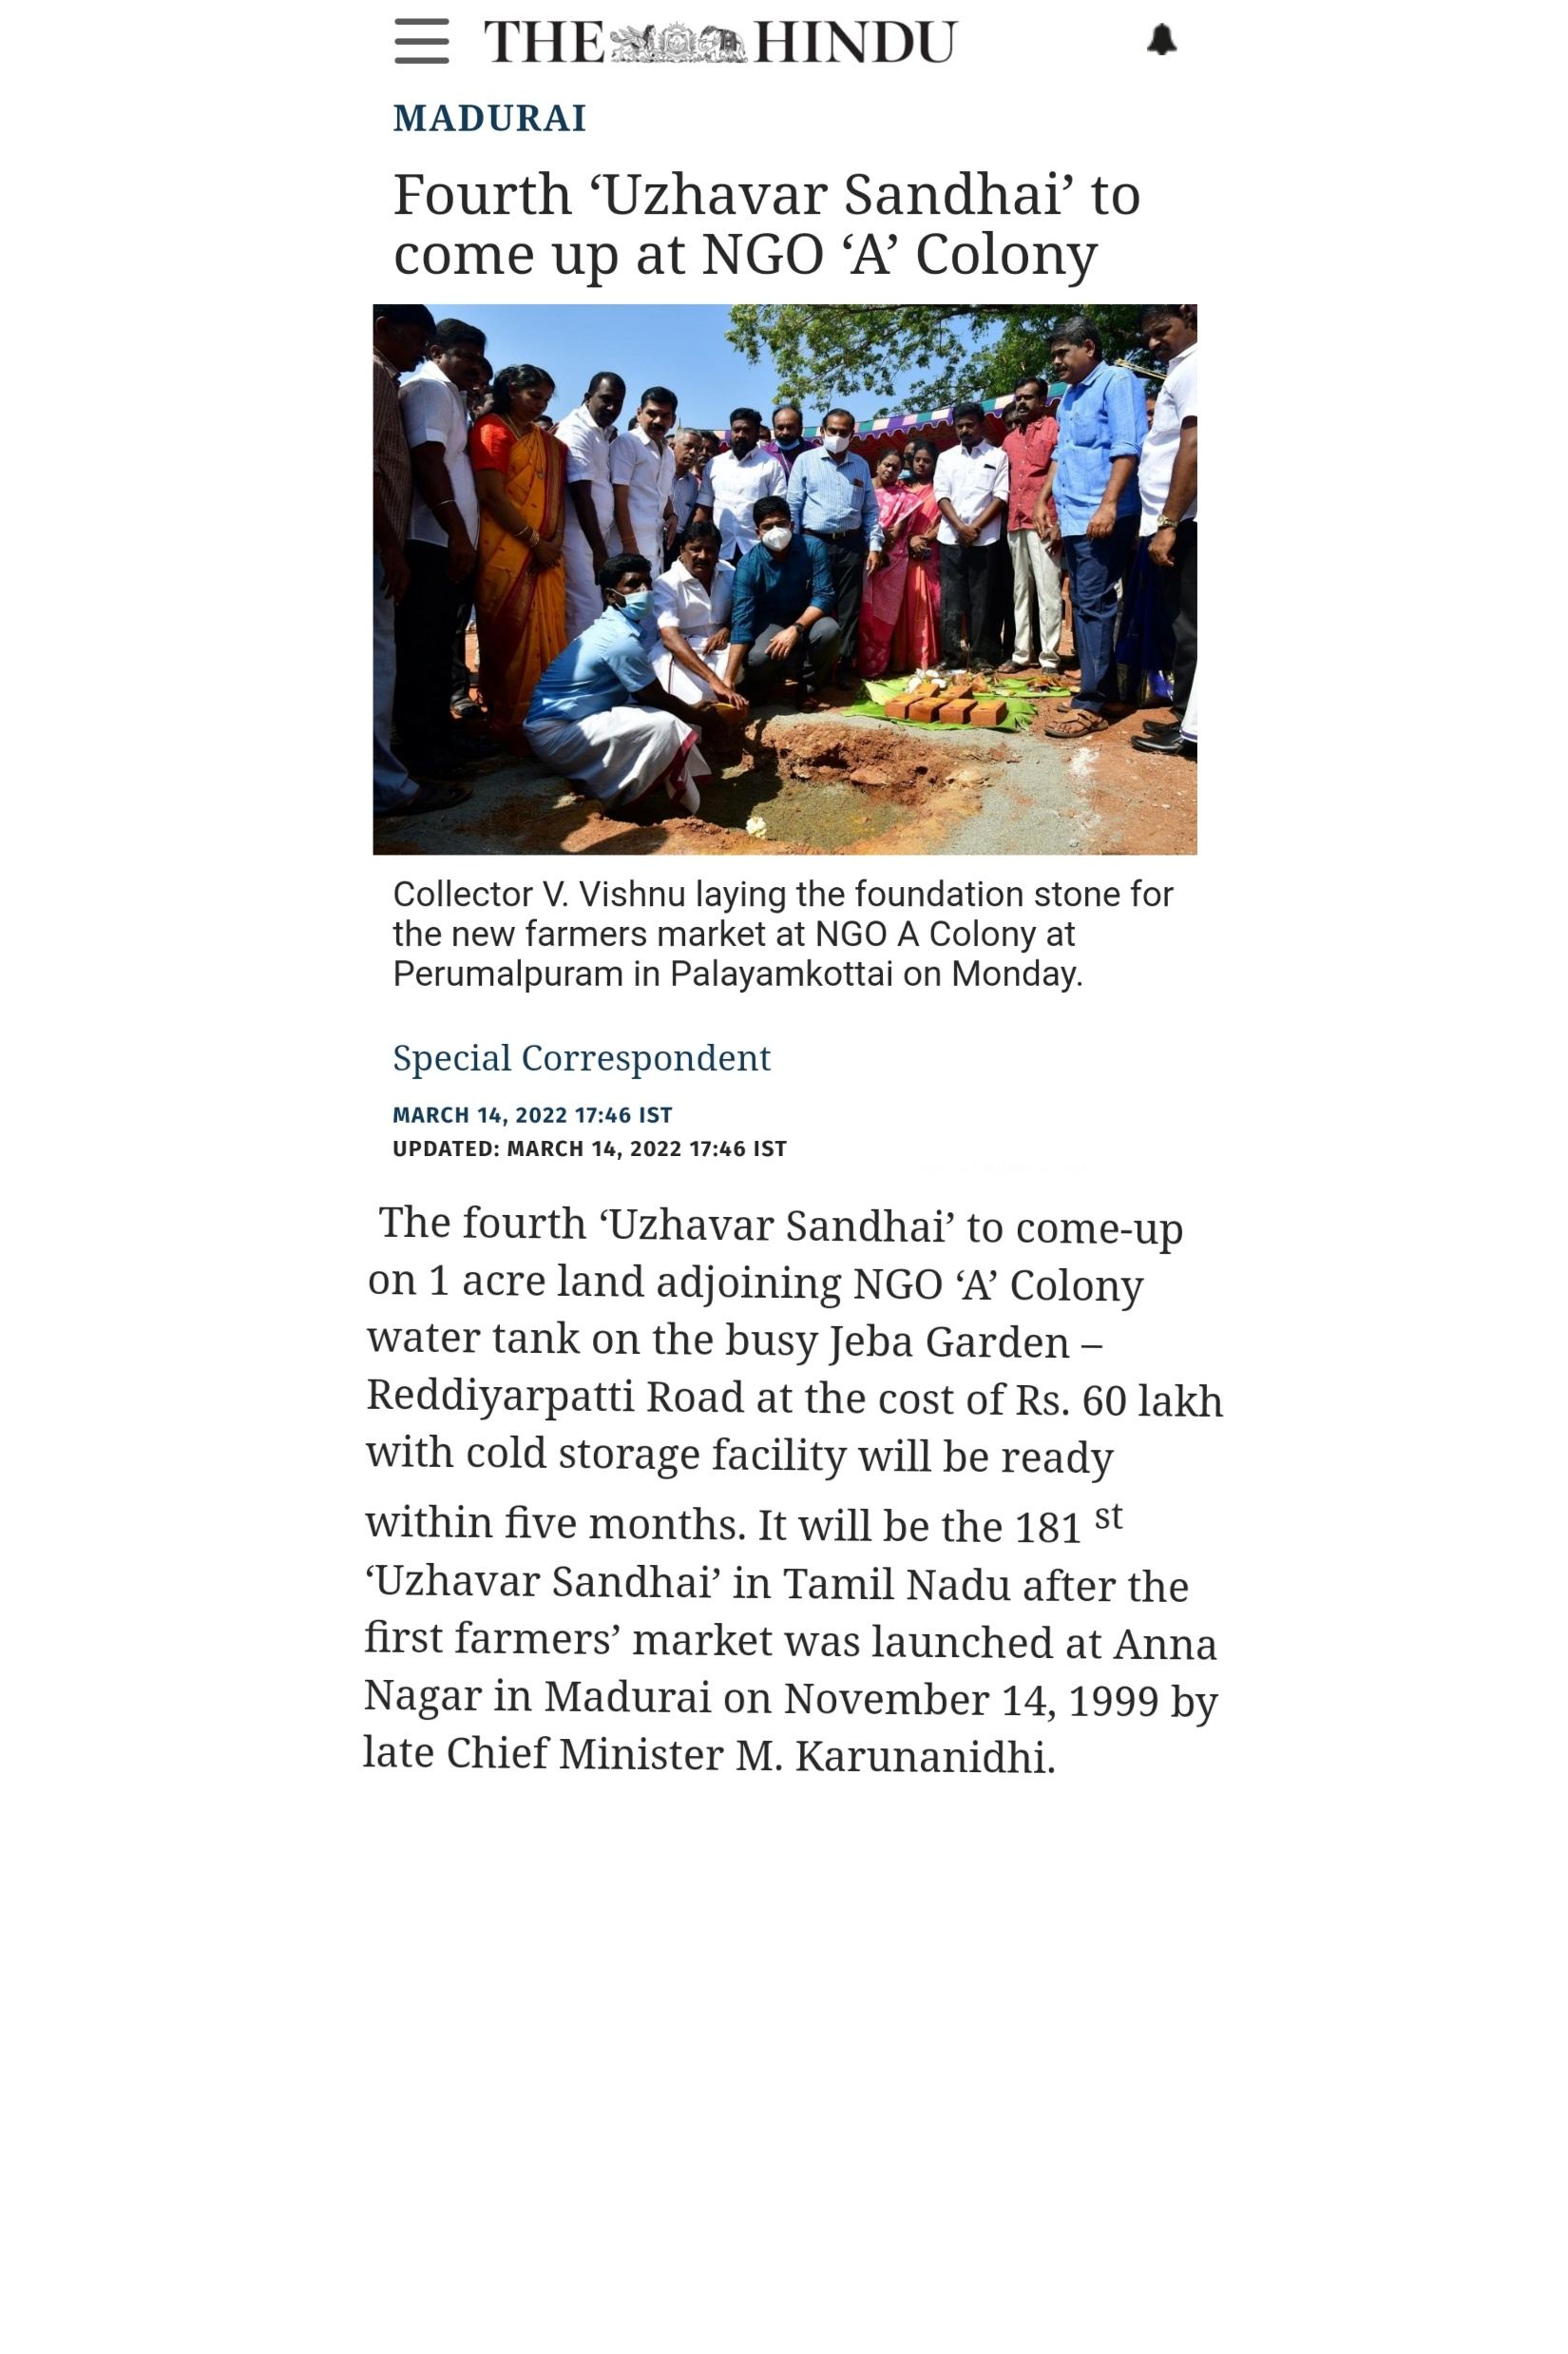
News paper clipping on March 14 2022.

Slide 75

Research Studies

Slide 76
Performance assessment of Krishi Bhagya scheme in
North Eastern Karnataka region
Research Study 1
Gondali et al.,(2022)
Methodology:
Ex post facto research design
The study was purposively conducted in Kalaburagi and Ballari districts of North-Eastern Karnataka region as these districts had highest number of beneficiaries in the Krishi Bhagya scheme of Government of Karnataka.
Two taluks from each district and 45 beneficiaries from each taluk. Thus study comprises of 180 respondents.

Slide 77
Table 1: Performance assessment of the respondents (component wise) of Krishi Bhagya scheme
S. No. | Components of KBS | Performance
 |  | Before KBS |  | After KBS
 |  | F | % | F | %
I | Farm pond | 2 | 1.11 | 180 | 100.0
2 | Diesel Pumpset | 23 | 12.78 | 157 | 87.22
3 | Micro Irrigation | 24 | 13.33 | 103 | 57.22
4 | Protective Cultivation | 0 | 0.00 | 17 | 9.44

Slide 78
Table 2: Performance assessment of the respondents based on farm pond utilization component of Krishi Bhagya scheme
Sl. No. | Components of KBS | Performance
 |  | Before KBS |  | After KBS
 |  | F | % | F | %
 | Farm pond utilization*
1 | Protective irrigation for crops | 2 | 1.11 | 180 | 100.00
2 | Raising of nursery seedlings | 2 | 1.11 | 17 | 9.44
3 | Store stream water / bore well water | 2 | 1.11 | 62 | 34.44
4 | Store water from run-of water | 2 | 1.11 | 33 | 18.33
5 | Recharge ground water | 2 | 1.11 | 77 | 42.78
6 | Drinking water facility for animals | 2 | 1.11 | 52 | 28.89

Slide 79
Table 3: Performance assessment of the respondents based on Diesel Pumpset utilization component of Krishi Bhagya scheme
S. No. | Components of KBS | Performance
 |  | Before KBS |  | After KBS
 |  | F | % | F | %
 | Diesel Pumpset utilization*
1 | Water lifting from farm pond | 2 | 1.11 | 178 | 98.89
2 | Water lifting from stream water | 4 | 2.22 | 39 | 21.67
3 | Water lifting from open well | 17 | 9.44 | 23 | 12.78

Slide 80
Table 4: Performance assessment of the respondents based on Micro irrigation component of Krishi Bhagya scheme
S. No. | Components of KBS | Performance
 |  | Before KBS |  | After KBS
 |  | F | % | F | %
 | Micro Irrigation utilization*
1 | Sprinkler | 24 | 13.33 | 103 | 57.22
2 | Drip | 0 | 0.00 | 24 | 13.33

Slide 81
Table 5: Performance assessment of the respondents based on Protective cultivation component of Krishi Bhagya scheme
S. No. | Components of KBS | Performance
 |  | Before KBS |  | After KBS
 |  | F | % | F | %
 | Protective Cultivation utilization*
1 | Shade net | 0 | 0.00 | 17 | 9.44

Slide 82
Impact of Uzhavar Sandhai on livelihood empowerment of farmers
Research Study 2
Indumathy et al.,(2016)
Methodology:
Expost facto research design
The present study was conducted in Vellore district of Tamil Nadu. Totally 7 uzhavar sandhais are working in Vellore district, out of that 4 uzhavar sandhais were selected based on convenience sampling method.
From the selected 4 blocks, sample of 20 respondents from Arcot, Ranipet, Katpadi and 30 respondents from Vellore uzhavar sandhai were selected. Thus, a total of 90 respondents were selected based on simple random sampling technique.

Slide 83
Table 1 : Distribution of respondents based on impact on purchasing power
 | Yes |  | No |  | Total
 | Frequency | % | Frequency | % | Frequency | %
Purchase TV | 8 | 8.90 | 82 | 91.10 | 90 | 100
Farm implements | 27 | 30.00 | 63 | 70.00 | 90 | 100
Farm animals | 32 | 35.50 | 58 | 64.50 | 90 | 100
Bought vehicle | 5 | 5.50 | 85 | 94.50 | 90 | 100
No purchasing | 24 | 26.00 | 66 | 74.00 | 90 | 100

Slide 84
Table 2 : Distribution of respondents based on impact on investment
 | Yes |  | No |  | Total
 | Frequency | % | Frequency | % | Frequency | %
Bought land | 0 | 0 | 90 | 90.00 | 90 | 100
Construct house | 38 | 43.00 | 52 | 57.00 | 90 | 100
Constructed irrigation sources | 0 | 0 | 90 | 100 | 90 | 100
Started new enterprises | 0 | 0 | 90 | 100 | 90 | 100
Insurance | 2 | 2.20 | 88 | 97.80 | 90 | 100
Opened savings account | 15 | 16.70 | 75 | 83.30 | 90 | 100

Slide 85


Slide 86


