Slide 1
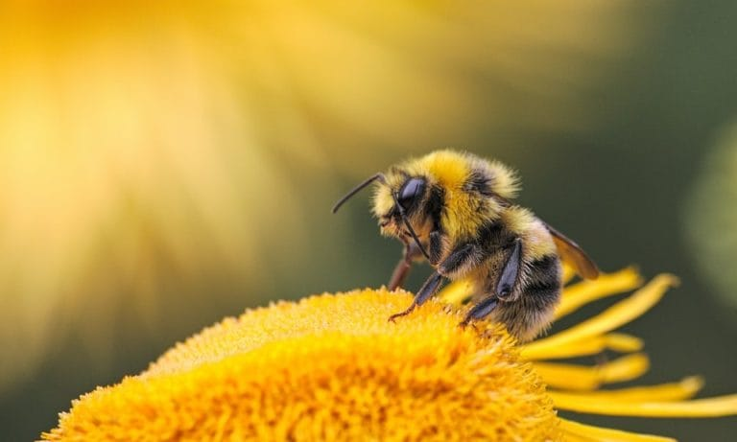

WELCOME

Slide 2


Slide 3
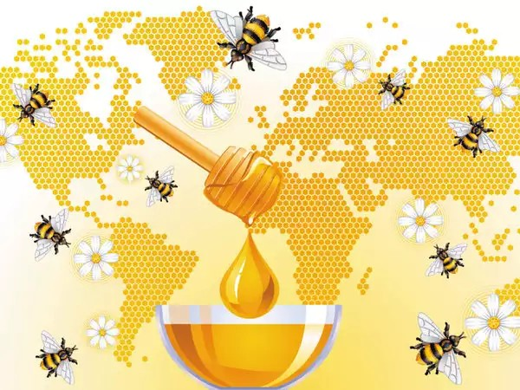
Seminar - II
Sweet revolution in India
Reshma M R
PAMB 0152
Sr M.Sc.(Agri)
Dept. Agricultural Extension

Slide 4
1.
Introduction
2.
Objectives
3.
Bee keeping
Flow of the Presentation
4.
NBHM
5.
National Bee Board
6.
AICRP on Honeybee and Pollinators
7.
Research Studies
8.
Conclusion

Slide 5
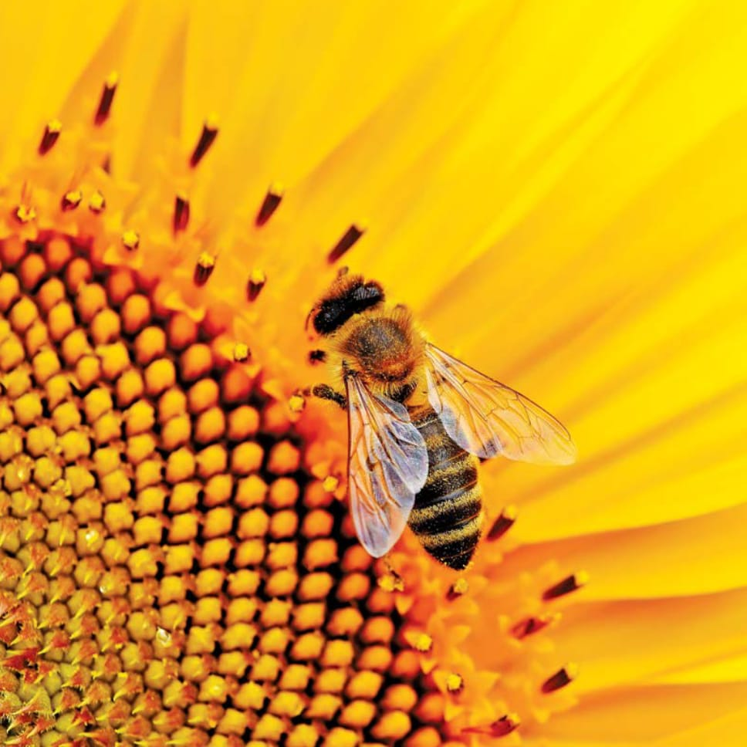
OBJECTIVES
01
To know about Bee keeping
02
To study National Bee keeping and Honey mission
03
To review the related research studies

Slide 6
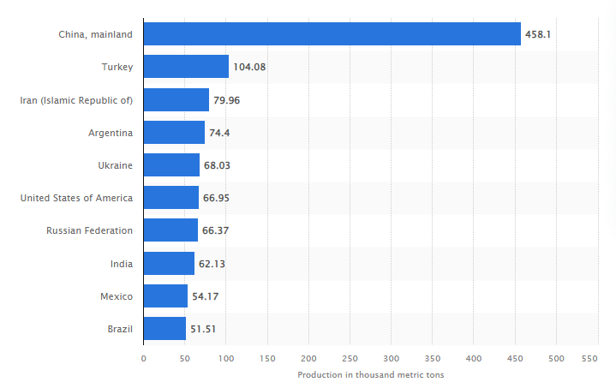
Global Scenario
Fig. 1:10 Largest Honey Producing countries in the world during 2020
Source: statista.com

Slide 7
Table 1: Export of honey by different countries of world
Exporting country | 2018-19 |  | 2019-20
 | Qty ( tonnes) | Value ( USD million) | Qty (tonnes) | Value ( USD million)
China | 1,31,361 | 250 | 1,40,726 | 255
New Zealand | 23,576 | 286 | 18,951 | 211
Argentina | 61,323 | 180 | 67,226 | 177
Germany | 25,134 | 136 | 24,142 | 134
Ukraine | 61,900 | 140 | 50,173 | 116
Mexico | 30,070 | 100 | 33,500 | 115
Brazil | 37,072 | 128 | 30,052 | 110
India | 34,857 | 107 | 59,536 | 188
Hungary | 25,726 | 94 | 24,269 | 96
Spain | 22,907 | 105 | 22,493 | 93
Source: FAOSTAT

Slide 8
Indian Scenario
Fig 2: Honey production in India from 2016-17 to 2020-21
Source: NBB, 2021

Slide 9
Table 2: Top 10 Honey Producing States in India
States | 2018-19 (in ‘000MT)
Uttar Pradesh | 22
West Bengal | 18.5
Punjab | 16.5
Bihar | 15
Rajasthan | 10.5
Himachal Pradesh | 6
Haryana | 4.8
Uttarakhand | 2.8
Madhya Pradesh | 2.6
Karnataka | 2.2
Source: theindianblog.in

Slide 10
Karnataka Scenario (2005-2020)
Production (in ‘000 MT)
Source: Karnataka State Department of Horticulture,2020

Slide 11
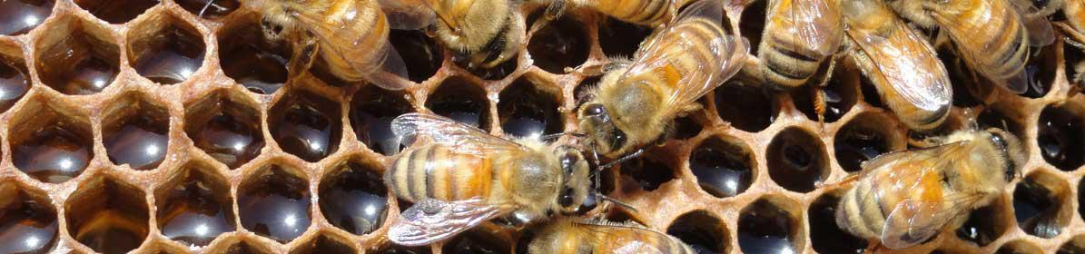
The apiculture (bee keeping) is an art and skill of maintaining the bees
It is an age old agribusiness activity
It has been practiced as early as 13,000 BC
Honey as a food
The medicinal importance of honey

Slide 12
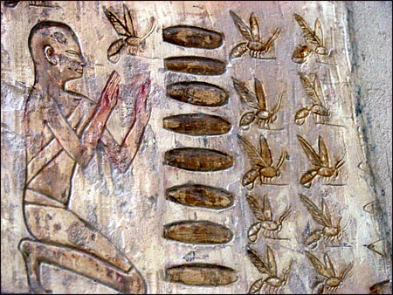
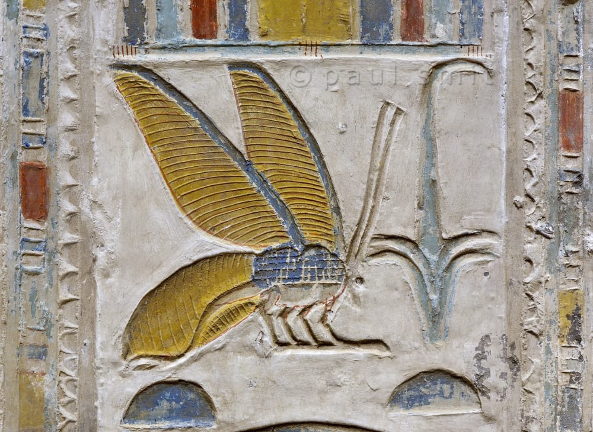
History

Slide 13

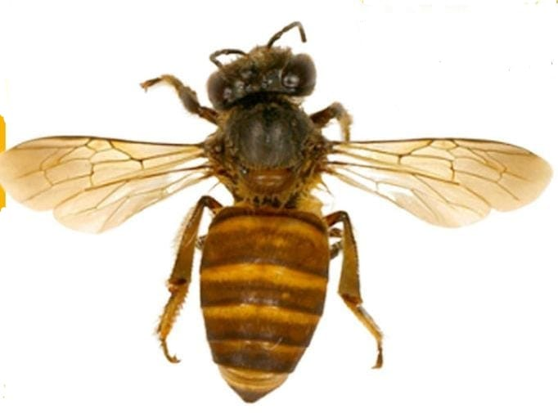
Species of Honey bees:
1. Apis dorsata (The rock- bee)
The largest honeybee
Builds single large open comb
Produces large quantity of honey
2. Apis cerana/indica (The Indian bee)
Medium – sized
Builds several parallel combs
This bee is not so ferocious

Slide 14
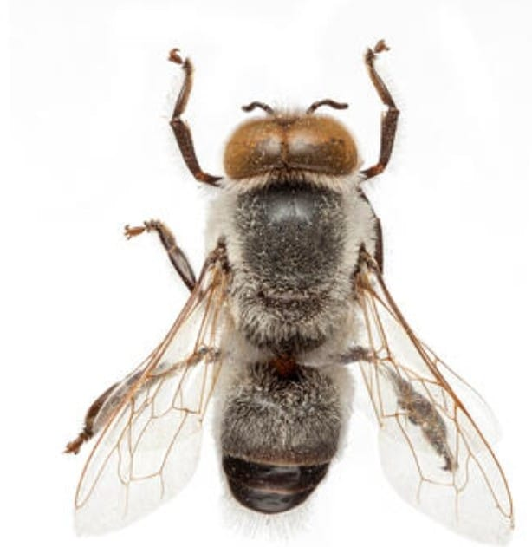
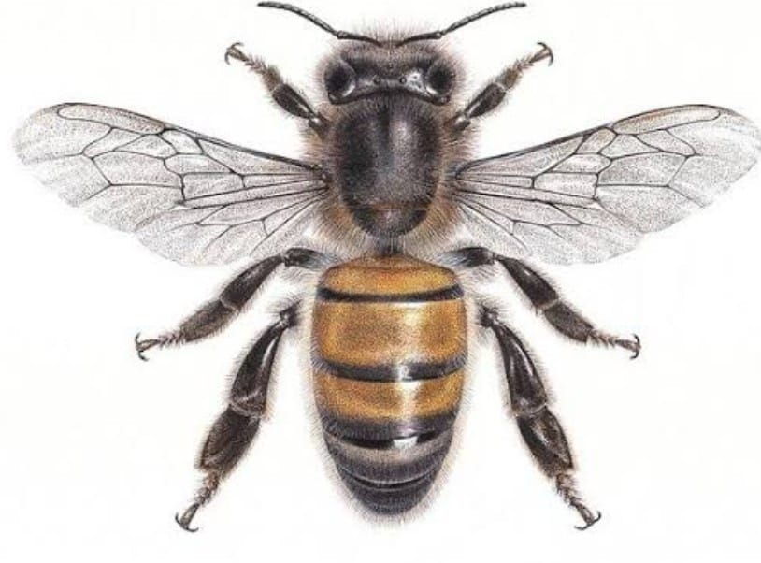
3. Apis florea (The little bee)
Small – sized
Builds single small combs in bushes, hedges, etc.
Honey yield is poor
4. Apis mellifera (The European bee)
Look likes the Indian bee
It is an introduced species
Easily domesticated

Slide 15
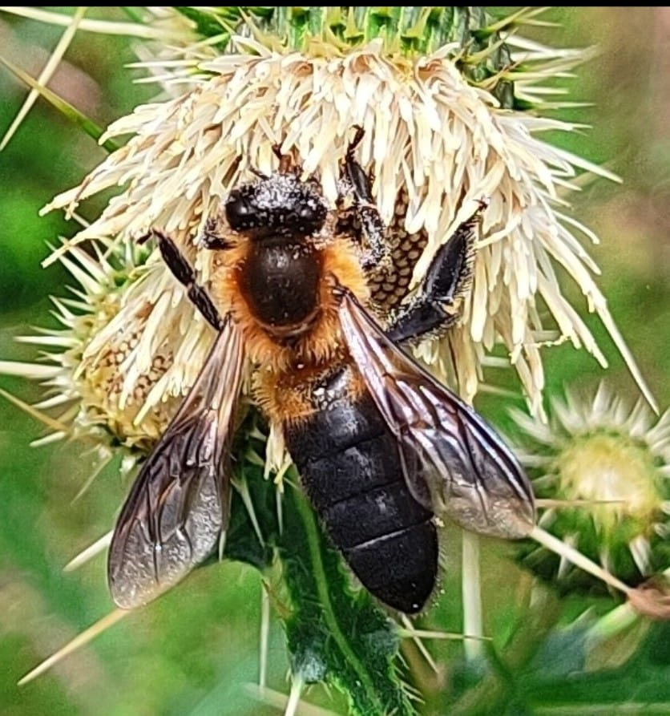
5. Apis laboriosa (Himalayan giant bee)

Slide 16
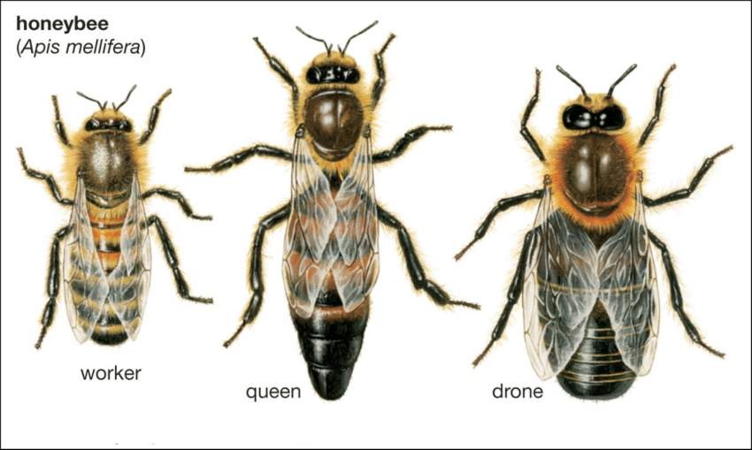
The Bee Family
A honey bee colony has three castes –Queen, worker and drone.
Queen Bee
It is the only fertile female in colony
She is largest in size
No wax glands
Live for about 3 - 4 years
May lay eggs at the rate of 1500-2000 per day

Slide 17
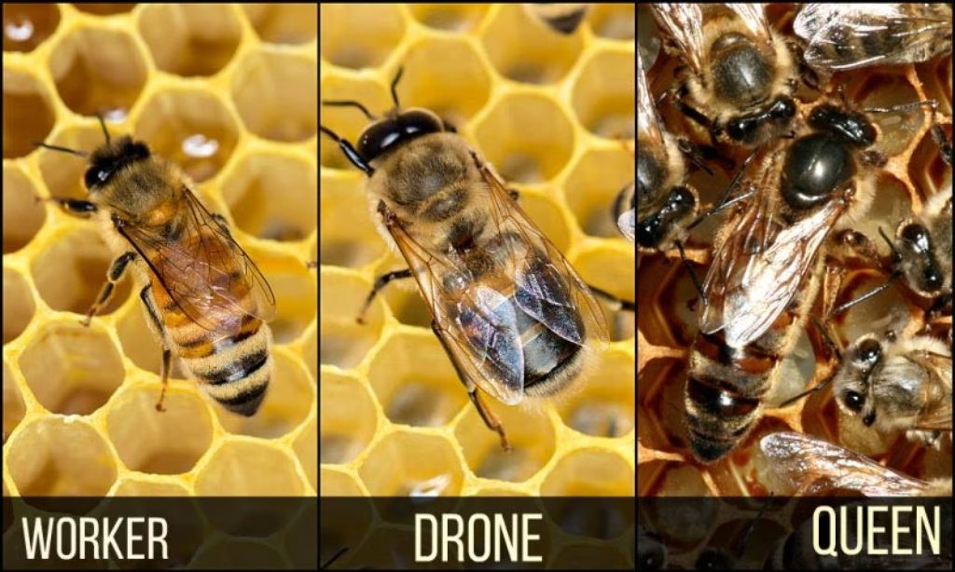
(ii) Drones
Male member of colony and can live up to about 60 days.
Sting and wax gland absent, develops from unfertilized egg.
The sole duty of drone is to fertilize the virgin queen.
(III)Worker Bee:
Have well-developed sting and hind legs
Day 1-14: Activity inside the hive such as cleaning the hive, feeding the larvae, etc. Day 14-20: Guard the entrance of the hive. Day 21- 35: Foraging, i.e. collecting the nectar and pollen from the surrounding.

Slide 18
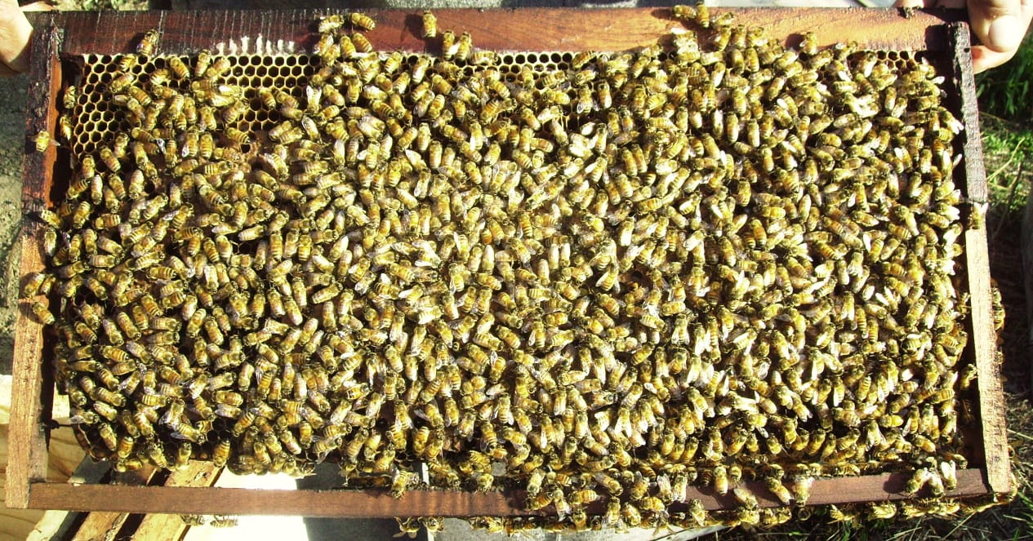
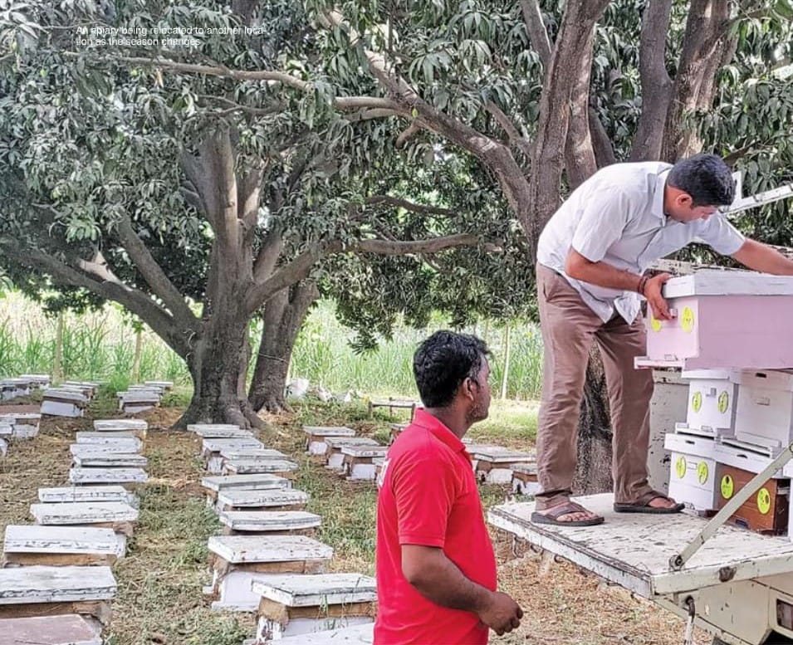
Methods of Beekeeping
(A) Indigenous methods of bee keeping:
(i) wall or fixed hive - It is purely natural type of comb
(ii) Movable hive- It comprises wooden boxes or earthen pitchers.
The traditional beekeepers catch clustered swarms from trees, bushes, etc and transfer them to the wooden boxes.

Slide 19
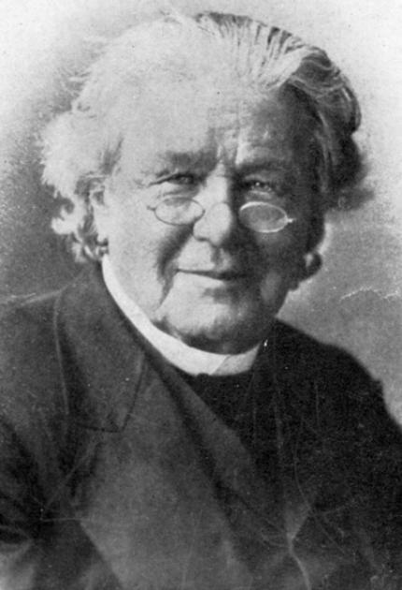
(b) Modern method of apiculture:
• The modern Bee hives were designed based on “Bee Space theory” by L.L.Langstroth in 1851.
• Bee space is the optimum distance to be left in between two adjacent comb surfaces in a bee hive which is essential for normal movement and functioning of bees.

Slide 20
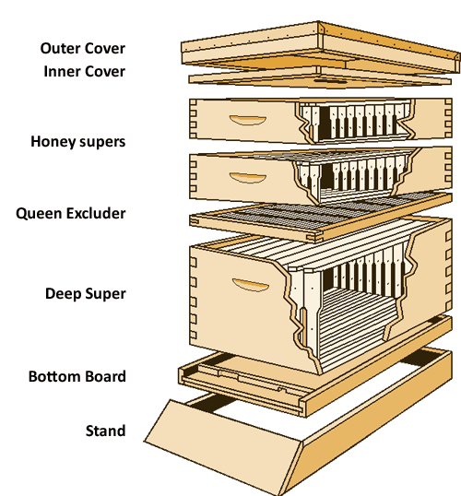
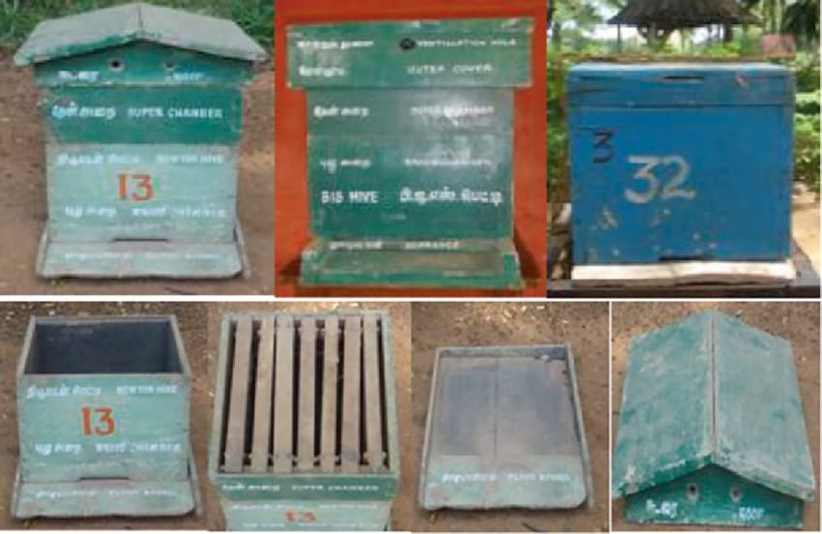
Types of hives
2. BIS (Bureau of Indian Standard) hive A and B type for A. cerana
1. Langstroth hive for A. mellifera

Slide 21
Table 3: Major Honey bee species in India
Sl. No | Common name | Scientific name | Honey yield (kg/colony)
1 | Indian bee | Apis cerena | 8-10
2 | European bee | Apis mellifera | 25-30
3 | Rock bee | Apis dorsata | 30-35
4 | Little bee | Apis florae | <1
5 | Himalayan bee | Apis laboriosa | 40-45
Source: AICRP on Honey Bee,2018

Slide 22
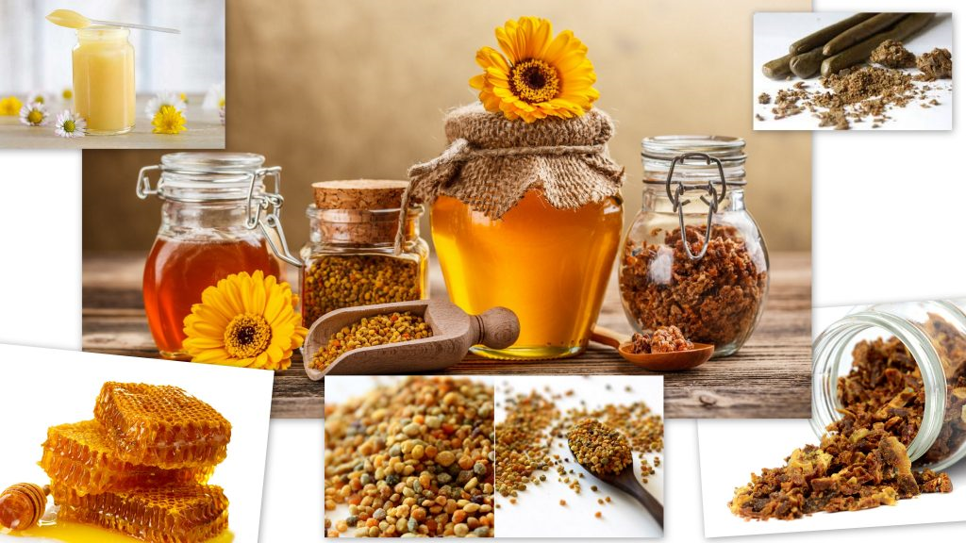
Bee products

Slide 23
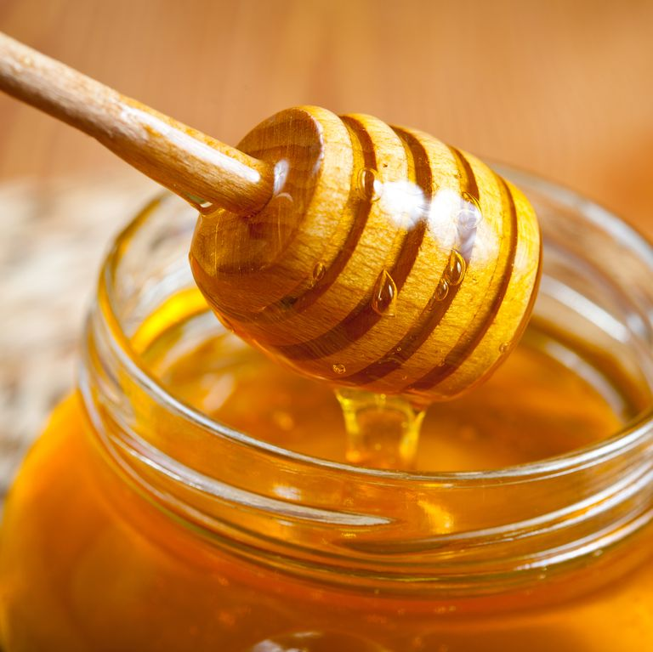
Honey
Liquid gold
According to the recent study by IMARC Group, titled “Indian Honey Market: Industry Trends, Share, Size, Growth, Opportunity and Forecast 2019-2024”, the Indian honey market reached a value of INR 15,579 Million in 2018, registering a CAGR of almost 11% during 2012-2018.
Most industrialized countries import honey to meet their demand.
This requirement can provide developing countries with a useful source of foreign exchange from honey exports.
Source: Food and Agriculture Organization,2018

Slide 24
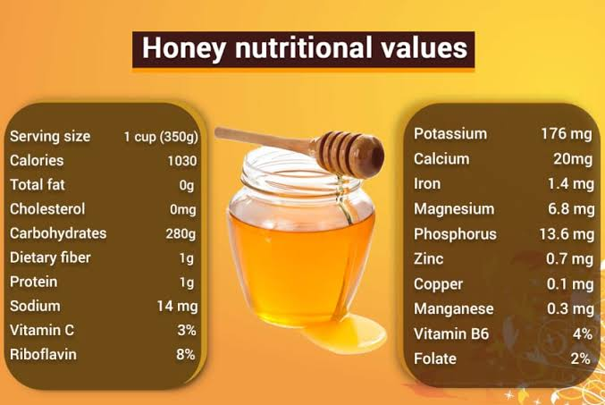

Slide 25
What are the benefits of consuming Honey
Helps in curing allergies and infections.
Great for the digestive health.
Boost the immune system.
For Wounds and cuts.
Cures obesity and helps in loosing weight.
Enhance skin and hair.
Good for brain health.

Slide 26
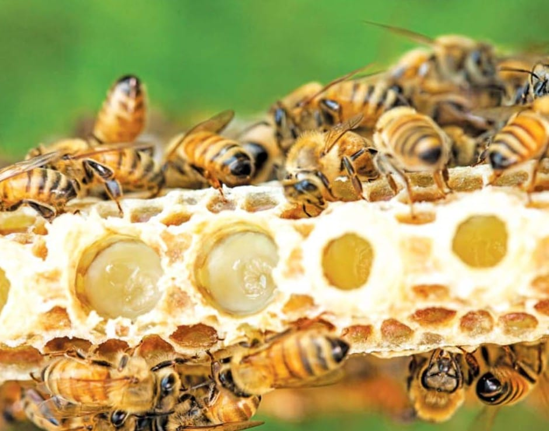
Royal jelly
Royal jelly is secretion by hypo-pharyngeal glands of worker bees of two weeks.
Royal jelly include improved health, increased body mass, enhanced fertility and additional longevity of Queen bee.
Cosmetics containing royal jelly are said to have anti-aging qualities.
On an average, half a Kilo royal jelly can be extracted from a box per year and sold at 15 to 25, 000 Rs/kg.
Source: Food and Agriculture Organization,2018

Slide 27
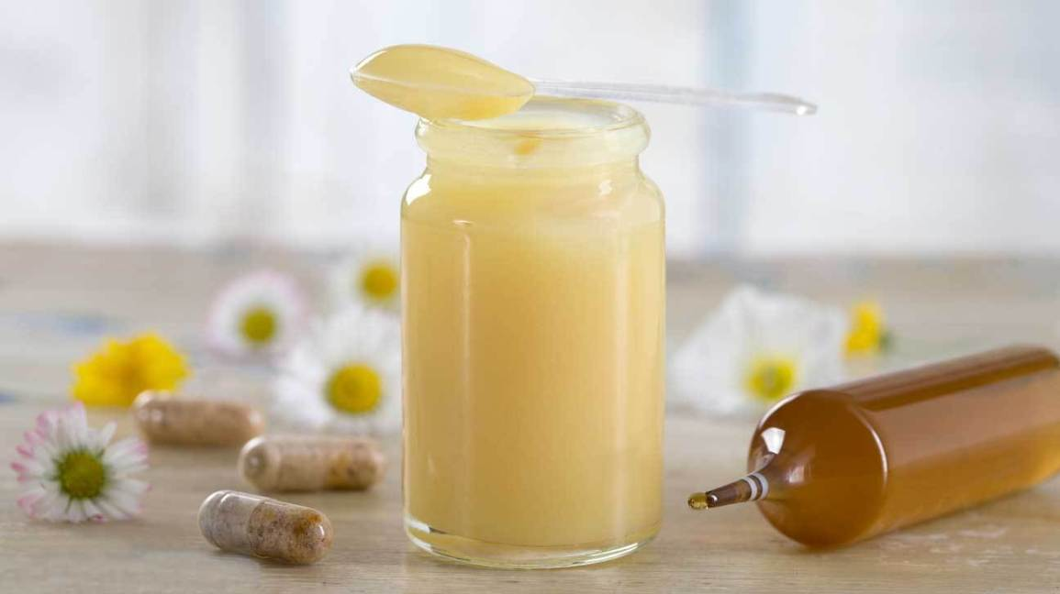
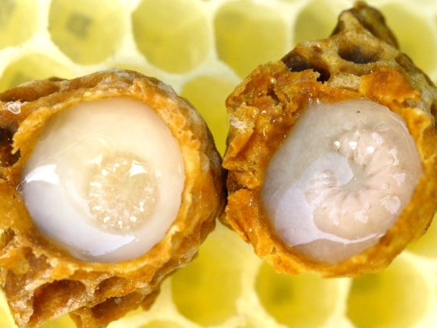
Most of the world’s royal jelly is consumed in China with much of the balance exported to Japan.
Table 4: Royal jelly production trend in world (tones)
Country | 1984 | 2017
China | 450 | 3500
Vietnam | 20 | 100
Taiwan | 140 | 80
Japan | 46 | 75
Korea | 20 | 50
India | - | 2
World total | 700 | 3885
Source: Crane and Sabatini ,2017

Slide 28
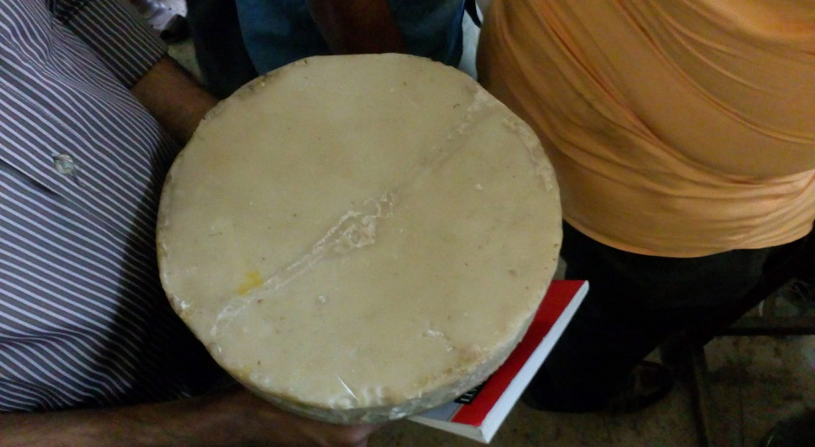
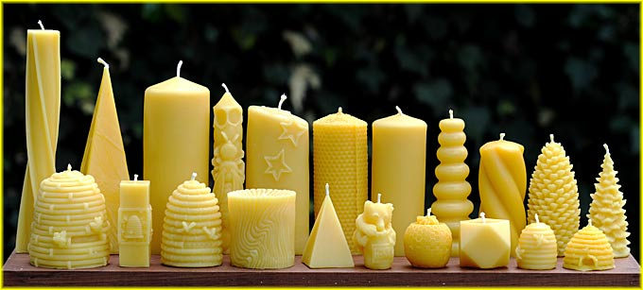
Bee-wax
Bees produce wax from the wax secreting glands and they use this wax for construction of comb.
The beeswax is used in several industries such as cosmetic, electric and textile industry, preparation of comb foundation sheet candles etc.
The market price of beeswax is varied between Rs.400 to 700 per kg.
Source: Food and Agriculture Organization,2018

Slide 29
Fig. 7: Market share of bee wax by different regions in the world
Source: FAO stat,2018

Slide 30
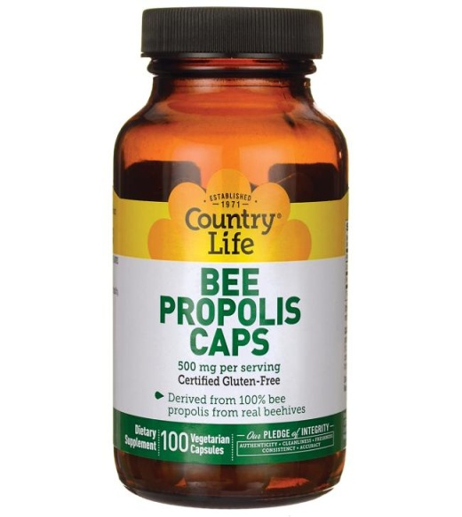
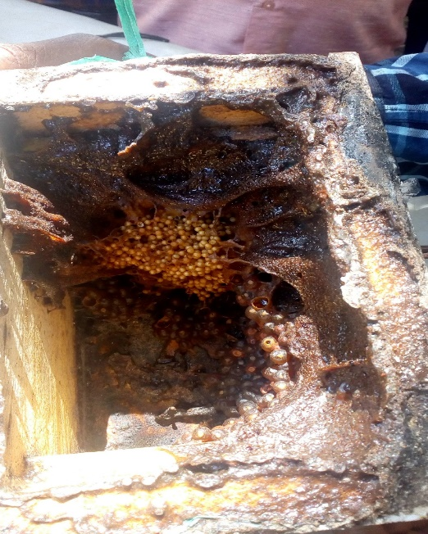
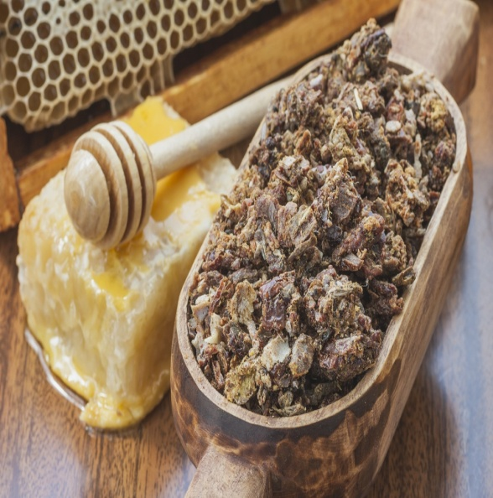

Propolis
It is produced by Italian and stingless bees and not seen in Indian bee, rock bee and little bee.
Honey bees use propolis for sealing the cracks, crevices and unwanted holes in the hive.
About 300g of propolis can be obtained from one colony per year and sold @ Rs 500/kg.
Propolis has been suggested to have a role in treating certain cancers as well (National Center for Biotechnology Information).
Source: Food and Agriculture Organization,2018

Slide 31

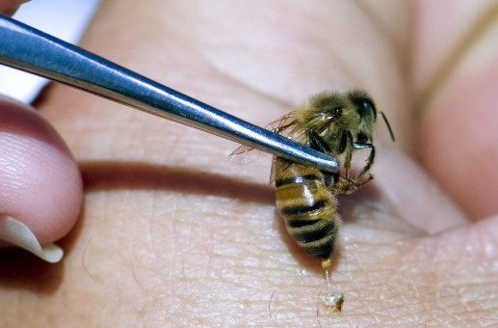
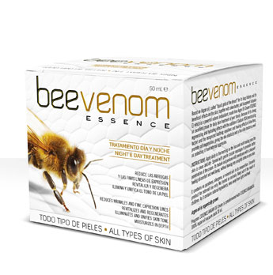
Bee venom
Apitoxin contains more than 40 biologically and pharmacologically active compound.
It is injected by honey bees using their sting to defend themselves from the intruders.
Quantity of bee venom produced by worker bees varies between 100 to150 micrograms. About 50 mg venom can be obtained per colony and sold @ Rs 1000/g.
The main bee venom producer is the USA has produced only about 3 kg of dry venom during the last 30 year.
Source: Food and Agriculture Organization

Slide 32
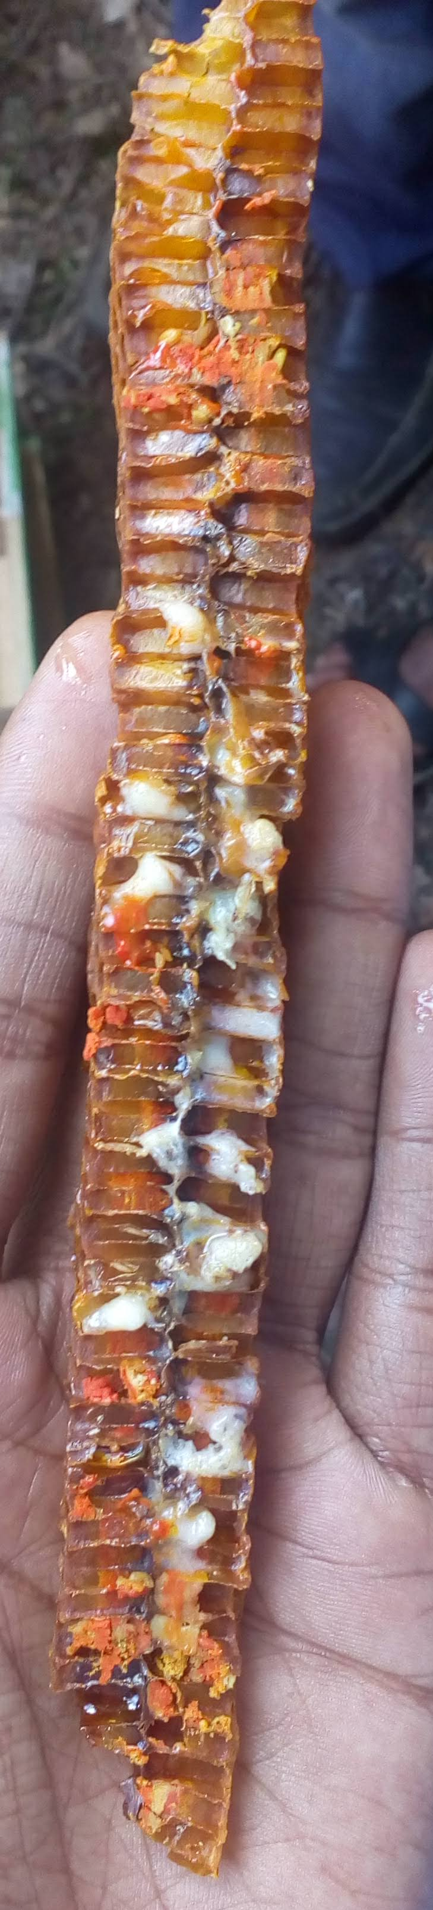
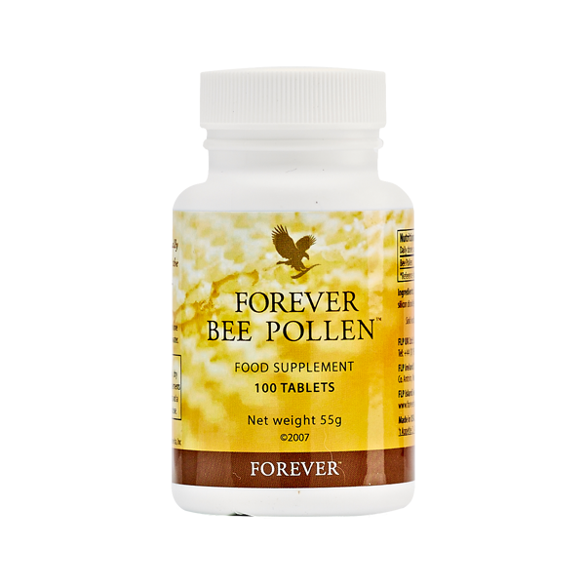
Pollen
It is the chief source of protein, lipids, amino acids, minerals, vitamins etc. in the honey bee diet.
It improves in Athletic performance.
Sold in the market for prices ranging from Rs. 2000 to 20,000 per kg depending on the crop from which it is collected by bees.
Source: Food and Agriculture Organization,2018

Slide 33
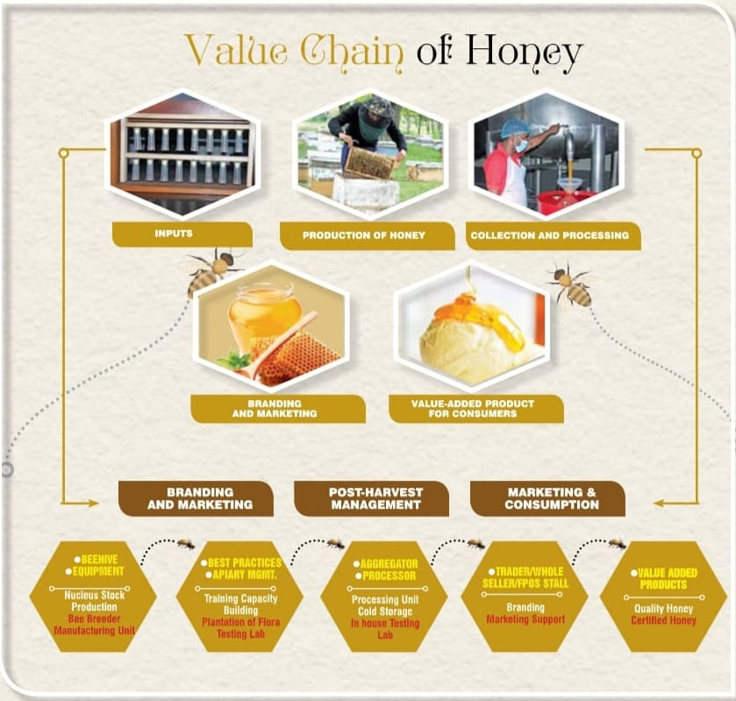
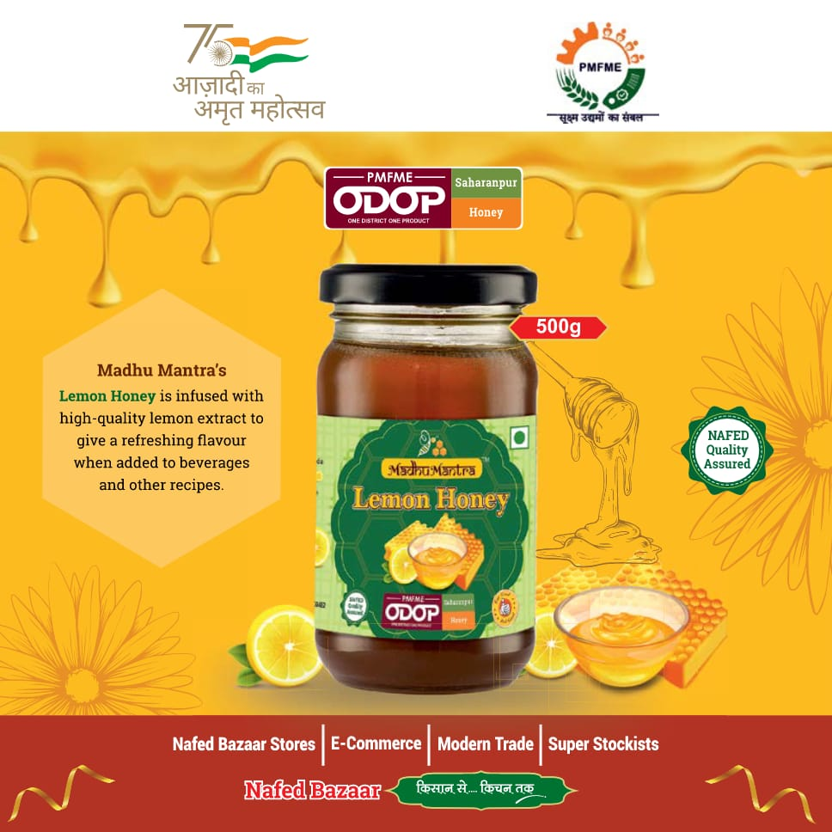
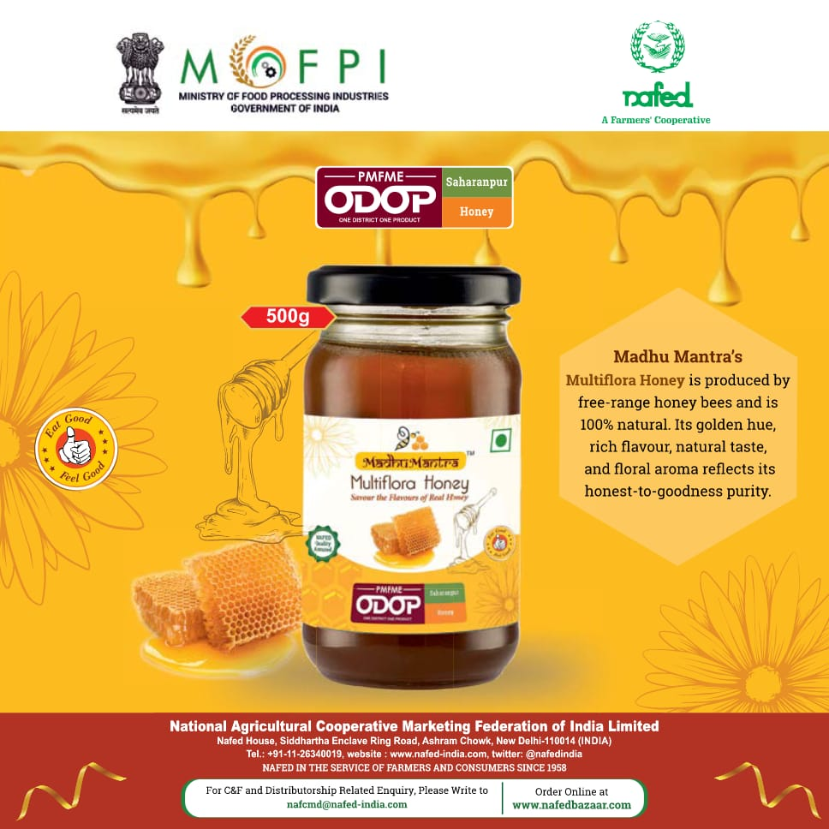

Slide 34


Slide 35
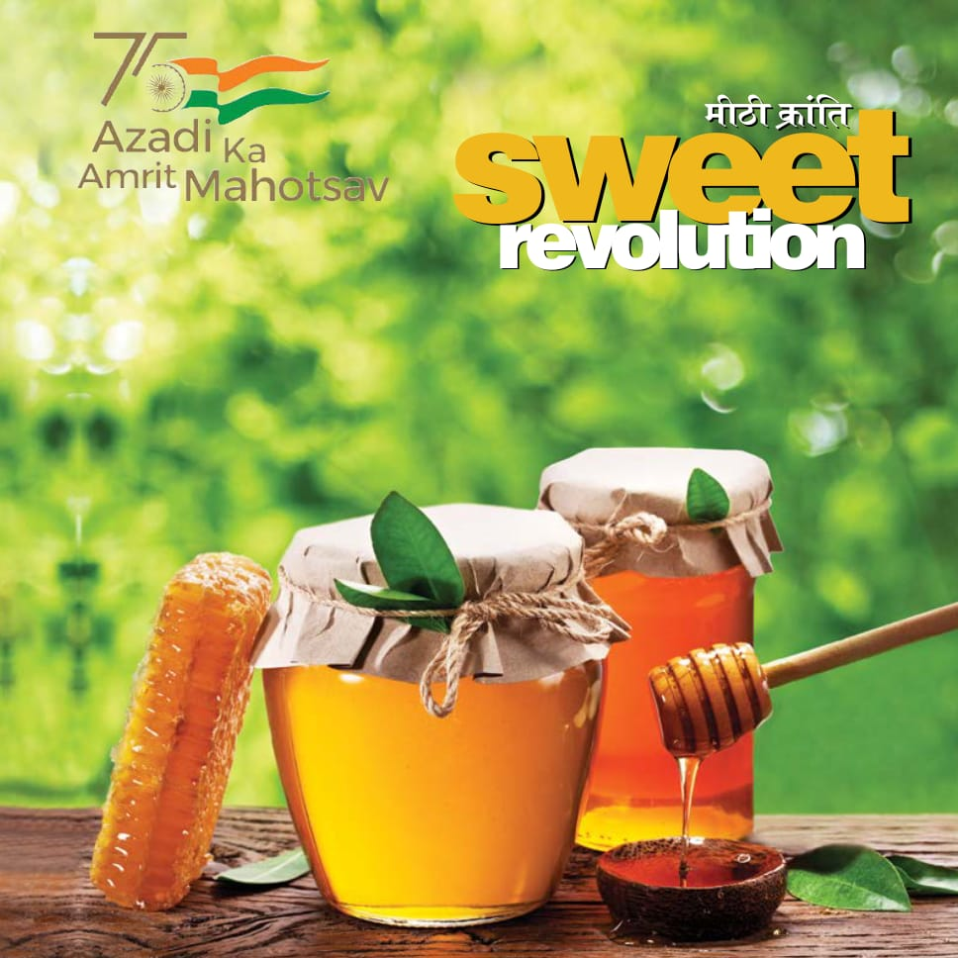
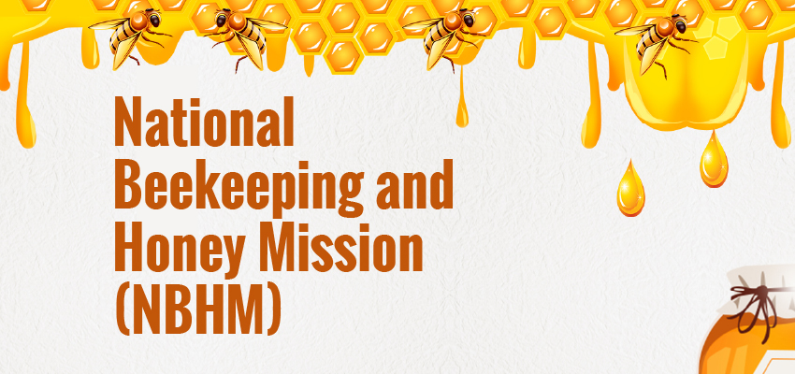
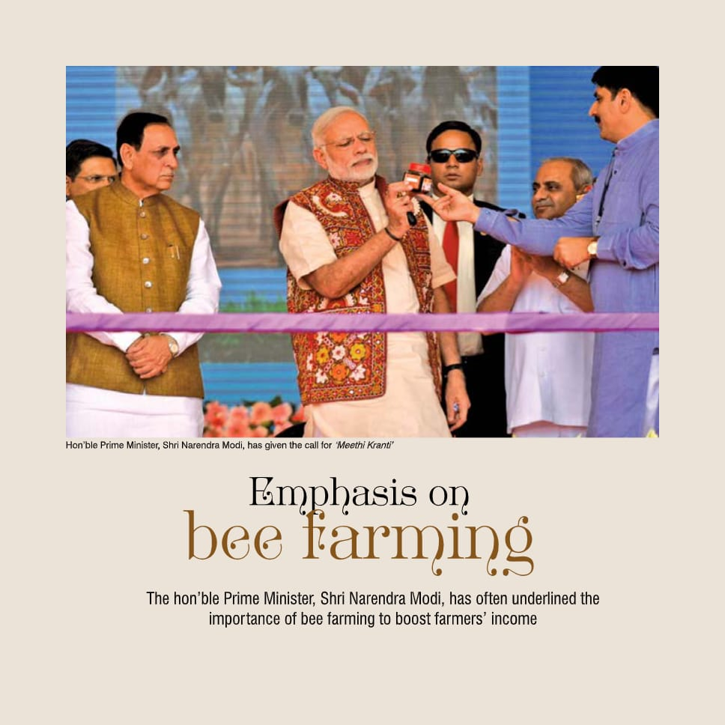

Slide 36
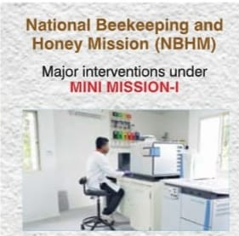
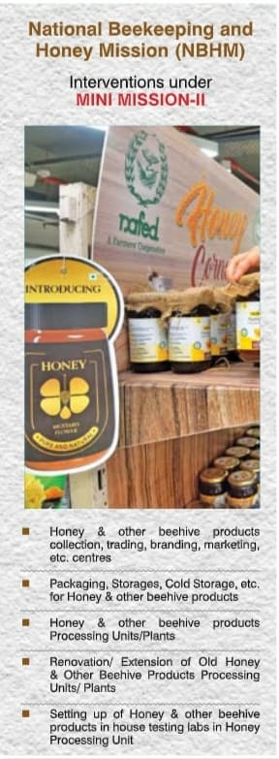
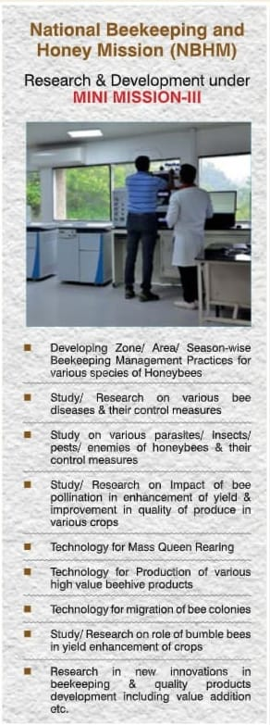

Slide 37
MAIN ACHIEVEMENTS:
Two World Class State of the Art Honey Testing Labs, one at NDDB, Anand, Gujarat & one IIHR, Bengaluru, Karnataka, have been approved/ set up.
10,000 Beekeepers & Honey Societies/Firms/Companies with 16.00lakhs honeybee colonies have been registered with NBB.
Proposal for developing Traceability Source of Honey and other Beehive Products approved and work has been started.
5 FPOs of honey producers in the States of Bihar, Uttar Pradesh, Madhya Pradesh, Rajasthan & West Bengal have been formed and launched by Minister of Agri.& FW on 26.11.2020.
16 Integrated Beekeeping Development Centres (IBDCs) as role model of beekeeping have been commissioned, one each in the States of Haryana, Delhi, Bihar, Punjab, Madhya Pradesh, Uttar Pradesh, Manipur, Uttarakhand, Jammu & Kashmir, Tamil Nadu, Karnataka, Himachal Pradesh, West Bengal, Tripura, Andhra Pradesh and Arunachal Pradesh.

Slide 38
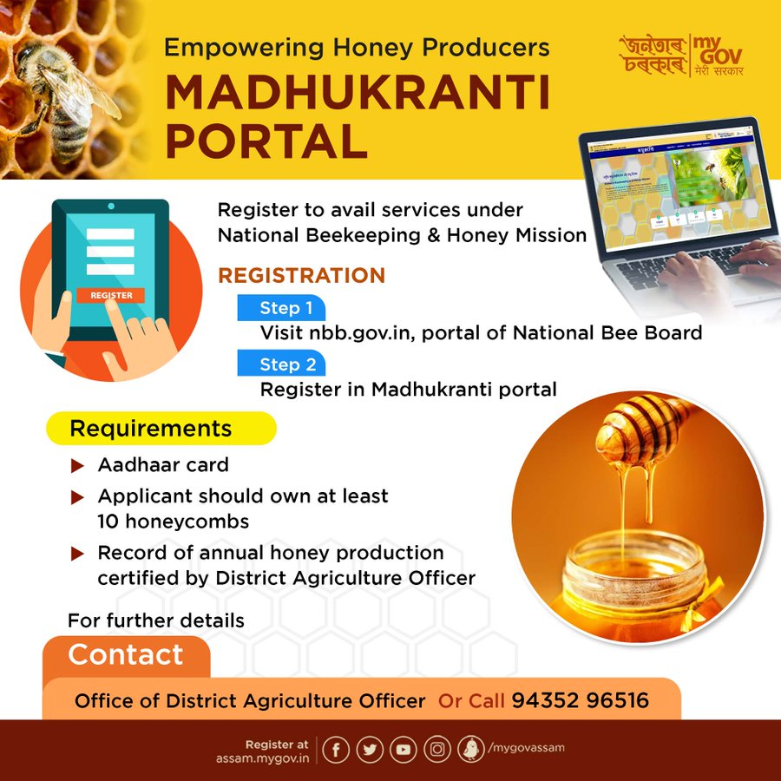
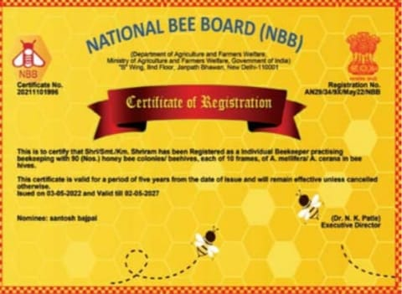
https://allbankcare.in/nbb/

Slide 39
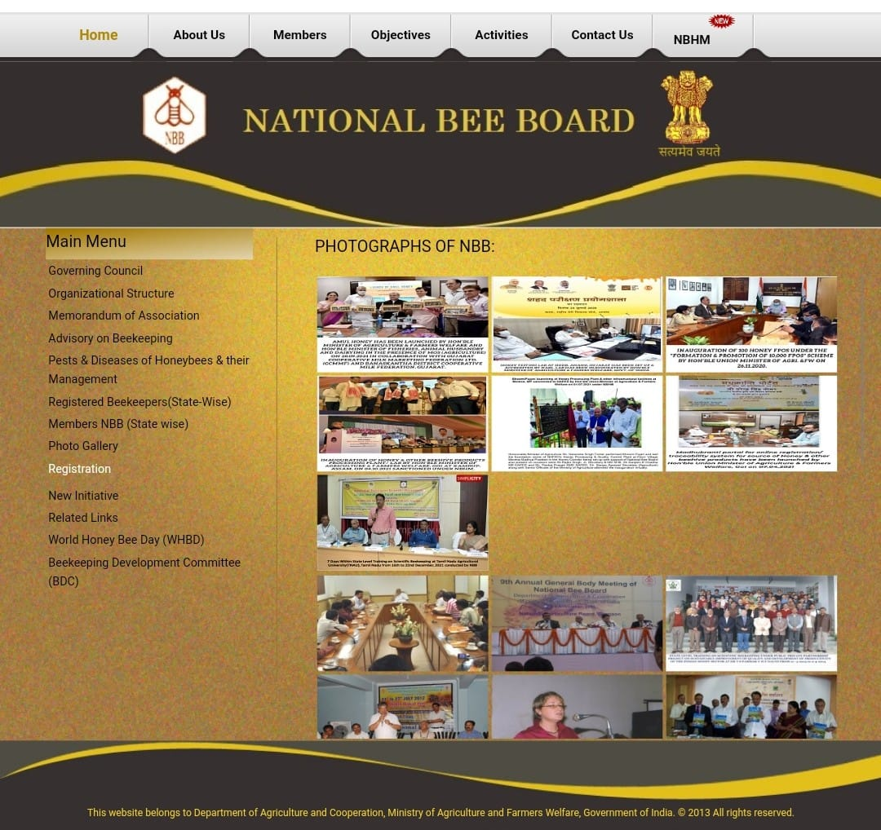

Slide 40







Productivity
OBJECTIVES
Pawanexh Kohli
Inclusivity
Sustainability
Technology
Quality
Marketability

Slide 41


Pawanexh Kohli
1 Registration of beekeepers and farmers for traceability purpose.
2
Integrating tribal and fringe communities of forest dwellers into beekeeping
3
Coordination for formulating standards for honey and other bee hive
products for domestic and international markets.
4 Ensuring free transportation of bee colonies during migration.
5
Advisories on good beekeeping practices.
6
HRD: Training, seminar, exposure visits, etc.
Providing bee boxes, bee colonies, etc. to beekeepers.
Publication of Magazine “Bee World”.

Slide 42


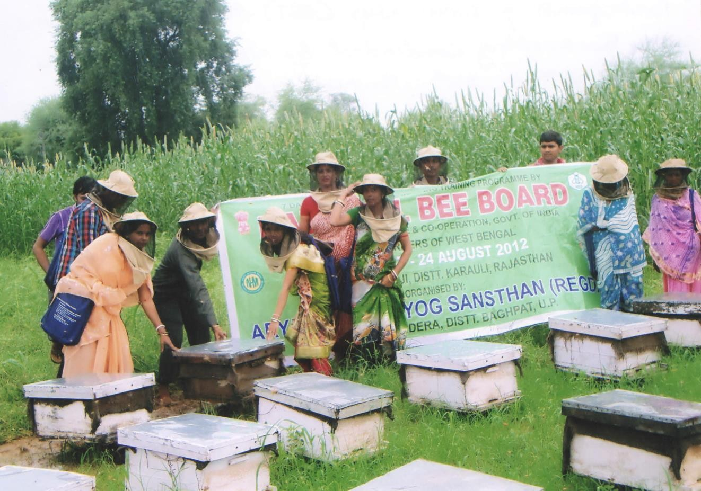
Pawanexh Kohli

Slide 43


All India Coordinated Research Project on Honey Bees and Pollinators
(AICRP-HB&P)
The National Commission on Agriculture in 1976 recommended the starting of a project entitled "All India Coordinated Project on Honeybee Research & Training" keeping in view the potential role of honeybees as pollinators.
The project was launched by the Indian Council of Agricultural Research during 1980-81.
Project started functioning at different locations with its Project Coordinating unit located at Central Bee Research & Training Institute (CBRTI), Pune with objectives to coordinate, counsel and monitor the activity of cooperating centers.
26 project centres are there

Slide 44
EXTENSION ACTIVITIES
Total 40,000 stakeholders were trained since inception of the project.
Monthly Beekeeping message to registered bee keepers based on information technology was developed by AICRP center of OUAT, Bhubaneswar.
The information is disseminated through mobile (voice message) to the Beekeepers of the state in collaboration with Reliance Foundation, Bhubaneswar.
It also engaged in organizing training programmes for the tribal’s on scientific bee keeping.
To date 27 such training programmes have been organized benefiting 1554 tribal’s in different parts of the country.
MadhuSandesh- mobile advisory service to bee keepers -a pilot project in collaboration with KVK, Baramathi and Crop life Asia limited launched by AICRP (HB& P) to save the bees from pesticide poisoning.

Slide 45
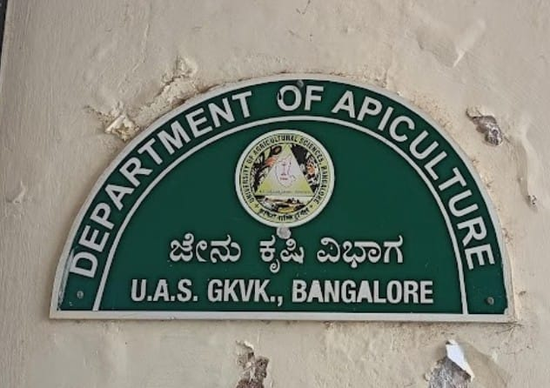
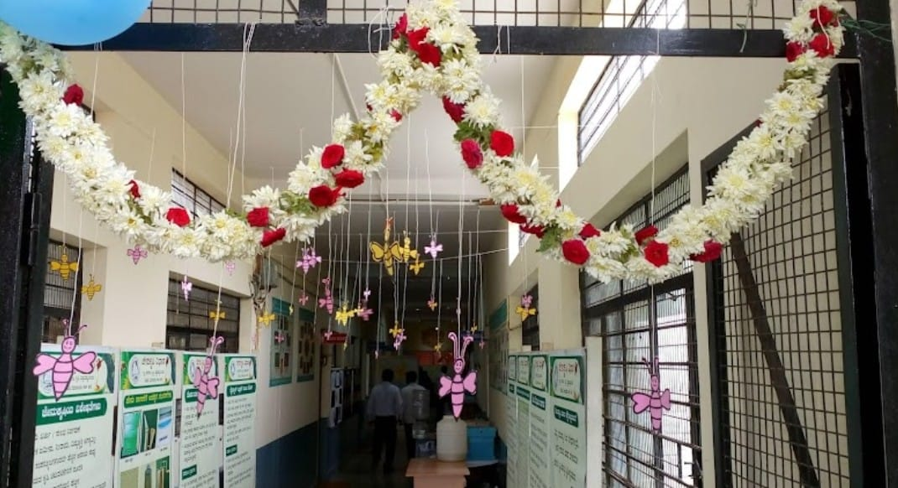
The first time in India, a separate Department of Apiculture was set up in UASB in December 1996.
The PG Programme was started during the academic year 1997-98.
AICRP on Honey Bees and Pollinators, UAS, Bangalore
The project got financial assistance from ICAR to implement the Tribal Sub-Plan (TSP).
More than 500 Apis cerana colonies, beehives, smokers, honey extractors and other equipment were distributed for rearing domestic honey bees.

Slide 46
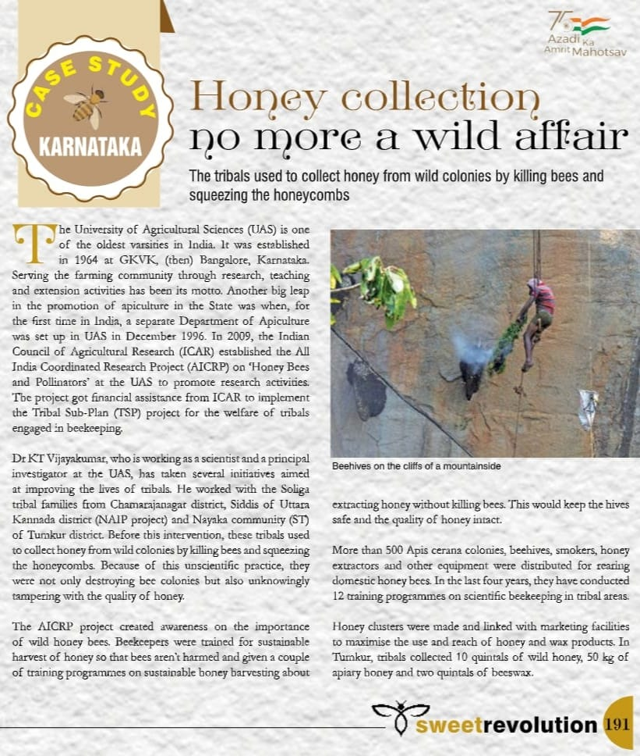
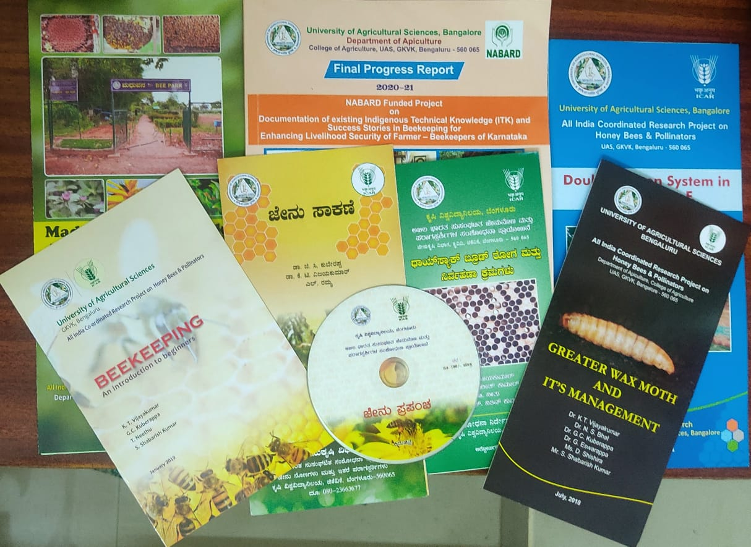

They have conducted 12 training programmes on scientific beekeeping in tribal areas.
In Tumkur, tribal's collected 10 quintals of wild honey, 50 kg of apiary honey and two quintals of beeswax.

Slide 47
Importance of Beekeeping in Agriculture
APICULTURE
POLLINATION
INCREASES CROP YIELD
AGRI-ENTERPRICE SOURCE OF LIVELIHOOD
ECOSYSTEM SERVICE
EXPORT VALUE

Slide 48
Table 8: Per cent increase in crop yield due to bee pollination
Sl. No. | Crops | Per cent increase in crop yield
1 | Sunflower | 45-50
2 | Mustard | 45-50
3 | Cotton | 25-50
4 | Tomato | 25-30
5 | Pumpkin | 100
6 | Cucumber | 25-30
7 | Watermelon | 80-90
8 | Grapes | 25-30
9 | Lime species | 50-55
10 | Apple | 50-60
11 | Clove | 50-60
12 | cardmom | 100
Source: AICRP on Honey Bees and Pollinators,2018

Slide 49
Economic value of pollination for crops
Source: Economic benefits of pollination to Indian agriculture, 2017

Slide 50


Slide 51
Major constraints faced by the beekeepers
Lack of infrastructure for producing genetically superior queen bees for supply to beekeepers.
Technical knowledge for efficient management of bee colonies for higher honey yield.
Lack of awareness about yield increase in crops by bee keepers through pollination.
Research for disease management & control.
Financial Institutional support
Consumer awareness about honey and its products
Poor quality control for production of honey
De-forestation
Indiscriminate use of insecticides, pesticides, weedicides, etc.
Global warming & unforeseen changes in climatic conditions.

Slide 52

Research Studies

Slide 53
1. Potentiality of beekeeping in doubling farmers’ income in jharkhand: a way to sweet
Revolution
Khanra and Mukherjee, 2018
Objective: To know the potentiality of bee keeping in doubling farmers income.

Slide 54

METHODOLOGY
Locale of the study: Ranchi district of Jharkhand
A total of 47 beekeepers were randomly selected those who get their inputs and information from the KVIC and Ramakrishna Mission, Divyayan KVK.
The primary data for the present study was collected using structured schedule .
Rank Based Quotient (RBQ) technique was applied to rank various parameters of interest.

Slide 55

RESULTS
Table-1 Cost of producing honey per 100 hives

Slide 56


Table-2 Income from honey/100 hives
Table-3 Quality parameters of the customers

Slide 57

Table-4 Constraints faced by the beekeepers

Slide 58
1. Perception towards adoption and constraints in beekeeping
Singh and Singh, 2019
Objective:
To assess the perception of the people toward adoption of beekeeping and possible constraint in this regard.

Slide 59

METHODOLOGY
Saina Nehwal Institute of Agricultural Technology, Training & Education, Directorate of Extension Education, Chaudhary Charan Singh Haryana Agricultural University, Hisar conducted eight training programmes (3-5 days duration) on bee keeping for farmers, women and unemployed youth in which a total of 272 trainees participated from different districts of Haryana and adjoining states.
To see the perception of trainees towards adoption of beekeeping as an enterprise and constraints in this activity, an evaluation of these programmes was conducted.
The data were tabulated and analyzed in terms of frequency and percentage using computer software MS Excel.

Slide 60

RESULTS
Table 1: Socio-economic profile of trainees (n= 272)

Slide 61

Table 2: Perception towards adoption and constraints in beekeeping
(n= 272)

Slide 62
CONCLUSION
Honey bees provide a variety of products such as honey, bee wax ,pollen ,royal jelly, bee venom and services like pollination to Human society and Ecosystem.
The apiculture was highly profitable enterprise in India due to rich floral source and geographical advantage.
Beekeeping gives additional income to farm households apart from crop production.
The honey production did not use any fertile land and more inputs than crops hence it can be recommended for rural people as a main or subsidiary enterprise to uplift their livelihood.

Slide 63






Thank You!

