Slide 1

.

Slide 2


Micro, Small, and Medium Enterprises in Agriculture : An Overview
NAGESH G S
PAMB0151
Sr.Msc

Slide 3


Micro, Small & Medium Enterprises (MSMEs) are the bedrock of India’s economy, contributing upwards of 30% to the country’s GDP and employing 130Mn+ people.
Contributing 40% in manufacturing output & 45% in Exports.
They have emerged as dynamic and vibrant sector of economy.

Slide 4



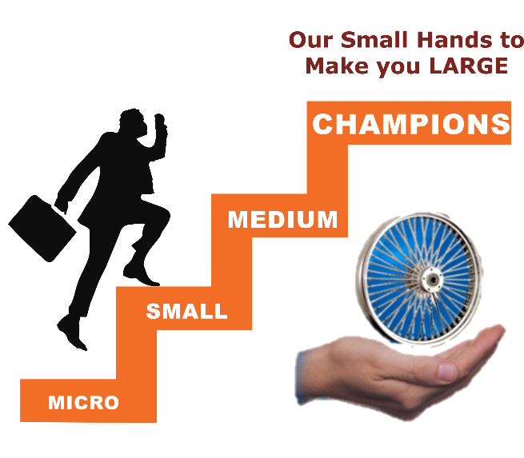
Contd..
The enterprise is regarded as BACKBONE of industrial development.
They are the nursery for entrepreneurship and innovations.

Slide 5
01
To understand the concept of MSME
02
To study the growth and development of MSME in rural and urban areas
objectives
03
To know the programmes implemented by Ministry of MSME
04
To review Research studies related to MSME

Slide 6
1. To understand the concept of MSME

Slide 7
Concept of MSME
In February, 2018, the Union Cabinet chaired by the Prime Minister Shri Narendra Modi has approved changes in the definition of the MSMEs.
Now, MSMEs will be defined on the basis of ‘annual turnover’ instead of earlier definition of investment in plant & machinery/equipment.

Slide 8

Categorization
Small
Not more than Rs.10 crore and Annual Turnover ; not more than Rs. 50 crore
Micro
Not more than Rs.1 crore and Annual Turnover ; not more than Rs. 5 crore
Medium
Not more than Rs.50 crore and Annual Turnover ; not more than Rs. 250 crore
Source: Ministry of MSME,2021

Slide 9
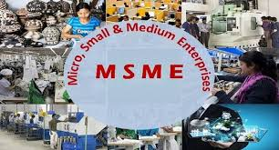
OBJECTICVE of MSME
To create immediate employment opportunities
To make small industries export oriented
To encourage growth in village and small towns
To remove economic backwardness
To provide steady source of income to the low income group

Slide 10

Creates large scale employment
Makes the economy stable in terms of growth
Production cost is low
Opens a great opportunity for the entrepreneurs in India

Slide 11
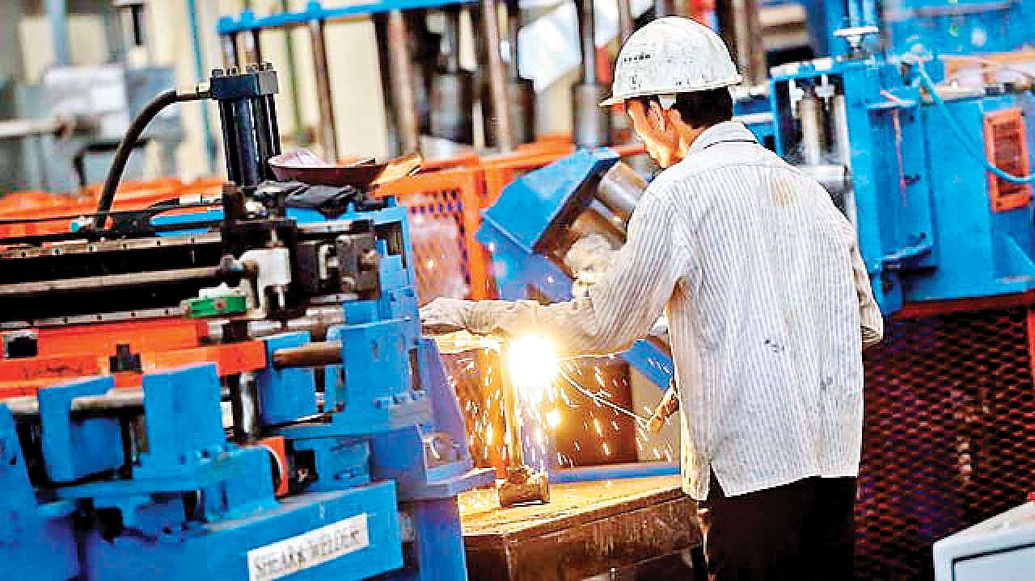
Scope of MSME
Less capital intensive
Effective tool for promotion of balanced regional development
It is extensively promoted and supported by the Government
Finance and subsidies are provided by the government
Produced goods are purchased by the Government

Slide 12

Benefits of MSME under the MSMED Act, 2006
Preference in procuring Government tenders
Protection against the delay in payment from Buyers
Right of interest on delayed payment
Time-bound resolution of disputes with Buyers through arbitration

Slide 13
Challenges faced by MSME
Absence of adequate and timely banking finance
Limited capital and knowledge, non-availability of suitable technology
Low production capacity
High cost of credit
Ineffective marketing strategy
Lack of skilled man power for manufacturing, services, marketing etc.

Slide 14

Lack of access to global markets.
Constraints on modernization of expansion.
Problems of storage, designing, packing and product display.
In adequate infrastructure facilities, including power, water, roads.

Slide 15
2. To study the growth and development of MSME in rural and urban areas.

Slide 16
Growth and development
Based on Ghandhi model
• Industrial policy resolution 1948
• High priority to small and medium enterprises
MSME has remained mostly small & technologically backward
Industrial policy(1991)
• This reflected the growth of SSI’s
• In 1991 the growth rate of SSI was almost 3 times of the total industrial sector from 1992 to 1995.

Slide 17
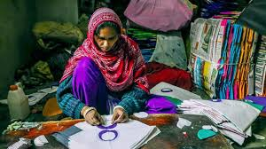
History
Clusters of micro, small and medium enterprises (MSMEs) are found in abundance across the globe more than 9 years ago
The Foundation for MSME Clusters (FMC) was conceptualized to contribute towards this process of cluster based development of MSMEs
The United Nations Industrial Development Organisation (UNIDO) conceptualized and initiated the process of creating the Foundation for MSME Clusters (FMC)
The Foundation for MSME (FMC) was supported by Ministry of Small Scale Industries (SSI), UNIDO & Entrepreneurship Development of India and was legally constituted in 2005

Slide 18

The Ministry of Small Scale Industries and Agro and Rural Industries (SSI&ARI) was created in October 1999. In September 2001, the ministry was split into the Ministry of Small Scale Industries (SSI) and the Ministry of Agro and Rural Industries (ARI)
The President of India amended the Government of India (Allocation of Business) Rules, 1961, under the notification dated 9 May 2007. Pursuant to this amendment, the ARI and SSI were merged into a single ministry, the current MSME

Slide 19
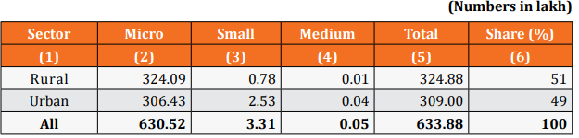
Distribution of Enterprises Category Wise
Annual report of MSME,2021

Slide 20
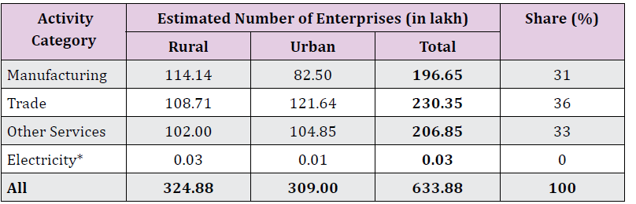
Estimated Number of MSMEs (Activity Wise)
Annual report of MSME,2021

Slide 21
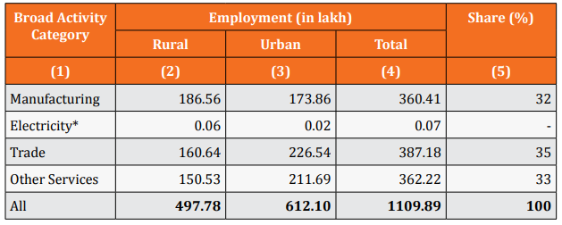
Estimated Employment in the MSME Sector (Activity Wise)
Annual report of MSME,2021

Slide 22
Percentage Distribution of Enterprises in rural and urban areas. ((Male/ Female ownership) category wise)
Sector | Male | Female | All
Rural | 77.76 | 22.24 | 100
Urban | 81.58 | 18.42 | 100
All | 79.63 | 20.37 | 100
Annual report of MSME,2021

Slide 23
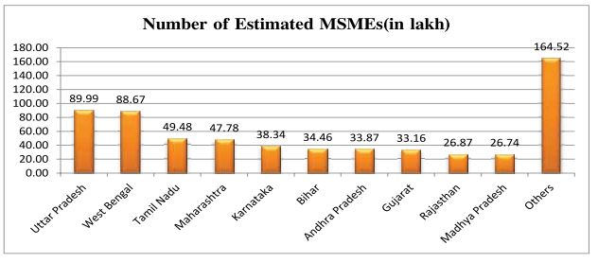
Distribution of MSMEs in Top Ten States
Annual report of MSME,2021

Slide 24
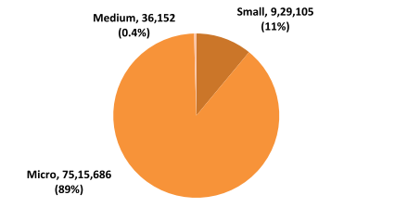
Distribution of Micro, Small and Medium Enterprises as per UAM filings
Annual report of MSME,2021

Slide 25
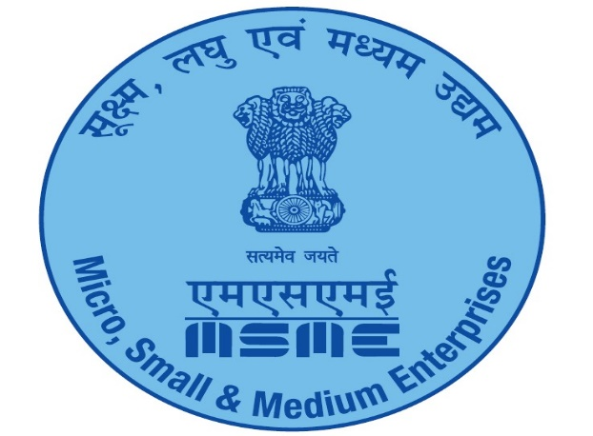
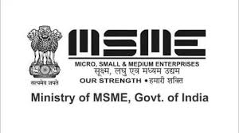

Major Schemes implemented by Ministry of MSME

Slide 26


1.Khadi and Village Industries Commission (KVIC)
Established under the Khadi and Village Industries Commission Act, 1956
It is a Statutory Organization under the ministry of MSME.
It is responsible for the planning, promotion, organizing and implementation of programmes for the development of Khadi and Village Industries in the country.

Slide 27
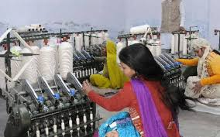
OBJECTIVE of KVIC:
The social objective of providing employment in rural areas
The economic objective of producing saleable articles
The wider objective of creating self-reliance amongst people and building up a strong rural community spirit.

Slide 28
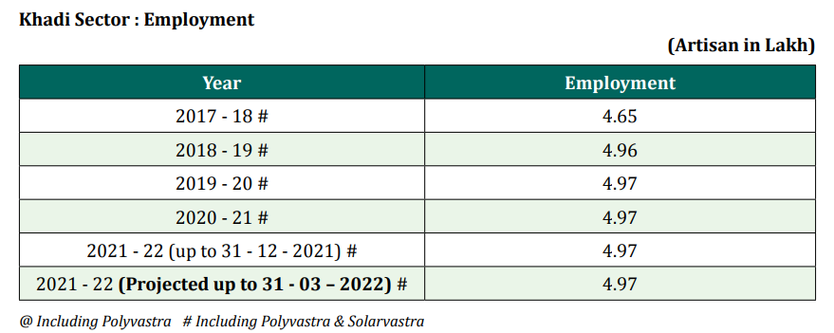
Annual report of MSME,2021

Slide 29

2.Prime Minister’s Employment Generation Programme (PMEGP)
PMEGP is a credit linked subsidy scheme to generate employment opportunities in rural as well as urban areas of the country, in non-farm sector, through setting up of new self-employment ventures/micro enterprise.
The Scheme is implemented by Khadi and Village Industries Commission (KVIC), as the nodal agency at the National level.

Slide 30
OBJECTIVES of PMEGP:
To generate continuous and sustainable employment opportunities in Rural and Urban areas of the country
To provide continuous and sustainable employment to a large segment of traditional and prospective artisans, rural and urban unemployed youth in the country through setting up of micro enterprises.
To facilitate participation of financial institutions for higher credit flow to micro sector.

Slide 31
Salient features of the PMEGP
In Urban and Rural areas in ratio of 30:30:40 between KVIC / KVIB / DIC respectively.
Per capita investment should not exceed Rs. 1.00 lakhs in plain areas and Rs. 1.50 lakhs in Hilly areas.
Maximum project cost of Rs. 25.00 lakhs in manufacturing sector and Rs. 10.00 lakhs in Service Sector.

Slide 32
Margin money subsidy varies from 15 to 35% for different categories.
Scheme is available for setting up of new units only. Since inception in 2010-11 and up to 31.12.2021, a total of about 5.7 lakh micro enterprises have been assisted with a margin money subsidy of Rs 13,033.3 crore providing employment to an estimated 47 lakh persons.

Slide 33
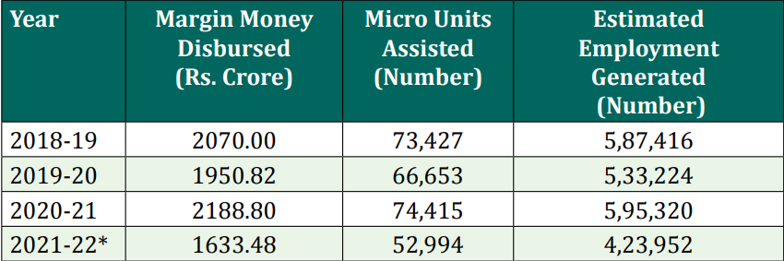
PMEGP performance during last three years and current year:
Annual report of MSME,2021

Slide 34
2.Scheme of Fund for Regeneration of Traditional Industries (SFURTI)
It is Cluster-based scheme of Govt. of India.
Govt. of India has launched the Scheme of Fund for Regeneration of Traditional Industries (SFURTI)
To make the Traditional Industries more productive, profitable and capable for generating sustained employment for traditional industry Artisans and subsequently empower and convert them as self-governing entrepreneurs
Under this scheme from the year 2015 to 30th November 2021
434 clusters have been approved with GoI grant worth Rs. 1106 crore that will benefit about 2.50 lakh artisans.

Slide 35
4. A Scheme for promoting Innovation, Rural Industry & Entrepreneurship (ASPIRE)
Objective:
(i)Create new jobs and reduce unemployment
(ii) Promote entrepreneurship culture in India
(iii) Boost Grassroots economic development at district level
(iv) Facilitate innovative business solution for un-met social needs, and
(v) Promote innovation to further strengthen the competitiveness of the MSME sector.

Slide 36
Activities covered
i)Create a database of technologies available with various Government/ private agencies and setup a Network of Technology Centres for sharing of best practices and experiences.
ii) Develop the required skilled Human Resources necessary for mentoring and handholding the incubates.

Slide 37
Contd..
iii) Incubation and Commercialisation of Business Ideas Programme through technical/research institutes, Ministries of GOI and Private incubators.
iv) Set up Livelihood Business Incubators (LBI) under National Small Industries Corporation (NSIC ), KVIC or Coir Board or any other Institution/agency of GOI/State Govt.

Slide 38
5. Scheme for Micro & Small Enterprises Cluster Development Programme (MSE -CDP )
The Ministry has adopted the cluster development approach as a key strategy for enhancing the productivity and competitiveness as well as capacity building of Micro and Small Enterprises(MSEs) and their collectives in the country.
Objectives of the Scheme:
i) To support the sustainability and growth of MSEs by addressing common issues such as improvement of technology, skills and quality, market access, access to capital etc.
ii) To build capacity of MSEs for common supportive action through formation of self-help groups, consortia, upgradation of association etc.

Slide 39
Status OF MSE-CDP:
76 Common Facility Centres and
169 Infrastructure Development Project have been commissioned so far.

Slide 40
6. Credit Linked Capital Subsidy Scheme(CLCSS )
The Scheme has been re-launched by Hon’ble Minister of MSME on 05th September 2019.
The objective of CLCS is to facilitate technology to MSEs through institutional finance for well established and proven technologies
15% on institutional credit up to Rs. 1.0 crore

Slide 41

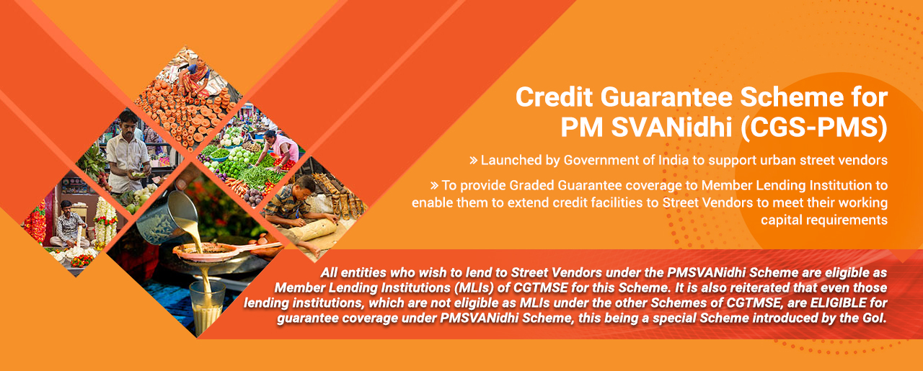

The Credit Guarantee Trust Fund for MSEs (CGTMSE).
Launched by ministry of MSME & SIDBI,
Year: 2000
Objective – To make available collateral-free credit to MSE through banks and financial institutions
STATUS: As on 31st December, 2021, cumulatively 56.03 lakh proposals have been approved for guarantee cover of Rs. 2.90 lakh crores
Notes:
Limit 2 crore

Slide 42
Coir Board Schemes
Coir Board is a statutory body established under the Coir Industry Act, 1953 for promoting the overall development of the coir industry and improvement of the living conditions of the workers engaged in this traditional industry.
Objective:
The Coir Board is tasked with promoting the overall development of the coir industry and improvement of the living conditions of the workers engaged in this traditional industry.

Slide 43
7.Coir Vikas Yojana (CVY)
The activities are in the areas of
Modernization of production processes,
Development of machinery and equipment,
(iii) Product development and diversification,
(iv) Development of environment friendly technologies, technology transfer, incubation, testing and service facilities, etc.

Slide 44
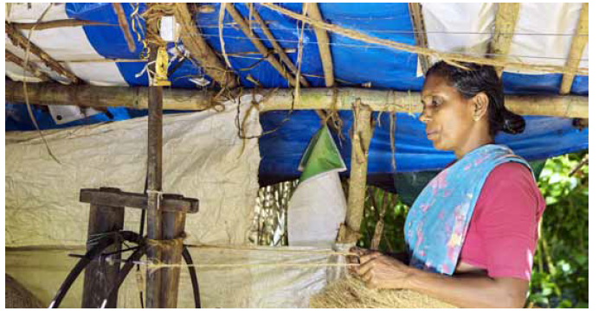
8.Mahila Coir Yojana
Mahila Coir Yojana is a women oriented, self-employment scheme being implemented by Coir Board.
The scheme envisages imparting training with stipend to women artisans on coir technology and scale up the skill of women coir workers.
The trained women artisans will be provided financial assistance for procurement of machinery/equipment under the Prime Minister’s Employment Generation Programme (PMEGP) with necessary handholding support by the Coir Board through its field offices.

Slide 45
Contd…
The financial assistance for procurement of machinery/equipment can be obtained under PMEGP scheme for setting up of new coir units for which the maximum project cost is Rs.25 Lakhs.
During the year 2020-21, the Board has imparted training to 1416 Coir units

Slide 46
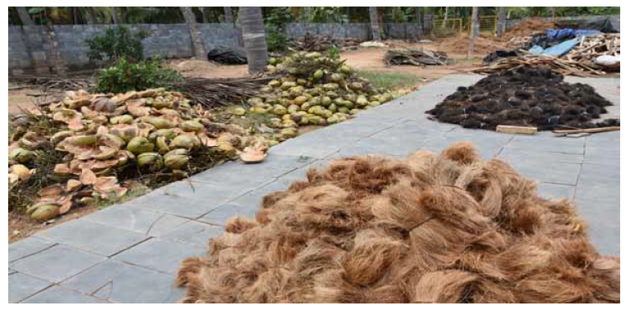
9.Coir Udyami Yojana (CUY)
This is a credit linked subsidy scheme for setting up of coir units with project cost upto Rs.10 lakhs plus one cycle of working capital, which shall not exceed 25% of the project cost.
Nature of asssistance
1.Beneficiary's contribution 5% of the project cost
2.Bank credit 55%.
3.Rate of Subsidy 40% of the project
During the year 2020-21, the Board has released an amount of Rs.173.89 lakhs fo General category to the financing banks for assisting 76 coir units

Slide 47

10.Aatma Nirbhar Bharat Abhiyan
It was launched on 12th May 2020.
The Prime Minister has announced a Rs. 20 lakh crore economic package under the ‘AatmaNirbhar Bharat Abhiyaan’, to aid our country out of the Coronavirus crisis (by making us self-reliant).

Slide 48
Contd…
Five pillars —
Economy
Infrastructure
Technology-driven system
Vibrant demography and
demand to make India Atmanirbhar (Self-reliant).
The Government boost to MSMEs is through the emphasis on using local products to boost the businesses of local manufacturers and retailers

Slide 49
Incentives Announced in Atmanirbhar Package for MSME
Government will facilitate provision of Rs. 20,000 crore subordinate debt to NPA or stressed MSMEs.
Govt. would further provide support of Rs. 4000 crore to CGTMSE who in turn will provide partial Credit guarantee support to the bank.
e-market linkage for MSMEs to be promoted to act as a replacement for trade fairs and exhibitions.

Slide 50
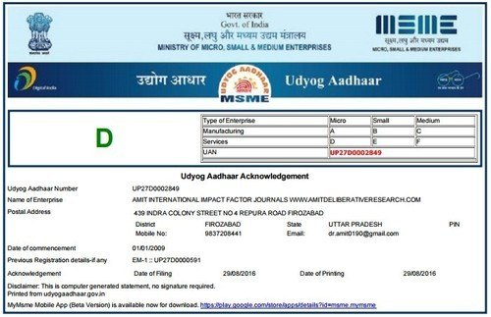
11.Udyam Registration
With effect from 1st July 2020, the process of registration of Udyog Aadhar is known as Udyam Registration.
Udyog Aadhar is a government registration provided with a recognition certificate known as Udyog Aadhar Certificate.

Slide 51
Benefits of Udyam registration
It Helps businesses to apply for numerous services which are offered by the Government
Provides identity without a fee to the concerned business as an MSME unit.
Provides a platform for resolving problems such as delay in receiving outstanding payments.
MSME’s can get subsidy/concessions in electricity bills, interest rates on bank loans, trademark registration fees, etc.

Slide 52
Udyam Registration process
Fill application form
Make online payment
Executive will call and process the application
Receive certificate through mail

Slide 53
MSME schemes for agriculture
Initiative for Development of Entrepreneurs in Agriculture (IDEA)
Marketing Research and Information Network (MRIN)
Development of Agricultural Marketing Infrastructure, Grading & Standardization.
Gramin Bhandaran Scheme.
SFAC (Small Farmers Agribusiness Consortium)

Slide 54
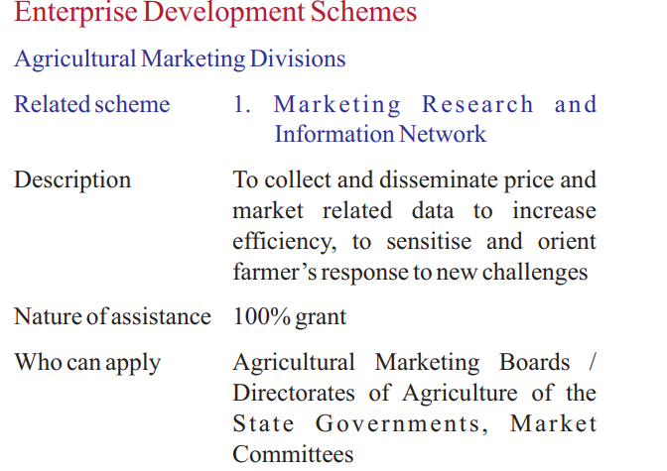
MSME schemes for Agriculture

Slide 55
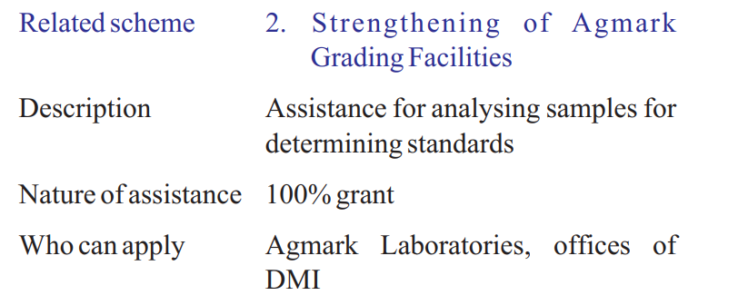

Slide 56
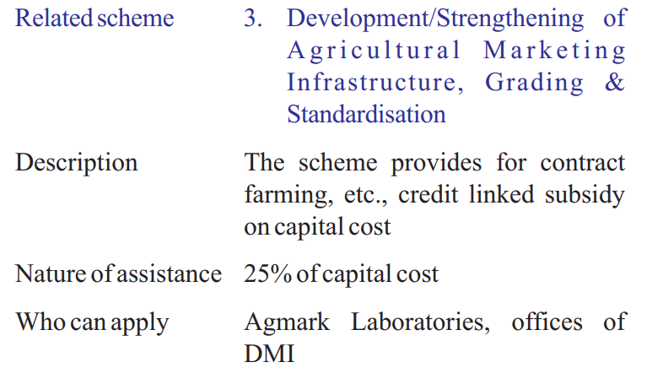

Slide 57
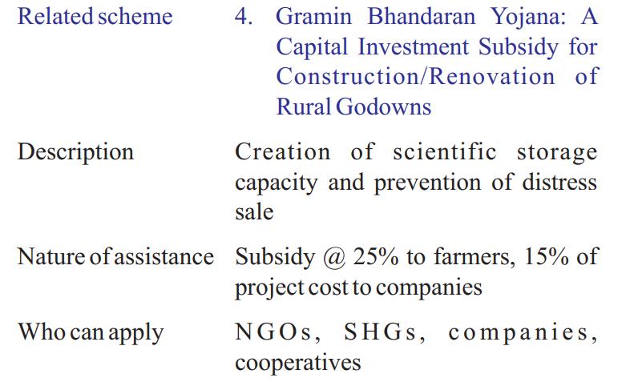

Slide 58
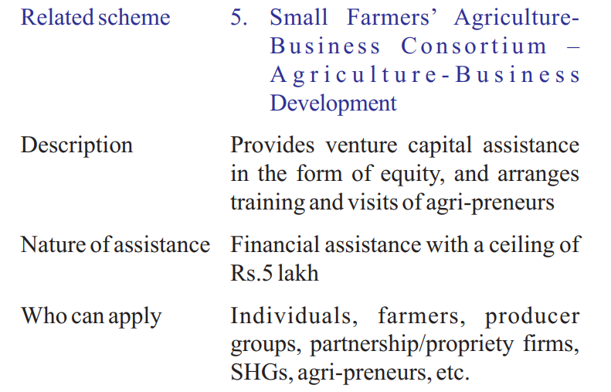

Slide 59
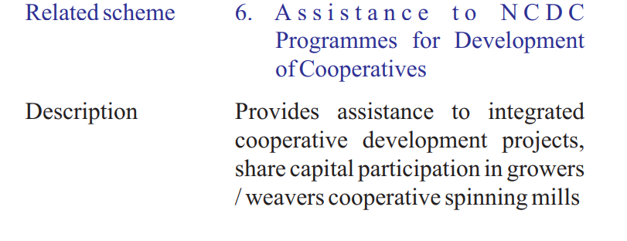

Slide 60
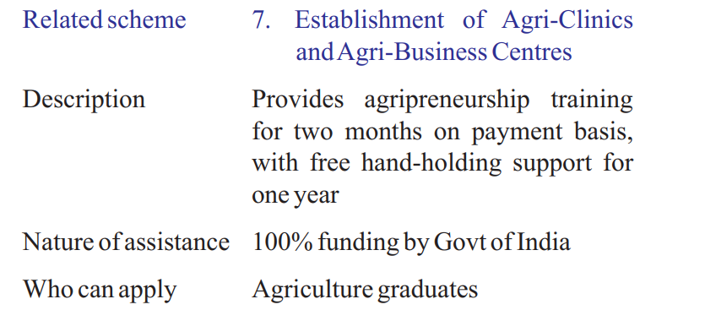

Slide 61

1.Role of MSMEs in Growth and Development of Indian Economy
Gola et al.(2019)
A Study of Meerut District in Uttar Pradesh
The primary objective of the paper is to investigate the Role of MSMEs in Growth and Development of Indian Economy
Methodology:
Research is based upon primary and secondary data.
A set of 100 Questionnaires were circulated among the MSMEs, in which 80 officials responded by the MSMEs and it was taken as the sample for this study.

Slide 62
Analysis of Employment Generation for Skilled and Unskilled Worker in Meerut
Year | Skilled worker | Year | Unskilled worker
2012-13 | 4908 | 2012-13 | 3914
2013-14 | 5643 | 2013-14 | 4639
2014-15 | 6848 | 2014-15 | 5012
2015-16 | 7217 | 2015-16 | 6381
2016-17 | 8551 | 2016-17 | 7716

Slide 63
Implication
In the last five year there has been an increasing number of skilled and unskilled labour that are being employed by SMEs, which is a positive indicator to the growth and development of SMEs sectors in India.

Slide 64
2. A Study on Start-up and its Impact on MSME in India
Patel and Shah (2021)
objective of the study was to know the start-up of entrepreneurs and their activities
Methodology:
The research design of this study is descriptive in nature. Both primary and secondary data used to study the start-up and its impact on MSME in India.
The data is gathered using a structured questionnaire, and the sample size is 100 respondents. The data were collected through convenient sampling method and samples are collected from start-up entrepreneurs. Secondary data were collected through internet, annual report, research papers.

Slide 65
Representing type of organization for start-up
Valid | Frequency | Percent
Sole Proprietary | 41 | 41
Partnership | 20 | 20
Family Business | 34 | 34
Limited liability partnership | 3 | 3
Company | 2 | 2
Total | 100 | 100

Slide 66
Implication
As per the study, majority of the entrepreneurs wants to do business through sole proprietary and family-owned organization.

Slide 67
CONCLUSION
MSME’s are boon for reducing regional imbalances and a means to utilize the natural and abundant human resources available in India.
It helps in generating employment opportunities in the rural areas with low capital, raising the real income of the people, contributing to the development of agriculture by reducing poverty, migration, economic disparity, unemployment.
Government and extension organizations should go for periodical appraisal of MSMEs development schemes and programmes in order to uplift rural areas. Innovations, infusion of new technologies, skilled manpower and availability of finances in the MSMEs can transform the lives in the rural landscape of the country.

