Slide 1

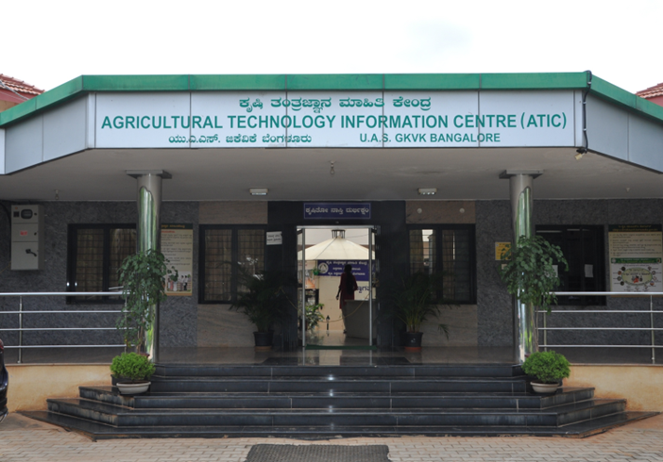
UNIVERSITY OF AGRICULTURAL SCIENCES, BANGALORE
Colloquium-II
Farmer’s Perception and Utilization of Services from Agricultural Technology Information Centre, UAS, Bangalore
Mohammed Thoufiq
PAMB 0150, Sr. M. Sc. (Agril.)
Department of Agricultural Extension, UAS, GKVK, Bengaluru

Slide 2
Suggestions given in colloquium I
Expand ATIC in the title of the study
Changes of empirical measurement of independent variable i.e., size of the land holding and annual family income
If possible, perception statements should be standardized by teacher made test method
If possible, make constraints and suggestions into one table

Slide 3
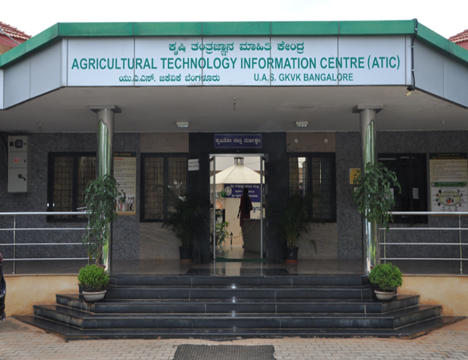
Introduction
November, 1999
In collaboration with ICAR under NATP
Advisory service
single window delivery system
Agricultural inputs
Agricultural information
Horticulture nursery
e-krishi UAS-B, portal

Slide 4
Statistics
Year-wise agricultural inputs sales, number of farmers visited for advisory services and e-krishi portal visitors of ATIC during the Last Three Years
Sl.no | Year | Agricultural Input sales Amount (Rs.) | Farmers visited for Advisory Services | Number of e-krishi portal visitors
1 | 2018-19 | 82,02,107 | 12765 | 1926936
2 | 2019-20 | 86,82,138 | 21124 | 647632
3 | 2020-21 | 94,41,162 | 33269 | 580249
Source: ATIC, UAS-B

Slide 5
Research objectives
To know the profile characteristics of beneficiary farmers of ATIC.
To study the farmer’s perception about ATIC services.
To study the extent of utilization of ATIC services by the farmers.
To study the relationship between the famers profile characteristics with perception and extent of utilization.
To document the constraints faced by farmers and suggestions to overcome them, in utilizing ATIC services.

Slide 6
Research hypothesis
There is no significant difference in farmer’s perception about ATIC services
There is no significant difference in extent of utilization of ATIC services by the farmers.
There is no significant relationship between profile characteristics of the farmers and their perception towards ATIC services.
There is no significant relationship between profile characteristics of the farmers and their extent of utilization of ATIC services.

Slide 7
Operational Definition
Perception: In the present study perception refers to interpretation or a view of farmers about the services of ATIC.
Extent of utilization of ATIC services: The frequency of use of services (agricultural inputs, advisory consultancy and e-krishi portal) by the farmers from ATIC.

Slide 8
Variables and their empirical measurement
Sl. No. | Variables | Empirical Measurement
A. | Dependent variables
1 | Perception | Schedule was developed for the study by Teacher made test
2 | Extent of Utilization of ATIC services | Procedure followed by Manisha Pandey

Slide 9
B. Independent Variables
1 | Age | Chronological age completed in years
2 | Education | Procedure followed by Ganesha (2013)
3 | Family size | Procedure followed by Chitrashree Kannur (2019)
4 | Size of land holding | Govt. of Karnataka land reforms Act 1966
5 | Annual family income | Schedule was developed
6 | Farming experience | Schedule was developed
7 | Distance from ATIC, UAS-B | Procedure followed by Dhanraj with slight modification (2010)

Slide 10
8 | Farm scientist contact | Procedure followed by Lakshminarayan (1998)
9 | No. of visits to ATIC in a year | Procedure followed by Neelam Yadava (2005)
10 | Achievement motivation | Procedure followed by Sushma (2007)
11 | Cosmopoliteness | Scale developed by Chaudhari (2006)
12 | Information seeking behaviour | Procedure followed by Chitrashree Kannur (2019)
13 | Extension participation | Procedure followed by Hiremath (2000)

Slide 11
Conceptual framework of the study
1)Age
2)Education
3)Family size
4)Size of land holding
5)Annual family income
6)Farming experience
7)Distance from ATIC, UAS-B
8)Farm scientist contact
9)No. of visits to ATIC in a year
10)Achievement motivation
11)Cosmopoliteness
12)Information seeking behaviour
13)Extension participation
Farmers perception
and
Extent of utilization of ATIC services

Slide 12
Methodology
Purposive sampling & random sampling
Ex-Post Facto design
Primary data
Samples (90)
Beneficiary farmers of ATIC services
Input buyers (30)
e-krishi portal farmers (30)
Advisory consultant farmers (30)

Slide 13
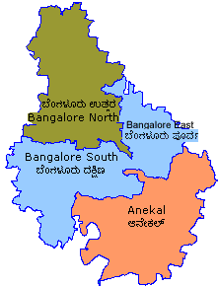
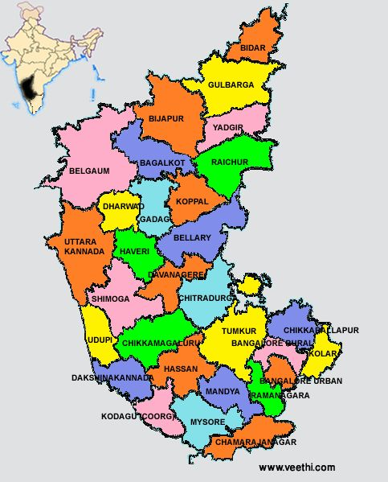
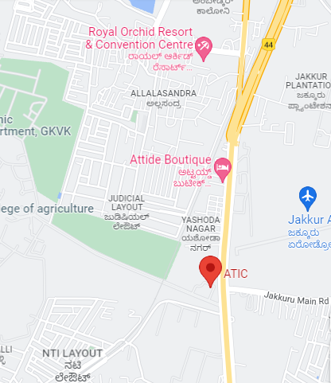
Study area: ATIC, UAS-B

Slide 14
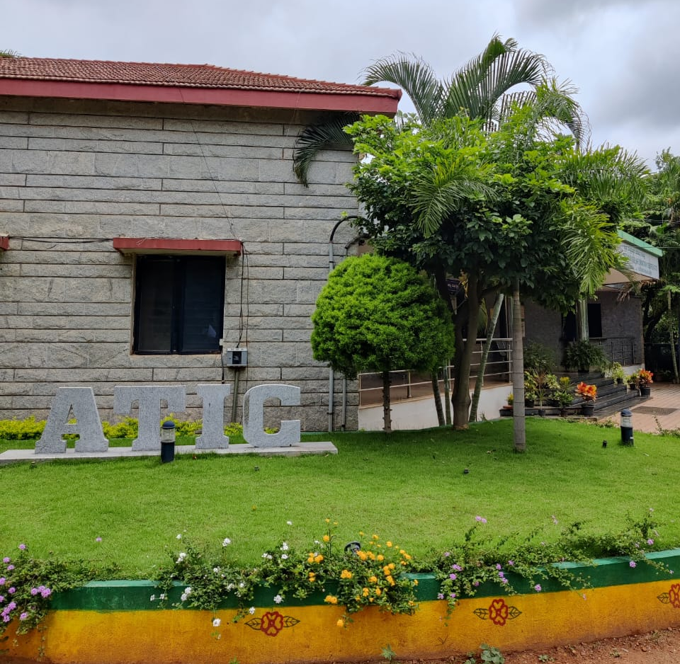
The data were collected from the farmers through personal interview method using pre-tested and well-structured schedules.

Slide 15
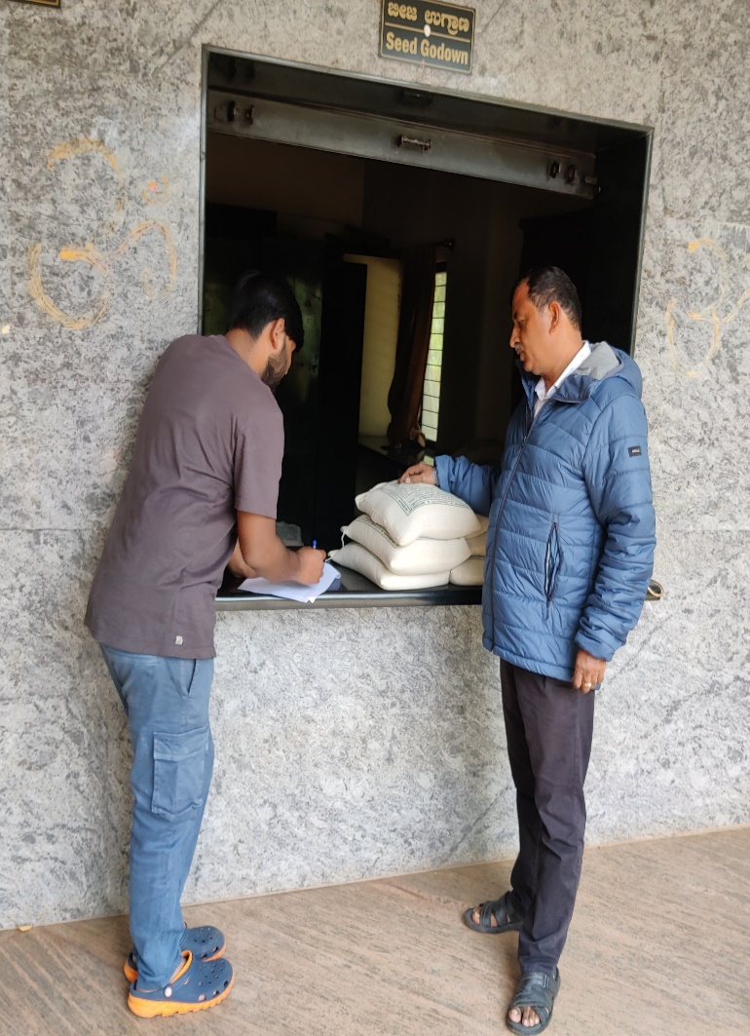
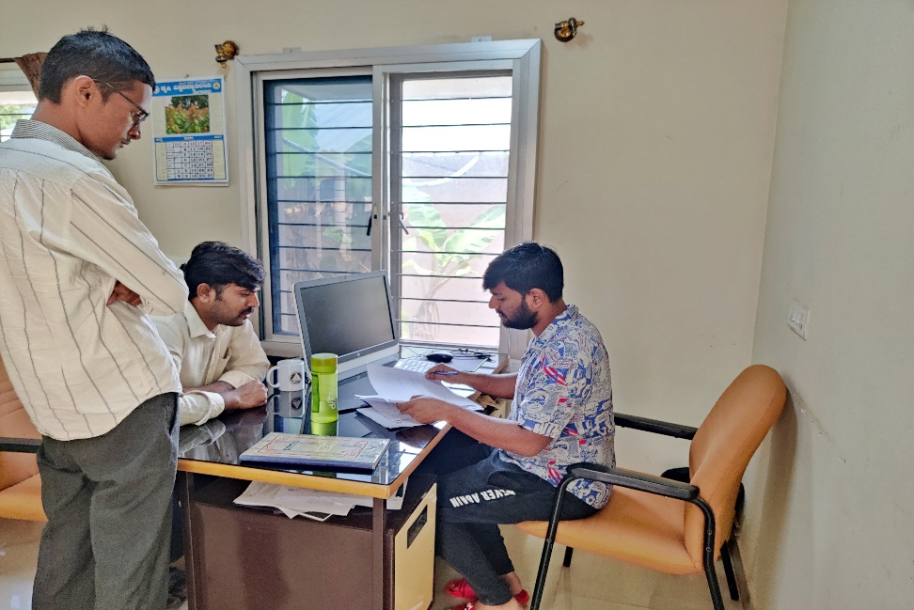
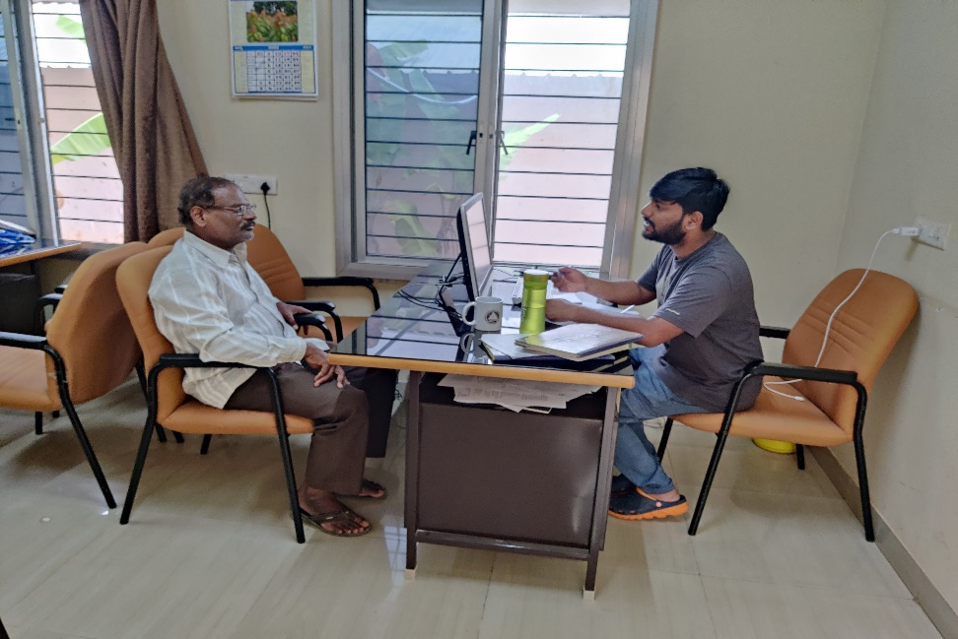
Glimpses of data collection from the farmers at ATIC, UAS, Bangalore

Slide 16
Results

Slide 17
Table 1: Profile characteristics of beneficiary farmers of ATIC services
Sl. No. | Characteristics | Category | Input | buyers (n₁=30) | Advisory consultant farmers (n₂=30) |  | e-krishi portal farmers (n₃=30) |  | Total (n=90)
 |  |  | No. | % | No. | % | No. | % | No. | %
1. | Age | Young (< 35 years) | 7 | 23.34 | 4 | 13.33 | 12 | 40.00 | 23 | 25.56
 |  | Middle (35 to 50 years) | 10 | 33.33 | 17 | 56.67 | 15 | 50.00 | 42 | 46.66
 |  | Old (>50 years) | 13 | 43.33 | 9 | 30.00 | 3 | 10.00 | 25 | 27.78

Slide 18
2. | Education | Illiterate | 0 | 0.00 | 0 | 0.00 | 0 | 0.00 | 0 | 0.00
 |  | Primary school | 1 | 3.34 | 0 | 0.00 | 0 | 0.00 | 1 | 1.12
 |  | Middle school | 0 | 0.00 | 2 | 6.67 | 0 | 0.00 | 2 | 2.22
 |  | High school | 3 | 10.00 | 9 | 30.00 | 1 | 3.33 | 13 | 14.44
 |  | PUC | 4 | 13.33 | 3 | 10.00 | 7 | 23.34 | 14 | 15.56
 |  | Graduation | 19 | 63.33 | 14 | 46.67 | 21 | 70.00 | 54 | 60.00
 |  | Post Graduate | 3 | 10.00 | 2 | 6.67 | 1 | 3.33 | 6 | 6.66

Slide 19
3. | Family size | Small (< 4 members) | 13 | 43.33 | 10 | 33.33 | 11 | 36.67 | 34 | 37.78
 |  | Medium (5-7 members) | 17 | 56.67 | 20 | 66.67 | 14 | 46.67 | 51 | 56.66
 |  | Large (>7 members) | 0 | 0.00 | 0 | 0.00 | 5 | 16.67 | 5 | 5.56
4. | Size of Land holding | Marginal farmers (<2.5 acres) | 8 | 26.67 | 10 | 33.33 | 5 | 16.67 | 23 | 25.56
 |  | Small farmers (>2.5-5.00 acres) | 5 | 16.67 | 8 | 26.67 | 10 | 33.33 | 23 | 25.56
 |  | Big farmers (>5.00 acres) | 17 | 56.67 | 12 | 40.00 | 15 | 50.00 | 44 | 48.88

Slide 20
5. | Annual family income | Low (< Rs 50000) | 5 | 16.67 | 8 | 26.67 | 8 | 26.67 | 21 | 23.34
 |  | Medium (50000-1 lakh) | 12 | 40.00 | 9 | 30.00 | 14 | 46.66 | 35 | 38.88
 |  | High (> Rs 1 lakh) | 13 | 43.33 | 13 | 43.33 | 8 | 26.67 | 34 | 37.78
6. | Farming experience | Less (< 8 years) | 8 | 26.67 | 7 | 23.33 | 10 | 33.33 | 25 | 27.78
 |  | Moderate (8 -16 years) | 3 | 10.00 | 6 | 20.00 | 9 | 30.00 | 18 | 20.00
 |  | More (>16 years) | 19 | 63.33 | 17 | 56.67 | 11 | 36.67 | 47 | 52.22

Slide 21
7 | Distance from ATIC, UAS-B | Less (< 35 km) | 12 | 40.00 | 16 | 53.33 | 5 | 16.67 | 33 | 36.67
 |  | Moderate (35 -75 km) | 9 | 30.00 | 9 | 30.00 | 8 | 26.67 | 26 | 28.88
 |  | Far (>75 km) | 9 | 30.00 | 5 | 16.67 | 17 | 56.67 | 31 | 34.45
8. | Farm scientist contact Mean = 3.86 SD =1.06 | Low (<3.33) | 5 | 16.66 | 1 | 3.34 | 14 | 46.66 | 20 | 22.22
 |  | Medium (3.33 - 4.39) | 12 | 40.00 | 11 | 36.66 | 9 | 30.00 | 32 | 35.56
 |  | High (>4.39) | 13 | 43.34 | 18 | 60.00 | 7 | 23.34 | 38 | 42.22
9. | Number of visits to ATIC in a year | Low (1 – 5 times) | 22 | 73.33 | 21 | 70.00 | 29 | 96.67 | 72 | 80.00
 |  | Medium (6 – 10 times) | 6 | 20.00 | 6 | 20.00 | 1 | 3.33 | 13 | 14.44
 |  | High (> 10 times) | 2 | 6.67 | 3 | 10.00 | 0 | 0.00 | 5 | 5.56

Slide 22
10. | Achievement Motivation Mean = 13.01 SD = 1.86 | Low (<12.07) | 7 | 23.33 | 6 | 20.00 | 9 | 30.00 | 22 | 24.45
 |  | Medium (12.07 – 13.94) | 13 | 43.33 | 15 | 50.00 | 11 | 36.66 | 39 | 43.33
 |  | High (>13.94) | 10 | 33.34 | 9 | 30.00 | 10 | 33.34 | 29 | 32.22
11. | Cosmopoliteness Mean = 14.02 SD = 1.47 | Low (<13.28) | 9 | 30.00 | 8 | 26.67 | 6 | 20.00 | 23 | 25.56
 |  | Medium (13.28 – 14.76) | 11 | 36.67 | 12 | 40.00 | 17 | 56.66 | 40 | 44.44
 |  | High (>14.76) | 10 | 33.33 | 10 | 33.33 | 7 | 23.34 | 27 | 30.00

Slide 23
12. | Information Seeking Behaviour Mean = 23.55 SD = 5.82 | Low (<20.64) | 10 | 33.33 | 8 | 26.67 | 8 | 26.67 | 26 | 28.88
 |  | Medium (20.64 – 26.47) | 11 | 36.67 | 10 | 33.33 | 12 | 40.00 | 33 | 36.67
 |  | High (>26.47) | 9 | 30.00 | 12 | 40.00 | 10 | 33.33 | 31 | 34.45
13. | Extension Participation Mean = 1.84 SD = 1.25 | Low (<1.21) | 10 | 33.33 | 6 | 20.00 | 9 | 30.00 | 25 | 27.78
 |  | Medium (1.21 - 2.47) | 13 | 43.33 | 11 | 36.67 | 11 | 36.67 | 35 | 38.89
 |  | High (>2.47) | 7 | 23.34 | 13 | 43.33 | 10 | 33.33 | 30 | 33.33

Slide 24
Table 2: Perception of farmers towards agricultural inputs at ATIC
(n=30)
Sl. No. | Statement | Farmers perception
 |  | Total score | Rank
1 | ATIC is a single window approach for the stakeholders where all the agricultural products are available under one roof | 137 | I
2 | Supply of Agricultural inputs (seeds, biofertilizer, biopesticides, micro-nutrients, planting material etc.) available at ATIC are in adequate quantity | 108 | VIII
3 | All the varieties required by the farmers are available at ATIC | 105 | IX
4 | The agricultural inputs are readily available to farmers before the planting/ sowing season | 121 | V
5 | Technical staff always provides updated information | 119 | VI

Slide 25
6 | Price of farm inputs (seeds, biofertilizer, biopesticides, micro-nutrients, planting material etc.) at ATIC are reasonable | 98 | X
7 | The agricultural inputs available at ATIC are of high quality | 133 | II
8 | The various planting material needed by farmer are always available at ATIC | 87 | XI
9 | Planting and gardening material at ATIC are reasonable in cost | 112 | VII
10 | Literature, books, publications and package of practices provided by ATIC are relevant and helpful | 128 | III
11 | Service personal/non-technical staff are cordial and famers friendly | 125 | IV

Slide 26
Table 3: Overall perception of farmers towards agricultural inputs at ATIC
(n=30)
Sl. No. | Perception category |  | Farmers
 |  |  | No. | %
1 | Poor (<40.58 score) |  | 7 | 23.34
2 | Better (40.58 - 44.34 score) |  | 14 | 46.66
3 | Good (>44.34 score) |  | 9 | 30.00
 |  | Total | 30 | 100.00
 |  | Mean |  | 42.43
 |  | Standard deviation |  | 3.77

Slide 27
Table 4: Perception of farmers towards consultancy services at ATIC
(n=30)
Sl. No. | Statements | Farmers perception
 |  | Total score | Rank
1 | ATIC is established at appropriate place in the university | 141 | I
2 | Working hours of ATIC (except public holidays) is convenient in getting required agricultural information | 132 | IV
3 | ATIC provides expert services and advice to all the category of the farmers | 139 | II
4 | Scientists at ATIC are always available for providing technical guidance at earliest possible time | 123 | V
5 | Technical guidance provided at ATIC has helped the farmers in getting increased crop productivity | 110 | VII

Slide 28
6 | ATIC scientists undertakes field visits to assist farmers in solving the technical problems of the farmers | 84 | X
7 | ATIC provides timely information to help farmers during e.g. pest attack epidemics, drought, floods, covid etc | 105 | VIII
8 | ATIC can help the farmers to solve the problems within short duration | 116 | VI
9 | The visit to ATIC has not influenced farmer to change anything in my farm | 90 | IX
10 | Visit to ATIC is worth and satisfactory | 134 | III

Slide 29
Table 5: Overall perception of farmers towards consultancy services at ATIC
(n=30)
Sl. No. | Perception category |  | Farmers
 |  |  | No. | %
1 | Poor (<37.03 score) |  | 10 | 33.33
2 | Better (37.03 - 40.90 score) |  | 8 | 26.67
3 | Good (>40.90 score) |  | 12 | 40.00
 |  | Total | 30 | 100.00
 |  | Mean |  | 39.13
 |  | Standard deviation |  | 3.89

Slide 30
Table 6: Perception of farmers towards e-krishi portal services of ATIC
(n=30)
Sl. No. | Statements | Farmers perception
 |  | Total score | Rank
1 | Latest and vital information are hosted in e-Krishi portal | 97 | XII
2 | Information provided in e-krishi portal is based on farmers need | 123 | VII
3 | Is e-krishi portal easily accessible | 121 | VIII
4 | Information in e-krishi portal is sufficient in quantity and quality | 107 | X
5 | Weather forecasting report in the portal is updated regularly | 108 | IX
6 | Information on pest and diseases management has helped the farmer to overcome with solution | 126 | VI

Slide 31
7 | e-krishi portal is acting as key agent for sharing knowledge to farmers | 139 | II
8 | e-krishi portal is helpful to all the farmers | 138 | III
9 | e-Krishi Portal is a web-based farmer help assistance | 144 | I
10 | Use of e-krishi portal is waste of time | 131 | V
11 | The information regarding crops in agri portal is updated frequently | 99 | XI
12 | Crop wise customized content of information is available in portal | 132 | IV
13 | The links of other institutions and departments can be easily assessed in the portal | 91 | XIII

Slide 32
Table 7: Overall perception of farmers towards e-krishi portal services of ATIC
(n=30)
Sl. No. | Perception category |  | Farmers
 |  |  | No. | %
1 | Poor (<52.79 score) |  | 7 | 23.34
2 | Better (52.79 - 57.27score) |  | 13 | 43.33
3 | Good (>57.27 score) |  | 10 | 33.33
 |  | Total | 30 | 100.00
 |  | Mean |  | 55.03
 |  | Standard deviation |  | 4.48

Slide 33
Table 8: Component wise utilization of agricultural inputs from ATIC by farmers
(n=30)
Sl.no | Inputs | Extent of utilization
 |  | Always (f / %) | Sometimes (f / %) | Never (f / %) | Mean Score
1 | Seeds | 15 (50.00) | 12 (40.00) | 3 (10.00) | 1.4
2 | Planting material | 15 (50.00) | 12 (40.00) | 3 (10.00) | 1.4
3 | Biofertilizer (Trichoderma, pseudomonas etc.) | 5 (16.66) | 4 (13.34) | 21 (70.00) | 0.46
4 | Micronutrient mixture | 5 (16.66) | 4 (13.34) | 21 (70.00) | 0.46
5 | Organic manure and bio pesticides | 4 (13.34) | 2 (6.66) | 24 (80.00) | 0.33
6 | Cycle weeder | 0 (0) | 2 (6.66) | 28 (93.34) | 0.06
7 | Groundnut sheller | 0 (0) | 1 (3.34) | 29 (96.66) | 0.03
8 | Coconut dehusker | 0 (0) | 1 (3.34) | 29 (96.66) | 0.03

Slide 34
9 | Mango harvester | 0 (0) | 0 (0) | 30 (100) | 0
10 | Sapota harvester | 0 (0) | 0 (0) | 30 (100) | 0
11 | Agricultural Technologies (CD’s, DVD’s, etc.) | 0 (0) | 0 (0) | 30 (100) | 0
12 | Vegetable/flower seed | 4 (13.34) | 12 (40.00) | 14 (46.66) | 0.66
13 | Gardening tools | 4 (13.33) | 16 (53.34) | 10 (33.33) | 0.8
14 | Package of practices | 0 (0) | 4 (13.34) | 26 (86.66) | 0.13
15 | Other books | 0 (0) | 4 (13.34) | 26 (86.66) | 0.13

Slide 35
Table 9: Overall utilization of agricultural inputs from ATIC by farmers
(n=30)
Sl. No. | Extent of Utilization |  | Farmers
 |  |  | No. | %
1 | Low (<3.90) |  | 9 | 30.00
2 | Medium (3.90 – 7.95) |  | 13 | 43.34
3 | High (>7.95) |  | 8 | 26.66
 |  | Total | 30 | 100.00
 |  | Mean |  | 5.93
 |  | Standard deviation |  | 4.05

Slide 36
Table 10: Component wise utilization of consultancy services by farmers from ATIC
(n=30)
Sl.no | Advisory services | Extent of Utilization
 |  | Always (f / %) | Sometimes (f / %) | Never (f / %) | Mean Score
1 | Personal consultancy | 12 (40.00) | 18 (60.00) | 0 (0) | 1.4
2 | Phone calls | 2 (6.66) | 12 (40.00) | 16 (53.34) | 0.53
3 | WhatsApp messages | 0 (0) | 3 (10.00) | 27 (90.00) | 0.1
4 | Problematic Field visits | 0 (0) | 0 (0) | 30 (100) | 0
5 | Newspaper (Raita Mithra column in Vijaya Vani) | 7 (23.33) | 13 (43.34) | 10 (33.33) | 0.9

Slide 37
Table 11: Overall utilization of consultancy services by farmers from ATIC
(n=30)
Sl. No. | Extent of Utilization |  | Farmers
 |  |  | No. | %
1 | Low (<2.22) |  | 12 | 40.00
2 | Medium (2.22 – 3.63) |  | 8 | 26.67
3 | High (>3.63) |  | 10 | 33.33
 |  | Total | 30 | 100.00
 |  | Mean |  | 2.93
 |  | Standard deviation |  | 1.41

Slide 38
Table 12: Component wise utilization of e-krishi portal services of ATIC by farmers
(n=30)
Sl.No | Portal Content | Extent of Utilization
 |  | Always (f / %) | sometimes (f / %) | Never (f / %) | Mean Score
1 | Agriculture | 4 (13.33) | 26 (86.66) | 0 (0) | 1.13
2 | Horticulture | 10 (33.33) | 14 (46.66) | 6 (20.00) | 1.13
3 | Sericulture | 2 (6.66) | 8 (26.66) | 20 (66.66) | 0.4
4 | Animal Husbandary | 2 (6.66) | 4 (13.33) | 24 (80.00) | 0.26
5 | Fishery | 0 (0) | 8 (26.66) | 22 (73.33) | 0.26
6 | Farm Mechanization | 0 (0) | 4 (13.33) | 26 (86.66) | 0.13
7 | Supplementary Topics | 0 (0) | 18 (60) | 12 (40.00) | 0.6
8 | Weather Report | 0 (0) | 4 (13.33) | 26 (86.66) | 0.13
9 | Krishi News | 0 (0) | 4 (13.33) | 26 (86.66) | 0.13
10 | E-krishi books | 0 (0) | 2 (6.66) | 28 (93.33) | 0.06

Slide 39
Table 13: Overall utilization of e-krishi portal services of ATIC by farmers
(n=30)
Sl. No. | Extent of Utilization |  | Farmers
 |  |  | No. | %
1 | Low (<3.16) |  | 14 | 46.67
2 | Medium (3.16 – 5.37) |  | 6 | 20.00
3 | High (>5.37) |  | 10 | 33.33
 |  | Total | 30 | 100.00
 |  | Mean |  | 4.26
 |  | Standard deviation |  | 2.21

Slide 40
Table 14: Relationship between profile characteristics of Input buyers, advisory consultant and e-krishi portal respondents with their Perception towards ATIC services
Sl. No. | Characteristics | Correlation Coefficient (r)
 |  | input buyers (n₁=30) | Advisory consultant farmers (n₂=30) | e-krishi portal farmers (n₃=30)
1 | Age | 0.061^{NS} | 0.050^{NS} | 0.354*
2 | Education | 0.371* | 0.382* | 0.481**
3 | Family size | -0.048^{NS} | -0.216^{NS} | -0.75^{NS}
4 | Size of land holding | 0.378* | 0.423* | 0.282^{NS}
5 | Annual family income | 0.685** | 0.408* | 0.131^{NS}
6 | Farming experience | 0.690** | 0.397* | 0.212^{NS}
7 | Distance from ATIC, UAS-B | 0.412* | 0.365* | 0.145^{NS}
8 | Farm scientist contact | 0.666** | 0.432* | 0.185^{NS}
9 | No. of visits to ATIC in a year | 0.272^{NS} | 0.272^{NS} | 0.049^{NS}
10 | Achievement motivation | 0.401* | 0.484** | 0.785**
11 | Cosmopoliteness | 0.211^{NS} | 0.374* | 0.438*
12 | Information seeking behaviour | 0.446* | 0.731** | 0.872**
13 | Extension participation | 0.384* | 0.688** | 0.412*

Slide 41
Table 15: Relationship between profile characteristics of Input buyers, advisory consultant and e-krishi portal respondents with their extent of utilization of ATIC services
Sl. No. | Characteristics | Correlation Coefficient (r)
 |  | Input buyers (n₁=30) | Advisory consultant farmers (n₂=30) | e-krishi portal farmers (n₃=30)
1 | Age | -1.88^{NS} | 0.035^{NS} | 0.359*
2 | Education | 0.662** | 0.389* | 0.472**
3 | Family size | -0.43^{NS} | -0.168^{NS} | -0.041^{NS}
4 | Size of land holding | 0.554** | 0.594** | 0.287^{NS}
5 | Annual family income | 0.411* | 0.458** | 0.137^{NS}
6 | Farming experience | 0.167^{NS} | 0.362* | 0.262^{NS}
7 | Distance from ATIC, UAS-B | 0.351* | 0.428* | 0.191^{NS}
8 | Farm scientist contact | 0.562** | 0.516** | 0.275^{NS}
9 | No. of visits to ATIC in a year | 0.028^{NS} | 0.082^{NS} | 0.018^{NS}
10 | Achievement motivation | 0.253^{NS} | 0.153^{NS} | 0.438*
11 | Cosmopoliteness | 0.049^{NS} | 0.219^{NS} | 0.367*
12 | Information seeking behaviour | 0.535** | 0.415* | 0.454**
13 | Extension participation | 0.888** | 0.436* | 0.414*

Slide 42
Table 16: Constraints faced by farmers in utilizing Services from ATIC
SL. No | Problems* | Farmers
 |  | No. | % | Rank
Input buyers (n₁=30)
1 | No provision for digital payments at ATIC | 21 | 70.00 | I
2 | Non availability of required packet size seeds | 7 | 23.33 | IV
3 | Non availability of Agricultural inputs (seeds, biofertilizer, biopesticides, micro-nutrients, planting material etc.) at required time | 5 | 16.66 | V
4 | Non availability of Agricultural inputs (seeds, biofertilizer, biopesticides, micro-nutrients, planting material etc.) at adequate quantity | 3 | 10.00 | VII
5 | Low quality of seeds | 1 | 3.00 | VIII
6 | High cost of agricultural inputs | 16 | 53.33 | II
7 | Problem in getting seeds/planting material of needed variety | 8 | 26.66 | III
8 | Non availability of required publication, POP’s, books etc. | 4 | 13.33 | VI

Slide 43
b) Consultancy service (n₂=30)
1 | Poor technical guidance and support by scientists at ATIC | 2 | 6.66 | III
2 | Non availability of subject matter specialist at the time of visit to ATIC | 6 | 20.00 | I
3 | Improper manage of WhatsApp and phone call (helpline) services | 3 | 10.00 | II
c) e-krishi portal (n₃=30)
1 | Difficult to access the portal | 4 | 13.33 | IV
2 | Lack of latest information in the portal | 20 | 66.66 | I
3 | Poor quality of photos and videos | 2 | 6.66 | V
4 | Web irresponsive/hang issues | 11 | 36.66 | II
5 | Login problem | 9 | 30.00 | III

Slide 44
Table 17: Suggestions of farmers for effective utilization of ATIC services
Sl. No | Suggestions* |  | Farmer | s
 |  | No. | % | Rank
Input buyers (n₁=30)
1 | Digital payment should be made available | 23 | 76.66 | I
2 | Required size of package of seeds should be made available | 7 | 23.33 | IV
3 | Agricultural inputs (seeds, biofertilizer, biopesticides, micro-nutrients, planting material etc.) at required time should be available | 5 | 16.66 | V
4 | Agricultural inputs (seeds, biofertilizer, biopesticides, micro-nutrients, planting material etc.) at adequate quantity should be available | 3 | 10.00 | VII
5 | Seed quality should be improved | 1 | 3.00 | VIII
6 | Agricultural inputs should be provided at reasonable rate | 16 | 53.33 | II
7 | Needful and improved variety of seeds/planting material should be made available at ATIC | 8 | 26.66 | III
8 | Required publication, POP’s, books etc. should be made available | 4 | 13.33 | VI

Slide 45
b) Consultancy service (n₂=30)
1 | Visit of scientists to the farmers field should be more | 17 | 56.66 | I
2 | WhatsApp and phone call (helpline) service should be managed properly | 3 | 10.00 | II
3 | Quality of technical guidance and support by scientists should be provided at ATIC | 2 | 6.66 | III
c) e-krishi portal (n₃=30)
1 | Latest information in the portal should be updated frequently | 22 | 73.33 | I
2 | High quality of photos and videos should be included in the portal | 4 | 13.33 | V
3 | Web irresponsive/hang issues should be solved | 13 | 43.33 | III
4 | Login problem should be rectified | 9 | 30.00 | IV
5 | A wide publicity of portal should be done | 18 | 60.00 | II

Slide 46
Implications
Majority of the beneficiary farmers belonged to better perception category which means that majority of the beneficiary farmers still do not have good perception regarding the services of ATIC. It indicates that there is a scope to expand more approaches for increasing the perception level of farmers. Further, services and activities of Agricultural Technology Information Centre have to be strengthened.
The study indicated that, majority of the beneficiaries of ATIC were belongs to low and medium level category of utilization of services. Hence, the centre may focus on organizing more number of awareness programmes on the availability of agricultural inputs and advisory consultancy services of ATIC.

Slide 47
Implications
3. As majority of the beneficiaries suggested that there is a need for wide publicity of UAS-B, e-krishi portal. Therefore, the centre can strengthen the links with other line departments so that more number of farmers can be reached.
4. Beneficiary farmers faced major constraints such as no provision for digital payments at ATIC, high cost of agricultural inputs, lack of latest information in the portal and Web irresponsive/hang issues of e-krishi portal. Hence, ATIC should consider these major constraints and efforts should be made to overcome these constraints.

Slide 48
Future line of work
The present study was conducted on limited sample, so it can be conducted covering large sample to understand the farmers views about ATIC along with variables related to ATIC
Comparative study of ATICs of different locations can be conducted
An intensive study to find out the impact of the single window extension approach on farming community can also be conducted

Slide 49



Thank you all
Your suggestions, Please

