Slide 1
Online Data collection and Interpretation
Dr. Ganesamoorthi, S.
Associate Professor of Agril. Extension,
College of Agriculture, GKVK, Bengaluru
aex201@gmail.com 9731876687
www.uasbangalore.edu.in

Slide 2

Contents
Introduction
Meaning of E-Data collection
Method/Types of Online-Data collection
Advantages
Disadvantages
Researchers used E-data
Articles
Research papers
Conclusion
Reference

Slide 3
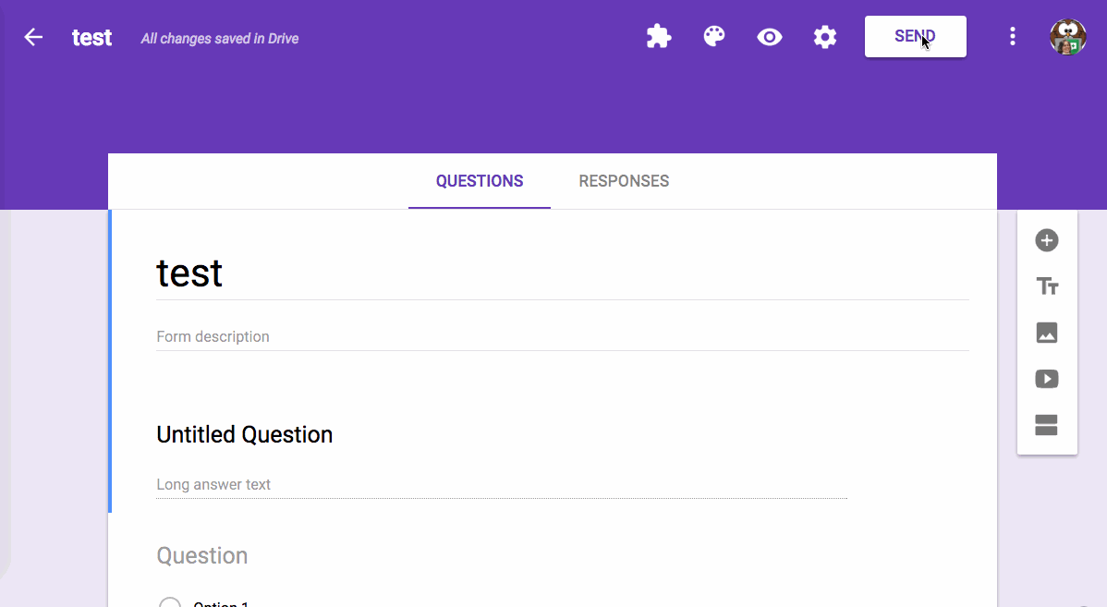
Introduction
What is Online Data collection?

Slide 4
What is Data?
Facts and statistics collected together for reference or analysis.
The quantities, characters, or symbols on which operations are performed by a computer, which may be stored and transmitted in the form of electrical signals & recorded on magnetic, mechanical recording media.
Data can be defined as the qualitative or quantitative value of a variable.
(Number, Images, Words, Figures,Facts)

Slide 5
It is the lowest unit of information from which other measurements and analysis can be done.
Collection of Data is a critical part of social and behavioral research.
Types of Data Collection
1.Offline Data collection
2.Online Data collection

Slide 6
Definition and Meaning
With the development of technologies, data collection method also changing according to development.
E-Data collection is a kind of collection of Data through Electronic devices and Internet.
With emergence of Electronic Gadgets and using them in research for collection of data ,the word
E-Data came in to existence.
E-Data collection is the process of gathering
information on variables of interest through
Electronic gadgets and software's.

Slide 7

Advantages
Low cost
Quick Response time
Convenience of time
Better respondent engagement
Extensive Research
Accuracy in data entry
Authentic data sources
Increases sample size
Easier Access & Convenience
No Interviewer

Slide 8
Disadvantages
Skewed Sample
Representativeness & authenticity
Significant cues
Malicious responses
Design problem
Technical problems
Power & internet Net instabilities

Slide 9
ELECTRONIC/ONLINE DATA
COLLECTION METHODS
Online Data collection can take on many forms ranging from mobiles,
computer to internet surveys.
Online data collection methods allow for the collection of much of the same information collected via paper based
surveys

Slide 10
Other benefits of collecting
data over Paper based
surveys
1.Photographs /Videos
2.GIS&GPS

Slide 11
Methods/Modes of E-Data
Collection
1.Computer administered survey (CASIC)
Computer-assisted survey information collection (CASIC) refers to a variety of survey modes that were enabled by the introduction of computer technology.
Computer administered surveys represented
the real first use of computers in collecting
survey data.
When using a computer administered survey, a program is written to administer the questions and to collect the answer as it is chosen by the respondent through online/offline.

Slide 12
The survey may be administered in several ways
By gathering a group of people in a
location to answer the questions at the
computer.
The survey may be installed on the
organization’s network
3. The program may be saved on disk so
that each individual can just open a
survey on their desktop and then return
the disc
(Booth Kewley, Rosenfeld, and Edwards1993)

Slide 13

CATI (Computer-assisted telephone
interviewing)
It is the initial CASIC mode where a
remotely present interviewer calls
respondents by phone and enters the answers into a computerized
questionnaire.

Slide 14
CATI function in the following manner:
A computerized questionnaire is
administered to respondents over the
telephone.
The interviewer sits in front of a computer screen.
Upon command, the computer dials the
telephone number to be called.
When contact is made, the interviewer read the questions posed on the computer
screen and records the respondent's answer
directly into the computer.

Slide 15
Intermediate and update reports can be compiled instantaneously, as the data are being collected.
CATI software has built-in logic, which also
enhances data accuracy.
The software has built-in branching logic, which will skip questions that are not applicable or will probe for more detail when warranted.
Automated dialers are usually deployed to lower the waiting time for the interviewer, as well as to record the interview for quality purposes.

Slide 16
2.Computer-assisted personal interviewing
(CAPI)
IT was enabled by the introduction of
portable computers where a physically
present interviewer brings the computer with the questionnaire to the respondent
and enters the answers into it.

Slide 17
Characteristics of this interviewing technique are
Either the respondent or an interviewer operates a
device (this could be a laptop, a tablet or a smartphone)
and answers a questionnaire.
The questionnaire is an application that takes the
respondent through a set of questions using a
pre-designed route based on answers given by the
respondent.
Help screens and error messages are provided.
Colorful screens and on and off-screen stimuli can add
to the respondent's interest and involvement in the task.

Slide 18
Advantages
The face-to-face setting allows the interviewer to capture verbal and non-verbal feedback.
Modern devices can record audio feedback from
respondent.
Track GPS location and allows pictures to be taken of the interview, thus adding to the quality of the data.
The presence of an interviewer helps when probing for spontaneous awareness of certain topics.
The interviewer can verify that the respondent answering the questions is the person that needs to be interviewed.

Slide 19
Disadvantages
It is a relatively expensive means of interviewing.
In comparison to web interviewing it can be more time consuming to gather data

Slide 20
3.Computer-Assisted Self Interviewing (CASI)
Interviewer Is absent
There are two kinds of computer-assisted self interviewing: a "video-CASI" and an "audio-CASI".
Both types of computer-assisted self interviewing might have a big advantage over personal
interviewing, because subjects could be more
inclined to answer sensitive questions. The reason for this is that they feel that a CASI is more private due to the absence of an interviewer.

Slide 21
Audio-CASI
It allows researcher to enter their questions,
without the respondent being able to see. Here, the respondent listens to the questions being asked through headphones, rather than reading them on screen. This is the most “private” mode and is used in surveys that contain questions of a more sensitive nature.
EX-Watsapp voice message, Audio messages

Slide 22
Advantages
There is no need to recruit or pay interviewers.
Respondents are able to fill in the questionnaires themselves.
The program can be placed on a web site,
potentially attracting a worldwide audience

Slide 23
Disadvantages
The survey is likely to attract only respondents who are "computer savvy", thus introducing
potential bias to the survey.
The survey can miss feedback and clarification/
quality control that a personal interviewer could
provide.

Slide 24
Video-CASI
It is similar to CATI but the communication between a remotely present interviewer and the
respondent is established via video chat.
Video Banking/Shopping orders

Slide 25
4.Disc by mail
It includes a floppy or optical disk
that is sent to the respondent.
The interviewer is not present.

Slide 26
5.Touch Tone Data Entry
It means that the respondent enters the
answers by the appropriate numeric keys on a
telephone handset or device
The interviewer is not present.

Slide 27
6.Interactive voice response
(IVR)
It includes a wide range of approaches for voice
communication with a computer using the phone. Modern speech recognition enabled IVR systems
allow the respondent to provide complex answers
through the telephone that are automatically
recorded as text.
The interviewer is not present.

Slide 28
7.Internet Surveys
It include a variety of survey modes (e.g. mail,
web) where the most widely used are web survey.
The interviewer is not present.

Slide 29
8.Virtual Interview survey
These are usually carried out via the Internet
where some kind of virtual interviewer
  (SBI-Ask Ila)
introduces the questions to the respondent
Future technological developments will enable increased virtualization and interviewers will probably become completely computerized virtual characters.
The interviewer is not present.

Slide 30
9. Computer-assisted web interviewing
Computer-assisted web interviewing (CAWI) is an Internet surveying technique in which the interviewee follows a script provided in a website.
  Investigations / Trials
The questionnaires are made in a program for
creating web interviews. The program allows for the
questionnaire to contain pictures, audio and video
clips, links to different web pages, etc.
The website is able to customize the flow of the
questionnaire based on the answers provided, as well
as information already known about the participant.
It is considered to be a cheaper way of surveying
since one doesn't need to use people to hold surveys

Slide 31
TRADITIONAL DATA COLLECTION METHODS
Vs
E DATA/ONLINE COLLECTION METHODS
S.NO | TRADITIONAL METHOD | ONLINE METHOD
1 | Researcher should have basic field experience | Field experience is not needed but requires computer knowledge
2 | Only basic infrastructure is needed to store finished and unfinished surveys. | The infrastructure must be in place to charge the devices, backup and upload the data, and restore the software on all devices.
3 | Presence of interviewer is must | It is not needed
4 | Rate of response is low | Rate of response is high
5 | chances of errors are more | Error free data collection method
6 | Expensive method and it consumes lot of time | Cost effective and it saves time

Slide 32
7 | Lesser sample diversity | Greater sample diversity
8 | Analysis of data requires more time and data entry is manual | Quick analysis of data Data entry is digitalized
9 | Difficult to access | Easy to access provided there is internet connection
10 | No technical problems | Technical problems like power failures
11 | The respondent is required to answer the questions immediately | The respondent can provide information or data for the researcher at his own time and convenience
12 | Simplest method of data collection where it is done in offline mode | Complex in nature as it is online
13 | Immediate rate of return of duly filled questionnaie | Low rate of return of the duly filled questionnaires.
14 | It is commonly used for iliterates | It is used for literates like scientists, extn personnel, academicians etc

Slide 33
Latest Online Software
These can be Grouped into 2
types:-
1.Paid
2.Free,open source

Slide 34

GOOGLE FORMS
Simple way to collect information Conduct surveys
Perform quick assessments
Can be shared with a link or via email
Responses can be viewed immediately with the option to save them to a spread sheet or Google sheet
Google Drive is a free, web - based data storage service offered by Google. It allows users to create online documents and edit them collaboratively. As well as word processing, spreadsheets and presentation .

Slide 35
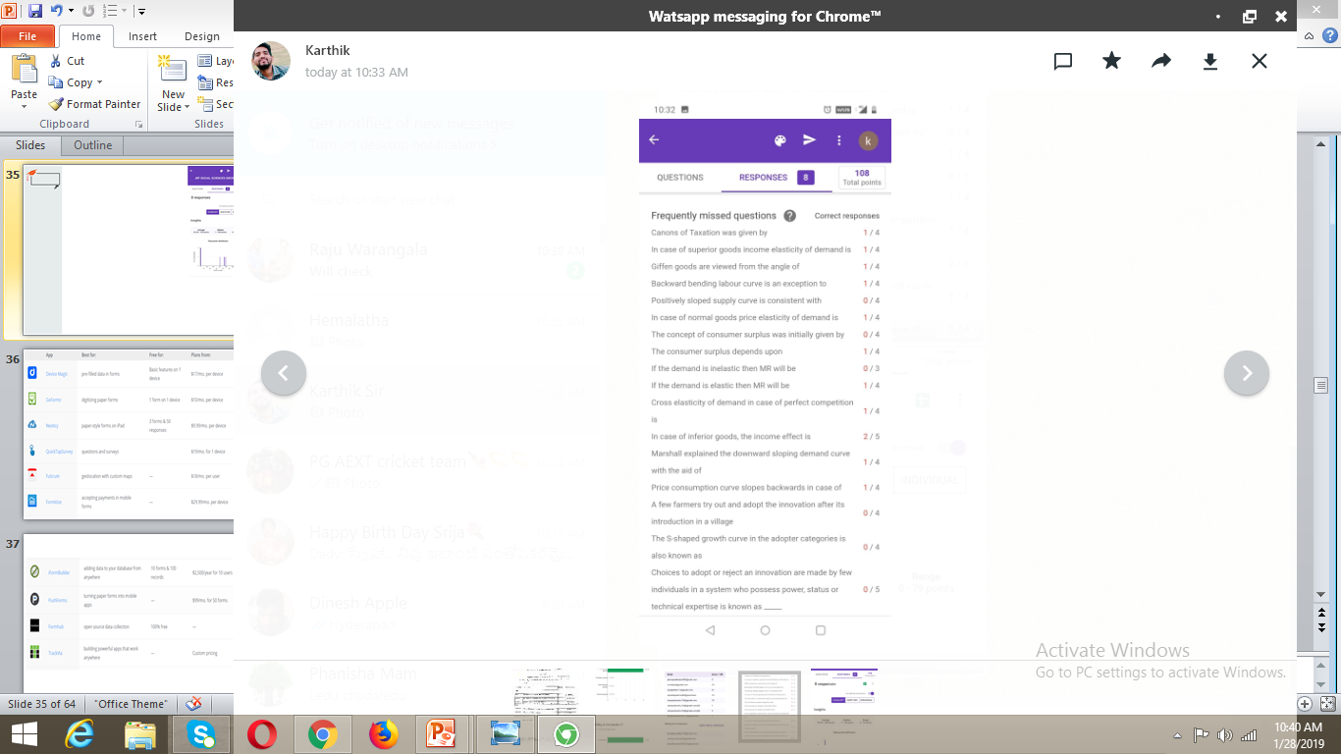
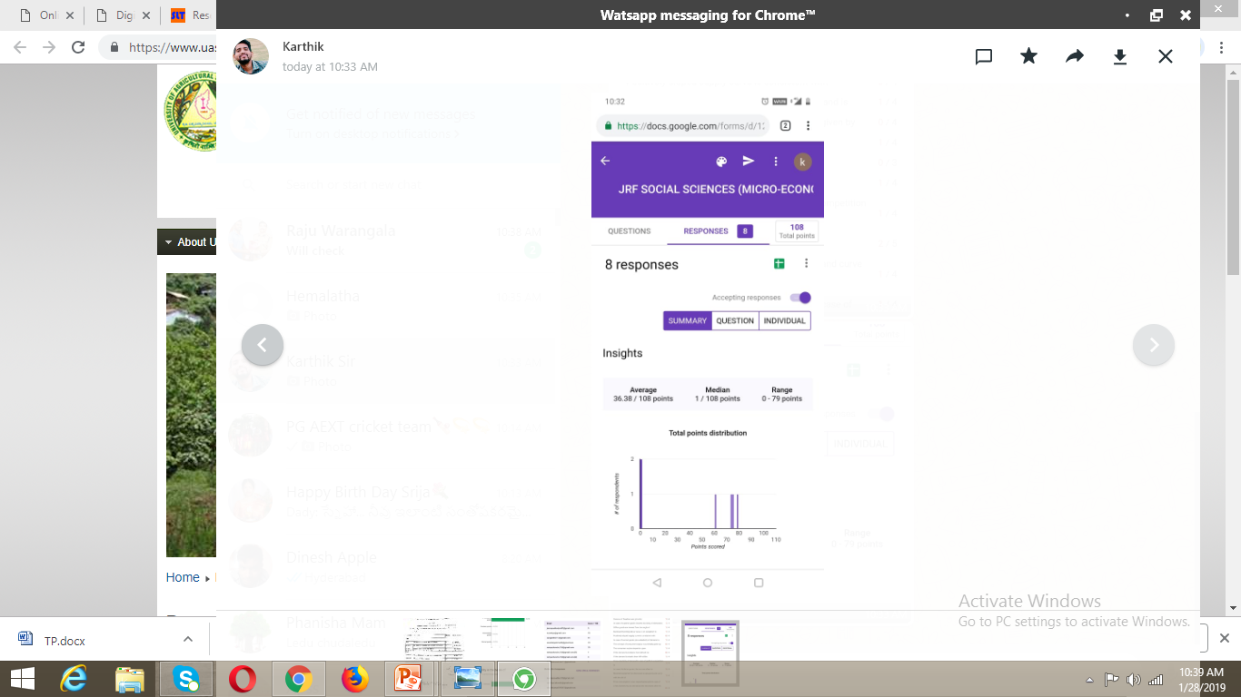

Slide 36
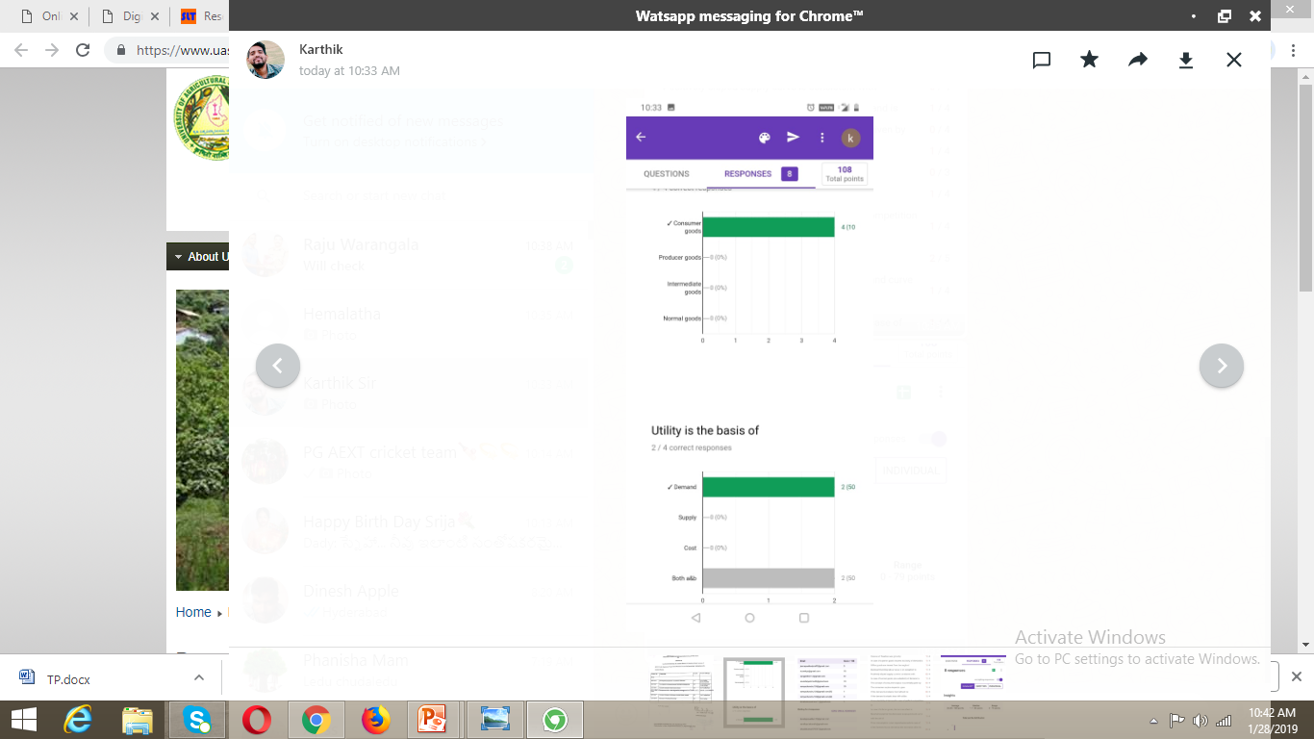
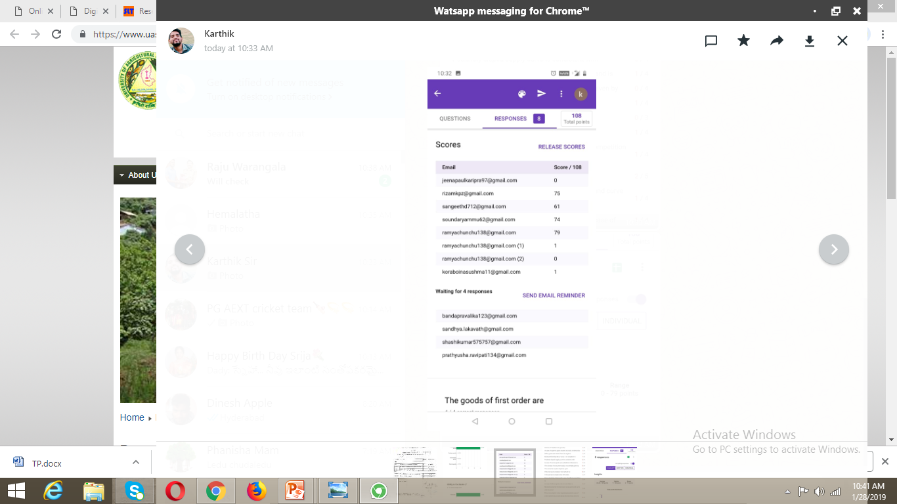

Slide 37
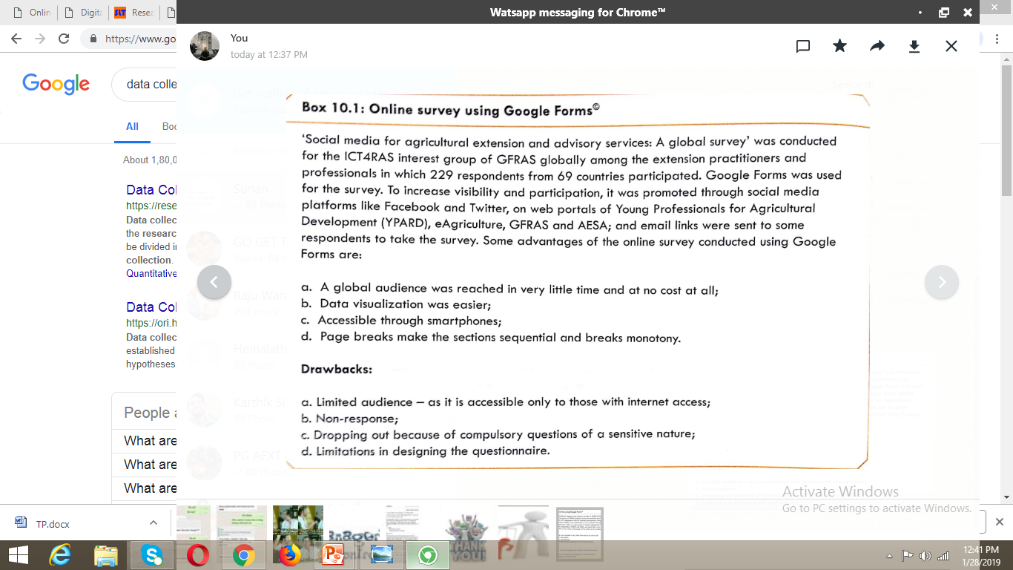

Slide 38
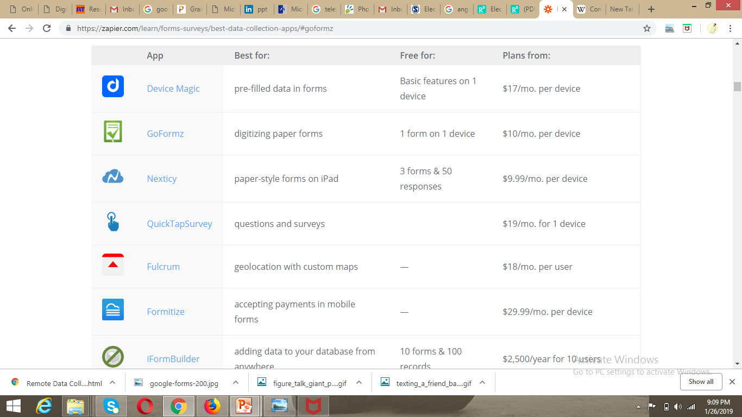

Slide 39
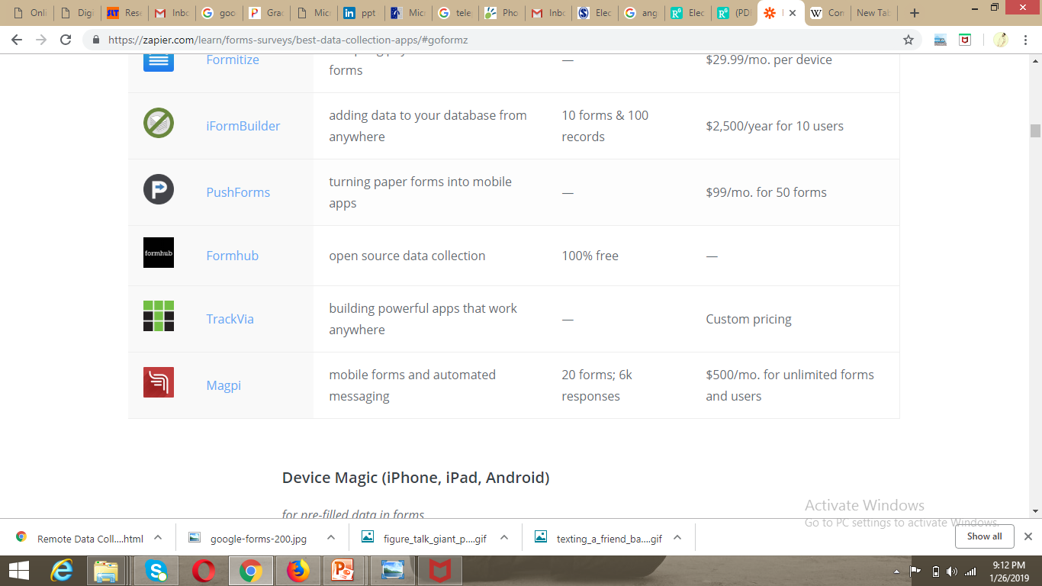

Slide 40
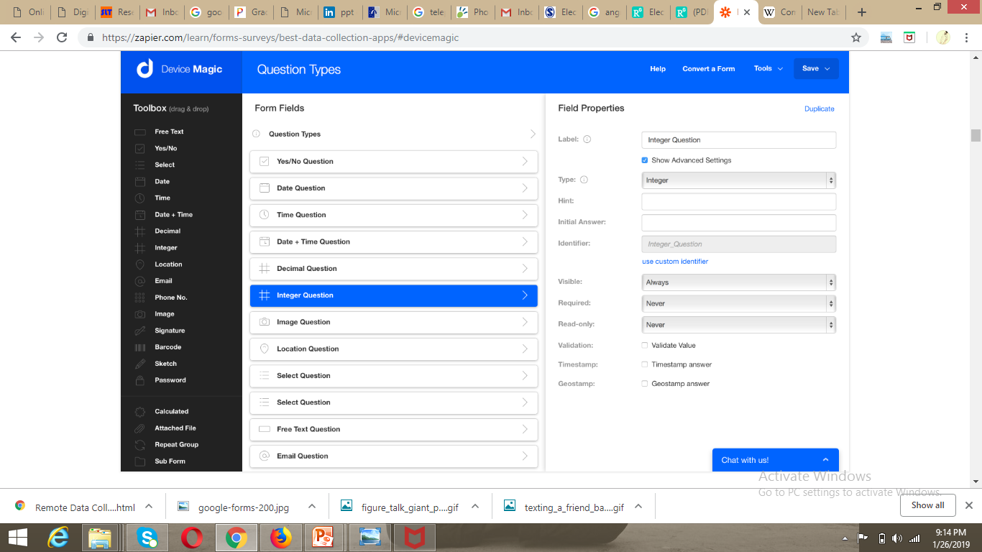

Slide 41
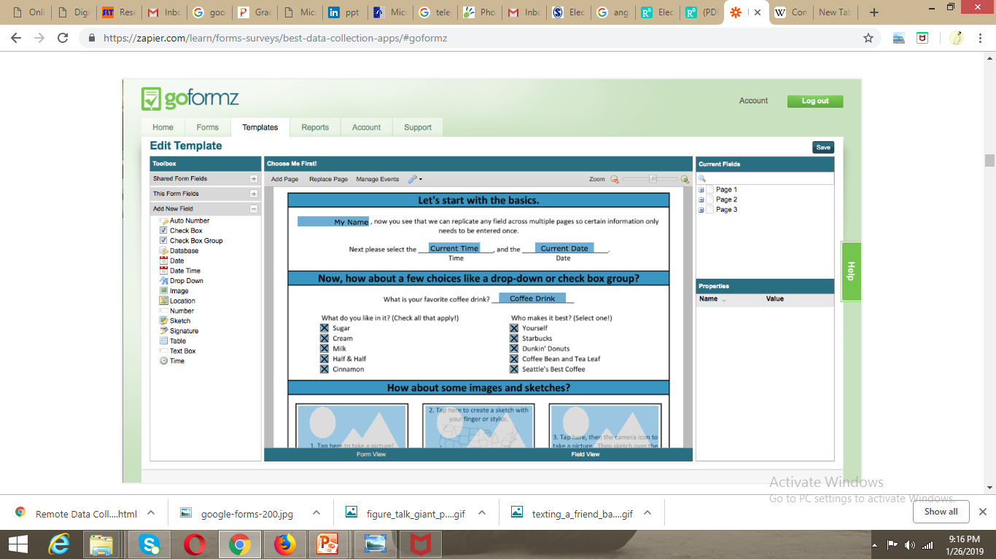

Slide 42
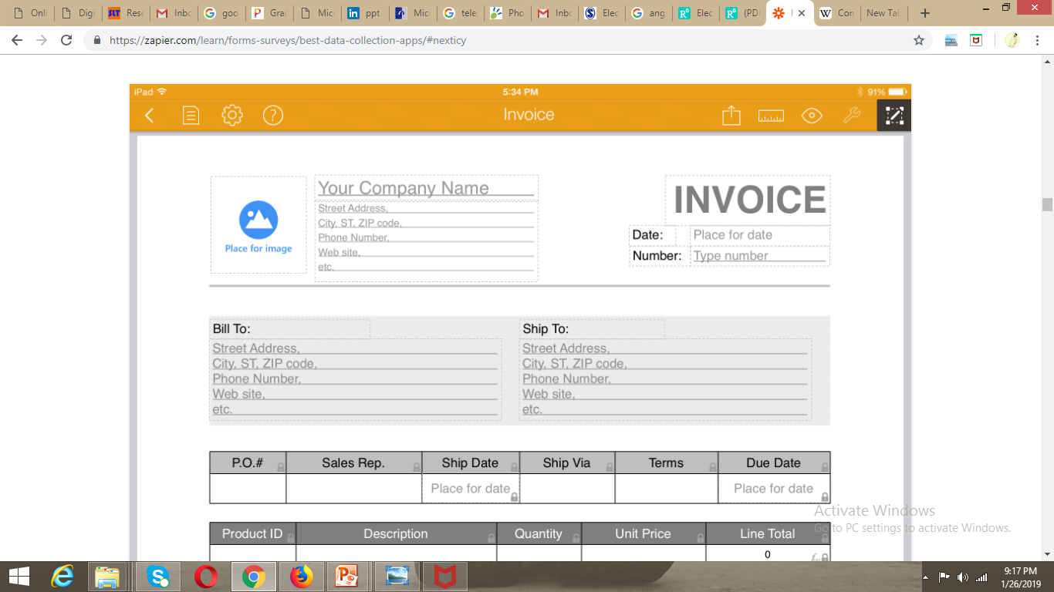

Slide 43
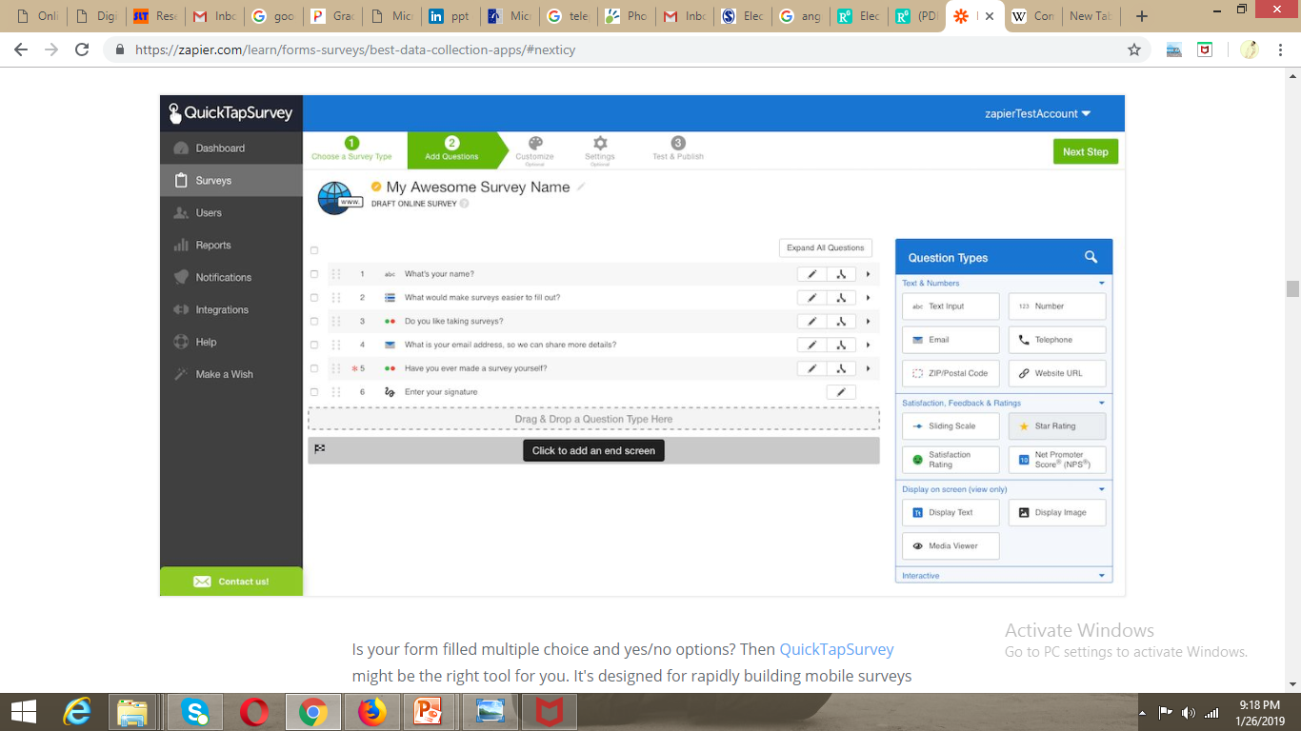

Slide 44
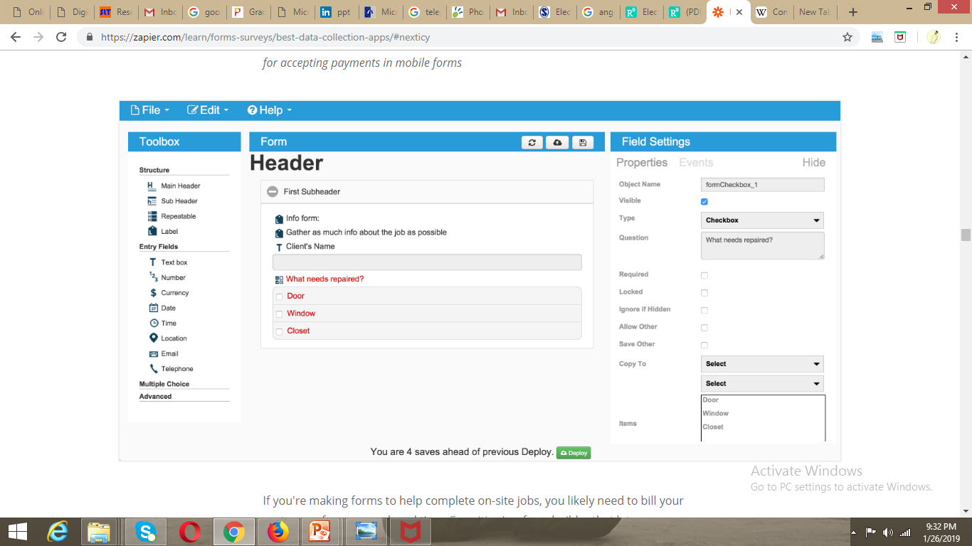

Slide 45
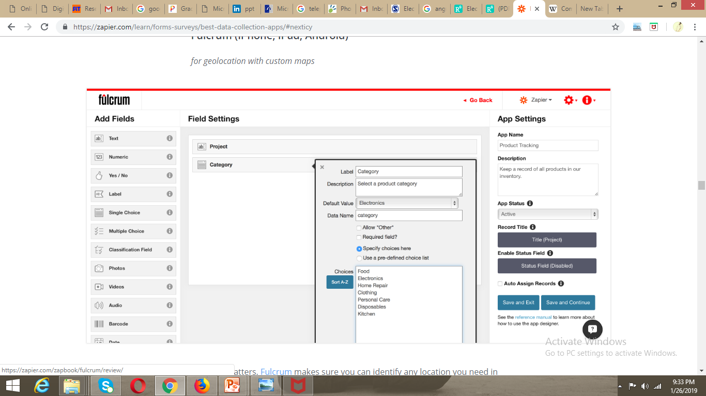

Slide 46
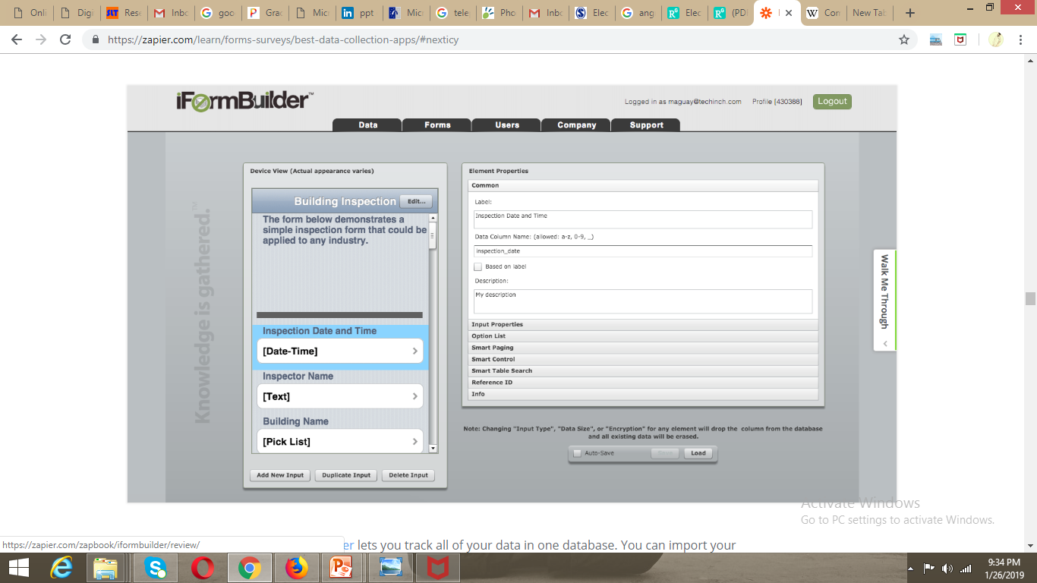

Slide 47
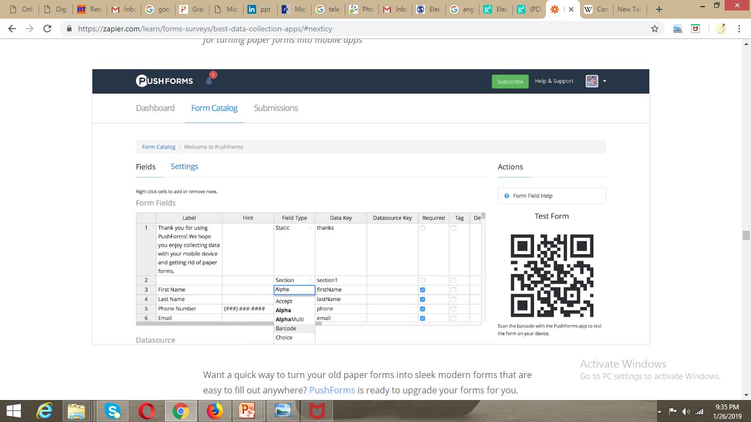

Slide 48
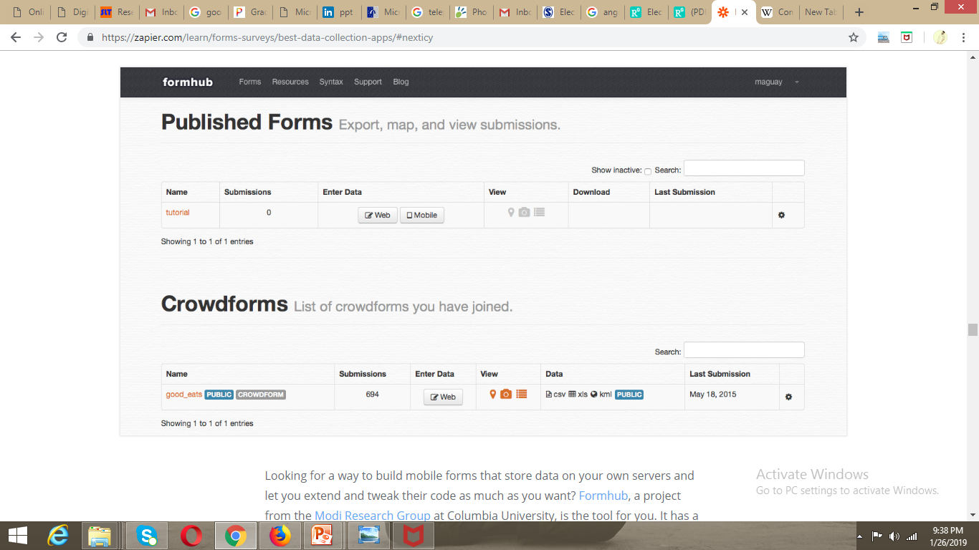

Slide 49
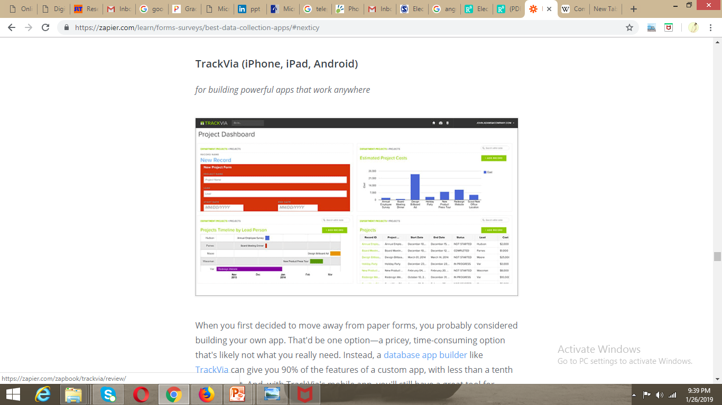

Slide 50
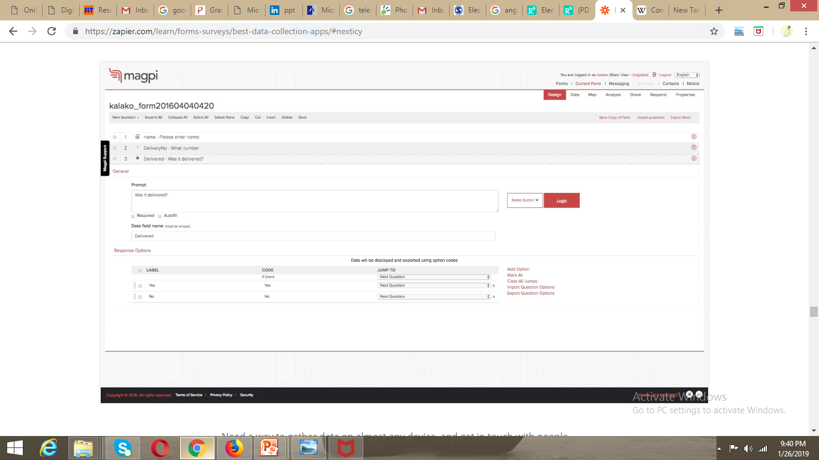

Slide 51


