Slide 1
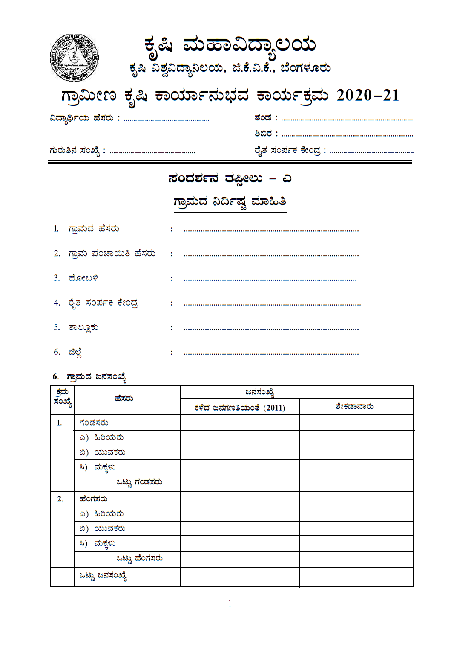
Name of the student Team :
ID No. District / State : RSK / Agri. Dept. :
Schedule A
Village Information
Name of the Village :
Name of the Gram Panchayat:
Hobli:
Raitha Samparka Kendra :
Taluk
District
Village Demography
Name Population
Last Census Percentage
Male
Elders
Youngsters
Children
Total male
Female
Adults
Youngsters
Children
Total Female

Slide 2
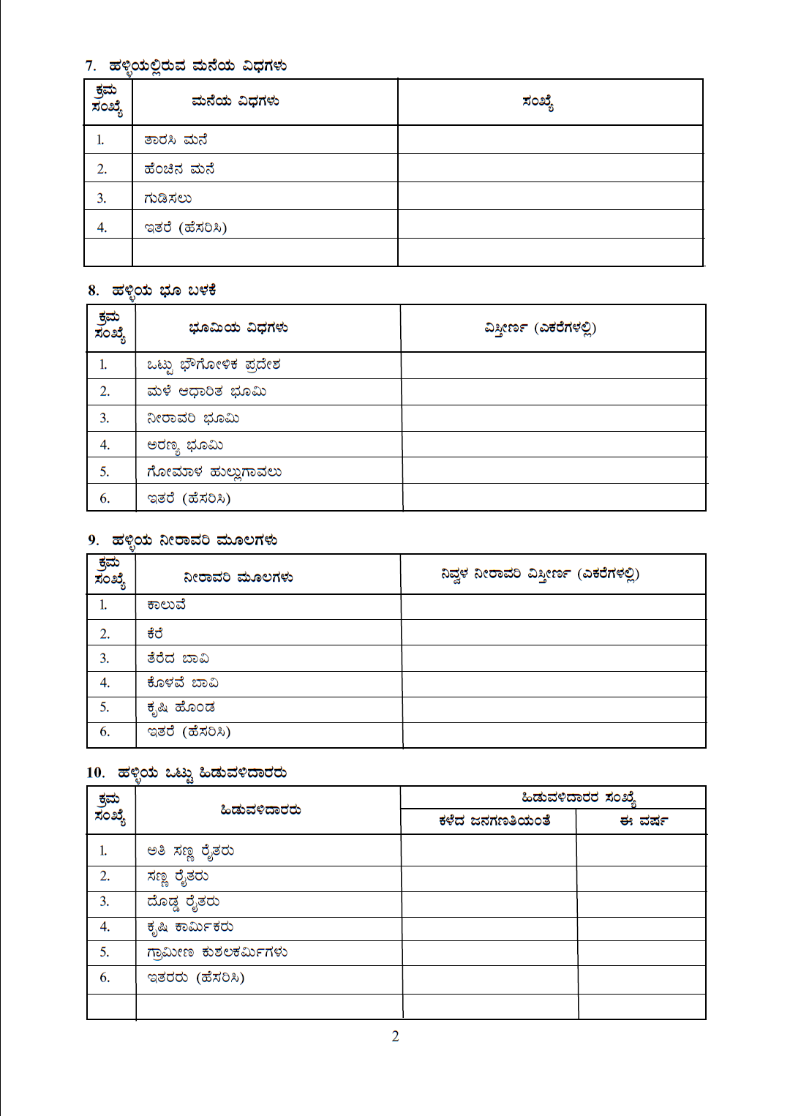
Details of houses in the village
Type of house
RCC house
Tiled house
Hut
Others (Detail)
No.
Type of land use
Total land use area
Rainfed area
Irrigated area
Forest area
Pastoral are
Others (Details)
Area (in acres)
Village irrigation sources
Canal
Tank
Open Well
Bore well
Farm Pond
Others (Detail)
Area irrigated (in acres)
No. of crop Growers
As per last census | This year
Total crop Growers
Marginal Farmers
Small Farmers
Big Farmers
Farm Labourers
Rural Artisans

Slide 3
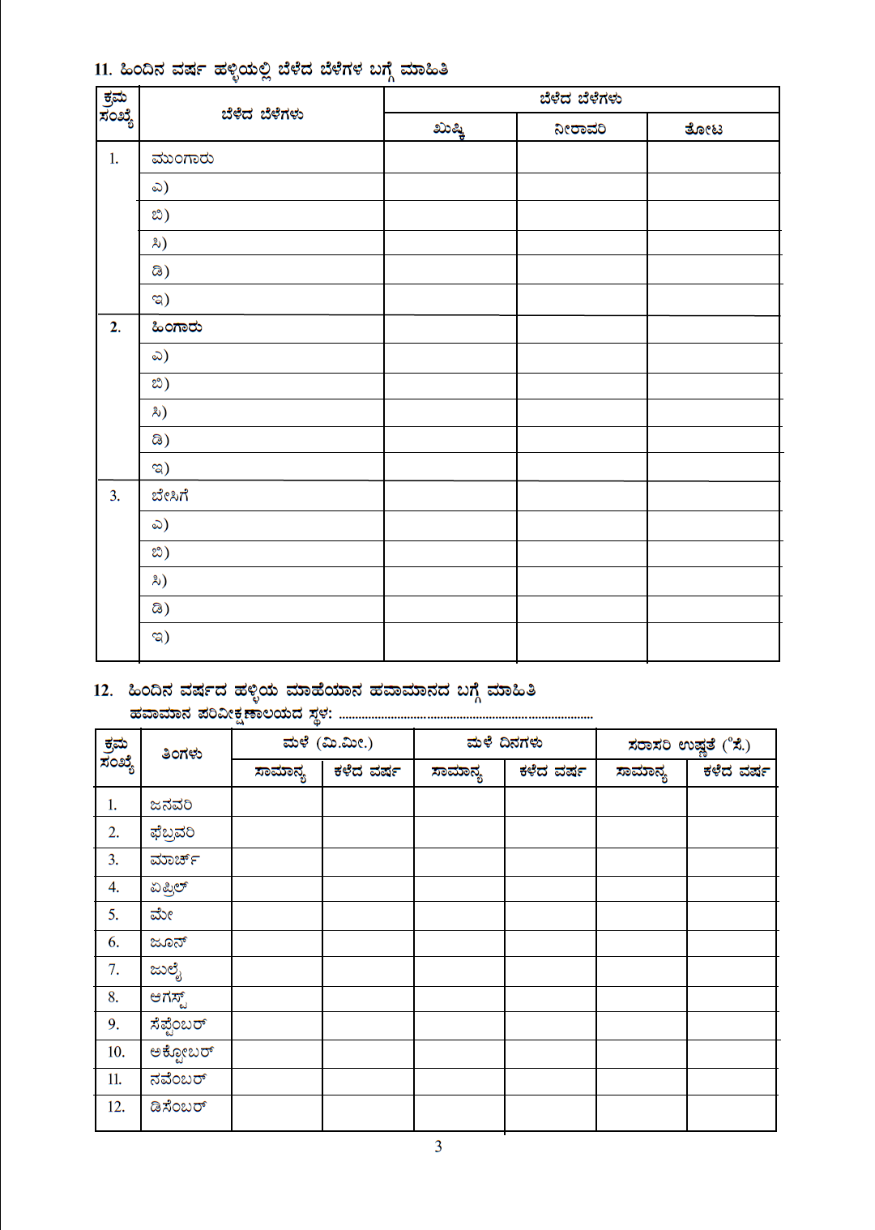
Details of crops grown in the village
Crops Grown
Crops Grown
Dryland
Irrigated
Gardenland
Kharif
Rabi
Summer
Place of Weather Observatory
Last year village weather info.
Rainfall
Average Temperature ⁰C
Month
Rainy Days
Jan
Feb
Mar
Apr
May
Jun
Jul
Aug
Sep
Oct
Nov
Dec
Usual
Last year
Usual
Last year
Usual
Last year

Slide 4
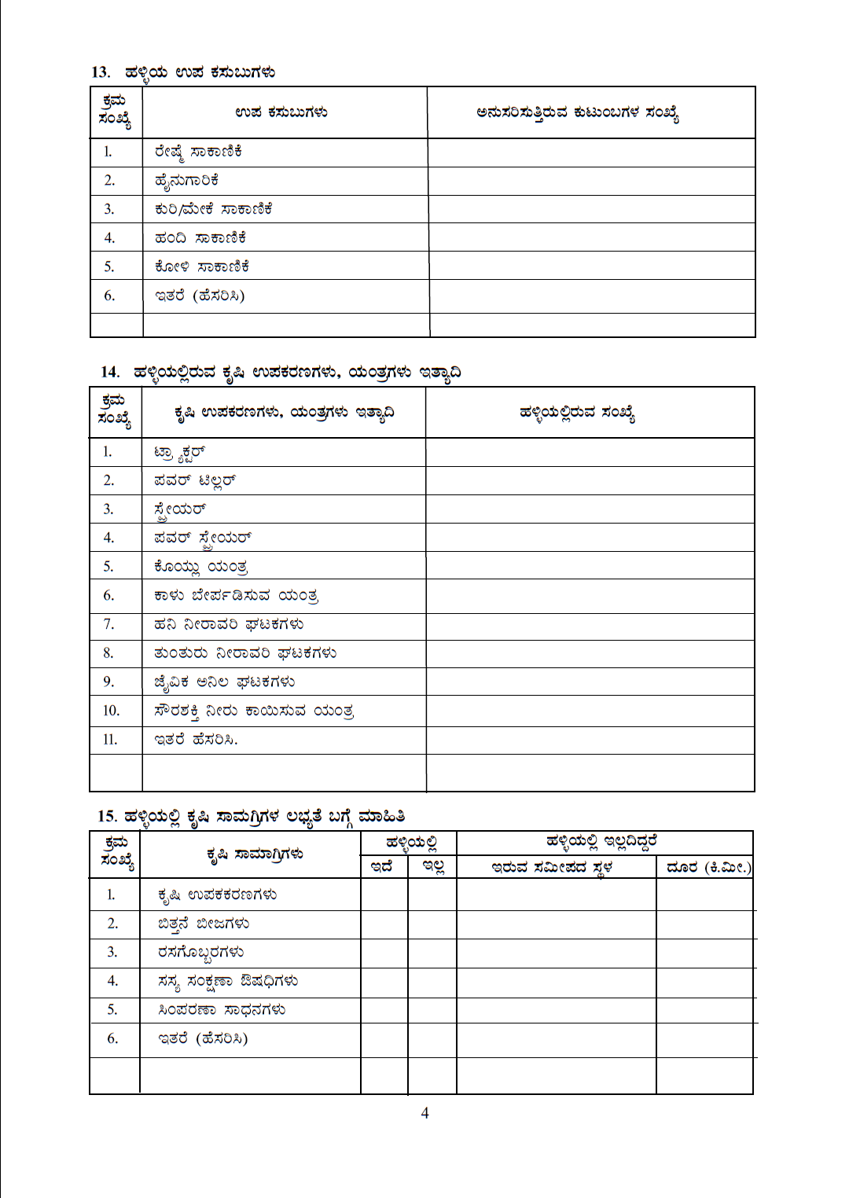
Allied activities of the Village
Allied activities
No. of Families involved
Sericulture
Dairy
Goat/Sheep
Piggery
Poultry
Others (Detail)
Details of Agricultural implements, machineries, etc. in the village
Agricultural implements, machineries, etc
No. in the Village
Tractor
Power tiller
Sprayer
Power sprayer
Harvester
Thresher
Drip irrigation units
Sprinkler units
Biogas units
Solar units
Others (Name)
Details of Agricultural Inputs availability
Agricultural Inputs
Place of nearest availability
Yes | No
Agril. Equipment
Sees for sowing
Chemical fertilisers
Plant protection chemicals
Sprayers
Others (Name)
Distance (km)

Slide 5
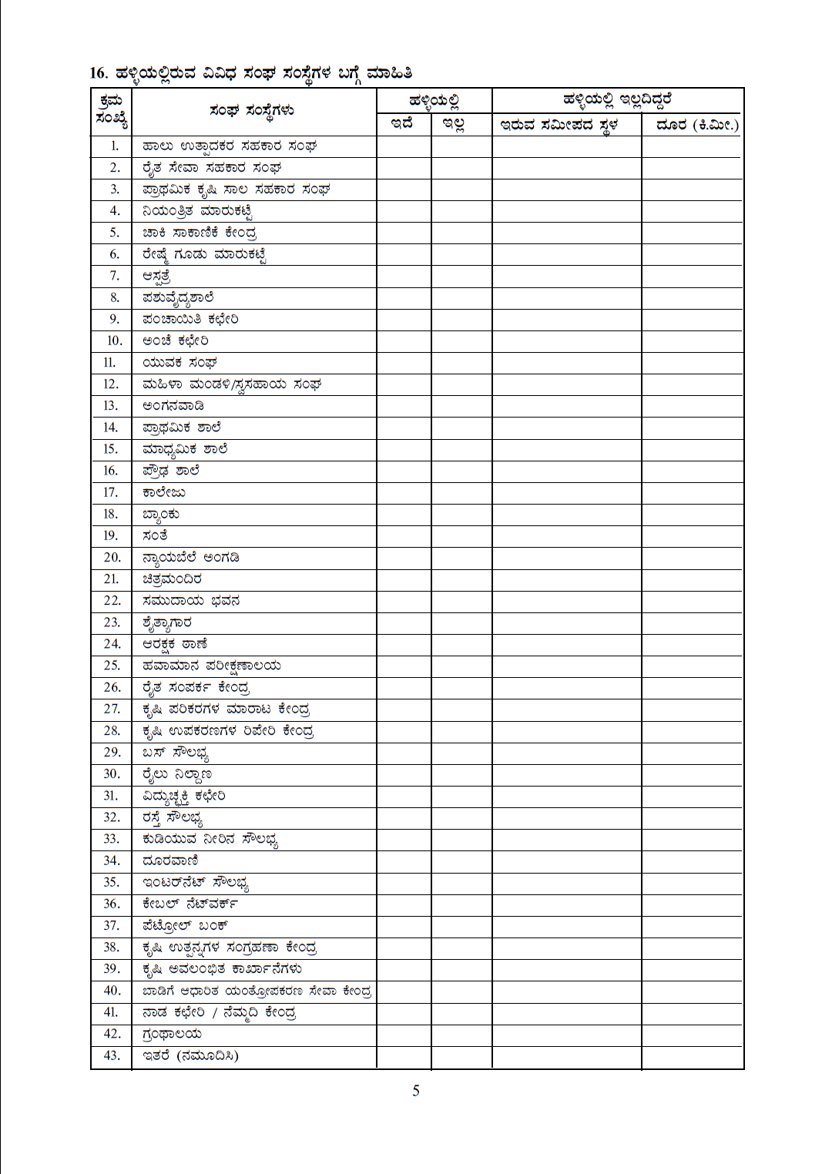
MPCS
Yes | No
Place of nearest availability
Distance (km)
Farmers Coop. Service Society
Primary Agril. Credit Society
Regulated Markets
Chawki Rearing Centre
Cocoon Market
Hospital
Veterinary Hospital
Panchayat Office
Post Office
Youth Society
Women Society/ Self Help groups
Anganwadi
Primary School
Middle School
High School
College
Bank
Sandy
Fair Price Shop
Theatre
Community Hall
d
Fire Station
Metrological Observatory
Raitha Samparka Kendras
Agri. Inputs Sales Centre
Agri. Implements Repair Centre
Bus Facility
Railway Station
Electricity Office
Road Connectivity
Telephone
Drinking Water Facility
Internet
Cable Network
Petrol Bunk
Agro-produce Storage Unit
Agro industries
Custom Hiring Centres for Farm Implements
Library
Nada Kacheri / Nemmathi Kendra
Others (List)

Slide 6
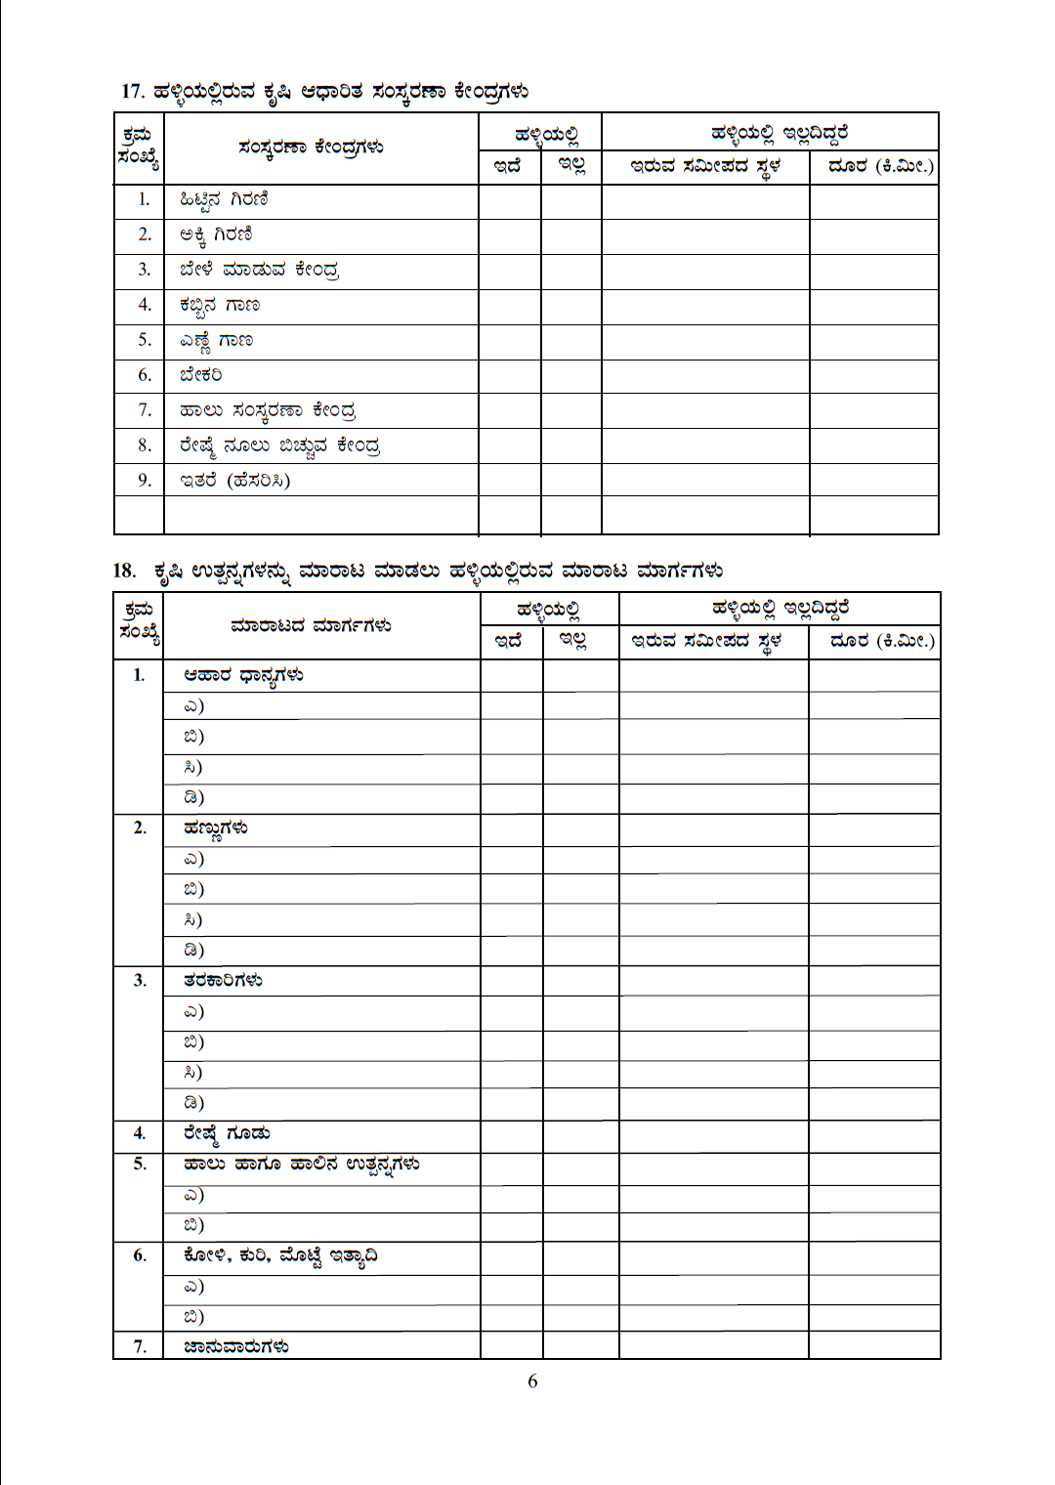
Agro processing units in the village
Processing units
Place of nearest availability
Yes | No
Distance (km)
Flour mill
Rice mill
Pulse mill
Cane milling
Oil expeller
Bakery
Milk processing
Silk reeling unit
Others
Marketing Channels available for sale of agricultural produce in the village
In Village
If not in Village
Marketing Channel
Place of nearest availability
Distance (km)
Food Grains Yes No.
Fruits
Vegetables
Cocoon
Milk and Milk Products
Poultry, Sheep, Egg, Etc.
Livestock

Slide 7
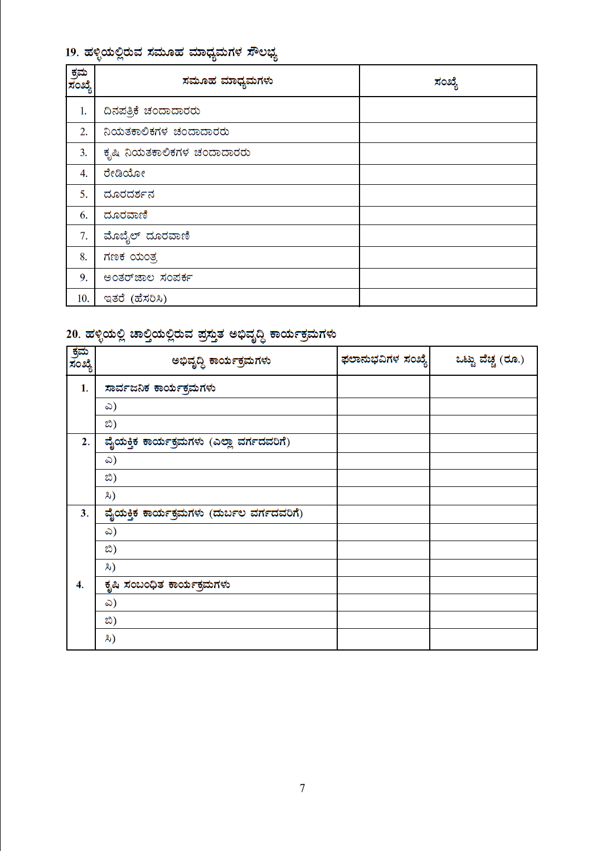
Mass media availability in the village
Mass media
No.
Subscriptions to Dailies
Subscriptions to Periodicals
Subscriptions to Agricultural Periodicals
Radios
Televisions
Telephones
Mobile Phones
Computers
Internet
Others
Major Schemes of the Village which are in operation
Development Schemes
No. of Beneficiaries
Total Cost
Public Programmes
Beneficiary Programmes (All sections)
Beneficiary Programmes (Weaker Sections)
Agriculture related programmes)

Slide 8
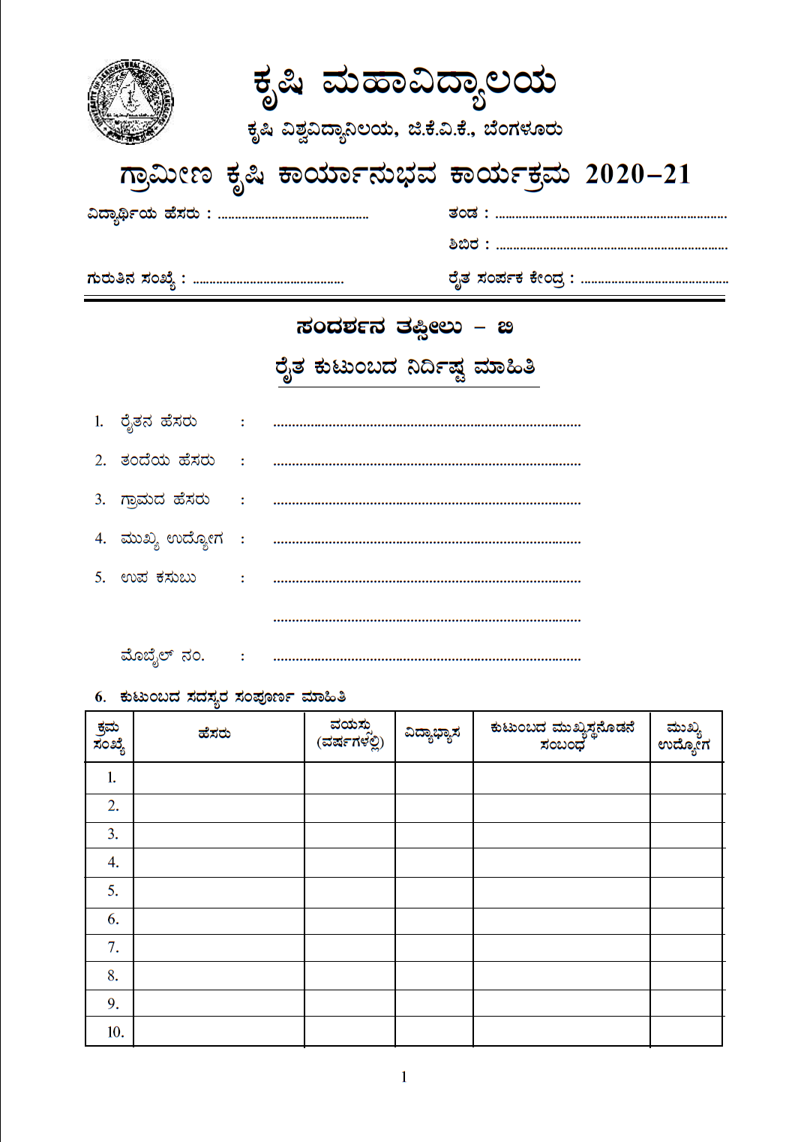

Slide 9
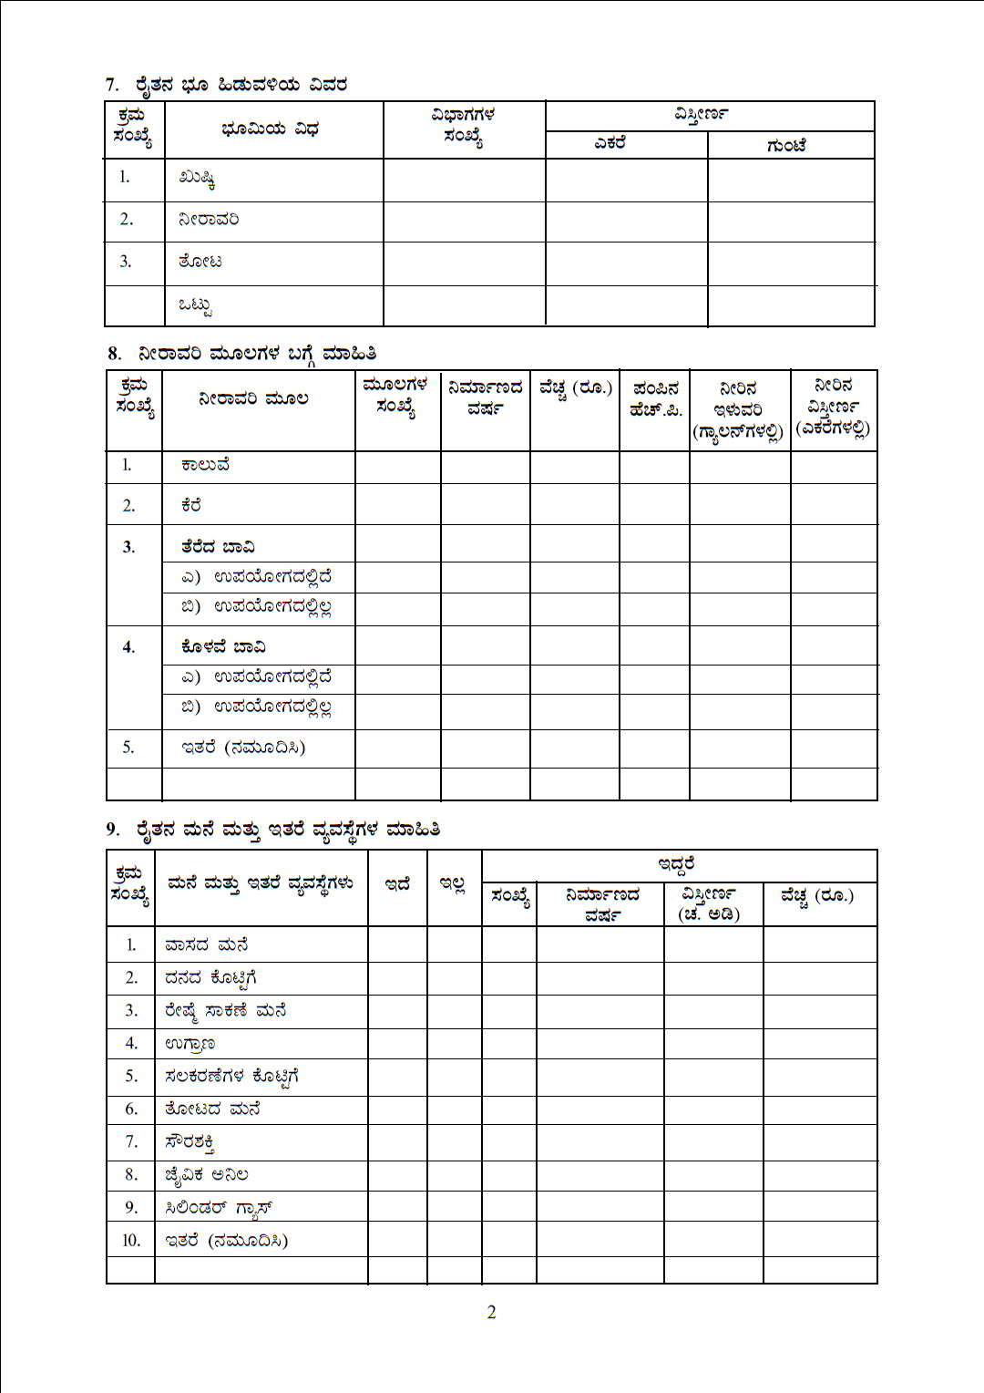

Slide 10
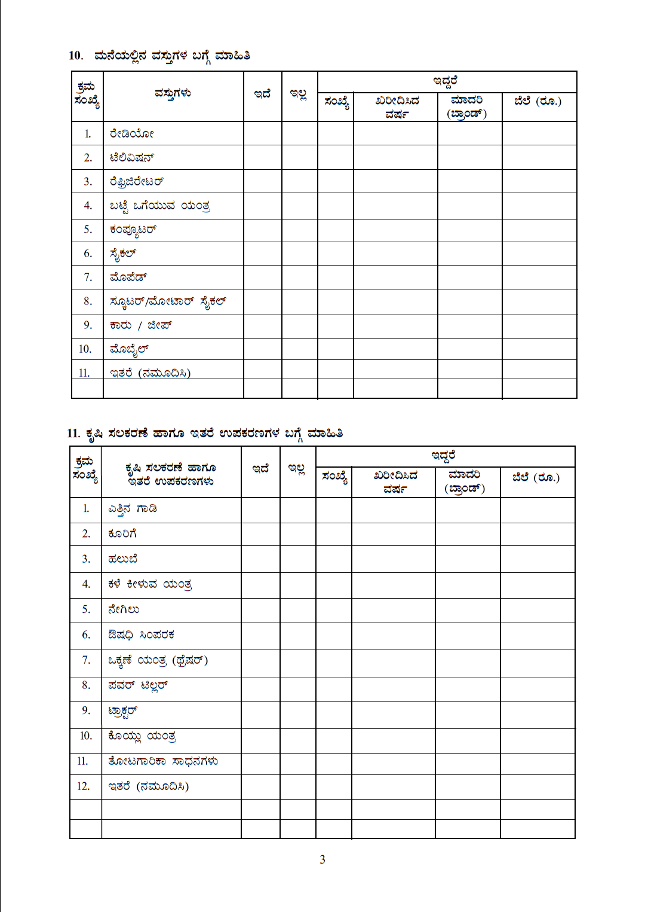

Slide 11
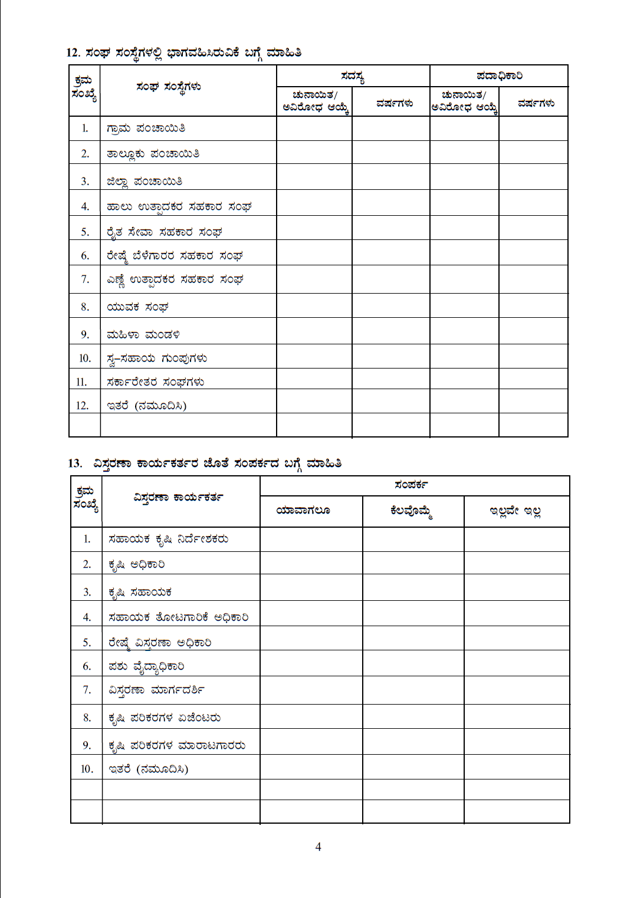

Slide 12
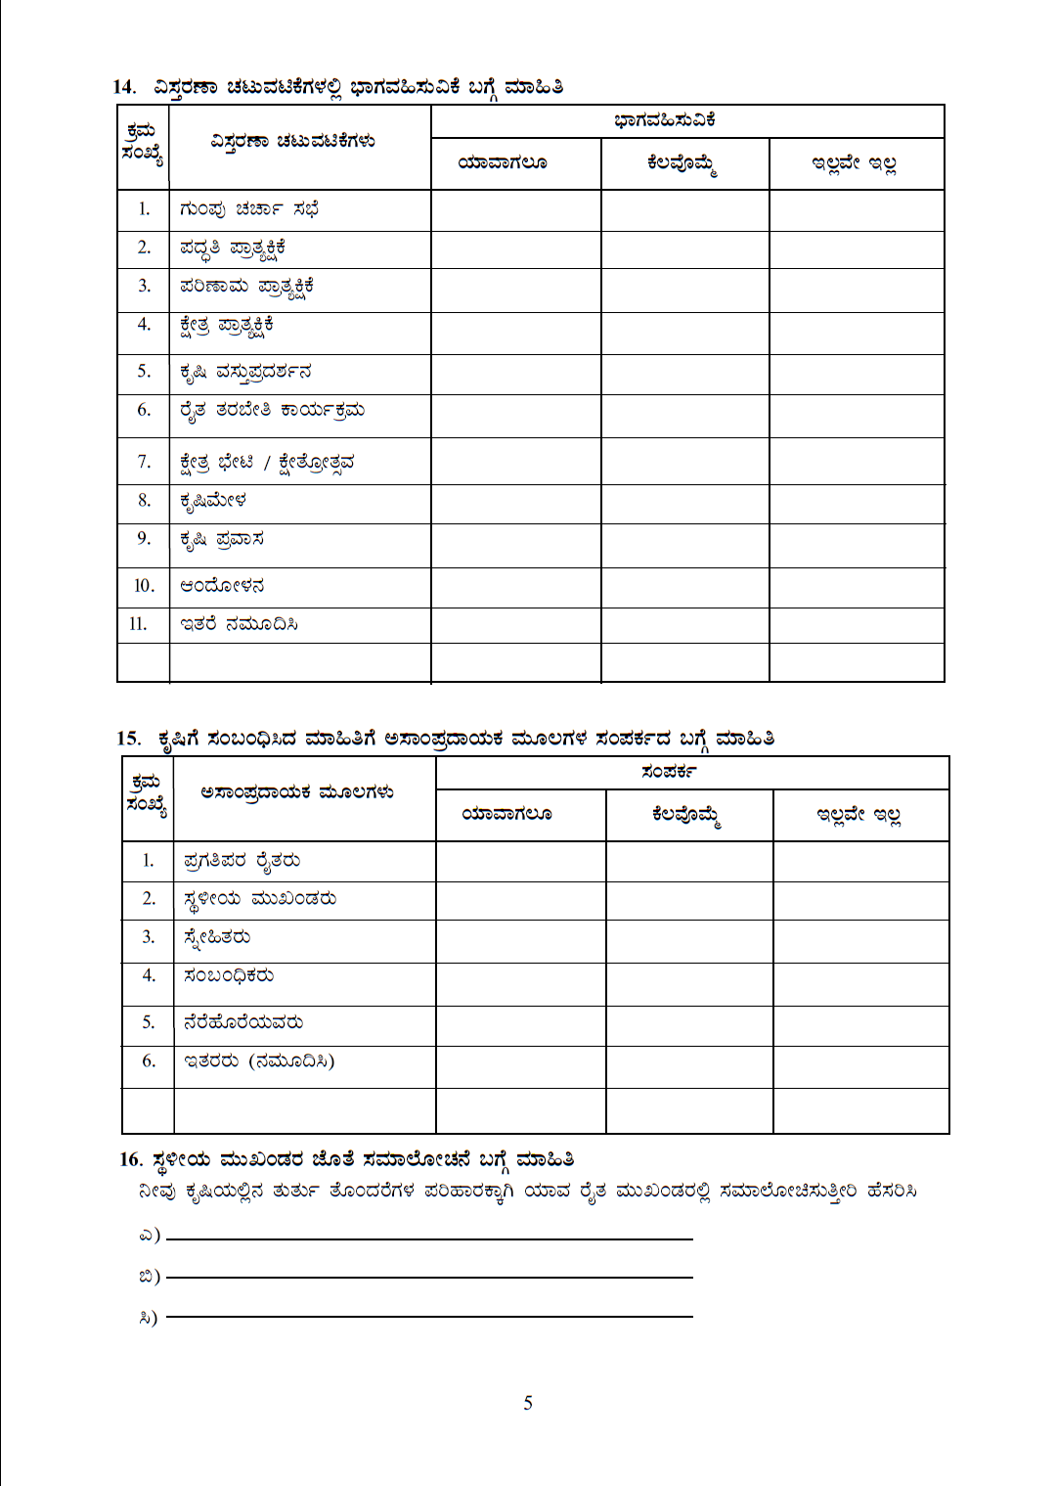

Slide 13
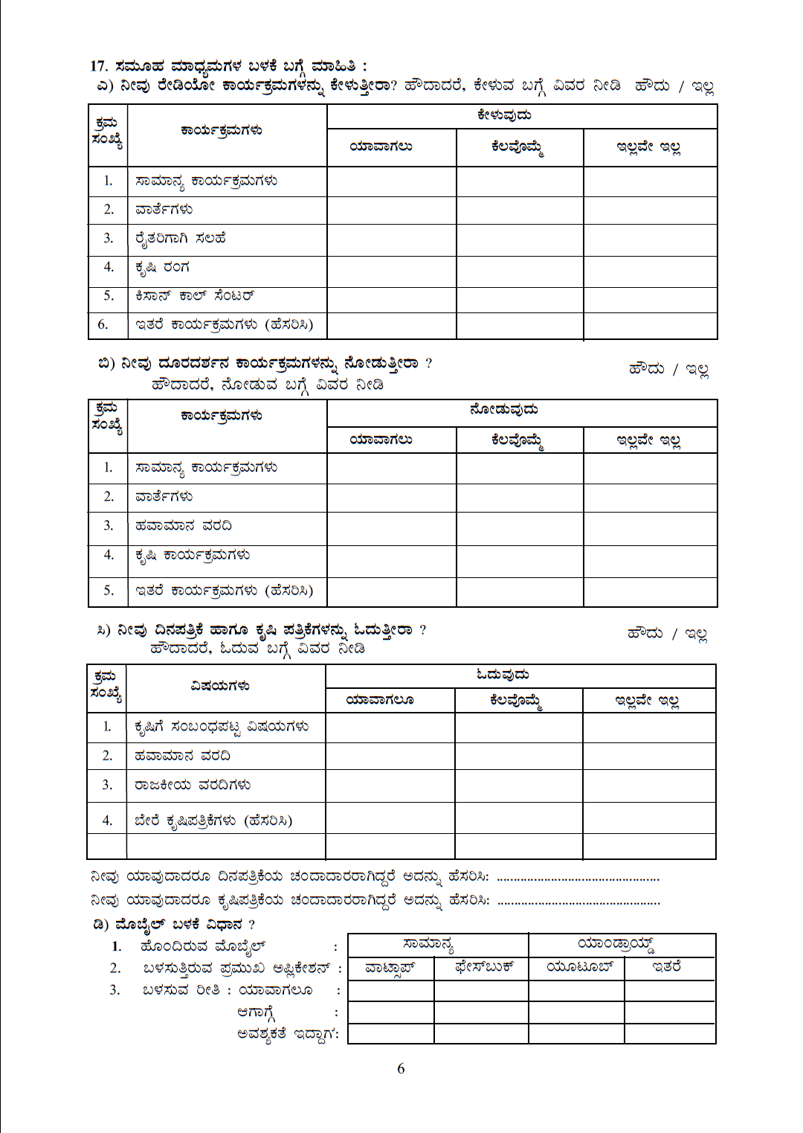

Slide 14
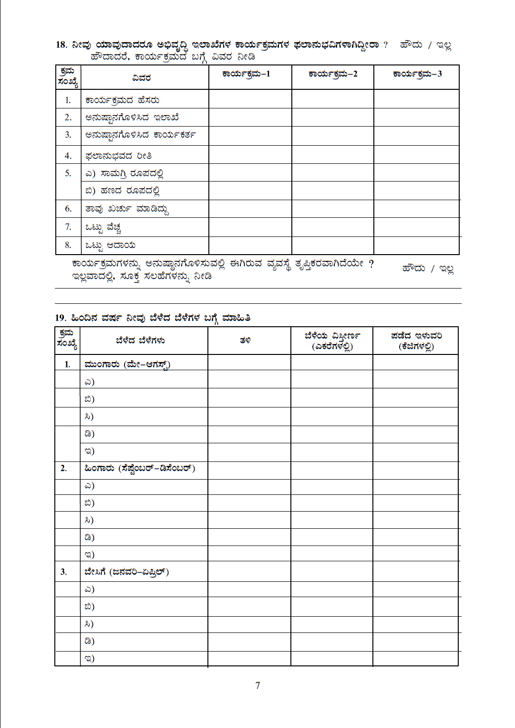

Slide 15
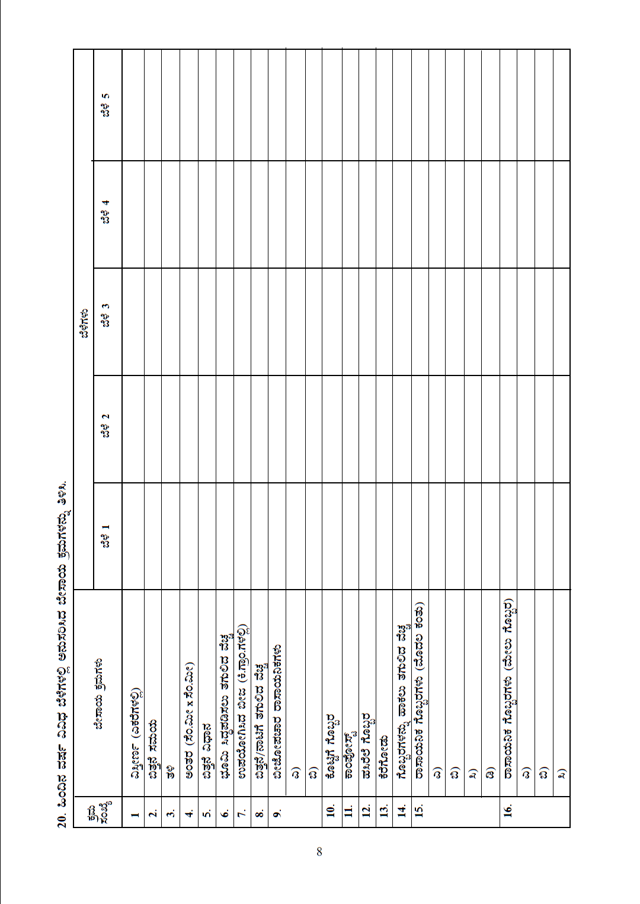

Slide 16
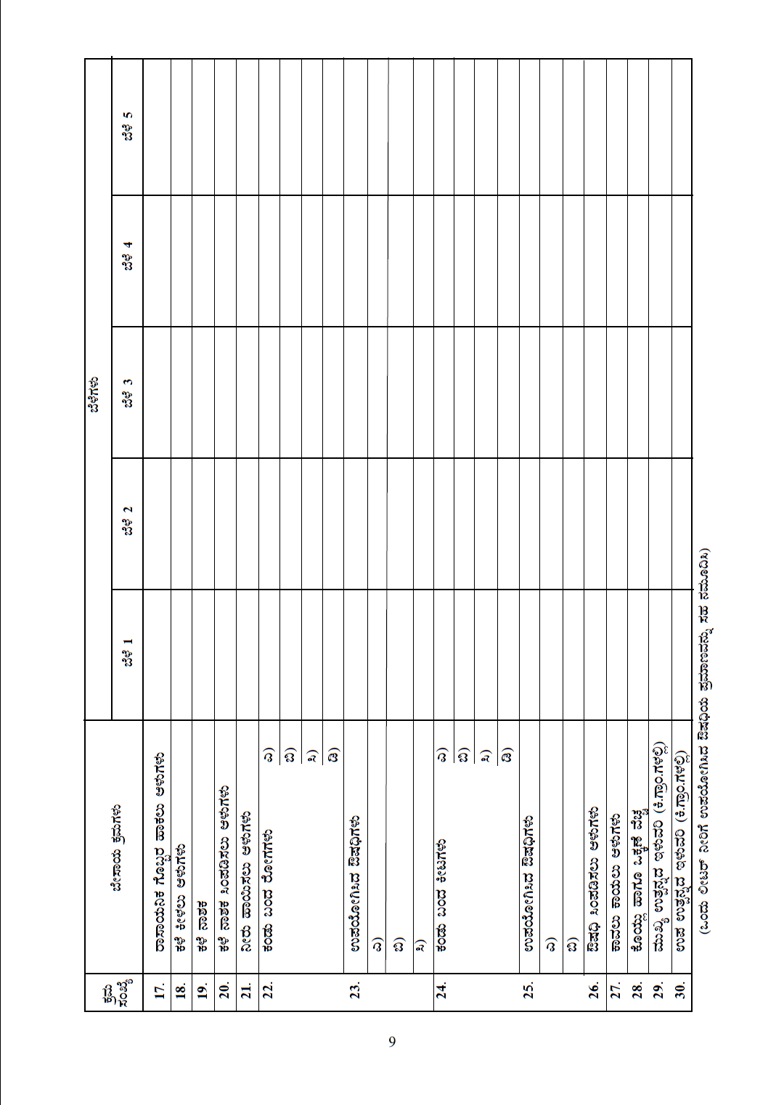

Slide 17
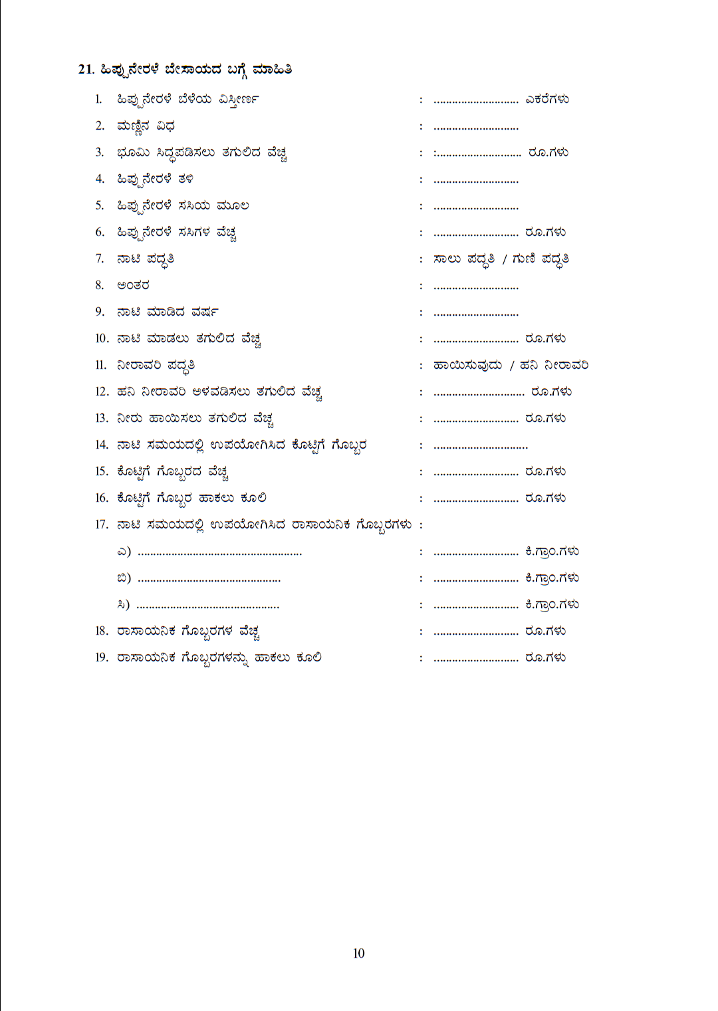

Slide 18
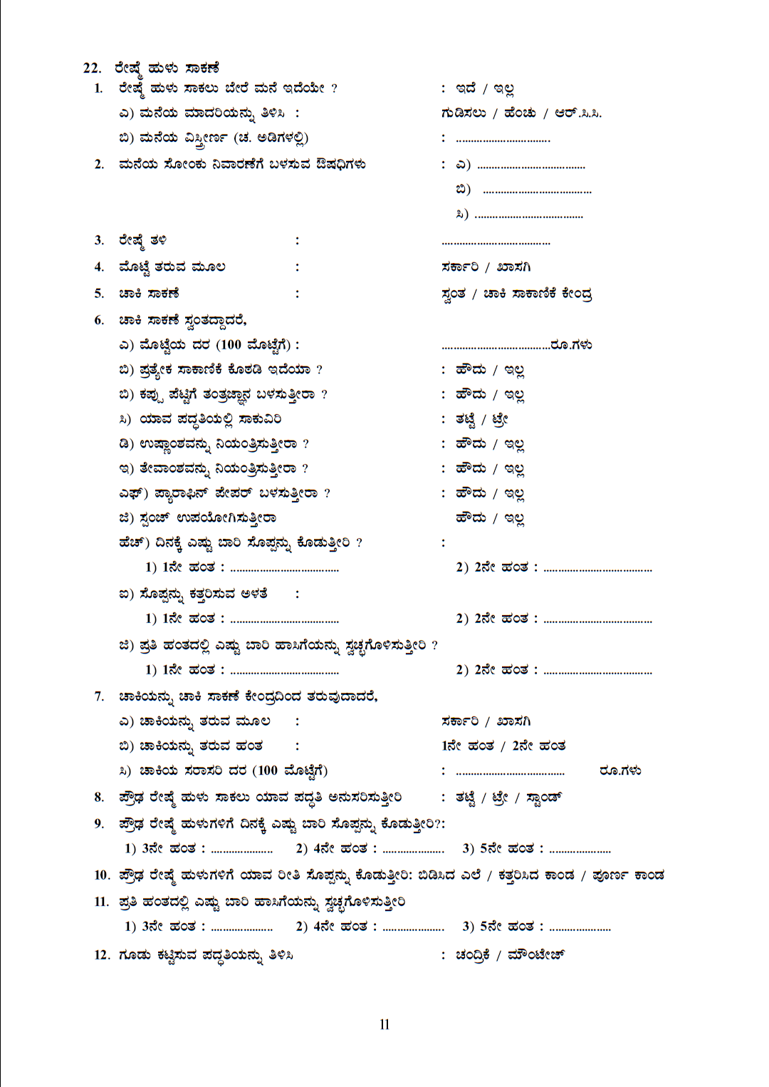

Slide 19
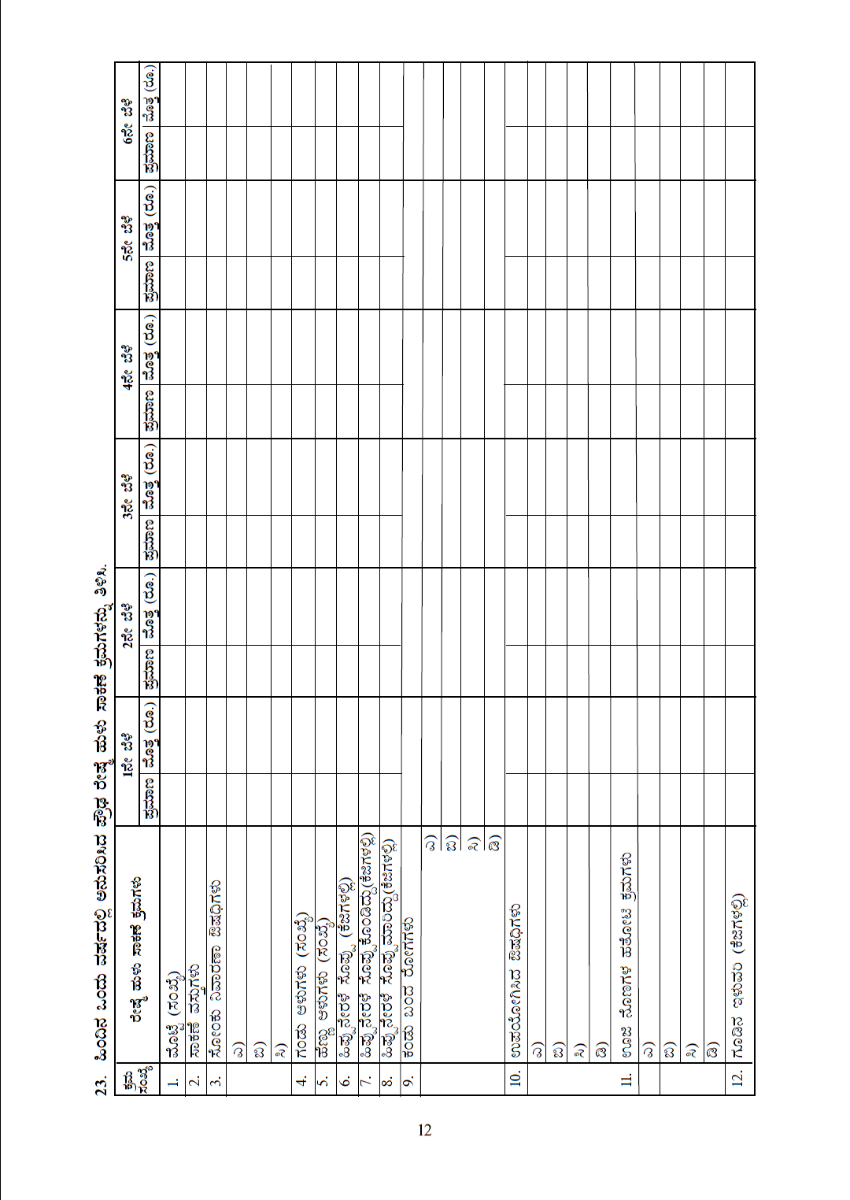

Slide 20
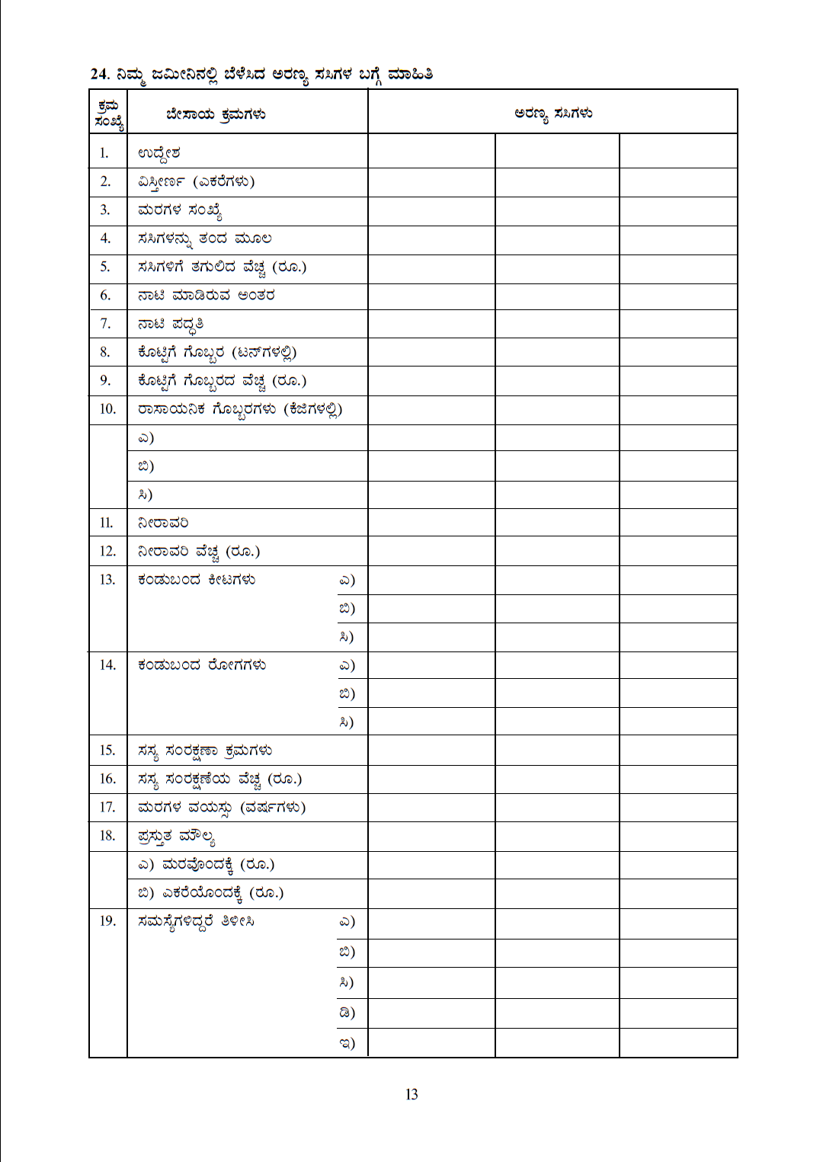

Slide 21
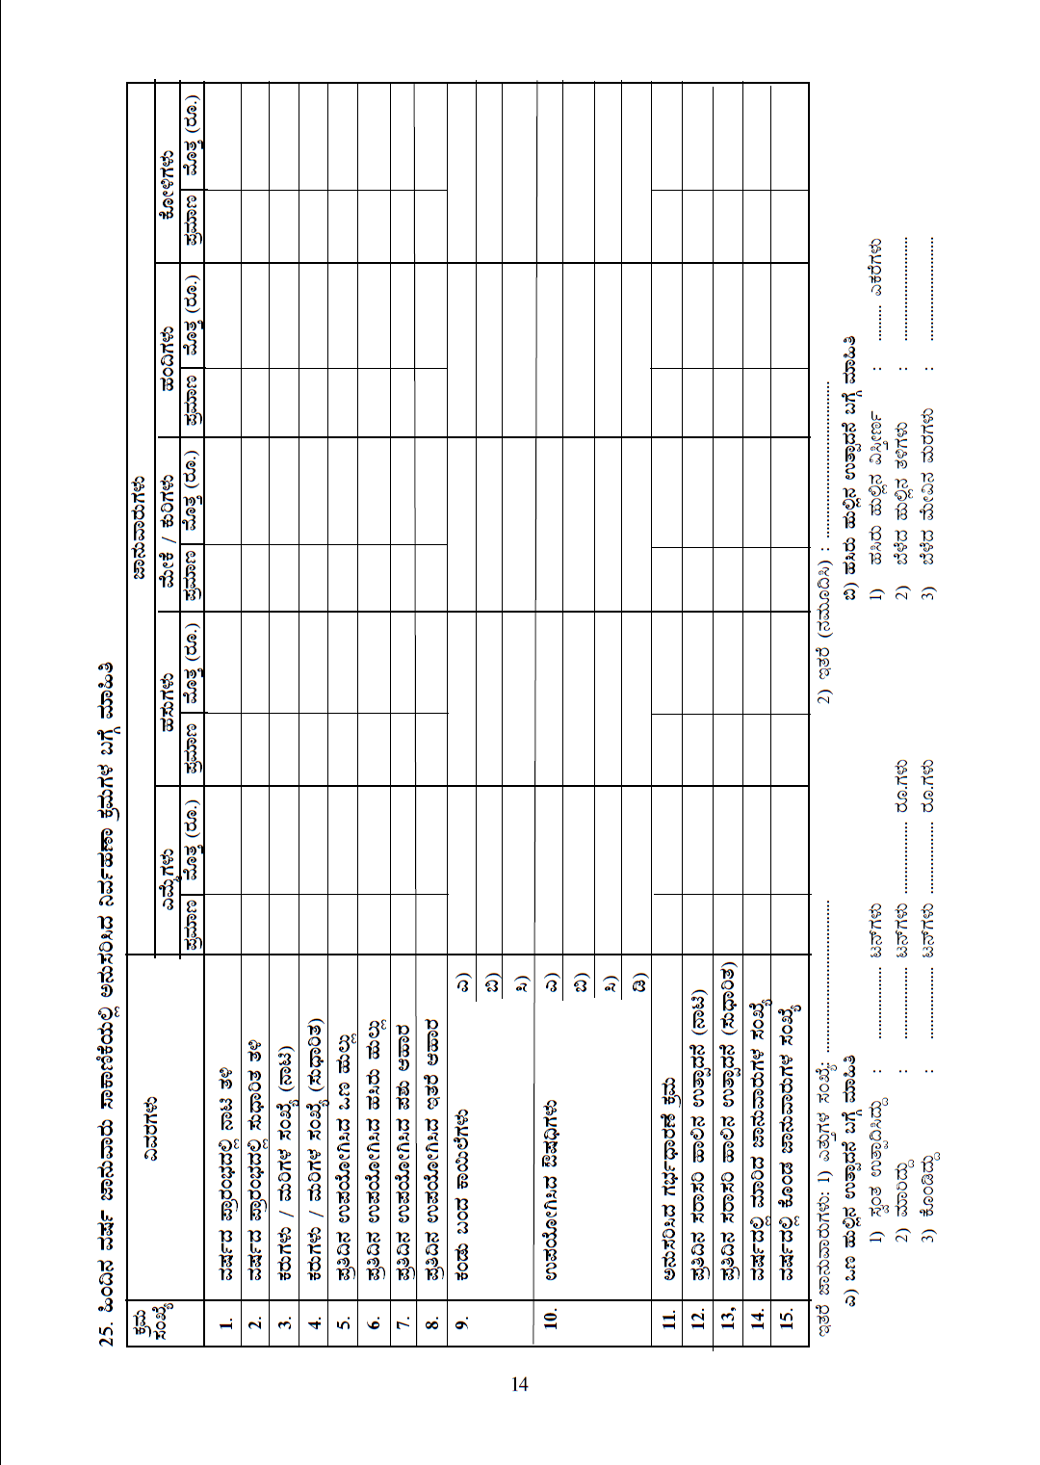

Slide 22
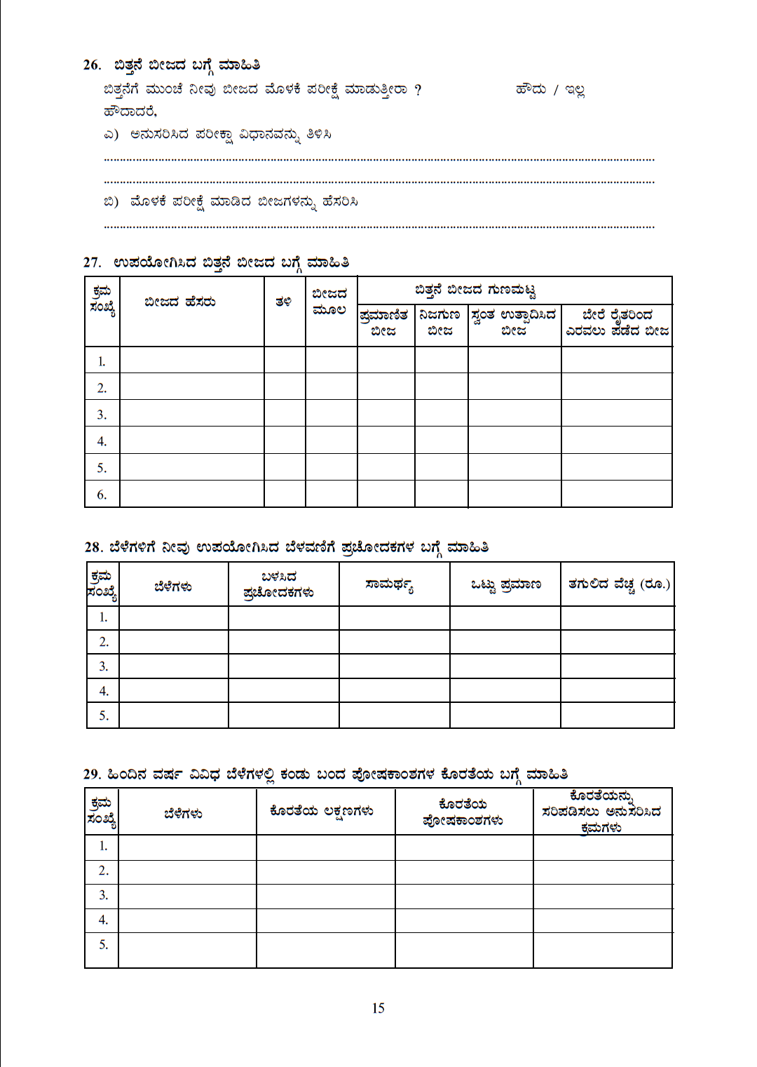

Slide 23
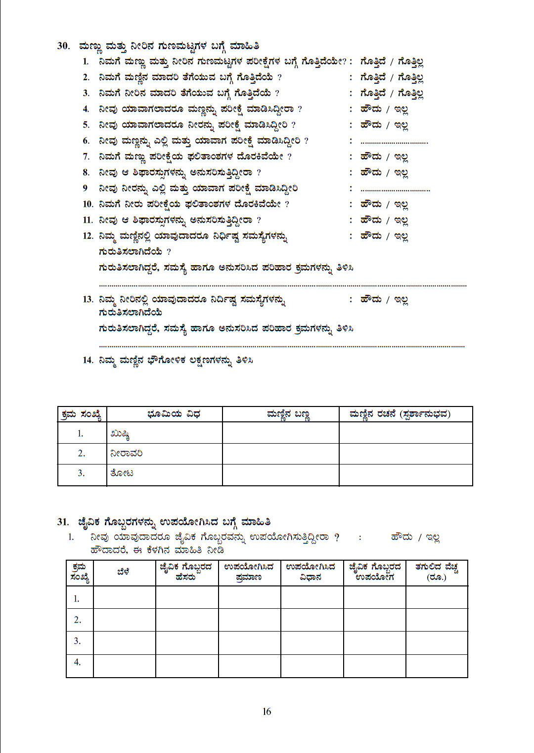

Slide 24
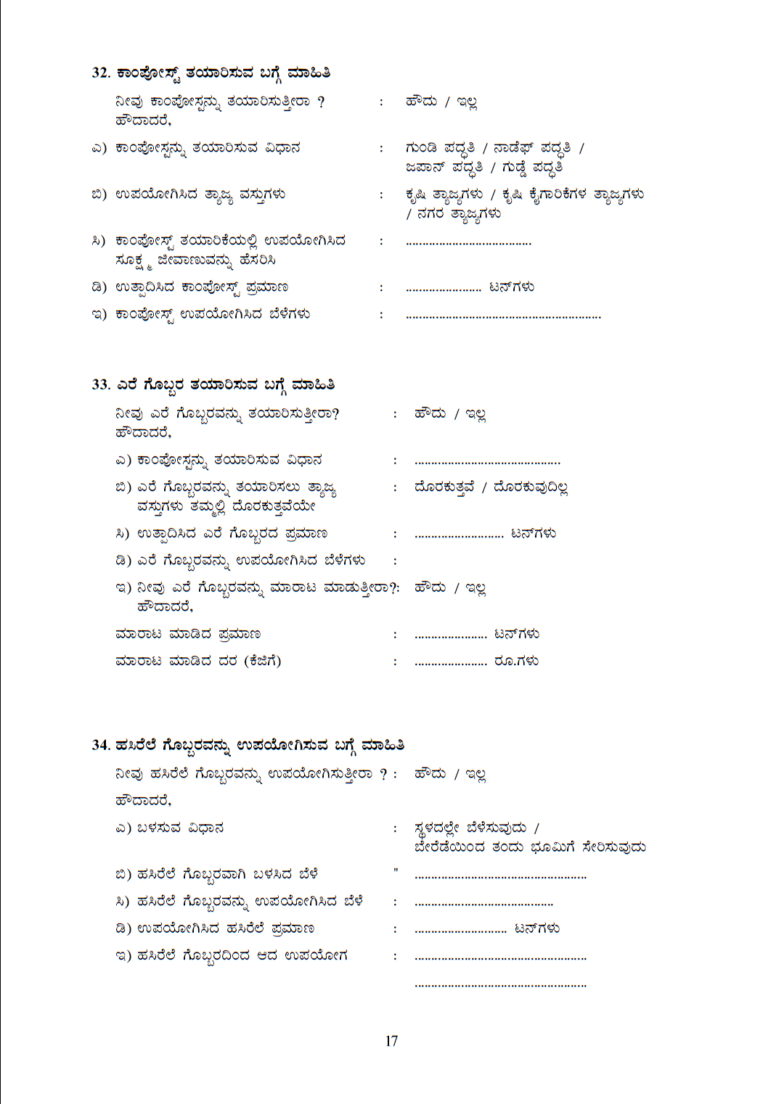

Slide 25
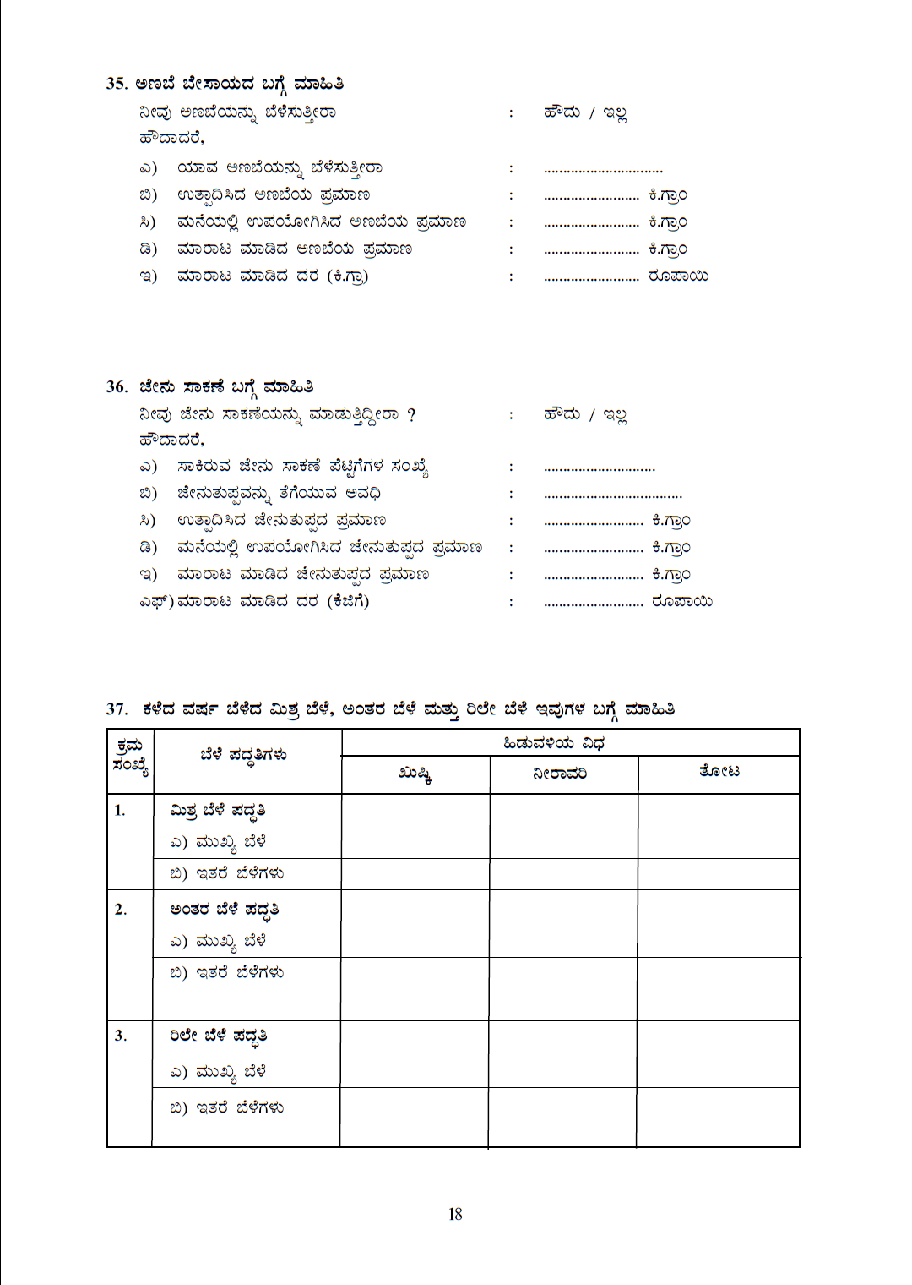

Slide 26
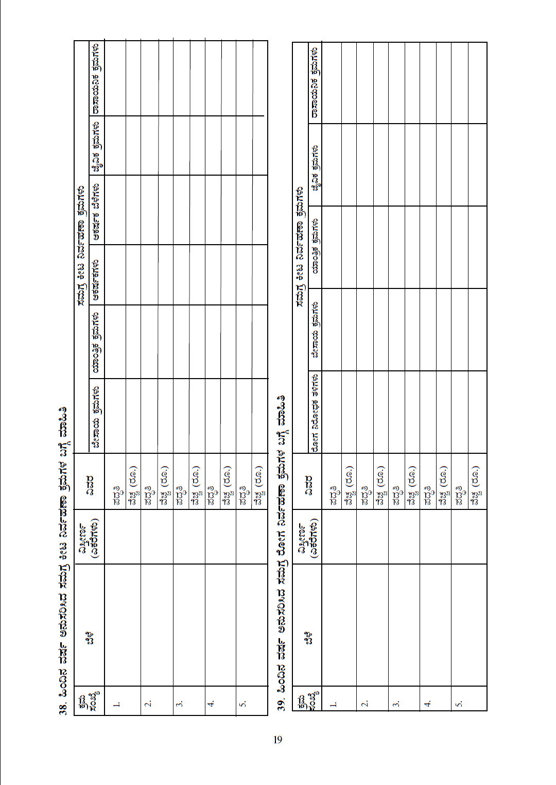

Slide 27
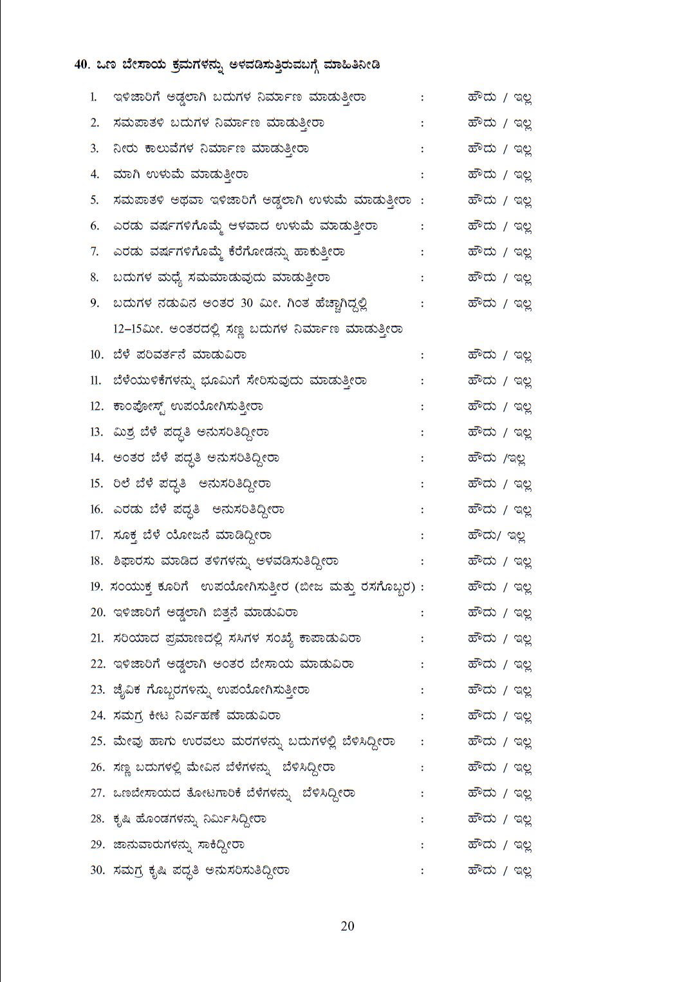

Slide 28
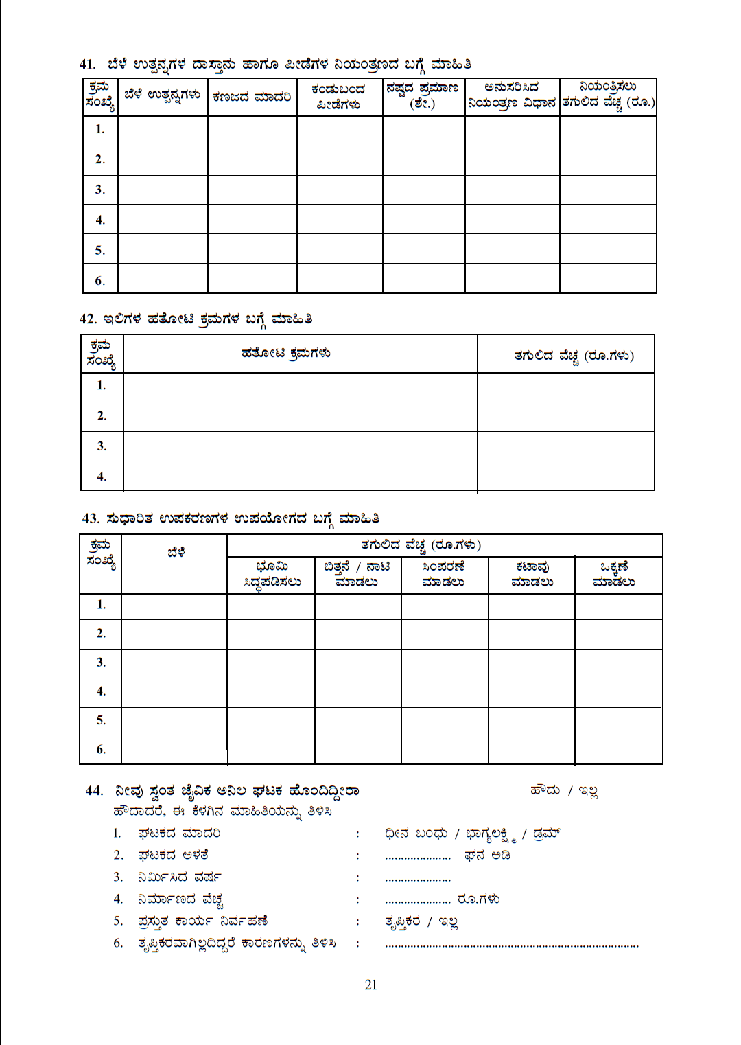

Slide 29
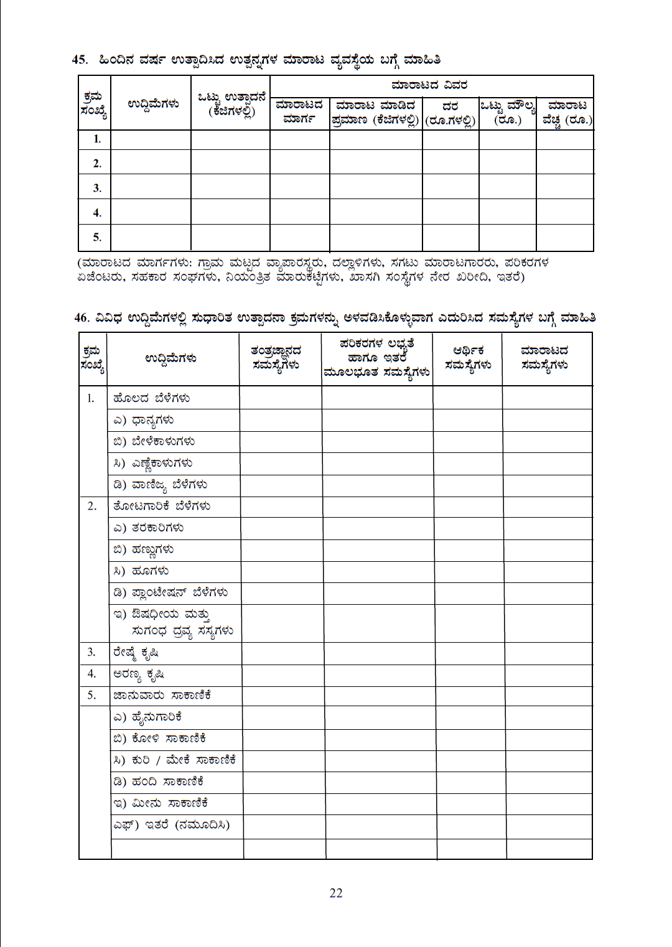

Slide 30
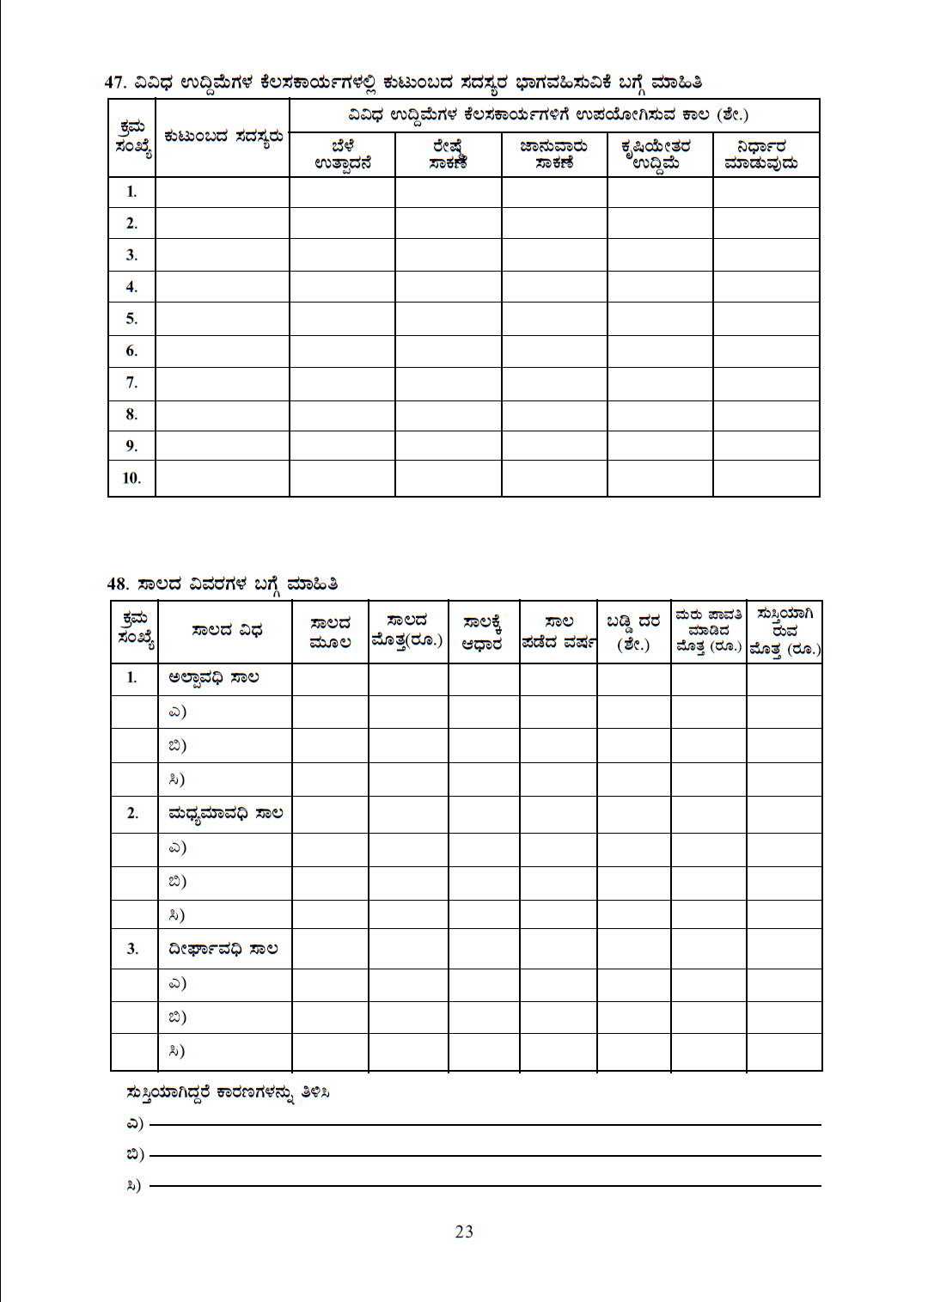

Slide 31
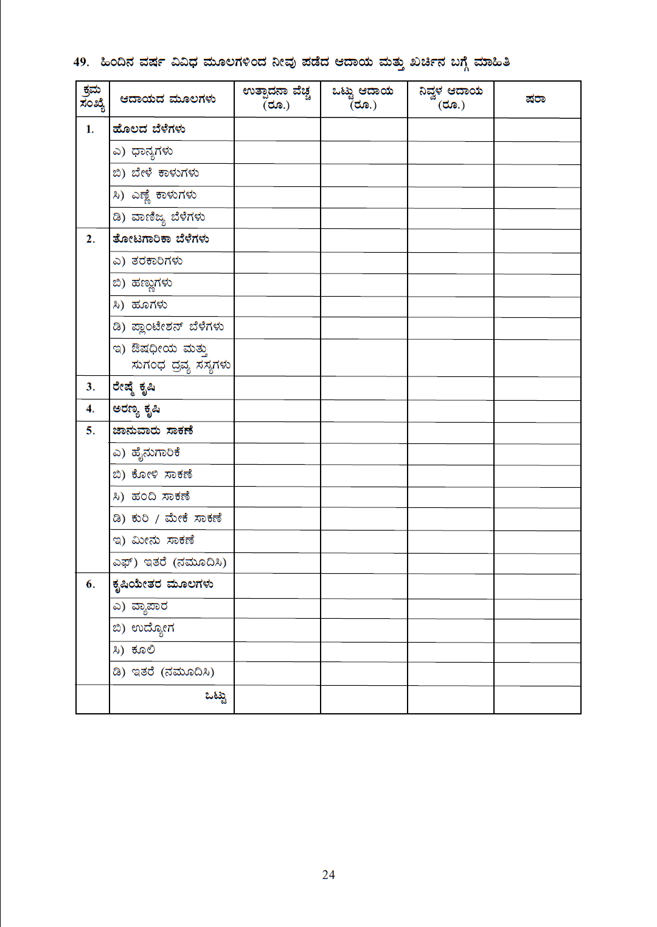

Slide 32
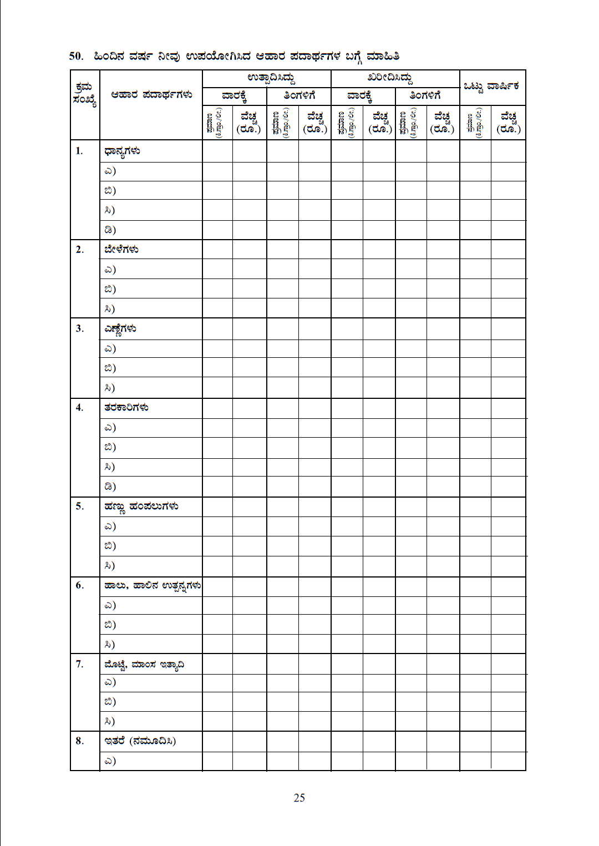

Slide 33
